Slide 1



FCC physics week
13-17 Feb. 2020
« …making the neutrino flavor visible in Z decays »
R.A. and S. Jadach
https://arxiv.org/abs/1908.06338
https://doi.org/10.1016/j.physletb.2019.135034
$$N_{ν}=2.984±0.008$$
$$N_{ν}=2.992±0.008$$
Neutrino counting measured at LEP with/without radiative γ :
Beam-beam effect correction
G. Voutsinas et al. , arXiv:1908.01704
$$N_{ν}=2.9975±0.0074$$
P.Janot S.Jadach , arXiv:1912.02067
No distinction between neutrino flavor

Slide 2
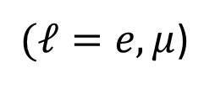
Motivation : Complementing tests of lepton universality
$$Δ_{W}^{τ/ℓ}=BR\left(W→τν\right)−BR\left(W→ℓν\right)= 0.00711±0.00237 \left(PDG:≈3σ\right)$$
$(ℓ=e,μ$)
$$={0.846 }_{−0.054}^{+0.060}{}_{ −0.014}^{ +0.016}{\left(syst\right) (2.5σ, LHCb)}$$

Slide 3


$$g_{Z}^{ν_{e}}$$
poorly measured
From ν_{µ} e and ν_{e} e scattering
PDG
$g_{Z}^{ν_{τ}}$= ?
How to do better at FCC-ee?
In the following we assume $N_{inv}≡3 ν$ since it will be measured at FCC with negligible error

Slide 4
Can one measure Neutrino flavor directly ?
With 150 ab⁻¹ at Z-pole, 2.4 10 ¹² neutrinos are produced.
Unfortunately, the cross section for $E_{ν}=45 GeV$ is low , ~0.3 pb
With 1 X₀ in the tracking area (much more than any reasonnable tracker),
only ~3 interactions expected !
a A dedicated detector with some 100 X₀ would be needed

Slide 5
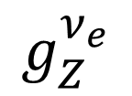
Search for interference with diagrams with well known couplings
Only ν_{e} interfere a interference effect measures
$$g_{Z}^{ν_{e}}$$

Slide 6
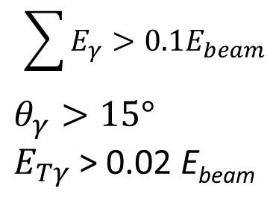
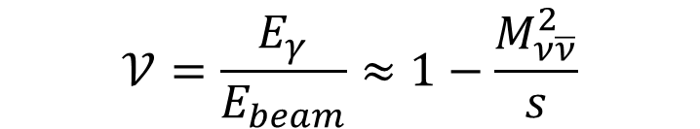

We concentrate on $\sqrt{S}=161 GeV$ with L=10ab⁻¹ (i.e. with 2 detectors)
MC used KKMC (see Staszek Jadach et al.)
$$\sum{E_{γ}>0.1E_{beam}}$$
$$θ_{γ}>15°$$
$E_{Tγ}$ > 0.02 E_{beam}
Cuts for
(b) curve
Essentially 1 γ after cuts
$$𝒱=\frac{E_{γ}}{E_{beam}}≈1−\frac{M_{ν\overline{ν}}^{2}}{s}$$

Slide 7
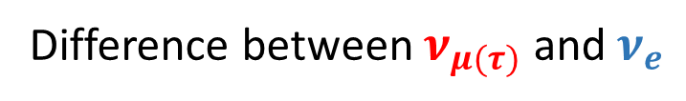

Zoom on Z Radiative Return (ZRR)
Difference between $ν_{μ(τ)}$ and $ν_{e}$
$$V_{Z}=1−\frac{M_{Z}^{2}}{S}$$

Slide 8
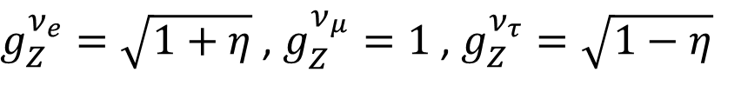
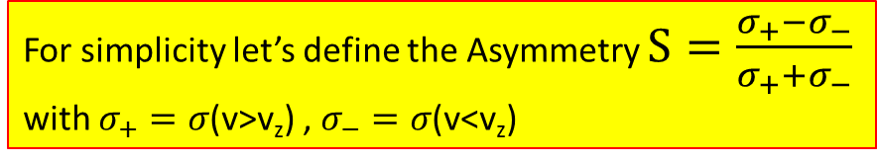
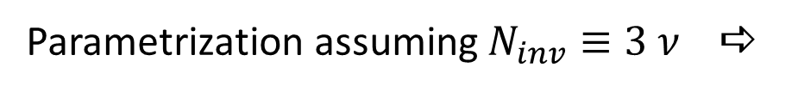
Interference effects may look small but
Huge statistics is available ~25 x 10⁶ events
For simplicity let’s define the Asymmetry $S=\frac{σ_{+}−σ_{−}}{σ_{+}{+σ}_{−}}$
with $σ_{+}=σ$(v>v_{z}) , $σ_{−}=σ$(v<v_{z})
Parametrization assuming $N_{inv}≡3 ν$a
$g_{Z}^{ν_{e}}=\sqrt{1+η}$ , $g_{Z}^{ν_{μ}}=1$ , $g_{Z}^{ν_{τ}}=\sqrt{1−η}$

Slide 9
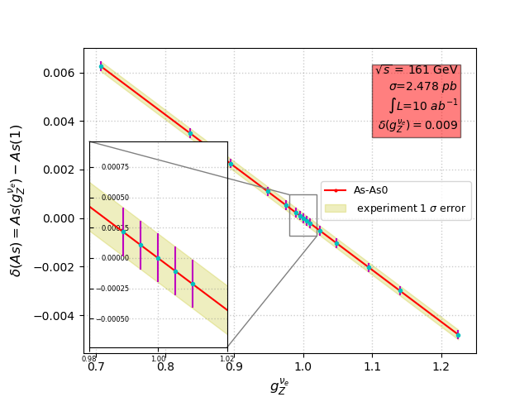
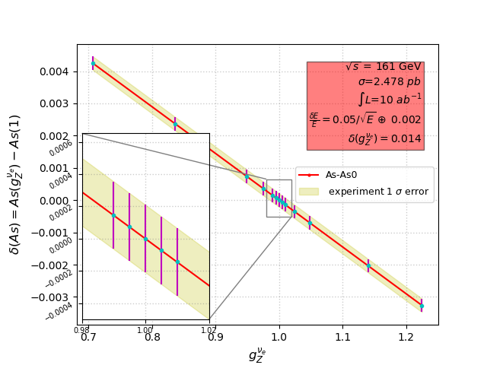


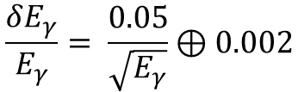


Error on${ g}_{Z}^{ν_{e}}$
With detector resolution dilution effects
$$\frac{δE_{γ}}{E_{γ}}= \frac{0.05}{\sqrt{E_{γ}}}⊕0.002$$
Can be calibrated with
μμγ events
Without detector resolution dilution effects
${ δ(g}_{Z}^{ν_{e}})= ±1.0\%$
${ δ(g}_{Z}^{ν_{e}})= ±1.4\%$
If stochastic term x2 (sampling detector) a
${ δ(g}_{Z}^{ν_{e}})= ±2.4\%$

Slide 10
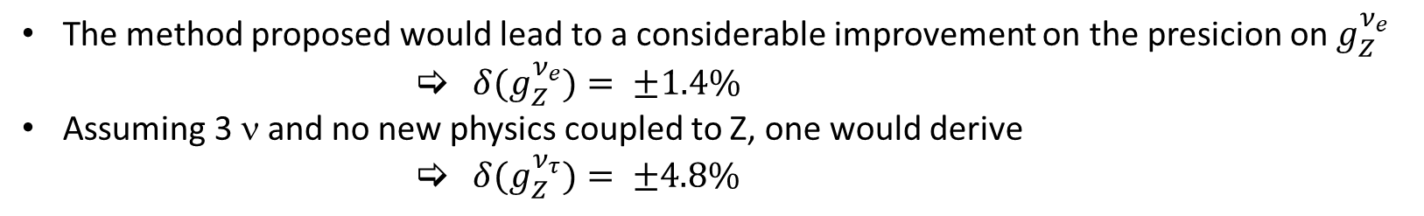
Summary
The method proposed would lead to a considerable improvement on the presicion on${ g}_{Z}^{ν_{e}}$
            ${ δ(g}_{Z}^{ν_{e}})= ±1.4\%$
Assuming 3 ν and no new physics coupled to Z, one would derive
            ${ δ(g}_{Z}^{ν_{τ}})= ±4.8\%$
$\sqrt{S}=161 GeV$ not optimal (but we will run there anyway), e.g. 6 months at$\sqrt{S}=105 GeV$ would allow for twice smaller errors

Slide 11
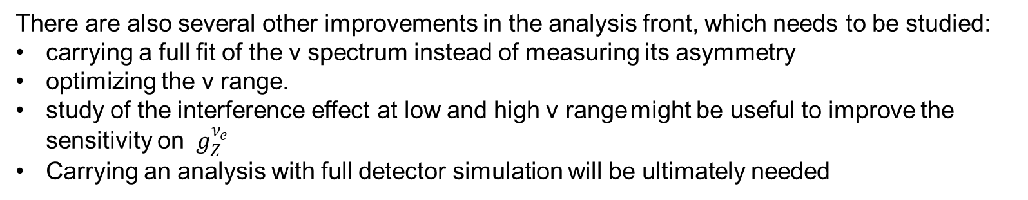
Final remarks :
This is a preliminary study and several complementary studies needed
virtual corrections for W contribution in KKMC matrix element has to be checked
the size and shape of the QED deformation of the Z peak in ZRR obtained from KKMC should be cross-checked using independent calculation
EW corrections were included in the presented KKMC calculation - their size and role should be examined quantitatively
dominant O(α³) QED non-soft corrections (in our convention) should be estimated/calculated.
There are also several other improvements in the analysis front, which needs to be studied:
carrying a full fit of the v spectrum instead of measuring its asymmetry
optimizing the v range.
study of the interference effect at low and high v range might be useful to improve the sensitivity on ${ g}_{Z}^{ν_{e}}$
Carrying an analysis with full detector simulation will be ultimately needed

