Slide 1

Extending the irradiation capabilities in the ISOLDE target area: Possibilities and Benefits
J. Vollaire, M. Calviani , J. P. Canhoto Espadanal, R. Catherall, V. Vlachoudis
ISOLDE - EPIC Workshop 3-4 December 2019

Slide 2
Outline
ISOLDE infrastructure (focused on irradiation possibilities)
Review of irradiation possibilities
Performances of ISOLDE as an irradiation facility
Conclusions

Slide 3
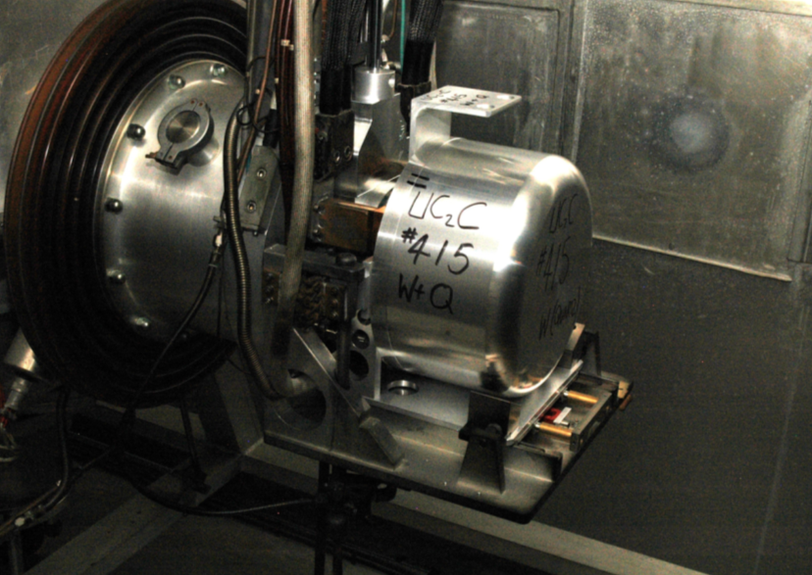
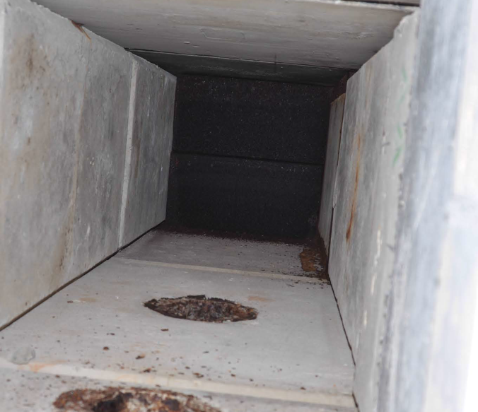
The ISOLDE target
Proton beam impact on the beam dump window
Behind the window
PS Booster
protons
Only a fraction of the beam interacts in the target material. Majority of the remaining protons and secondary particles absorbed in the beam dumps
Going toward higher beam intensity, higher energy and “thinner” targets (lower density material) even more particles will be “lost” into the dumps
MEDICIS is already exploiting this “feature” on the HRS target side (see the presentation given by Thierry)

Slide 4
Infrastructure (focused on irradiations)
Remote handling capabilities:
  Three industrial robots (made radiations hard) for targets handling
  A rail conveyor system going from the HRS irradiation point (MEDICIS) to the laboratory area (accessible during beam operation)
Shielded storage (inside the target area and in the laboratory)
A shielded hot cell:
  Providing 15 cm lead equivalent shielding
  Dedicated mainly to targets dismantling (mandatory for waste disposal) but scope of use could be extended
A “hot-laboratory” with the technical and procedural (close RP support) requirements for handling of radioactive materials

Slide 5
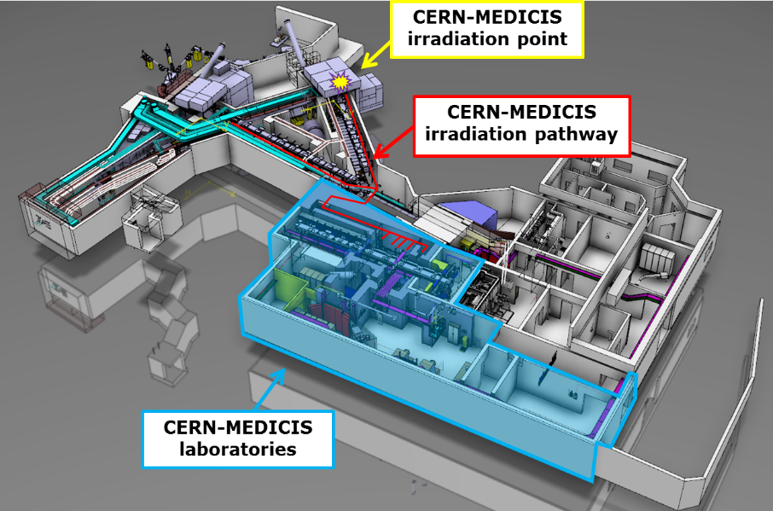
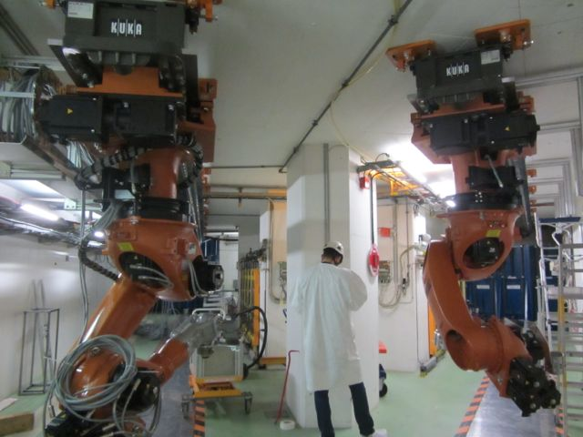
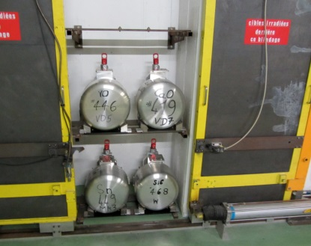
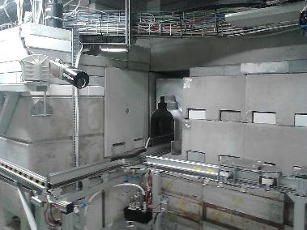
Infrastructure (focused on irradiations)
GPS and HRS robots (target area)
Storage (target area)
RCS chicane toward the laboratory

Slide 6
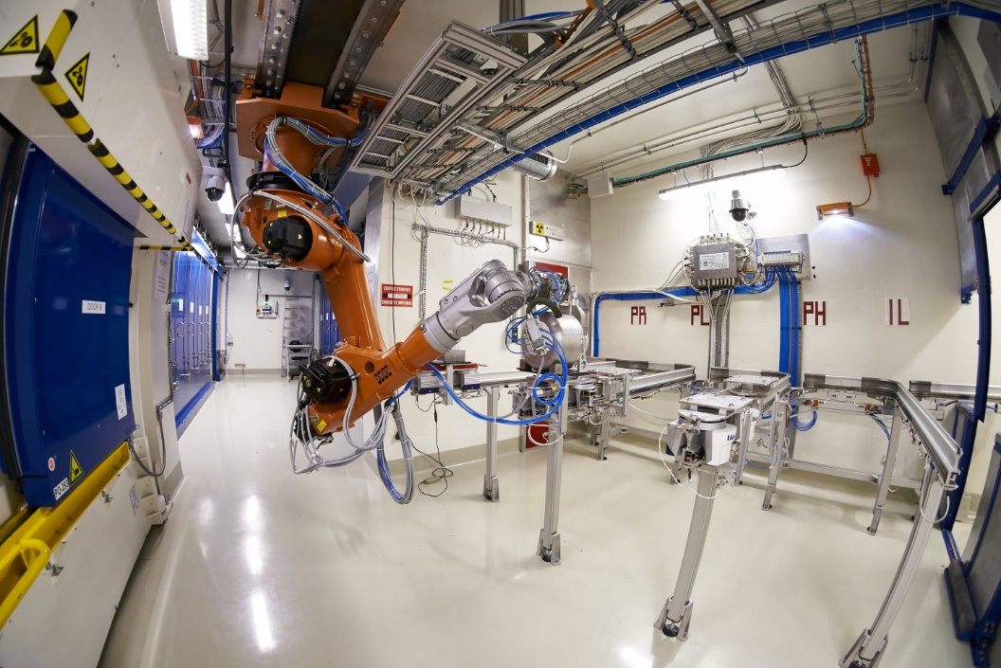
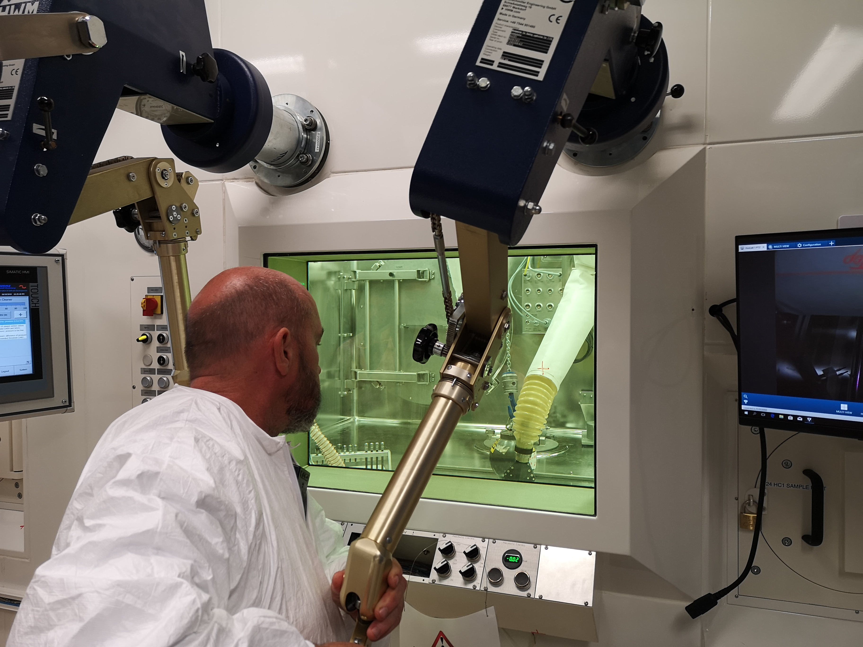
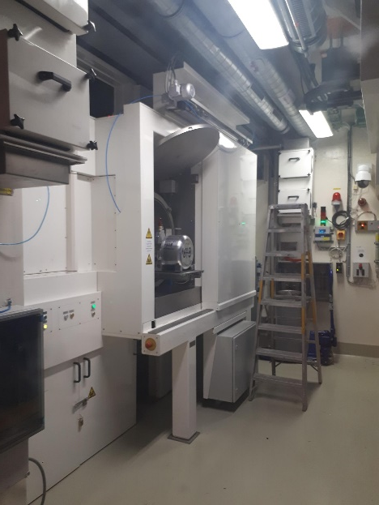
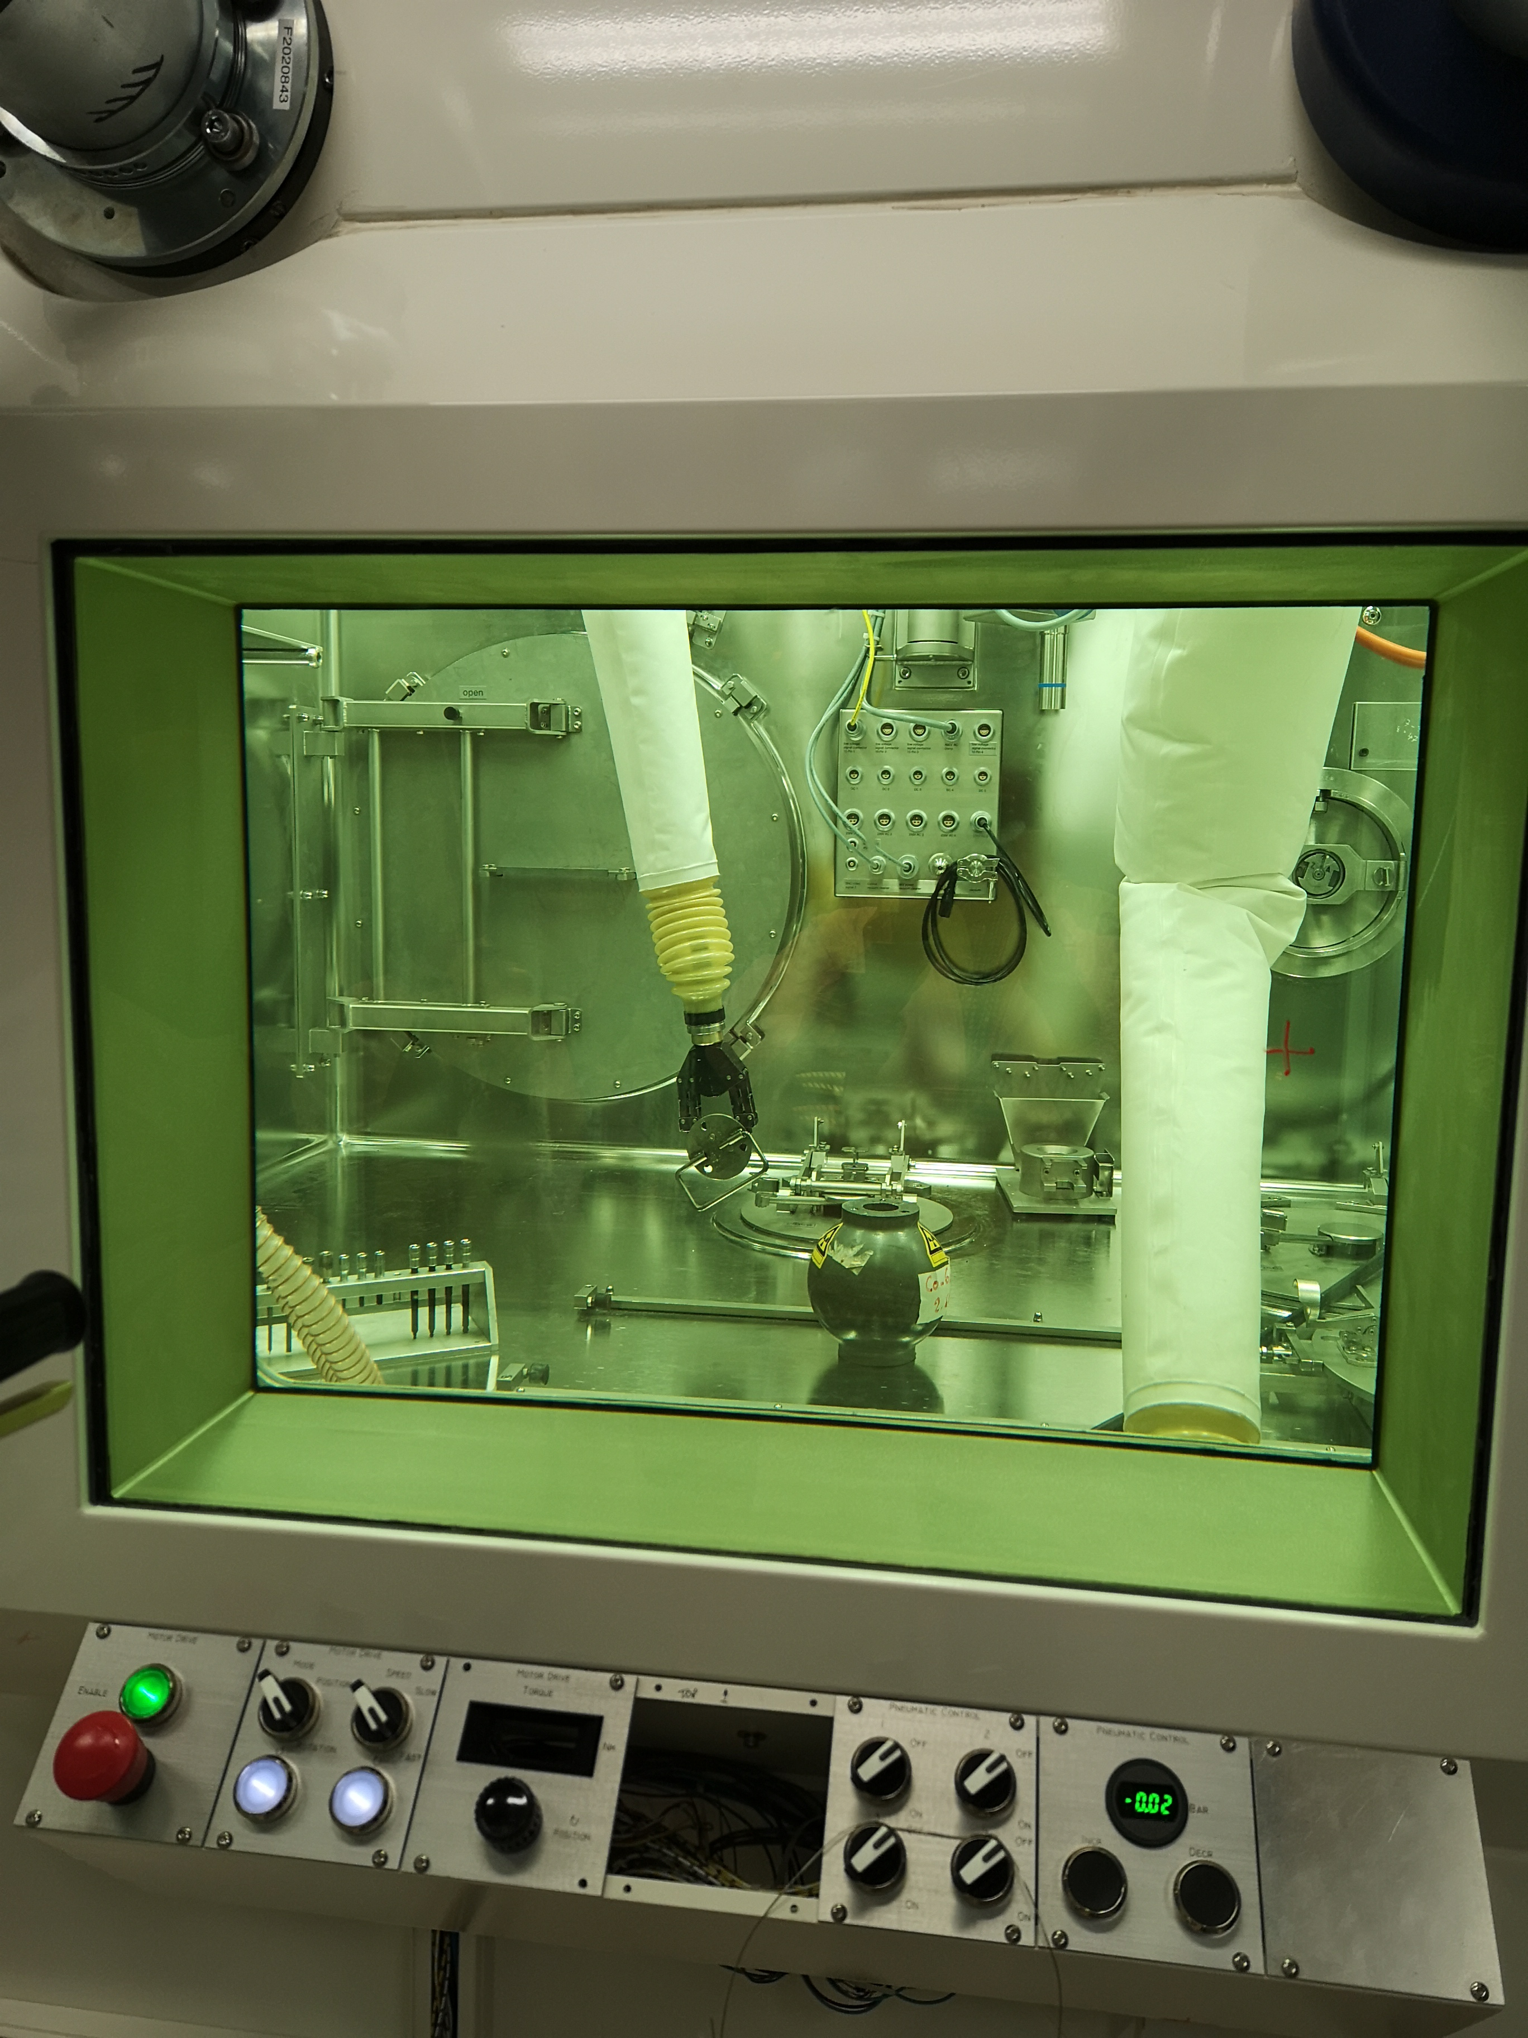
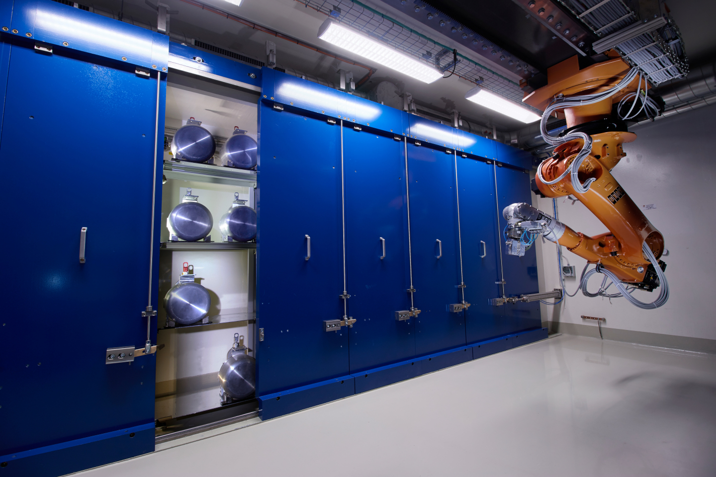
Infrastructure (focused on irradiations)
Telemanipulator
RCS and robot
Hot Cell window
Targets Storage
Target Loading

Slide 7
Outline
ISOLDE infrastructure (focused on irradiation possibilities)
Review of irradiation possibilities
Performances of ISOLDE as an irradiation facility
Conclusions

Slide 8
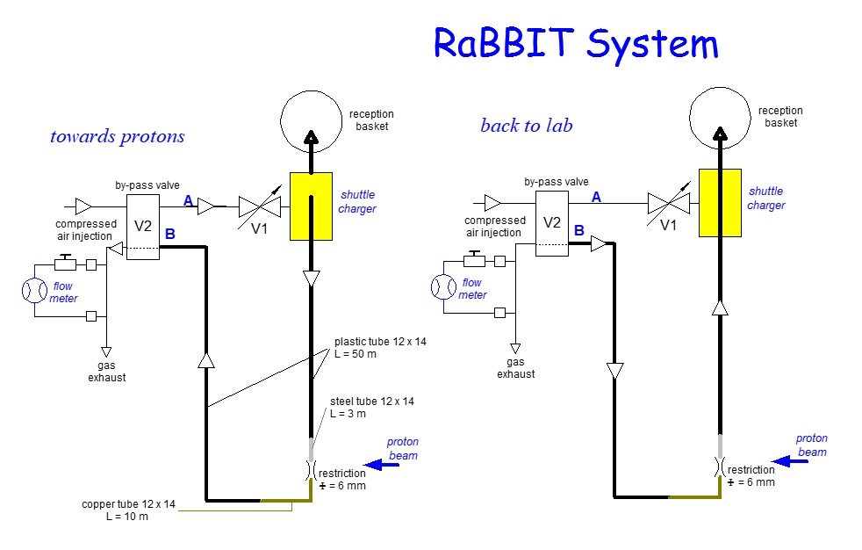
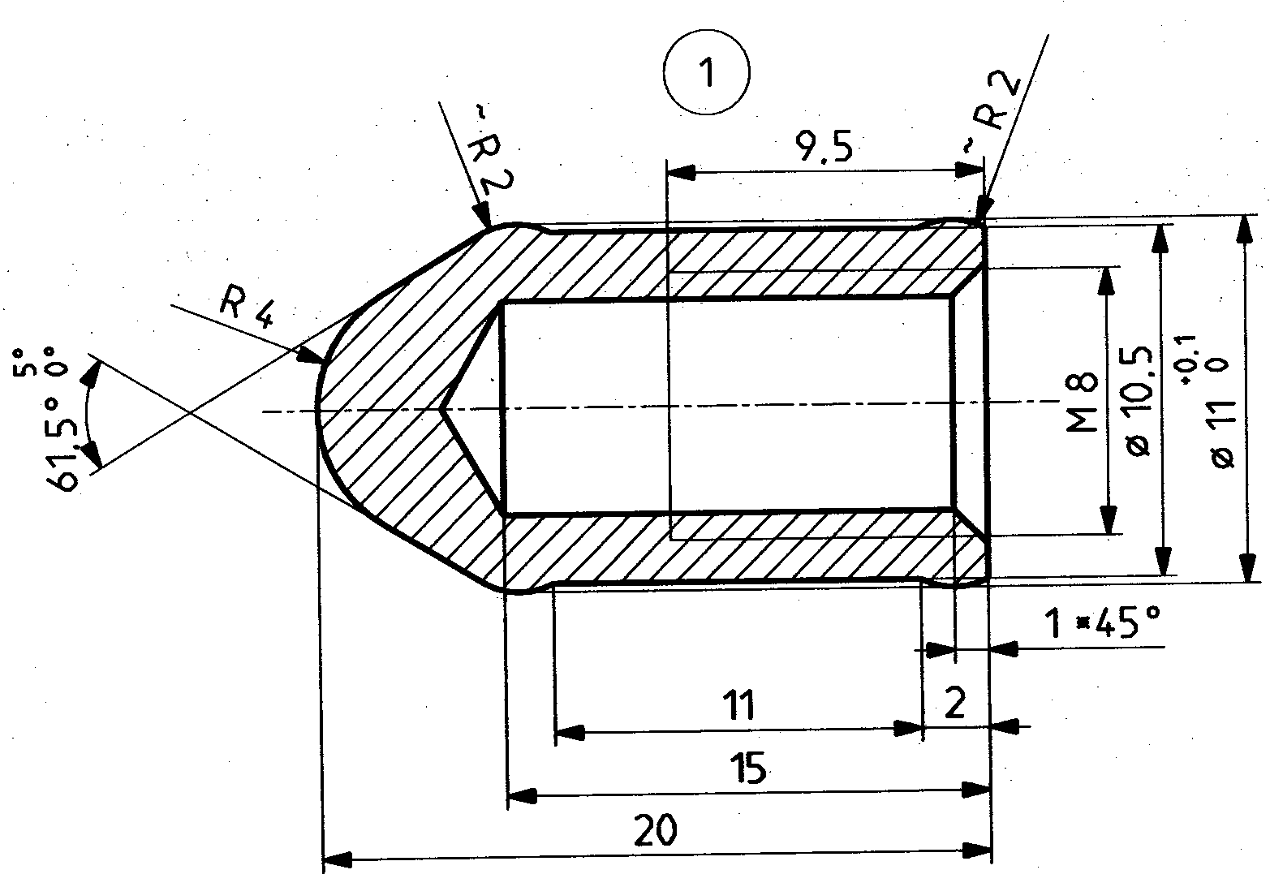
Old rabbit system
Shuttle
Dedicated irradiations (less than ~1E16 protons)
System has been dismantled several years ago

Slide 9
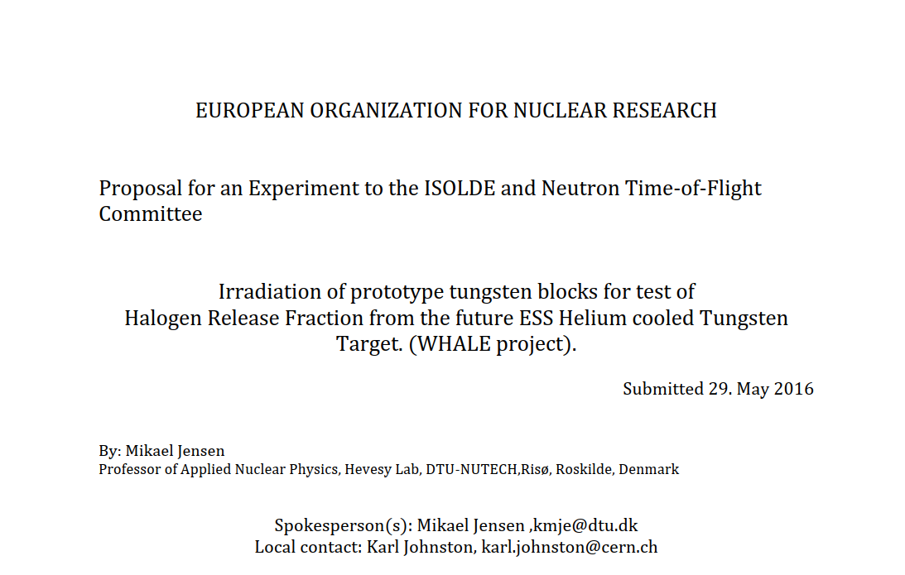
Online irradiation
Irradiation inside the ISOLDE target unit for the study of the release properties of halogen in tungsten
Well characterized beam parameters (position, number of protons…) but no online physics…
Irradiation performed with beam on the target station (no RIB production) for ESS target study

Slide 10
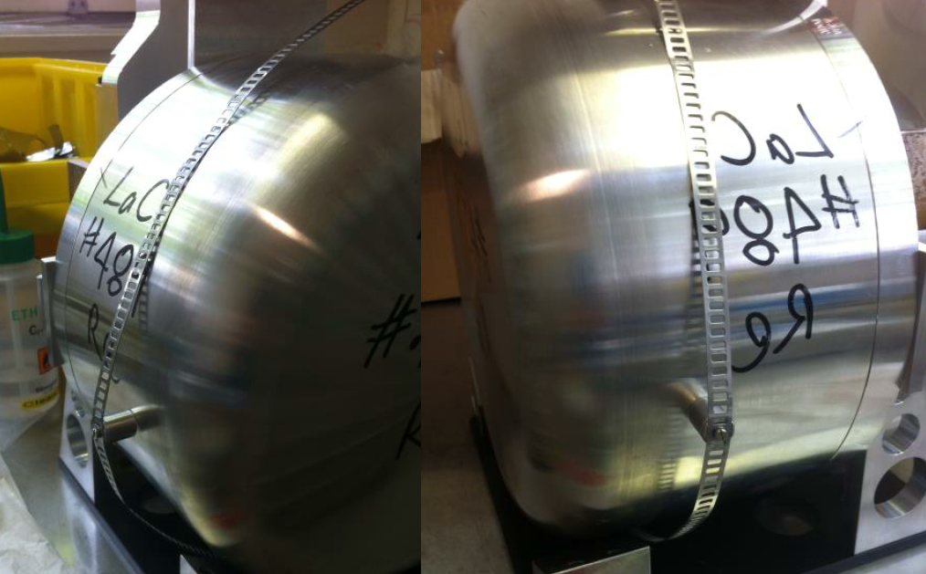
Outside target irradiations
Passive irradiations outside the ISOLDE target (~2 weeks of beam time)
Example: Retrieval at the end of the run target transport (ISOLDE hot cell could be used (once commissioned) for retrieval after the target decoupling if dose rate allows (light targets)

Slide 11
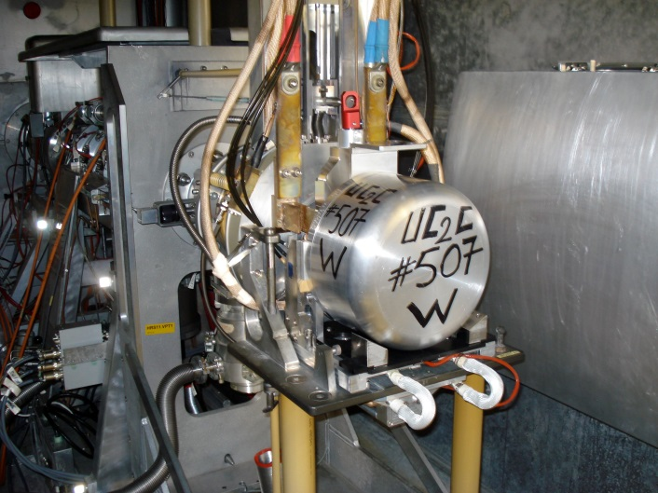
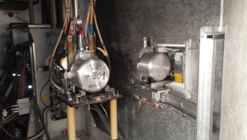
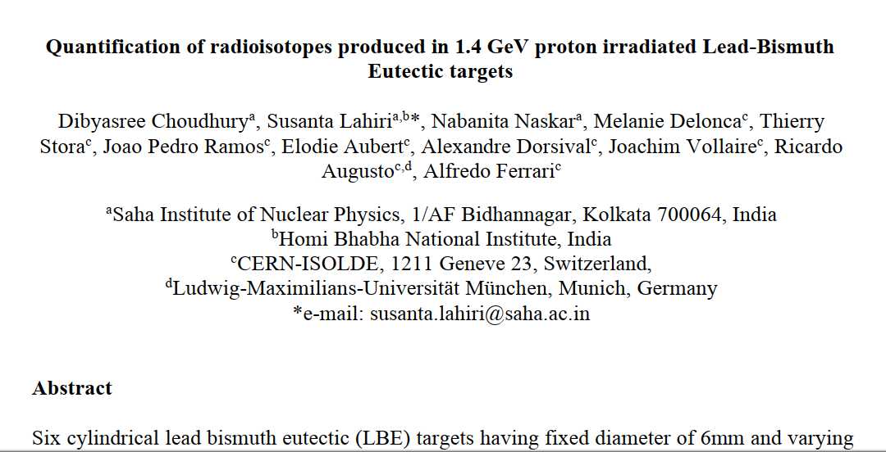
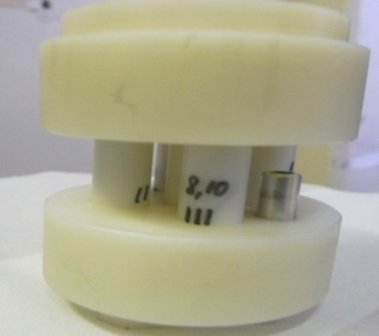
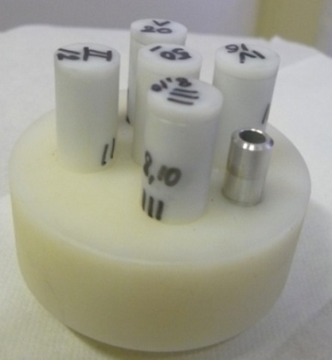
MEDICIS irradiation point
Passive (parasitic to ISOLDE operation) irradiation of targets for collection of radioisotopes (routine MEDICIS operation)
Irradiation for targetry R&D done in the past (irradiation of lead bismuth eutectic in view of the design of a prototype target)
MEDICIS irradiation point
with its cover
without its cover

Slide 12
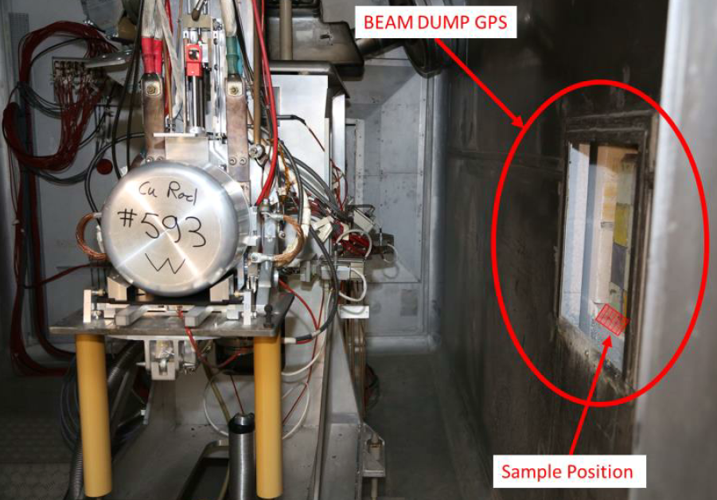
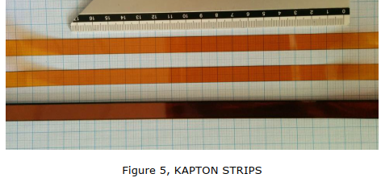
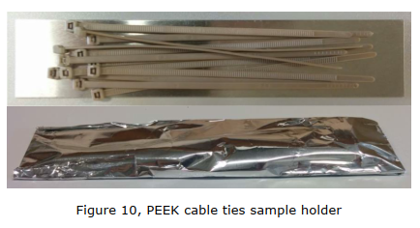
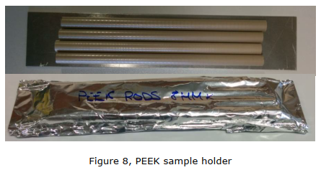
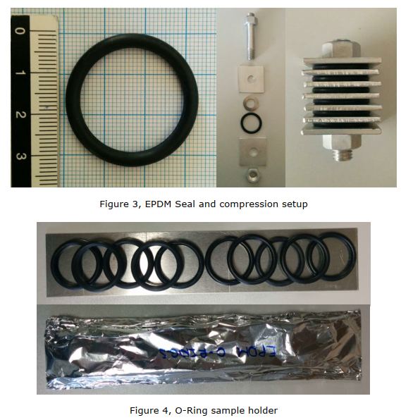
Radiation hardness tests
Materials used for the Front End and targets placed behind the GPS beam dump window
  EDPM Ethylenee Propylene Diene (EPDM) O-ring seals (compressed and not compressed during irradiation)
  Kapton (commonly used insulator in radiation environment)
  PEEK samples (High Voltage Insulator for the Front Ends)
Samples placed during the 2018 run (to be analyzed)
Courtesy of J. Cruikshank

Slide 13
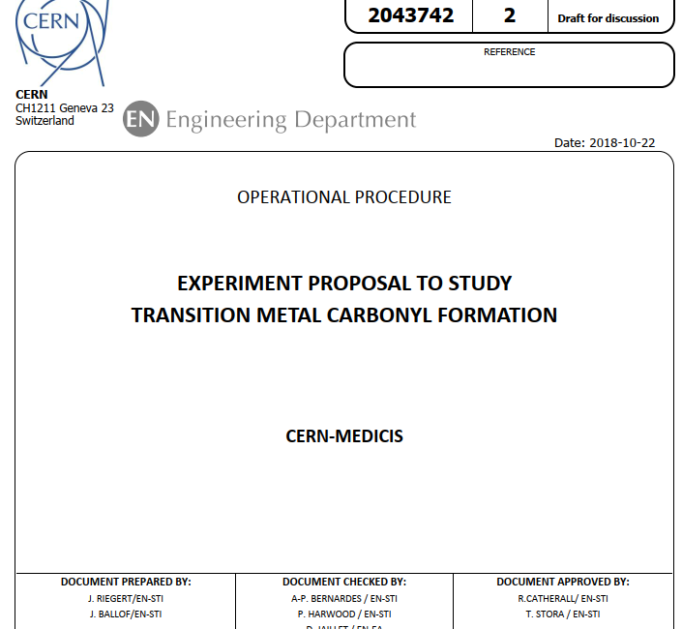
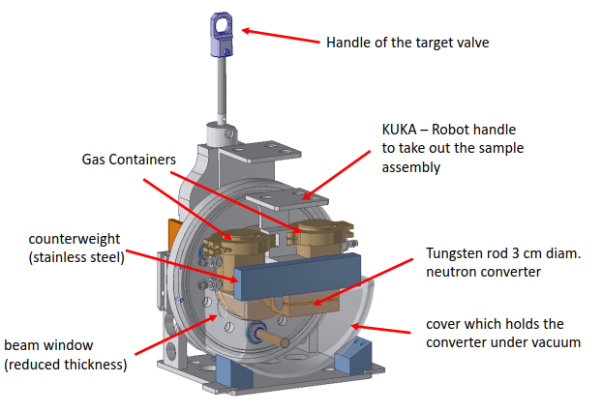
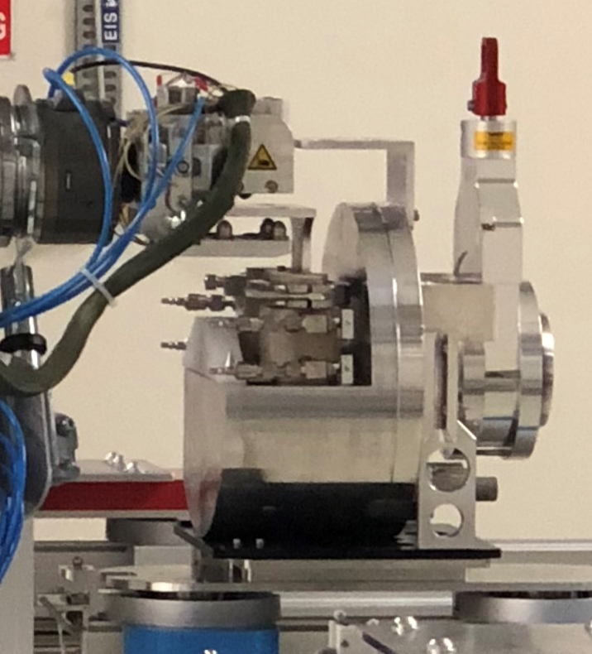
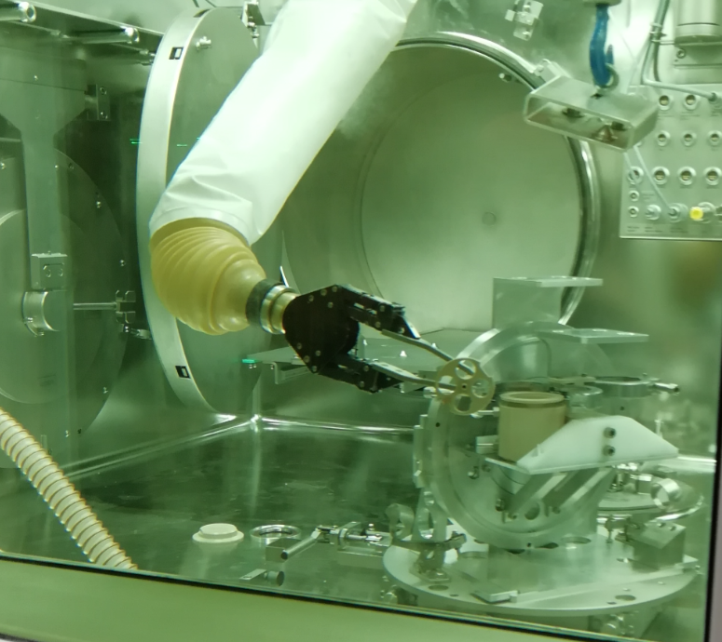
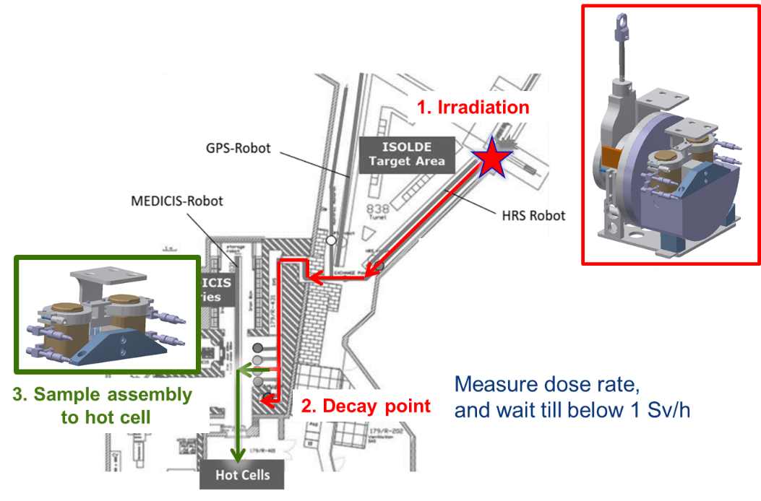
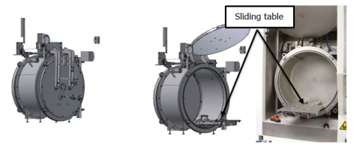
Prototype target (proposal)
Versatile irradiation unit with a neutron convertor and separate holder for the samples
Take benefit of use of RCS, robot, hot cell, storage…

Slide 14
Outline
ISOLDE infrastructure (focused on irradiation possibilities)
Review of irradiation possibilities
Performances of ISOLDE as an irradiation facility
Conclusions

Slide 15
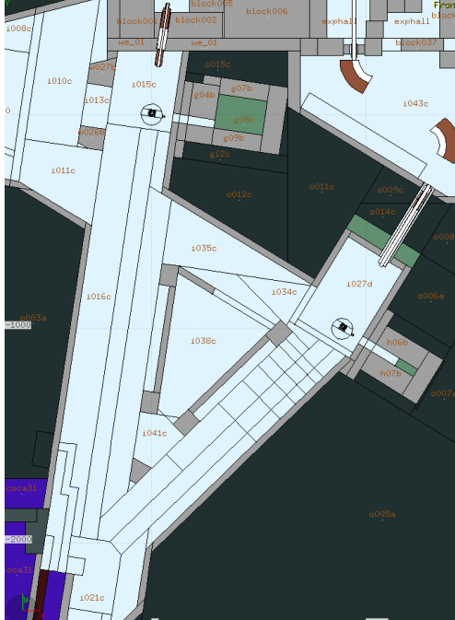
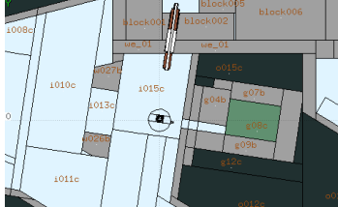
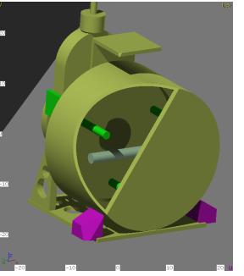
MC calculations (FLUKA)
Detailed model of the target and target area implemented in FLUKA
Using “standardize quantities for comparison of different radiation fields (dose, 1 MeV neutron equivalent, high energy hadron equivalent)
Normalization to 5x10¹⁹ protons (in 2018 ~1x10²⁰ protons equally shared between GPS and HRS). All quantities scale to the number of protons delivered (intensity, irradiation time…)
Comparison of 1.4 GeV/2.0 GeV protons and 3.5/1.3 g/cm³ UCx
FLUKA model

Slide 16
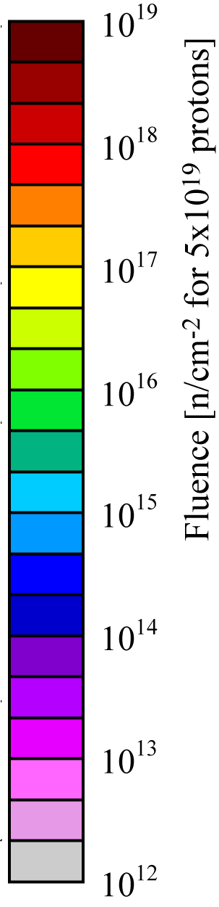
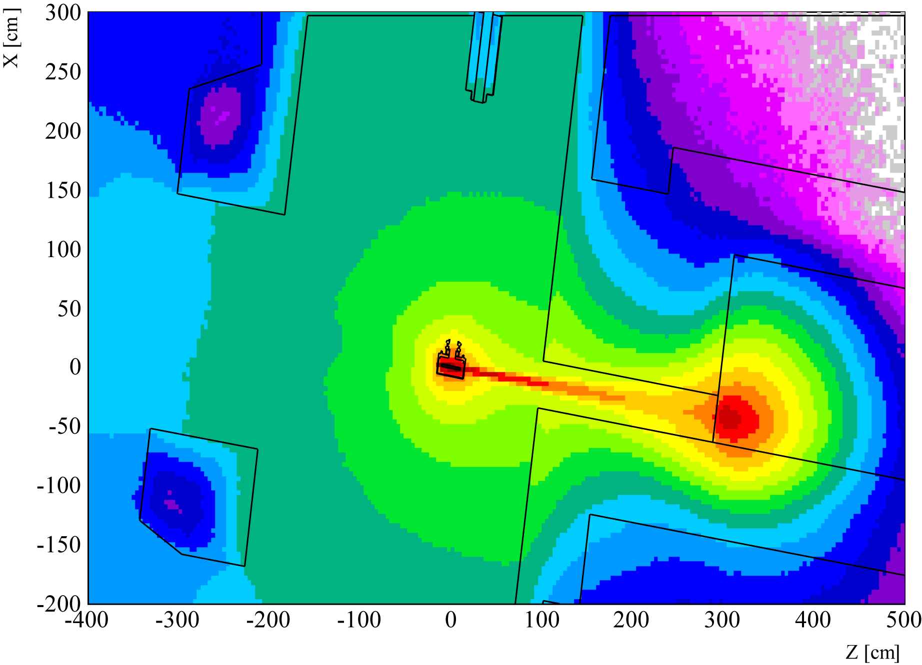
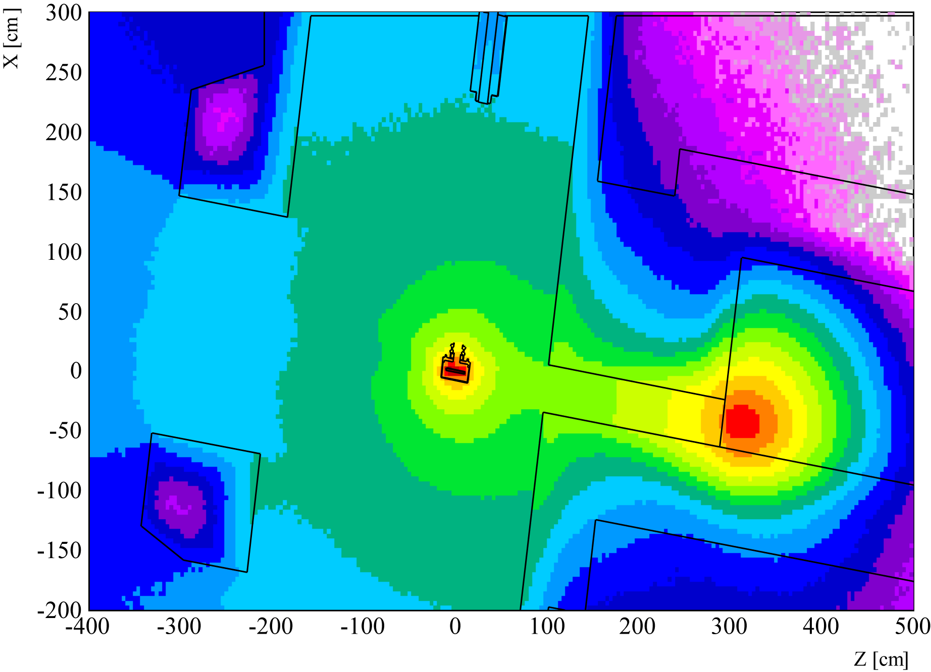
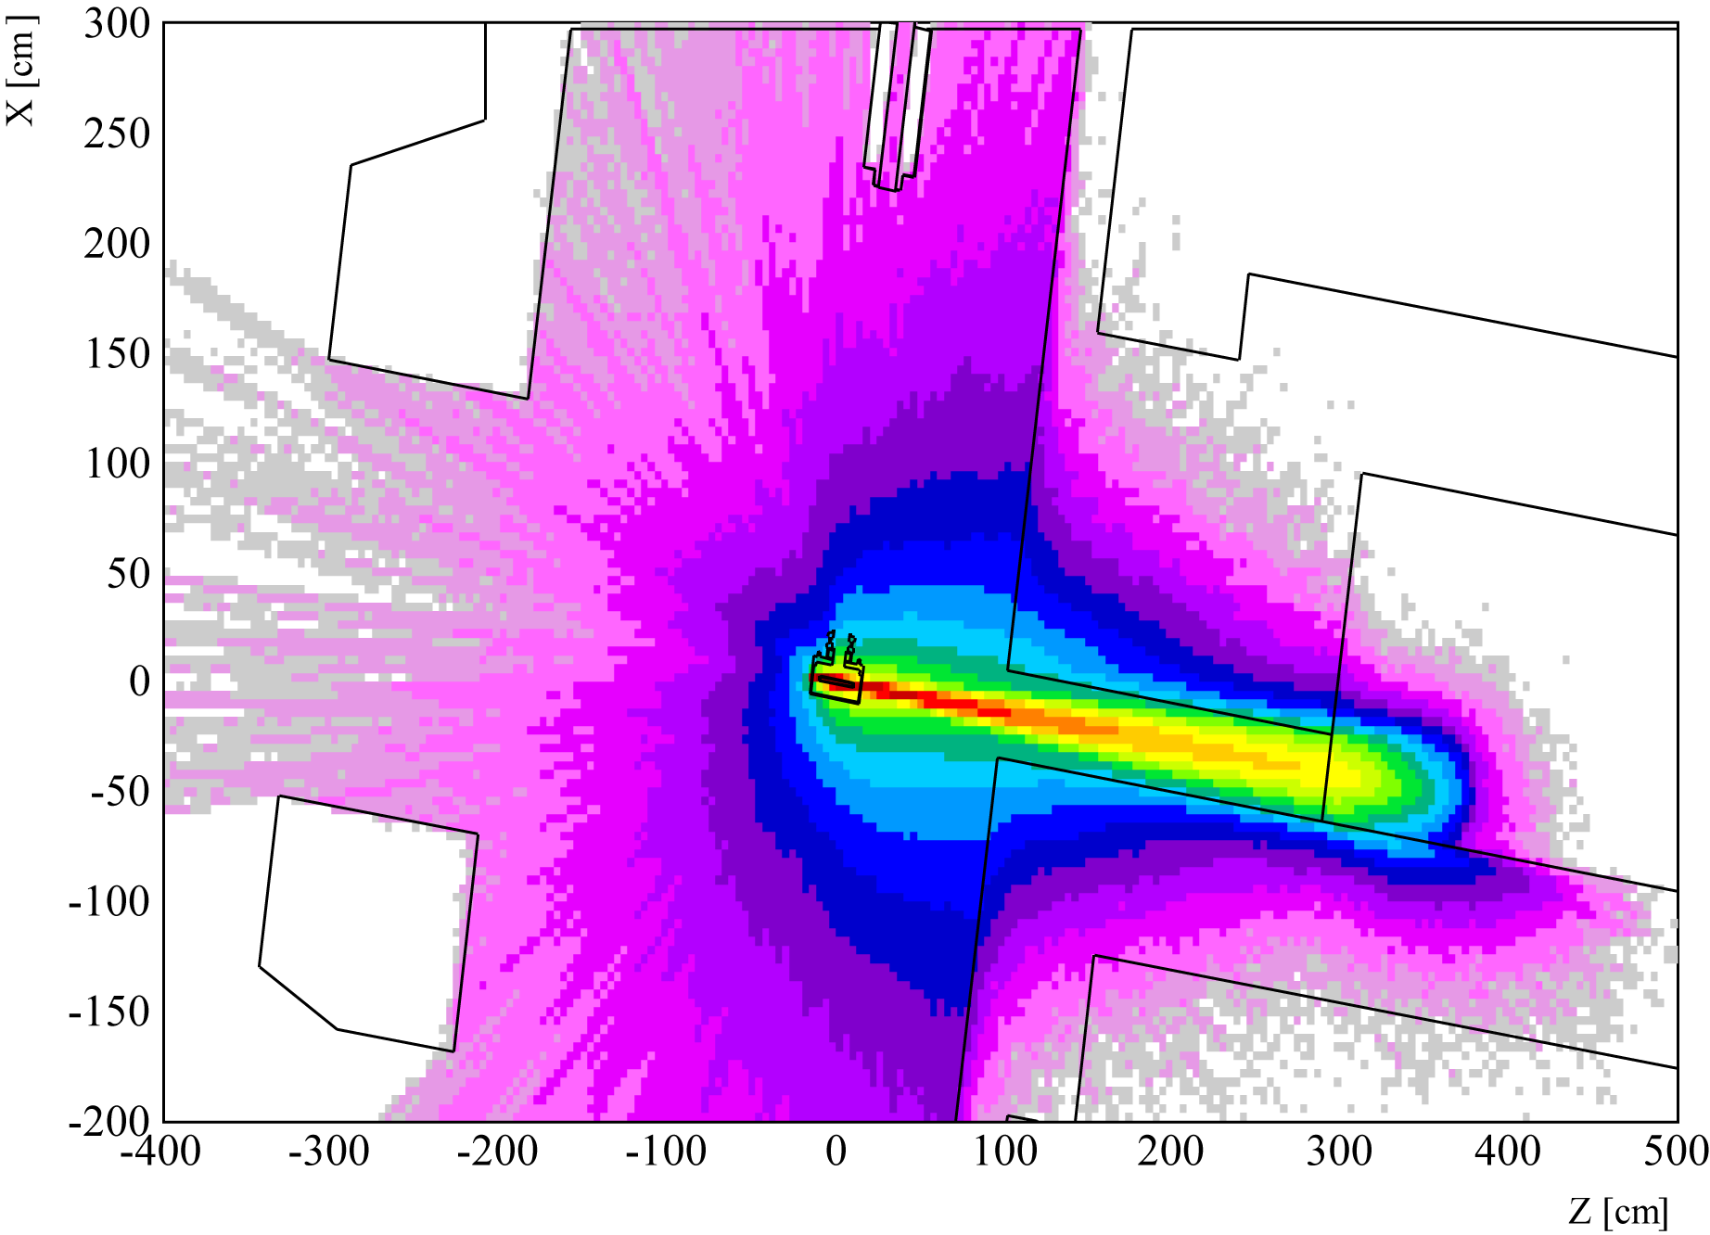
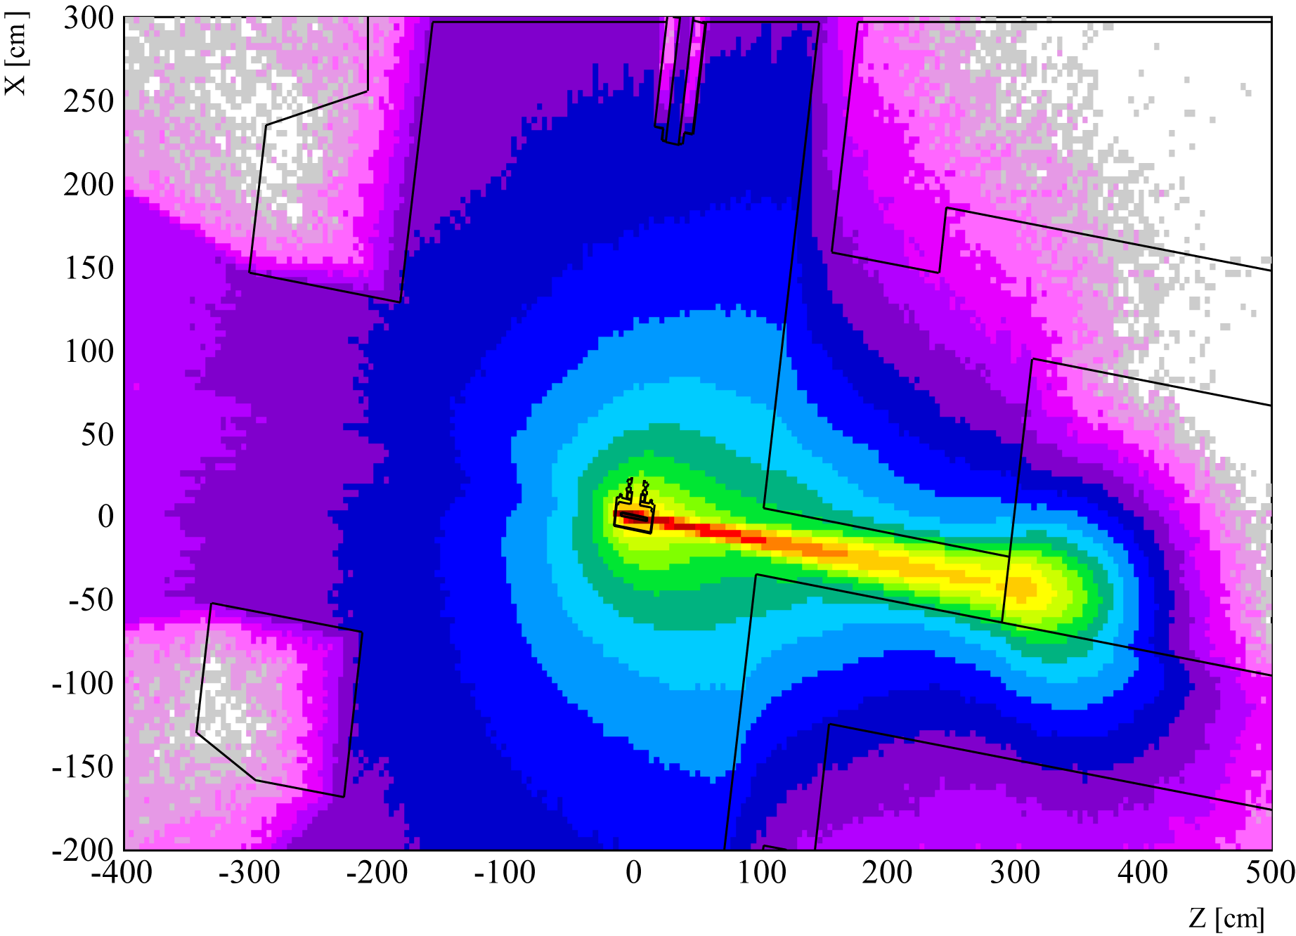
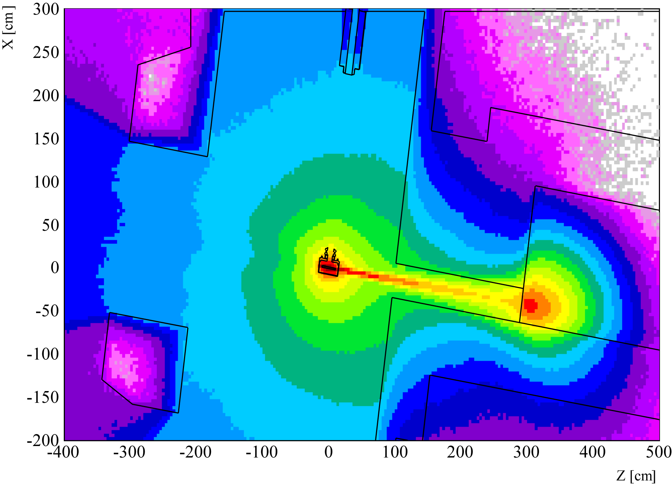
Fluence mapping (1.4 GeV – 3.5 g/cm3 UC_{X})
All particles
Neutrons
Protons
Heavy Hadrons eq.
1 MeV neutrons eq.
ISOLDE 2021 parameters:
@1m from the target:
~ 4-5x10¹⁷ HH along beam
~ 8-9x10¹⁴ HH 90°
~ 2-3x10¹⁷ 1_MeV_n along beam
~ 4-5x10¹⁵ 1_MeV_n_eq 90°

Slide 17
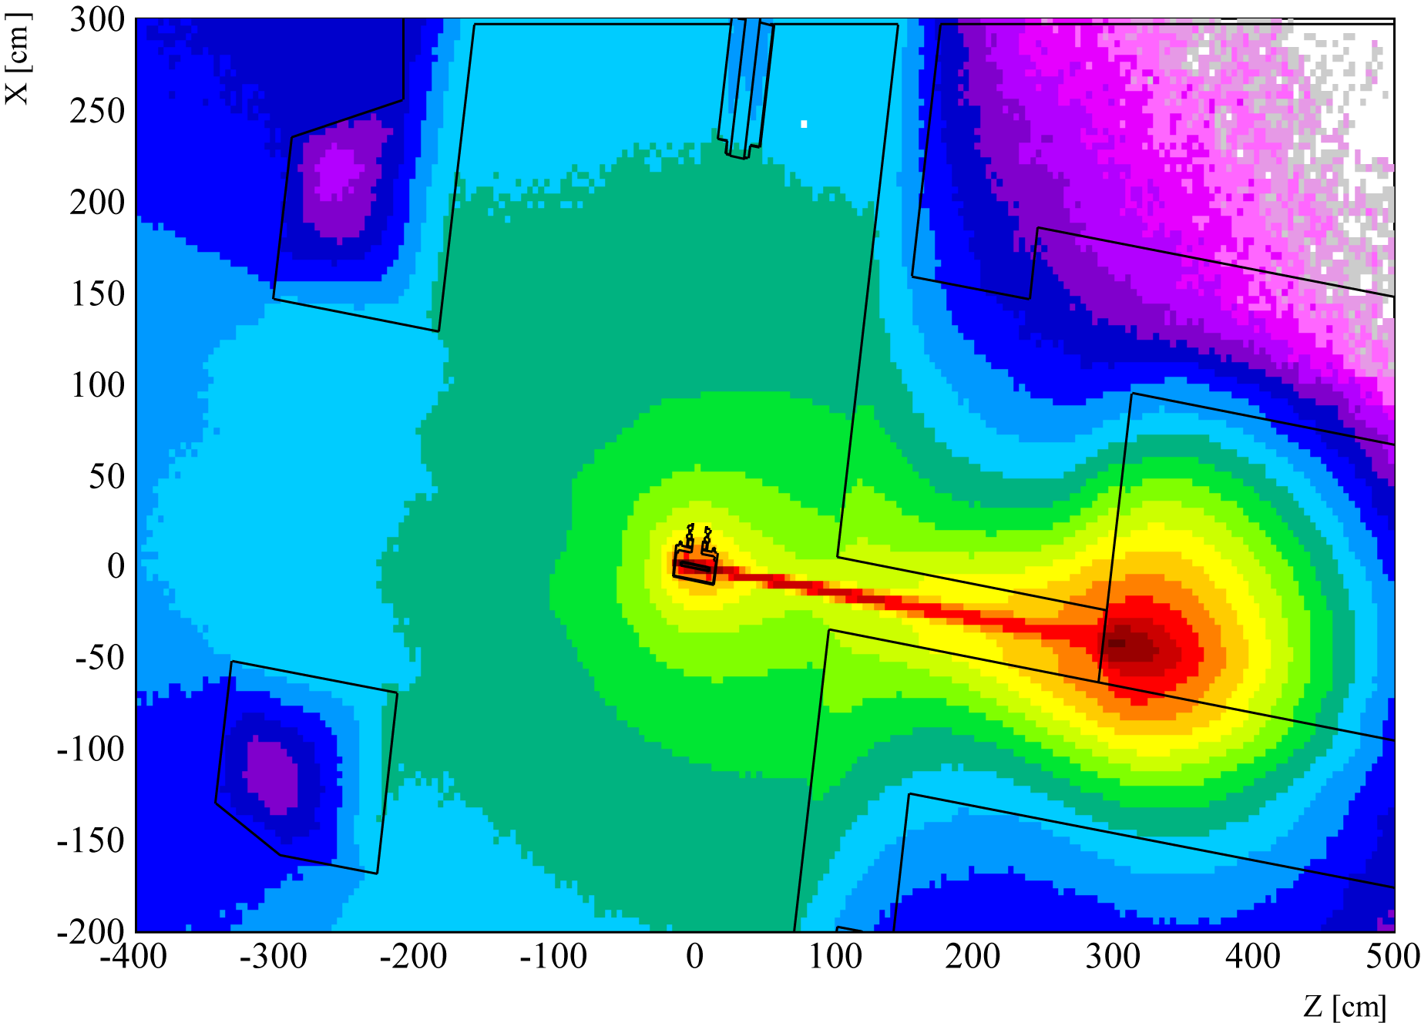
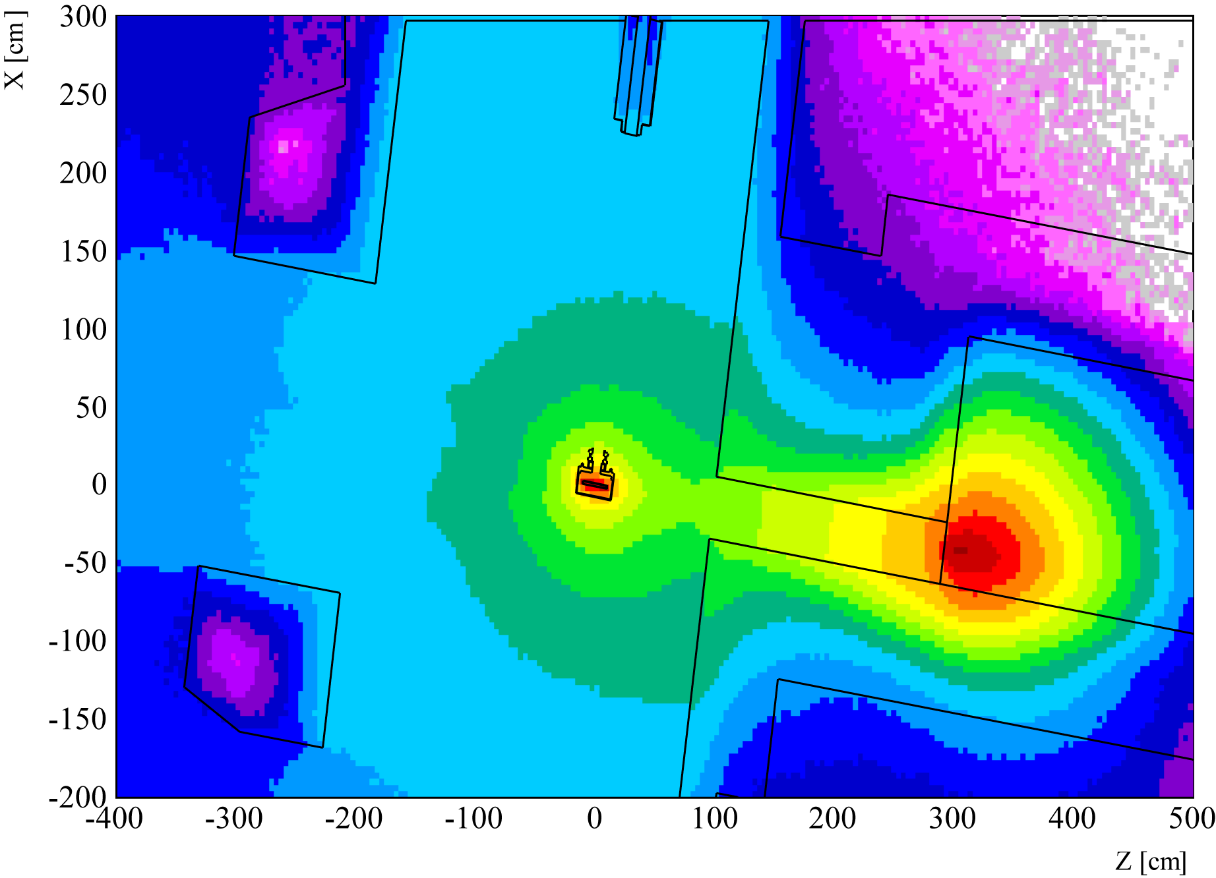
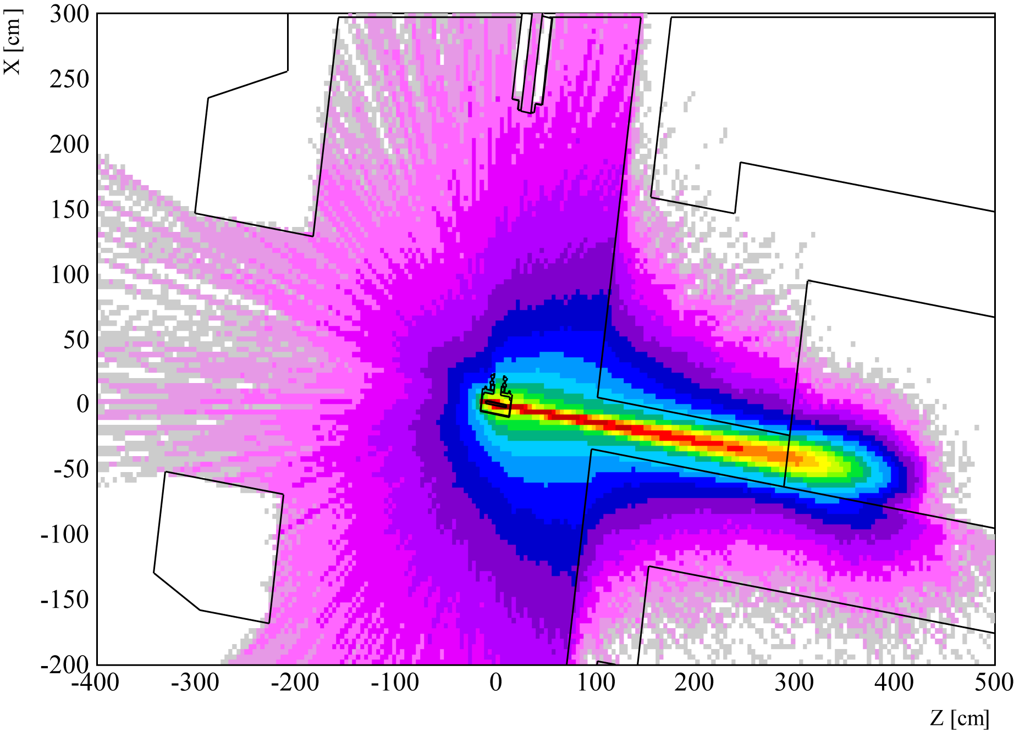
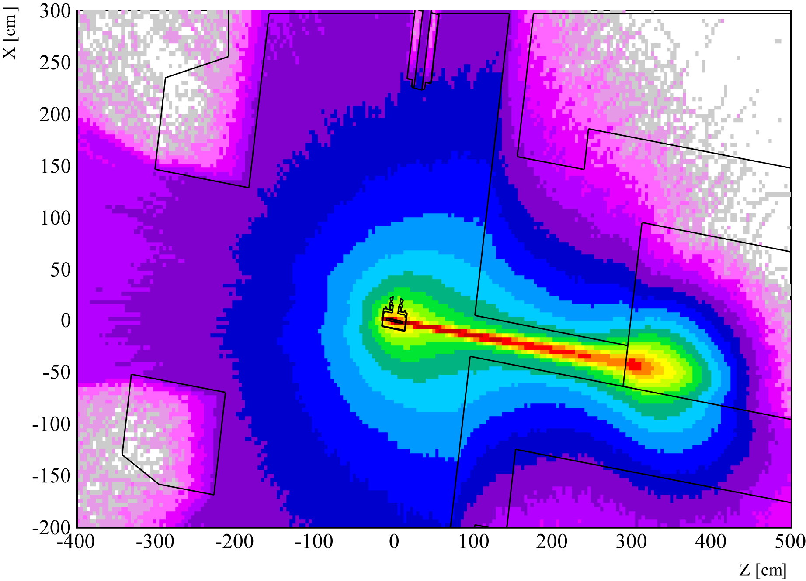
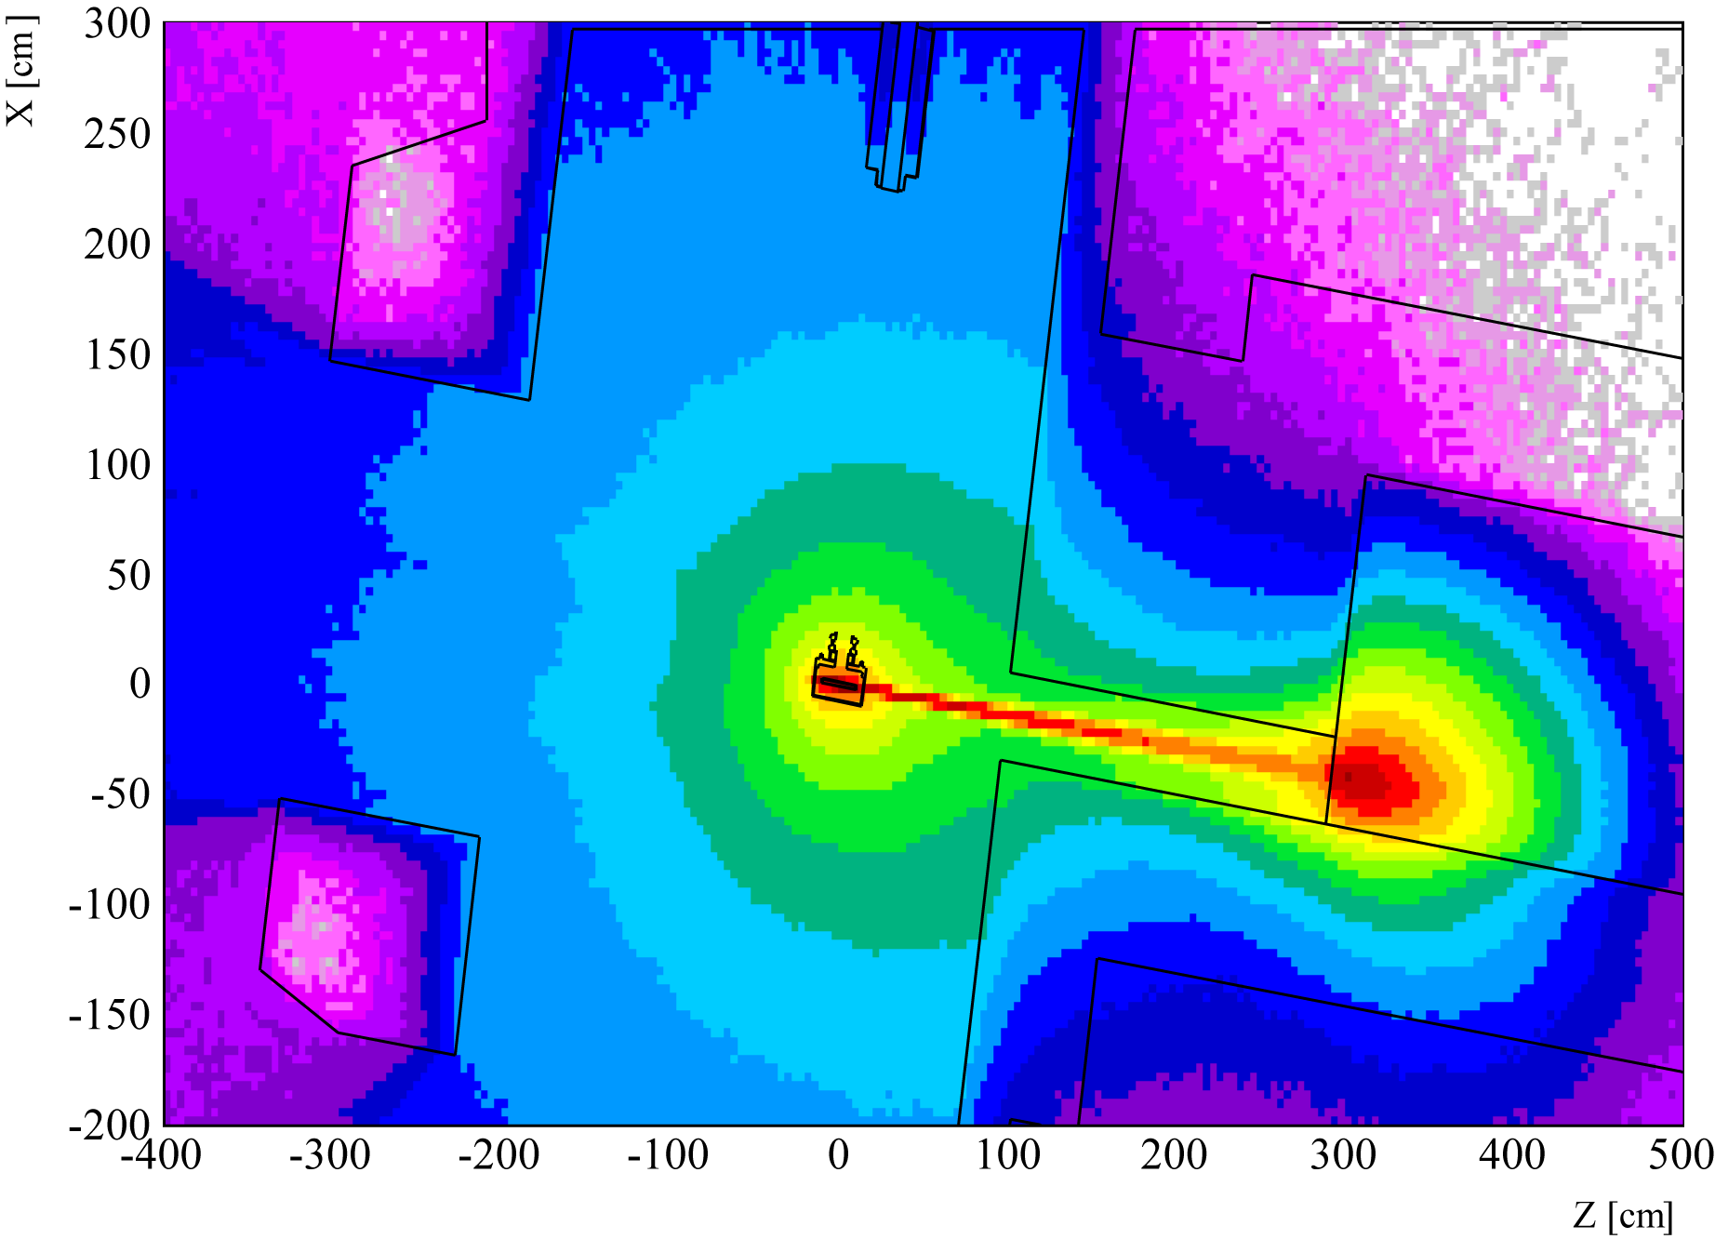
Fluence mapping (2.0 GeV – 1.3 g/cm3 UC_{X})
All particles
Neutrons
Protons
Heavy Hadrons eq.
1 MeV neutrons eq.
ISOLDE 2 GeV low density:
@1m from the target:
~ 1-2x10¹⁸ HH along beam
~ 5-6x10¹⁴ HH 90°
~ 6-7x10¹⁷ 1_MeV_n along beam
~ 2-3x10¹⁵ 1_MeV_n_eq 90°

Slide 18
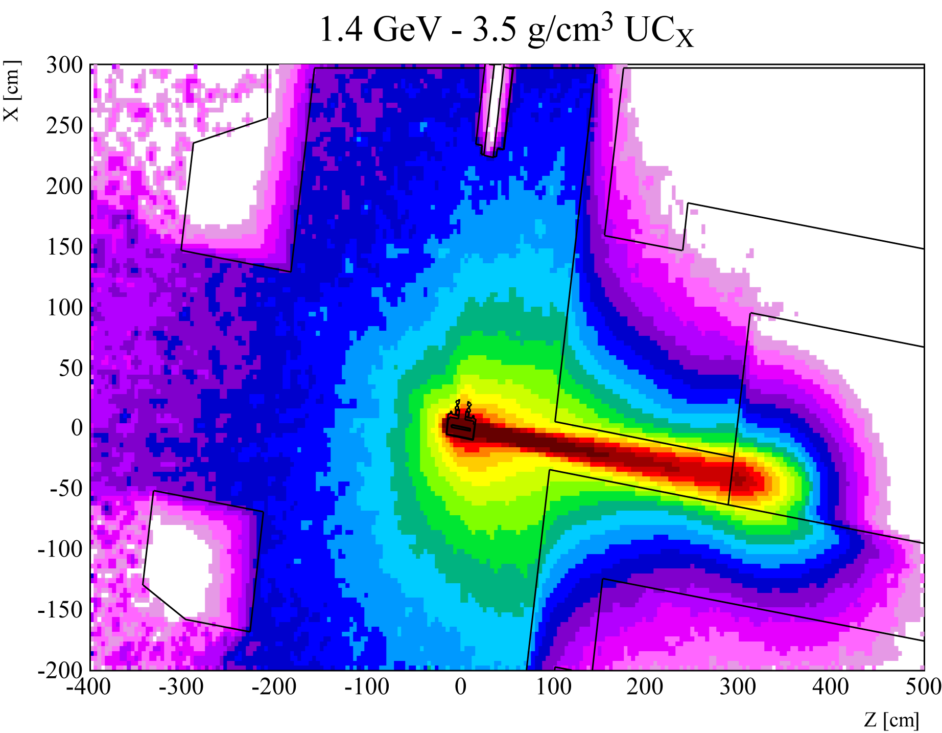
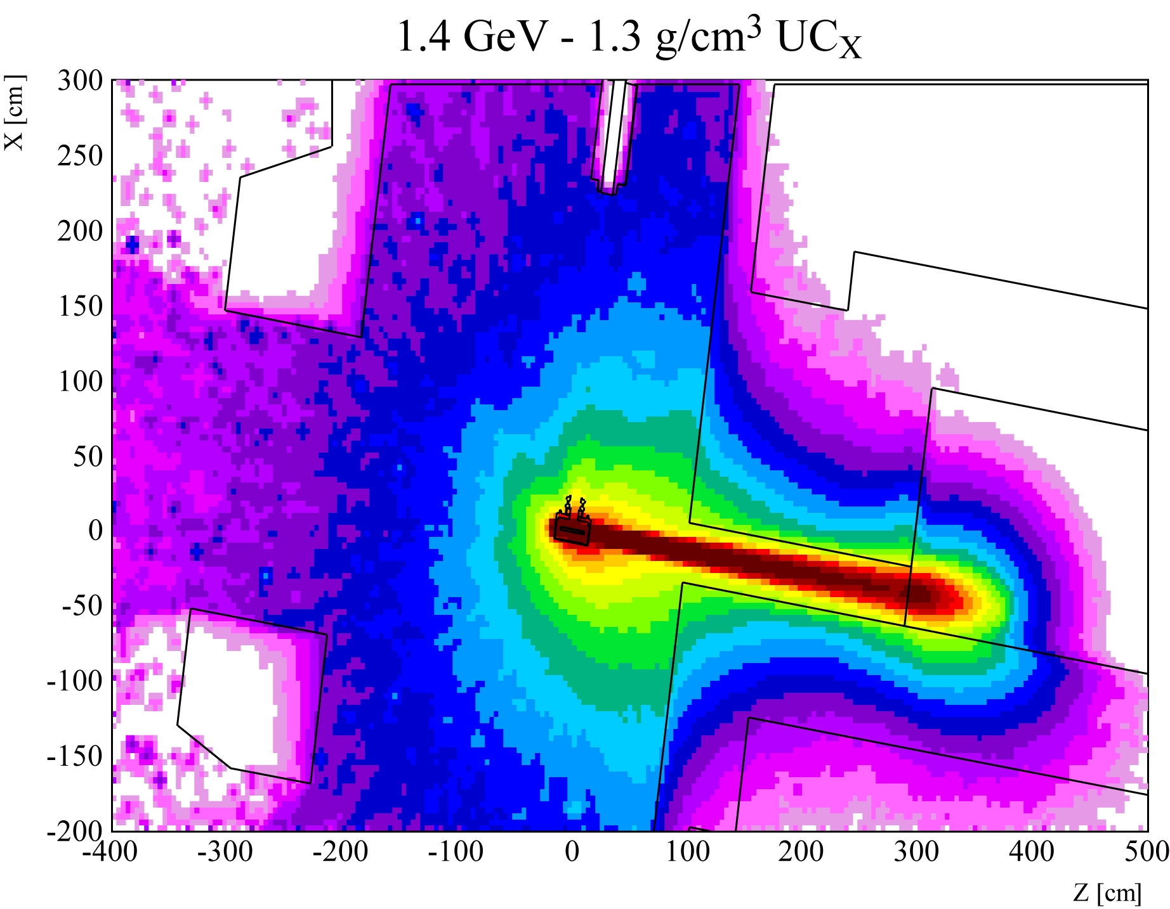
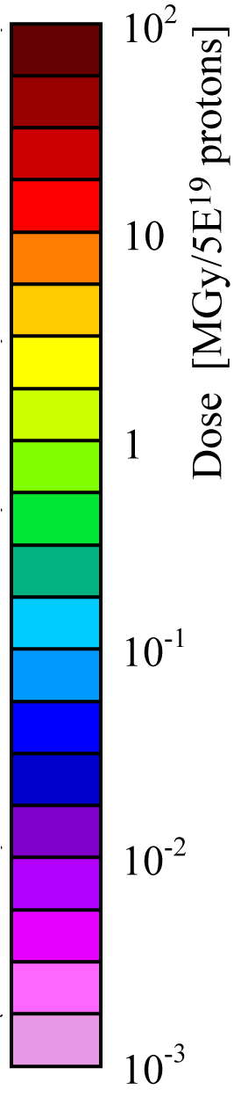
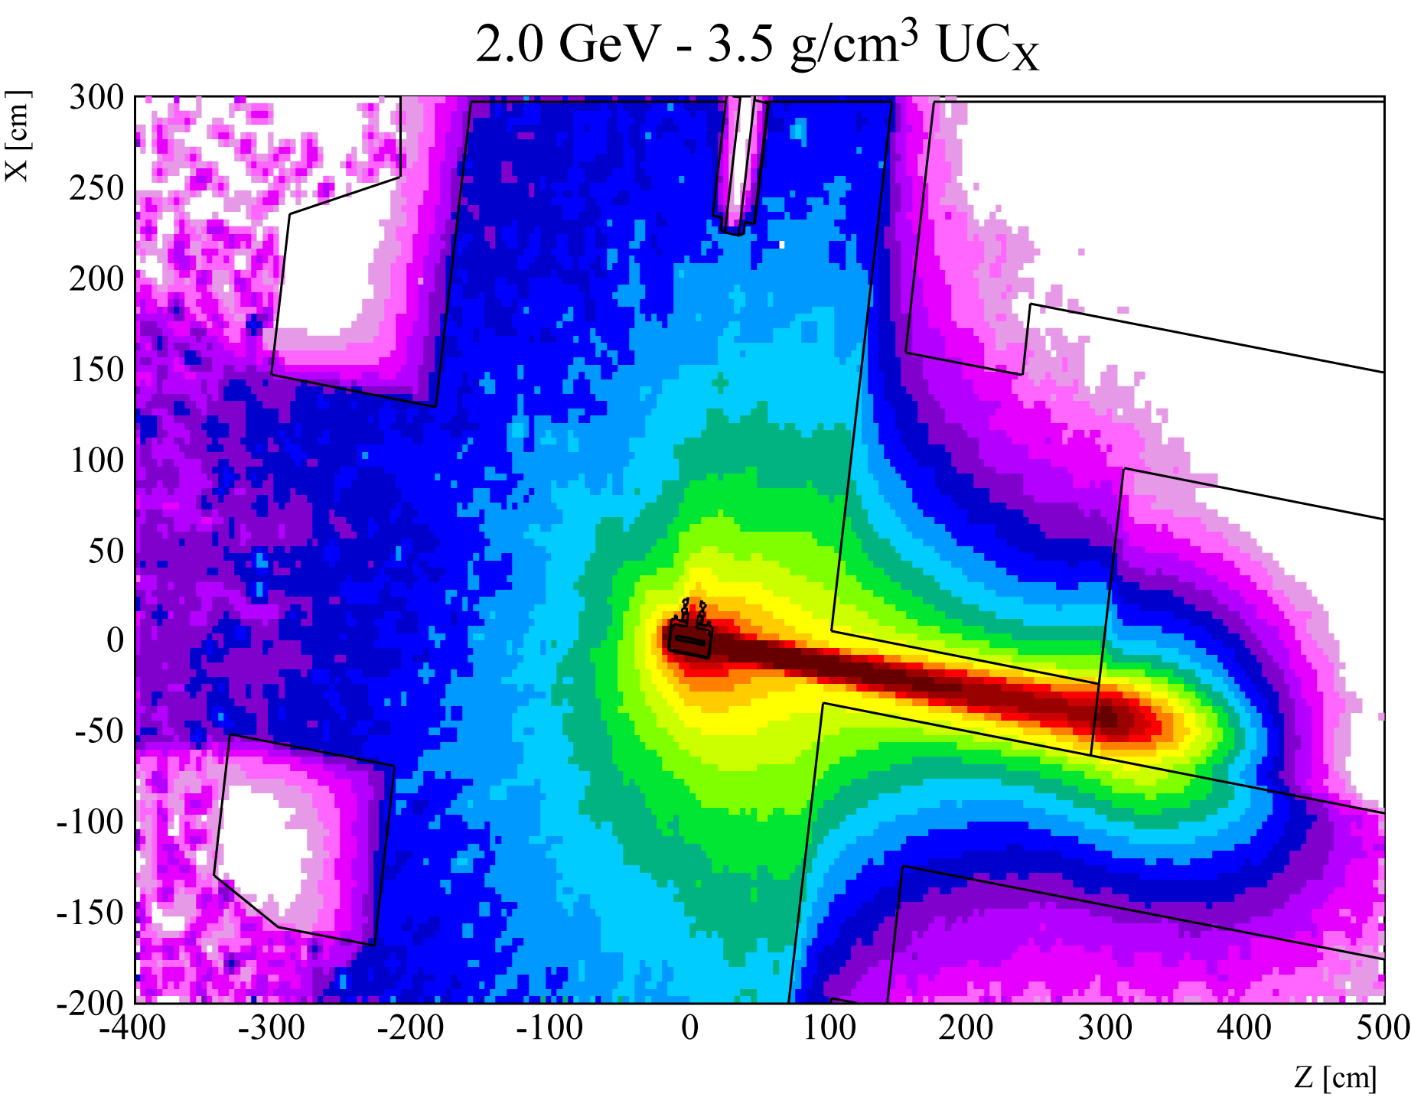
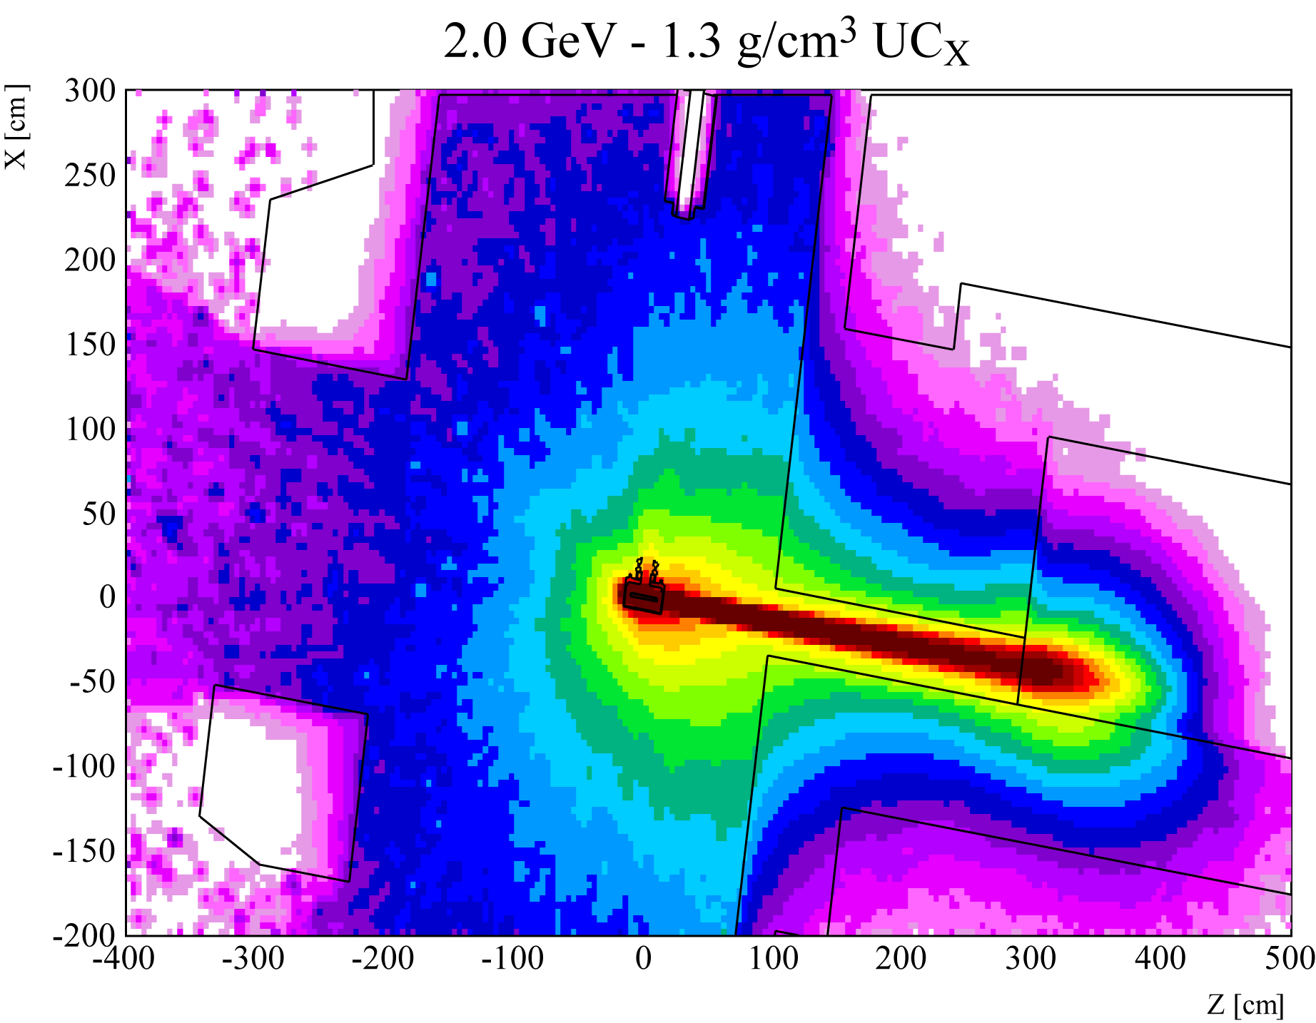
Dose (deposited energy)

Slide 19



Dose Profiles
Lateral profile
Beam axis profile
~100 MGy/year @ 1 m forward direction
Several hundreds of kGy laterally (Front End)
Higher energy increases dose in the forward direction relatively more than laterally (good for Front End considering that a good dump design can ensure a safe beam absorption)
Going to “thinner” targets, use of the area before the beam dump even more interesting

Slide 20
Conclusions
Irradiation possibilities have been exploited to support target design activities, material tests and radioisotopes production (see next presentation)
Irradiations can be parasitic to ISOLDE “online” operation or use dedicated beam time
Considering future development, even more protons and secondary particles may be “lost” in the dumps
  Quite specific mixed field (high energy neutrons, gamma) representative of target environment at accelerator
  We should maximize the use of the beam and include appropriate infrastructure to allow more systematic irradiation tests in safe conditions (and parasitically to ISOLDE operation)
  Such capabilities could be a benefit for the ISOLDE community (target material tests and radiation hardness) but could also attract people interested in testing materials for their own applications (reproduce damage in the 100 MGy range for one year of operation)

Slide 21

1 MeV neutrons equivalent Front End

