Slide 1
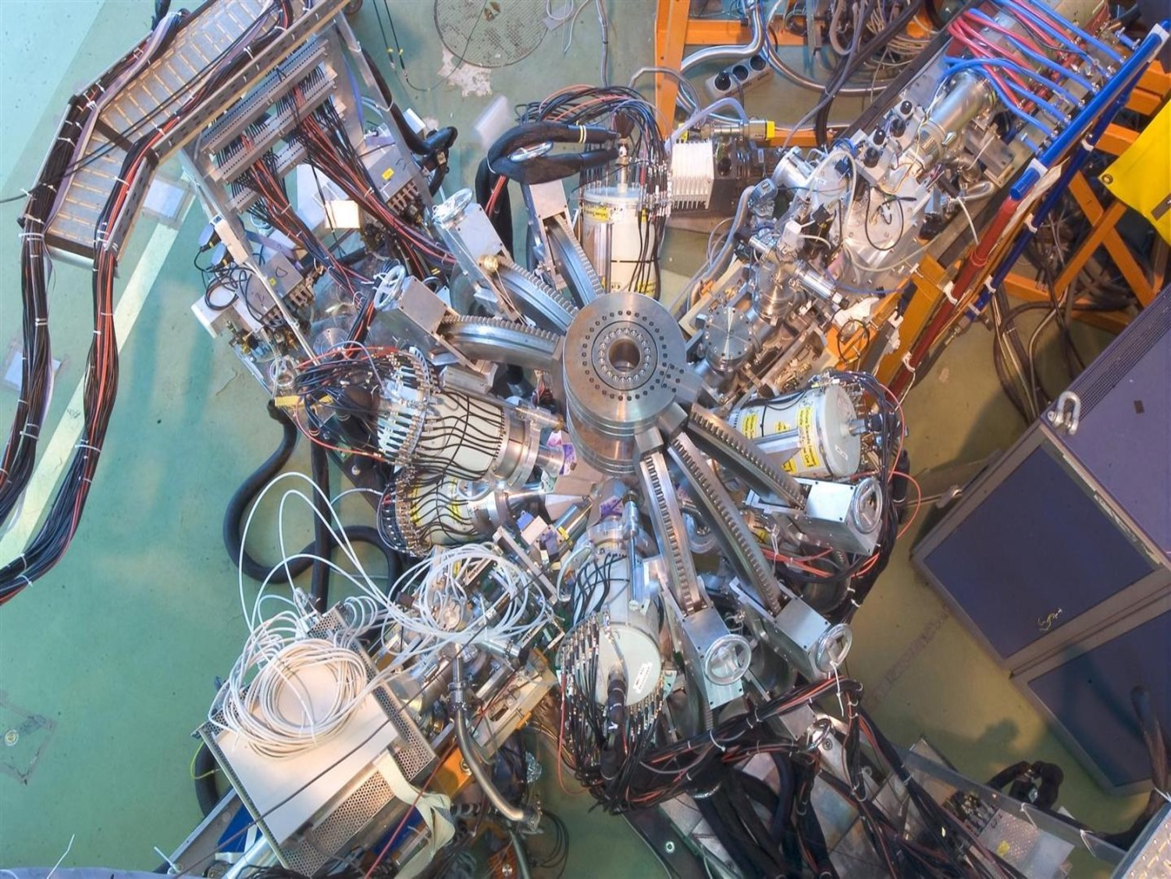


EPIC: HIE-ISOLDE working group report
Liam Gaffney (University of Liverpool)
EPIC Workshop – 04/12/2019

Slide 2
Summary of discussion
Priority from working group:
  Room temperature upgrade to allow for A/Q < 5.5
  EBIS developments, we take as granted that developments are on-going
  Reach 10 MeV/u for all masses, requires CM5 under realistic conditions.
Parallel operation is a must to give HIE-ISOLDE full exploitation.
  No compromise in the GLM/GHM style
  Separate ion sources, separators and beam line desired
Buncher comes with room temperature upgrade
  Chopper must be inlcuded, but high energy version is possible
Storage ring brings new physics opportunities and beam quality
  Best to deal with it as an independent project from the EPIC shopping list
  Bypass line to allow all experimental stations to take direct beam
Purification gains from MR-TOF or upgraded REX-TRAP
  Manpower and resource intensive, but on the wish list.

Slide 3

Different upgrade options:
REX/HIE-ISOLDE today:
RFQ
Buncher
IHS
7GP1
7GP2
7GP3
9GP
CM1
CM2
CM3
CM4
HIE-ISOLDE phase 3:
RFQ
Buncher
IHS
low beta CM1
low beta CM2
CM2
CM3
CM4
CM1
Room temperature upgrade of REX:
(1)
RFQ
Buncher
ST1
ST2
ST3
ST4
ST5
ST6
CM1
CM2
CM3
CM4
HIE-ISOLDE phase 3 + replacement of IHS structure:
RFQ
Buncher
ST1
ST2
low beta CM1
low beta CM2
CM2
CM3
CM1
CM4
Room temperature upgrade of REX + fifth high-beta cryomodule:
(3)
RFQ
Buncher
ST1
ST2
ST3
ST4
ST5
ST6
CM1
CM2
CM3
CM4
CM5
J.A. Rodriguez, N. Bidault – EPIC Workshop – 2019/12/04

