Slide 1
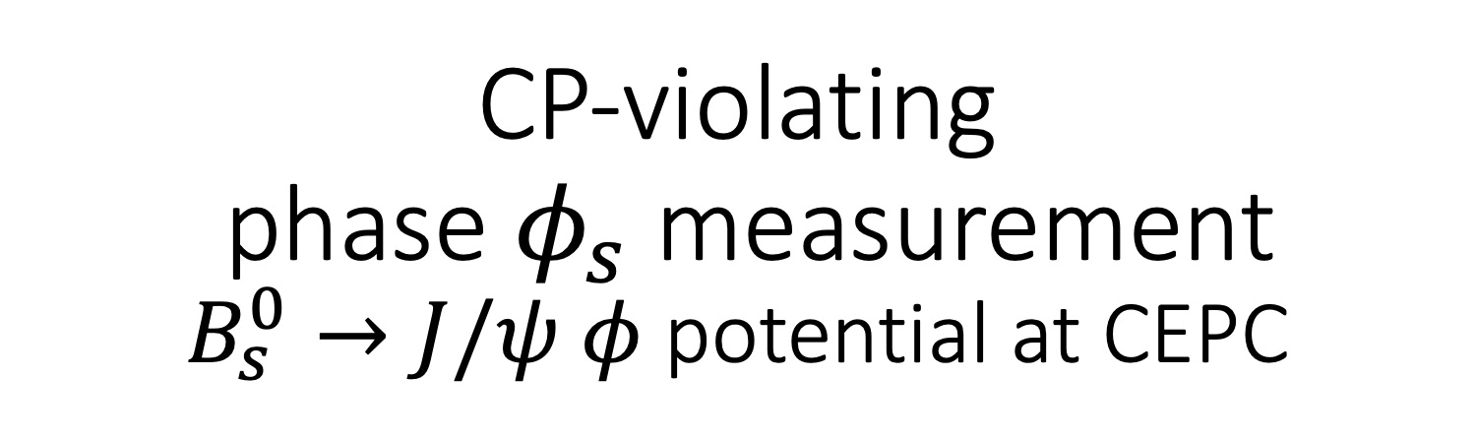
CP-violating phase $φ_{s}$ measurement
$B_{s}^{0}→J/ψ φ$potential at CEPC
Mingrui Zhao on behalf of the studying group
mingrui.zhao@mail.labz0.org
China Institute of Atomic Energy
Conference on Flavour Physics and CP violation (FPCP) 2020

Slide 2
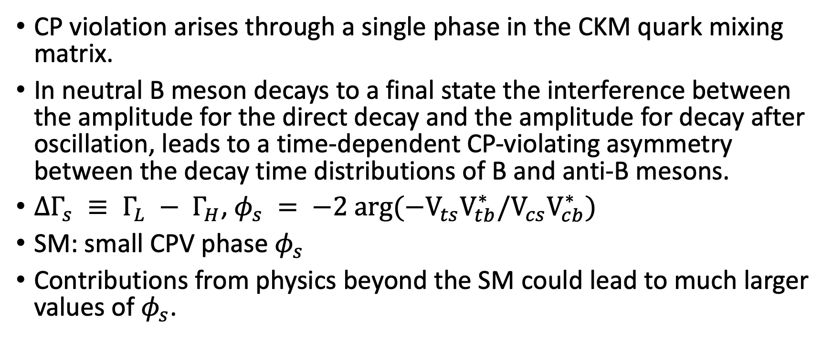
Introduction
CP violation arises through a single phase in the CKM quark mixing matrix.
In neutral B meson decays to a final state the interference between the amplitude for the direct decay and the amplitude for decay after oscillation, leads to a time-dependent CP-violating asymmetry between the decay time distributions of B and anti-B mesons.
$∆Γ_{s} ≡ Γ_{L} − Γ_{H}$, $φ_{s} = −2 arg(−V_{ts}V_{tb}^{∗}/V_{cs}V_{cb}^{∗})$
SM: small CPV phase $φ_{s}$
Contributions from physics beyond the SM could lead to much larger values of $φ_{s}$.

Slide 3
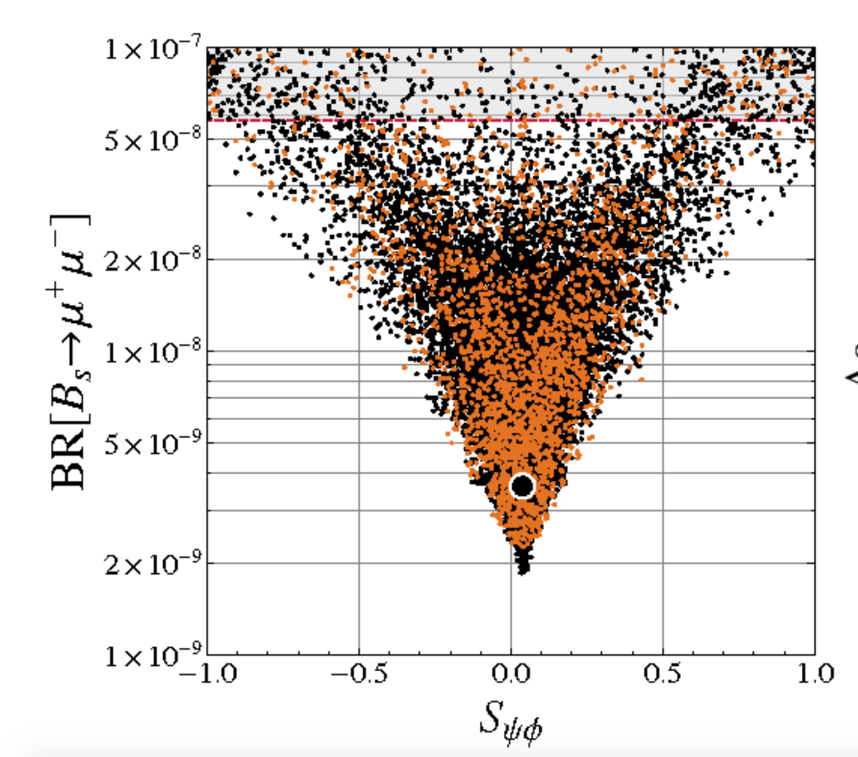
NP prediction
AC model (0910.1032)
Red line: measurement
Large black dot: SM
Small dots: NP model predictions
Deviation ~ 0.1

Slide 4

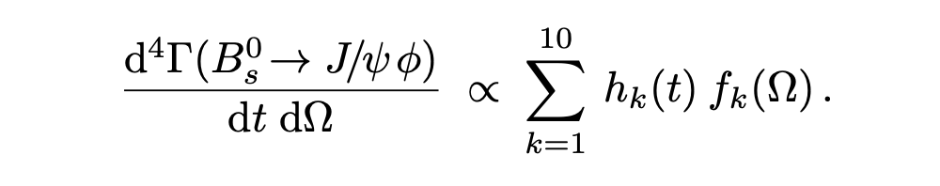
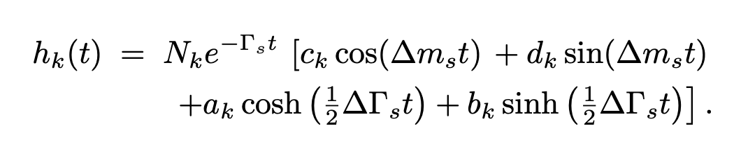
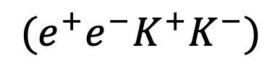
Analysis strategy for real analysis
$$(e^{+}e^{−}K^{+}K^{−})$$
Disentangle the CP -even and CP -odd components.
Distinguish B, anti-B: Flavour tagging(tagging power)
Time resolution

Slide 5
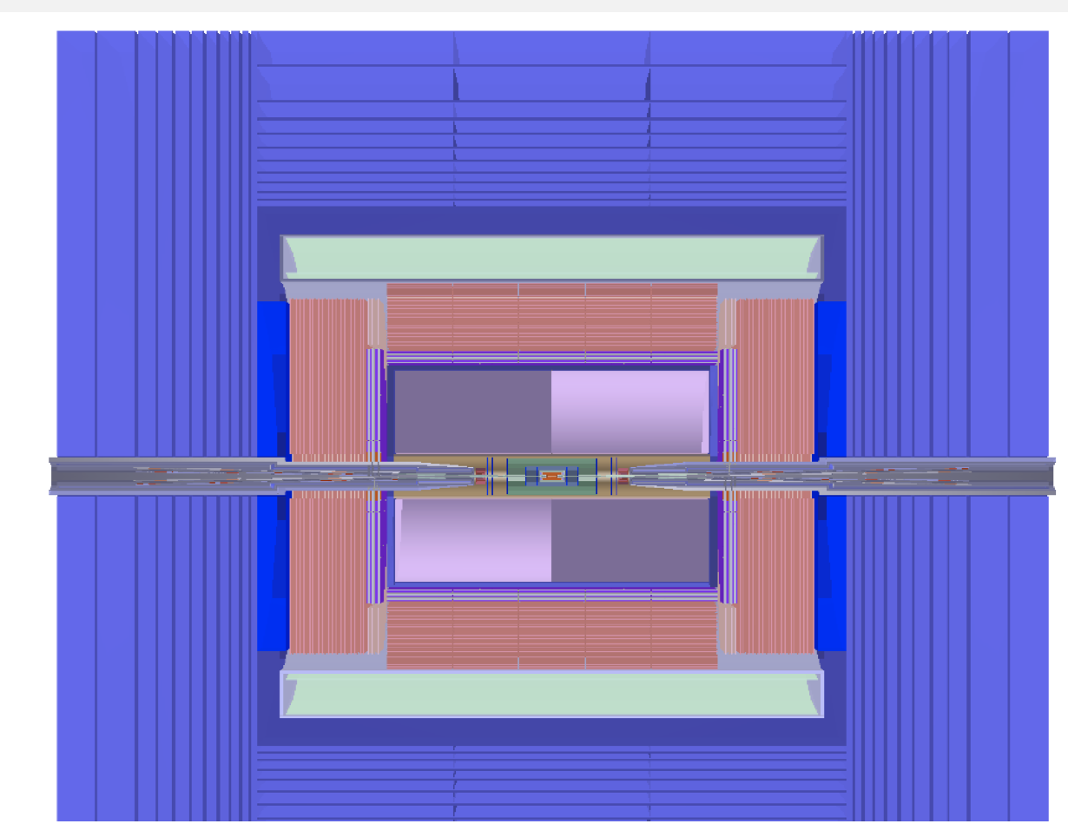
CEPC benchmark detector
CEPC:
circular electron-position collider
Higgs factory/Z factory
Excellent vertex reconstruction.
Good PID!
Clean environment.
Huge B production in Z pole run

Slide 6
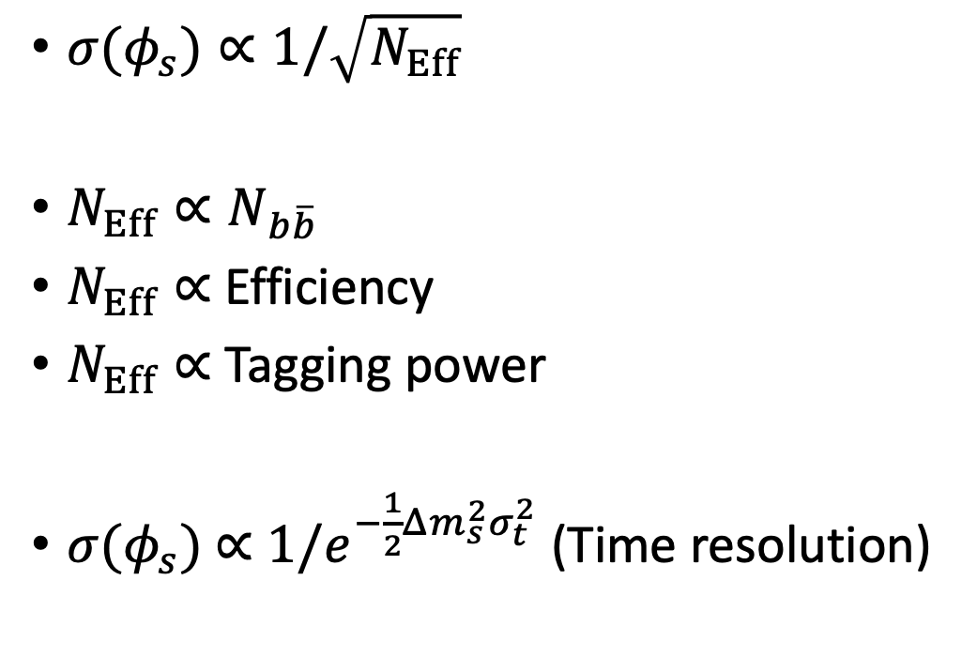

Estimation of $σ({ φ}_{s})$ at CEPC
${σ(φ}_{s})∝1/\sqrt{N_{Eff}}$
$N_{Eff}∝N_{b\overline{b}}$
$N_{Eff}∝$ Efficiency
$N_{Eff}∝$ Tagging power
${σ(φ}_{s})$ $∝$ ${1/e}^{−\frac{1}{2}Δm_{s}^{2}σ_{t}^{2}}$ (Time resolution)
Scaling from LHCb measurement

Slide 7
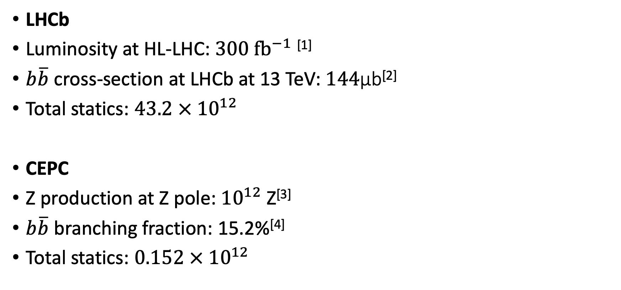
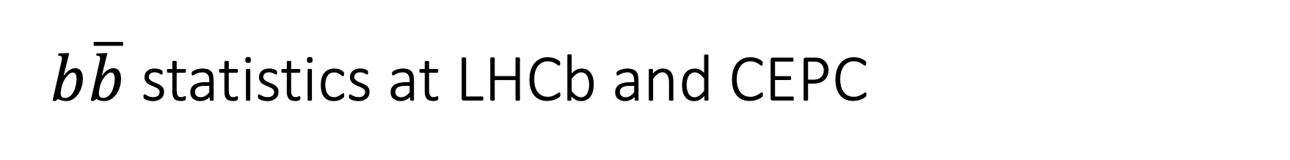
$b\overline{b}$ statistics at LHCb and CEPC
LHCb
Luminosity at HL-LHC: $300 fb^{−1}$^{[1]}
$b\overline{b}$ cross-section at LHCb at 13 TeV: $144$μb^{[2]}
Total statics: $43.2 × {10}^{12}$
CEPC
Z production at Z pole: ${10}^{12}$ Z^{[3]}
$b\overline{b}$ branching fraction: 15.2%^{[4]}
Total statics: $0.152 × {10}^{12}$

Slide 8
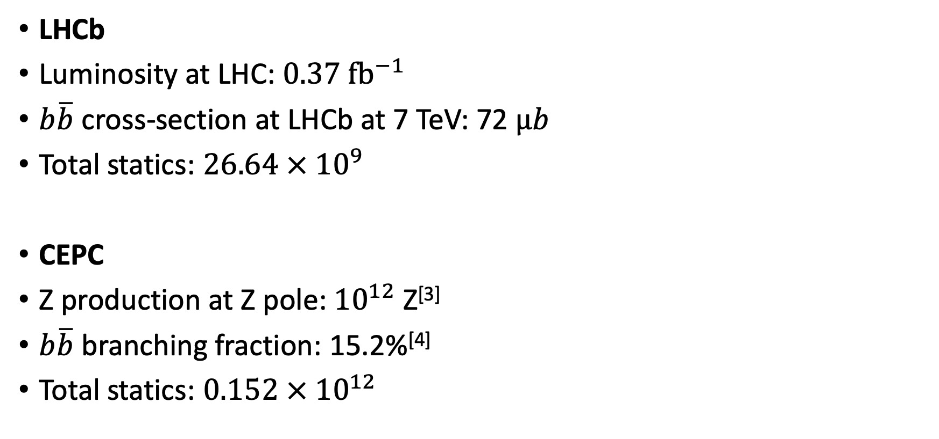

$b\overline{b}$ statistics at LHCb(run 1) for cross check
LHCb
Luminosity at LHC: $0.37 fb^{−1}$
$b\overline{b}$ cross-section at LHCb at 7 TeV: 72 $μb$
Total statics: $26.64 × {10}^{9}$
CEPC
Z production at Z pole: ${10}^{12}$ Z^{[3]}
$b\overline{b}$ branching fraction: 15.2%^{[4]}
Total statics: $0.152 × {10}^{12}$

Slide 9
Reconstruction efficiency
Acceptance * Reconstruction * Trigger
LHCb: 20%
CEPC: 100%
Full-simulation is needed for more detailed study. (on going)

Slide 10
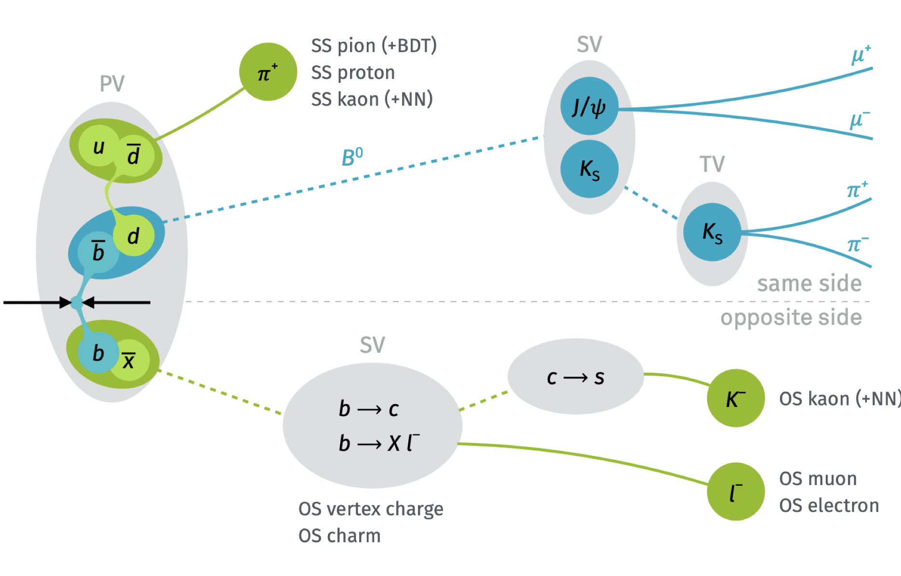
Flavour tagging power
LHCb: 3~4%
CEPC: 15%
B factory: ~30%
It is conservative to give a 15% tagging power at CEPC. (Clean environment and energetic particles)

Slide 11
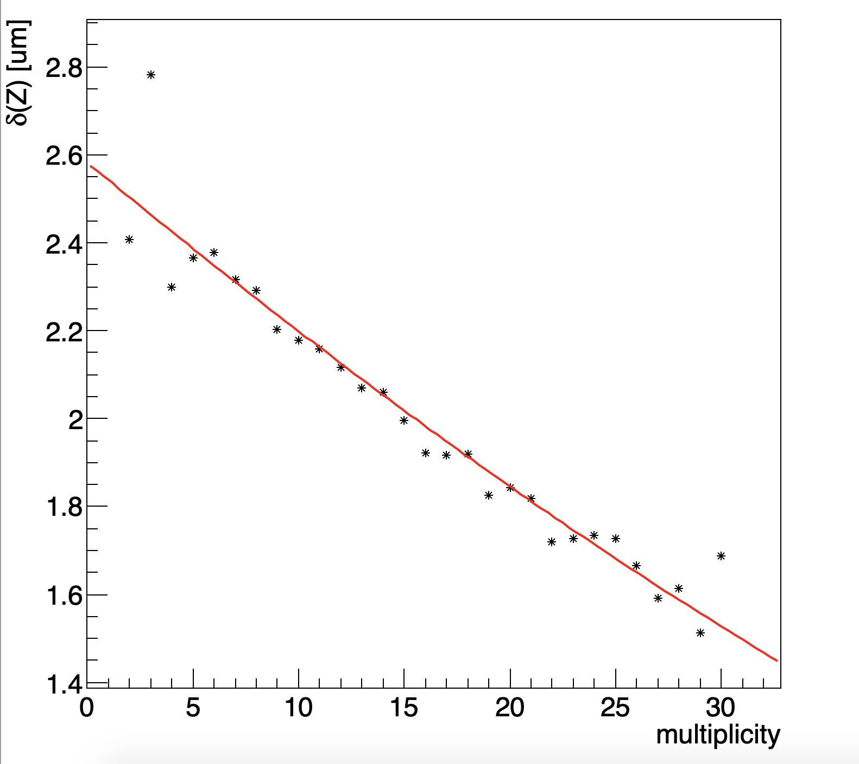
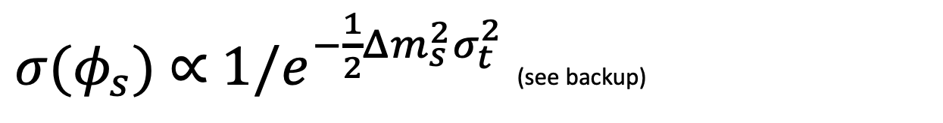
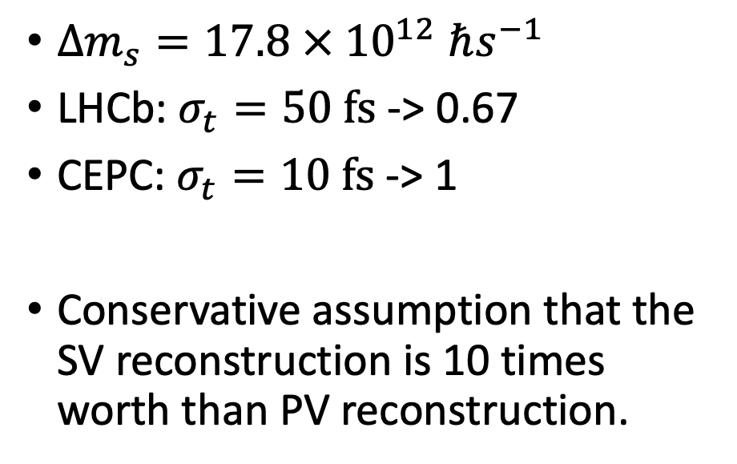

Time resolution effect
${σ(φ}_{s})$ $∝$ ${1/e}^{−\frac{1}{2}Δm_{s}^{2}σ_{t}^{2}}$ (see backup)
PV reconstruction by Zhigang
$Δm_{s}=17.8 × {10}^{12} ℏs^{−1}$
LHCb: $σ_{t}=50 fs$ -> 0.67
CEPC: $σ_{t}=10 fs$ -> 1
Conservative assumption that the SV reconstruction is 10 times worth than PV reconstruction.
$$B_{s}^{0}\sim 33GeV$$

Slide 12
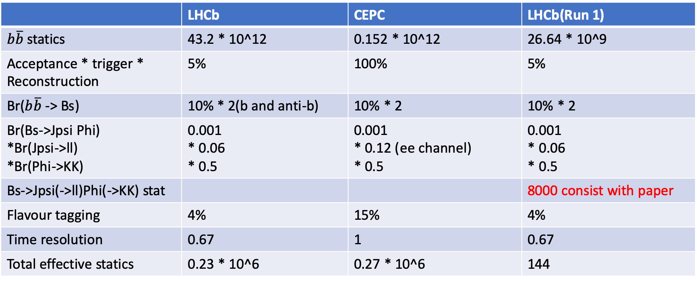
Summary on effecitive stat
 | LHCb | CEPC | LHCb(Run 1)
$b\overline{b}$ statics | 43.2 * 10^12 | 0.152 * 10^12 | 26.64 * 10^9
Acceptance * trigger * Reconstruction | 5% | 100% | 5%
Br($b\overline{b}$ -> Bs) | 10% * 2(b and anti-b) | 10% * 2 | 10% * 2
Br(Bs->Jpsi Phi) *Br(Jpsi->ll) *Br(Phi->KK) | 0.001 * 0.06 * 0.5 | 0.001 * 0.12 (ee channel) * 0.5 | 0.001 * 0.06 * 0.5
Bs->Jpsi(->ll)Phi(->KK) stat |  |  | 8000 consist with paper
Flavour tagging | 4% | 15% | 4%
Time resolution | 0.67 | 1 | 0.67
Total effective statics | 0.23 * 10^6 | 0.27 * 10^6 | 144

Slide 13
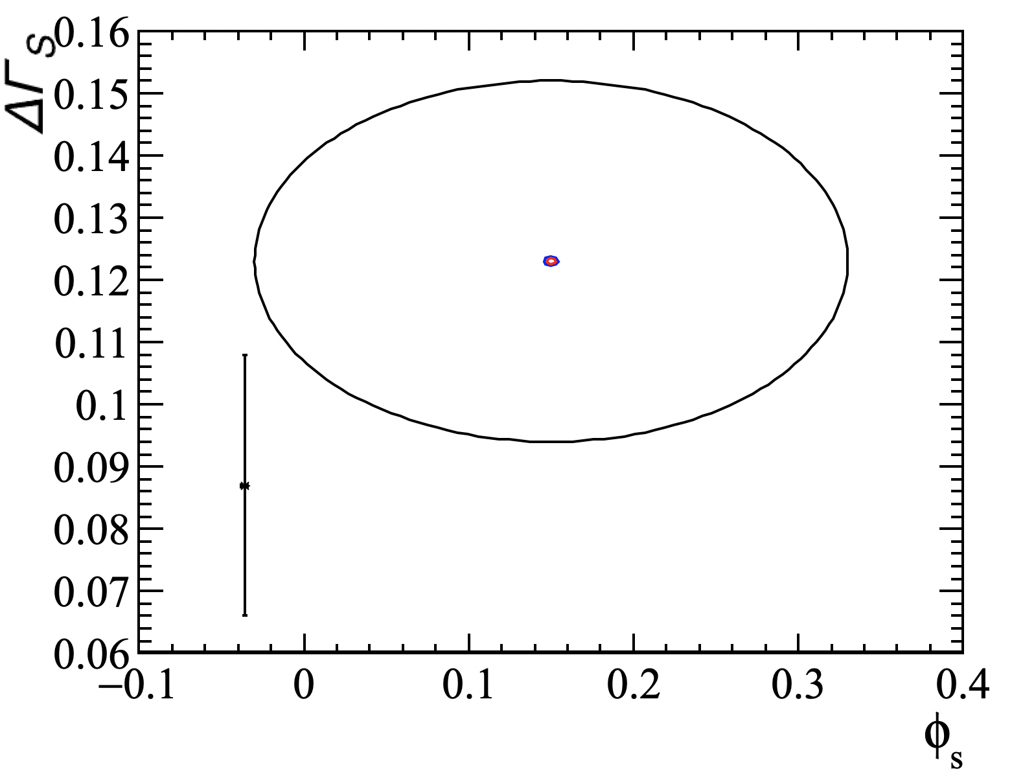
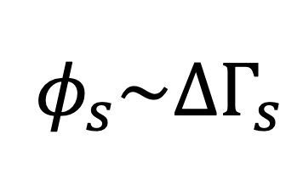
$$φ_{s}\sim ΔΓ_{s}$$
Dot: SM prediction
Black: LHCb(Run 1)
Blue: LHCb(HL-LHC)
Red: CEPC
68% CL

Slide 14
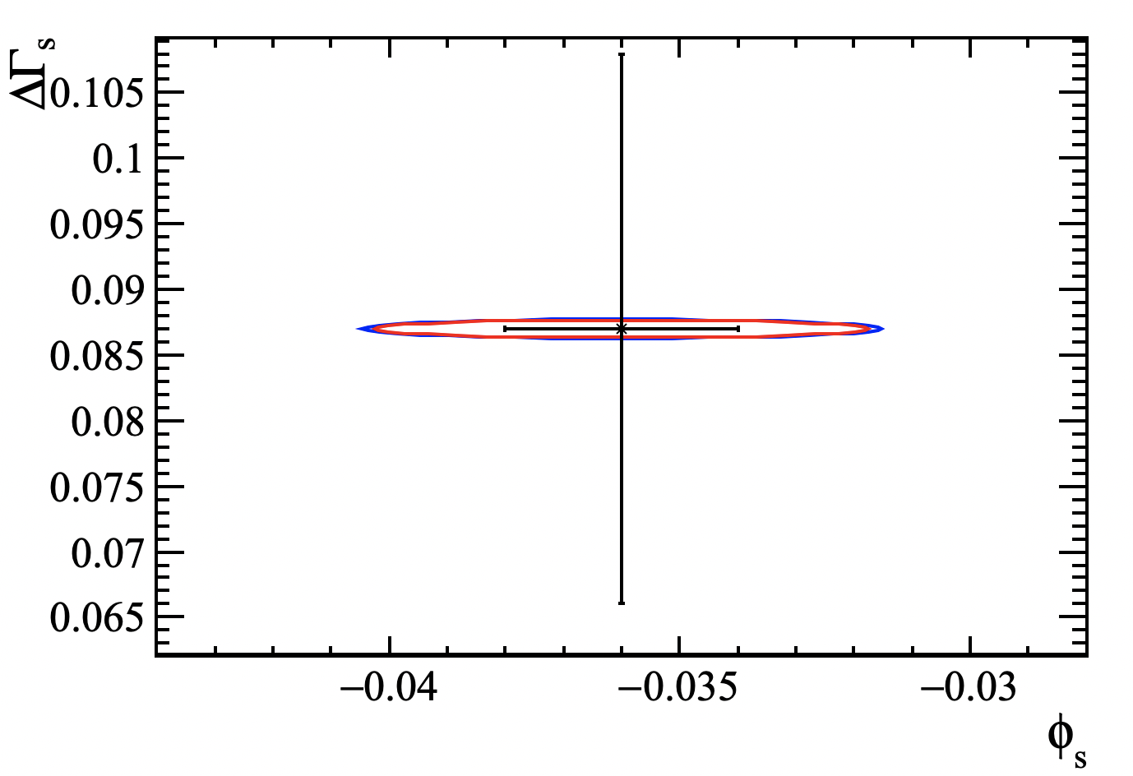
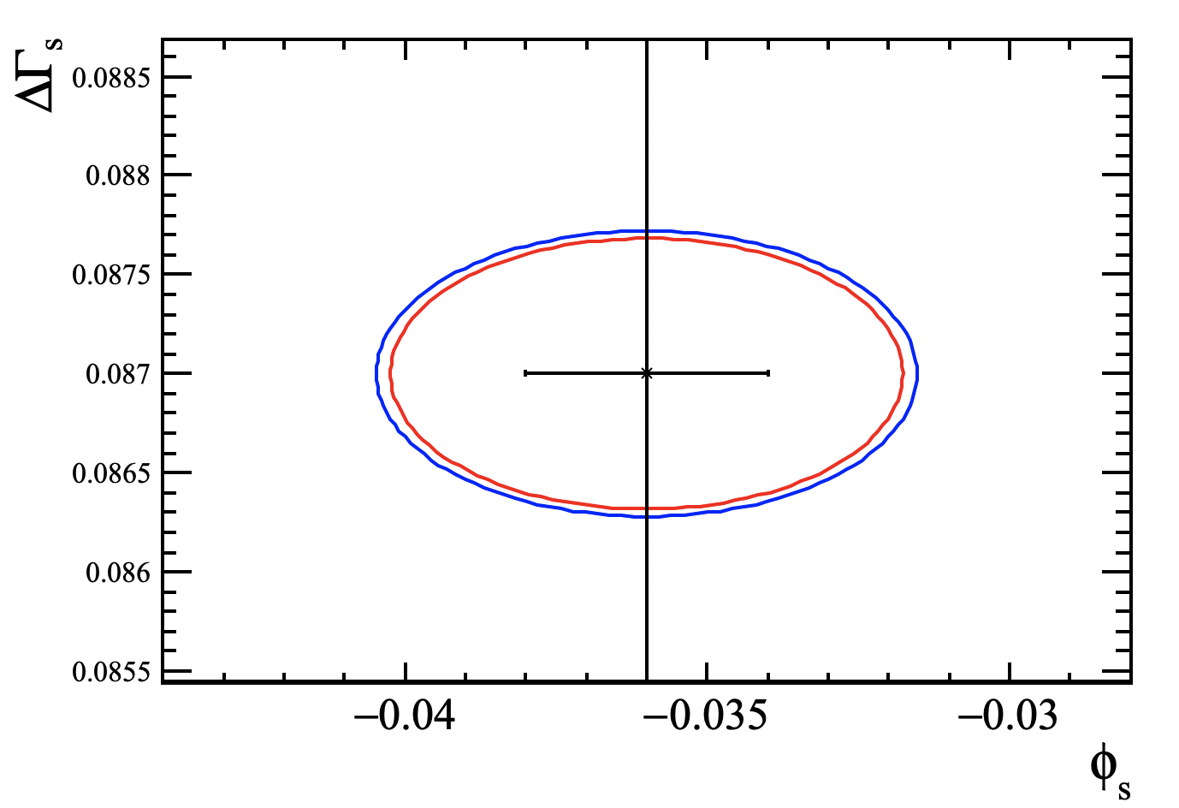
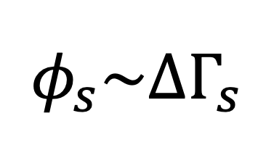
$$φ_{s}\sim ΔΓ_{s}$$
Dot: SM prediction
Black: LHCb(Run 1)
Blue: LHCb(HL-LHC)
Red: CEPC
Zoomed and move the central value to SM prediction

Slide 15
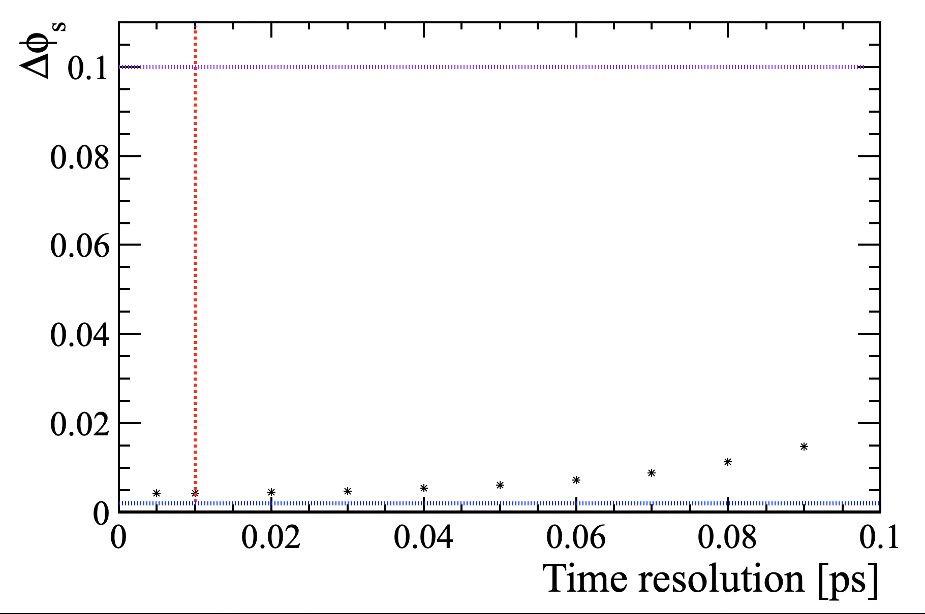
Time resolution effect
Red: 10fs(CEPC)
Blue: SM resolution
Purple: NP deviation

Slide 16
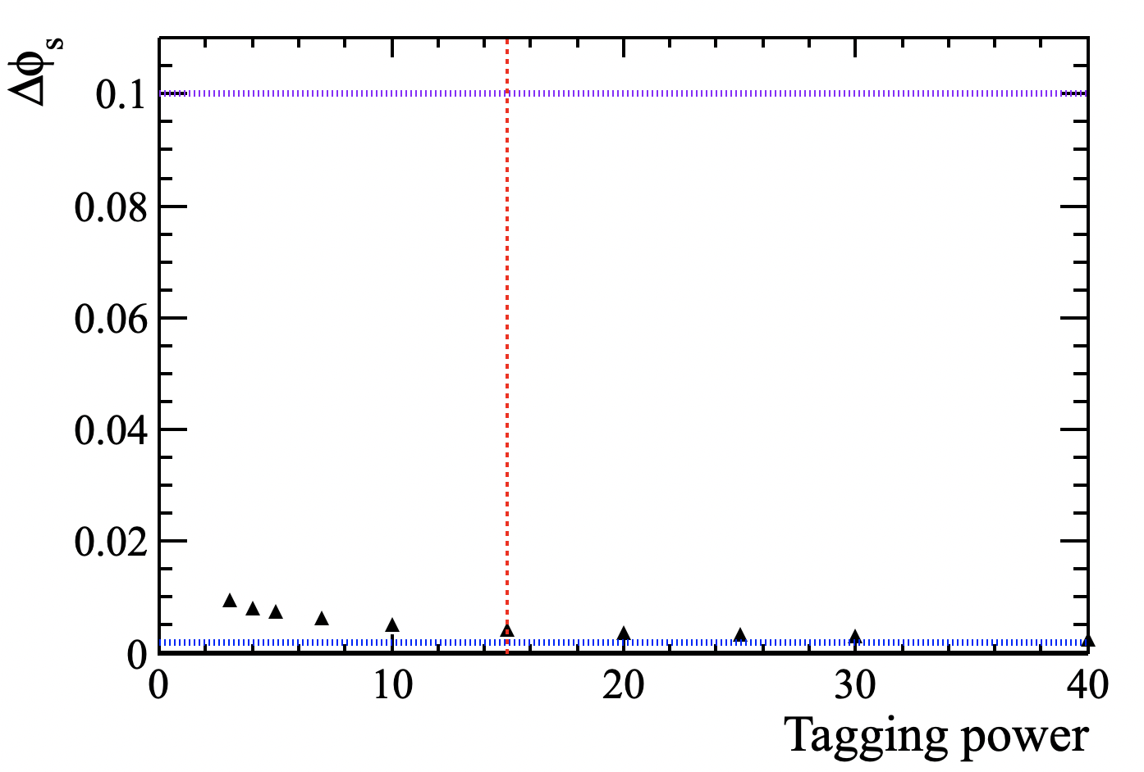
Flavour tagging effect
Red: 15(CEPC)
Blue: SM resolution
Purple: NP deviation

Slide 17
Conclusion
Study of CPV-phase is promising at CEPC.
Competitive with LHCb(HL-LHC).
Powerful to test new physics model.
Promising to reach SM accuracy.
More detailed full-simulation analysis is on going.
Thank you

Slide 18
References
[1]https://cds.cern.ch/record/2630496/files/Parkes_ICHEP_U2_070718_vFinal.pdf
[2] https://arxiv.org/pdf/1612.05140.pdf
[3] CEPC CDR
https://arxiv.org/abs/1811.10545
https://arxiv.org/abs/1809.00285
[4] PDG

Slide 19
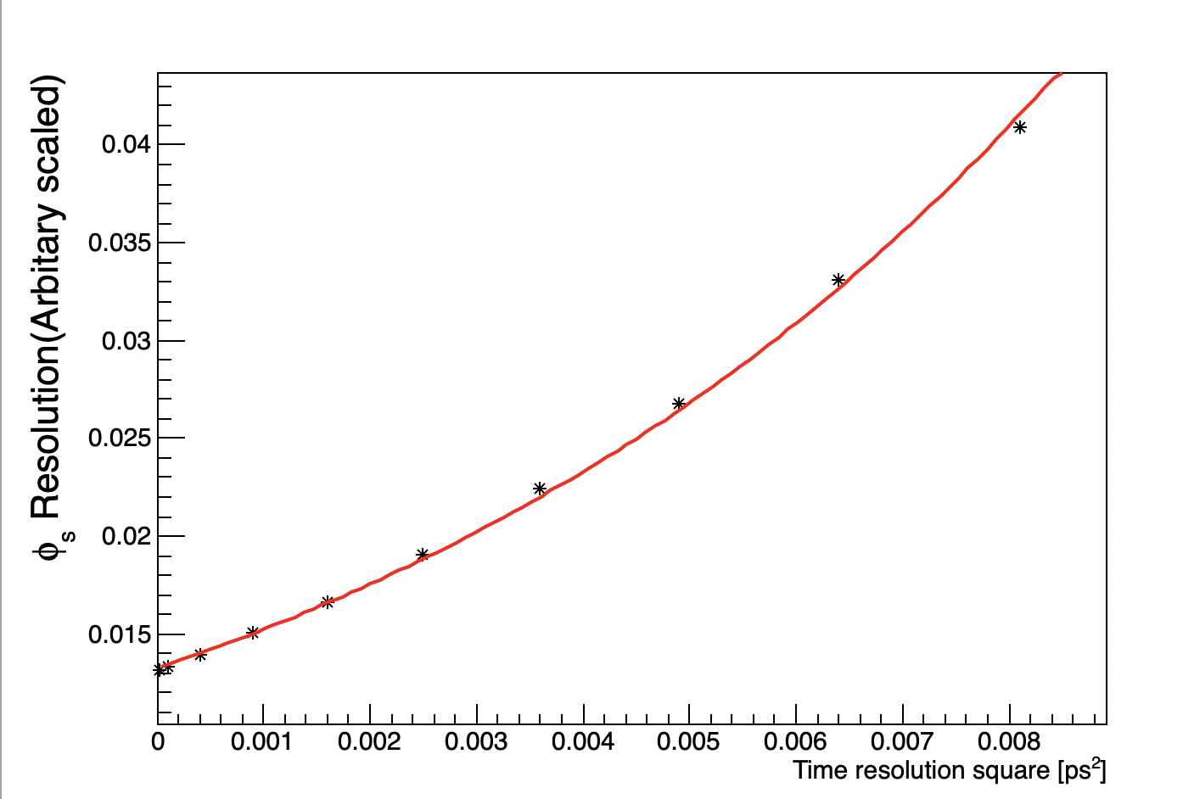


Backups
Validation of ${σ(φ}_{s})$ $∝$ ${1/e}^{−\frac{1}{2}Δm_{s}^{2}σ_{t}^{2}}$
Using toy MC and fitted with ${1/e}^{−\frac{1}{2}Δm_{s}^{2}σ_{t}^{2}}$
The advisors of the work:
Manqi Ruan: IHEP China
Liming Zhang: Tsinghua University
Yuehong Xie: Central China Normal University
Wenbin Qian: IHEP China
Jibo He: University of Chinese Academy of Sciences

