Slide 1
Safety Briefing for the ALICE / LHC-P2” Supervised Area Guides and Crowd Marshals
K. BARTH, LEXGLIMOS & RSO ALICE

Slide 2
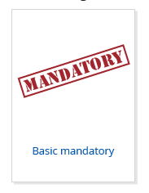


Outline
Safety File OD2019 « ALICE - LHC2 UNDERGROUND»
Safety Training Requirements
Safety Hazards and Measures
Evacuation
Communication
Basic rules + First Aid Response + Safety Organization
Questions & Answers -> Practical Tour

Slide 3
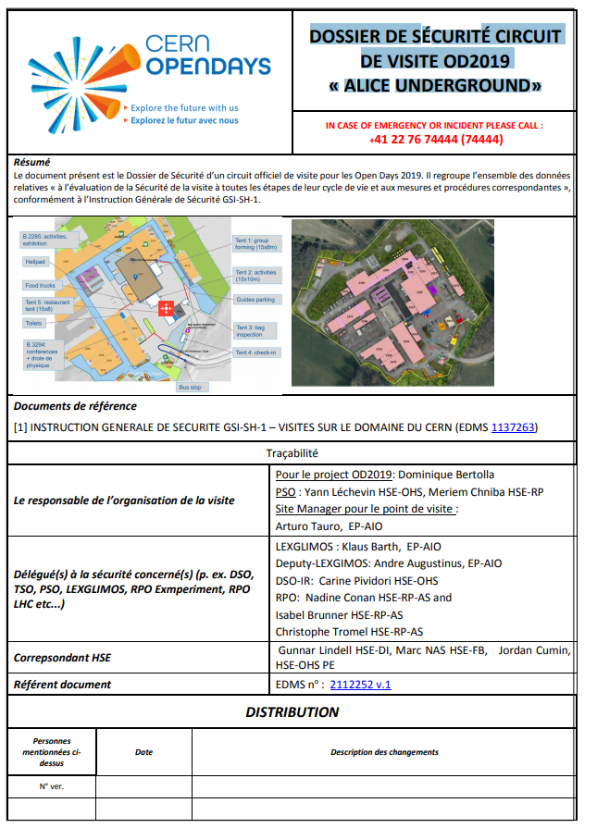
OD2019 ALICE / LHC-P2 Safety File
The supervised area underground guides (UG) and crowd marshals (UCM) have all necessary safety training.
They know the visits itinerary and associated safety hazards.
They have the responsibility for the accompanied visitors and know how to react in case of emergency.

Slide 4
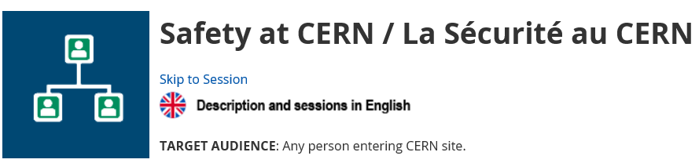
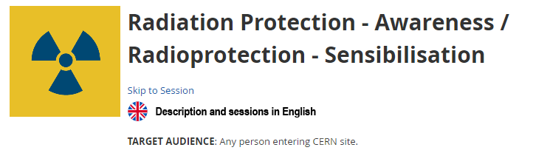
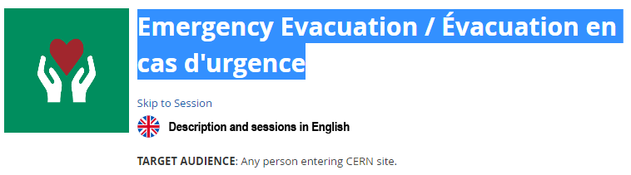

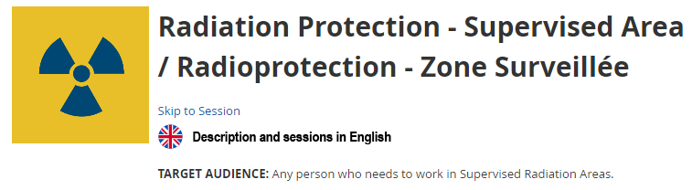
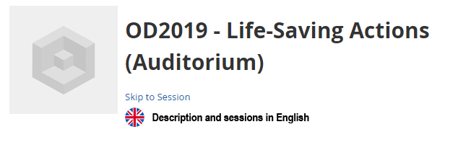
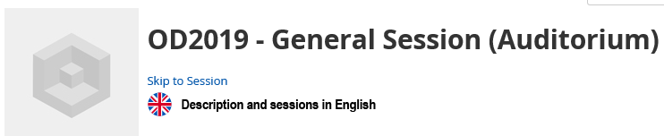
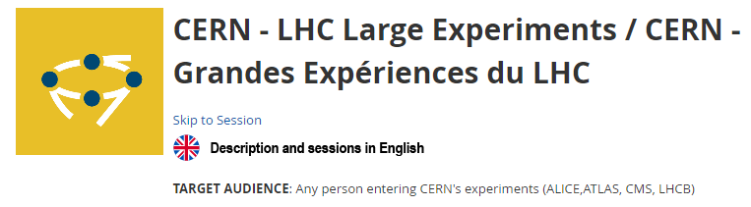
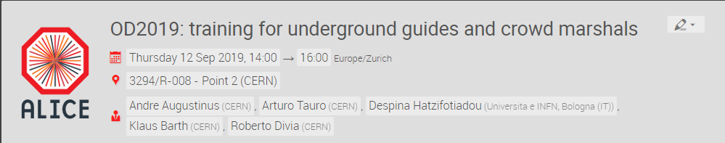
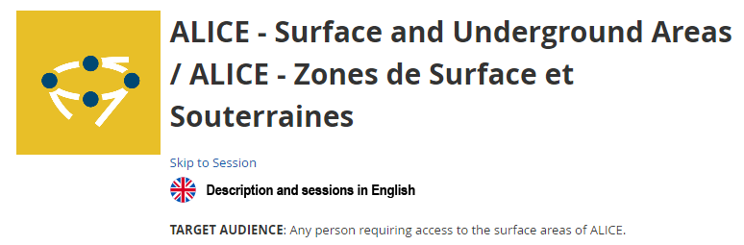
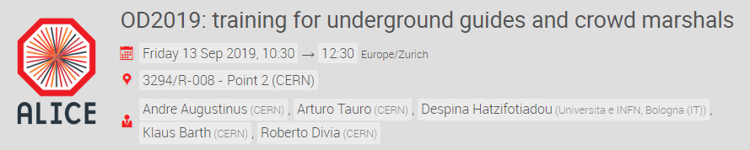
Safety Training Requirements
+ one of the two specific ALICE OD2019 trainings

Slide 5
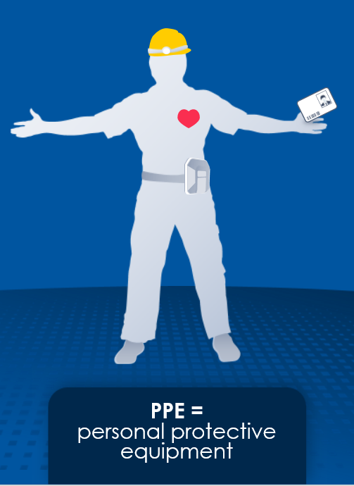
PPE for Underground Guides (UG) and Crowd Marshals (UCM)
Helmet with headlight
Safety shoes
Personal Dosimeter
Operational Dosimeter for monitoring zero-exposure of visitors
Self Rescue Mask
Replaced for OD19 only by this safety briefing
Remark:
UG and CM to check that visitors have close shoes and no bags.
There will be one TETRA handset carried by UG or UCM per group.
All UGs and UCMs should carry their mobile phone.

Slide 6

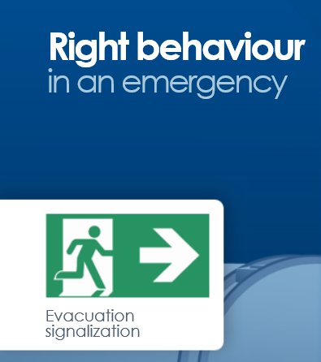
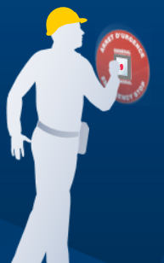
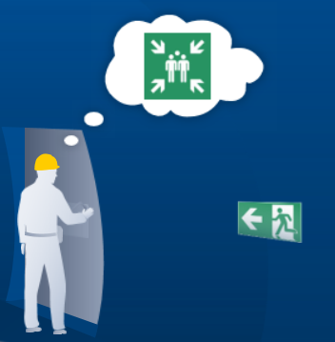
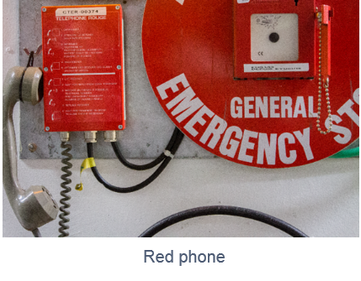
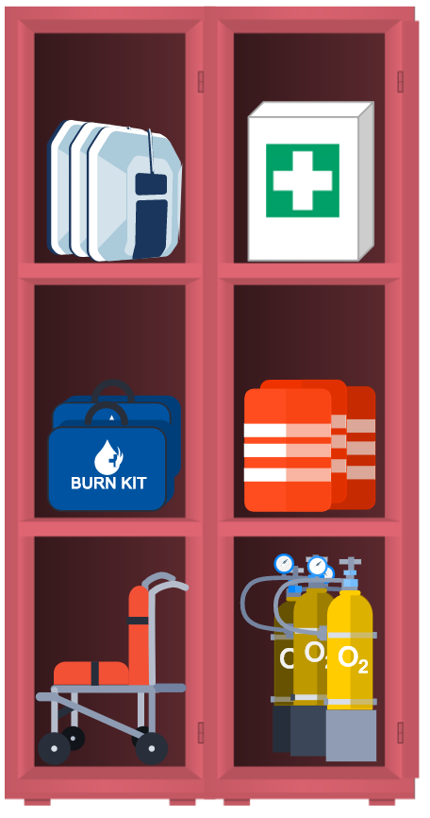

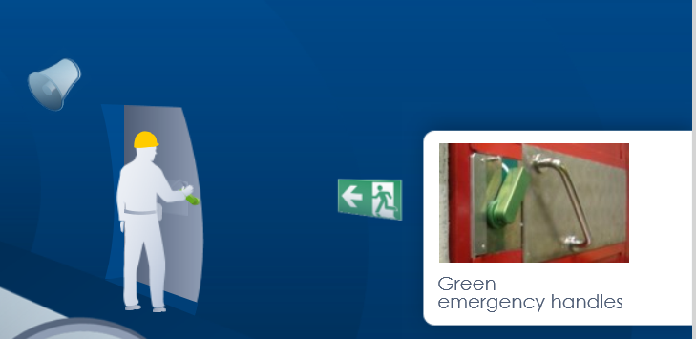
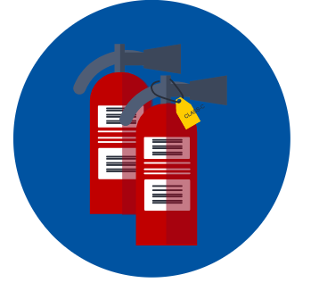

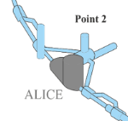


Safety Hazards and Measures (1)

Slide 7

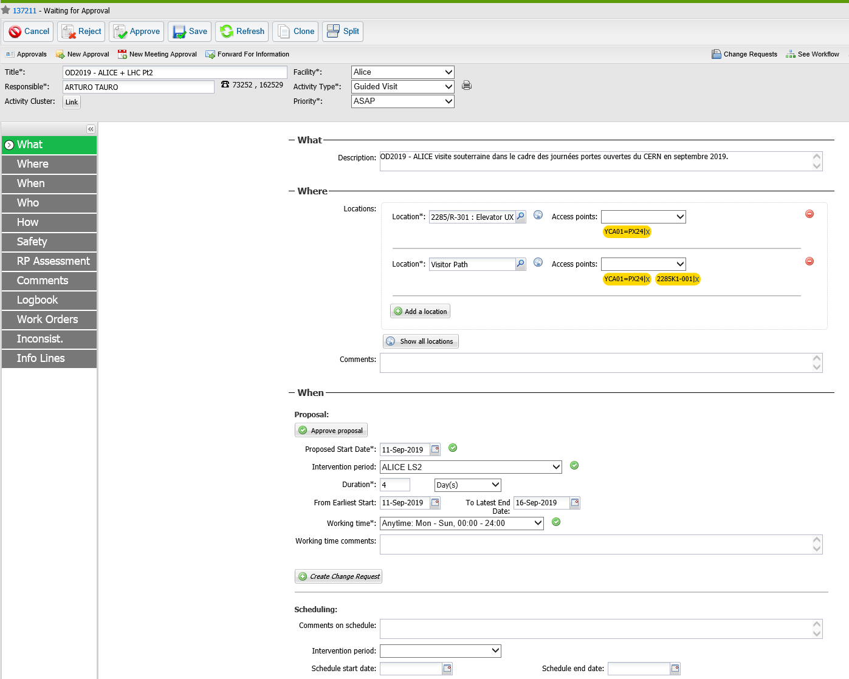
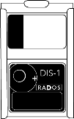
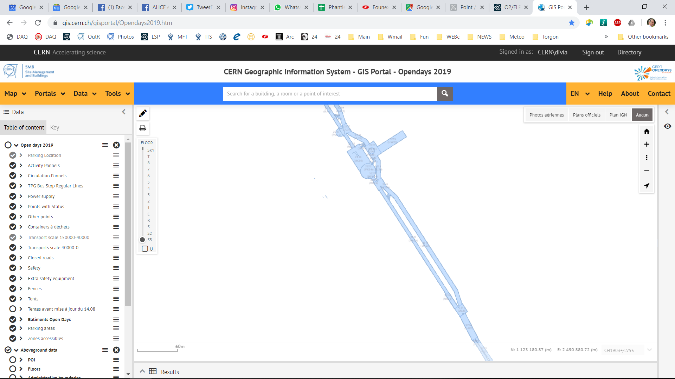
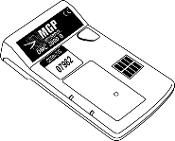
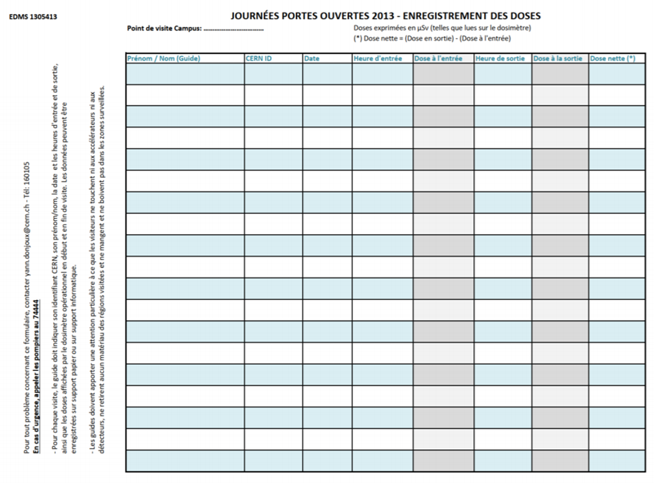

Safety Hazards and Measures (2)
OD2019 ALICE LHC-P2 IMPACT No.: 137211
ALICE / LHC P2 OD2019 Underground Visits Path crosses ALICE and LHC classified supervised areas.
The UG’s and UCM’s shall wear a personal dosimeter.
One operational dosimeter shall be carried per visits group by the UG.
The UG shall fill out the dose sheet per visit (see Roberto's presentation). If dose not zero call RSO / LEXGLIMOS 163204
No smoking eating or drinking underground !

Slide 8
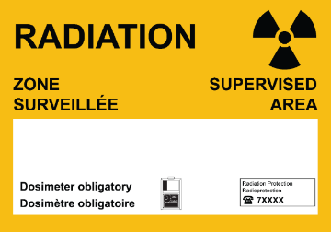
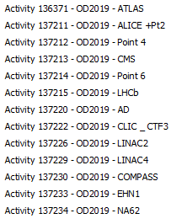
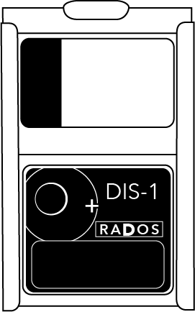
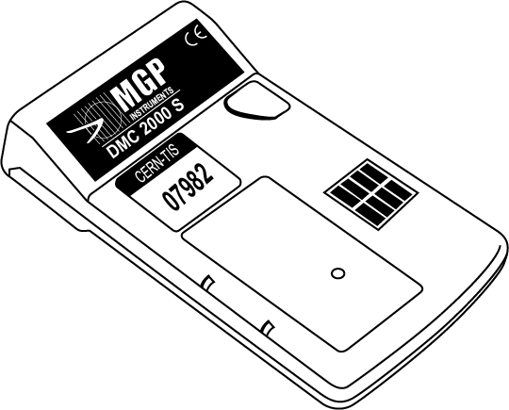
OD2019 Radiation Areas
IMPACTs
Each Supervised Radiation Area Guide :
Mandatory
Personal dosimeter (passive)
Operational dosimeter (active)
Mandatory
Operationnal dosimeters activated :
  Specific IMPACT
  Each Shift (Beginning 1st guide: activation – End last guide: reset)
Before after each visit : Guides:
  Write down : Name, CERN id, time of the visit and the dose on the dosimeter

Slide 9

Contact RP
If :
  The dose on the dosimeter >= 3uSv
  Issues with the dosimeters
  Any doubt concerning radiation areas
  Use on an emergency exit going through Supervised Radiation Areas
  Call LEXGLIMOS / RSO 163204
RP

Slide 10

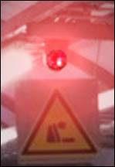
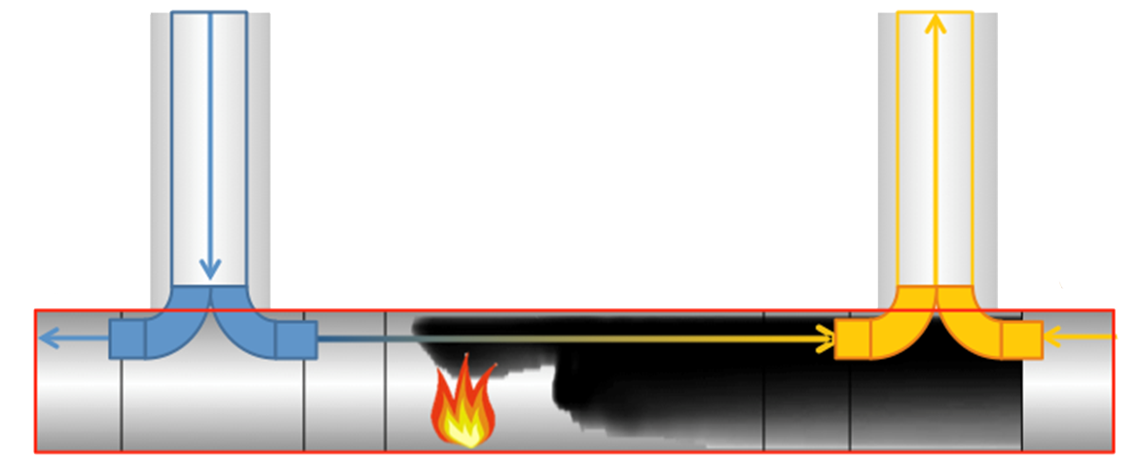



Safety Hazards and Measures
Hazardous scenario: Fire - ODH
Main causes: Electrical equipment, hot work and welding
Dangerous aspects of a fire:
Toxic fumes
Oxygen deficiency in an enclosed area
Heat and hot smoke
Reduction of the visibility
Alarm & Evacuate calmly
via nearest safest exit
to assembly point!
Do not cross the smoke cloud / fire hazard for evacuation!
Vent.
Vent.
Vent.
LSS
LHC 2 P_{even}
LSS
Alarm Zone
LSS
LHC 1 P_{odd}
LSS
Tunnel Sector

Slide 11

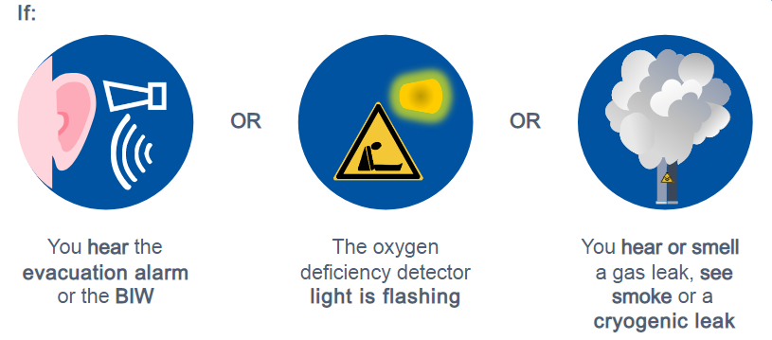

Evacuation
Stay calm and evacuate the area with the visitors immediately, following the green evacuation signs.
UCM and UG to take to make sure not to loose a vistor during evacuation!
Trigger the evacuation alarm manually (if it is not already sounding) by breaking the glass of the box without putting you in danger.
Force the emergency handles of the doors if needed.
Emergency guides might be present in order to help you evacuate: follow their instructions.
Go to the assembly point at the entrance of the site. Once there, wait for instructions from the Fire Brigade.

Slide 12
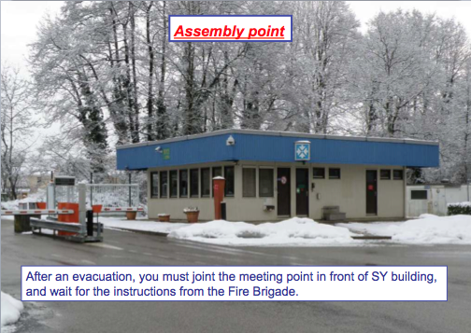
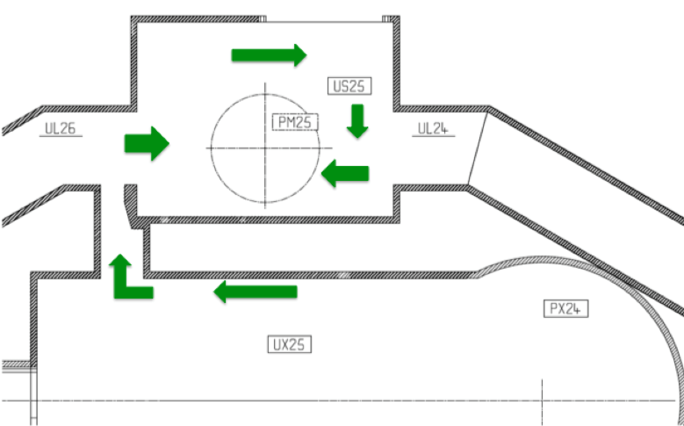
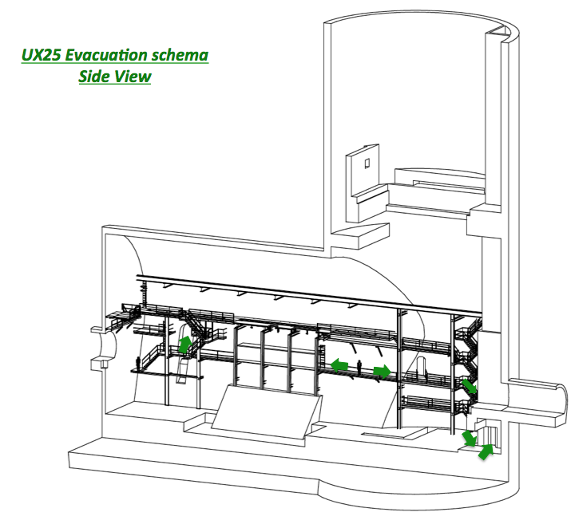
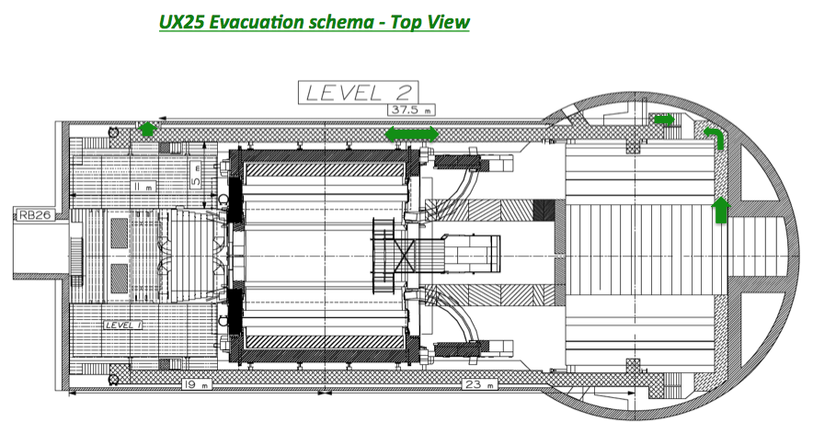
Evacuation Path
From PM25/SD2
Safe Zone
LHC-P2 PM25
From tunnel return back to Safe Zone PM25!
If safety hazard is between you and PM25, evacuate to LHC-P1!
From cavern C-side continue tour to reach PM25 Safe Zone through UP25.
From cavern A-side go back to tunnel to reach PM25 Safe Zone through UJ24.
Alternatively, go down stairs to UX25 Safe Zone. In this case visitor group has to be split in 2 (part with UG, part with UCM).
SX2/PX24 Surface Top View
Safe Zone
ALICE UX25

Slide 13
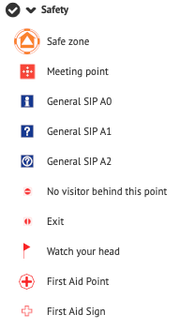
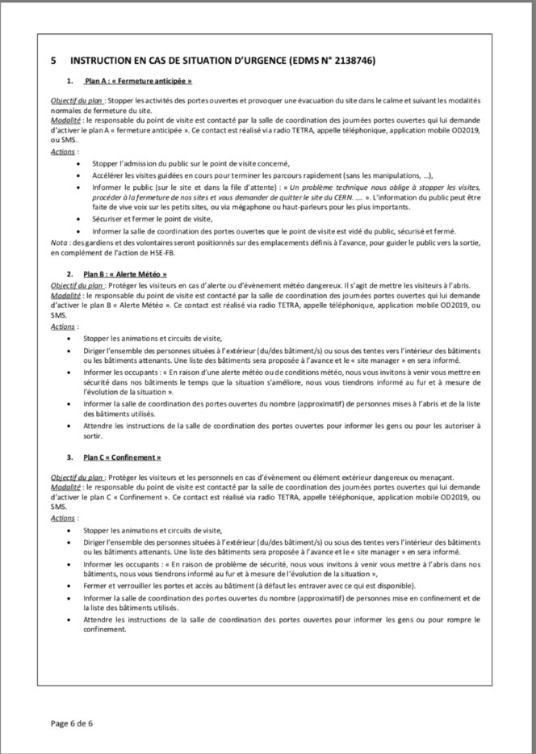

OD2019 ALICE / LHC-P2 Safety File
Three scenarios:
  Plan A: Early closure
    Goal – “soft” evacuation of sites
  Plan B: Weather alert
    Goal – harbor visitors in safe buildings
  Plan C: Confinement from harmful exterior event
    Goal – harbor visitors in safe buildings
List of safe buildings ALICE / LHC-P2:
SXL2, SX2 and SD2

Slide 14
Communication
Urgencies: (Managed by SCR) red phone or 74444 or TETRA emergency call (without delay transferred to PCO).
Incidents and non-urgent demands: (managed by Site Manager and transferred to PCO) call 162529 / 163534 / 163204 or TETRA
ALICE P2 Site Manager has a TETRA emergency link to PCO as well as a satellite phone link to PCO.
TETRA handsets are backup and local broadcast medium between UGs / CMs and Site Manager.

Slide 15
Reporting – Best practices
In case of doubt about an object or a situation, do not hesitate to report it to the 74444 (00 41 22 767 4444), the guards nearby or PCO (66001 or 66002), depending on the urgency.
→ Do not rely on anyone else to do so.
→ It is better to warn 10 times for nothing than not to do it.
Safety is everyone’s matter!

Slide 16







Behind the scenes
FB :
FB intervention
Piquet RP
Piquet HSE
Building 160
TI :
Piquet ELEC
Piquet ASC
Piquet CV
Piquet Gas / DET
Direct line :
66001
66002
77777 :
Daily support
Garbage,
Toilets,
Bus,
…
Source S. Lueders

Slide 17
Basic rules during visit
Keep group together (between UG and UCM)
Make sure Visitors do not touch anything
If Visitors are “difficult” to not hesitate to call help / report via TETRA or GSM
Monitor (UCR) and respect (UG) the timing of the visit !
In case of emergency, incidents and evacuation stay calm.

Slide 18
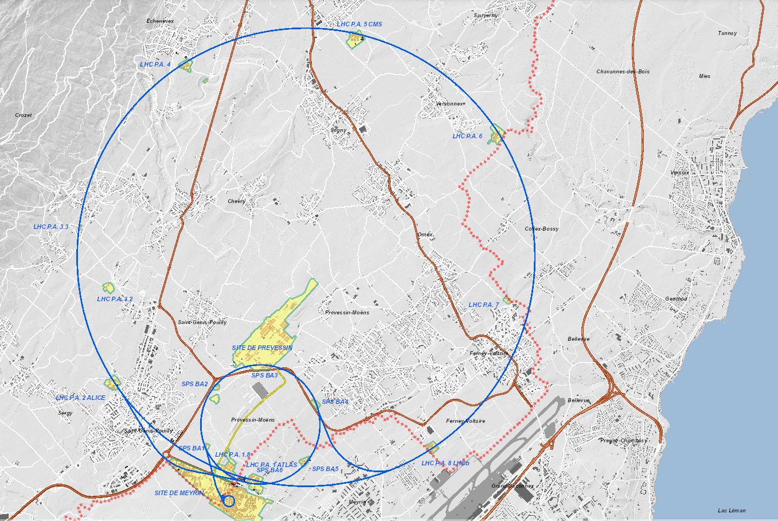








First aid response - Medical
Remark:
There is a defibrillator available in UX25 Safe Zone.

Slide 19
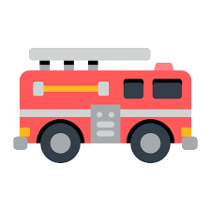
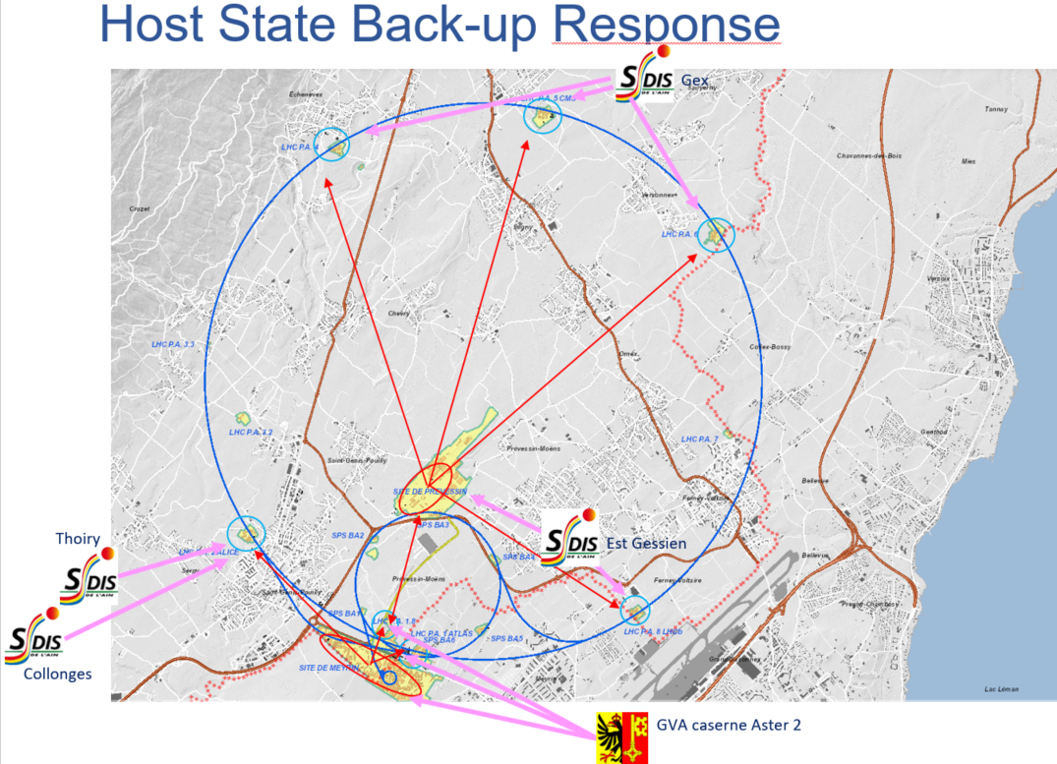
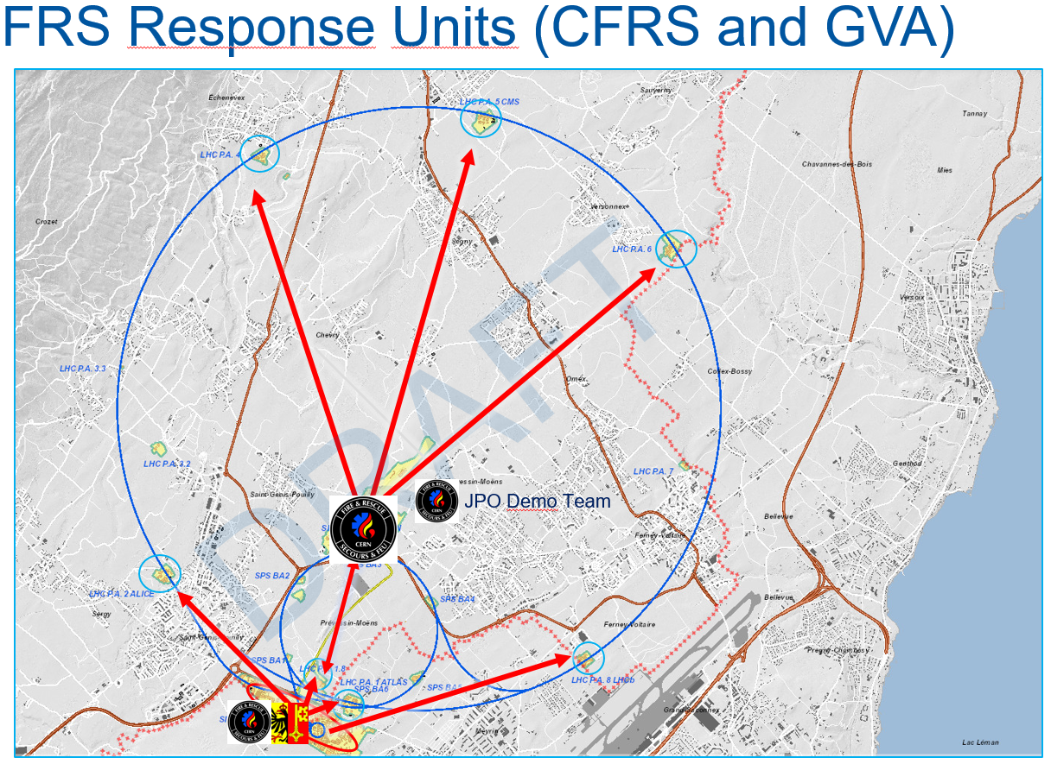
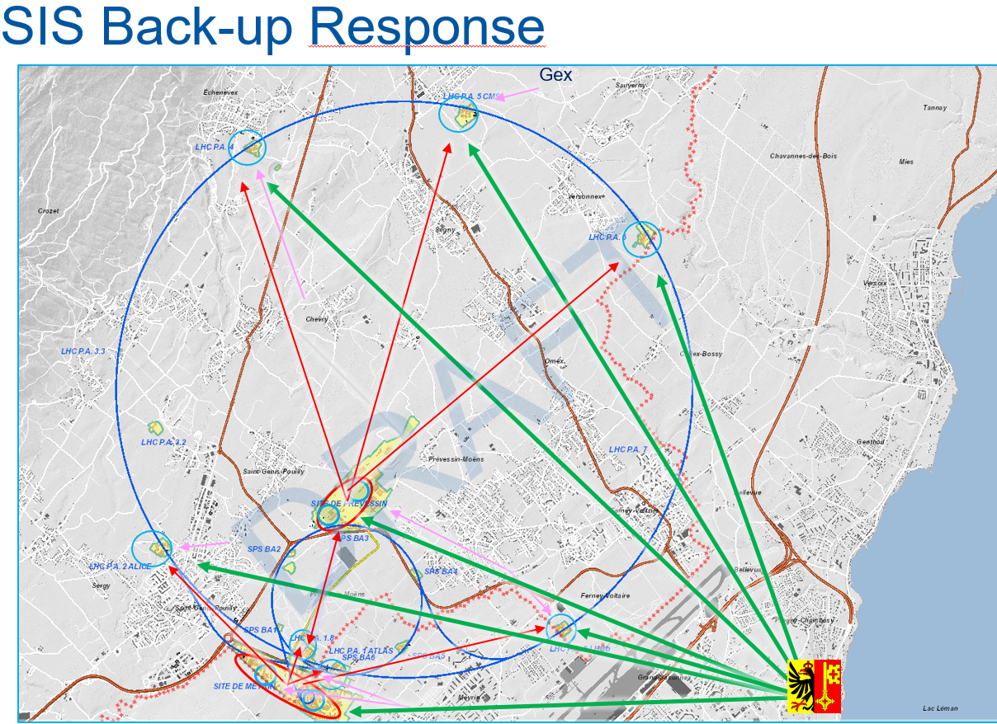
First aid response - Fire
Réponse SSF
Réponse SDIS 01 / SIS
SIS Back up
27.06.2019
HSE-FB
Source : M. NAS HSE-FB

Slide 20
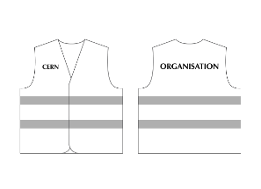
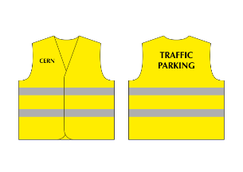
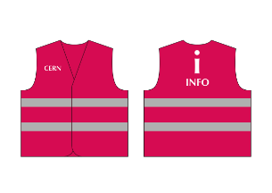
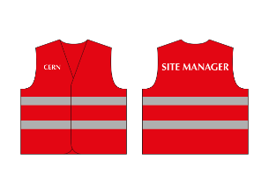
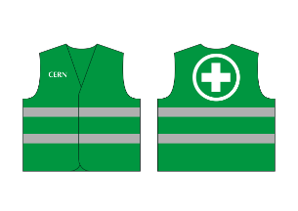


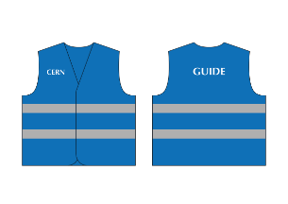

Safety Vest - General organization
*
* : HSE Teams, HSE RP Teams, LEXGLIMOS / DSO Teams

Slide 21

Safety Vest - General organization

Slide 22


Questions & Answer Session
Coordination Center (JPO):
Bldg. 160, manned Sat. & Sun. 7:30 – 20:30
Site Managers OD2019 ALICE & LHC-P2:
A. Tauro (162529),
Deputy: A. Augustinus (163534)
Safety (LEXGLIMOS,RSO): K. Barth (163204)

