Slide 1


The Structure of di-$J/ψ$ States
Richard Lebed
Quarkonium Working Group 2021
14th International Workshop on Heavy Quarkonium
UC Davis
March, 2021

Slide 2
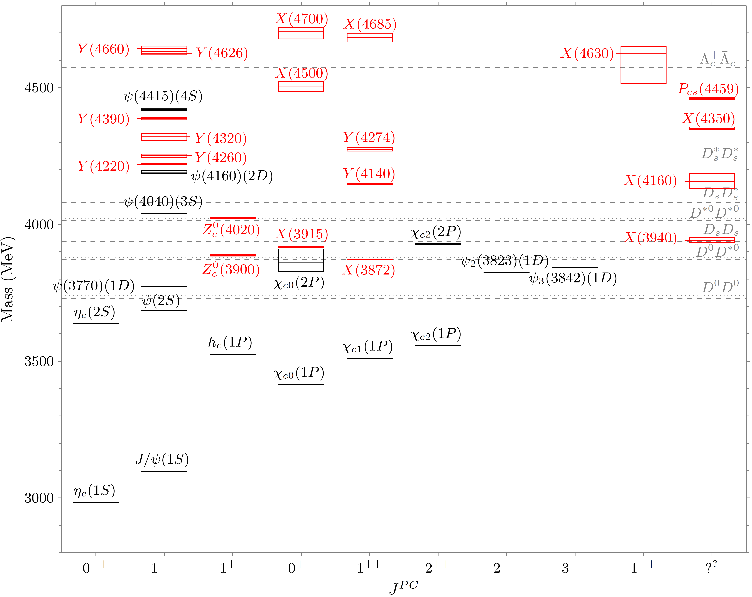
Neutral charmoniumlike sector,
March 2021
X(6900)

Slide 3
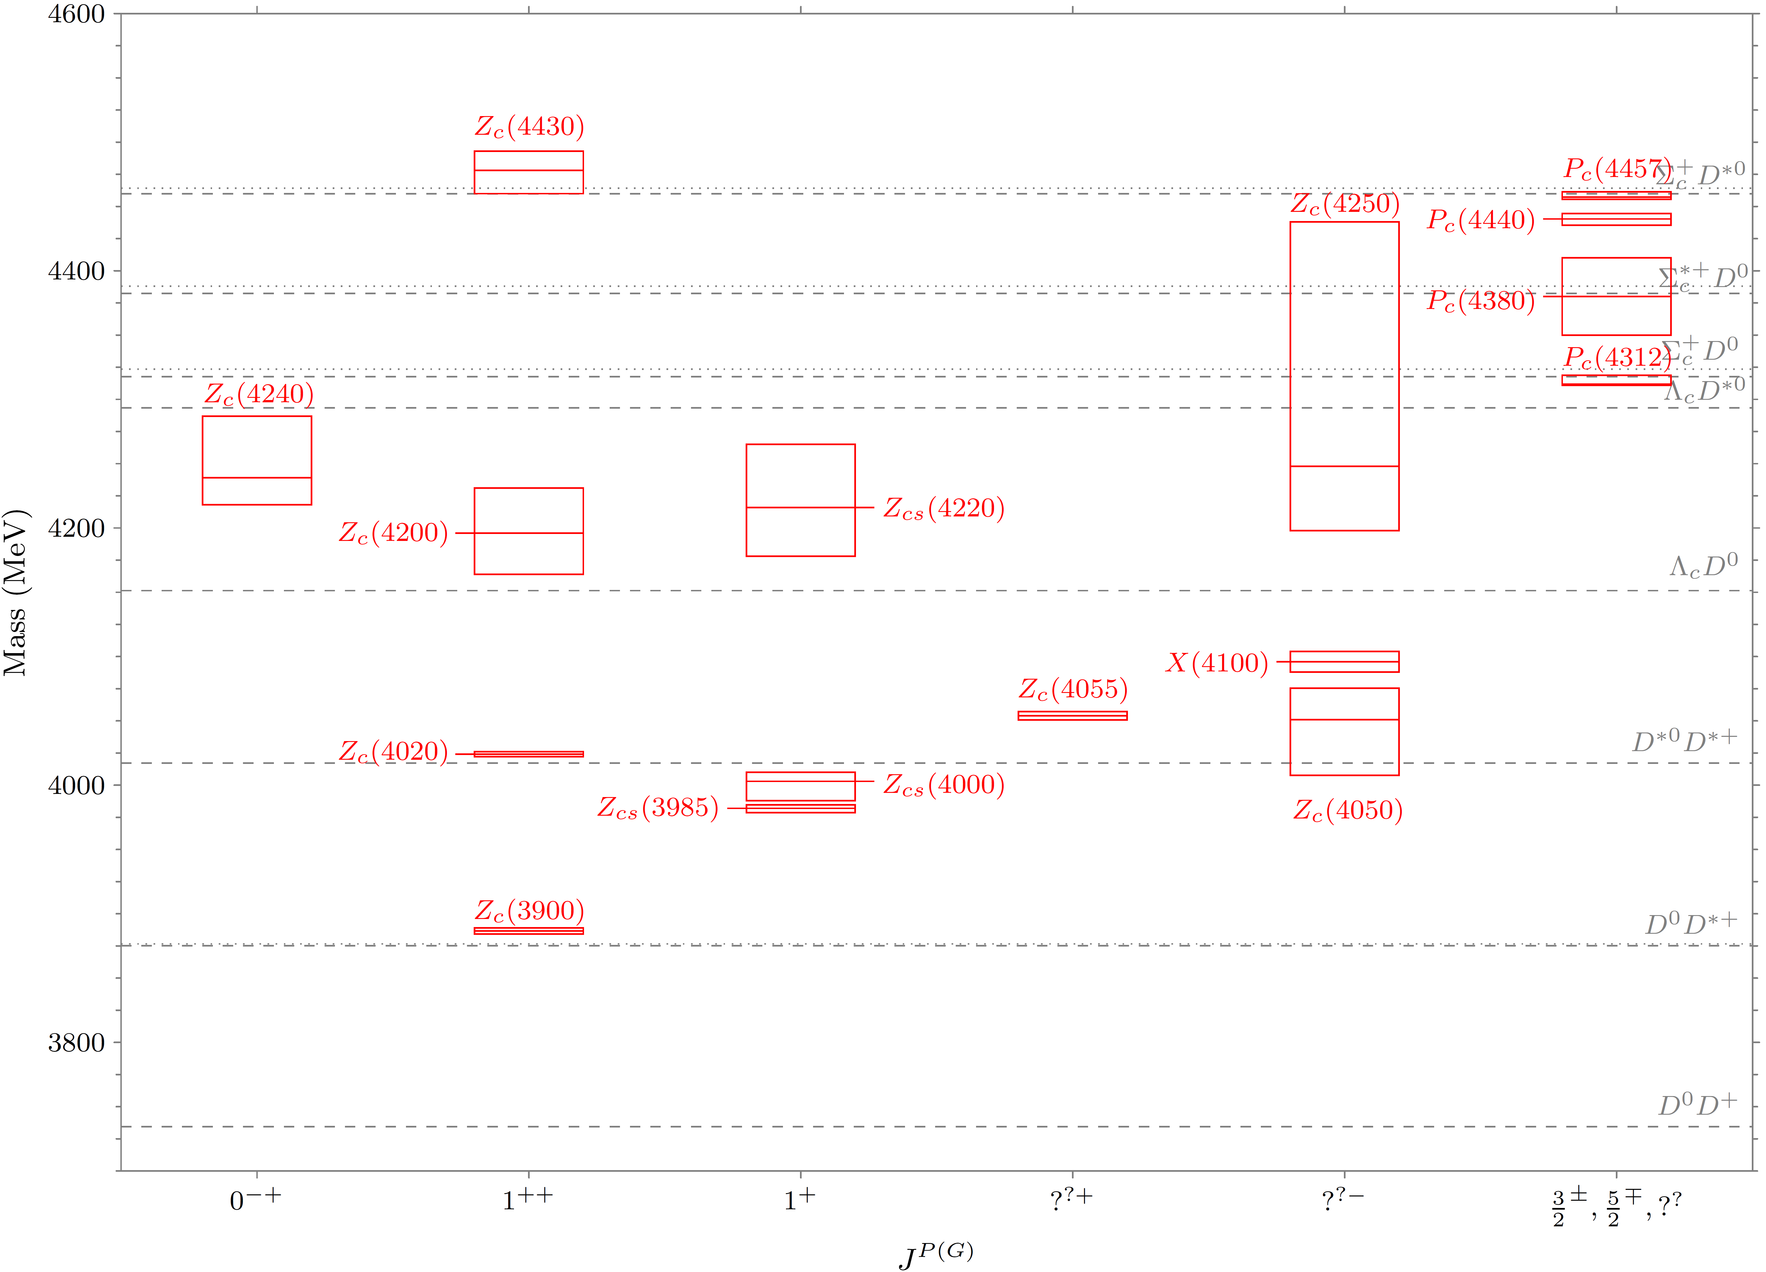
Charged charmoniumlike sector,
March 2021

Slide 4
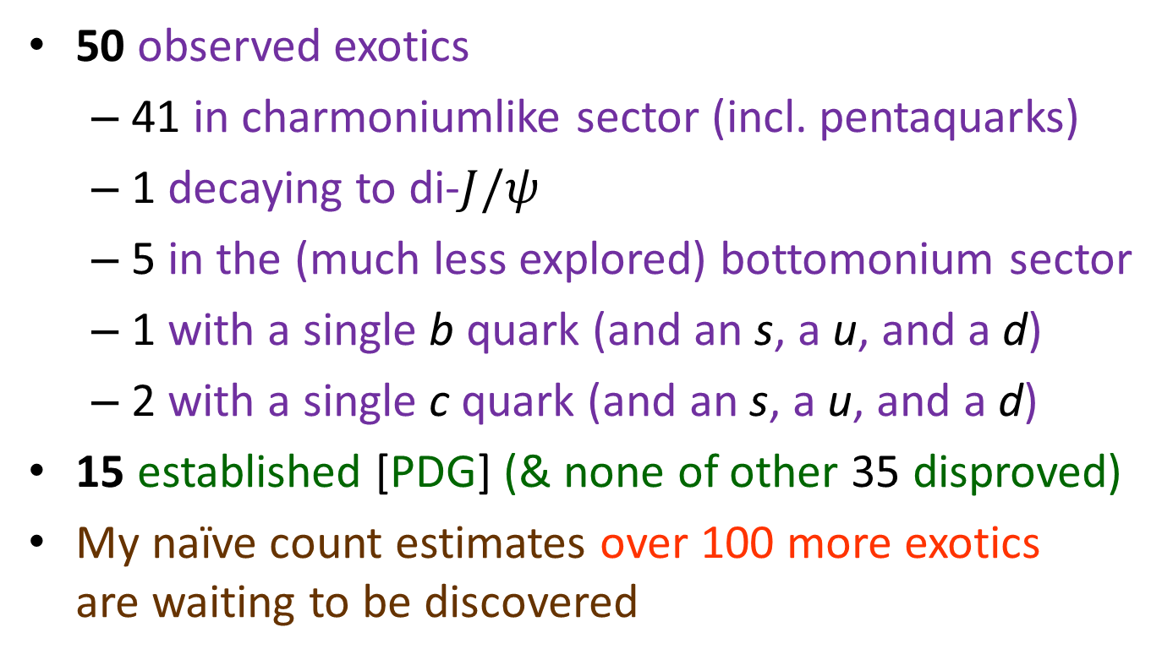
The heavy exotics scorecard: March 2021
50 observed exotics
  41 in charmoniumlike sector (incl. pentaquarks)
  1 decaying to di-$J/ψ$
  5 in the (much less explored) bottomonium sector
  1 with a single b quark (and an s, a u, and a d)
  2 with a single c quark (and an s, a u, and a d)
15 established [PDG] (& none of other 35 disproved)
My naïve count estimates over 100 more exotics
are waiting to be discovered

Slide 5
The Plot That Launched 100 Theory Papers
LHCb Collaboration, Sci. Bull. 65 (2020) 1983 [2006.16957]
See talk by
Yanxi Zhang

Slide 6
The Eye Immediately Notices…
6.4-6.5 GeV
X(6900)
~6.75 GeV
~7.2 GeV

Slide 7
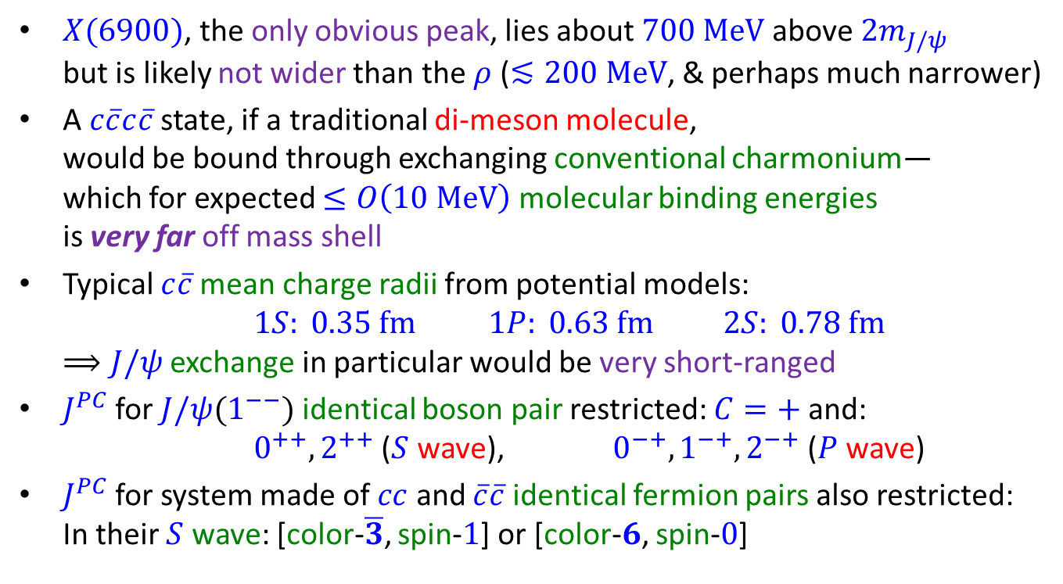
The Most Important Apparent Features
$X(6900)$, the only obvious peak, lies about $700 MeV$above $2m_{J/ψ}$
but is likely not wider than the $ρ$ ($≲200 MeV$, & perhaps much narrower)
A $c\overline{c}c\overline{c}$ state, if a traditional di-meson molecule,
would be bound through exchanging conventional charmonium—
which for expected $≤O\left(10 MeV\right)$ molecular binding energies
is very far off mass shell
Typical $c\overline{c}$mean charge radii from potential models:
$1S: 0.35 fm$ $1P: 0.63 fm$ $2S: 0.78 fm$
$⟹J/ψ$ exchange in particular would be very short-ranged
$J^{PC}$ for $J/ψ(1^{−−})$ identical boson pair restricted: $C=+$and:
$0^{++}, 2^{++}$ ($S$ wave), $0^{−+},1^{−+},2^{−+}$ ($P$ wave)
$J^{PC}$ for system made of $cc$ and $\overline{c}\overline{c}$ identical fermion pairs also restricted:
In their $S$ wave: [color-$\overline{3}$, spin-$1$] or [color-$6$, spin-$0$]

Slide 8
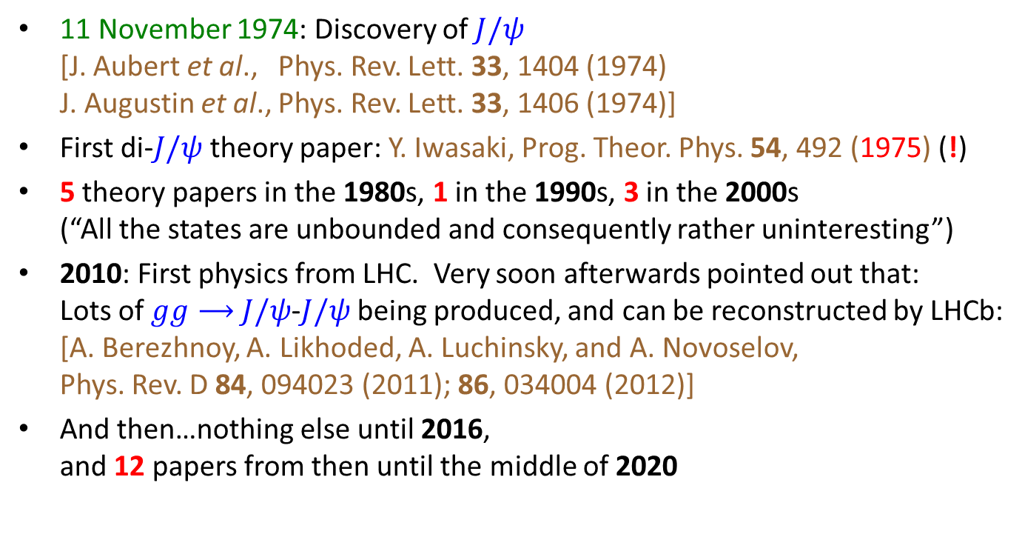

History of $c\overline{c}c\overline{c}$Theory Studies
11 November 1974: Discovery of $J/ψ$
[J. Aubert et al., Phys. Rev. Lett. 33, 1404 (1974)
J. Augustin et al., Phys. Rev. Lett. 33, 1406 (1974)]
First di-$J/ψ$ theory paper: Y. Iwasaki, Prog. Theor. Phys. 54, 492 (1975) (!)
5 theory papers in the 1980s, 1 in the 1990s, 3 in the 2000s
(“All the states are unbounded and consequently rather uninteresting”)
2010: First physics from LHC. Very soon afterwards pointed out that:
Lots of $gg⟶$ $J/ψ$-$J/ψ$ being produced, and can be reconstructed by LHCb:
[A. Berezhnoy, A. Likhoded, A. Luchinsky, and A. Novoselov,
Phys. Rev. D 84, 094023 (2011); 86, 034004 (2012)]
And then…nothing else until 2016,
and 12 papers from then until the middle of 2020

Slide 9
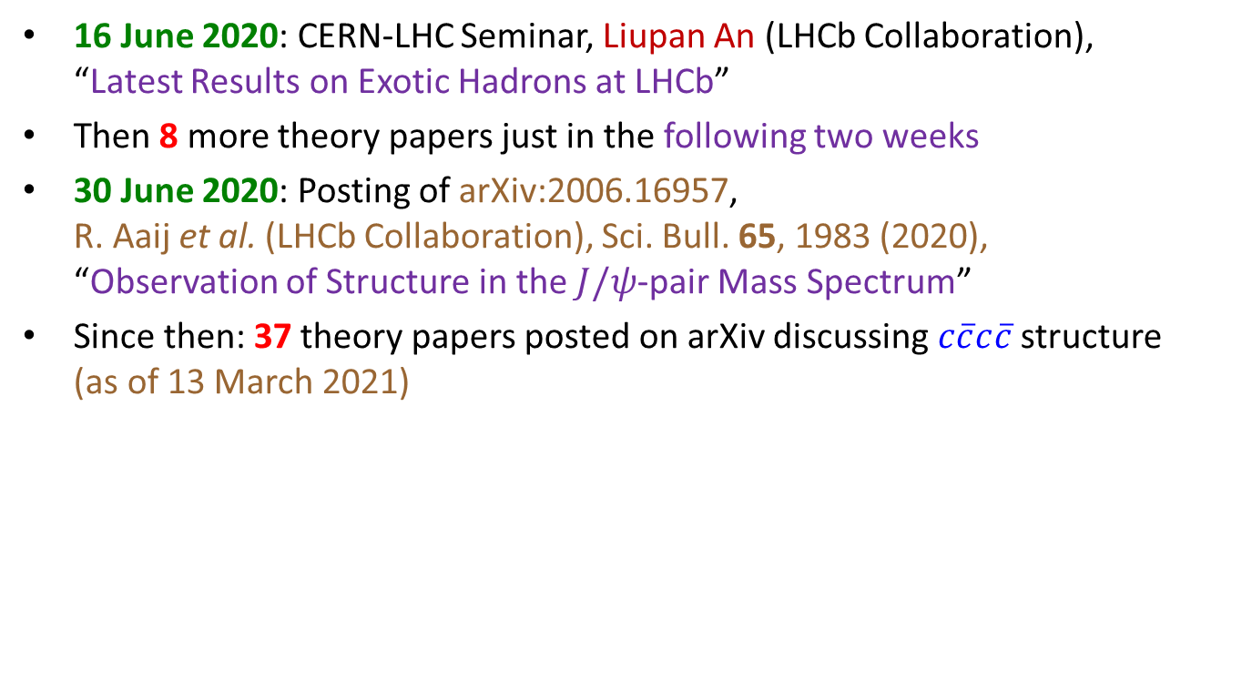
History of $c\overline{c}c\overline{c}$Theory Studies
16 June 2020: CERN-LHC Seminar, Liupan An (LHCb Collaboration),
“Latest Results on Exotic Hadrons at LHCb”
Then 8 more theory papers just in the following two weeks
30 June 2020: Posting of arXiv:2006.16957,
R. Aaij et al. (LHCb Collaboration), Sci. Bull. 65, 1983 (2020),
“Observation of Structure in the $J/ψ$-pair Mass Spectrum”
Since then: 37 theory papers posted on arXiv discussing $c\overline{c}c\overline{c}$structure
(as of 13 March 2021)

Slide 10
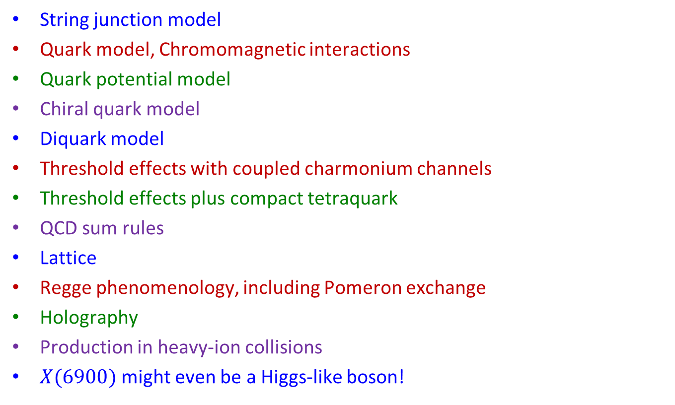
What Has Been Tried?
(with apologies to the many authors whose names are not listed here!)
String junction model
Quark model, Chromomagnetic interactions
Quark potential model
Chiral quark model
Diquark model
Threshold effects with coupled charmonium channels
Threshold effects plus compact tetraquark
QCD sum rules
Lattice
Regge phenomenology, including Pomeron exchange
Holography
Production in heavy-ion collisions
$X(6900)$might even be a Higgs-like boson!

Slide 11







The Relevant Charmonium Thresholds
$η_{c}$-$η_{c}(2S)$
$χ_{c0}$-$χ_{c0}$
$χ_{c1}$-$χ_{c1}$
${\overline{Ξ}}_{cc}$-$Ξ_{cc}$
$J/ψ$-$J/ψ$
$J/ψ$-$ψ(2S)$
$J/ψ$-$ψ(3S)$

Slide 12
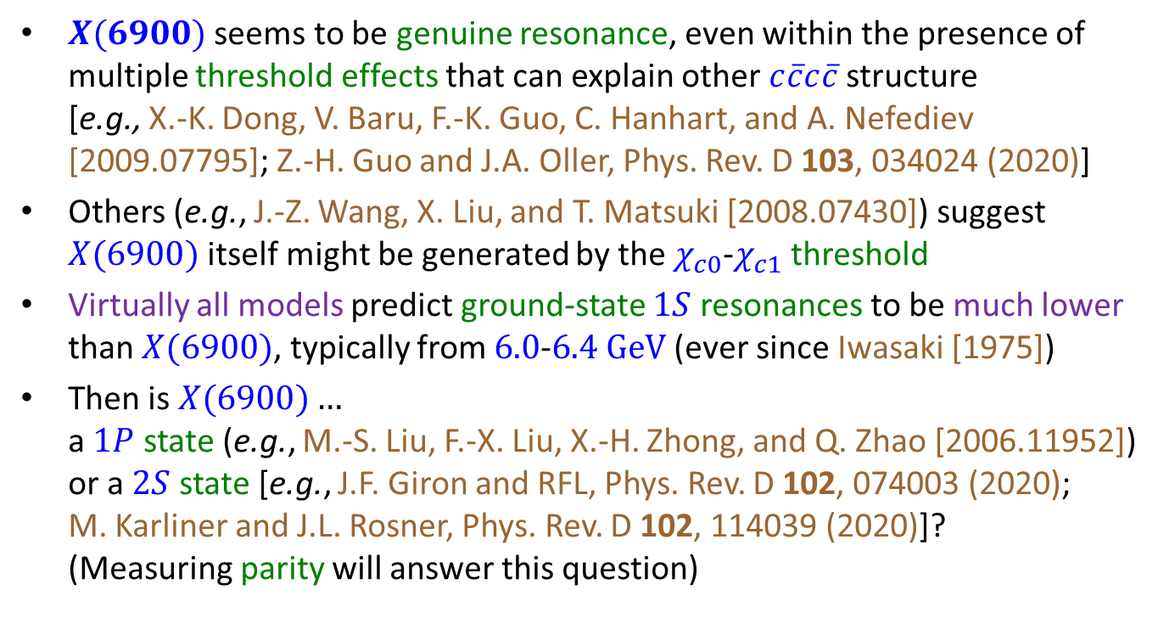
Any Solid Conclusions/Consensus?
$X(6900)$ seems to be genuine resonance, even within the presence of multiple threshold effects that can explain other $c\overline{c}c\overline{c}$structure
[e.g., X.-K. Dong, V. Baru, F.-K. Guo, C. Hanhart, and A. Nefediev [2009.07795]; Z.-H. Guo and J.A. Oller, Phys. Rev. D 103, 034024 (2020)]
Others (e.g., J.-Z. Wang, X. Liu, and T. Matsuki [2008.07430]) suggest $X(6900)$ itself might be generated by the $χ_{c0}$-$χ_{c1}$ threshold
Virtually all models predict ground-state $1S$ resonances to be much lower than $X(6900)$, typically from $6.0$-$6.4 GeV$(ever since Iwasaki [1975])
Then is $X(6900)…$
a $1P$ state (e.g., M.-S. Liu, F.-X. Liu, X.-H. Zhong, and Q. Zhao [2006.11952])
or a $2S$ state [e.g., J.F. Giron and RFL, Phys. Rev. D 102, 074003 (2020);
M. Karliner and J.L. Rosner, Phys. Rev. D 102, 114039 (2020)]?
(Measuring parity will answer this question)

Slide 13
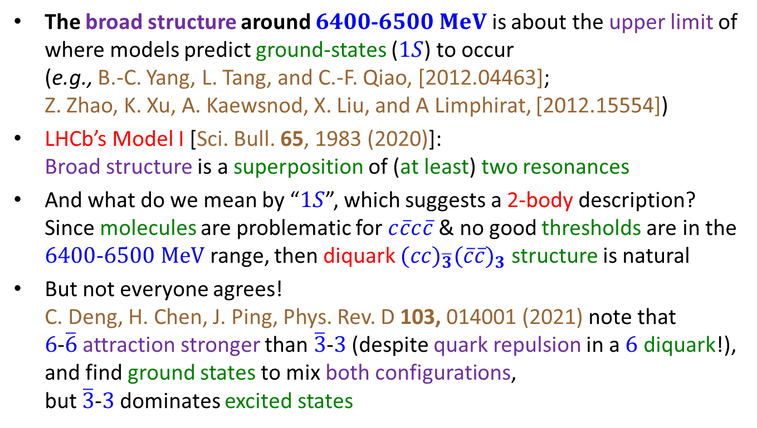
Any Solid Conclusions/Consensus?
The broad structure around $6400$-$6500$ $MeV$ is about the upper limit of where models predict ground-states ($1S$) to occur
(e.g., B.-C. Yang, L. Tang, and C.-F. Qiao, [2012.04463];
Z. Zhao, K. Xu, A. Kaewsnod, X. Liu, and A Limphirat, [2012.15554])
LHCb’s Model I [Sci. Bull. 65, 1983 (2020)]:
Broad structure is a superposition of (at least) two resonances
And what do we mean by “$1S$”, which suggests a 2-body description?
Since molecules are problematic for $c\overline{c}c\overline{c}$& no good thresholds are in the $6400$-$6500$ $MeV$ range, then diquark $(cc)_{\overline{3}}(\overline{c}\overline{c})_{3}$ structure is natural
But not everyone agrees!
C. Deng, H. Chen, J. Ping, Phys. Rev. D 103, 014001 (2021) note that
$6$-$\overline{6}$ attraction stronger than $\overline{3}$-$3$ (despite quark repulsion in a $6$ diquark!),
and find ground states to mix both configurations,
but $\overline{3}$-$3$dominates excited states

Slide 14
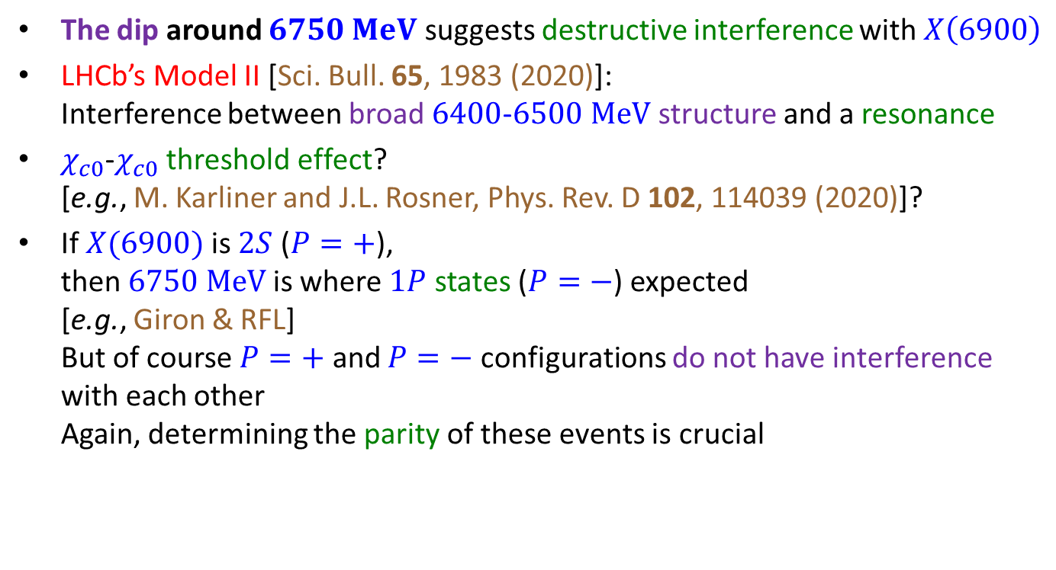
Any Solid Conclusions/Consensus?
The dip around $6750 MeV$ suggests destructive interference with $X\left(6900\right)$
LHCb’s Model II [Sci. Bull. 65, 1983 (2020)]:
Interference between broad $6400$-$6500$ $MeV$ structure and a resonance
$χ_{c0}$-$χ_{c0}$ threshold effect?
[e.g., M. Karliner and J.L. Rosner, Phys. Rev. D 102, 114039 (2020)]?
If $X(6900)$is $2S$ ($P=+$),
then $6750 MeV$is where $1P$ states ($P=−$) expected
[e.g., Giron & RFL]
But of course $P=+$ and $P=−$ configurations do not have interference
with each other
Again, determining the parity of these events is crucial

Slide 15
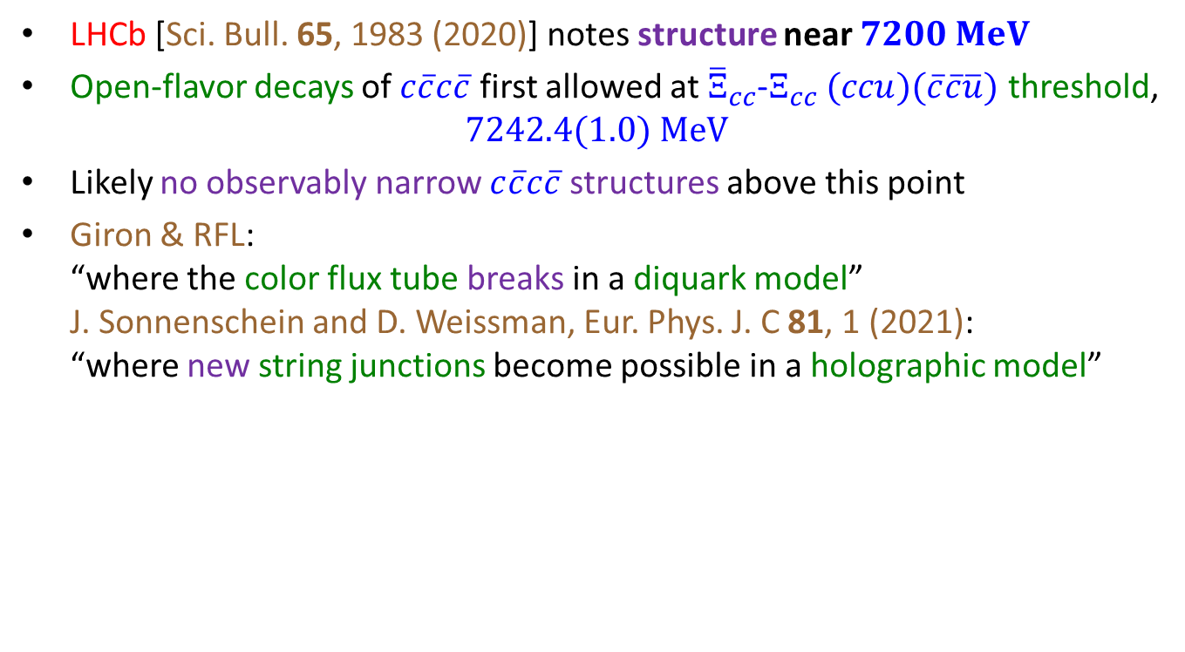
Any Solid Conclusions/Consensus?
LHCb [Sci. Bull. 65, 1983 (2020)] notes structure near $7200 MeV$
Open-flavor decays of $c\overline{c}c\overline{c}$ first allowed at ${\overline{Ξ}}_{cc}$-$Ξ_{cc}$ $(ccu)(\overline{c}\overline{c}\overline{u})$ threshold,
$7242.4(1.0) MeV$
Likely no observably narrow $c\overline{c}c\overline{c}$ structures above this point
Giron & RFL:
“where the color flux tube breaks in a diquark model”
J. Sonnenschein and D. Weissman, Eur. Phys. J. C 81, 1 (2021):
“where new string junctions become possible in a holographic model”

Slide 16
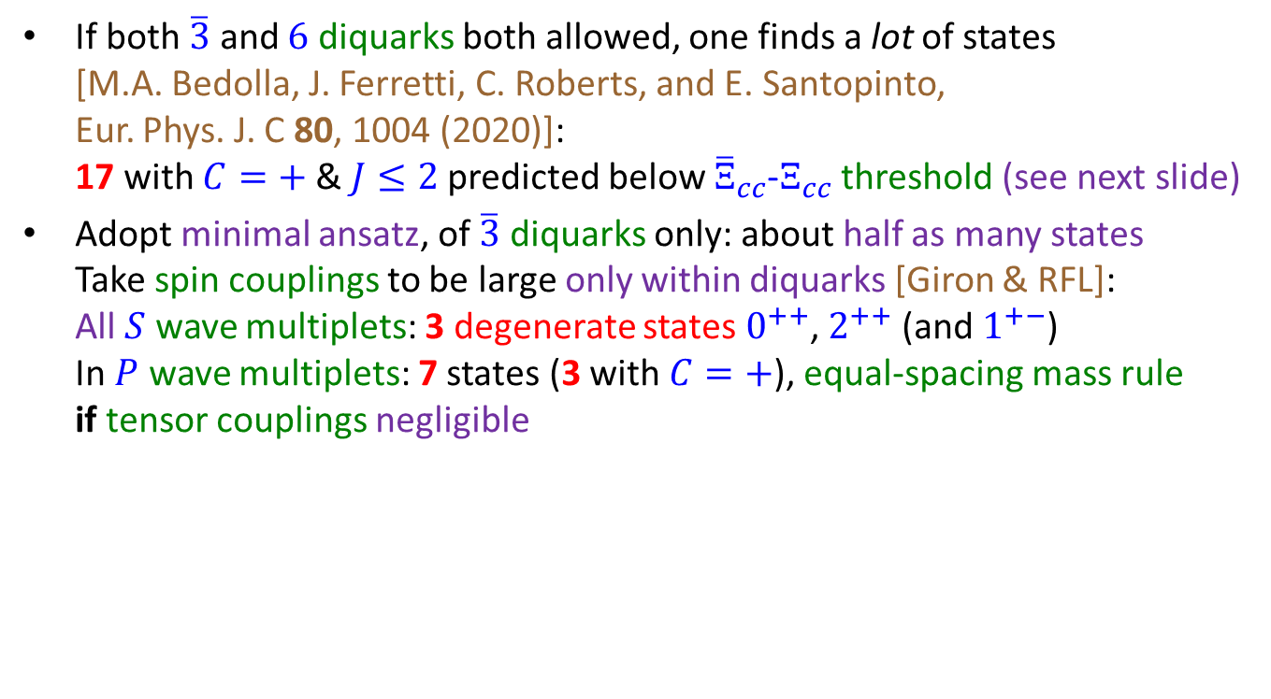
How Many States?
If both $\overline{3}$ and $6$ diquarks both allowed, one finds a lot of states
[M.A. Bedolla, J. Ferretti, C. Roberts, and E. Santopinto,
Eur. Phys. J. C 80, 1004 (2020)]:
17 with $C=+$& $J≤2$predicted below ${\overline{Ξ}}_{cc}$-$Ξ_{cc}$ threshold (see next slide)
Adopt minimal ansatz, of $\overline{3}$ diquarks only: about half as many states
Take spin couplings to be large only within diquarks [Giron & RFL]:
All $S$ wave multiplets: 3 degenerate states $0^{++}$, $2^{++}$ (and $1^{+−}$)
In $P$ wave multiplets: 7 states (3 with $C=+$), equal-spacing mass rule
if tensor couplings negligible

Slide 18
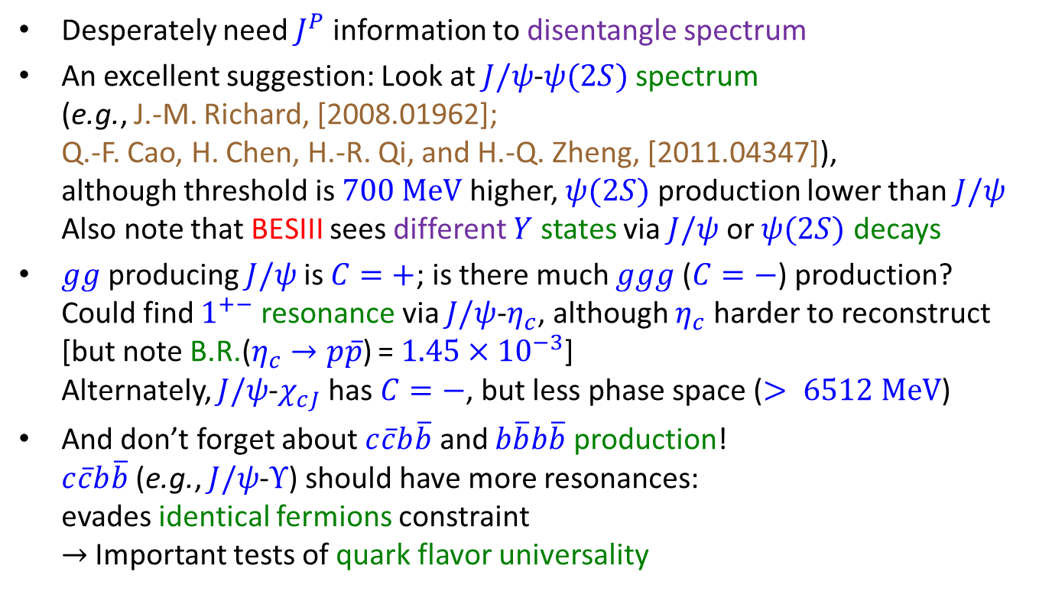
Some Parting Thoughts
Desperately need $J^{P}$ information to disentangle spectrum
An excellent suggestion: Look at $J/ψ$-$ψ(2S)$ spectrum
(e.g., J.-M. Richard, [2008.01962];
Q.-F. Cao, H. Chen, H.-R. Qi, and H.-Q. Zheng, [2011.04347]),
although threshold is $700 MeV$higher, $ψ(2S)$ production lower than $J/ψ$
Also note that BESIII sees different $Y$ states via $J/ψ$ or $ψ(2S)$ decays
$gg$ producing $J/ψ$is $C=+$; is there much $ggg$ ($C=−$) production?
Could find $1^{+−}$ resonance via $J/ψ$-$η_{c}$, although $η_{c}$ harder to reconstruct
[but note B.R.($η_{c}→p\overline{p}$) = $1.45×{10}^{−3}$]
Alternately, $J/ψ$-$χ_{cJ}$ has $C=−$, but less phase space ($> 6512 MeV$)
And don’t forget about $c\overline{c}b\overline{b}$ and $b\overline{b}b\overline{b}$ production!
$c\overline{c}b\overline{b}$ (e.g., $J/ψ$-$Υ$) should have more resonances:
evades identical fermions constraint
$→$ Important tests of quark flavor universality

Slide 19
Backup slides

