Slide 1
WP6 status
Avni Aksoy
Institute of Accelerator Technologies

Slide 2
The layout
Linac4
H/S XR
Linac0
Linac1
Linac2
Linac3
H/S XR
Two bunch for driving two HXR at 100 Hz (2.74-5.5 GeV)
Two bunch for driving two SXR at 250 Hz (1-2 GeV)
  Same beamline o two bunch for driving SXR at 1000 kHz
Two bunch driving SXR at 100 Hz (1-2 GeV) and HXR at 100 Hz (2.75-5.5 GeV)

Slide 3
We focus on two injector
C-band
gun
C-band
Booster
Linac4
H/S XR
Linac0
Linac1
Linac2
Linac3
H/S XR
K-band
Linearizer
S-band
TDS
Linac4
H/S XR
Linac0
Linac1
Linac2
Linac3
H/S XR
X-band
gun
X-band
Booster
Linac4
H/S XR
Linac0
Linac1
Linac2
Linac3
H/S XR
All Linacs are X-Band s

Slide 4
Electron Beam Parameters
Parameter | Unit | HXR |  |  | SXR
Beam Energy | GeV | 5,5 | 3,9 | 2,75 | 1,95 | 1,37 | 0,97
Photon Energy Range | keV | 16 - 8 | 8 - 4 | 4 - 2 | 2 - 1 | 1 - 0.5 | 0.5 - 0.25
Minimum Peak Current * | kA | 5.0 | 2.5 | 1.5 | 0.925 | 0.65 | 0.35
RMS Slice Energy Spread | % | 0.01 | 0.014 | 0.02 | 0.028 | 0.04 | 0.056
Peak Current-1 | pC/fs | 75/15 | 75/30 | 75/50 | 75/75 | 75/115 | 75/200
Peak Current-2 | pC/fs | 50/10 | 50/20 | 50/30 | 50/50 | 50/75 | 50/75
Peak Current | pC/fs | 75/15 |  |  | 75/50
Photon Pulse duration | fs | 0.1-15 |  |  | 1-50
Normalised Emittance | mm-mrad | 0.2

Slide 5
Module layout
1-2 GeV
8-cav
Linac4
Linac0
Linac1
Linac2
Linac3
H/S XR
4-cav
16-cav
8-cav
68-cav
Hig reprate case 1-2 GeV
~300 MeV
~1 GeV
2.75-5.5 GeV
1-str beween quads
2-str beween quads
2-str beween quads
4-str beween quads
Low energy Hig rep-rate case is the worst case..

Slide 6
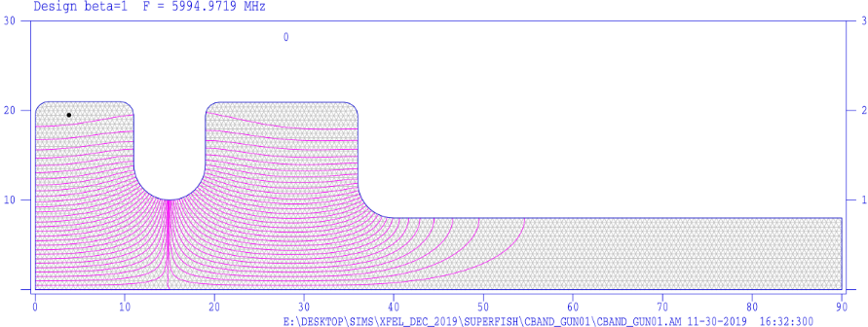
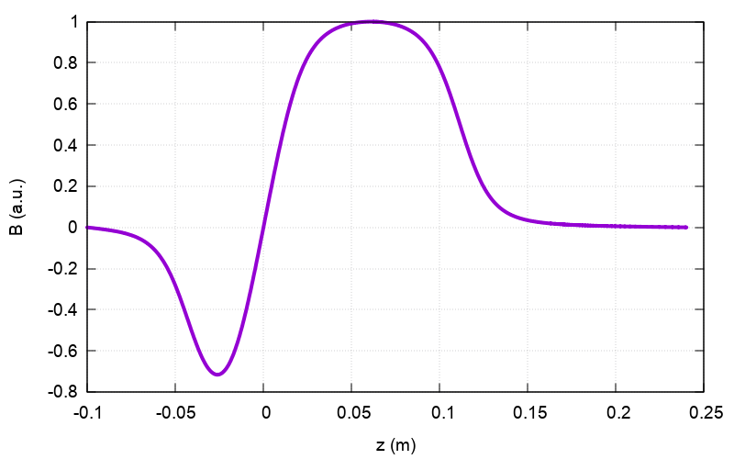
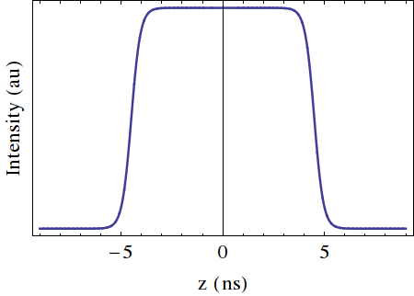
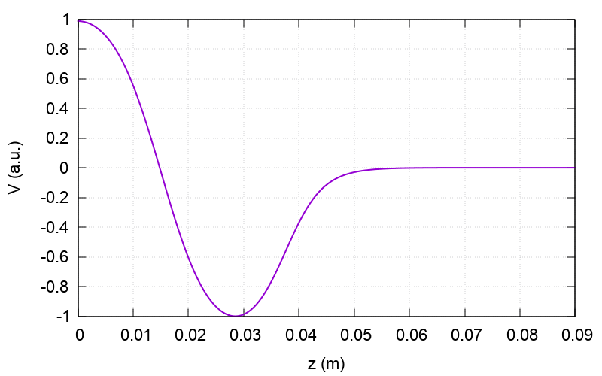
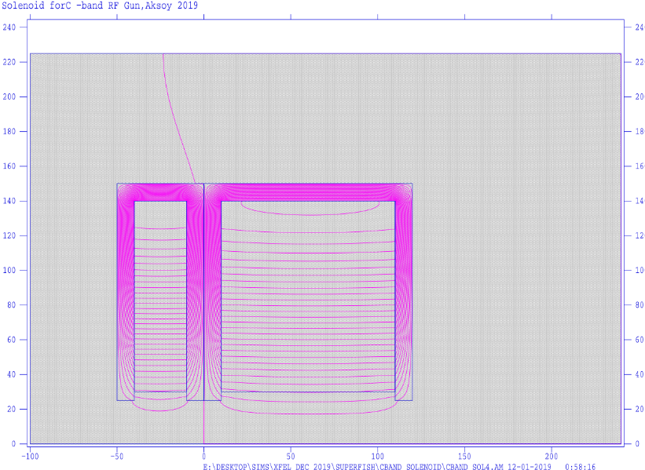
C-band based Injector
Laser
12 GHz Traveling wave structures
108 cell, ~0.9 m, 65MV/m, 120 degree
6GHz RF Gun
1.6 Cell, 260 MV/m
6 GHz Traveling wave structures
105 cell, ~1.8 m, 30MV/m, 120 degree
σ_{z} = 4 ps (FWHM)
σ_{x,y} = 0.3 mm
Parameter | Value | Unit
Frequency | 6 | GHz
Gradient | 240 | MV/m
Cell number | 1.6 | #

Slide 7
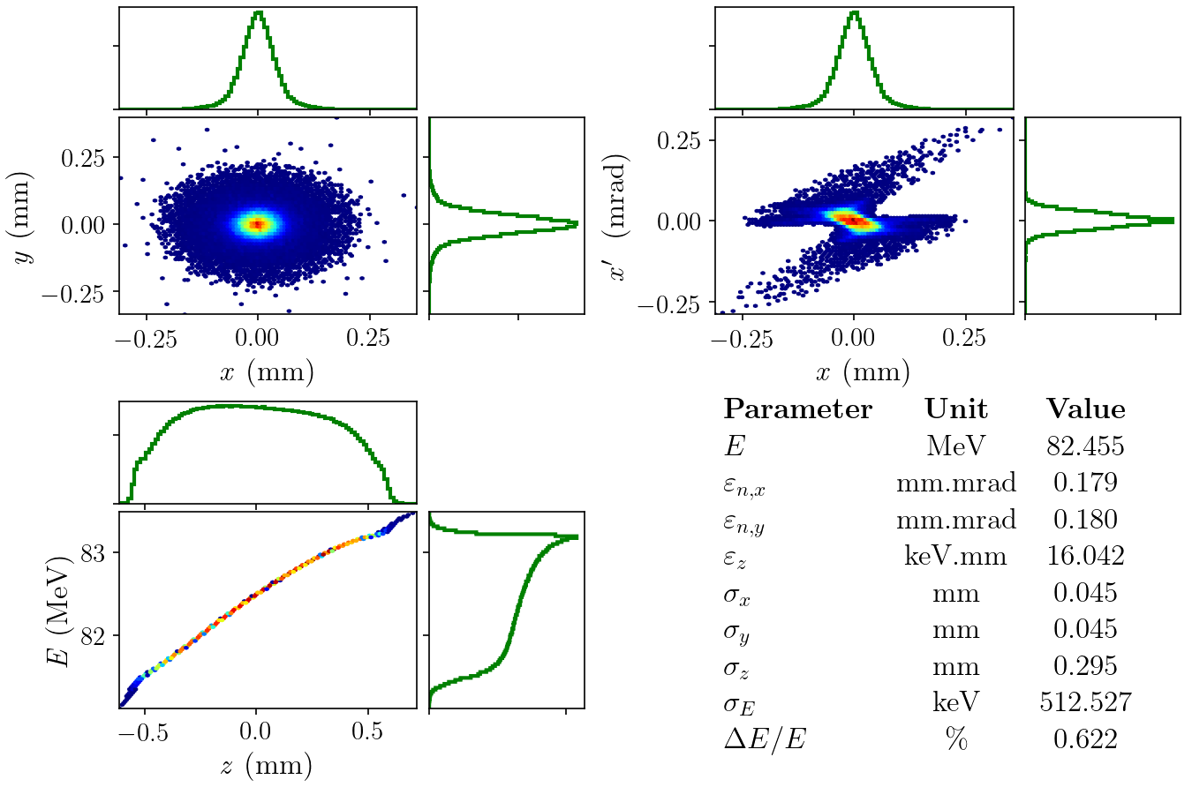
C-band based Injector
Laser
12 GHz Traveling wave structures
108 cell, ~0.9 m, 65MV/m, 120 degree
6GHz RF Gun
1.6 Cell, 240 MV/m
6 GHz Traveling wave structures
105 cell, ~1.8 m, 30MV/m, 120 degree

Slide 8
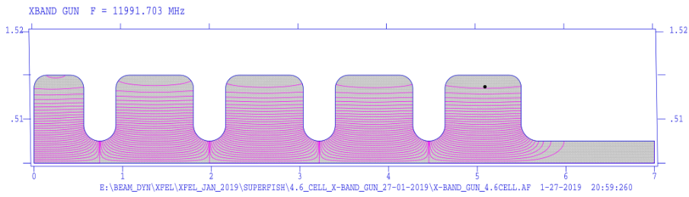
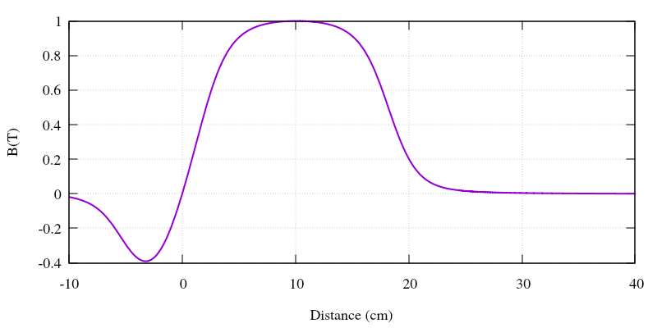
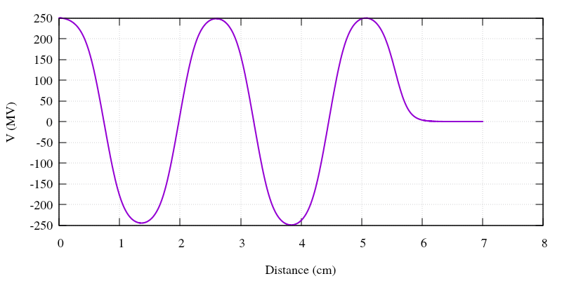
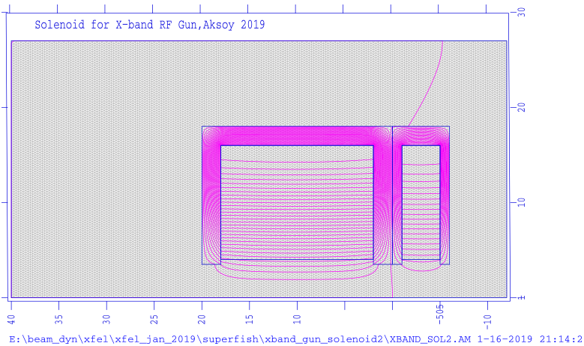
X-band based Injector
Laser
12 GHz RF Gun
5.6 Cell, 200 MV/m
12 GHz Traveling wave structures
108 cell, ~0.9 m, 65MV/m, 120 degree
σ_{z} = 2 ps (FWHM)
σ_{x,y} = 0.25 mm
Parameter | Value | Unit
Frequency | 12 | GHz
Gradient | 250 | MV/m
Cell number | 4.6 | #

Slide 9
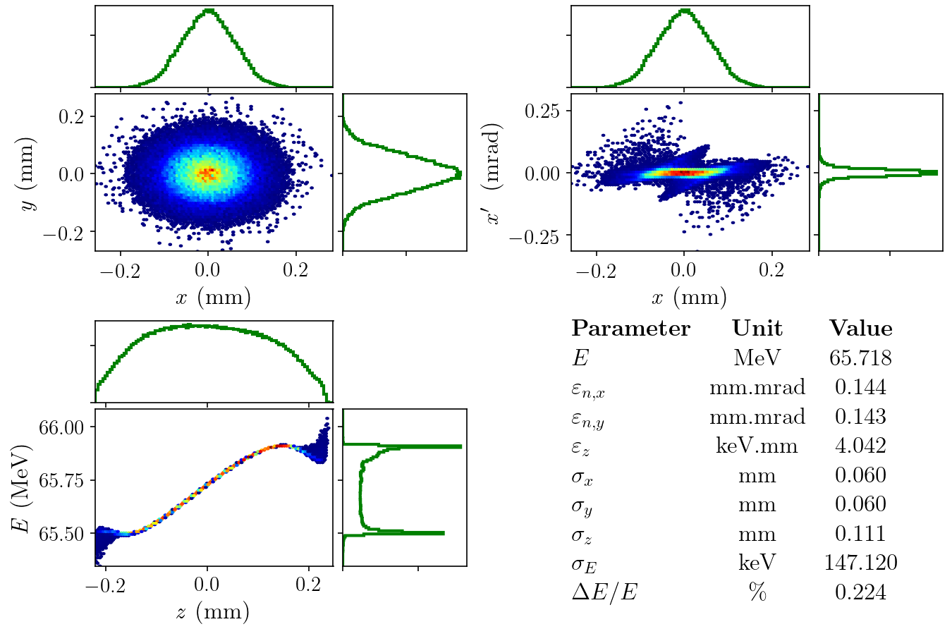
X-band based Injector
Laser
12 GHz RF Gun
5.6 Cell, 200 MV/m
12 GHz Traveling wave structures
108 cell, ~0.9 m, 65MV/m, 120 degree

Slide 10
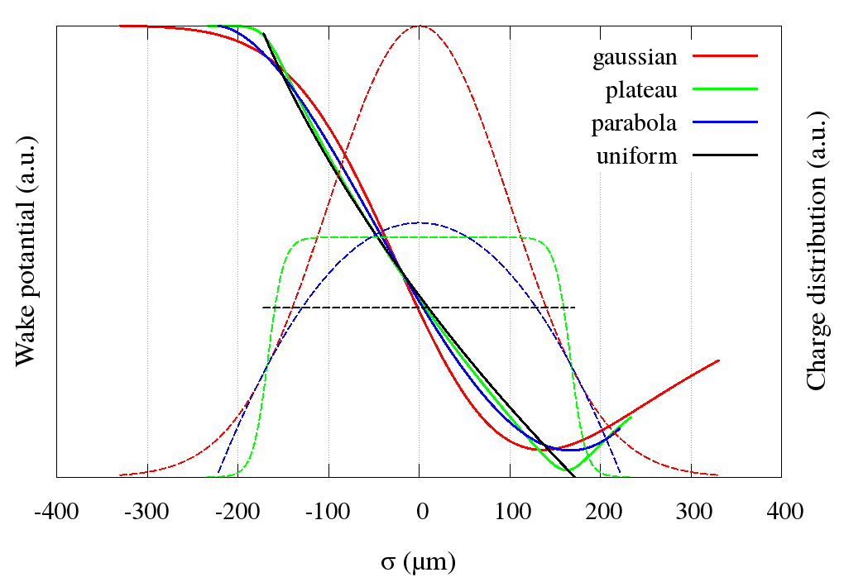
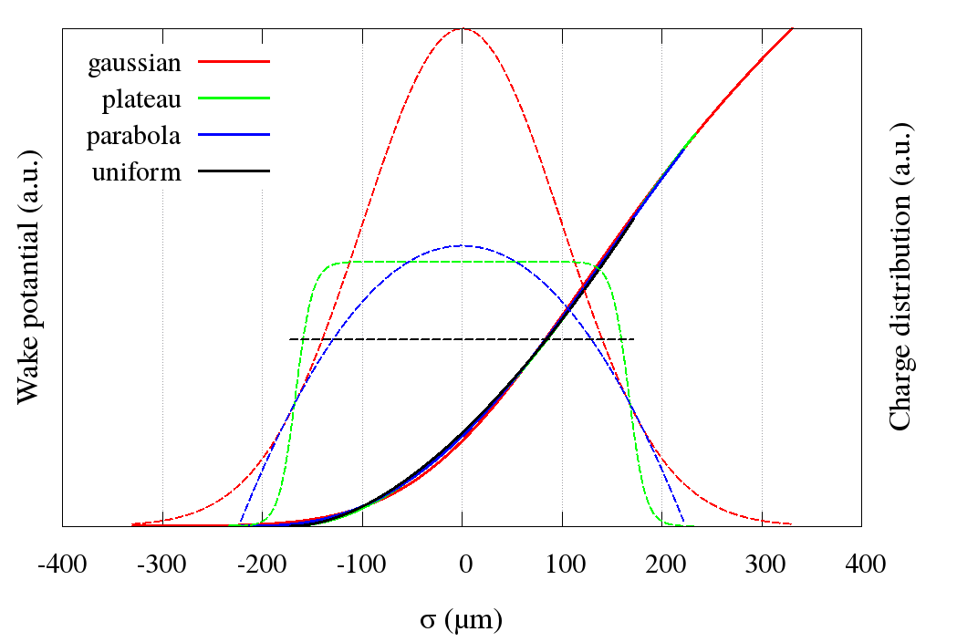
Wake poetantials ↔ Bunch charge distribution
Instability is driven by strong wake field of high frequency structure.
Causes transverse deflection along bunch
Transverse wake potential
Longitudinal wake potential
Causes enegy change along bunch
To reduce the wake effect → Optimize charge distribution
Longitudinal wake potential
Transverse wake potential
σz=100 um
σz=100 um
For both transverse and longitudinal case
  uniform bunch distribution and no tail is preferred
  Bunch distribution is fixed in injector → try to make it uniform on bunch compressors
10 / 30
A. Aksoy CLIC Workshop 2015
29.01.2014

Slide 11
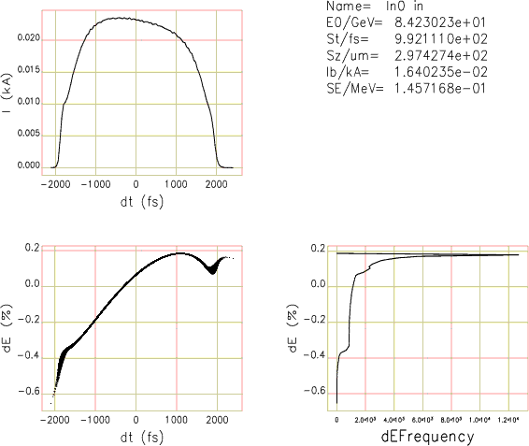
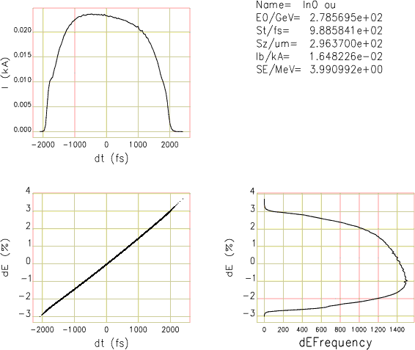
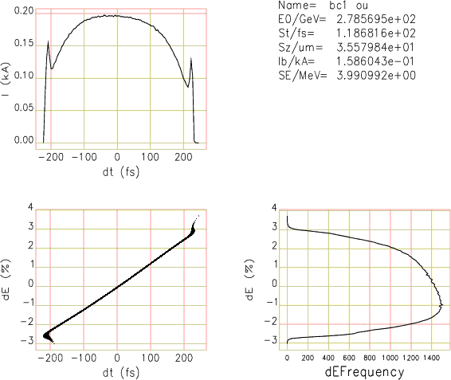
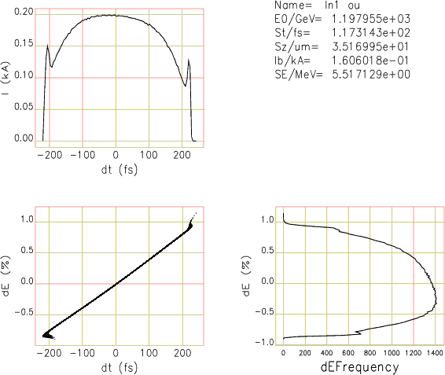
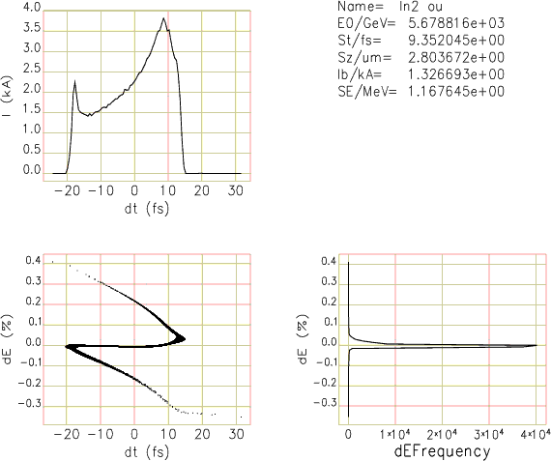
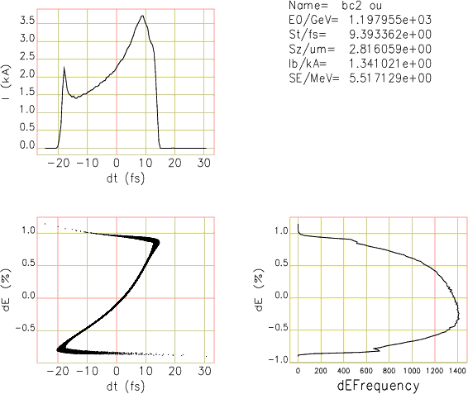
Evaluation of phase space
Cband injector
Linac0
Linac1
Linac2
Linac3
H/S XR

Slide 12
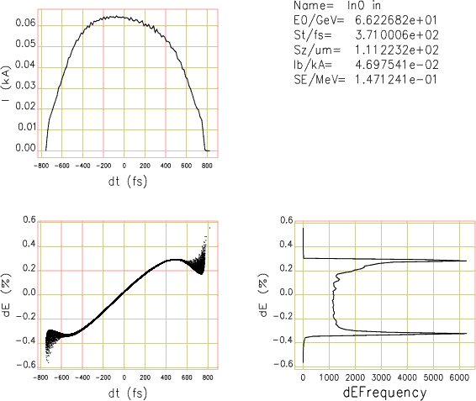
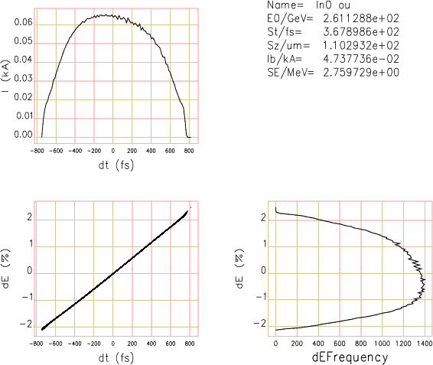
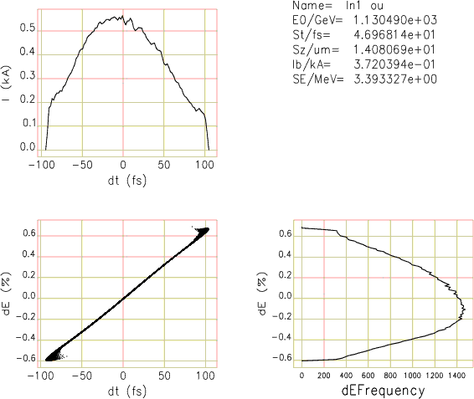
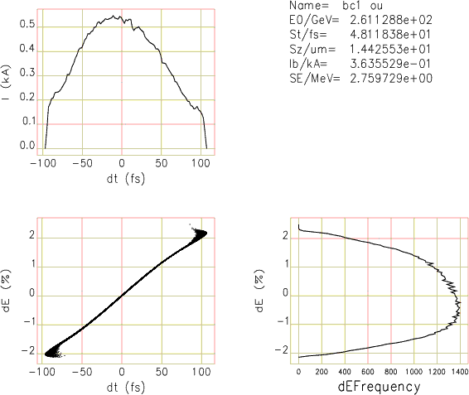
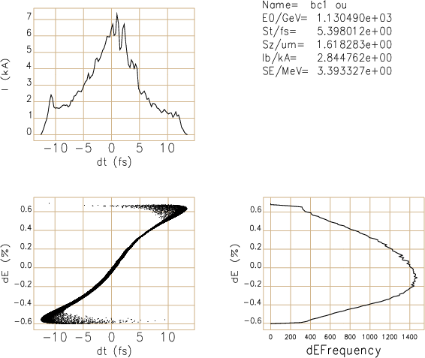
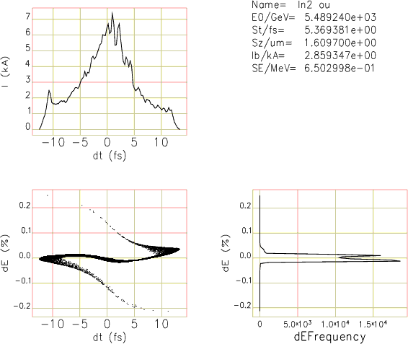
Evaluation of phase space
Xband injector
Linac0
Linac1
Linac2
Linac3
H/S XR

Slide 13
Conclusion
We are trying to set up lattice for requested beam
  To achieve peak current and optimum charge profile for FEL
Once completed we will study imperfections and fix the lattice layout
  Low gradient multibunch case is the most importance
Deflectors and BCs will be studied alone in detail
In addition
Simulations are in progress for FEL
  Wakefield, seeding scheme etc..

Slide 15
Backup slides

Slide 16
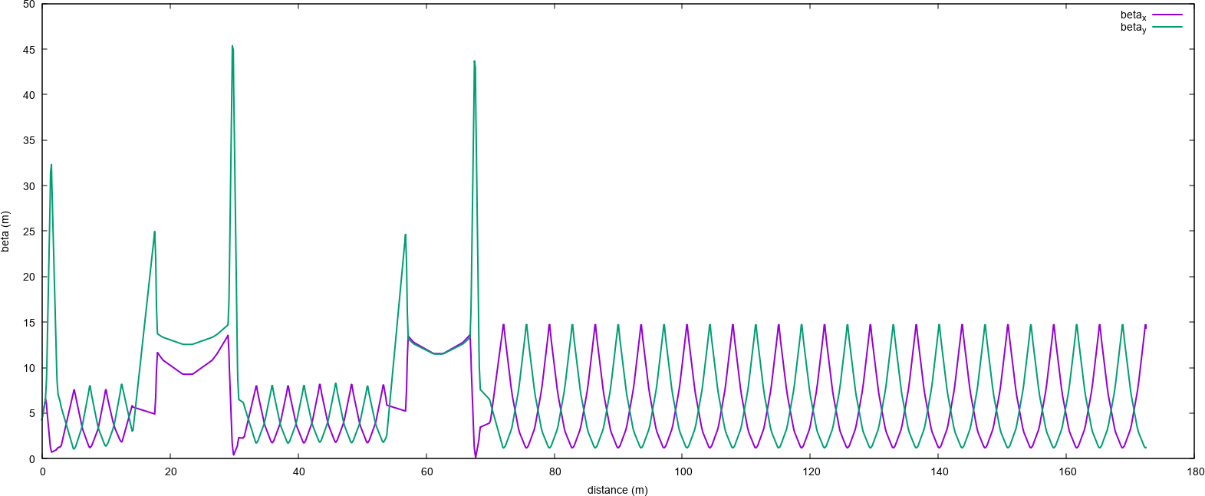
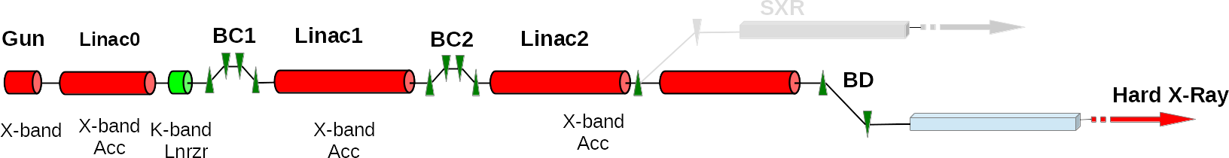
R56=0.01
R56=0.004
(4+1) * X-band
2 str between quads
2 * K-band
2 str between quads
78* X-band
3 str between quads
12 * X-band
2 str between quads

