Slide 1
WP7: Data management (EDMS)
Markus Aicheler
Helsinki Institute of Physics
15.10.2019

Slide 2
EDMS Features implemented for XLS
Contexts
Limited selection of available documents
New e-groups for administration
Two release procedures
Commenting
”Public, restricted document ” document visibility

Slide 3
EDMS context
Is a predefined ”framework” or ”template” with allowed release procedures, documents and user groups
Can be changed and modified at any moment
New documents have automatically preselected the correct context

Slide 4
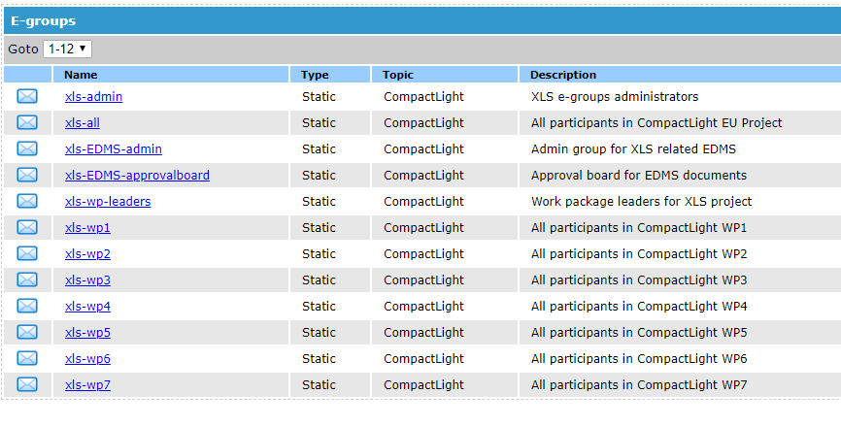
Two new e-groups for EDMS administration and approval

Slide 5
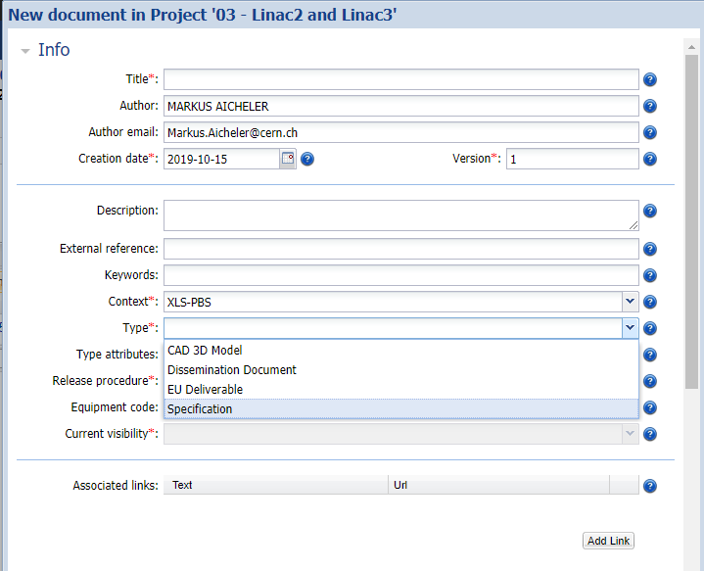
Limited preselction of documents:

Slide 6
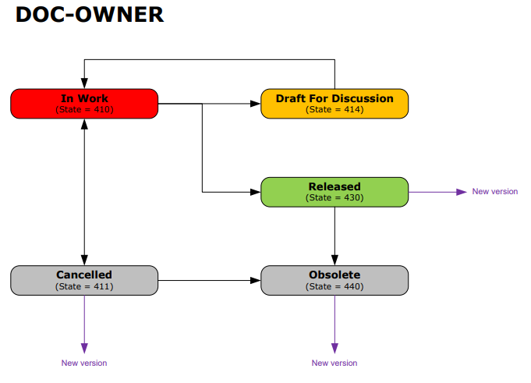
Release procedures general:

Slide 7
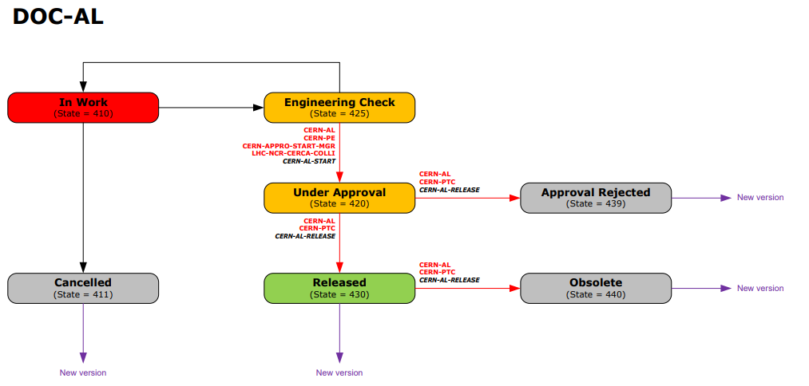
Release procedures PBS:

Slide 8
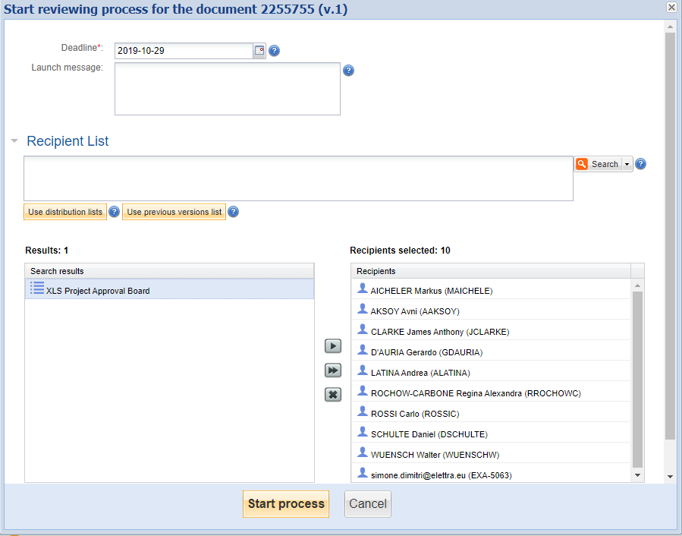
Review process PBS:

Slide 9
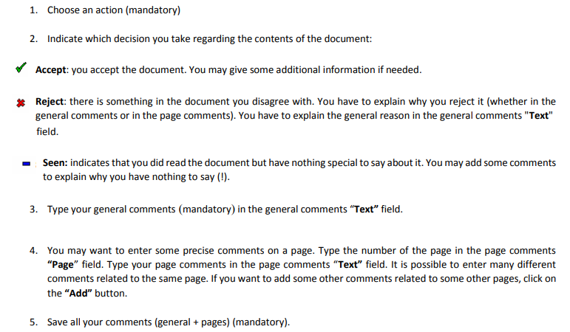
Commenting during approval process:
https://edms.cern.ch/ui/file/1523542/LAST_RELEASED/How_to_give_comments_during_a_reviewing_process.pdf

Slide 10
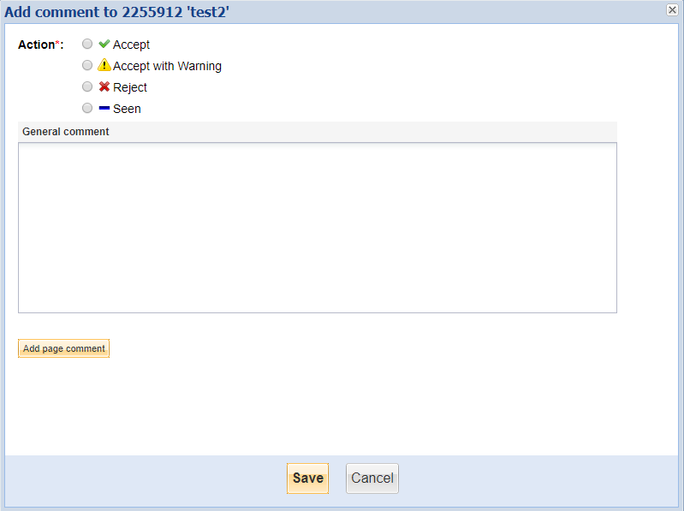
Commenting during approval process:

Slide 11
Visibility of documents:
”public access” (not available in PBS context)
  not findable through external search engines but browsable and retrievable without CERN account
”restricted” (default)
  Findable without CERN account, but retrievable only for access group.
”sensitive”
  Not findable if you are not part of the access group

