Slide 1



Introduction & Goals for the 3rd MDI workshop of FCC-ee
Manuela Boscolo
CERN, 9-20 September 2019

Slide 2
FCC-ee MDI workshops
1° MDI workshop 16-27 January 2017: https://indico.cern.ch/event/596695/
  Goal was to validate and revisit the MDI layout and freeze the baseline design to be used for coherent studies for the CDR
2° MDI workshop 20 Jan-9 Febr 2018: https://indico.cern.ch/event/694811/
  Goal was to review the design and discuss the mechanical design with integration and assembly
3° MDI workshop 9-20 September 2019
Link to this workshop: https://indico.cern.ch/event/839155

Slide 3
Introduction
Third edition of extended two week working meeting on the Machine Detector Interface (MDI) of the FCC-ee collider from Sepember 9 to 20.
It will be organized with presentations in the morning to open the discussion on various topics, and time for dedicated individual work plus group discussions in the afternoon.

Slide 4
Highlights of the agenda
9/9 Monday: Opening
  Intro & goals
  Lattice
10/9 Tuesday MDI: integration with detector
  FCC-ee Overview
  MDI status
  CLD detector and MDI elements
  IDEA detector
  Experience with DAFNE- CRAB-WAIST scheme
  Luminometer
11/9 Wednesday Heat load, HOM & integration
  Heat load and HOM analyisis in the MDI area
  Experience with DAFNE crab-waist: integration, assembly
12/9 Thursday Beam dynamics related to MDI
  Preliminary result of beam loss due to radiative Bhabha using BBBrem+SAD
  Polarization requests on beam controls, etc
  Beam dynamics: vertical emittance blow-up, 3D magnetic field map
13/9 Friday Mechanical stabilization and alignment
  presentations by CERN and LAPP groups

Slide 5
Highlights of the agenda
16/9 Monday
  discussion / working session
17/9 Tuesday IR magnets & SR
  SuperKEKB superconduction magnet quench
  Recent developments in direct wind IR magnet production at BNL
  CCT design for IR final focus quad
  SR backgrounds with smaller central beam pipe
  SR from SYNRAD+
  SR with MDISim
18/9 Wednesday IR Beam Losses and MDI software
  Beam backgrounds and IR losses
  Particle tracking for IR beam losses studies: first results for Coulomb scattering
  MDI software tools for FCC study
19/9 Thursday Discussion in preparation for summary
20/9 Friday Workshop Summary

Slide 6
Topics to be addressed & Goals
The goal of this working meeting by the core MDI team is to progress on the mechanical design and integration of the interaction region layout including the MDI area, as a natural follow up to the conceptual design phase.
Present optics and beam dynamics studies will be discussed with the goal of reviewing and, if necessary, improving the design and progressing with more and more realistic simulations.
During the event the following topics will be addressed:
  Mechanical integration of the baseline design
  Mechanical stabilization and alignment
  Assembly concept
  Heat load evaluation with HOM analysis in the MDI area
  Final Focus quadrupole design
  Present baseline IR optics and with 4 IPs
  IR layout
  Synchrotron Radiation in the MDI area: characterization, impact on detectors and mitigation
  Beam dynamics studies, including beam backgrounds
  Luminosity measurement

Slide 7
Systems that influence the MDI design
Magnets: FF quads, solenoids, correctors
Cryogenic system for the cryostat, one from each side of the IP
Cooling system: central Be pipe, Y-chamber, SR masks, HOM absorbers
Vacuum system: vacuum pumps, beampipe, SR masks
Detector equipment: luminometer, cables, ....
Beam diagnostics (BPM, fast lumi monitor?, Beamstrahlung monitor?,..)
Mechanical design for integration
Mechanical tolerances and stabilization

Slide 8
expected participants
A. Andreazza (INFN-Mi) - remote
M. Benedikt (CERN)
A. Blondel
A. Bogomyagkov (BINP)
M. Boscolo (INFN/LNF)
H. Burkhardt (CERN)
A. Ciarma (INFN/LNF)
T. Charles
M. Dam (NBI)
Helene Mainaud Durand (CERN)
K. Elsener (CERN)
P. Janot (CERN)
Marc Jones (CERN)
R. Kersevan (CERN)
M. Koratzinos
E. Leogrande
E. Levichev (BINP)
M. Lueckof (Univ. Hamburg)
A. Novokhaski (SLAC)
N. Ohuchi (KEK) - remote
K. Oide
B. Parker (BNL)
L. Pellegrino (INFN-LNF)
Emmanuel Perez (CERN)
T. Pieloni (EPFL)
S. Pivovarov (BINP)
Maurizio Serluca (LAPP)
D. Schulte (CERN)
S. Sinyatkin (BINP)
M. Sullivan (SLAC)
R. Tomas (CERN)
Georgios Voutsinas (CERN)
Jorg Wenninger (CERN)
F. Zimmermann (CERN)

Slide 10
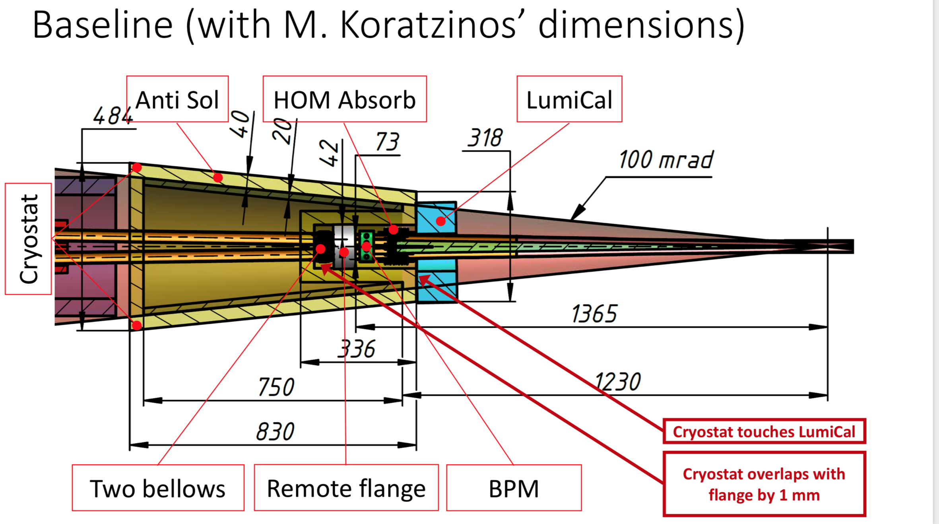

Slide 11

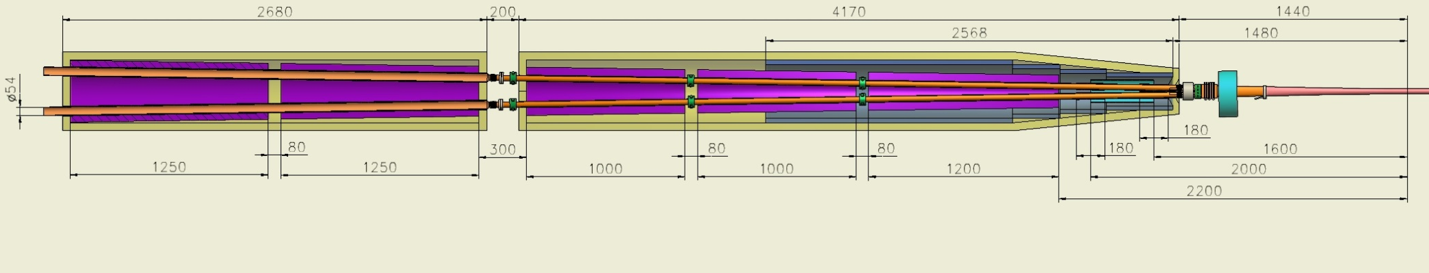
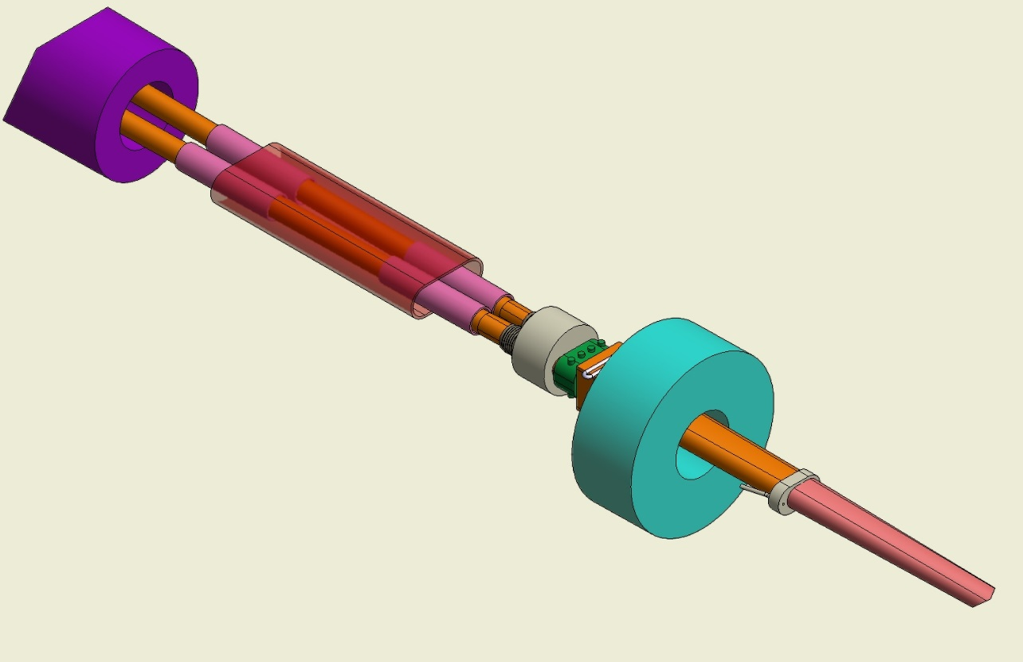
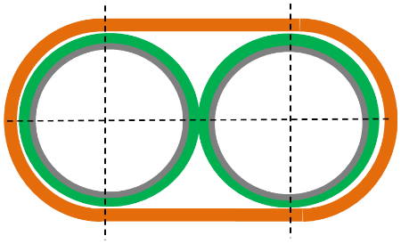
3D conceptual design Interaction Region.
BINP
QC2.2
QC2.1
QC1.3
QC1.2
QC1.1
Screening sol.
QC1.1
Cryostat “walls” thickness.
Outer SS wall 10 mm
Remote flange
10 mm vacuumn
Thermal shield 3 mm
HOM Absorber
10 mm vacuum
LumiCal
Correct. sol.(4)
Inner wall 6 mm
In total: ~40…45 mm
Anti-sol.
Cooling
Anti sol.
Two bellows
BPM
Connection Be-Cu
Compens. colls

Slide 12
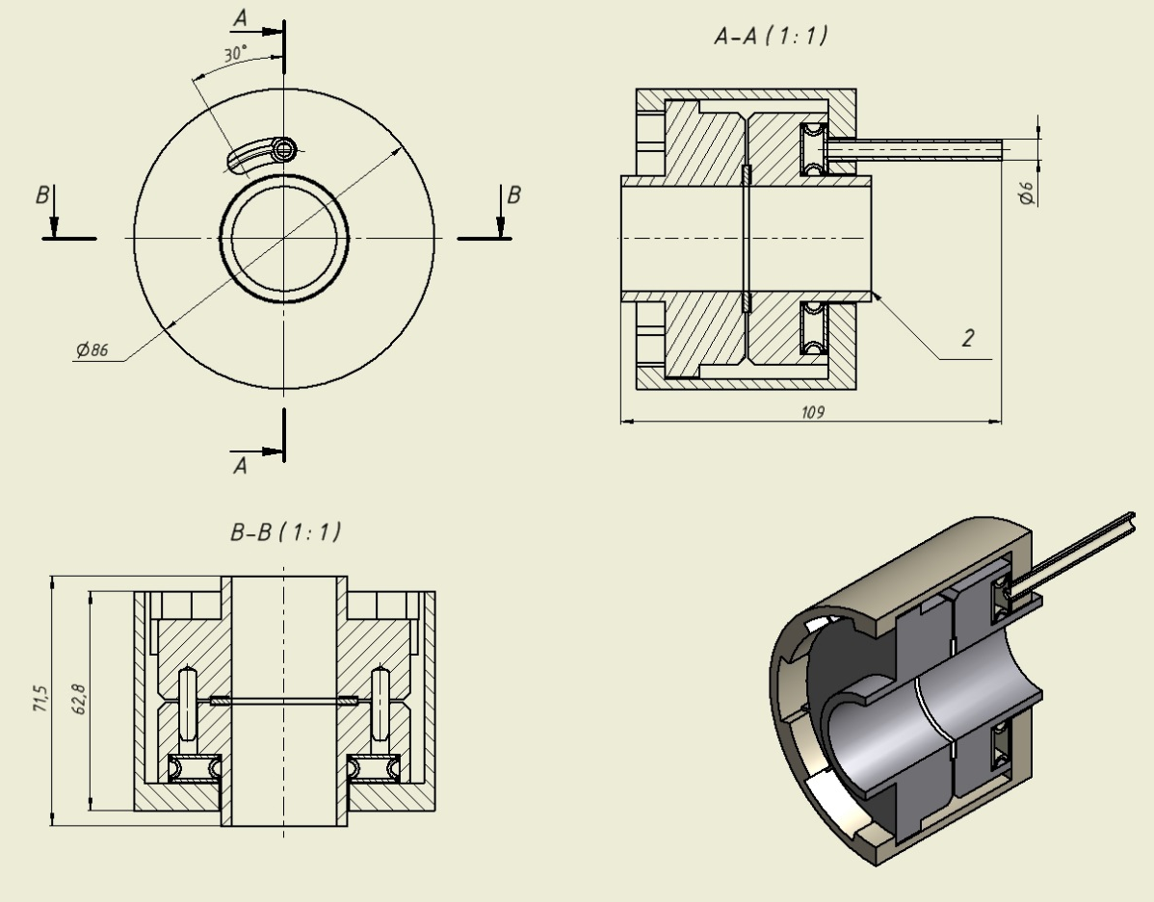
BINP
Vacuum chamber inside the cryostat
Rough estimation shows for the SCTF MDI vacuum chamber ~100 W/m thermal load due to HOMs and image currents. The task is to develop, produce and test a prototype for the multilayer vacuum chamber inside the cryostat providing tolerable heating of FF magnets.
Inner vessel 0.7 mm thick with copper coating, T=300K
0.7 mm cooling water gap against HOM & IC
Vacuum tube 0.7 mm with mirror-like coating (Cu or Au), T=300K
0.9 mm vacuum gap
Outer 1 mm vessel coated by Cu, T=4.2K
Superconducting coil on a mandrel
P=100…200 bar
Remote flange prototype

Slide 13
Summary table for 1 cm central beam pipe
M. Sullivan, FCCWEEK19
Mask at -2.1 m | Z case |  | ZH case
 | Upstream of CC | Central Chamber | Upstream of CC | Central chamber
Std 10 mm radius mask | 3.64e5 | 903 | 1.59e9 | 8.72e4
7 mm radius mask | 0.2 | 17.9 | 3753 | 1.24e4
6 mm radius mask | 0.2 | 16.7 | 485 | 2310
5 mm radius mask | 0.2 | 8.5 | 88.5 | 570
The 1 cm radius beam pipe (even though shorter) intercepts FF quadrupole radiation even with a 5 mm radius mask
For the Z case a 7mm mask is fine (even 10 mm mask is OK?)
For the ZH case a 5 mm mask is needed

Slide 14
Transmission numbers and forward scattered numbers to the CC
M. Sullivan, FCCWEEK19
Mask at -2.1 m | Z case |  | ZH case
 | Upstream of CC scattered to CC (incident on CC) | Direct hits through Central Chamber beam pipe | Upstream of CC scattered to CC (incident on CC) | Direct hits through Central chamber beam pipe
Std 10 mm radius mask | 126 | 7.3 | 1.32e6 | 1.13e4
7 mm radius mask | 1.7e-3 | 0.14 | 7.67 | 1602
6 mm radius mask | 1.7e-3 | 0.13 | 0.99 | 298
5 mm radius mask | 1.7e-3 | 0.07 | 0.18 | 73.6
These numbers are for forward scattered and for direct hits that go through the beam pipe coming from the table in slide 14
For the Z case a 7mm mask is fine (even 10 mm mask is OK?)
For the ZH case at least a 6 mm mask is needed

