Slide 1
MAMBO III
Monolithic Active Pixel Matrix with Binary Counters
Farah Khalid
Alpana Shenai
Gregory Deptuch
Raymond Yarema

Slide 2
Presentation Outline
Applications
Previous Work: MAMBO II
  Design
  Results
MAMBO III development
  Goals
  Schematic
  Layout
T-Micro (ZyCube) 3D Integration
MAMBO IV: Future work

Slide 3
POSSIBLE APPLICATIONS

Slide 4
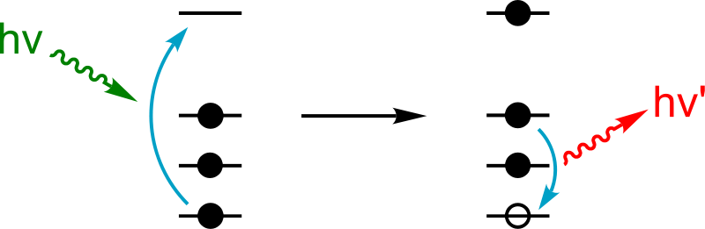
Possible applications
Low energy applications up to 12kEv
E.g.
X-ray autoradiography
Fluorescence X-ray spectroscopy

Slide 5
PREVIOUS WORK

Slide 6
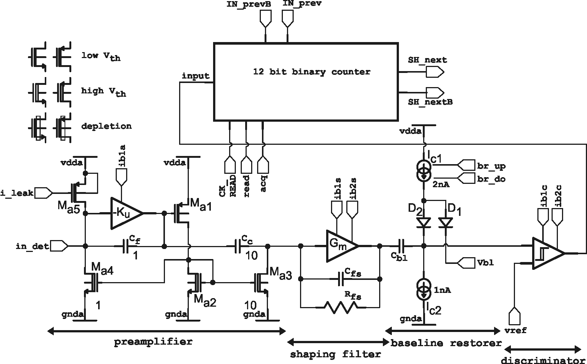
MAMBO2
Design details of pixel imaging detector „MAMBO”
MAMBO = Monolithic Active Pixel Matrix with Binary Counters
MAMBO II architecture
each pixel:
integrating CSA w/ p-z network, shaping filter CR-RC² with τ_{p}=200ns; gain=~200 μV/e⁻ for small Q, multiple diodes/pixel, ripple counter reconfigurable into shift register
C_{h}
compact design excluding use of physical resistors
C_{c}=28 fF, C_{fs}=3.3 fF, R_{fs}=50 MΩ, G_{m}=5.8 μS, C_{h}=30 fF,

Slide 7
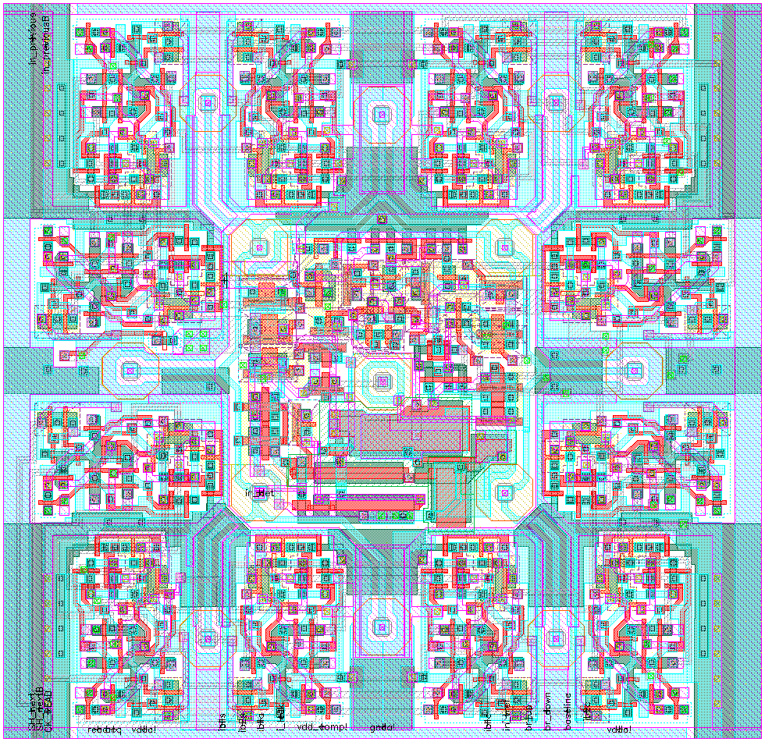
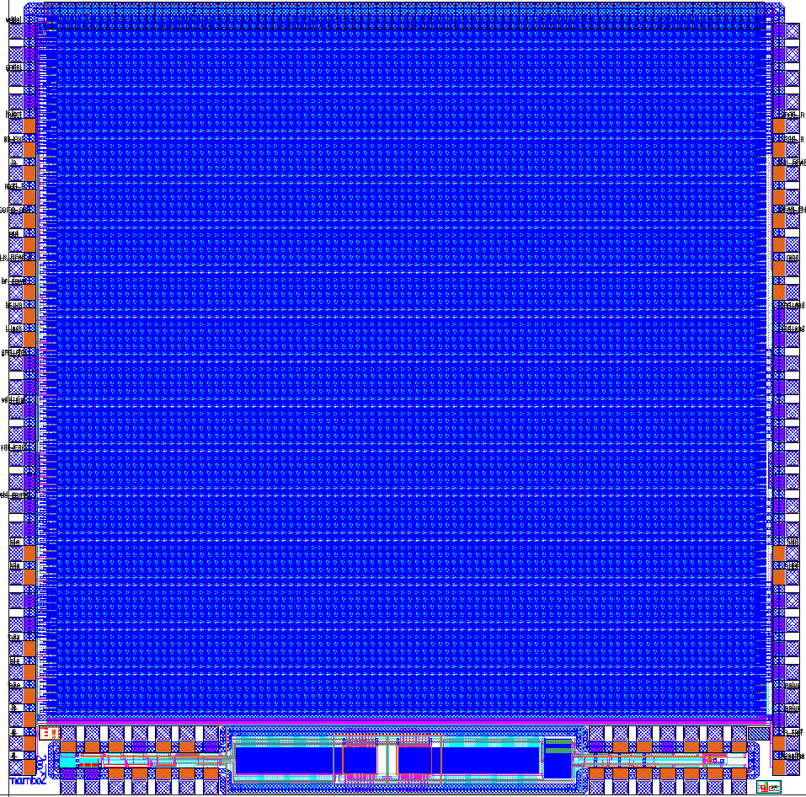
MAMBO2: PREVIOUS WORK….
Design details of pixel imaging detector „MAMBO”
MAMBO II pixel layout
MAMBO II chip layout
47 μm
single pixel
test structrue
47 μm
94×94
pixels
array
13 diodes
in parallel
connection
8×10 20×20 μm² 3T pixel matrices for x-talk and test charge collection tests
Multiple p-taps (used as signal electrodes) present per pixel for reduction of shifts of threshold voltages. Partial success: adjustment of bias voltages and currents (referred to V_{GS}) up to several tens of mV still required for V_{back} from the range from 0 to 10V.
Single pixel test structure is a fully functional ciruit allowing monitoring: shaper output, discriminator output, counter output

Slide 8
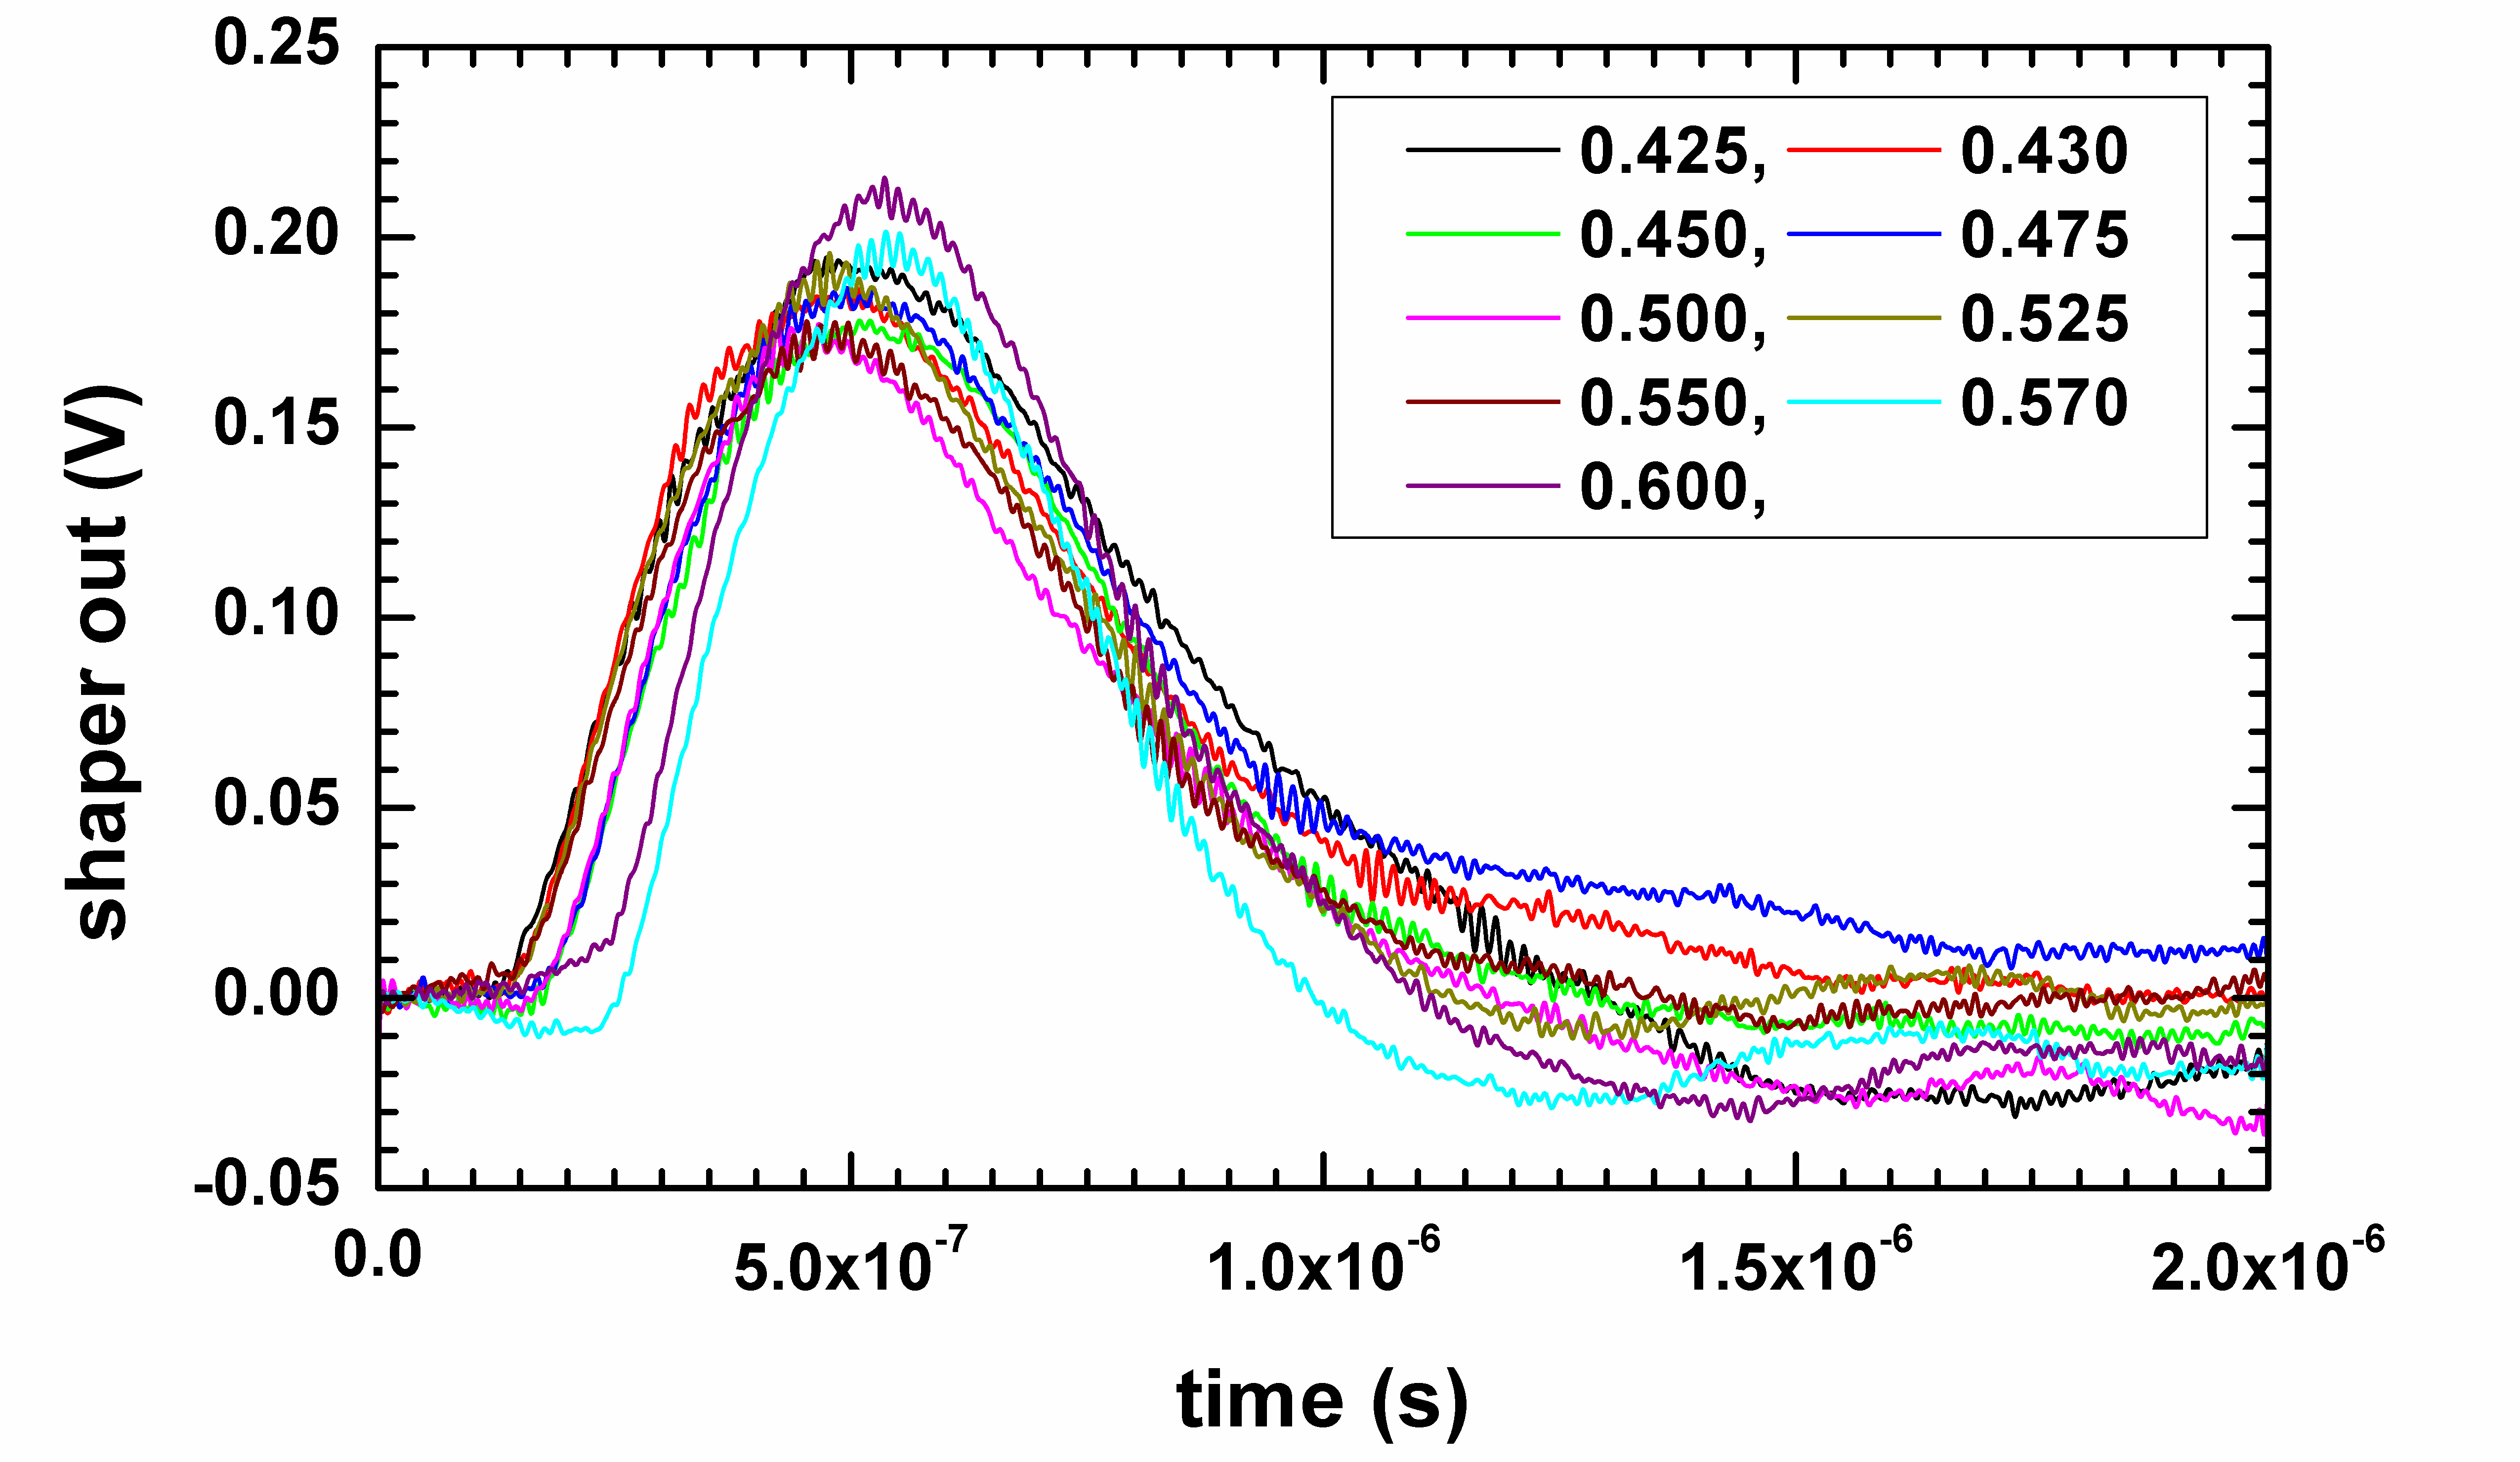
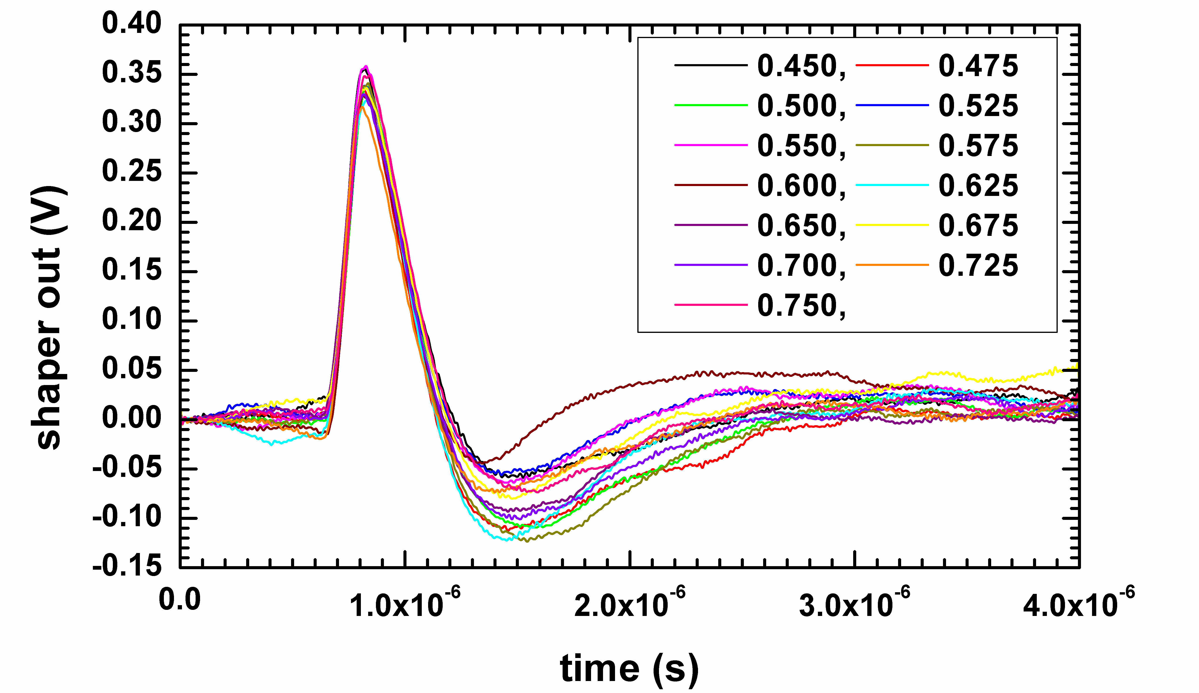
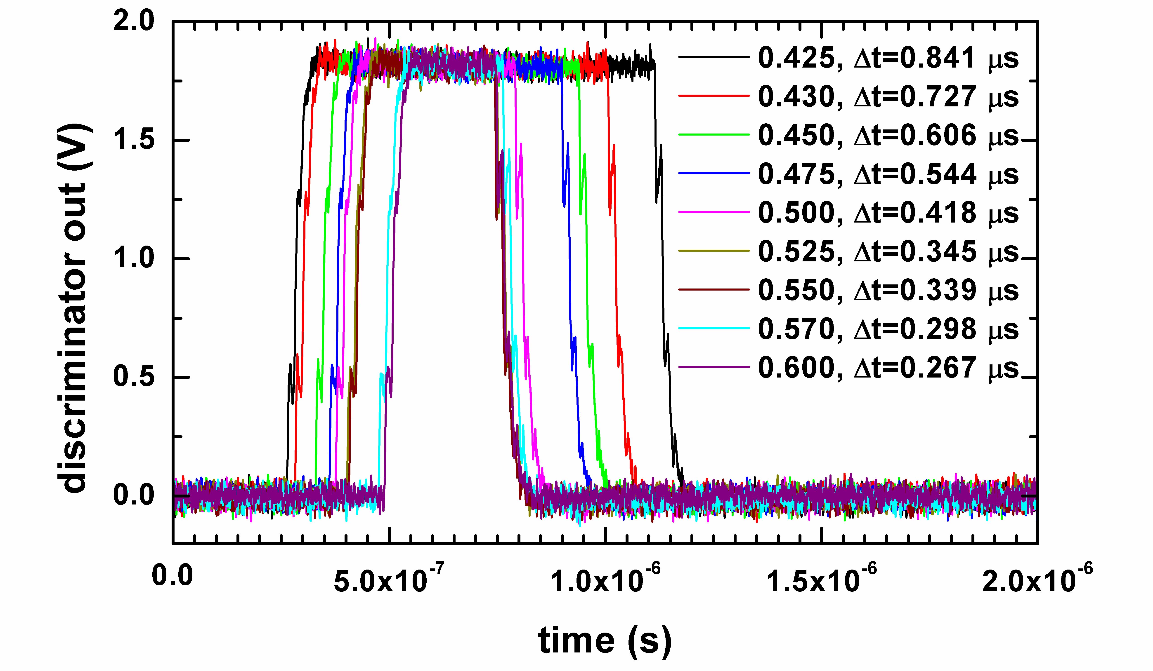
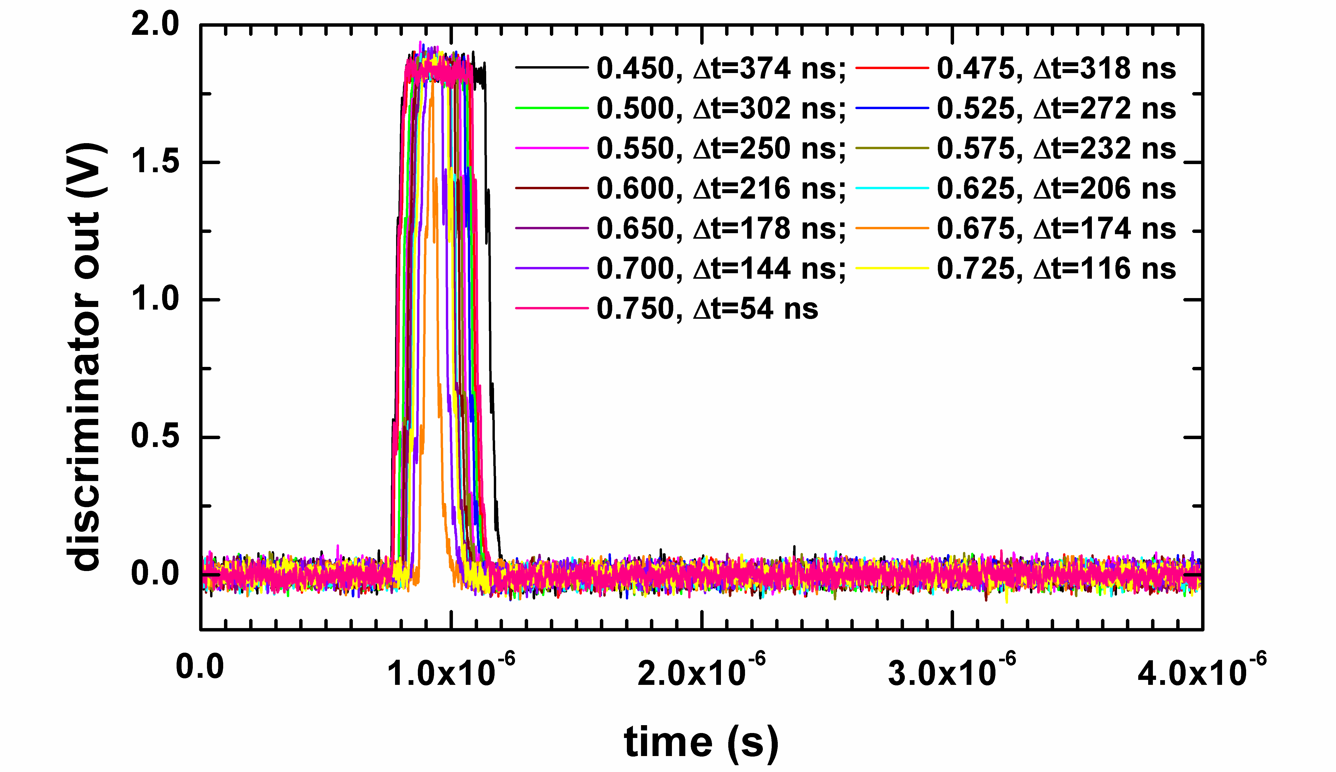
Achievements, observations and investigations
MAMBO II single pixel test
Monitoring of the shaper and discriminator outputs (transient signals )
⁵⁵Fe
¹⁰⁹Cd

Slide 9

Conclusions
credo: strength of the SOI monolithic active pixel technology is integration of whole processing circuitry directly into ‘the focal plane’
J
the OKI process offers enhancements: through BOX contacts and diode and ohmic implants in the substrate material for the first time in a commercial approach!
J
monolithic detector structures can operate depleted for the first time succesfully!
K
matrices using 3T-type pixels can succesfully be built (NMOS/PMOS switches may be used); – some progress but not too much beyond bulk MAPS.
L
mutual influence of CMOS circuitry and the detector is affecting designs of more advanced circuits for imaging.
L
FD-SOI represents challenges for precise analog circuits, one would prefer different flavor!
the properties of the substrate material and how it is depleted is far from being understood. The depletion may depend on transient and statically hold voltage states in the CMOS circuitry!
observed high sensitivity to irradiation; overnight exposure under 100 μCi ¹⁰⁹Cd under full operation causes ~100 mV voltage levels shifts.
the process must be enhanced.
The first priorities are to separate substrate and CMOS circuitry

Slide 10
MAMBO iii

Slide 11
Goals
R&D
Detector and electronics on different layers (to avoid coupling)
Diodes with PPLUS with BPW to reduce leakage
Diode of the same size as the pixel to obtain parallel electric field in active volume, and avoid potential pockets
Shielding on detector layer
Possibility of changing gated diode voltage to enhance performance of the diode
Explore 3D IC technology with T-Micro

Slide 12
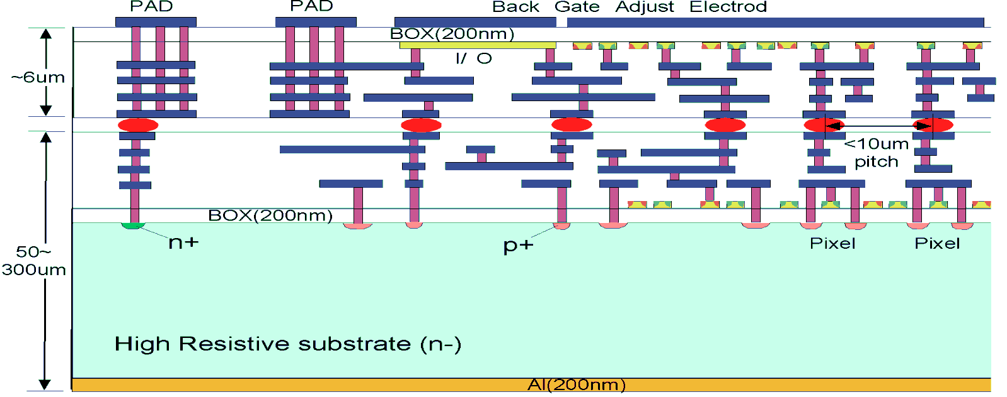
3D : MAMBO 3
MAMBO 3 top ASIC
Tier 1 contains only diodes and shielding metal
MAMBO 3 bottom ASIC

Slide 13
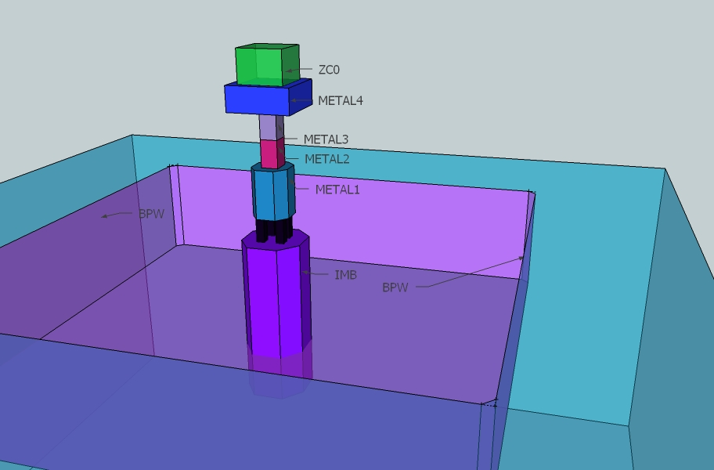
3D Model: Diode (Bottom Pixel)

Slide 14
Top ASIC: PIXEL Design

Slide 15
Preamplifier
Regulated Cascode
Leakage current compensation
1.7fF I/P test capacitance
Protection
diode
Feedback Capacitor
Coupling Capacitor
Cfs=5fF, Gm=6.5µS, Rfs=28MΩ, Ch=25fF,
Cc=35fF
Test Setup

Slide 16
Shaper and Baseline Restorer

Slide 17
Analog Test Buffer
Source Followers using Zero Vt DMOS transistors
Single Stage amplifier
Disconnected during normal mode of operation
10 µA current

Slide 18
Comparator
Trimming DAC current
outputs
Hysteresis Comparator
Connected to Vref during normal operation
OR
Connected to baseline for trimming
OR
Connected to gnd! when disabled

Slide 19
Window Comparator
VthL – Lower Threshold
VthH –Upper Threshold
VthL < Signals < VthH is recorded as HIT
Comparators are independently trimmed to cancel offsets

Slide 20
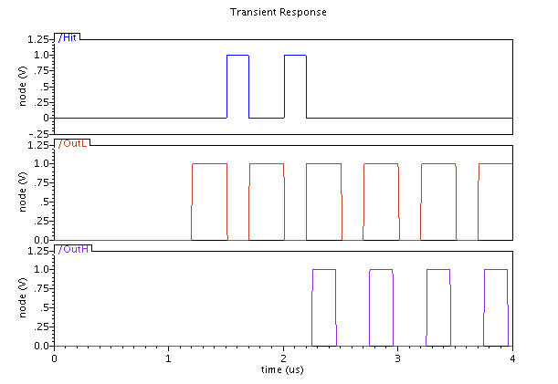
Double Discriminator Logic
Output of the Lower Threshold comparator behaves as a clock
Output of the Upper Threshold comparator behaves as a Reset
When both comparators fire the hit is not counted

Slide 21
Current Steering DAC (4 bits)
Cascode
current source
Binary weighted current mirrors
Switches are also binary weighted
Current can be steered either to positive or negative output

Slide 22
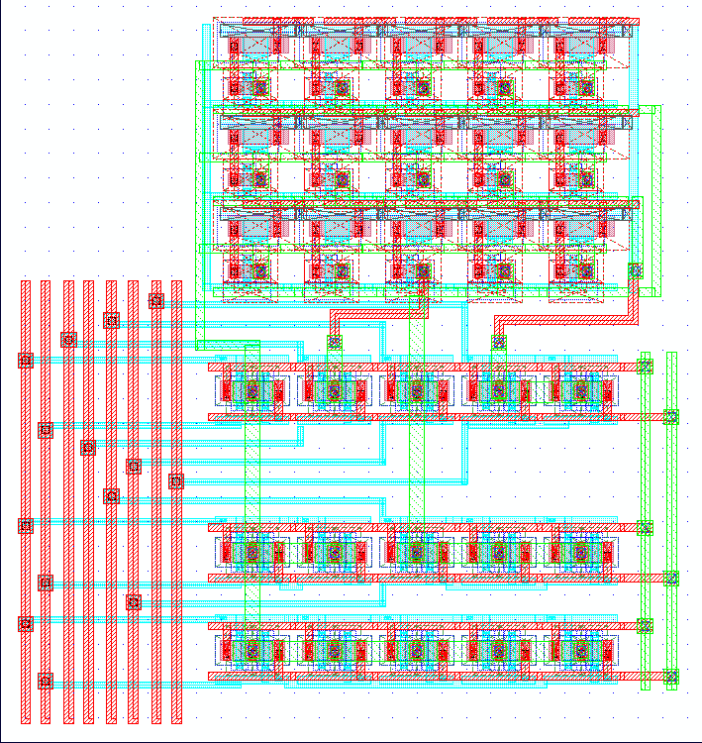
DAC Layout
4 | 3 | 4 | 3 | 4
4 | 2 | 1 | 2 | 4
4 | 3 | 4 | 3 | 4
Conventional symmetrical common centroid geometry for current mirrors
Helps to average out global errors
Matching is critical for monotonic performance

Slide 23
Trimming DACs
Matching is expected to be worse for SOI, Data here corresponds to a typical bulk CMOS process
Offset distribution before compensation
Offset distribution after digital compensation
Uniform distribution
Residual offset depends on DAC resolution
Gaussian distribution
Depends on component matching

Slide 24
Configuration Register
Serial In Parallel Load
(4b x 2) for DAC settings
3 bit test setup
Test Control block used as decoder to control switches for test
Q
Latch11
D
C
Q
FlipFlop11
D
C
 | Setup
000 | Normal Operation
001 | Analogue Output for test calibration
010 | Test Input, counter connected
011 | Calibrate DAC L
100 | Calibrate DAC H
101 | xx
110 | xx
111 | Pixel Disabled
Q
Latch2
D
C
Q
FlipFlop2
Q
D
C
Latch1
D
C
Q
FlipFlop1
D
C
Parallel Load
Serial Clk

Slide 25
1bit Counter
Can be configured as:
  Counter (s1 is ON)
  Shift Register (s2 is ON)
s1 and s2 are non-overlapping clocks

Slide 26
Counter /Shift Register
12 bit ripple counter
Count switch disconnects counter from comparator while shifting
CK_READ is external clock used for shifting data
Shift switch applied shifting clock
s1 and s2 are non-overlapping clocks

Slide 27
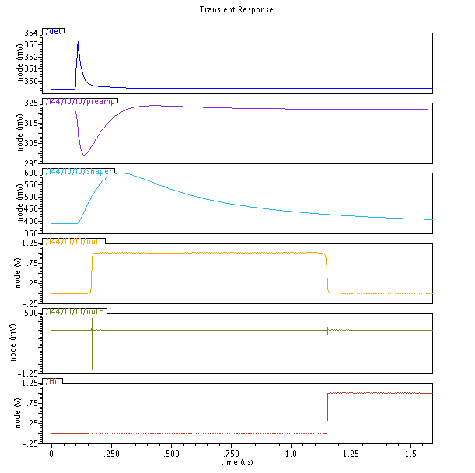
Simulation result
I/P charge of 2000e-
PREAMP INPUT
PREAMP OUTPUT
SHAPER OUTPUT
Comparator : Lower Threshold
Comparator : Upper Threshold
DDL Output

Slide 28
LAYOUT

Slide 29
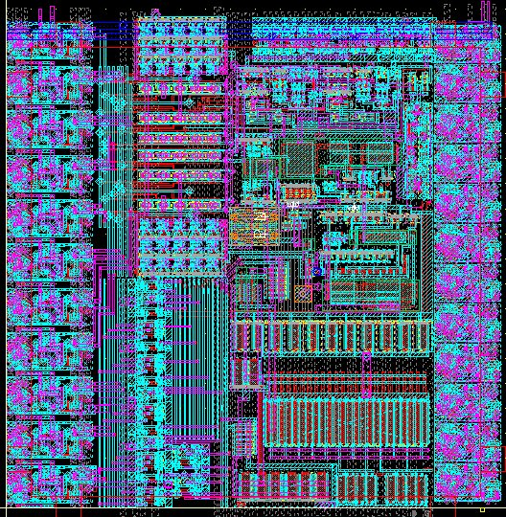
MAMBO3: top pixel
Configuration Register
DACs
Double Discriminator Logic
100µ x 100µm
Transistor count ~ 950
Analogue and Digital buffers only active during single pixel test
Counter / Shift Register
Comparators
Digital Buffer
Shaper
Preamplifier
Test
Control
Logic
Analogue Buffer

Slide 30
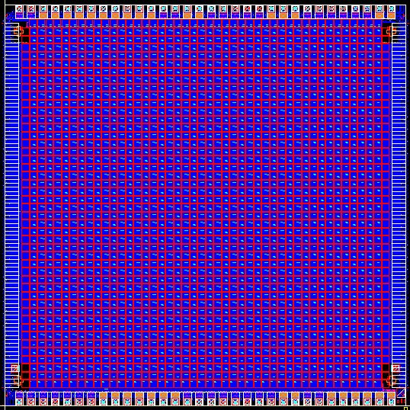
Upper Chip
5mm x 5mm
1936 pixel matrix (44 x44)
Each column has additional buffering of analog and digital signals
Pads with back metal opening
Alignment markers on all 4 corners

Slide 31
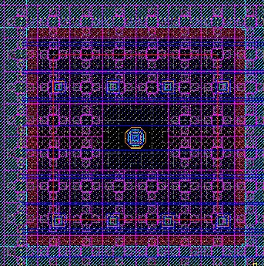
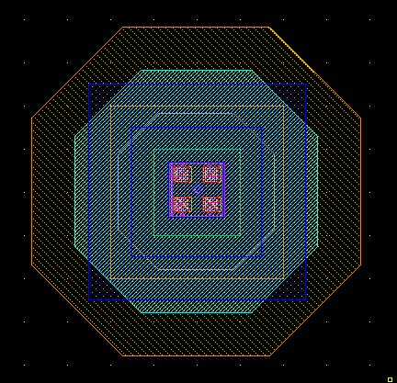
Lower chip: Diode Pixel
DIODE
100µ x 100µ

Slide 32
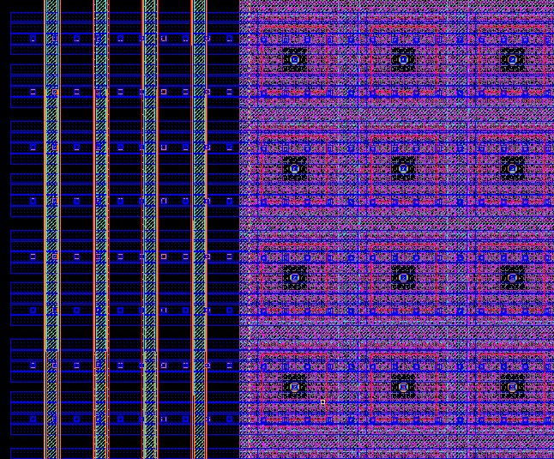
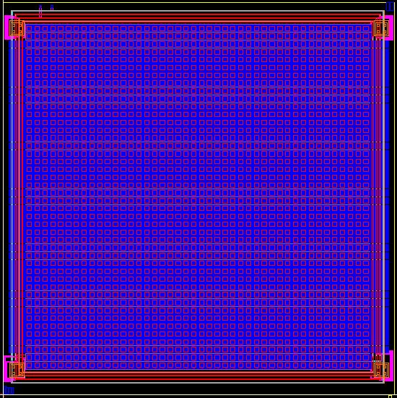
Lower Chip
5mm x 5mm
1936 pixel matrix (44 x44)
4 guard rings around the matrix
No bond Pads contains only micro bump pads, aligned with the top chip.
Alignment markers on all 4 corners

Slide 33
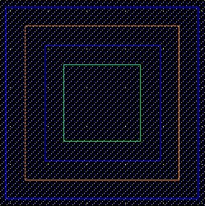
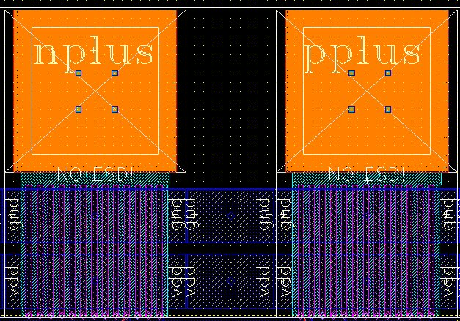
Chip connection
MICROBUMP (5µmx5µm)
-Diode connection per pixel
-Dummy connections
-guard rings
-diode shielding (gnd!)
-gate control

Slide 34

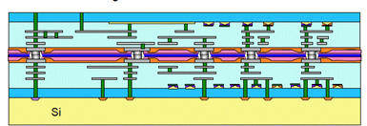
Protection
After handle wafer is removed the bodies of transistors and sensitive nodes are exposed to electrical coupling from external environment
Backplane connected to Analogue Ground per pixel
Peripheral digital logic connected to Digital ground plane
BMetal
Slot in BMetal
Shielding per pixel using back metal
exposed transistor

Slide 35
INTEGRATION

Slide 36
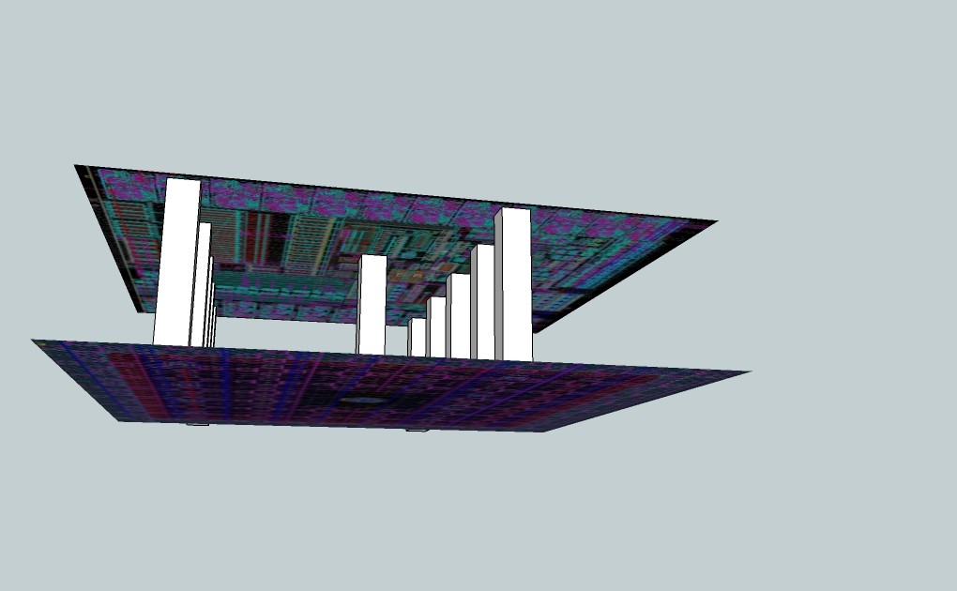
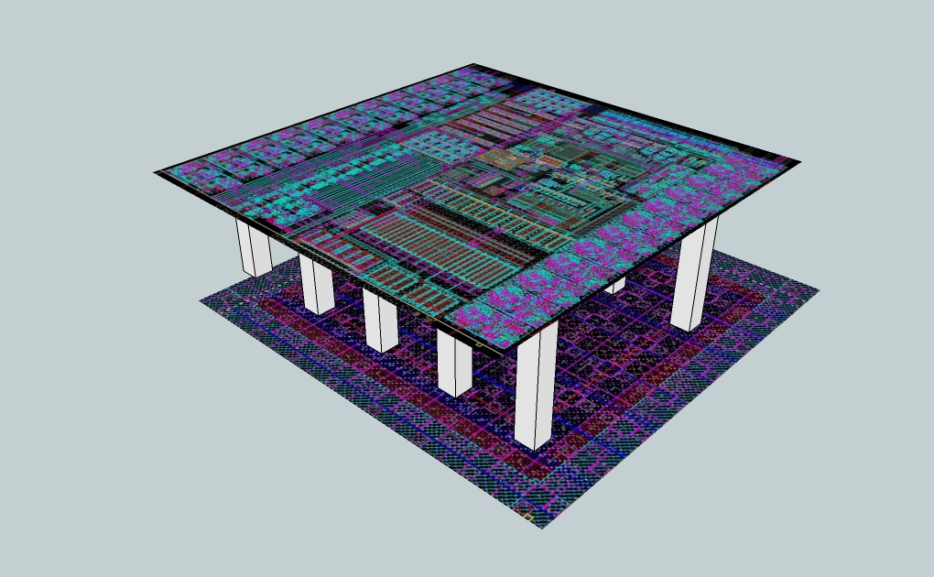
3D Model

Slide 37
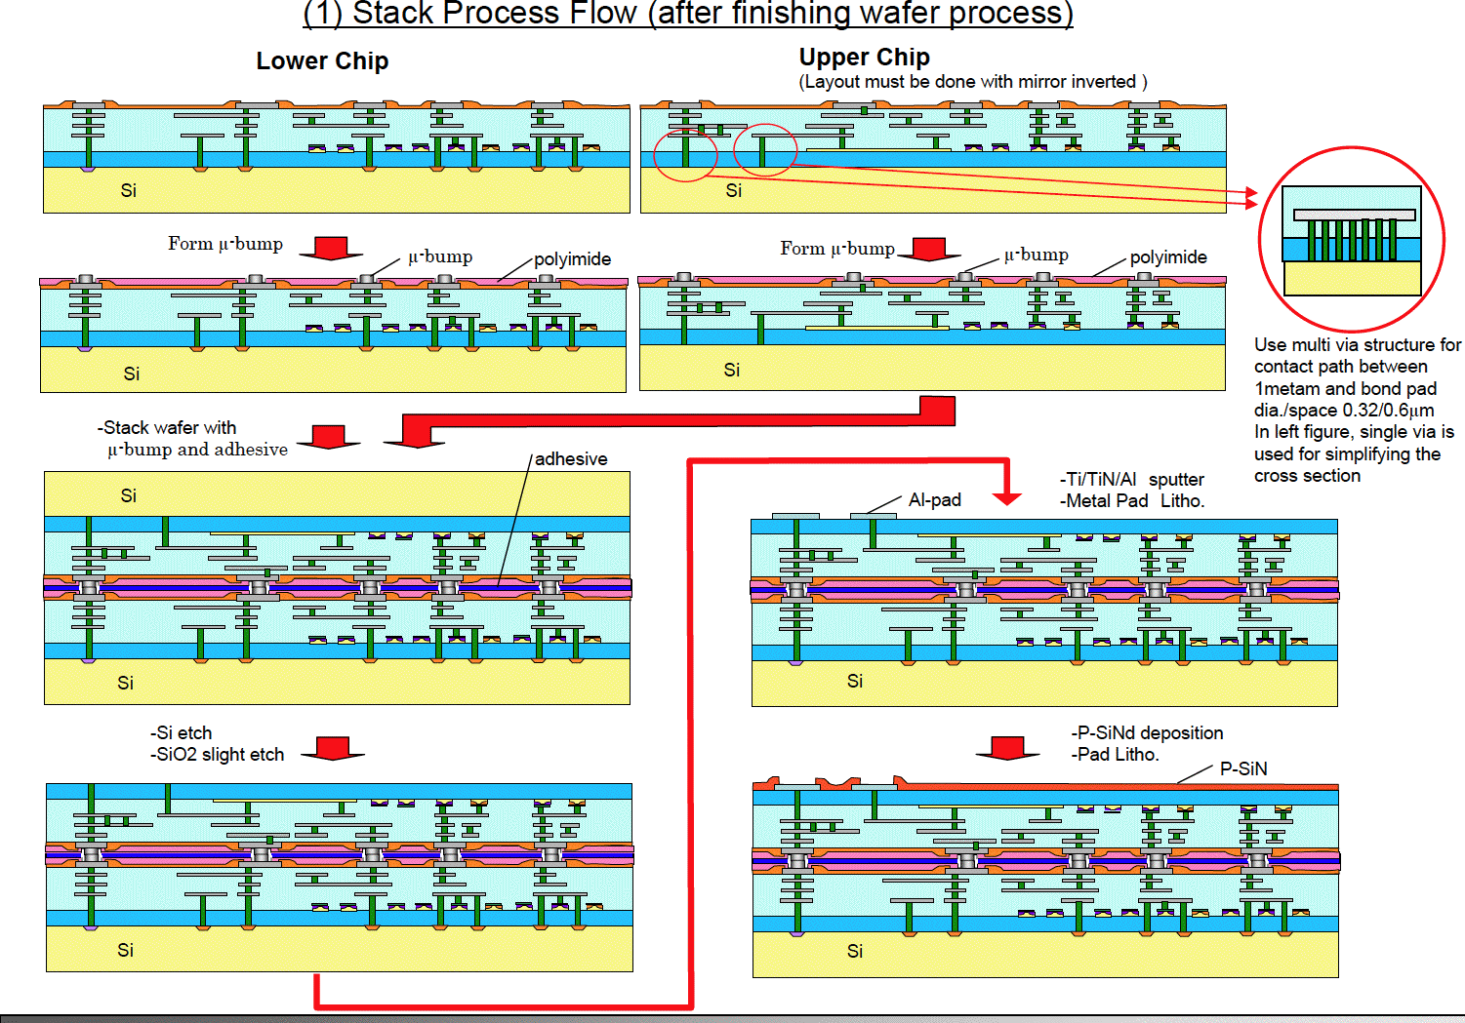
T-Micro 3D Integration process

Slide 38
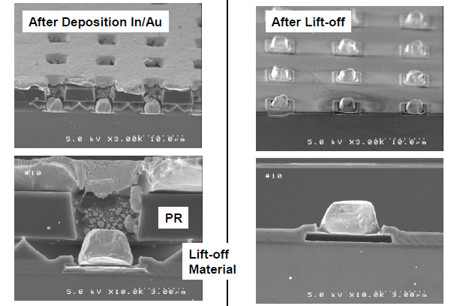
µ-bump process
© T-Micro, VIPS2010

Slide 39
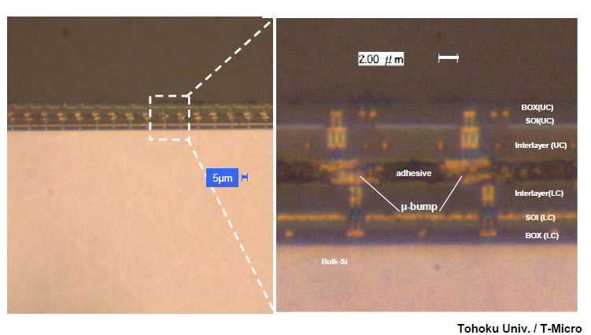
Cross sectional view

Slide 40
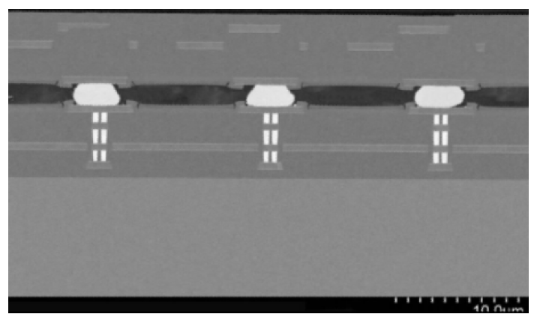
Cross sectional view:
Test chip with adhesive
© T-Micro , VIPS 2010

Slide 41
Mambo iv: FUTURE WORK

Slide 42
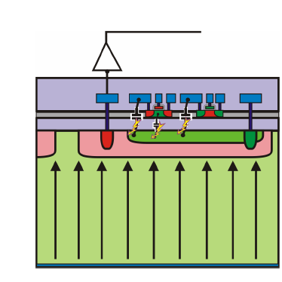
Back to 2D
Availability of nested well option
BNW layer inside a deeper BPW implant
Isolation of diode and electronics
Increased parasitic junction capacitance (currently undetermined)
BNW
BPW

Slide 43
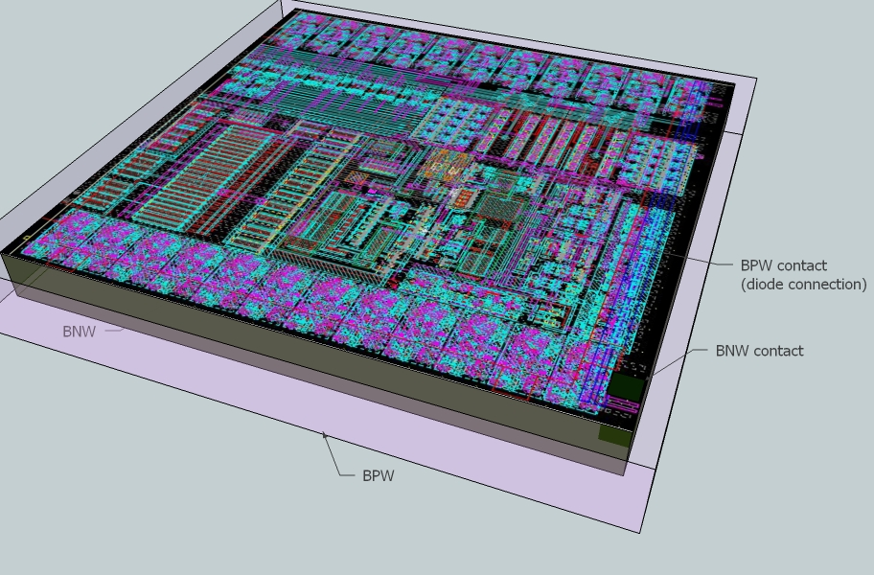
MAMBO IV

Slide 44
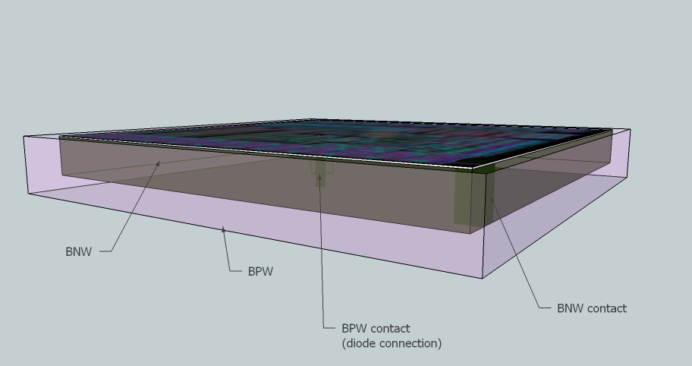
MAMBO IV

Slide 45
Thank you

