Slide 1
Industrialization of Silicon Detector Module Production
A. Honma, CERN
Outline
Module production: definitions, scope
Industrialization: What do we mean?
Possibilities for automation and outsourcing
Automation example: CMS module assembly robot
Outlook for SLHC and other large projects (ILC)
Comments on large scale module production
Conclusions

Slide 2
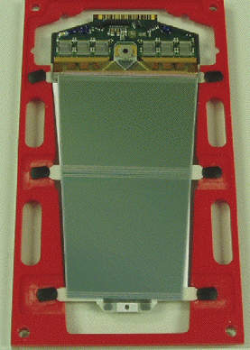
Module production: definition, scope (1)
Define “module”: The basic building unit of a detector that usually consists of one or more silicon sensors connected (daisy chained if multiple sensors) to a front-end readout PCB.
There are other levels of modularity in detectors (strings of these basic modules on a common support structure: a stave or ladder or half-cylinder, etc.) but I will not consider these.
Front-end hybrid
Pitch Adapter
or Fan-in
Sensor #1
ATLAS SCT
Endcap Module
Sensor #2

Slide 3
Module production: definition, scope (2)
Module production usually consists of the following steps:
Procurement, reception, inspection, testing of components
Assembly of components on module support structure (usually gluing) followed by metrology
Wire bonding of sensors, pitch adapters (if used) and front-end hybrid (FEH)
Testing (mechanical, electrical, electronic, environmental)
Main components include: silicon sensors, pitch adapter, FEH, mechanical support (frame or spine), cable.
In many cases these production steps also apply to complicated sub-assemblies (e.g. FEH can be: readout chips, SMD components, connectors, pitch adapter, PCB, thermal substrate).

Slide 4
Industrialization: What do we mean?
Will consider 3 kinds of industrialization of module production:
Manual (no industrialization), assumed in-house
Automation done in-house (partial or full)
Outsourced to industry (could be manual or automated)
Before LHC: production steps used mostly Manual with some in-house Automation and some Outsourcing.
LHC and other large scale detectors: Less Manual, more in-house Automation and much more Outsourcing.
In general, if one has unlimited resources and ample time, one would outsource component fabrication and all steps of module production. The main issue would be QA (to be discussed).
Real life resource and time limitations: in-house Automation.

Slide 5
Possibilities for Automation and Outsourcing
Aim of this talk is Automation and Outsourcing, so look at examples of this for current LHC and other large detectors.
Note: Pixel detectors are not being addressed here because they typically have a “small” number of modules (<100!).
Outsourcing is standard for many parts of module production:
Nearly all component fabrication (silicon sensor, pitch adapter, FEH components, mechanical support parts)
Some sub-assemblies (FEH, structural elements)
Wire bonding (rarely)
Some aspects of testing
There are numerous companies with competence in these areas. However, it is rare to find sufficiently competent and affordable companies for full module assembly.

Slide 6
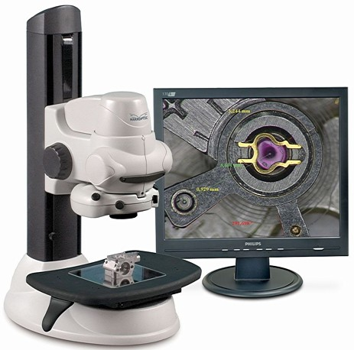
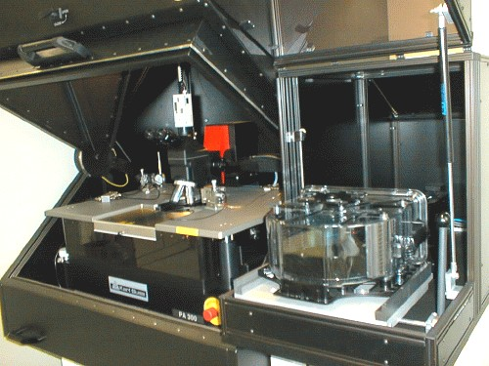
Possibilities for Automation and Outsourcing (2)
Examples of in-house automation possibilities:
For inspection of components: microscope video camera with pattern recognition for defect detection
For component testing: automatic probe station with wafer loader

Slide 7
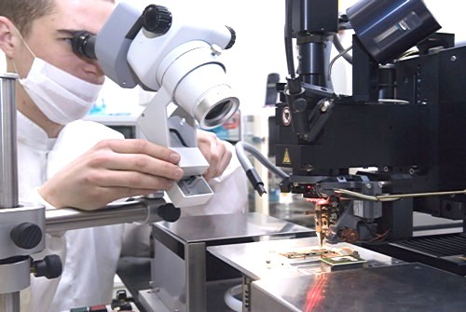
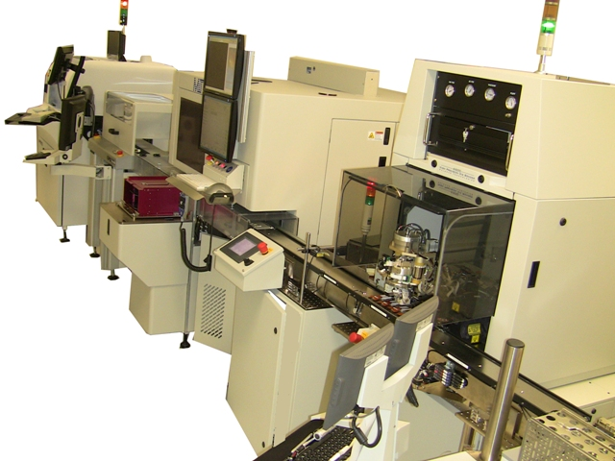
Possibilities for Automation and Outsourcing (3)
More examples of in-house automation possibilities:
For wire bonding: large area automatic wire bonding machine
For FEH assembly: why not a fully automated PCB assembly line with conveyor including a pick and place surface mount shooter and die bonder for accurate chip placement?

Slide 8
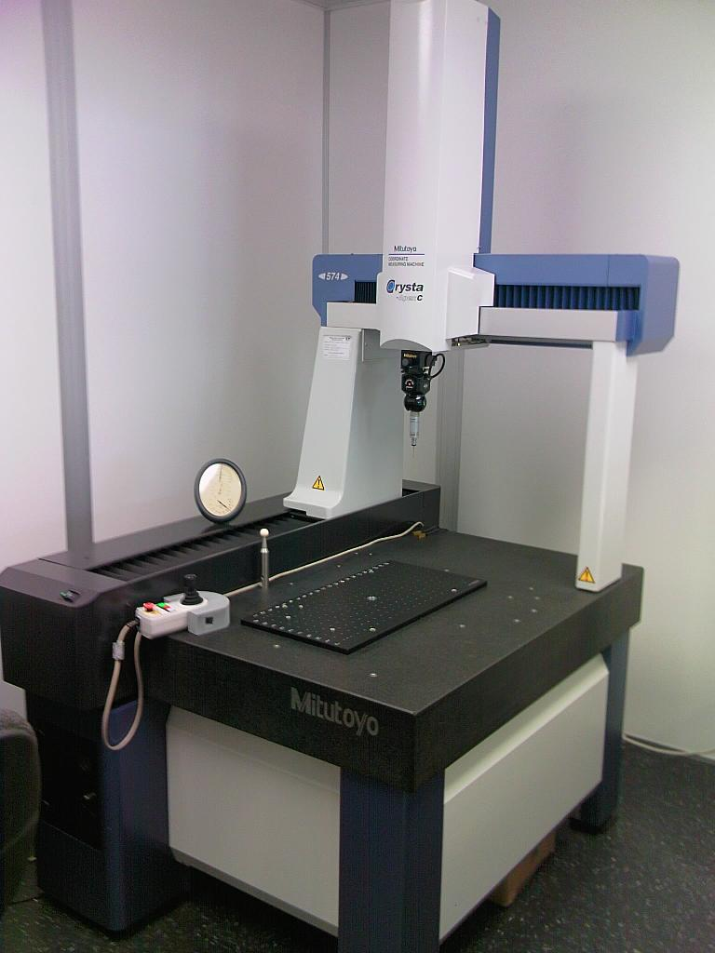
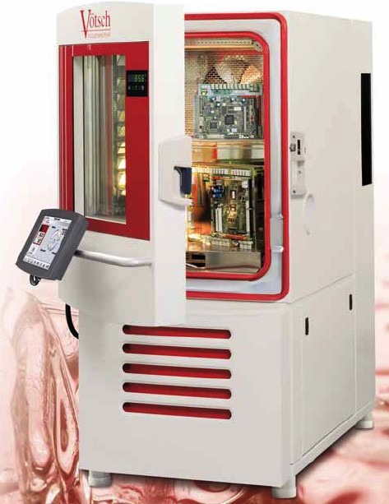
Possibilities for Automation and Outsourcing (4)
More in-house automation possibilities:
For post assembly metrology: Coordinate measurement machine (CMM) for high precision over large areas (modules and groups of modules on detector sub-structures)
For final reliability testing: Large volume rapid cycling climatic chamber for thermal and humidity resistance tests
Sadly, in-house automation usually involves a significant financial equipment investment, often will not be cost effective.

Slide 9
Automation example: CMS module assembly robot
I am here, largely because one of my main tasks in the CMS tracker was to achieve a (nearly) fully automated robotic module assembly. Why did we choose in-house automated assembly?
15148 modules needed (17000 with losses and spares)
Tight schedule (1 year for preparation, 2 years for production)
Budget not sufficient for outsourcing
Manpower not sufficient for manual assembly
We felt that we could build a robot with sufficient precision and functionality
An estimate of the time required to do a manual assembly given our budget and manpower gave a minimum of 3.5 years.

Slide 10
Automation example: CMS module assembly robot
Basic description of CMS tracker assembly robot:
Large work area (50cm x 50cm) gantry robot with magnetic air bearing X-Y movement and stepping motor Z-ϕ movement.
Gantry = overhead (crane-like) suspended working head. Chosen on purpose so table does not move (no vibrations or shocks).
Trays with pre-placed components are put on gantry table. Module components held in place with vacuum during assembly and curing.
Permanent rack of tools located at back of work area. Contains vacuum pick-up tools and syringes with glue.
Working head carries microscope camera and vacuum-based tool holder. Serves dual function of metrology and pick/place/dispense.
Software control of 4 axis motion, vacuum and air pressure valves. Pattern recognition used to find and measure positions of components and check final placement accuracy.

Slide 11
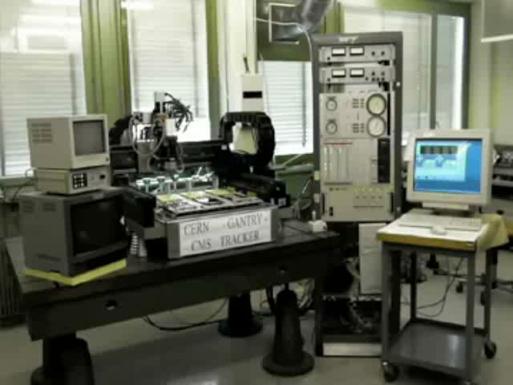
Automation example: CMS module assembly robot
movie

Slide 12
Automation example: CMS module assembly robot
Time scale for development to point of “proof of principle”: 1.5 years. Additional time to reach steady full production rate: 1-1.5 years.
The proof of principle was done at CERN, but the module assembly was done at 6 other collaborating institutes. The CERN robot was reconfigured to do all hybrid + pitch adapter assemblies (17000 using one robot).
Because of the large variety of module types (15) this implied many different component and module trays as well as different types of pick-up tools. Strong engineering and machining support groups at each assembly centre were essential for achieving reliable results.
Conception of the structural components and overall module design was based on knowledge that assembly would be done by robot. This meant keeping all parts flat and with correct thicknesses. It also meant trying to keep things as simple as possible (single-sided sensors, minimal numbers of individual components and types of material).
Once final tooling and procedures were in place for full production, the expected assembly rate (15-20 modules per day per robot) was reached. The failure rate (from assembly only) was very low (<1%).

Slide 13
Other Examples in LHC Experiments
I was not able to find any other examples of significantly large scale automation of module assembly in the other LHC experiments.
ALICE silicon strip, silicon drift, pixel: in-house manual assembly.
ATLAS silicon strip, pixel: small robot for strip sensor positioning, otherwise in-house manual assembly and outsourced assembly.
CMS preshower (silicon pad) and pixel: in-house manual assembly.
LHCb VELO, silicon strip: in-house manual assembly.
However…

Slide 14
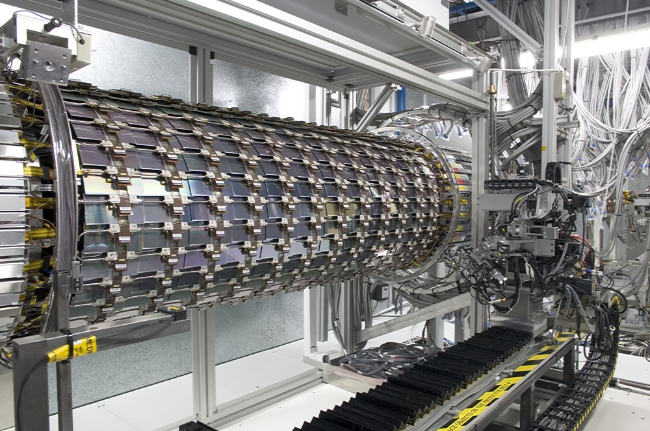
Other Examples in LHC Experiments
Not for module assembly but for assembly of modules onto the cylinder structure, ATLAS SCT used a sophisticated robot to achieve precision placement because clearances were extremely small.
Module handling mechanism
The robot did metrology, pick and place of modules and even inserted and tightened the screws!

Slide 15
Outlook for SLHC or other large projects
At what point does automation become of interest?
Calculation used for CMS tracker manual assembly:
Schedule: finish 3 years from “now”
Budget: 2MCHF for module assembly (for equipment and hired personnel, not for components)
Personnel: 10 in-house technicians for performing assembly
Number of modules: 17000
Estimated module assembly rate (manual): 3 per man-day. Note that for LEP detectors it was 1 per man-day at best!
Use 1.5MCHF for hiring more personnel (8 skilled technicians for 2.5 years), rest is for equipment and tooling.
Assume 1 year preparation, 2 years production (400 work days).
Answer: finish in 4 years but with no contingency, so 4.5-5 years.

Slide 16
Outlook for SLHC or other large projects
At what point does automation become of interest?
Calculation using automation:
Need 1.5 years for preparation 1.5 for production. Need 1MCHF for equipment (6 robots), can hire 10 techs/operators for 2 years. What rate is needed?
Answer: 10 modules/day/robot (no contingency). We showed that a robot could produce 15-20 modules per day.
Manually, we could have produced at most 8000 modules based on our constraints. Smaller collaborations would have to scale down appropriately but I would say that below about 5000 modules, this highly automated approach is not necessary. However, like for the ATLAS robot, considerations of reproducible high quality and low losses point to automation.

Slide 17
Outlook for SLHC or other large projects
Prospects for SLHC?
Nearly all upgrades are being re-discussed given recent changes to LHC upgrade schedule. So scope of SLHC upgrades is fuzzy.
ALICE upgrade: In most aggressive case, could have both outer silicon detectors replaced, upgrade of 2000+ modules?
ATLAS upgrade: In most aggressive case (replace straw tubes), could have similar size to CMS, upgrade of 20000 modules?
CMS upgrade: Probably replacement of existing volume with modified geometry. Also upgrade of around 20000 modules?
LHCb upgrade: In most aggressive case, probably an upgrade of less than 1000 modules?
How about ILC? SiD (ver.2) silicon tracker has 10978 modules.
Space detectors? Not aware of any planned with much silicon.

Slide 18
Outlook for SLHC or other large projects
So, only ATLAS, CMS and SiD reach automation threshold.
ATLAS likely to do upgrade progressively over time and may have very different technologies for the different parts. If any one section of similar module design has >5000 modules, this would be a good candidate for automated module assembly.
CMS is more likely to do an upgrade at one time although there may be significantly different technologies for different parts. Is a strong candidate to use another automated system.
SiD is still in the very early R&D phase. If the barrel and endcap modules use similar technology and module design, this could be a strong candidate for automation.
Automated module assembly should not be ruled out for the other projects, especially if precision, reproducibility and high yield are important. They should do their own detailed analysis.

Slide 19
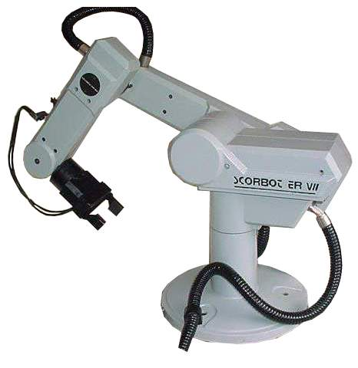
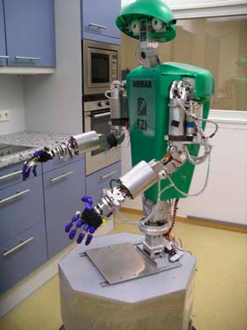
Outlook for SLHC or other large projects
Can we profit from the latest in robotic development?
Too many degrees of freedom?
Would you trust your module to this?

Slide 20

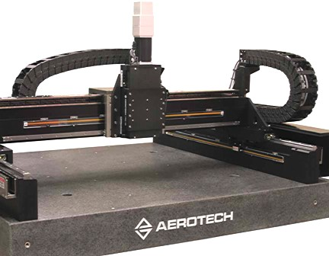
Outlook for SLHC or other large projects
Can we profit from the latest in robotic development?
Only if your lab needs cleaning
For a planar geometry, hard to beat the old reliable cartesian robot …
No novel robot technology found to revolutionize module assembly

Slide 21
Comments on large scale module production
The role of quality assurance (QA):
From the experience of large scale module production, whether it was manual, automated, or outsourced, there was a consensus that a very high level of QA was essential. Even small mistakes could result in large financial and time penalties.
Here are some QA related issues that seem most relevant:
QA needs to start at the design phase (design for reliability)
In electronics, the “standard” quality is consumer electronics, built to have a mean lifetime of about 3 years. Is this enough for you? What you will get from industry will usually be only as good as what you specified and only if you verify.
Large needs for outsourcing to industry imply rigorous Technical Specification Documents including QA plan and test procedures.

Slide 22
Comments on large scale module production
Similar TSD, QA plan and test procedures should be applied to in-house production (whether manual or automated) especially if assembly will be performed at multiple sites.
Further comments on automation:
Don’t underestimate the time needed to get from R&D “proof of principle” to full scale automated production. Robotic equipment can have a steep learning curve.
The threshold for automation is not as easy to “calculate” as I pretended. In-house technical competence, existing laboratory resources, the nature of the funding (in-kind, only for spending in MY country, etc.), virtual deadlines, the complexity of the module design (single-sided vs. double-sided), the required reliability level, ... all factor into the final calculation.

Slide 23
Comments on large scale module production
Final comments on diverse issues:
The move toward integration of readout-on-sensor or bump bonded to sensor will affect many issues of module production. Much R&D will be needed to find successful solutions.
Wire bonding will continue to have a role and module design should be kept optimized for efficient and reliable results.
To avoid bottlenecks in component inspection/testing and final module testing, in-house automation and outsourcing solutions should be fully investigated. Often this has design implications (fiducial marks, mechanical robustness, …).
From my experience, lack of realistic system tests lead to many delays in module production owing to the need for re-design.
One of the worst enemies for production organization were fake deadlines and unrealistic schedules.

Slide 24
Conclusions
All 3 types of “industrialization”: manual (no industrialization), in-house automation, and outsourcing to industry will remain significant for the silicon detector module productions to come.
In-house automation and outsourcing will be increasingly important for large scale module production, especially concerning components, sub-assemblies, interconnects and final module testing.
Robotic module assembly is cost effective when at least 5000 modules are required in a short time (<2 years). Precision, reproducibility, and yield may also argue for a robotic solution.
Meetings like this one, where experiences are discussed, help to increase communication between experiments and hopefully avoids repeating mistakes. Many thanks to our organizers!

