Slide 1
Electron Cooling in a medical Synchrotron
C. Carli Workshop on “Ions for Cancer Therapy”, 20th June 2018
What is Electron Cooling
Examples of Facilities with Electron Cooling used for Ion Therapy
Arguments for an Electron Cooler in a medical Synchrotron
Conclusion

Slide 2
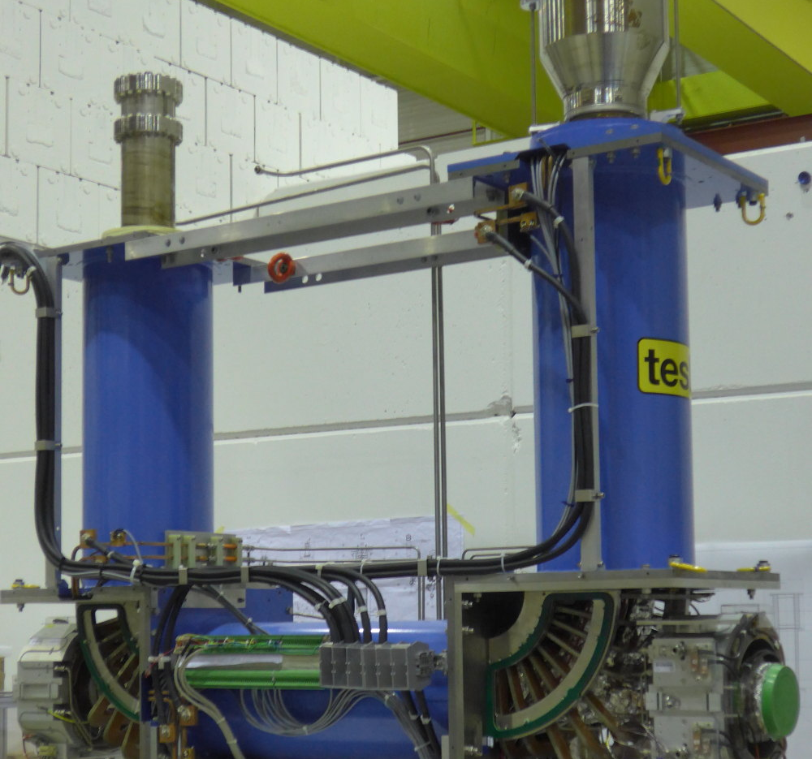
What is Electron Cooling
Electron gun
Electron collector
Drift solenoid
(where “cooling” takes place)
Magnetic system –
magnetic field guiding the
electrons from gun to collector
Almost completely mounted ELENA Cooler
Circulating beam mixed with electrons travelling with same (average) velocity
In co-moving Coordinate System:
No average velocity of beam, but individual particles have velocities
Unordered Motion associated with Temperature
Mixing of hot circulating Beam with cold Electrons inside “drift solenoid”
Temperature Transfer reduces unordered Motion and Size (Emittance)

Slide 3
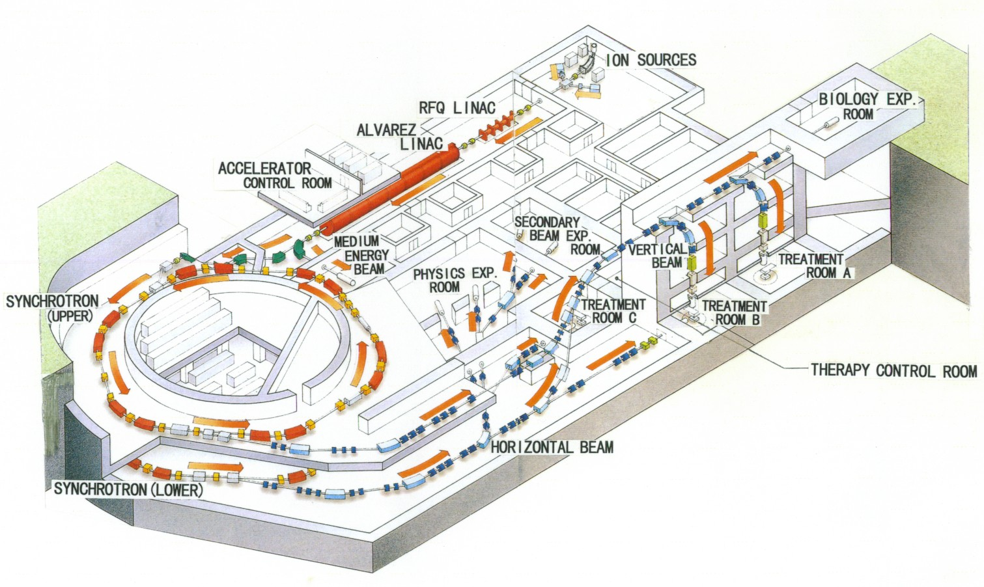
Examples of Facilities with Electron Cooling used for Ion Therapy
HIMAC
Pioneering installation for Light Ion Therapy
First medical synchrotron equipped with electron cooler
Many tests on electron cooling until about 10 years ago
  Discontinued due to other higher priority developments

Slide 4
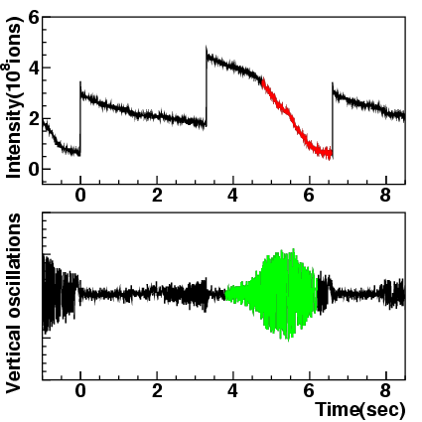
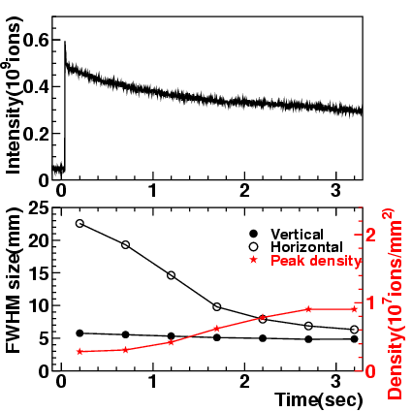
Examples of Facilities with Electron Cooling used for Ion Therapy
HIMAC
(2) Burst of v- oscill.
f_{β}
Beam loss due an instability generated
by the cooler (and coupling)
Extensive tests on electron cooling until about 10 years ago
  Motivation (main relevant here): accumulation of ¹¹C
  Cooling times about 1 s for Ar¹⁸⁺, several instabilities seen and cured
  Discontinued to give priority to other projects started in 2006

Slide 5
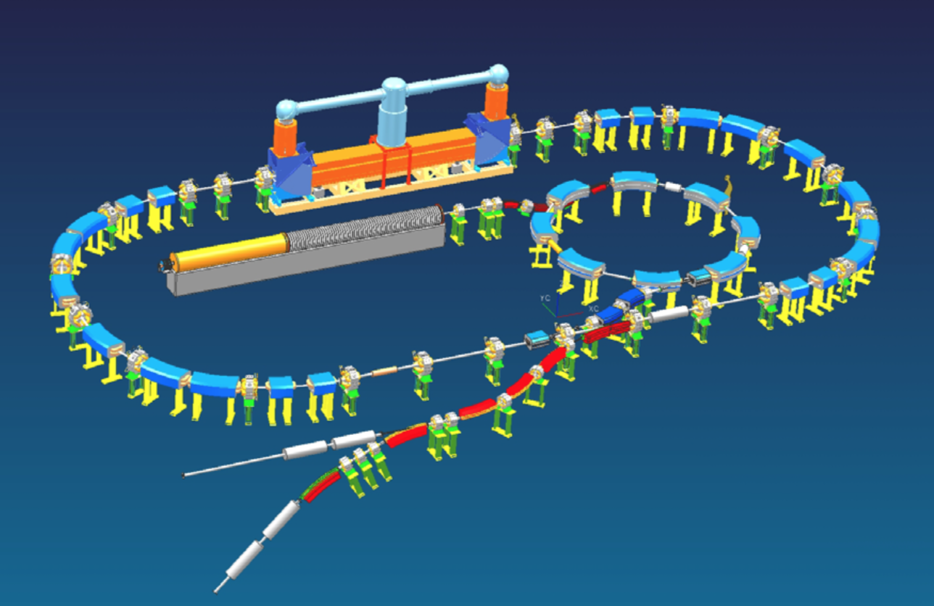
Examples of Facilities with Electron Cooling used for Ion Therapy
HITS Proposal/Study
Proposal/Study by BINP
Accumulation of several Shots from Injector and Cooling at low and high Energy

Slide 6
Arguments brought up in Favor of an Electron Cooler for Ion Therapy
Savings for Extraction Lines
  But significant additional Cost and Complexity for Ring
  Large Apertures for Scanning at end of Line needed anyhow
  Increase of Cycle Length may decrease Patient Throughput
Improved Beam Quality
  Significant contribution of Scattering to transverse Beam Size (cannot be improved with Cooling and smaller emittances)
Accumulation to relax Requirements for Injector (Source and Linac)
  In general not an Issue – Accumulation would increase Cycle Length
  Potential Interest with reduced repetition rate and higher intensity per cycle
Recombination (circulating Ion capturing an Electron) for Extraction
  Not simpler than “conventional” methods (e.g. RF knock-out) for extraction
  Needs modulation of Electron Current to adjust to required particle Flux and remaining Intensity
Accumulation of radio-active Ions (¹¹C) to treat and Treatment Verification of Interest

Slide 7
Summary and Conclusions
Electron Cooling proposed and even tested for ion Therapy
  To my knowledge never used in Practice for Ion Therapy
  None of the new Proposals presented at this Conference foresees an Electron Cooler
Advantages and additional Complexity and Cost to be evaluated carefully
  Can Cost of additional Equipment, longer Synchrotron and larger Building compensated by Savings for Lines?
  Impact on Cycle Length, Duration of Treatment and Throughput of facility
  May-be accumulation of higher intensities to reduce number of Cycles of interest (superconducting synchrotron)
    => Coherent Instabilities and their Cures a possible Complication and
    Source of additional Cost
Accumulation of radio-active Ions (¹¹C) to treat and Treatment Verification of Interest
  Significant additional Complexity and Cost does not fit with simpler facilities advocated here
  Diagnostics for Treatment Verification

Slide 8
Acknowledgements
Thanks a lot to K. Noda, V. Parkhomchuk, U. Amaldi,
E. Benedetto and A. Garonne for information and explanations to prepare this talk!
Thanks for your attention

