Slide 1



The C400: the ARCHADE multi-ions cyclotron
Jacques BALOSSO
CFB at Caen and UGA at Grenoble

Slide 2


Outline
History of the C400 project
The ARCHADE project in Caen
The CYCLHAD SAS in Caen
The use of C400 in CYCLHAD
The production of C400 by Normandy Hadrontherapy SAS
Medical interest and constrains

Slide 3
History of the C400 project
After ASCLEPIOS (2005-2007) challenger of ETOILE …
ARCHADE was a pure scientific resource project (2008) with a unique industrial partner (IBA)
But… economically unsustainable
Introduction of the principle of a limited proton treatment production (2012) by a Proteus®One equipment
ARCHADE progresses as a scientific project with mixed clinical/scientific activities
A specific Co. and building are devoted : CYCLHAD SAS
The heart of the project is the development and the scientific use, mostly by external users, of the multi-ions superconducting cyclotron C400

Slide 4

The ARCHADE project in Caen
Normandy Region
Research Institutions
CHU Caen
ARCHADE
(Assoc loi 1901) 2008
Medical institution
CRLCC F. Baclesse

Slide 5
The ARCHADE project in Caen
Normandy Region
SAPHYN (SEM)
2009
Research Institutions
CHU Caen
UNICAEN
ENSICAEN
GANIL
CYCERON
CNRS
CEA
Etc.
ARCHADE
(Assoc loi 1901) 2008; 2010
CYCLHAD (SAS) 2010; 2017
Medical institution
CRLCC F. Baclesse
Stocke holders

Slide 6
The ARCHADE project in Caen
Normandy Region
SAPHYN (SEM)
2009
Research Institutions
CHU Caen
UNICAEN
ENSICAEN
GANIL
CYCERON
CNRS
CEA
Etc.
ARCHADE
(Assoc loi 1901) 2008; 2010
CYCLHAD (SAS) 2010; 2017; 2022
Medical institution
CRLCC F. Baclesse
Normandy Hadrontherapy (SAS)
2018; C400
Stocke holders

Slide 7
The ARCHADE project in Caen
Normandy Region
SAPHYN (SEM)
2009
Research Institutions
CHU Caen
UNICAEN
ENSICAEN
GANIL
CYCERON
CNRS
CEA
Etc.
ARCHADE
(Assoc loi 1901) 2008; 2010
Scientific project
External users
CYCLHAD (SAS) 2010; 2017; 2022
Medical institution
CRLCC F. Baclesse
Proton therapy
Normandy Hadrontherapy (SAS)
2018; C400
Stocke holders

Slide 8
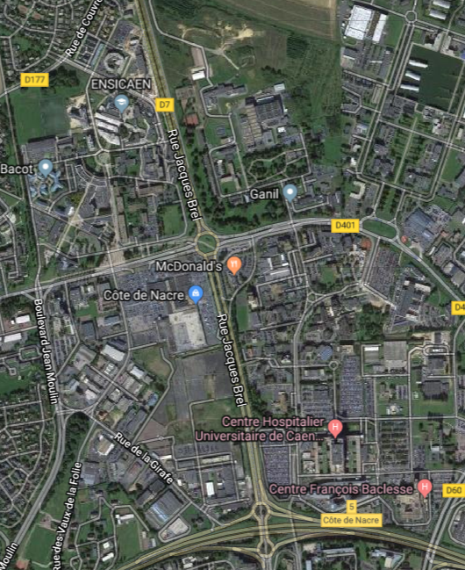


The ARCHADE project in Caen
ARCHADE partners are all located in the « North end » of Caen
CYCLHAD
GANIL
Guesthouse for external users
CIMAP-LARIA
CYCERON-ISTCT-CERVOxy
Medical School
ENSICAEN-LPCCaen-GREYC
Scientific Univ.
Univ. Hospital
ABTE-TOXEmac
Centre Fr Baclesse
1300m

Slide 9
The ARCHADE project in Caen
External users welcoming
Beamline renovation
GANIL as > 30 years of experience on welcoming experiments
ARIBE
2020
IRRSUD
2015
LARIA
2012
IRAP
SHIM-ICACS
LIMBE
SHIM
ISIAC
2000
IISC
REI
SME
1997
HCI
1st beam
LISE
1995
SHIM
JECR
1989
1983
SHIM
Notes:
We have more than 30 years of experience on welcoming experiments at GANIL. The first beam was delivered in 1983 on LISE. Then the CIRIL took in charge the Medium Energy Line development, the Low energy facility and the Radiobiology lab. Later, we had access to another beamline call IRRSUD mainly dedicated for material sciences. Many conferences organized by the CIMAP lab allowed to reinforce the communities using ion beams. ARIBE facility was an upgrade of the low energy beam. Since 2015, we are in the renovation of our beamlines and on-line equipements in order to make them more performants

Slide 10
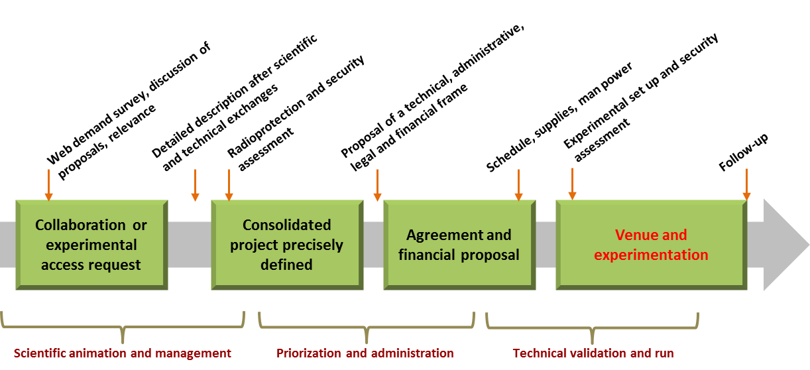
Practical organization
The ARCHADE project in Caen
Organization with a Proposal advisory committee
Notes:
In any case this demand will follow a formal path to warrant the adaptation of the demand to the technical possibilities and availability of the facilities and operators, the appropriateness to the ARCHADE project purpose at both the scientific and ethical point of view. Selection and ranking of the proposals will be done on a basis of scientific relevance and feasibility. For this, a scientific (ARCHADE’s PAC) and technical (ARCHADE’s TAC) committees will be set up and will work at a frequency adapted to a quick answer and planning of the experiments.
Once the proposal will be granted by ARCHADE’s PAC or CYCLHAD company (private or industrial users), a specific partition for users for beam time or laboratory access will be available online. Specific on line web tools will be available for these demands and for the internal work, the tracing of the process and the answer, then for the preparation, the cost estimation, the agreement and the organisation of the venue; the follow-up and the common publications. To help and define the offer, the ARCHADE web site will provide detailed description of the available scientific tools.

Slide 11
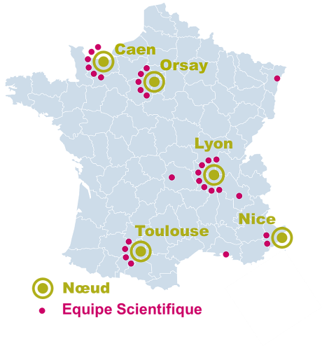
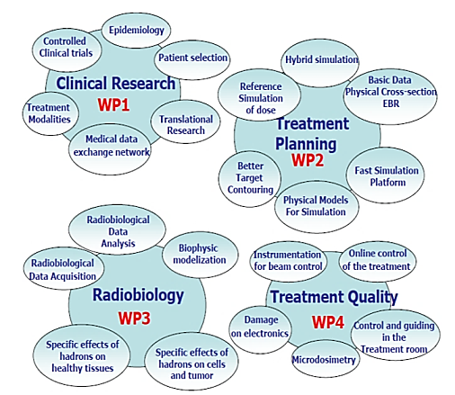

The ARCHADE project in Caen : position in France …
… coming soon: RADIOTRANSNET

Slide 12
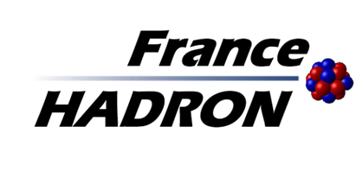

An exact correspondence of ARCHADE scientific program and FrHA project
WP1: Clinical research in hadrontherapy
WP2: Basic physicochemical data for hadrontherapy
WP3: Radiobiology data for hadrontherapy
WP4: Operational developments for improving the quality of treatments

Slide 13
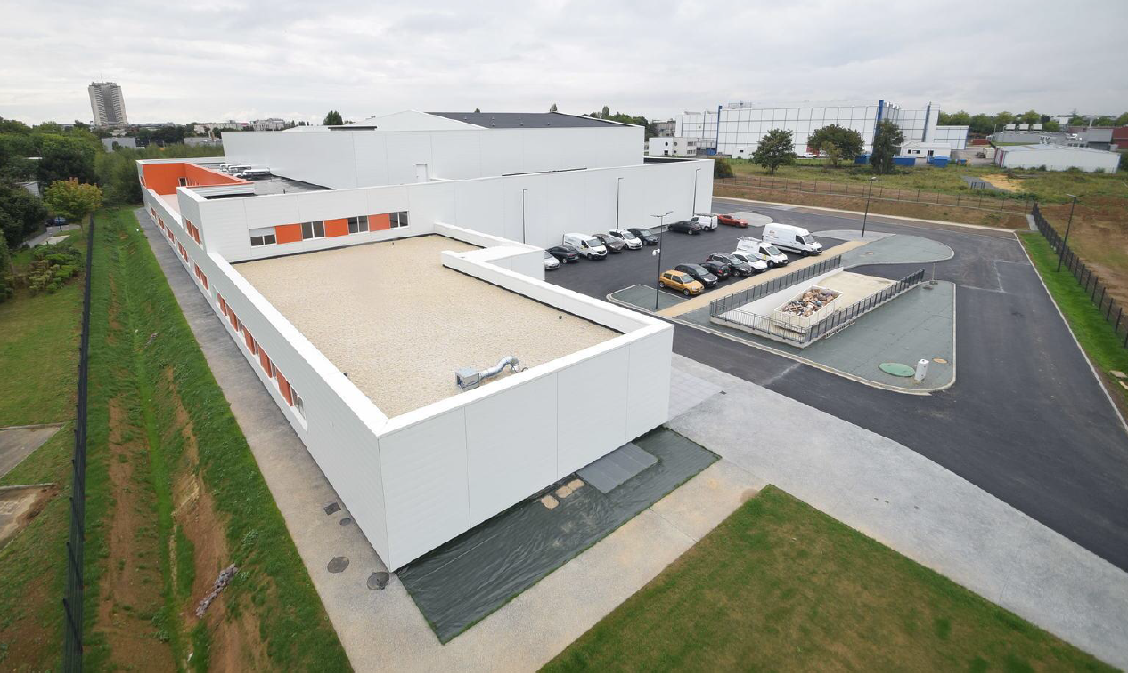
The CYCLHAD SAS in Caen building completed in 2017

Slide 14
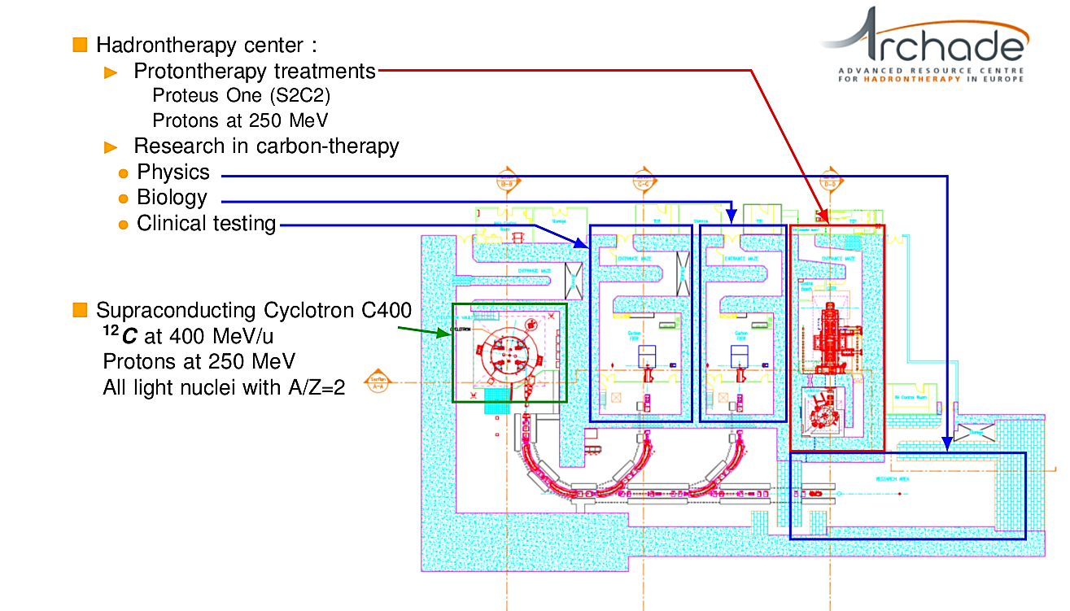
The CYCLHAD SAS in Caen the treatment and experimental rooms
1
2

Slide 15
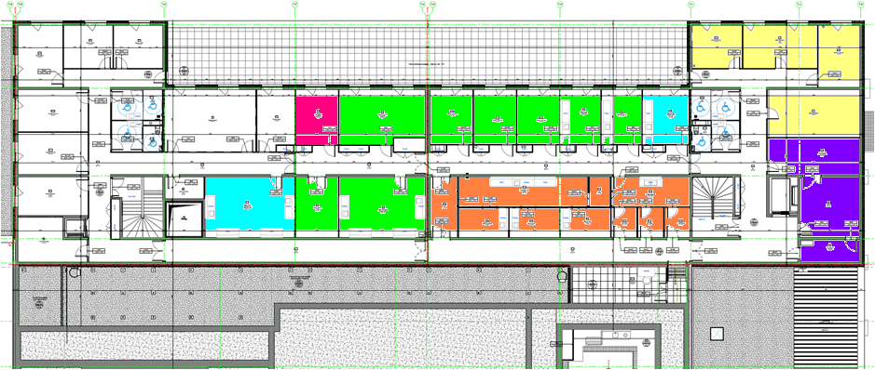
The CYCLHAD SAS in Caen the surfaces for laboratories
At the 2nd floor, 28 rooms devoted to science (researcher offices, laboratories, animal house, and logistic spaces) totalizing about 500 m ²

Slide 16
The CYCLHAD SAS in Caen the installation of the Proteus®One in September 2017

Slide 17
The CYCLHAD SAS in Caen the pillars to receive the C400 for its assembly starting in 2020

Slide 18
The CYCLHAD SAS in Caen the beam lines hall seen from the physics exp. room

Slide 19
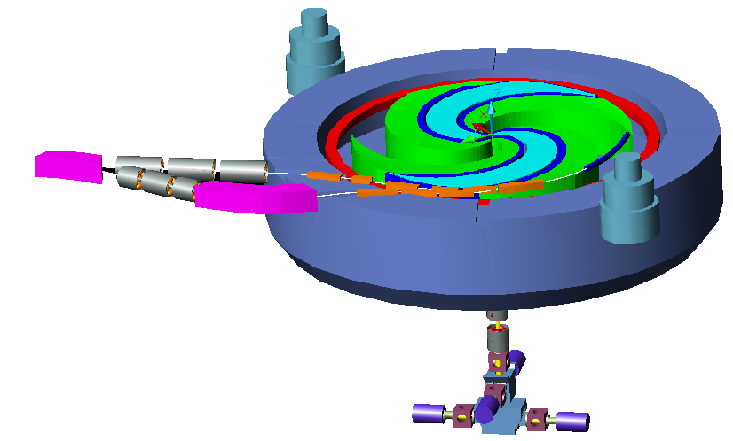
The production of C400 by NHa SAS
The C400 has been designed by Russian teams of Doubna between 2006-2009 for IBA under the direction of Yves Jongen
The PI is presently owned by the ARCHADE organization
It will by an isochrone super conducting cyclotron able to accelerate Protons, He, Li, B, C, N, O, Ne

Slide 20
The production of C400 by NHa SAS
The main parameters of the C400 cyclotron for carbon ions
Energy (fixe) 400 MeV/u
Courant extracted beam → Maximum 30 enA
Minimum 0,03 enA
Emittance of extracted beam
maximum (1 σ) → (horizontal) 6 π mm.mrad
(vertical) 8 π mm.mrad
External diameter of the magnet 628 cm
Total height of the magnet 340 cm
Total weight 694 tonnes

Slide 21
The production of C400 by NHa SAS
The main parameters of the C400 cyclotron helium ions
Energy (fixe) 400 MeV/u
Courant extracted beam → Maximum 300 enA
Minimum 0,3 enA
Emittance of extracted beam
maximum (1 σ) → (horizontal) 6 π mm.mrad
(vertical) 8 π mm.mrad
The main parameters of the C400 cyclotron for protons
Energy (fixe) 260 MeV/u
Courant extracted beam → Maximum 500 enA
Minimum 0,5 enA
Emittance of extracted beam
maximum (1 σ) → (horizontal) 8 π mm.mrad
(vertical) 9 π mm.mrad

Slide 22
The production of C400 by NHa SAS

Slide 23
The production of C400 by NHa SAS

Slide 25
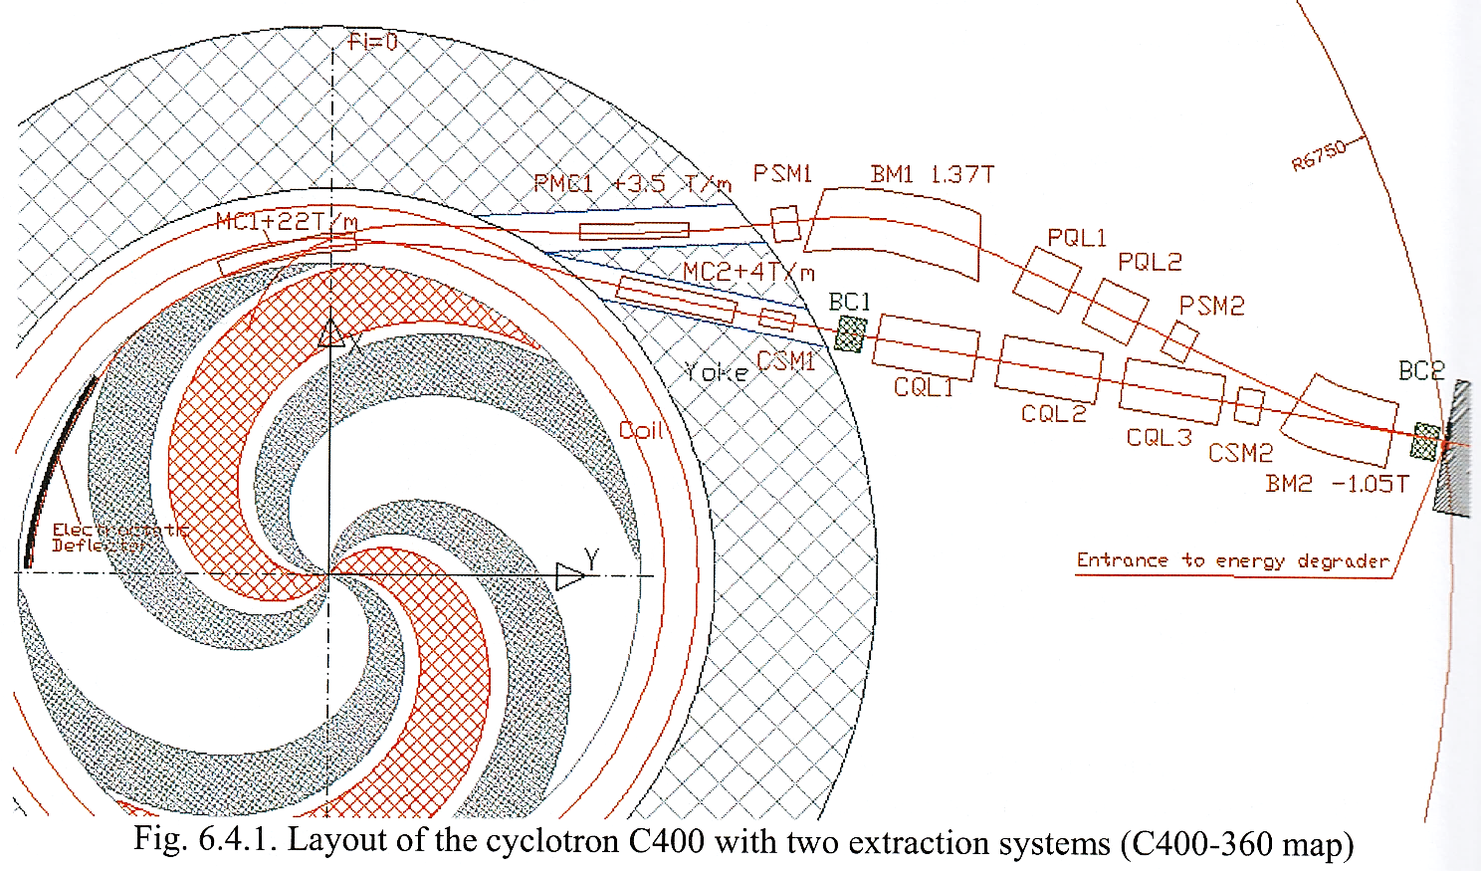

Slide 26
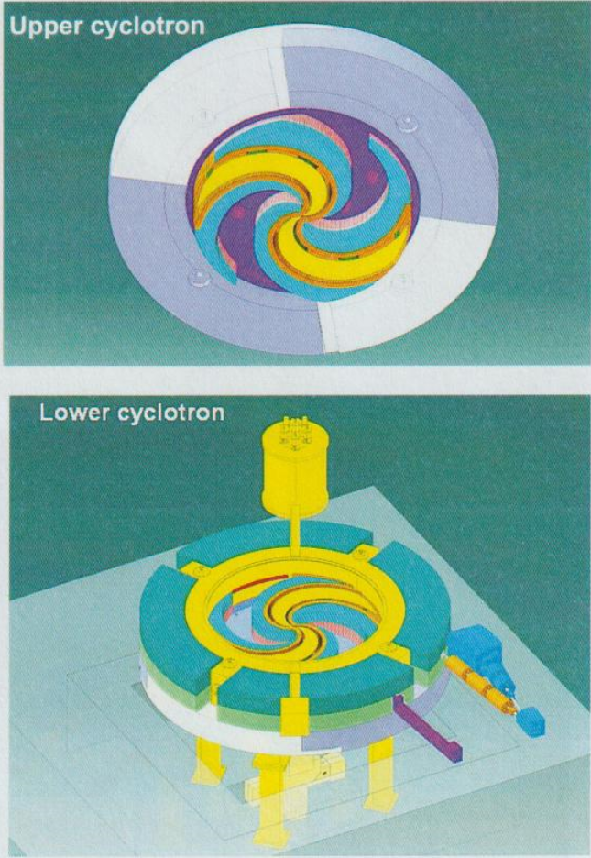

Slide 27
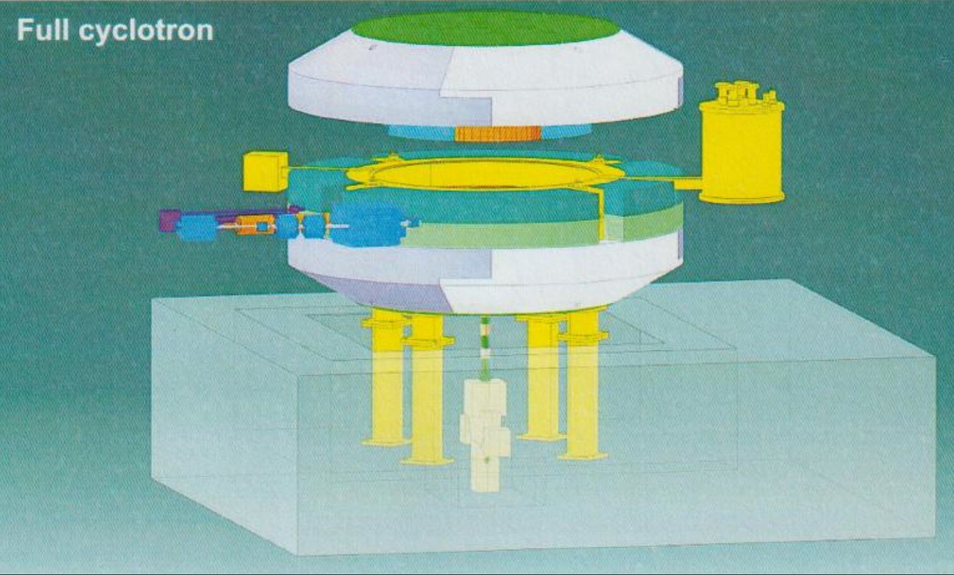

Slide 28
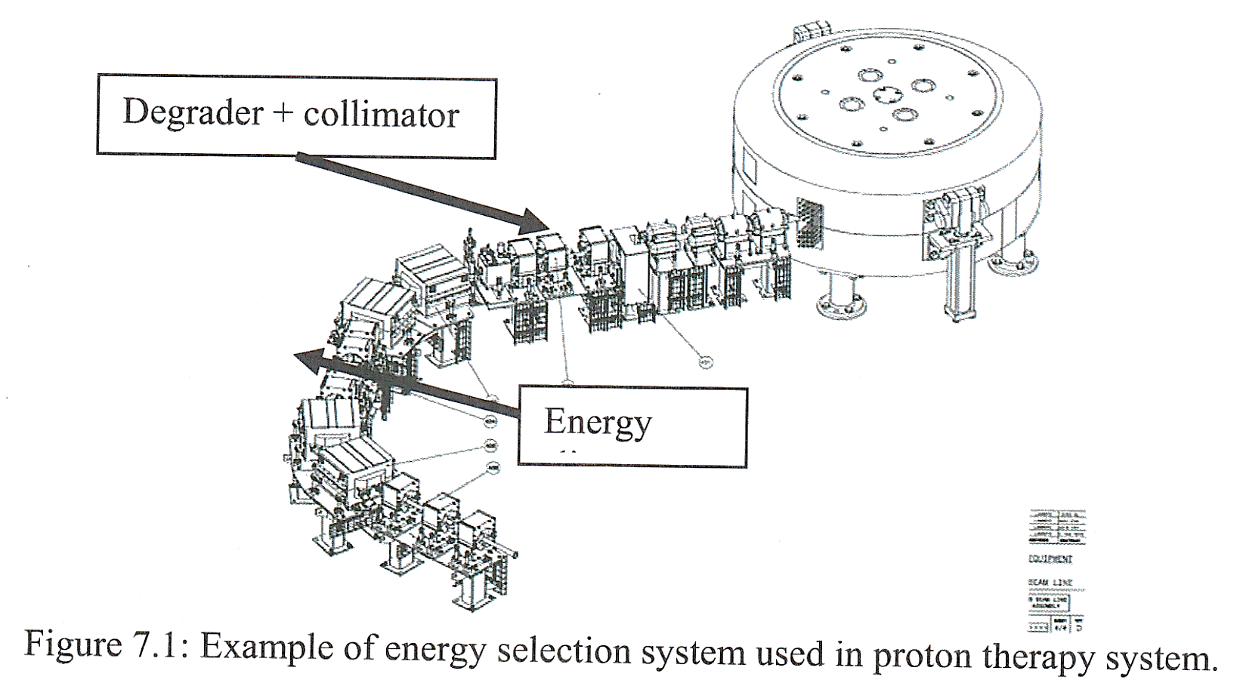

Slide 29
The production of C400 by NHa SAS
2010 the PI of C400 is sold to Normandie
2010 legal creation of Normandy Hadrontherapy (Nha)
2018 complete capitalization of Nha
2019 review of the specifications and design
2020 initiation of the construction on site in CYCLHAD
2022 starting the commissioning
2023 validation and beginning of use / test / upgrade

Slide 30
Medical interest and constrains
From the C400 we are awaiting:
  High dose rate for fast irradiation
  Limited cost of running
  Real multi-ions capacity in the same fraction…
  Hight level of up time
The use will be shared:
  50% for medical use
  50% for experimental use including machine tests and upgrades.

Slide 31
Medical interest and constrains
The business model of CYCLHAD could be:
50% of the C400 beam time will be devoted to radiation oncology (protons and ions) and sold to the Centre Fr Baclesse (as for the ProteusOne presently)
Up to 50% will be devoted, “free of charge” to non profit scientific users in the frame of ARCHADE scientific project and external users
  However the access to CYCLHAD installation will not be “no cost” for ARCHADE: so the ARCHADE costs will have to be compensated.
  We hope not to have to go beyond “marginal costs” but it will largely depend upon availability of running fundings…
  Thus ion beam access in CYCLHAD will NOT be no cost!

Slide 32
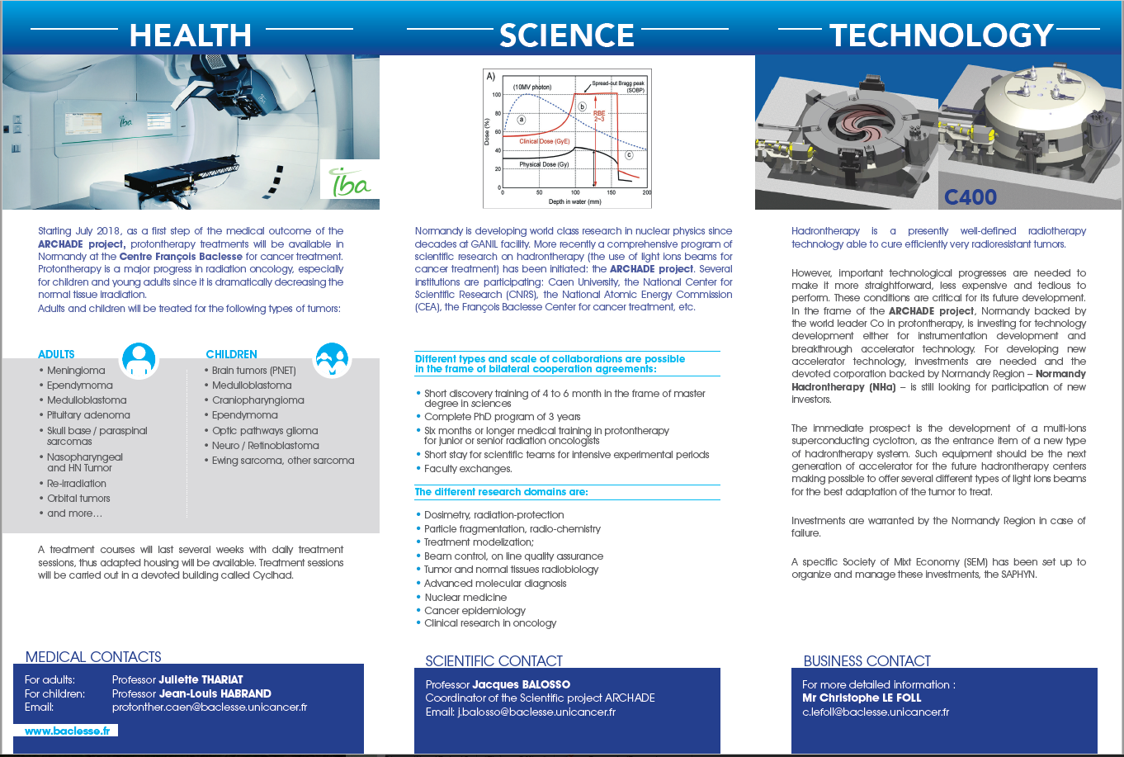
To conclude… ARCHADE project is three folds

Slide 33









Thank-you, questions ?

