Slide 2
Some activities at CNAO

Slide 3
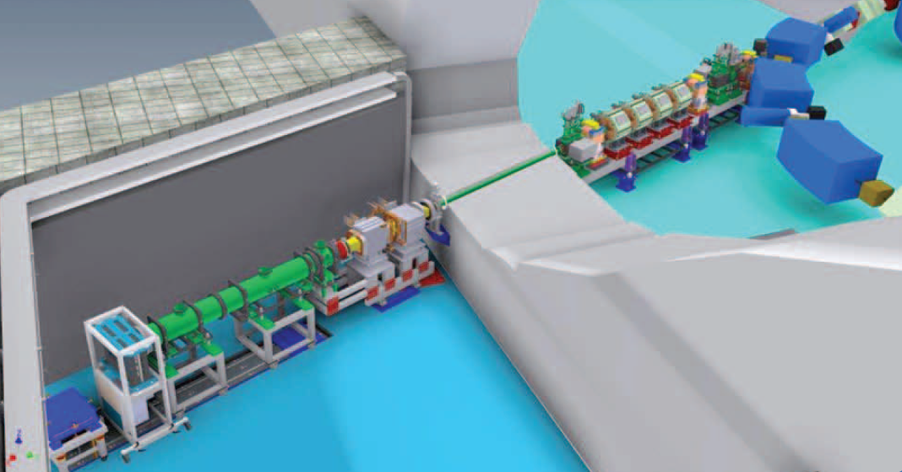
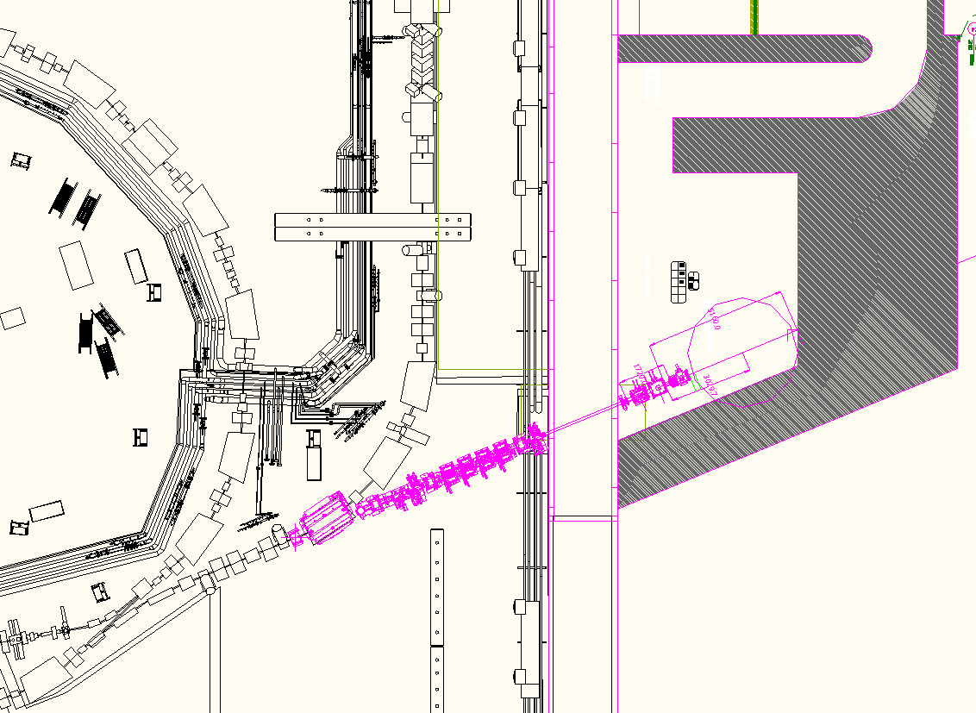
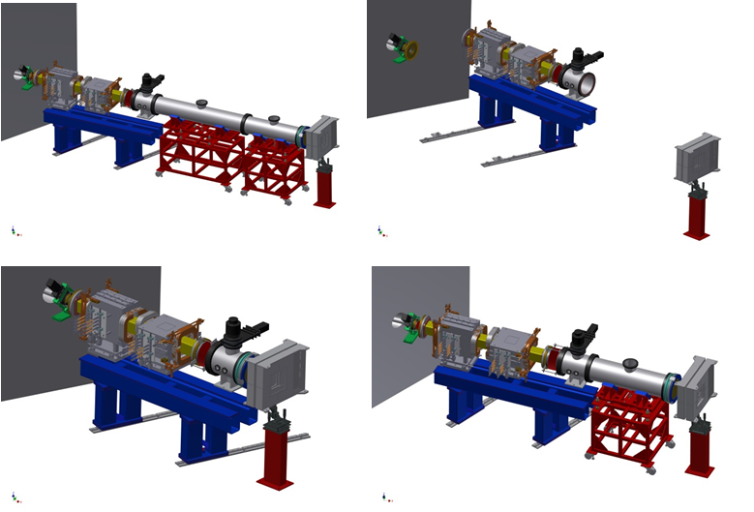

Experimental room

Slide 4
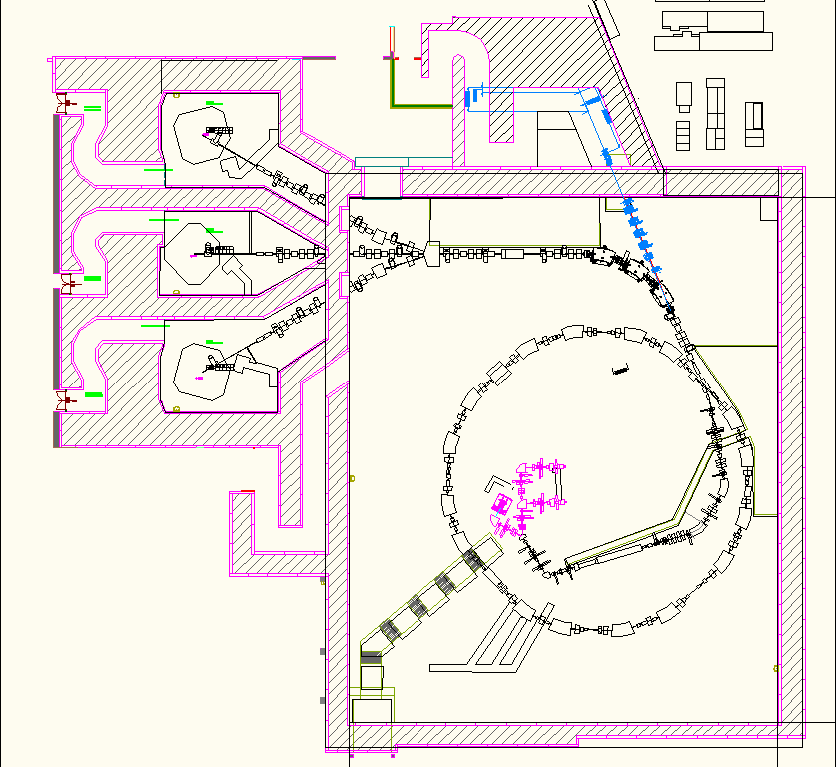
Experimental room – phase 2 – 3rd source
Additional ion species
Higher performances source
Ion | SUPERNANOGAN (14.5 GHz) | AISHa (18 GHz + TFH)
 | [μA] | [μA]
H⁺ | 2000 | 4000
H²⁺ | 1200 | 2000
H³⁺ | 800 | 1000
³He⁺ - ⁴He⁺ | 800 | 2000
¹²C⁴⁺ | 200 | 800
⁶Li²⁺ | // | 600
¹⁸O⁶⁺ | 250 | 1000
¹⁶O⁶⁺ | 400 | 1200
²¹Ne⁷⁺ -²⁰Ne⁷⁺ | 120 | 600

Slide 5
Treatment execution
1 s
Sync
Extraction magnets
Injection magnets
Extracted beam

Slide 6
Dipole PS control in field
Saved time
1 s
Sync
Extraction magnets
Injection magnets
Extracted beam

Slide 7
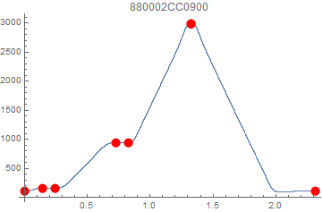
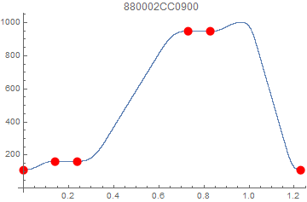
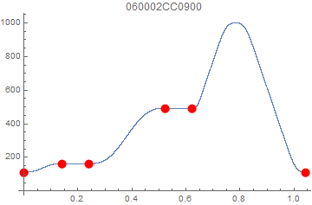
Other magnets short cycles
Ramp to lower Imax
Old cycle
New cycles

Slide 8
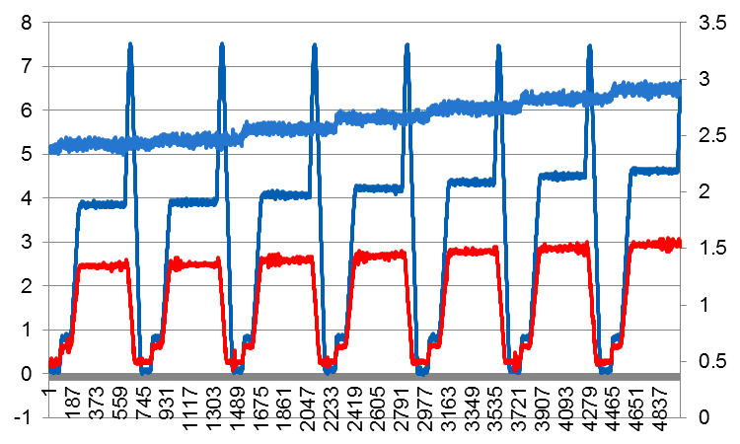
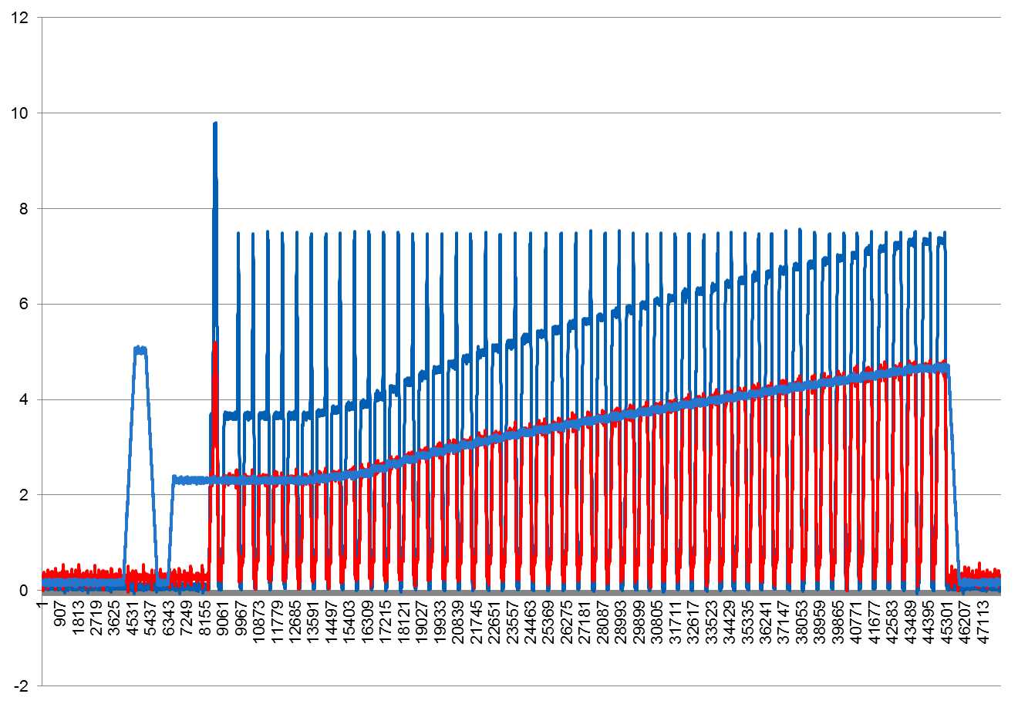

Slide 9
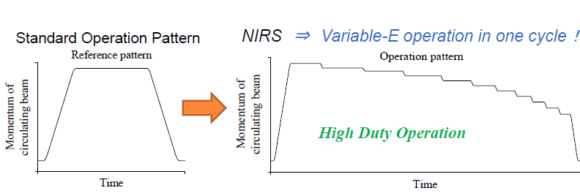
Treatment execution with Multi Energy Extraction
(Courtesy K. Noda – CAS Medical)
Saved
time
Saved
time
1 s
Sync

Slide 10
Implementation of RFKO in addition to betatron
Amplitude-momentum
selection
RF-KO
Amplitude
Amplitude
Standard method
at CNAO
Being implemented
for multi energy
extraction studies
direct comparison
of the two methods
(b)
(c)
Δp/p
Δp/p
X’
X’
X_{ES}
X_{ES}

Slide 11
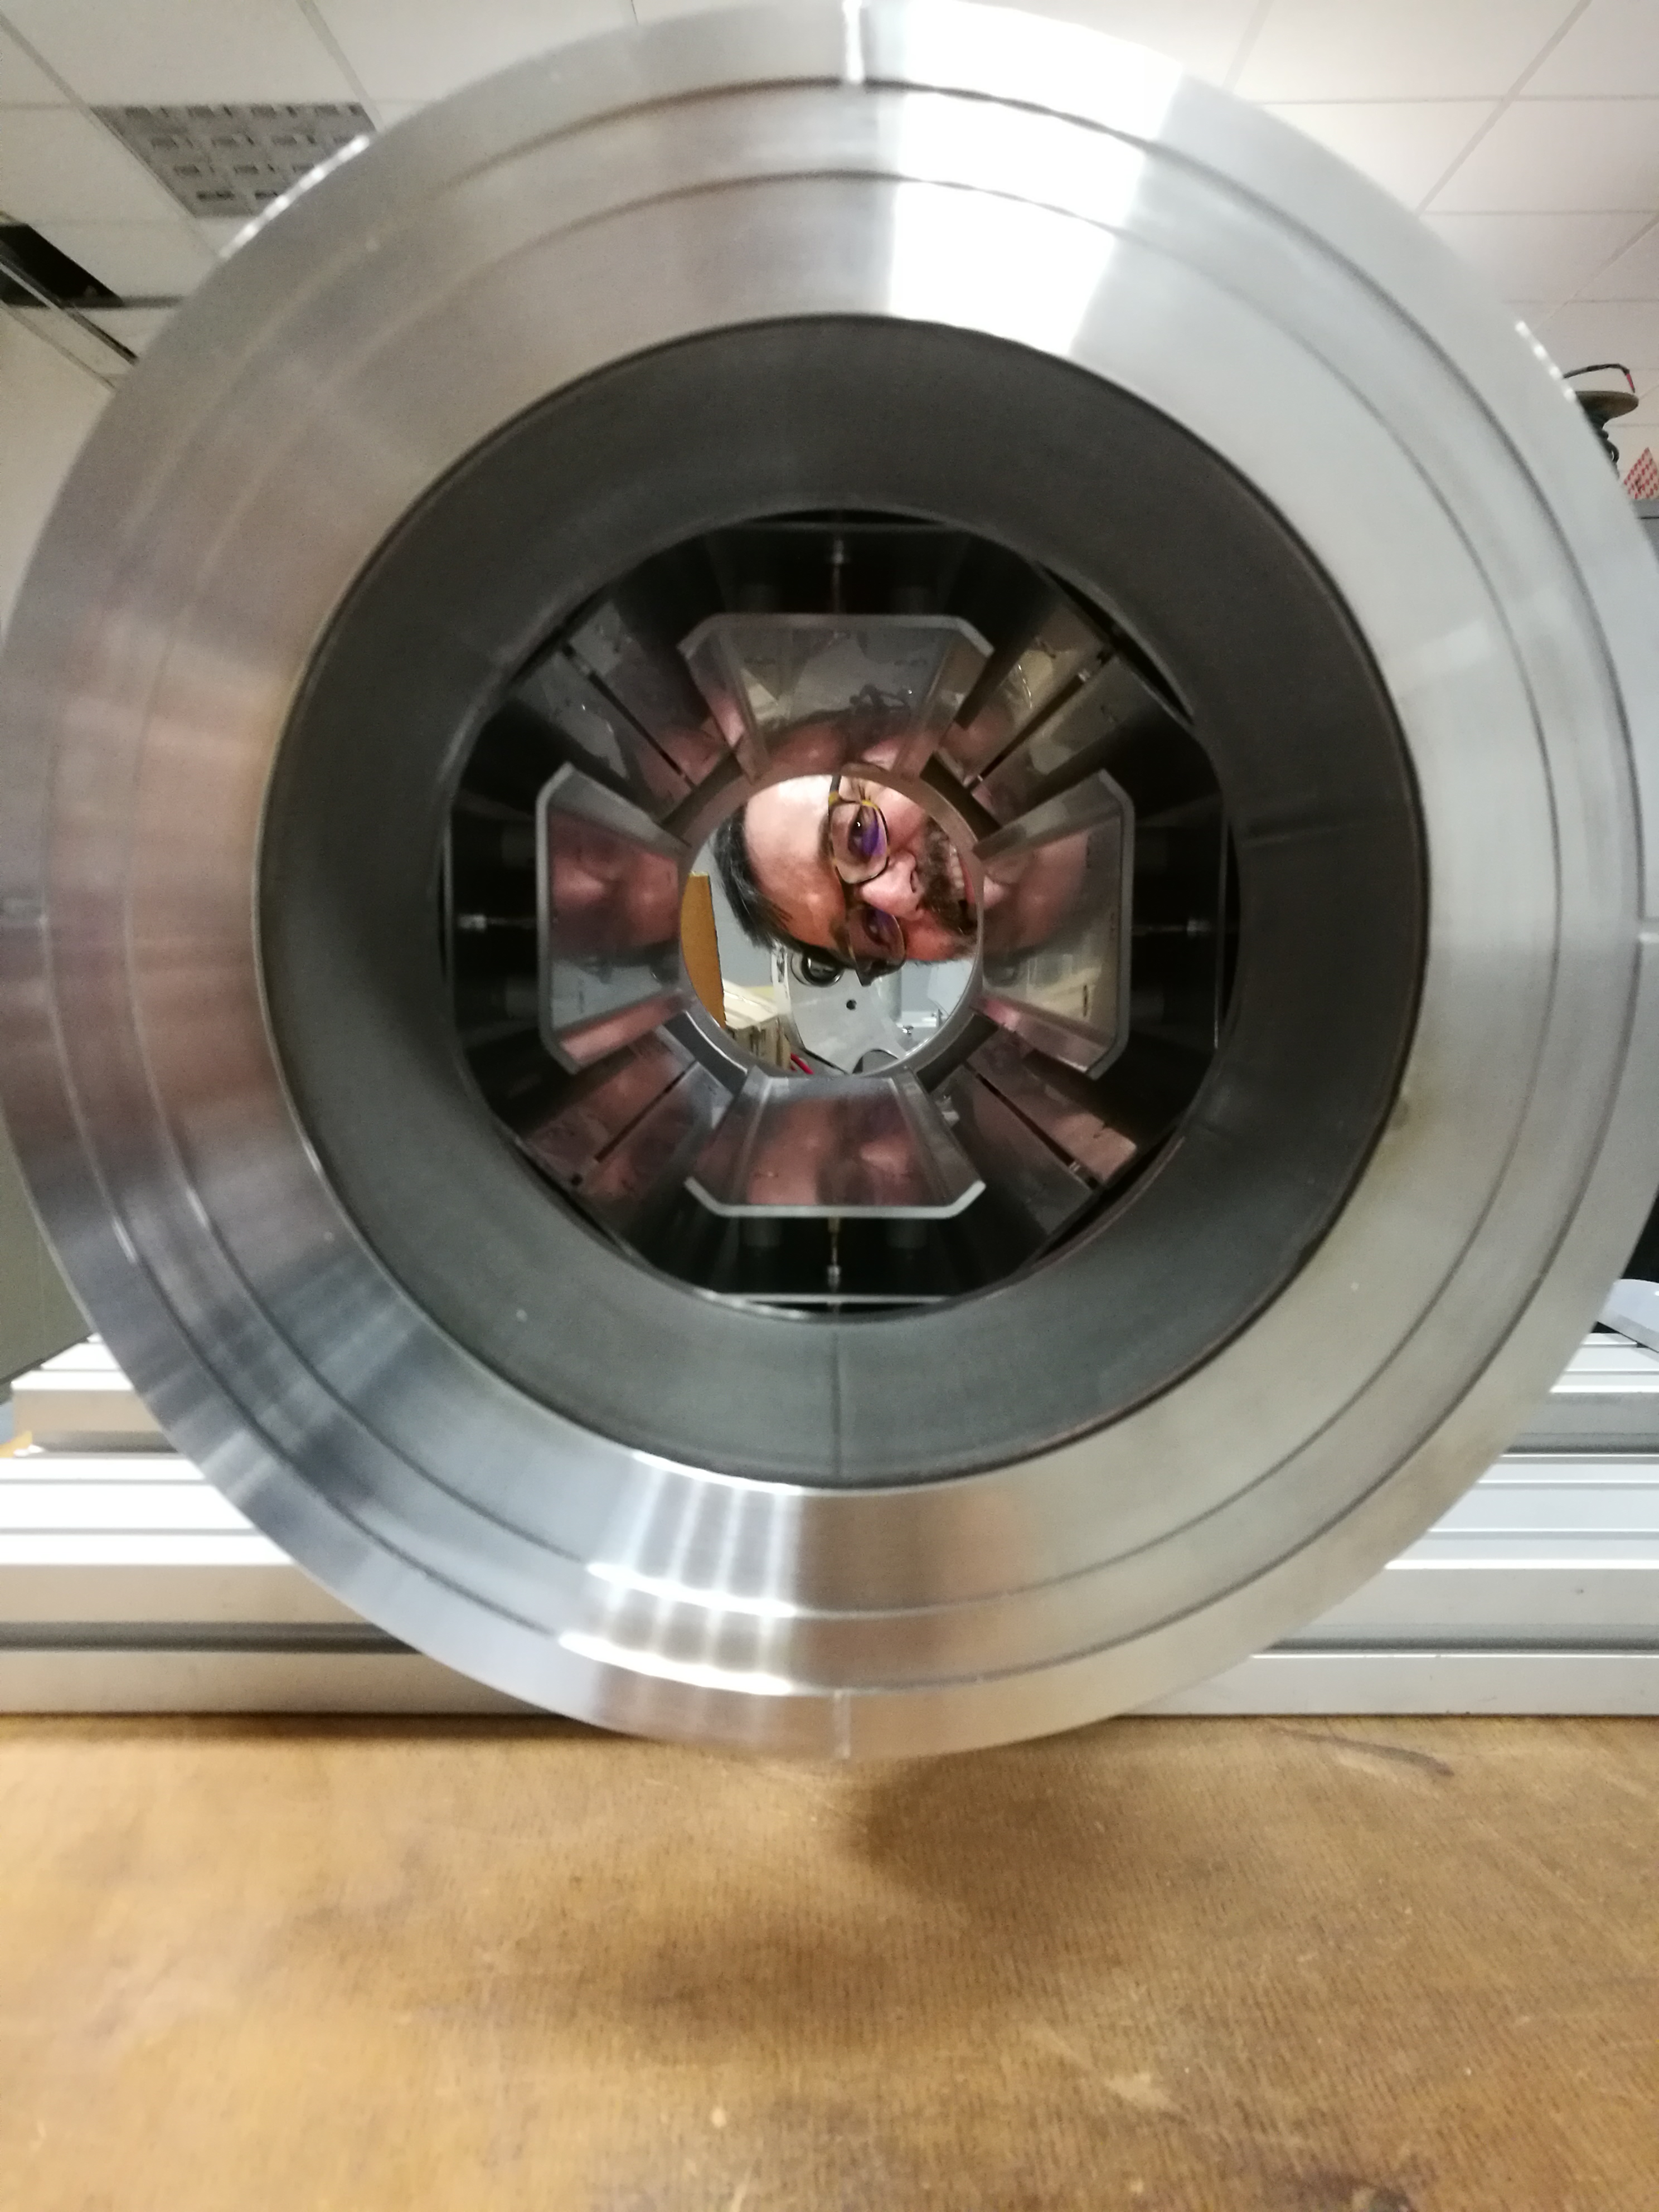
RFKO implementation
RFKO Kicker just arrived
Installed in the synchrotron
but not yet operational

Slide 12
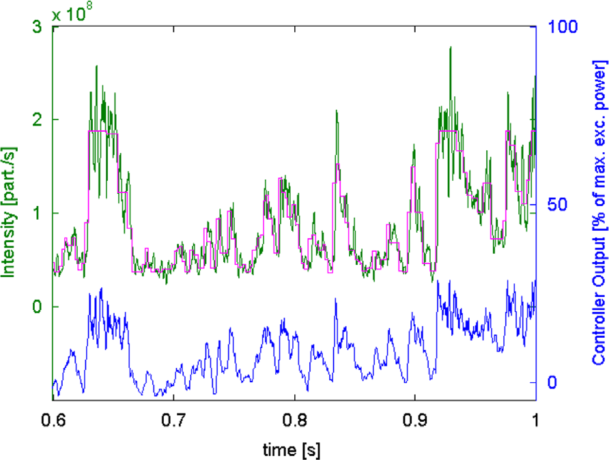
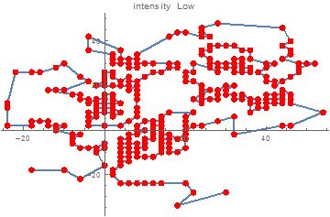
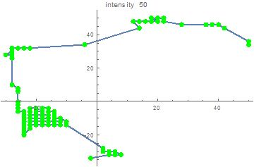
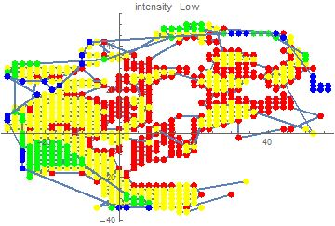
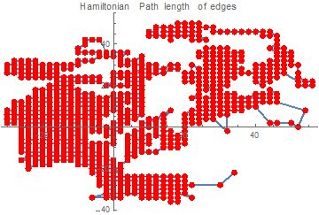
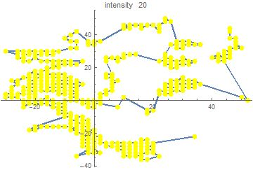
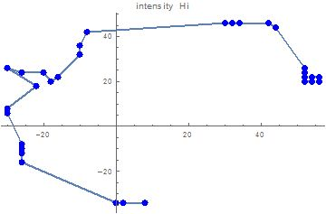
Intensity modulation for slow betatrons
Nmax/Nmin > 100
Subdivide voxels in classes and increase intensity during slice
Schoemers et Al, NIM A 795 (2015) 92-99

Slide 13
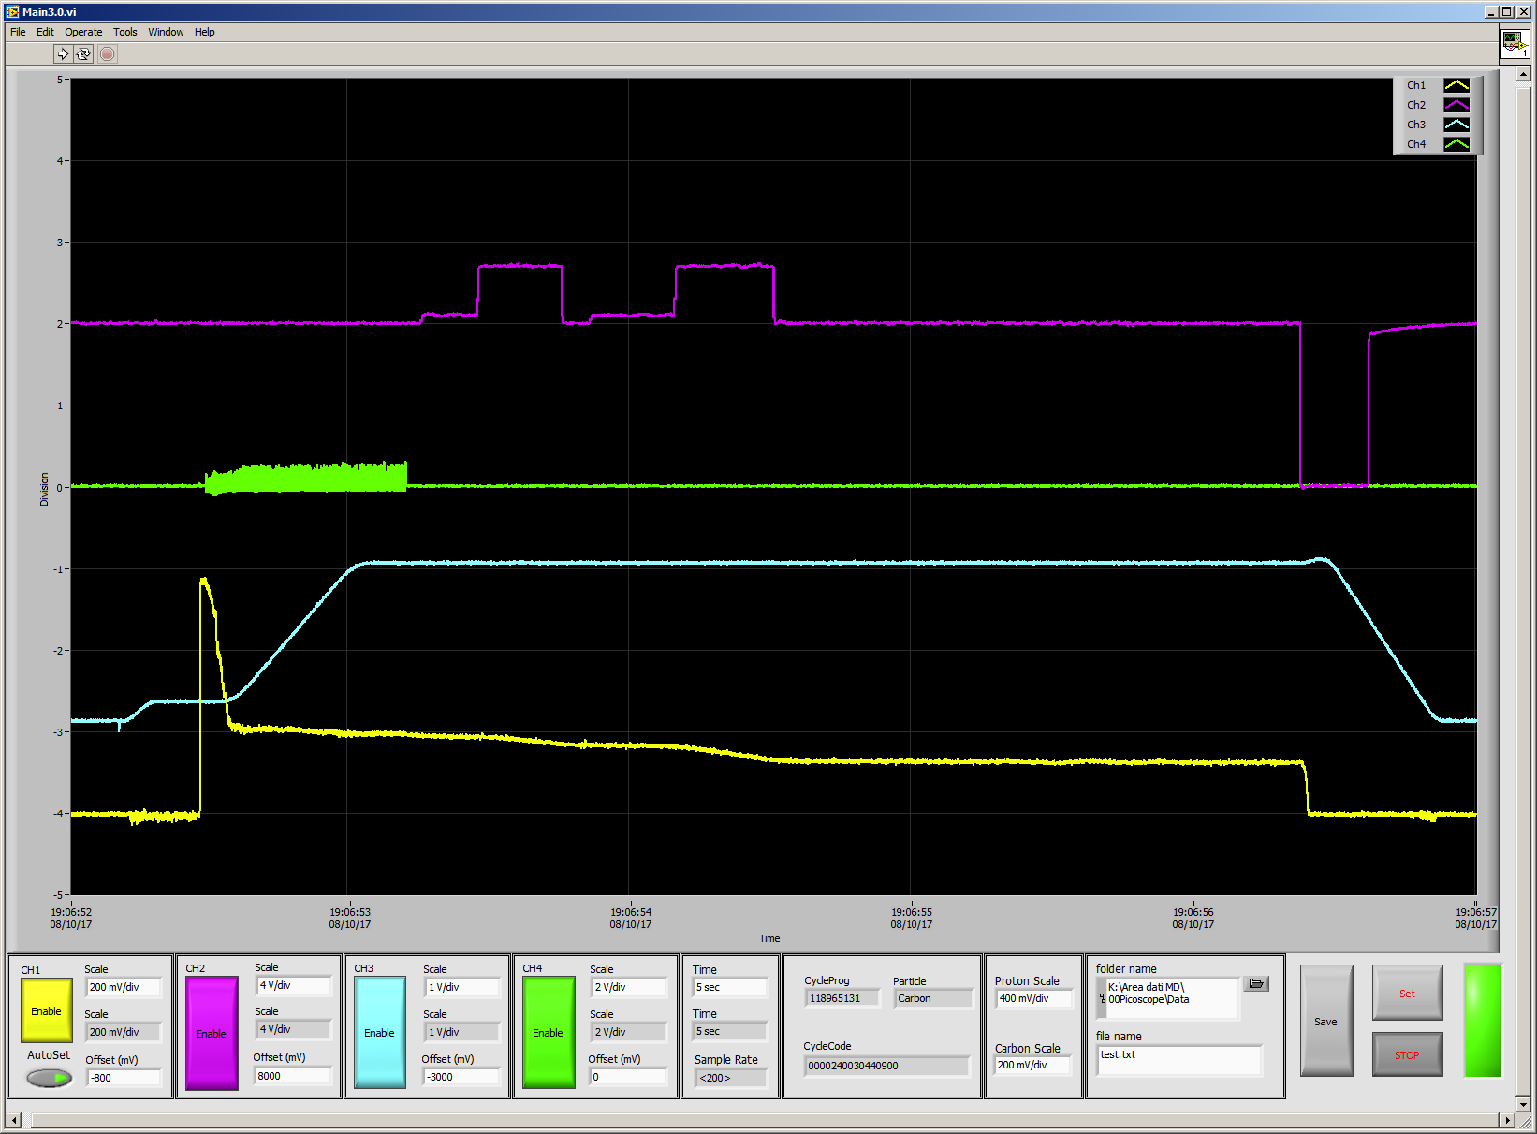
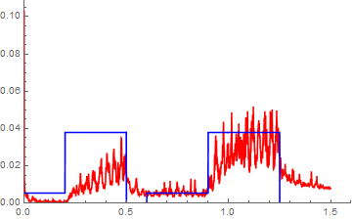

Slide 14
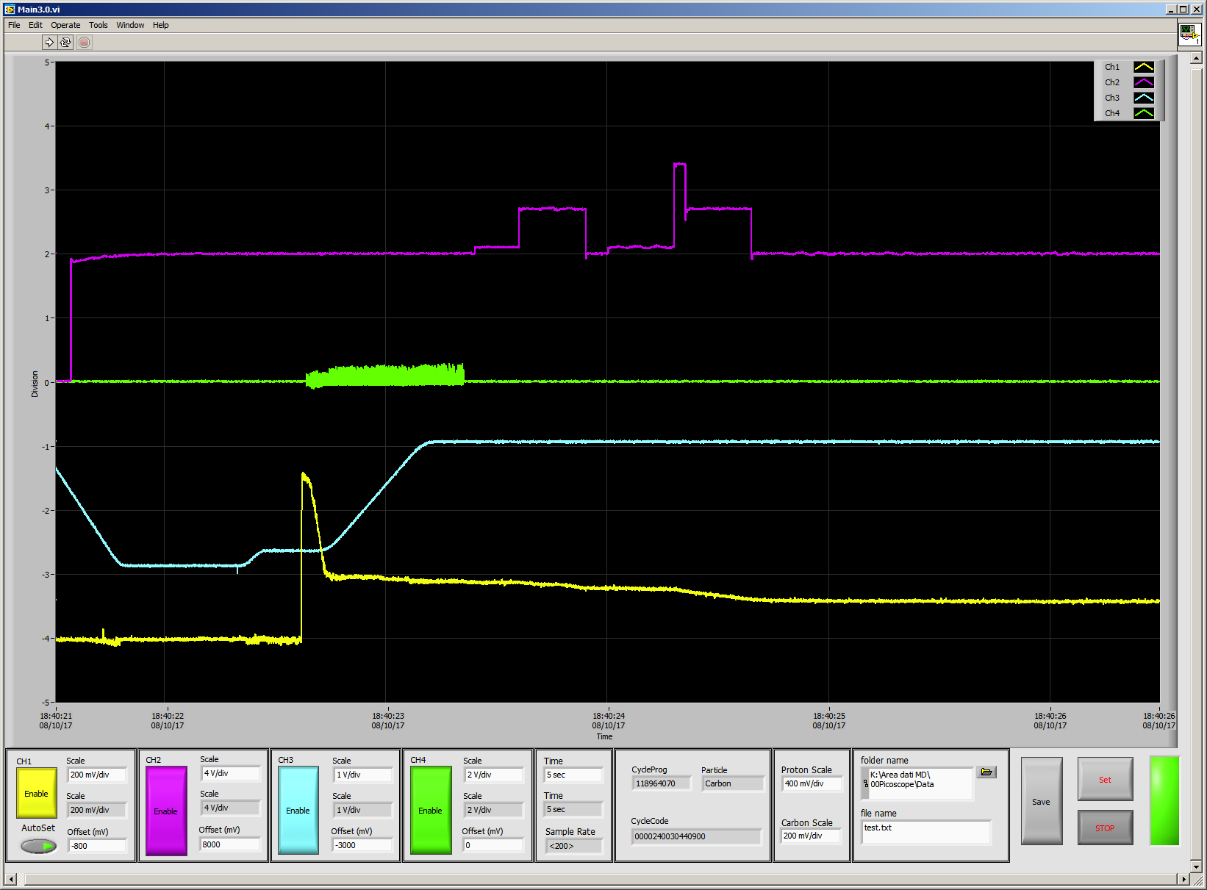
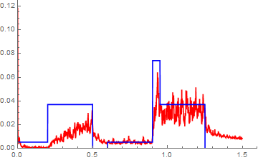
< 25 ms reasonable

Slide 15
Intensity step up test

Slide 16
Low intensities
For some applications like detector tests, some nuclear physics experiments (see FOOT exp.) a low intensity (10³ - 10⁴ particles/s) is required
Such low intensities are out of the measurement range of the DDS
A dedicated detector, capable to count the incoming ions and to monitor the beam position in the x-y plane, was provided by the Foot group (INFN - Roma - SBAI)

Slide 17
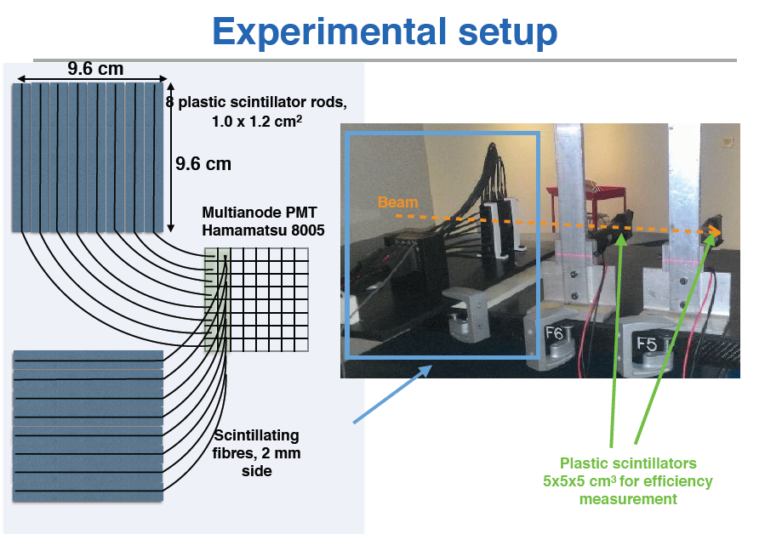
(Courtesy of Giacomo Traini)

Slide 18
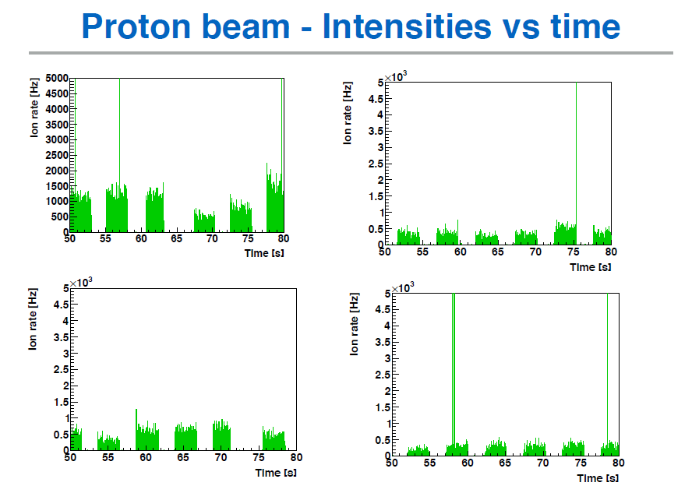
(Courtesy of Giacomo Traini)

Slide 19
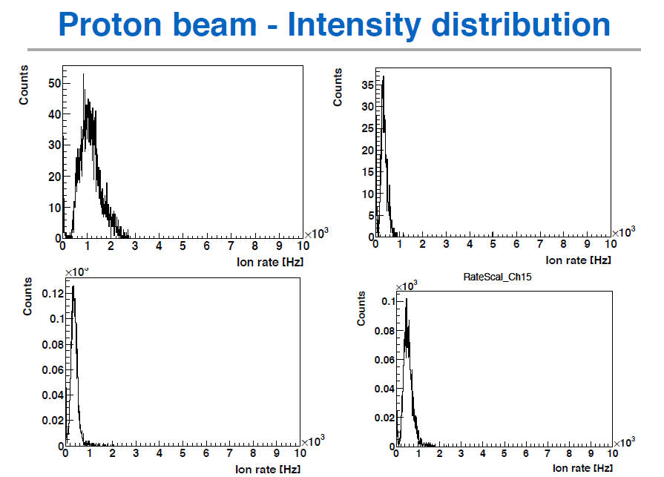
(Courtesy of Giacomo Traini)

Slide 20
What I would like in the next machine
Just my opinion and wishlist

Slide 21
What I would like in the next machine
Small
Cheap
Fast

Slide 22
What I would like in the next machine
Small
Cheap
Fast
Large number of particles (Multi En Ext)

Slide 23
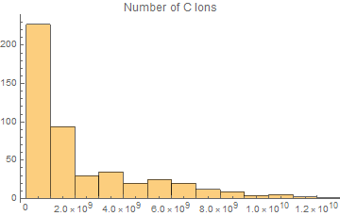
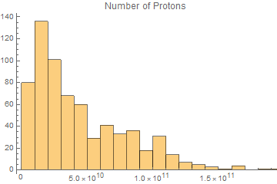
Large number of accelerated particles
Number of particles required in the fields delivered at CNAO last year
Nc = 1.5 E10
Np = 2 E11

Slide 24
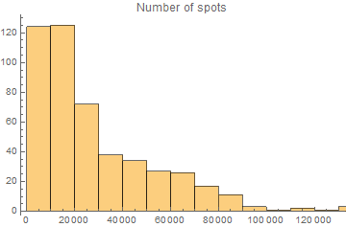
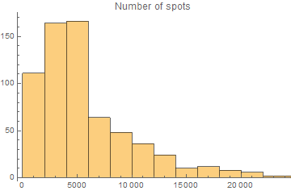
Number of spots required in the fields delivered at CNAO last year
C
p

Slide 25
What I would like in the next machine
Small
Cheap
Fast
Large number of particles (Multi En Ext)

Slide 26
What I would like in the next machine
Small
Cheap
Fast
Large number of particles (Multi En Ext)
Field control

Slide 27
What I would like in the next machine
Small
Cheap
Fast
Large number of particles (Multi En Ext)
Field control
Dose driven DDS (fast)
Large range DDS

Slide 28
What I would like in the next machine
Small
Cheap
Fast
Large number of particles (Multi En Ext)
Field control
Dose driven DDS (fast)
Large range DDS
Get rid of the LINAC?
(KEK DA style)

Slide 29
What I would like in the next machine
Small
Cheap
Fast
Large number of particles (Multi En Ext)
Field control
Dose driven DDS (fast)
Large range DDS
Get rid of the LINAC?
(KEK DA style)
C⁶⁺ source

Slide 30
What I would like in the next machine
Small
Cheap
Fast
Large number of particles (Multi En Ext)
Field control
Dose driven DDS (fast)
Large range DDS
Get rid of the LINAC?
(KEK DA style)
C⁶⁺ source
LINAC for A/Q=4 for HeCheck

Slide 31
HeCheck
Proof of principle
He 10% in number wrt C
1% in dose
(Courtesy of D. Mazzucconi)

Slide 32
HeCheck
Frammenti da carbonio da 280 MeV/u e 5x10⁷ primari.
Protoni (5x10⁵) da 226.5 MeV e carbonio (5x10⁶) alla stessa energia per nucleone.
Protoni da 81 MeV e 5x10⁵ primari.
(Courtesy of D. Mazzucconi)

Slide 33
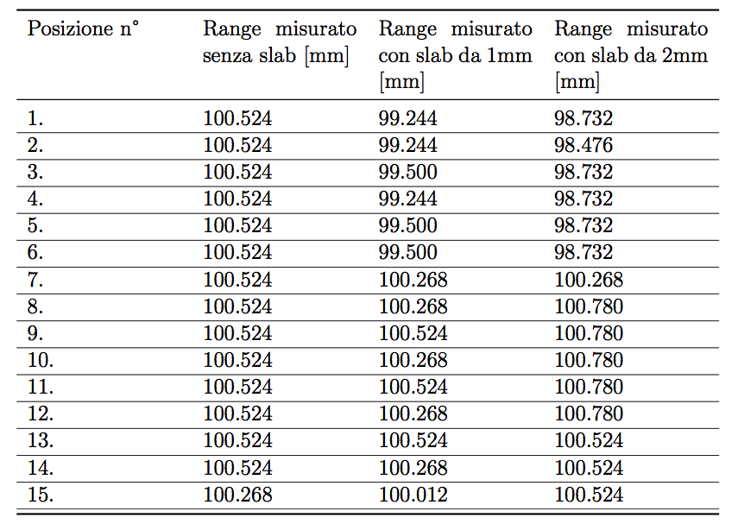
Resolution < 1 mm
(Courtesy of D. Mazzucconi)

Slide 34
What I would like in the next machine
Small
Cheap
Fast
Large number of particles (Multi En Ext)
Field control
Dose driven DDS (fast)
Large range DDS
Get rid of the LINAC?
(KEK DA style)
C⁶⁺ source
LINAC for A/Q=4 for HeCheck
¹¹C source?

Slide 35
What I would like in the next machine
Small
Cheap
Fast
Large number of particles (Multi En Ext)
Field control
Dose driven DDS (fast)
Large range DDS
Get rid of the LINAC?
(KEK DA style)
C⁶⁺ source
LINAC for A/Q=4 for HeCheck
¹¹C source?
Gantry (small, cheap…)

Slide 36
What I would like in the next machine
Small
Cheap
Fast
Large number of particles (Multi En Ext)
Field control
Dose driven DDS (fast)
Large range DDS
Get rid of the LINAC?
(KEK DA style)
C⁶⁺ source
LINAC for A/Q=4 for HeCheck
¹¹C source?
Gantry (small, cheap…)
Experimental room

Slide 37
What I would like in the next machine (cont)
Multi ion
Multi ion treatment (fast particle switch)
Larger field to avoid patching (increase Np and Nc?)
Hypofractionation (increase Np and Nc?)
3D Tracking
Real time imaging (at least pre treatment He radiograph)
Simple operation but with R&D and upgrade possibility
safety, efficiency, reliability, maintainability

Slide 39
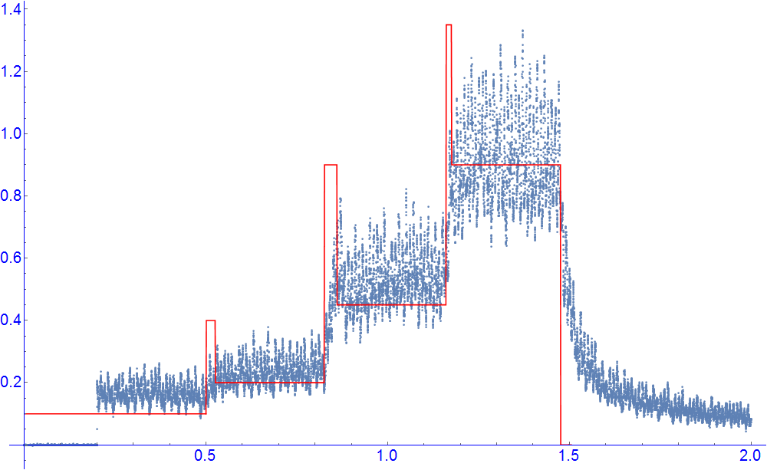
Intensity modulation for slow betatrons
Subdivide voxels in classes and increase intensity during slice
Schoemers et Al, NIM A 795 (2015) 92-99

