Slide 1
The CNAO Experience
Notes:
1

Slide 2
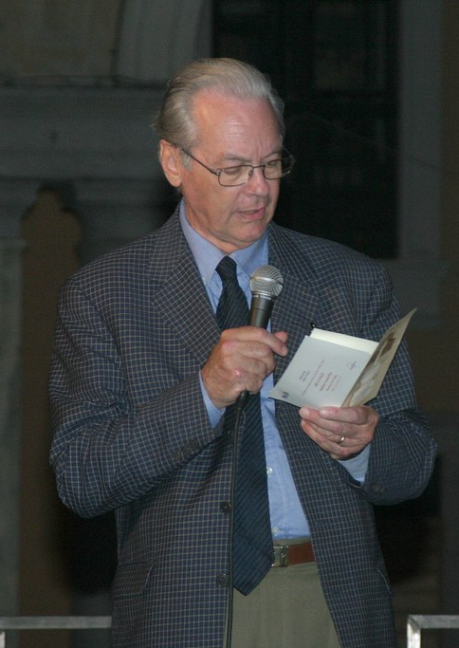
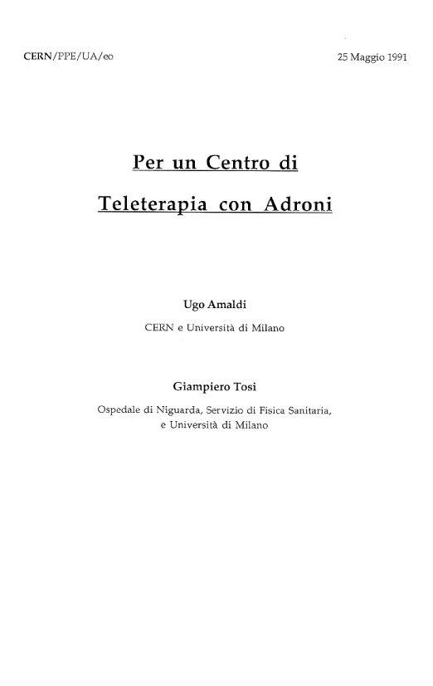
Year 1991…
ATER-INFN

Slide 3
From 1996 to 1999 at CERN
PIMMS (Proton-Ions Medical Machine Study)
CERN-GSI-MedAUSTRON-Oncology2000-TERA
PL: P. Bryant (CERN+experts)
PAC: G. Brianti chairman
TERA: 25 man×yrs
MedA.: 10 man×yrs
O2000: 3 man×yrs
GSI: experts advices
Objective: define the optimal hadrontherapy centre without constraints

Slide 4

Created by ministry of health
Art. 92 Law 23 December 2000, n. 388
Established 21 Novembre 2001:
To build and run CNAO
To carry on care activities and research

Slide 5
The CNAO board
Founders:
Fondazione Policlinico Ospedale Maggiore - Milano
Fondazione Istituto Neurologico C. Besta - Milano
Fondazione Istituto Nazionale dei Tumori - Milano
Istituto Europeo di Oncologia - Milano
Fondazione Policlinico San Matteo - Pavia
Fondazione TERA - Novara
Institutional participants:
Istituto Nazionale di Fisica Nucleare
Università di Milano
Politecnico di Milano
Università di Pavia
Comune di Pavia
Participants:
Fondazione Cariplo
Health ministry

Slide 6
Collaborating Institutes: a network for construction and research
NATIONAL
TERA Foundation: final design and high tech specifications
INFN: co-direction HT, technical issues, radiobiology, research, formation
University of Milan: medical coordination and formation
University of Pavia: technical issues, radiobiology, formation
University of Catania: medical physics
University of Florence: medical physics
Università del Piemonte Orientale: clinical activities
University of Turin: interface beam-patient, TPS
Polytechnic of Milan: patient positioning, radioprotection, authorisations
European Institute of Oncology: medical activities, authorisations
San Matteo Foundation: medical activities, logistics
Town of Pavia: land and authorisations
Province of Pavia: logistics and authorisation

Slide 7
Collaborating Institutes: a network for construction and research
INTERNATIONAL
CERN (Geneva): technical issues, PIMMS heritage
GSI (Darmstadt): linac and special components
LPSC (Grenoble): optics, betatron, low-level RF, control system
Med-Austron (Vienna): technical collaboration for MA centre
Roffo Institute (Buenos Aires): medical and research activities
NIRS (Chiba): medical activities, radiobiology, formation
HIT (Heidelberg): research activities
KIRAMS (Corea del Sud): clinical and accelerator activities
CLH - Plc (Croazia): hadrontherapy center development
IFJ PAN (Cracovia - Polonia): medical activities
Uni Essen (Germania): medical activities
Sykehuspartner (Norvegia): medical activities

Slide 8
The CNAO Phases
Phase 0: organisation
Years: 2002 - 2004
Phase 1: construction
Years: 2005 - 2009
Phase 2: experimentation
Years: 2010 - 2013
Phase 3: running
Years : 2014 …

Slide 9
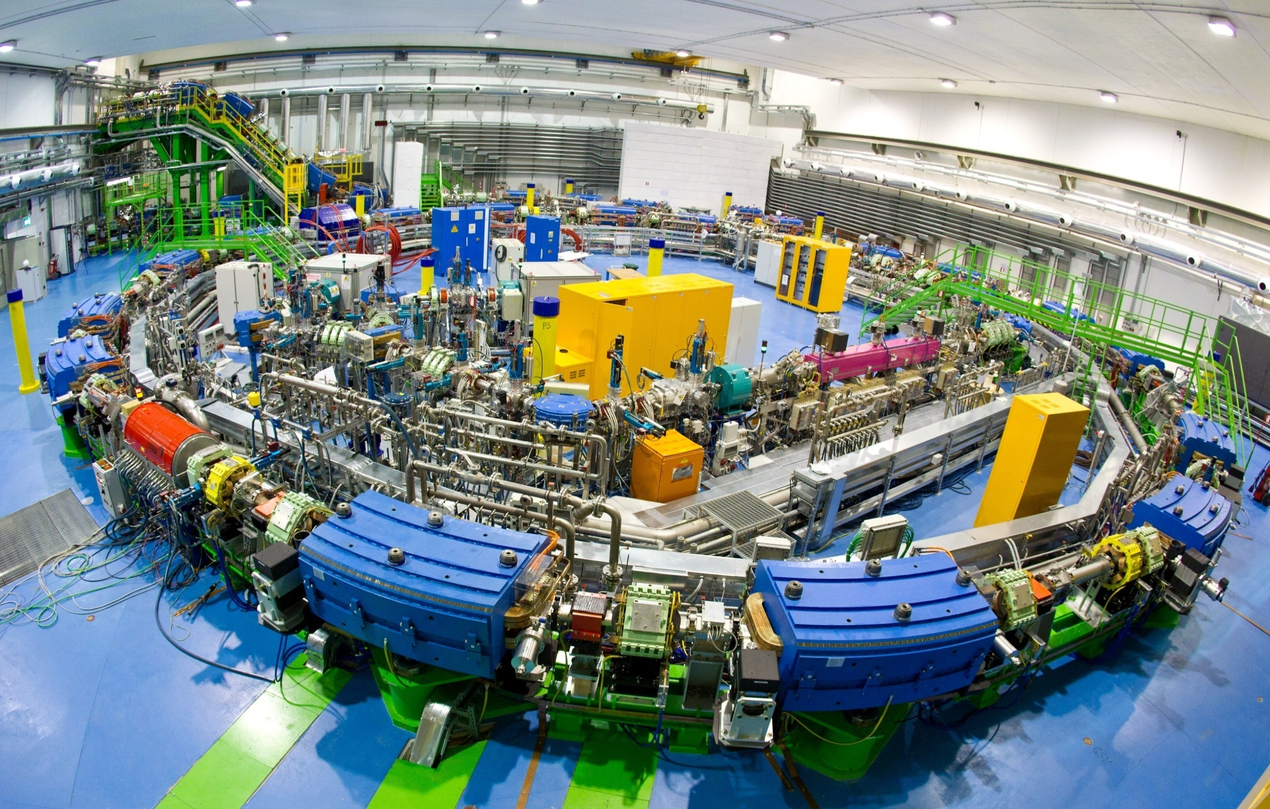
The high-tech for protons and carbon ions

Slide 10
AIM OF THE PROJECT
To treat deep tumours :
With ion beams in the range 1 ≤ Z ≤ 6
With active scanning
In approximately 3 min/field
Synchrotron with slow extraction!
Everything safe, proven and/or redundant

Slide 11
Basic specs
Starting from the patient

Slide 12
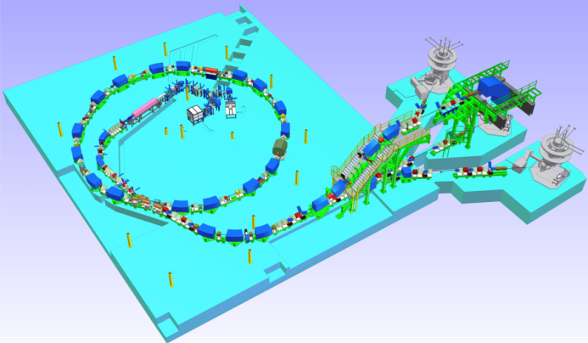
Compact design
Synchrotron
25m diameter
7 MeV/u LINAC
2 ECR sources
4 treatment lines
3 treatment rooms
Designed and built for:
safety, efficiency, reliability, maintainability

Slide 13
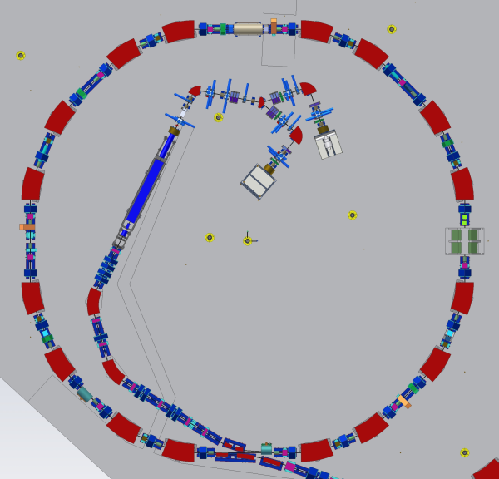
LEBT
0.008 MeV/u H₃⁺
0.008 MeV/u C⁴⁺
I ~ 0.7 mA (H₃⁺)
I ~ 0.2 mA (C⁴⁺)
Two sources
Continuous beam
LEBT Chopper

Slide 14
RFQ-LINAC
217 MHz
RFQ
0.008-0.4 MeV/u H₃⁺
0.008-0.4 MeV/u C⁴⁺
LINAC
0.4-7 MeV/u H₃⁺
0.4-7 MeV/u C⁴⁺

Slide 15
MEBT
7 MeV p
7 MeV/u C⁶⁺
I ~ 0.7 mA (p)
I ~ 0.15 mA (C⁶⁺)
Stripping foil

Slide 16
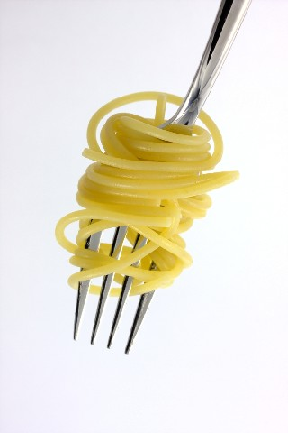
Multiturn injection
Incoming beam
The bumpers create an orbit bump collapsing in tens of turns
Septum
Closed orbit
Bumper
Bumper

Slide 17
Synchrotron
7-250 MeV p
7-400 MeV/u C
I ~ 0.1-6 mA (p)
I ~ 0.03-1.5 mA (C)
Slow extraction

Slide 18
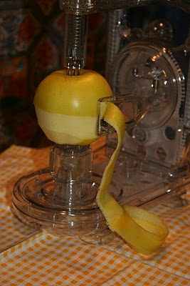
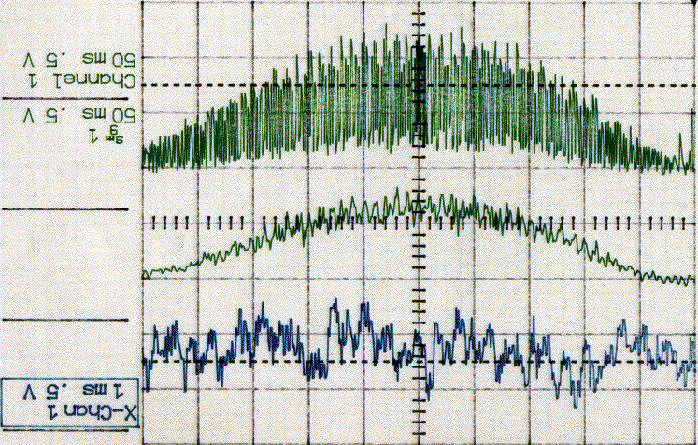
Smooth spill to allow tumour painting
Intensity ripple (ΔI/I) ≤ ± 20% at 2 kHz
(extraction with a betatron core - PIMMS)
0 V
50 ms

Slide 19
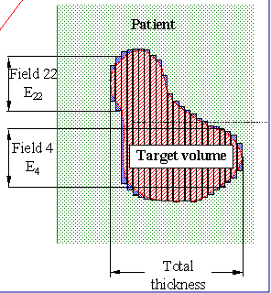
Treatment execution
Synchrotron magnets
1 s
Extraction magnets
Injection magnets
Extracted beam

Slide 20
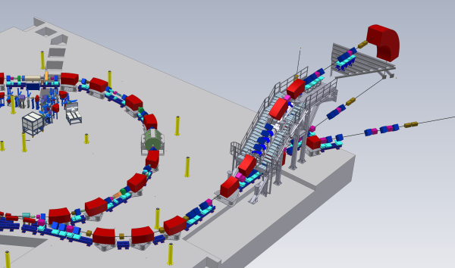
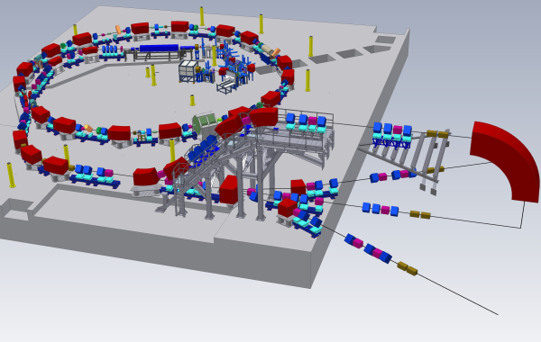
HEBT
60-250 MeV p
120-400 MeV/u C
10¹⁰ p/spill (~2nA)
4 10⁸ C/spill (~0.4nA)
different settings for
Treatment Line
Horizontal beam size
Vertical beam size
Extraction energy

Slide 21
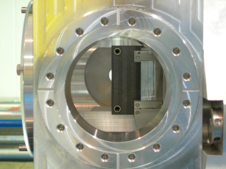
Chopper
Fast turn on/off for the beam
Intrinsically safe
Allows beam qualification
The chopper stops (and starts)
the beam within 200 μs.
Used for irradiation of separated parts
of slices and for synchronization with
breathing.

Slide 22
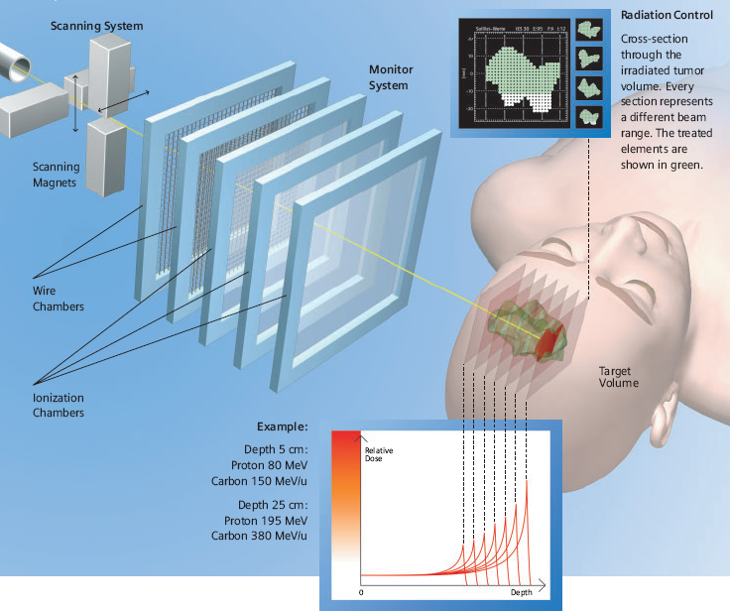
Irradiation technique active scanning
(Courtesy of Siemens Medical)

Slide 23
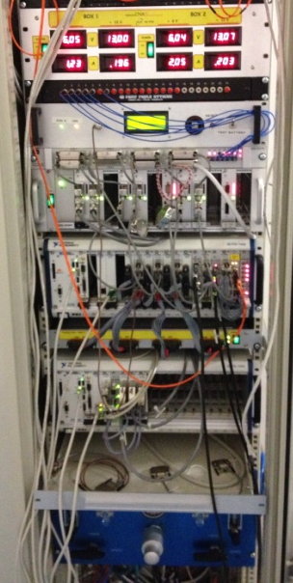
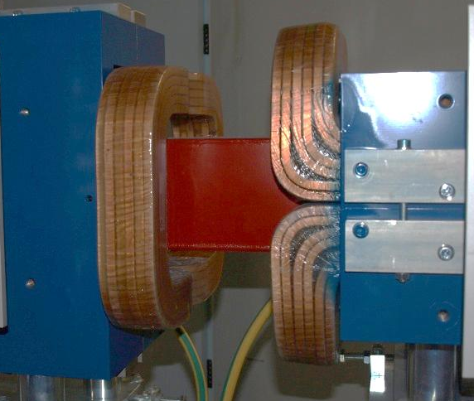
Dose Delivery System
DD control system
        Real time measurement and control of beam position and delivered number of particles
        Set the current of the scanning magnets spot by spot
        Real time correction of the beam position (feedback)
        Stop beam delivery at the end of each slice or in case of interlock
I_{DD}
I_{DD}
PS
PS
FPGAs
I_{PS}
I_{PS}
BOX 1
BOX 2
En-1
En
Intensity and position
monitors
Scanning magnets

Slide 24
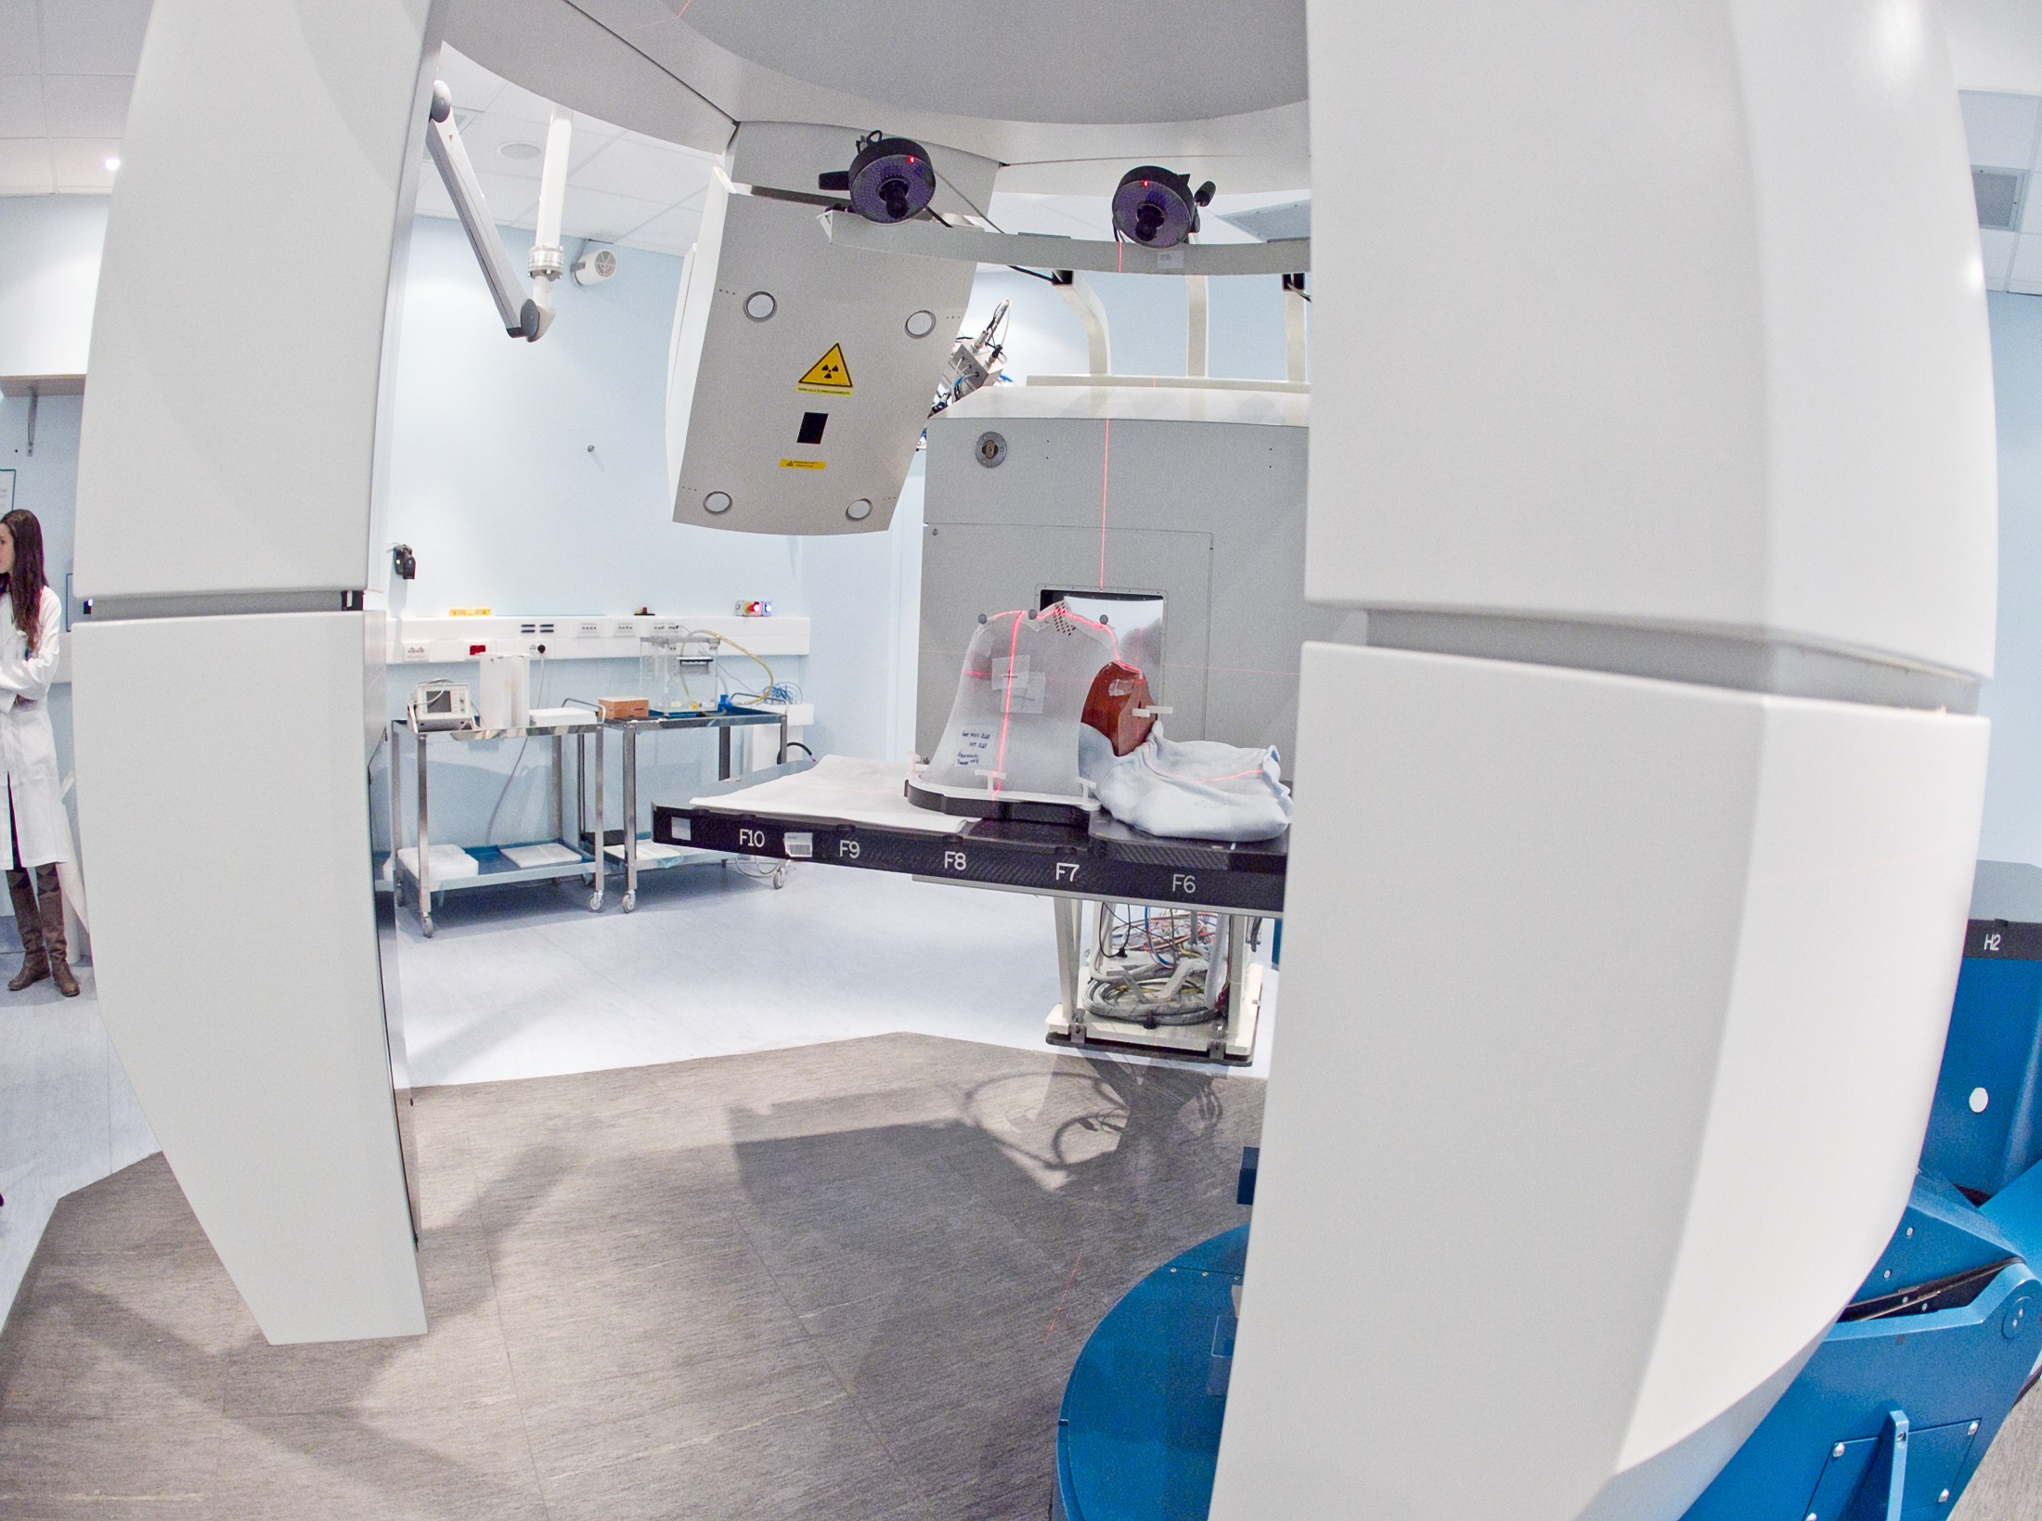
High precision devices for patient positioning
Collaboration CNAO-PoliMi

Slide 25
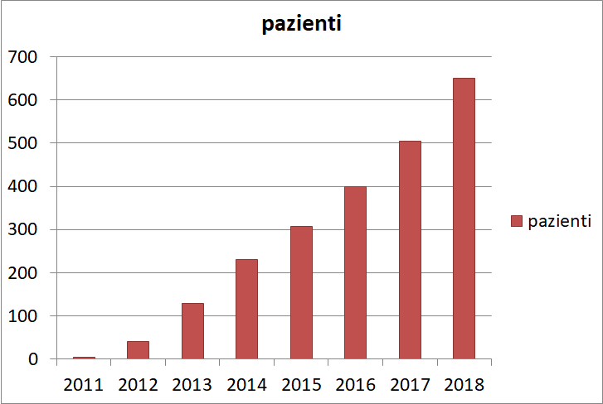
CLINICAL ACTIVITY
Patients per year
CE Marking

Slide 26
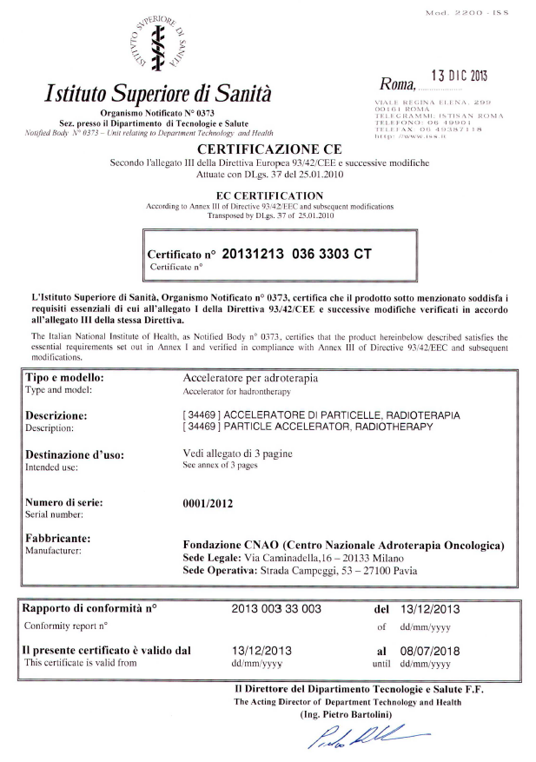
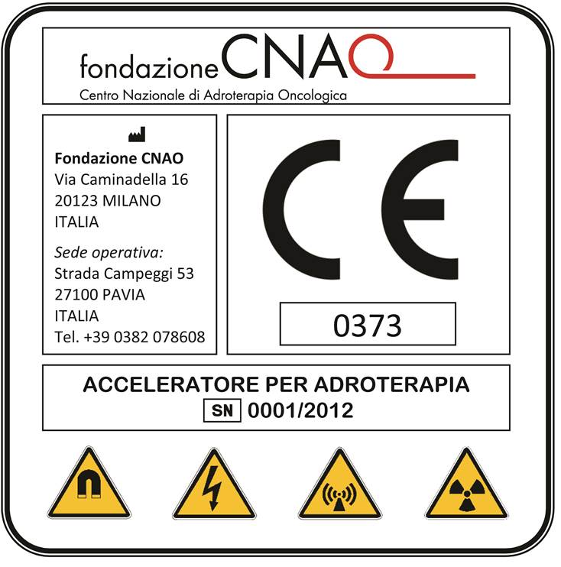
CNAO is Manufacturer of Medical Device (directive 93/42/EEC)
CNAO obtained the CE label after clinical experimentation

Slide 27
CNAO: > 1800 patients
66% carbon ions – 34% protons

Slide 28
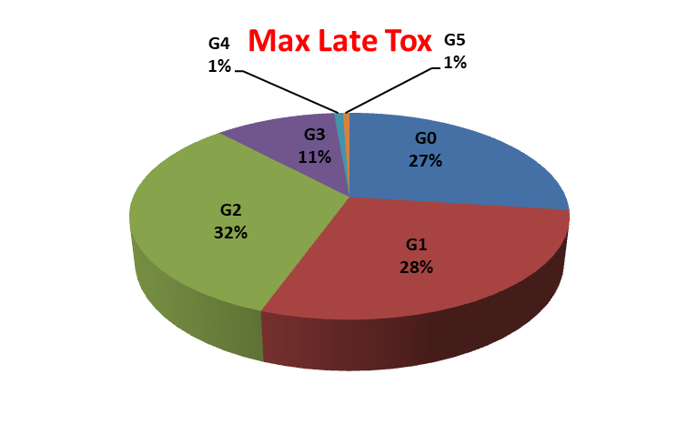
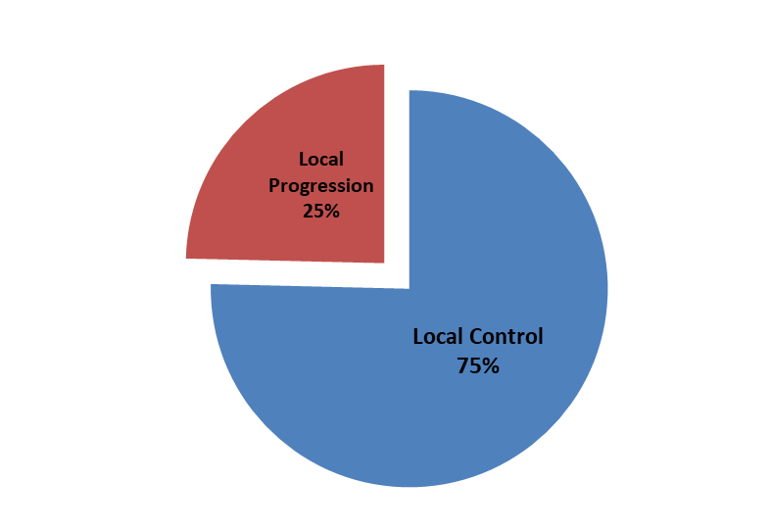
Treatment results: outcome + toxicity
Outcome

Slide 29
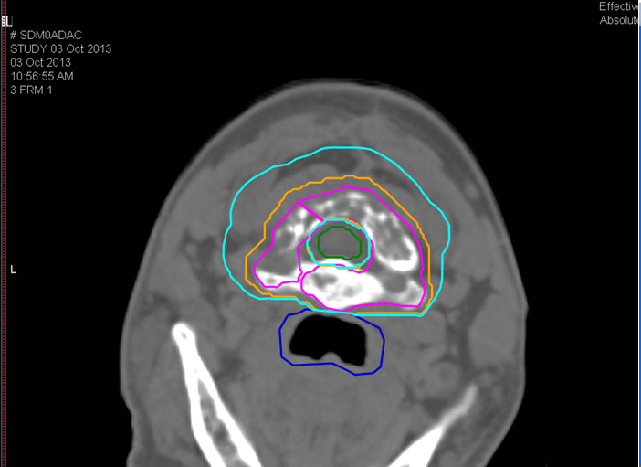
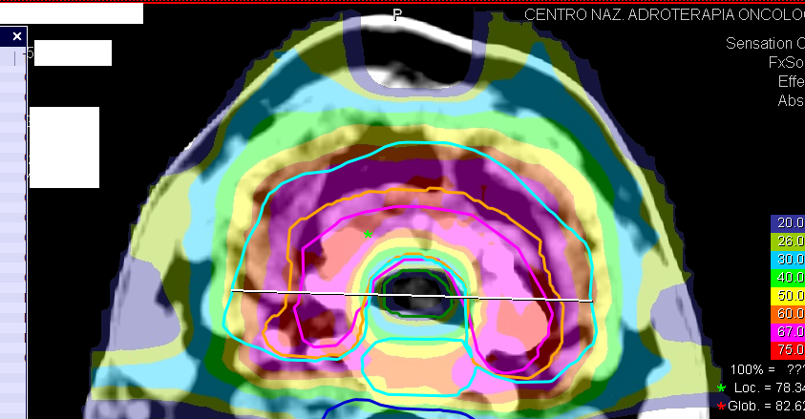
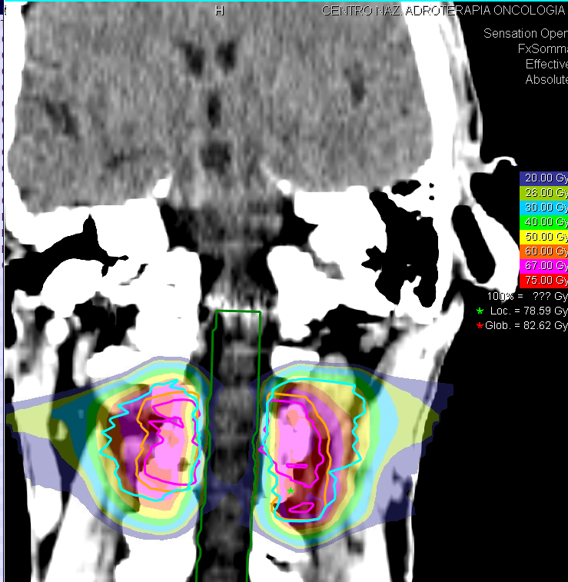
56 anni maschio
Osteosarcoma di basso grado vertebra C1-C2
eritema G1 al termine della CIRT
Effetto stabile dopo 1 anno
Caso simile al NIRS in CR dopo 7 anni
Imai et al. Lancet Oncology 2006
CIRT 73.6 GyE
16 frazioni IMPT

Slide 30
Clinical experience
SKULL BASE TUMORS | TOT (PT/CIRT) | Median FU (months) | LC (%) | Local Failures
CHORDOMAS | 108 | 27,8 | 85 % | 16
CHONDROSARCOMAS (G1-G2) | 28 | 26,9 | 97 % | 1
Gross tumor volume (GTV)
Chordomas > median (GTV) : 33.4 mL (range, 0-127 mL)
Chondrosarcomas > median (GTV) : 16.9 mL (range, 7,9-53,3 mL)

Slide 31
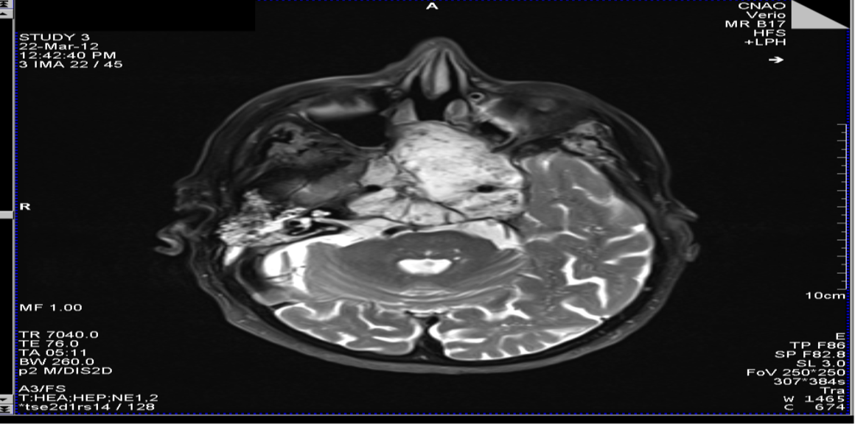
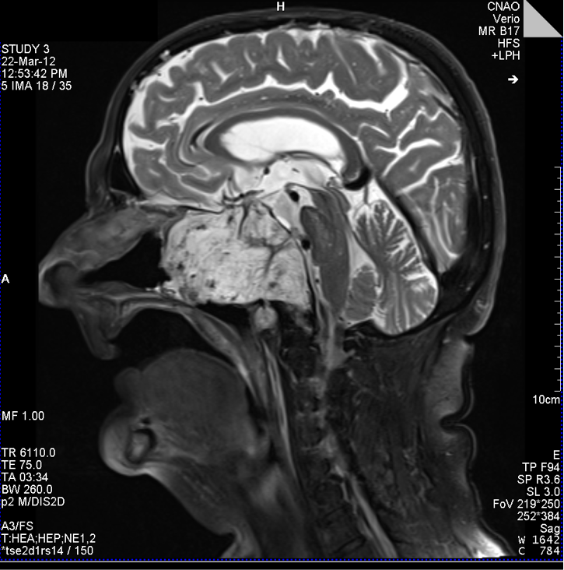
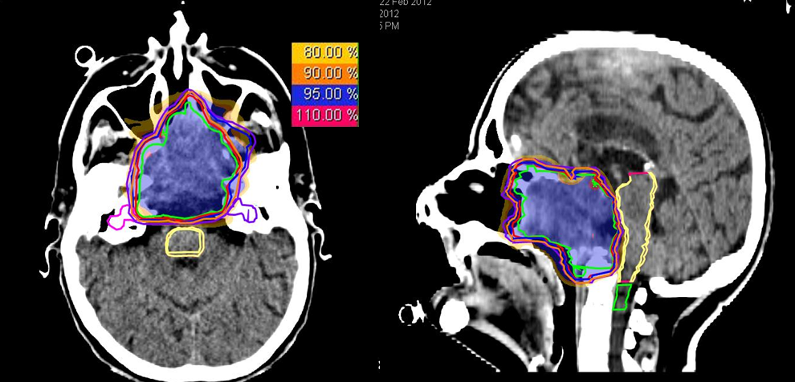
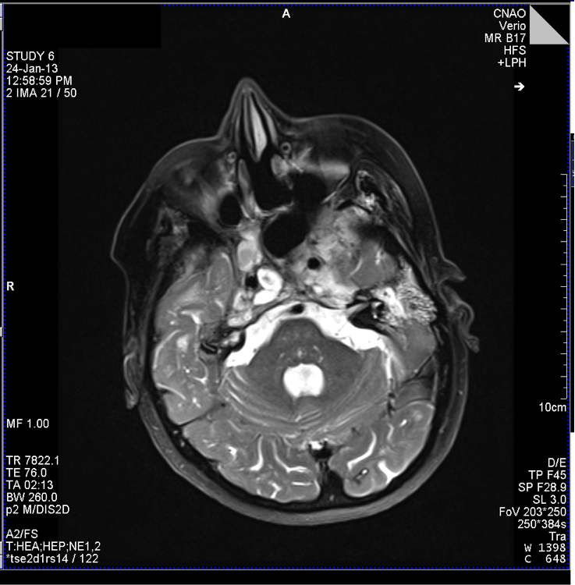
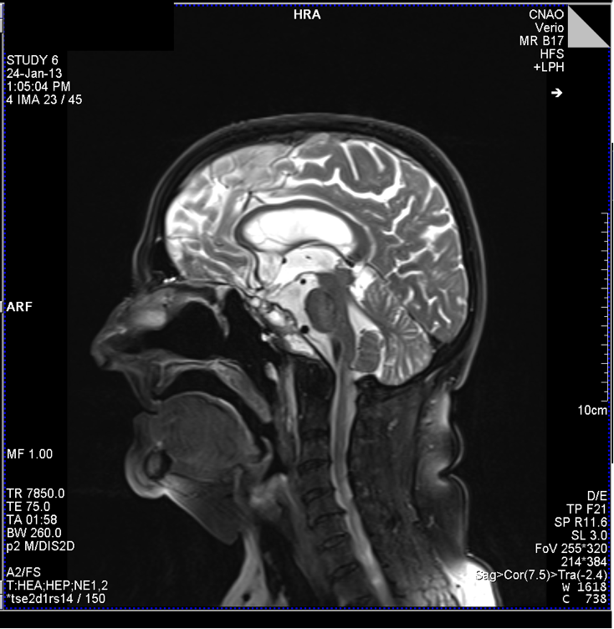
Skull base chordoma: carbon ions
10 months F-UP

Slide 32
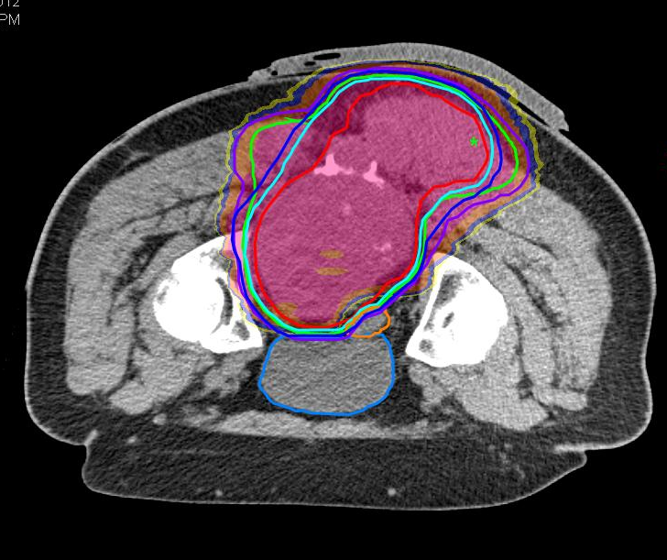
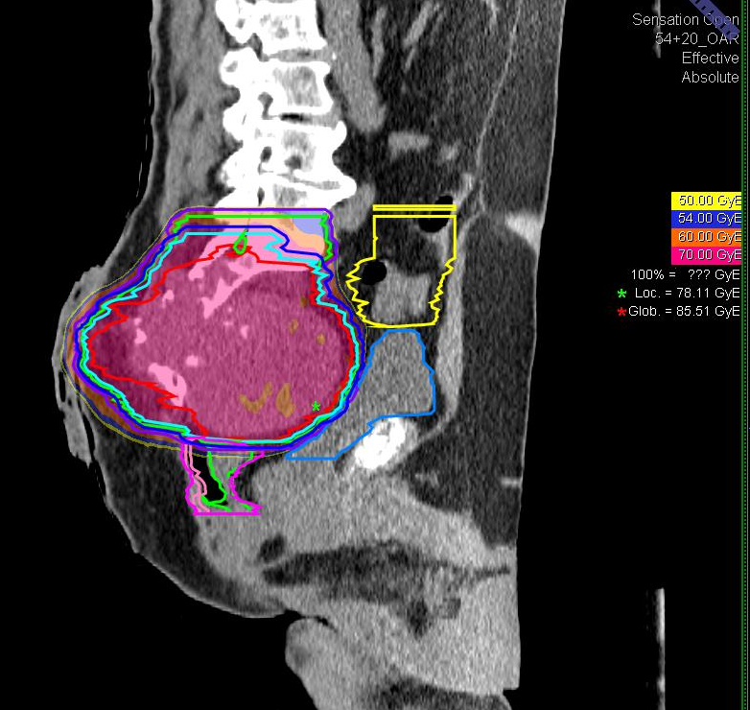
Sacral Chordoma
52 patients treated from january 2013
CIRT 74 GyE/16 fractions
35 patients Fup mean: 21.8 m (range 7- 43)
CR → 0 (0%)
PR → 10 ( 28%)
SD → 18 ( 51%)
PD → 7 (20%)
79% LC
Notes:
70 Gy(RBE) for chondrosarcoma

Slide 33
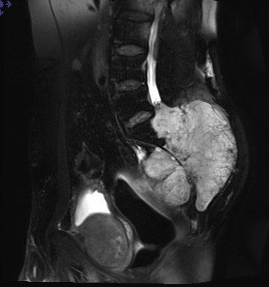
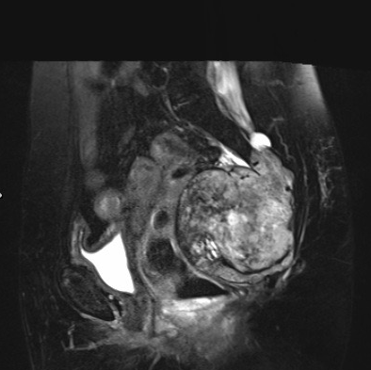
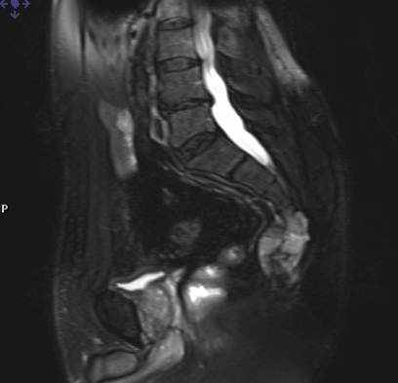
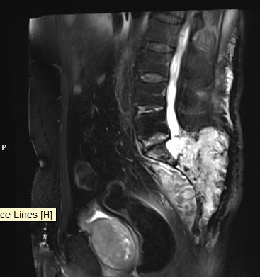
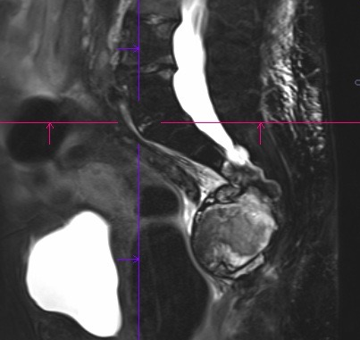
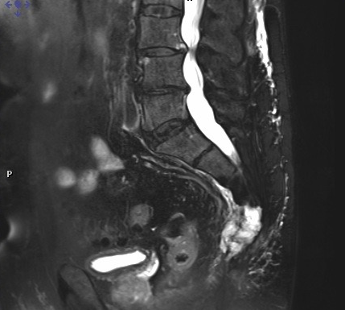
CIRT 74 GyE
16 fractions IMPT
CNAO experience after 1 year
Notes:
This is Cnao experience
Among the patients with partial response we had some encouragin results after 1 year.
About PR we started to observe very good response on some pts in terms of mass reduction as you cans see on this images
Analazing data based on RECIST criteria we don’t have any partial response even if we can see the reduction of mass, so…

Slide 34
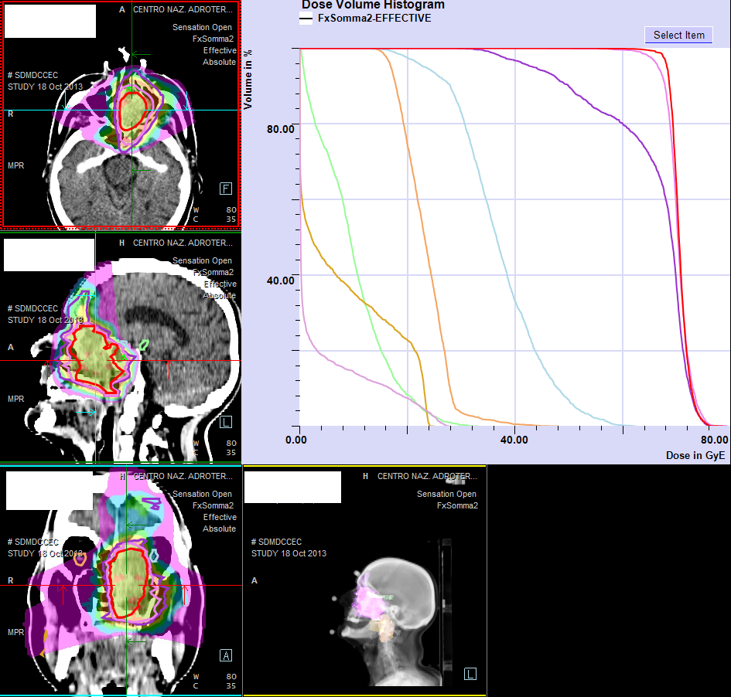
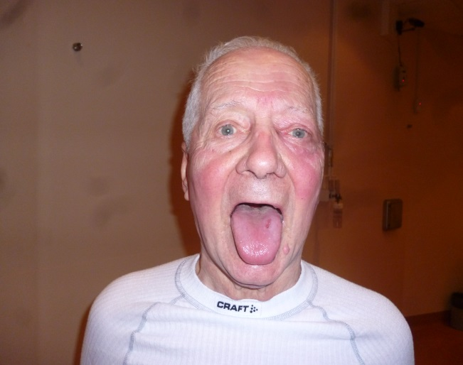
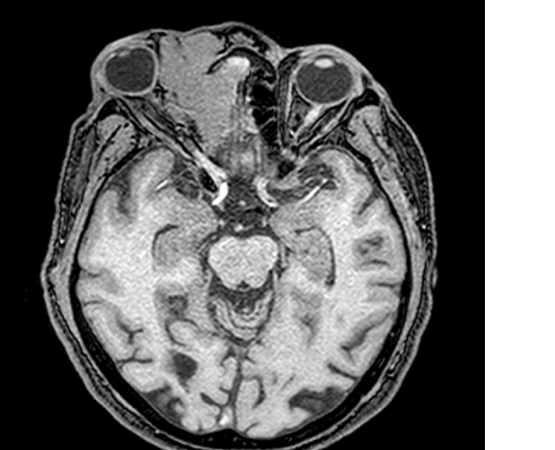
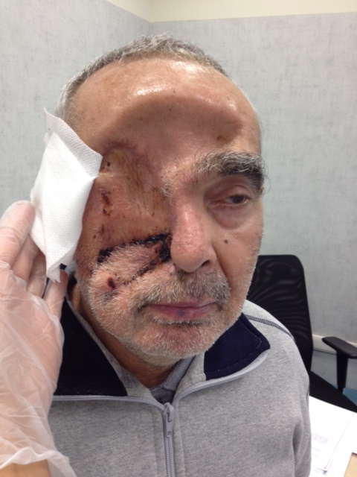
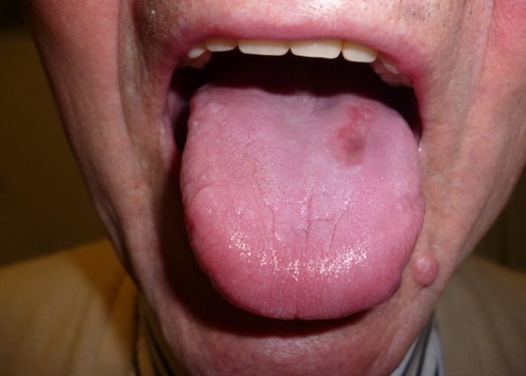
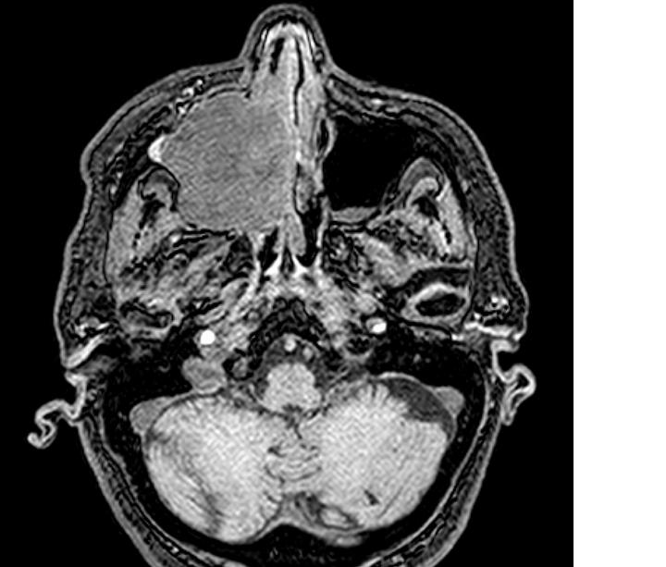
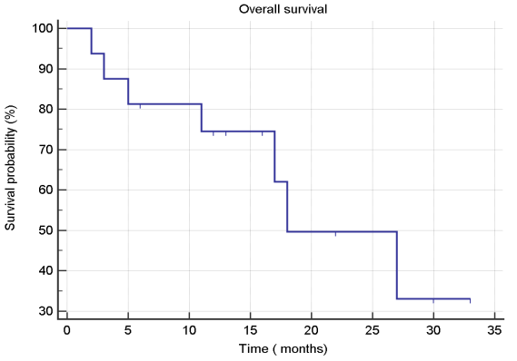
Mucosal Melanoma:
carbon ions could change the paradigm
CIRT
VS
Surgery
1Y OS 74.5 %
Notes:
Quality of life

Slide 35
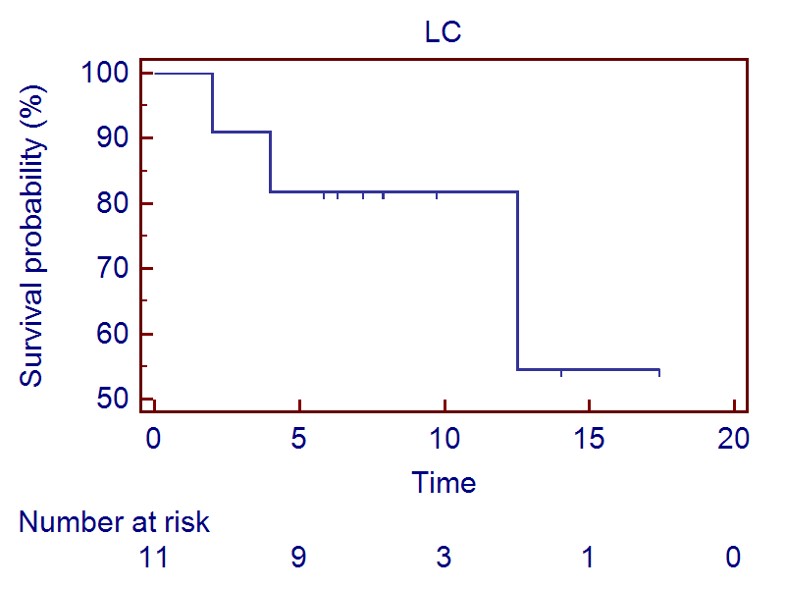
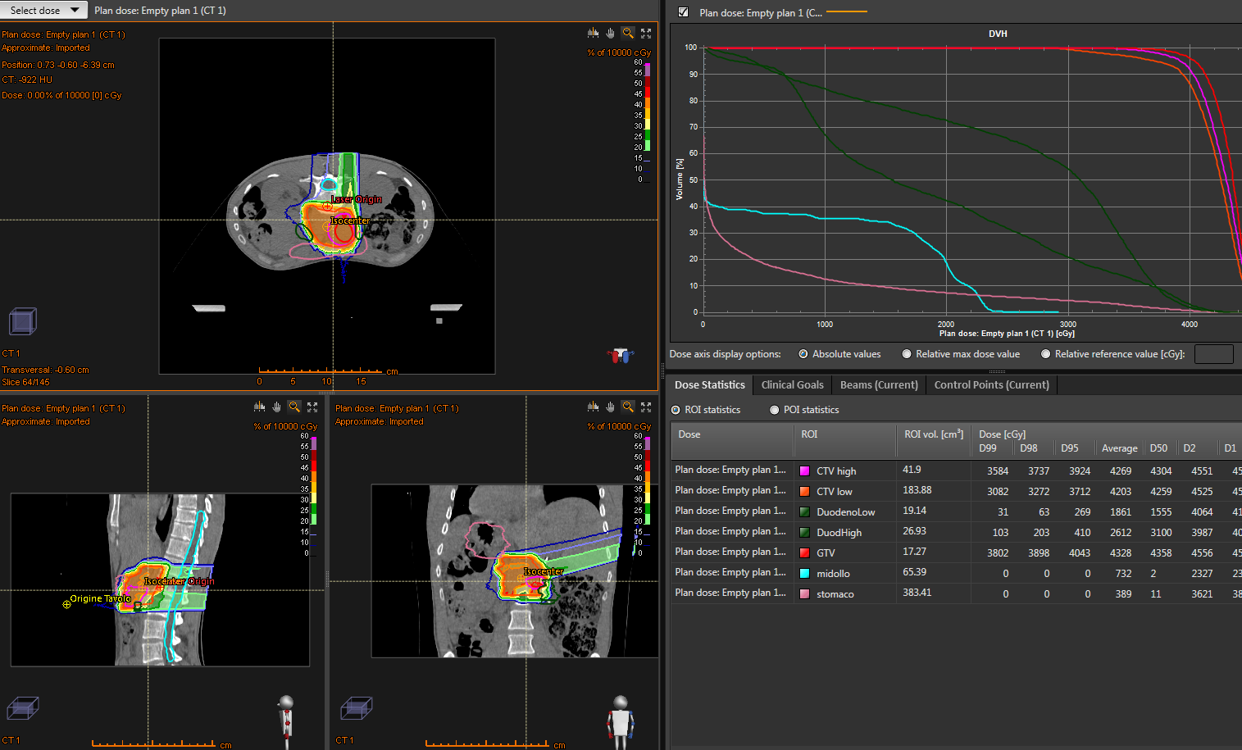
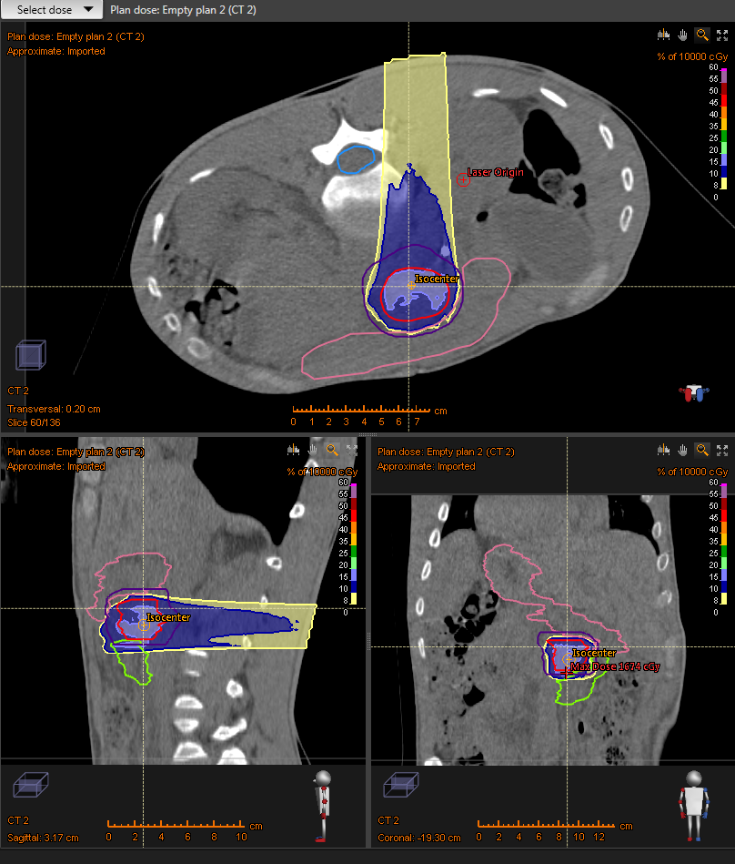
Big killers: pancreatic cancer – Clinical Trials
CTV1: Tumor＋N2 nodes
and plexus
9 fractions, prone position,
2 fields
CTV2 ( Main tumor)
3 fractions, 1 field, rolled position
43.2 Gy RBE in 9 fx
11 patients: 1 Year actuarial LC 82%
14.4 Gy RBE in 3 fx
Randomized Clinical Trial
CIPHER
CNAO – USA – Germany - Japan

Slide 36
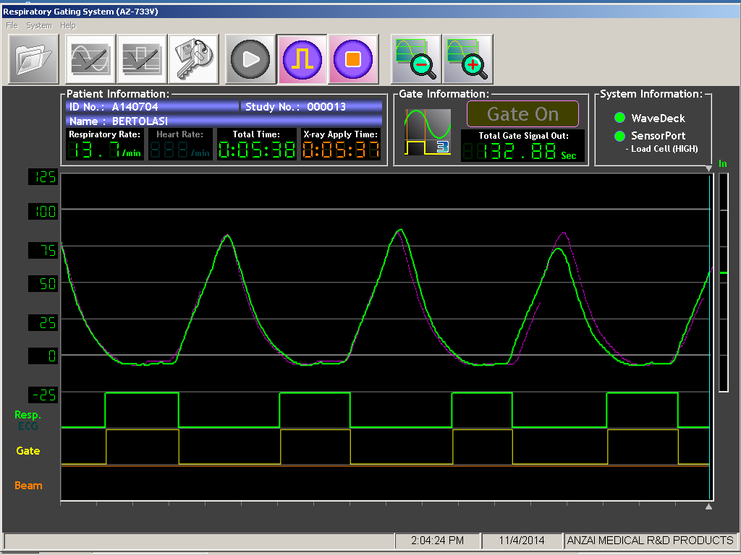
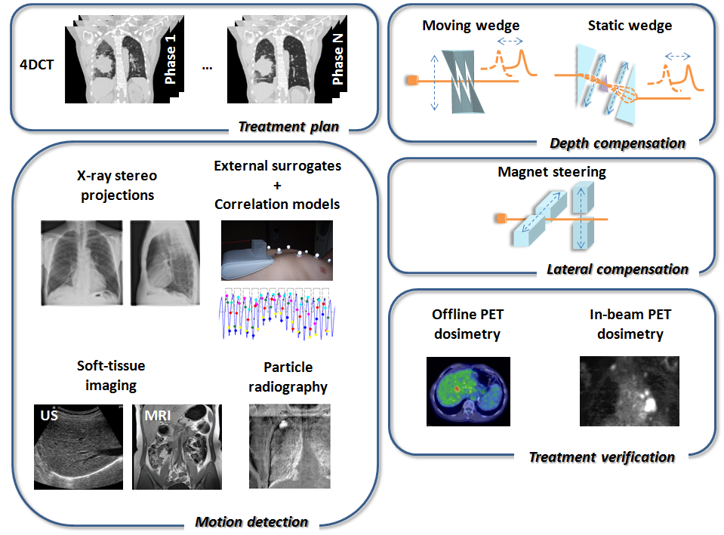
CNAO is treating tumours in moving organs
Accelerator cycle synchronized with patient breathing (gating)
Goal:
tumour tracking
in real time

Slide 37
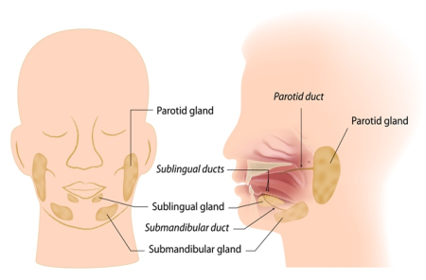









Re-treatments: 160 patients
NO OTHER THERAPEUTIC OPTION
Notes:
Network for patient collection needed

Slide 38


Ocular treatments with active scanning: FIRST TIME EVER !
250 patients/year in Italy
Non invasive eye tracking system for intraocular tumour localization in proton therapy treatments
(Collaboration with PoliMi, Galliera, INT, Sacco, UniPv and INFN)

Slide 39


Pediatric patients elective for protons
Less dose to healthy tissues
to reduce long term risks of secondary tumours
Protons
Protons
X-rays
Notes:
In the real world, with a real patient on a real tumor now with modern radiotherapy we have a lot of choise:
Do you want to irradiate a lesion with an irregular shape? You can use Intensity Modulated. But the low dose will spread around.
OF course hadrontherapy is better.
Do you want to irradiate a lesion with high doses, with ablative intent and sparing the most of normal tissue around? You can use radiosurgery.
Hadrontherapy can be a choice in both cases!
in pediatrics cases like this the sparing of the dose at healty tissues is mandatory, for the late toxicity and the high risk of second tumor

Slide 40
Essential Levels of Assistance (LEA)
Chordoma & chondrosarcoma base/spine
Meningiomas
Brain tumors (trunk)
ACC Salivary Glands
Orbit tumors including eye melanoma
Sinonasal carcinoma
Soft Tissue & bone Sarcoma (every sites)
Recurrent tumors (retreatment)
Patients with immulogical desorders
Pediatric solid tumors
Tumors for which hadrontherapy guarantees a better
dose distribution wrt the best alternative providing a
10% better result in terms of NTCP or TCP

Slide 41

Access to CNAO

Slide 42






Il percorso del paziente
First visit
Weekly internal
Board
Waiting list
Treatment begins
Weeks or
monts
REGIONS

Slide 43






Pretreatment imaging procedures
TAC
RNM
TC/Pet
ANZAI and OTS
Moving organs:
4-D treatment
Gating and rescanning
Images Fusion

Slide 44
Individual Treatment Plan Optimization
Target D_{min}
OAR DVH
OAR D_{max}

Slide 45

10% difference is clinically relevant
High dose
(70.4 Gy (RBE)_{jp} )
5yrs. 76.4%
Low dose
(64.0 or 57.6 Gy (RBE)_{jp})
5yrs. 21.4%
H&N Sarcoma at NIRS
LogRank
p<0.0001
Courtesy of Dr. Hasegawa, NIRS

Slide 46



Plan verification:
simple cases
Excellent agreement <±2%

Slide 47







“LEGO Model”: integrated technical and medical solutions
The real challenge:
make ALL systems running together
safely, efficiently, reliably and easily maintainable.

Slide 48
Performance CNAO from Nov. 2011 to Dec. 2017
Year 2017
2095 running days
1523 treatment days
129 days preventive maintenance
36 days of downtime
System availability: 94.2%
System reliability (days): 98.3%
System reliability (sessions)
327 gg
238 gg
25 gg
0 gg
92.8%
100%
96.8% (314 vs 9937)

Slide 49

Research: the second pillar of CNAO

Slide 50

Research beamtime with external groups
224 h

Slide 51

New beamline for Research
Linac
Coming up in 2018
New experimental room
(in collaboration with INFN)
Ion Sources
Synchrotron
High Energy
Transfer Lines
Treatment Rooms

Slide 52



(Courtesy C. Bisogni)

Slide 53













In beam PET - panels
10 x 25 x 5 cm³
Distance from the
isocenter=30 cm
256 LFS pixel crystals (3x3x20mm³) coupled one to one to MPPCs (Multi Pixel Photon Counters, SiPMs).
Dose Profiler
2 planes, each one composed of 2 segmented thicker plastic scintillators (6 mm), to perform the energy measurement with a better resolution
6 planes, each one composed of 2 orthogonally oriented scintillating fibres layers
Notes:
The INSIDE system is mounted on a cart to be fully compatible with clinics

Slide 54




Measurement of 3D energy deposition in water phantom
GEMPix, reference PTW ion chamber and 3D movement in water phantom, HW/SW integrated in one system
IC
Beam
Beam
Bragg Peak
Fragmentation Tail
GEMPix
Measurements at CNAO – Italian National Centre for Oncological Hadron therapy

Slide 55

Cancer stem cells
“A small subset of cancer cells within the tumor mass, which constitutes a reservoir of self-sustaining cells with exclusive ability of self-renewal and tumor maintenance” (from the Cancer Stem Cell Workshop of the American Association for Cancer Research in 2006)
bio-markers
Since cancer stem cells appear to be responsible for driving and maintaining tumor growth in many tumors, it is critical to understand the mechanisms by which these cells resist commonly used therapies such as chemotherapy and radiotherapy
Notes:
There is increasing evidence that CSCs have a higher intrinsic radioresistance than non-CSC tumor cells
While standard therapies, including chemotherapy and radiation, may initially shrink tumors by killing tumor bulk, the failure of these therapies to eradicate CSCs may be a major contributor to treatment failure, tumor relapse and poor survival.
It has also been suggested that cancer stem cells are more resistant to chemo- and radiotherapy than other cells in a tumour. This could be one cause of tumour relapse after therapy. Understanding how cancer stem cells resist medical therapy could lead to the development of new, more efficient cancer treatments.

Slide 56



Combined treatments
Particles + radiosensitizers = ???
Particles + chemotherapics = ???
Particles + photons = ???
Particles + …..= ???
Although heavy-ion therapy has provided favorable clinical outcome with irradiation alone, the suitability of particle beam irradiation for combination with other therapeutic modalities such as chemotherapy, endocrine therapy, low LET radiation (“boost protocols”) and biological therapies warrants extensive studies, in the context of both enhancing tumor control and reducing normal tissue complications.

Slide 57

View of the site
Expansion Area 1
Expansion Area 2

Slide 58

Expansion Area 1
Work in progress in collaboration with TERA Foundation

Slide 59

Expansion Area 2
Work in progress in collaboration with TERA Foundation

