Slide 1
Physics with spectators in MPD/NICA experiment
A.Ivashkin, M. Golubeva, V. Volkov
(Institute for Nuclear Research RAS, Moscow)
LXX International conference "NUCLEUS – 2020. Nuclear physics and elementary particle physics. Nuclear physics technologies"
The report was funded by RFBR according to the research project No 18-02-00065

Slide 2
Outline
MPD experiment;
Spectators in ion collisions;
Forward calorimeter in MPD;
Simulations with fragmentation models;
Geometry of collisions:
Reaction plane,
Centrality;
Spectators as a probe of nuclear models:
Energy distributions,
Scattering angles.

Slide 3

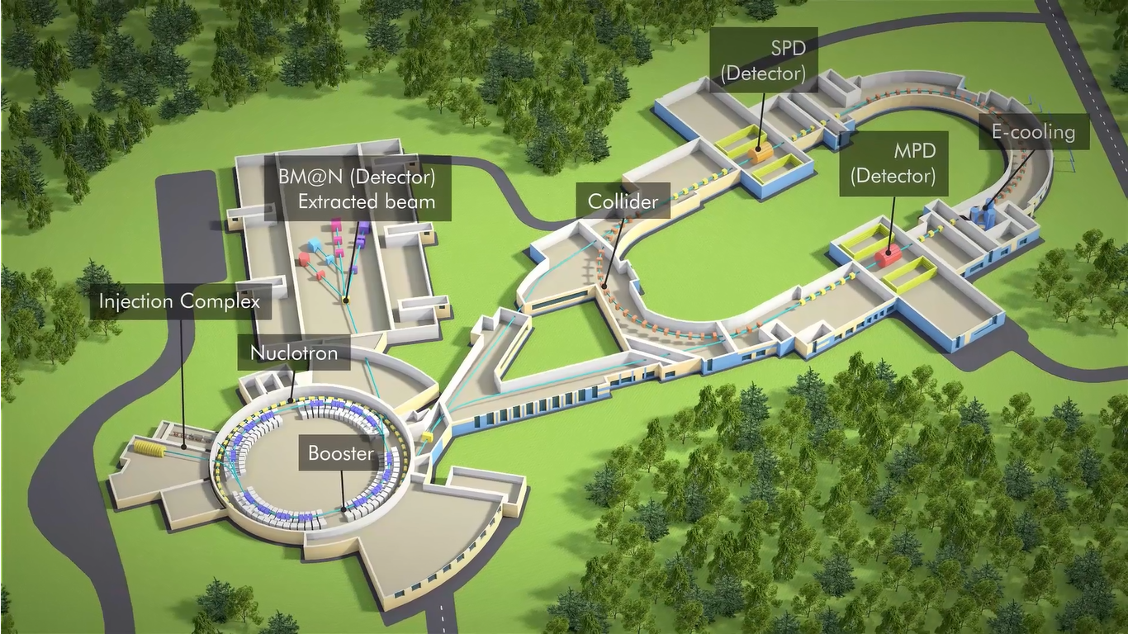
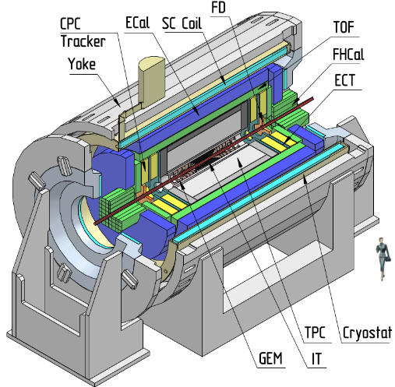
NICA facility
(Dubna, Russia)
MPD
Notes:
This is a view of major NICA facilities. The Nuclotron – supercoducting synchrotron with circumference of 250 meters was put in operation 24 years ago. The beams from Nuclotron are extracted to the experimental hall, where the first experiment of NICA program BM@N is located. The plan is to put in operation a booster in 2019, and collider - in 2020 simultaneously with the MPD.

Slide 4
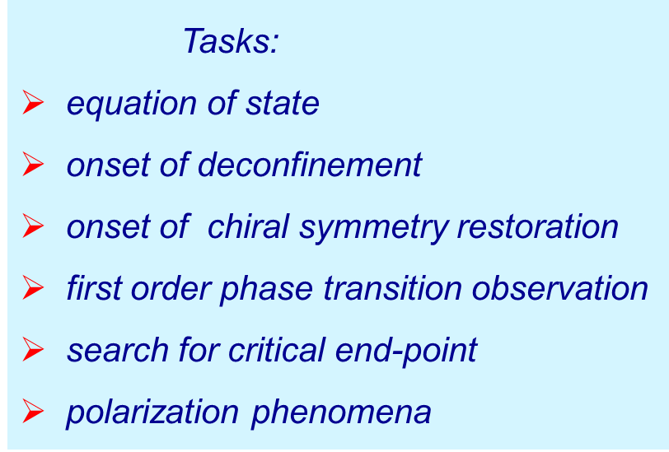
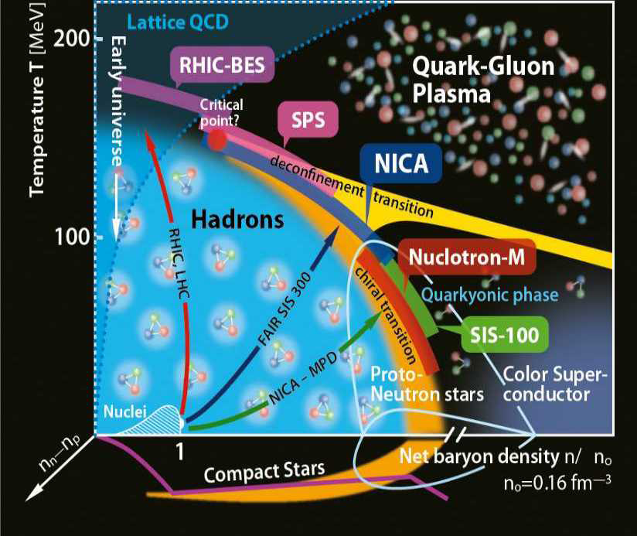
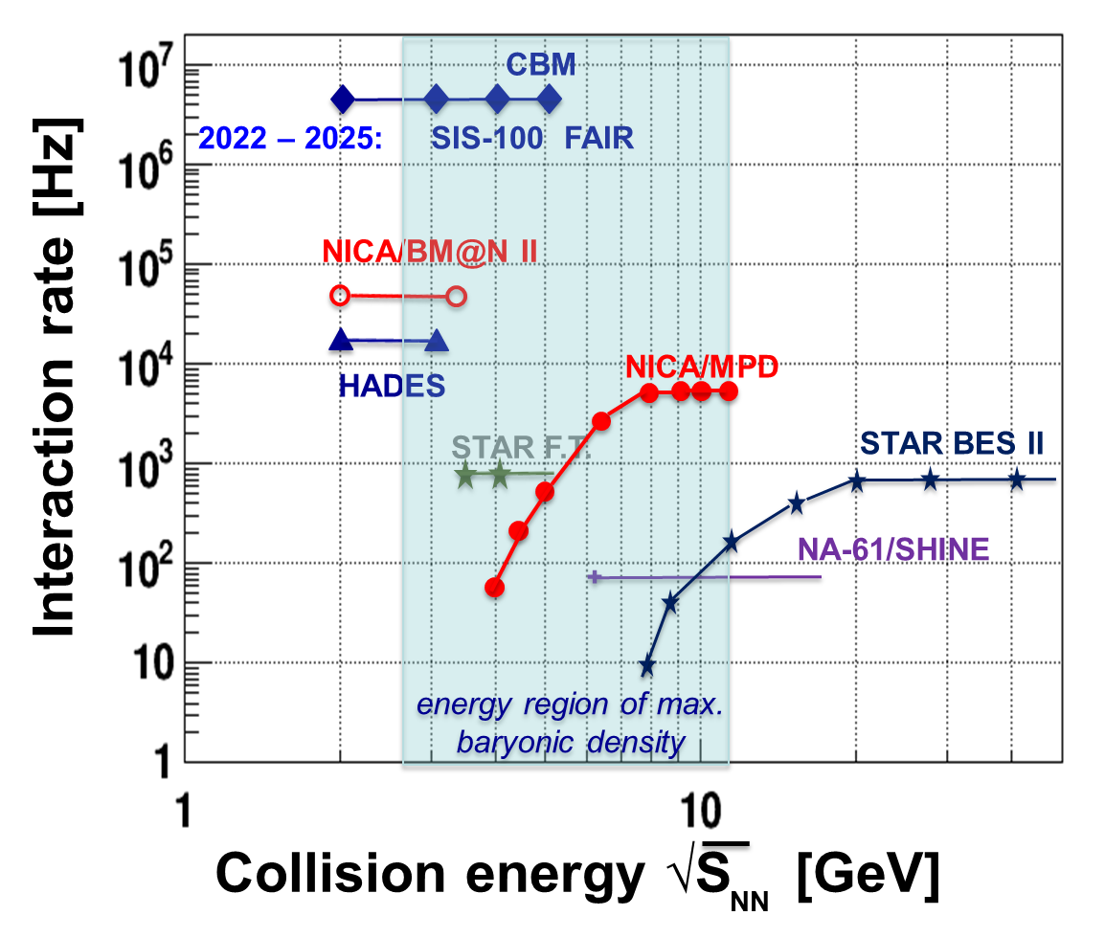
NICA experimental program:
map out the QCD phase diagram and to establish the properties of the different phases
Energy range:
√s_{NN}=4-11 GeV (Au-beam).

Slide 5
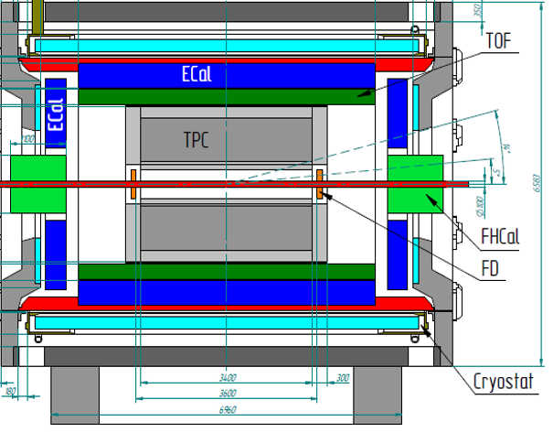
Multi-Purpose Detector (MPD)
Stage 1:
TPC, TOF, ECAL, FHCAL, FFD
tracking:
up to |η|< 1.8 (TPC)
PID:
had., e, γ (TOF, TPC, ECAL)
Reaction:
centrality & plane determination (FHCal)
Detector requirements:
Large homogenous acceptance : 2π in athimutal angle, |η|<3, 0.1<p_{t}<3 GeV/c
High efficient 3-D track reconstruction
Powerful PID: π/K up to 1.5 GeV/c, K/p up to 3.0 GeV/c
ECAL for γ, e
Careful event characterization: impact parameter & event plane reconstruction
High event rate capability up to ~ 6 kHz
Notes:
The MPD will be put in operation at two stages. At the first one the barrel part will be equipped with major tracking detector TPC, TOF end ECAL. FHC and FD will be operational as well.
At the second stage the detector will be supplemented with IT and end cap subdetectors.

Slide 6
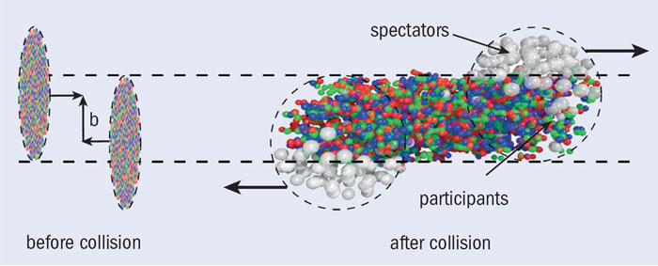
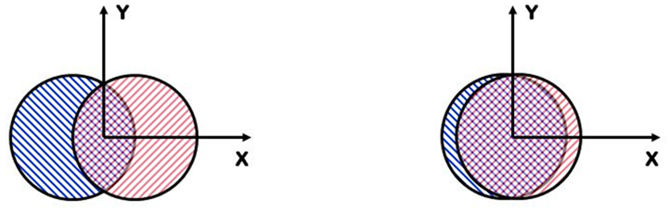
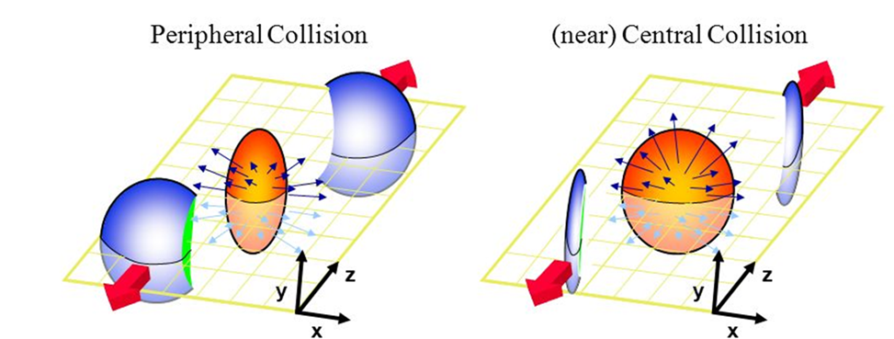
Spectators in ion collisions.
Spectators – non-interacting projectile nuclear fragments.
spectators
Reaction plane:
plane of b and Z (beam).
Free spectators – protons and neutrons.
Bound spectators with A>1.
Spectators are effective tool in the measurements of centrality and the reaction plane of collisions.
Spectators are sensitive to the fragmentation models.
Can spectators be an additional probe of the fireball?

Slide 7

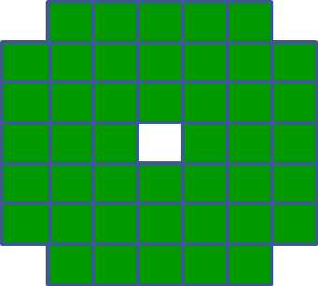
FHCal as a dedicated detector of spectators in MPD
FHCal modules
FHCal
FHCAL consists of 2x44 modules.
~1x1 m² each part.
Beam hole 15x15 cm².
Lead/scintillator sampling calorimeter.
Longitudinal segmentation;
Light readout- WLS-fibers;
7 sections/photodetectors in each module.
Two arms of hadron calorimeter at opposite sides in forward regions.
At the distance 3.2 meters from the interaction point.
Available acceptance corresponds to pseudorapidity 2.0<η <5.0

Slide 8
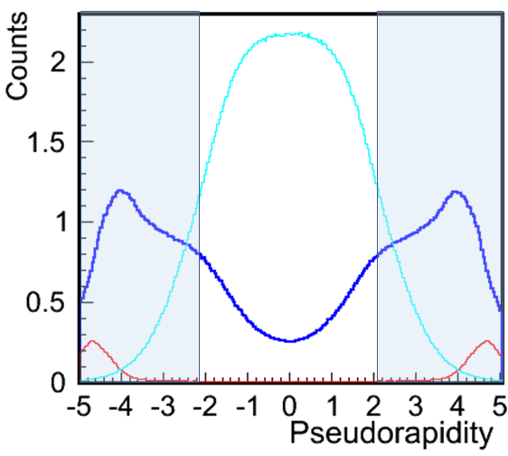
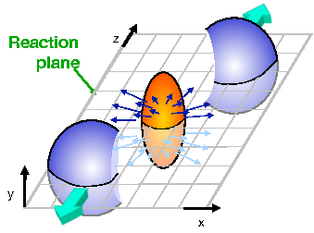
FHCal features
Pions
Protons + neutrons
Fragments
FHCal acceptance
Event plane
FHCal detects the energy of spectators;
FHCal detects the space distribution of the spectators;
FHCal detects the produced particles in forward region.
Spectator spot
Since FHCal has a beam hole, most of the bound spectators escape in this hole.
Mainly, free spectators (protons and neutrons) deposit energy in FHCal.
FHCal simulation response depends on the fragmentation model/generator.

Slide 9
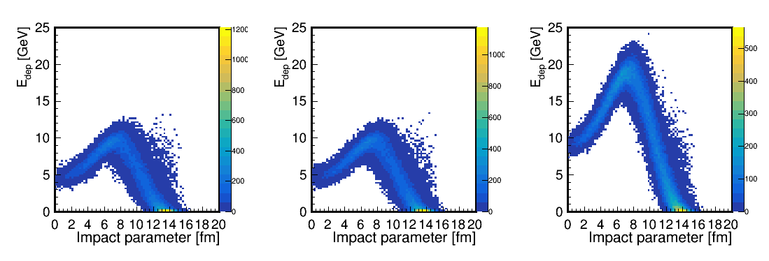
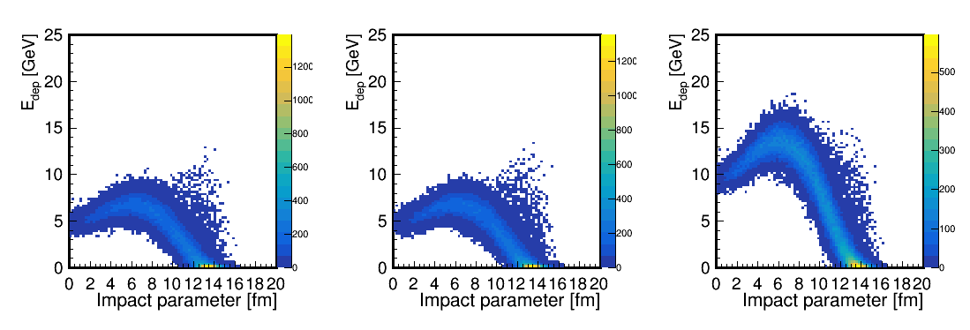
Fragmentation models/generators
Depending on fragmentation model, simulated energy deposition in FHCal can be quite different.
LAQGSM
DCM-SMM
Non-spectator’s contributions
LAQGSM: S. G. Mashnik, K. K. Gudima, R. E. Prael, A. J. Sierk, M. I. Baznat, N. V. Mokhov, CEM03.03 and LAQGSM03.03 Event Generators for the MCNP6, MCNPX, and MARS15 Transport Codes,
arxiv:0805.0751 [nucl-th] (2008)
For DCM-SMM, the maximum energy deposition in FHCal is about 30% less due to the larger number of intermediate mass fragments
(effect of beam hole).
DCM-SMM: M. Baznat, A. Botvina, G. Musulmanbekov, V. Toneev & V. Zhezher Monte-Carlo Generator of Heavy Ion Collisions DCM-SMM, Phys. Part. Nuclei Lett. 17, 303–324 (2020). https://doi.org/10.1134/S1547477120030024
A few models must be compared!

Slide 10
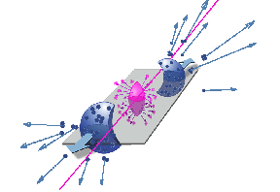
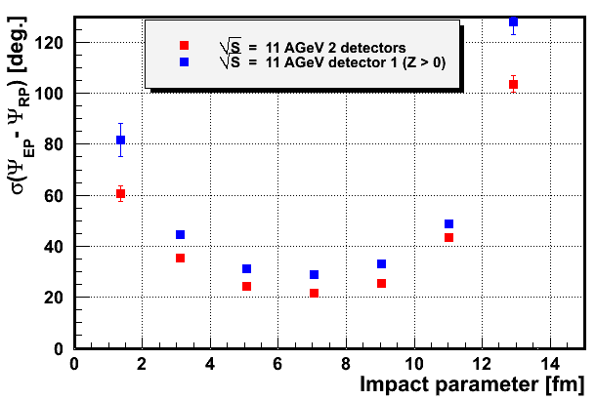
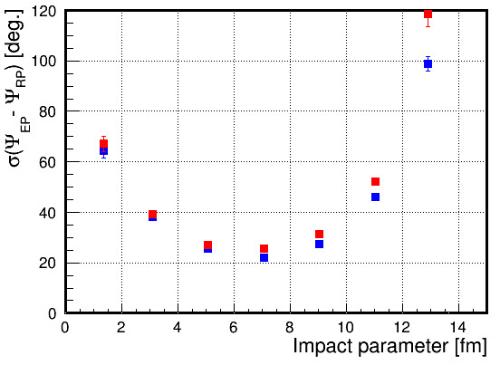
Reconstruction of the event plane with spectators
From energy and space distribution of spectators one can determine the event plane as an experimental estimate of the reaction plane.
E_{i} , (x_{i} ,y_{i}) – energy and coordinates of i-module.
spectators
Event plane in first FHCal part:
Event plane in both FHCal parts:
Resolution: difference between true reaction plane and reconstructed event plane.
(LAQGSM)
(DCM-SMM)
Detection of all types of the spectators (protons, neutrons) for both colliding nuclei would ensure the outstanding ~20⁰ angular resolution of the event plane!

Slide 11
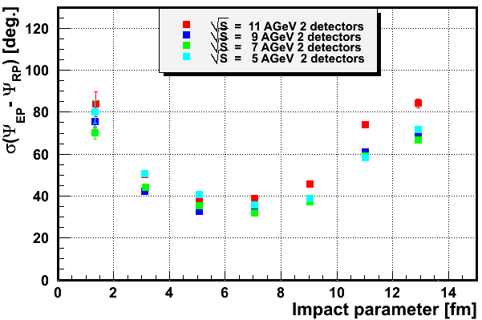
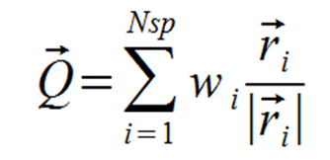
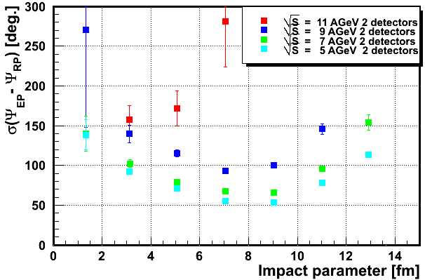
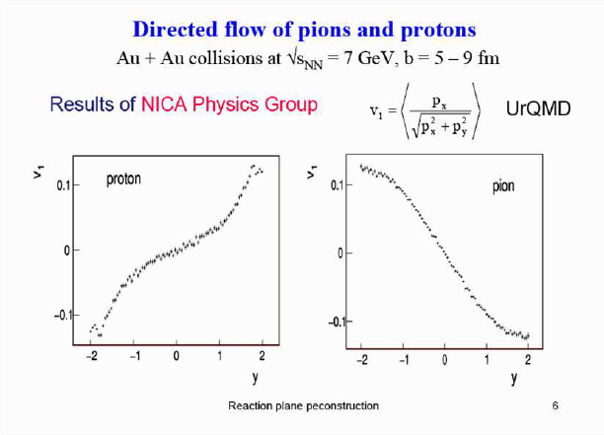
Resolution of the event plane for only charged particles
Only charged spectators (protons and fragments)
All charged particles (including pions)
Weight w_{i}=1.
The best resolution of event plane is about 30⁰-40⁰ in case of charged spectators only.
For all charged particles (including pions) the resolution is 60⁰ and larger.
It is a factor of 3 and more worse comparing to FHCal option.
The resolution degradation is due to the fact that protons and pions have an opposite signs of v₁ flow.
Impact of pion multiplicity at the event plane resolution is very strong. The contribution of pion energy in calorimeter is less significant.
Hadron calorimeter is the best option!

Slide 12
Centrality. Problem with beam hole in FHCAL.
For hermetical calorimeter the energy deposition of spectators has monotonic dependence on impact parameter.
It is not true in real situation.
Bound fragments have small transverse (Fermi) momentum and escape into beam hole.
LAQGSM
Energy deposition in FHCal can not resolve the central and peripheral events.
New observables are needful to resolve ambiguity in energy deposition of the central and peripheral events.
The space information about the spectator hit points can be used additionally to the detected energy.
One can construct a few such observables.

Slide 13
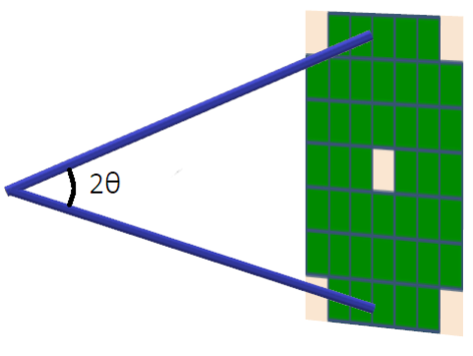
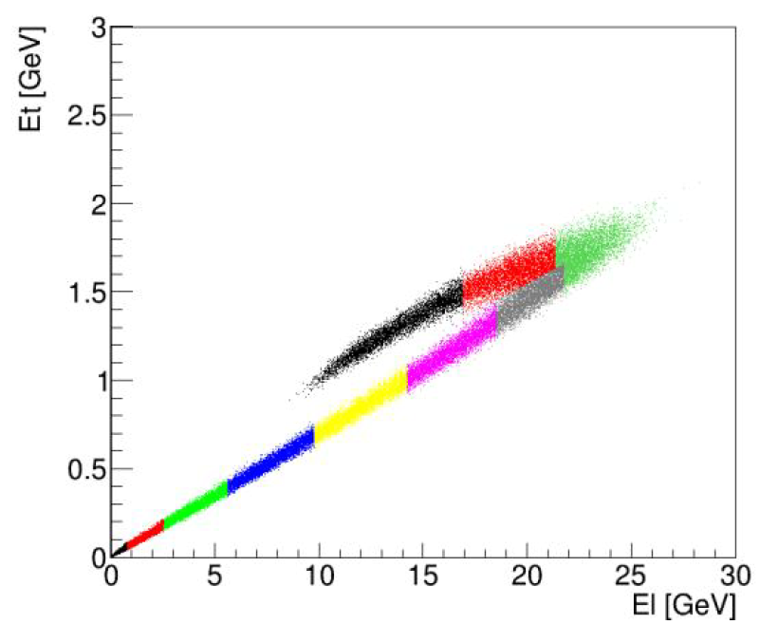
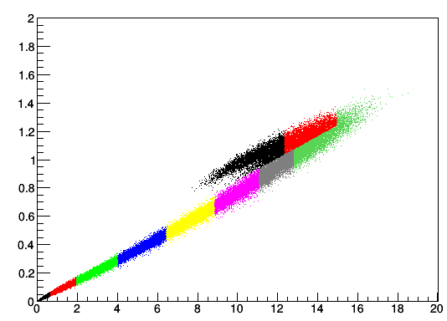
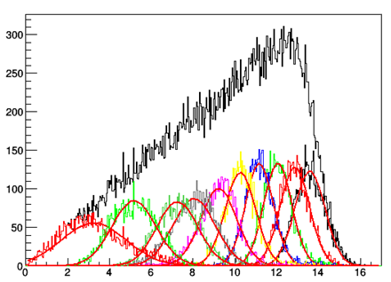
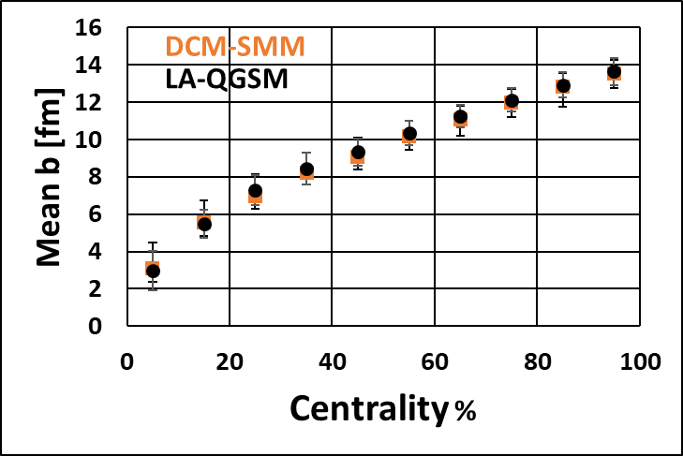
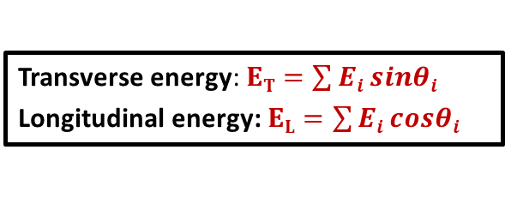





($ET$, $EL$) observables in FHCal for the centrality measurement
Transverse energy: $ET=\sum{Ei sinθi}$
Longitudinal energy: $EL=\sum{Ei cosθi}$
$$Ei$$
interaction point
Each color bin is 10% fractions of the total number of events.
$ET [$GeV]
Each color bin is 10% fractions of the total number of events.
LAQGSM
$ET [$GeV]
Each color bin is 10% fractions of the total number of events.
DCM-SMM
$EL [$GeV]
$EL [$GeV]
counts
DCM-SMM
For DCM-SMM model the identification of central events is not suitable.
New approaches are needed!
Impact parameter [fm]
13

Slide 14
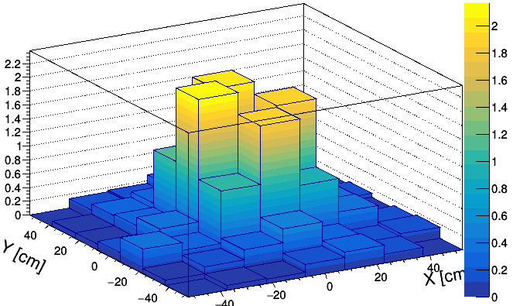
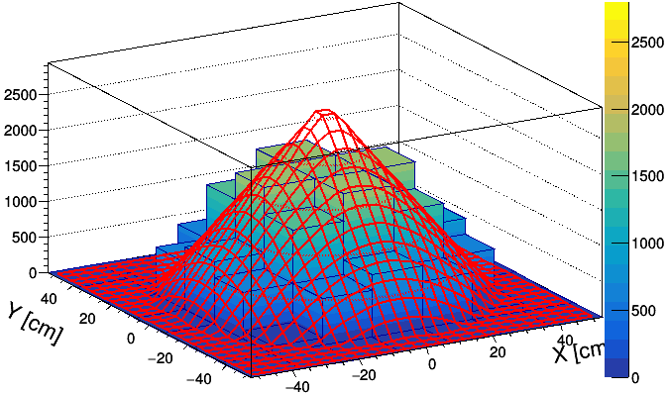
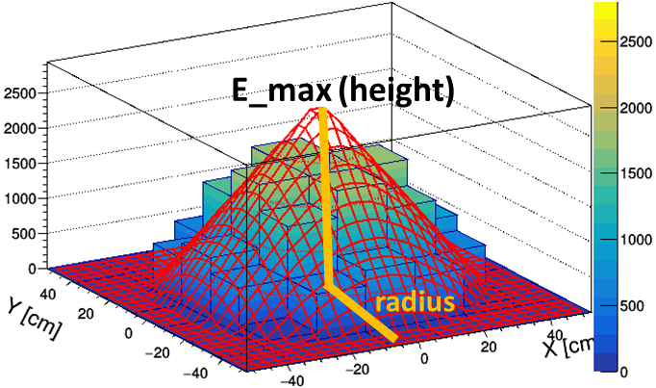
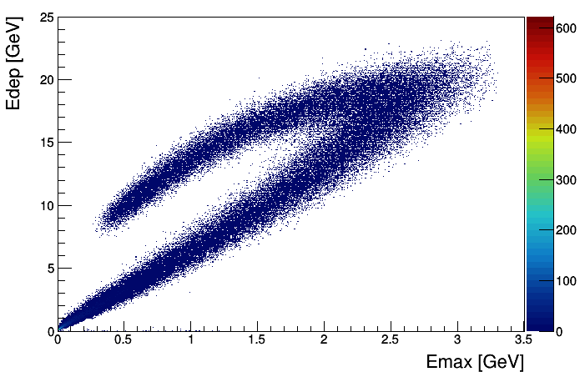
Centrality: 2D-fit of energy distributions (linear approach)
In this method the space energy distribution in FHCal modules is used.
The histogram is fitted by a symmetrical cone (linear approximation).
Weight of each bin is proportional of the energy deposited in corresponding FHCal module.
Energy distribution in FHCal modules
Single event
Fitted event
Initially we have experimental energy deposition E_{dep} in FHCal.
E [GeV]
E [MeV]
Energy deposition vs maximum energy in FHCal center
After linear fit we have:
E_{fit} is reconstructed energy (volume of cone);
E_{max} – maximum energy in central bin (in FHCal hole);
Radius is defined by the scattering angle of spectators.
central events
peripheral events
This correlation can be used for the centrality determination.
LAQGSM

Slide 15
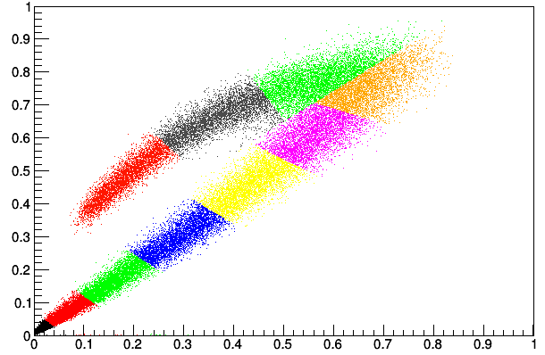
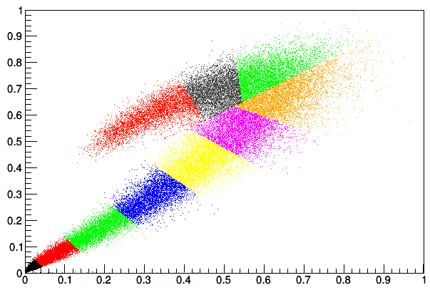
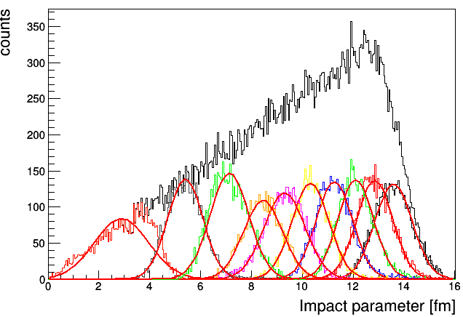
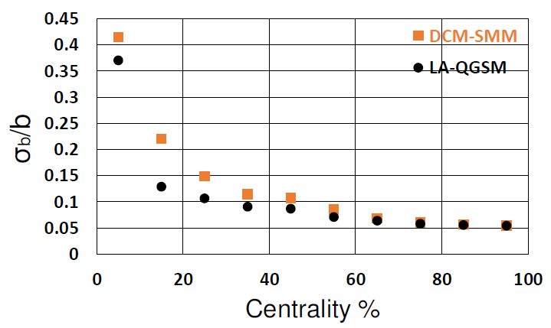
Centrality resolution for E_{dep} vs E_{max}
Each color bin is 10% fractions of the total number of events.
LAQGSM
DCM-SMM
Edep [a.u]
Edep [a.u]
E_max [a.u]
E_max [a.u]
Energy deposition vs maximum energy in FHCal center
DCM-SMM
The accuracy of centrality determination depends on fragmentation model.
Real data can be quite different!

Slide 16
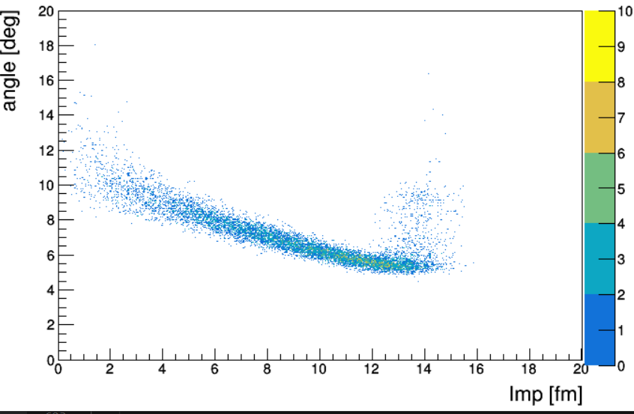
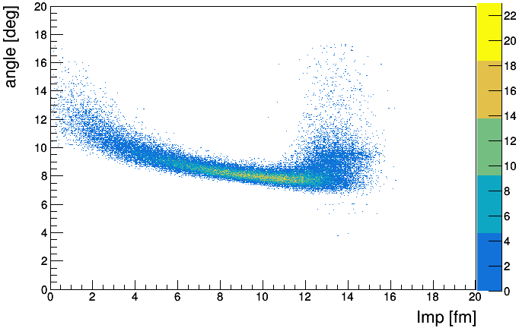
Scattering angles of spectators
Can spectator’s scattering angle be sensitive to the fireball?
E [MeV]
Interaction point
2θ
Interaction point
Radius of spectator’s spot is provided by fit.
Free spectators (protons&neutrons)
Full event
(pion contamination)
Scattering angle [deg]
LAQGSM model
Scattering angle [deg]
Impact parameter [fm]
Impact parameter [fm]
According to the models, the size of the spectator’s spot (scattering angle) depends on the impact parameter. It reflects the spectator’s transverse momenta obtained from fireball.
Can it be used to probe the fireball properties?

Slide 17
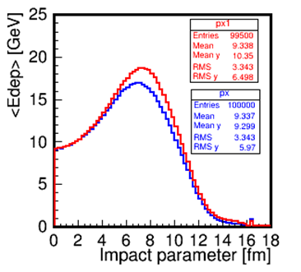
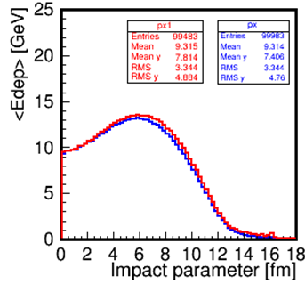
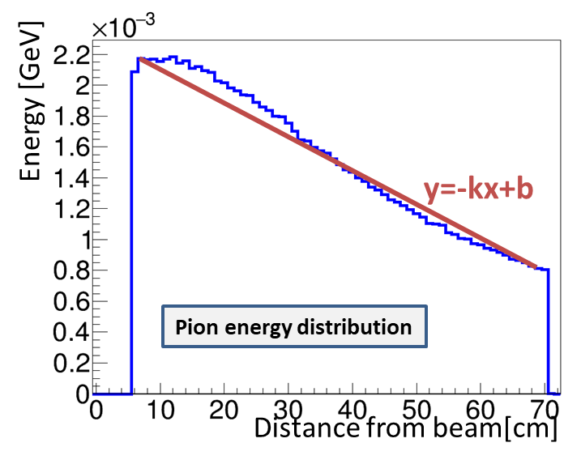
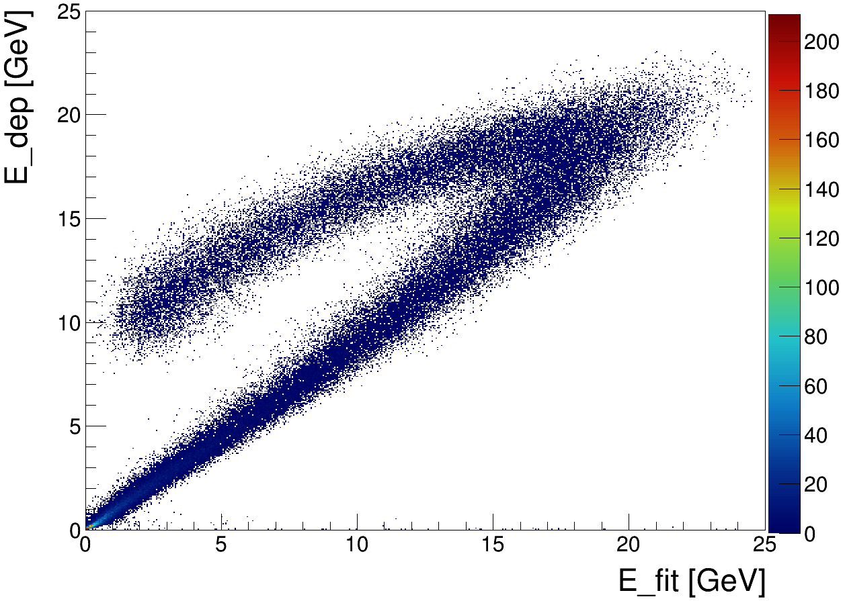
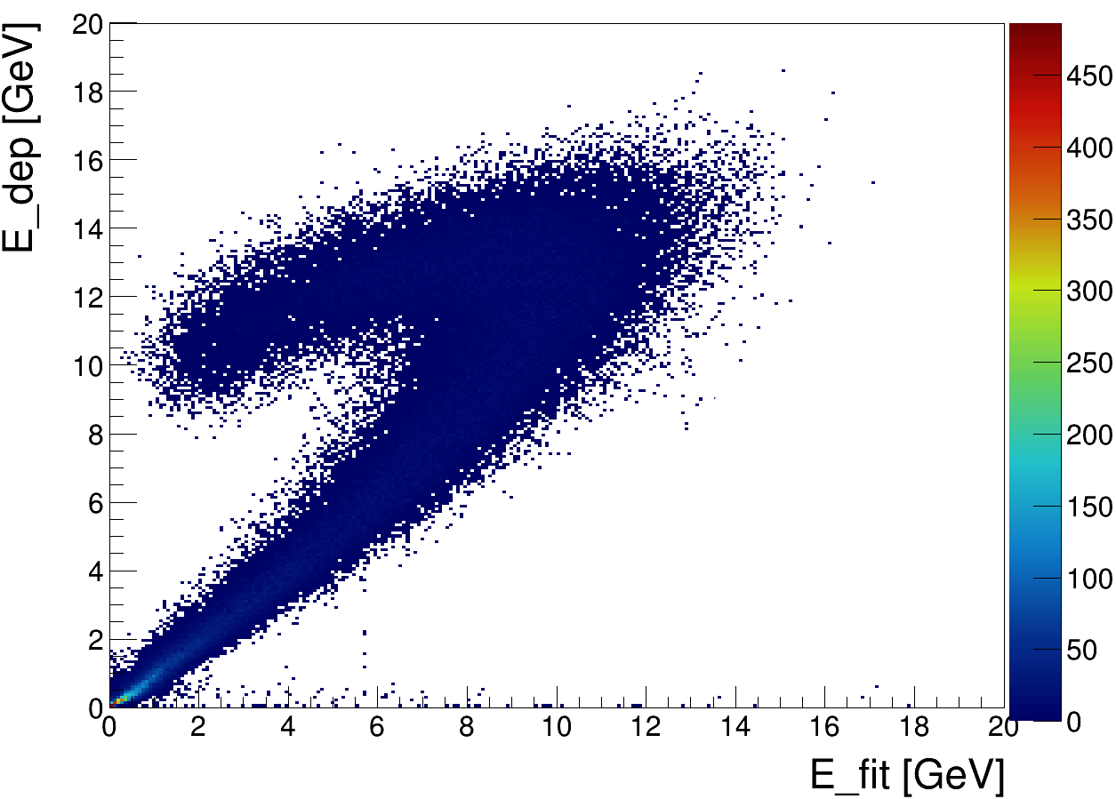
Energy of spectators as a probe of fragmentation model
Energy depositions in FHCal strongly depend on the composition of the free and bound spectators.
Most of bound spectators escape in beam hole, while free spectators deposit energy in FHCal.
LAQGSM
DCM-SMM
No bound spectators.
All spectators
No bound spectators.
All spectators
E_fit is a volume of a cone
Subtracting the pion energy contribution from the FHCal full energy one can obtain the energy of spectators which is dependent on the fragmentation model.
E [MeV]
LAQGSM
DCM-SMM

Slide 18
Conclusion.
Spectators in spite of their oblique participation in nuclei collisions have very interesting applications.
The determination of the collision geometry with spectators allows to avoid the impact of the participant region.
Detection of all free spectators types (protons and neutrons) of both colliding nuclei provides the outstanding angular resolution of the event plane of about 20⁰.
FHCal at MPD is unique tool for the measurements of the spectators.
The beam hole in FHCal makes a serious problem with the centrality measurements because of the leak of heavy fragments.
Space information about the spectator’s hit points allows to construct a few observables to resolve the ambiguity in energy deposition from central/peripheral events.
Angular distribution of the spectators can carry information about the fireball.
Simulated energy depositions in FHCal depend on the fragmentation model. Therefore, the experimental energy depositions can probe the models.

Slide 19
Thank you!

Slide 20
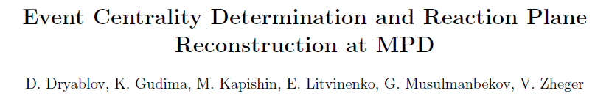
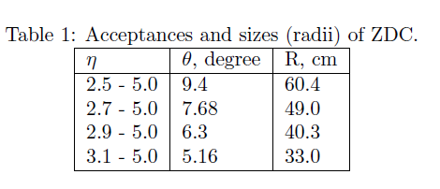
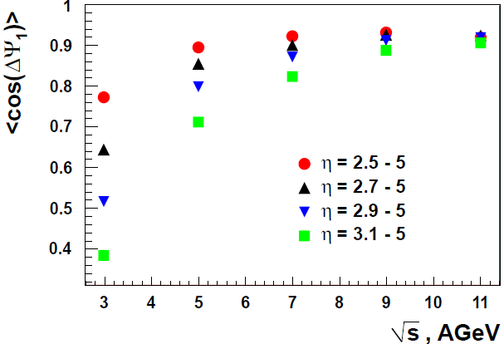
Influence of FHCal acceptance at event pane reconstruction.
http://mpd.jinr.ru/data/presentations/notes/mpd_phys-002.pdf
Calorimeter with diameter 100-120 cm has an appropriate accuracy in event plane reconstruction in all range of beam energies.

Slide 21
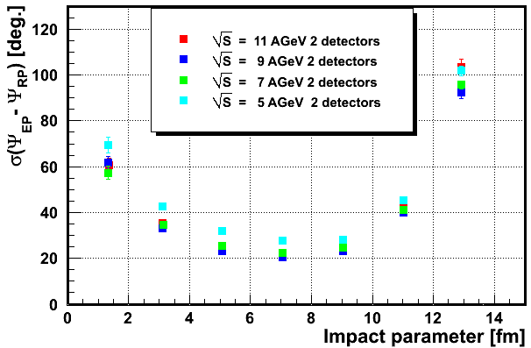
Angular resolution of the reconstructed event plane.
Independent measurements of the spectators in both arms of FHCal improves the resolution for a factor of 1.4.
(DCMSMM)
(LAQGSM)
For the maximum beam energy the angular resolution achieves 20⁰!

Slide 22
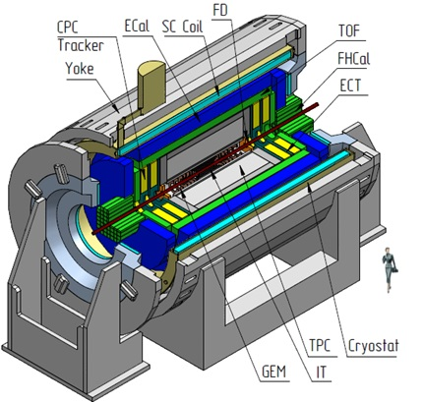
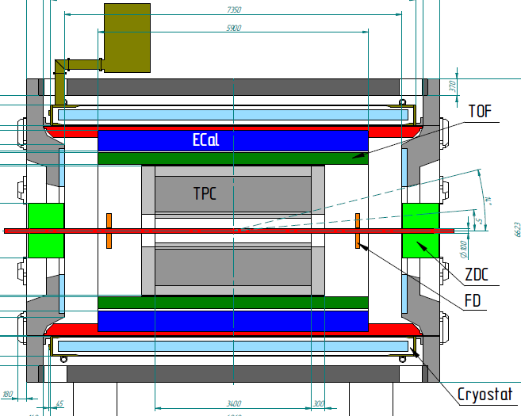
1st stage
FHCal
ITS
TPC
Notes:
The MPD will be the fist detector operated at the Collider. Main target is …..
The collaboration is permanently growing.

Slide 23
Structure of Accelerator Complex and Operation Regimes
Linac HILac
KRION
Booster (25 Tm)
storage of
(2 ÷ 4)×10⁹ ions,
acceleration
up to 600 MeV/u
Ion sources
Linac LU-20
Fixed Target Area
Stripping (80%) ¹⁹⁷Au³¹⁺ => ¹⁹⁷Au⁷⁹⁺
Nuclotron (45 Tm)
injection bunch
~ 2×10⁹ ions
acceleration up to
1 - 4.5 GeV/u
IP-2
Two SC collider rings
~ 2 x 22 injection cycles
22 bunches per ring
IP-1
Notes:
The structure and operation regime of NICA accelerator complex are the following. An existing facility, injection block and superconducting synchrotron Nuclotron, which have been modernized, provide beams to the hall with experimental set-ups. The complex development include: construction of a new injection complex for heavy ions, booster, and two storage rings with two interaction points.

