Slide 1
NUCLEUS–2020
The meaning behind observed p_{T} regions at the LHC energies, some properties of the regions.
Presenter : Professor Mais Suleymanov
Department of Physics and Institute for Physical Problem of Baku State University , Azerbaijan
Time: 18:40 - 19:05 (Online)
19:20 - 20:05
October 12, 2020

Slide 2
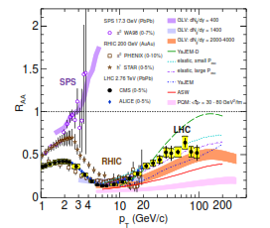
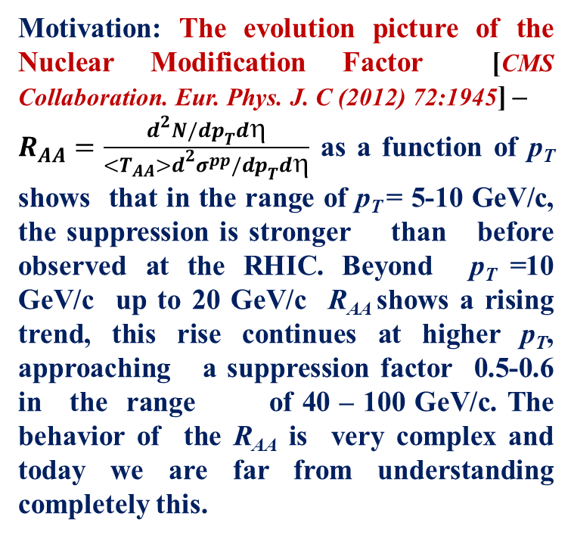
Introduction
Motivation: The evolution picture of the Nuclear Modification Factor [CMS Collaboration. Eur. Phys. J. C (2012) 72:1945] –
$R_{AA}=\frac{d^{2}N/dp_{T}dη}{<T_{AA}>d^{2}σ^{pp}/dp_{T}dη}$ as a function of p_{T} shows that in the range of p_{T} = 5-10 GeV/c, the suppression is stronger than before observed at the RHIC. Beyond p_{T} =10 GeV/c up to 20 GeV/c R_{AA} shows a rising trend, this rise continues at higher p_{T}, approaching a suppression factor 0.5-0.6 in the range of 40 – 100 GeV/c. The behavior of the R_{AA} is very complex and today we are far from understanding completely this.
Goal : to understand the behavior of the R_{AA} from the initial p_{T} distributions.

Slide 3
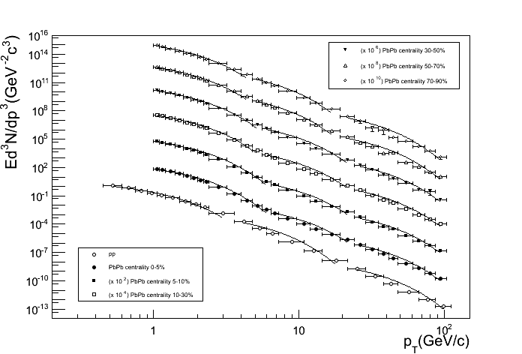
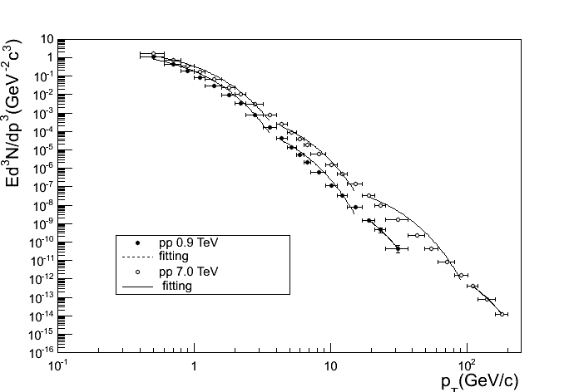
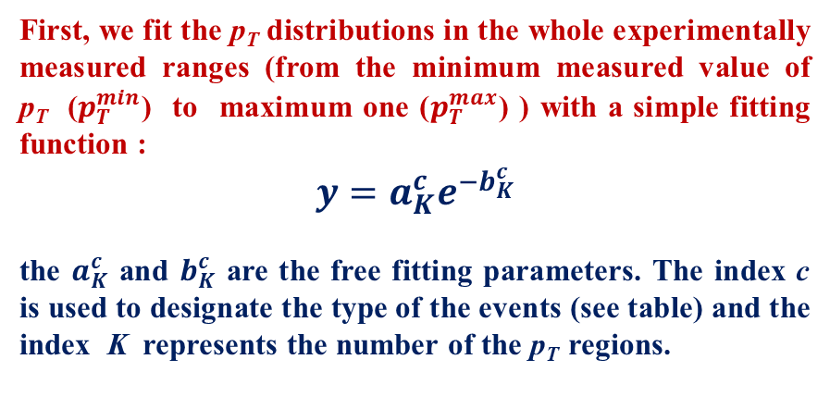
Method
The invariant differential yield of the charged particles , π⁰ – and η - mesons as a function of p_{T} in pp and Pb-Pb collisions at the LHC energies were analyzed /Mais Suleymanov, Int.J.Mod.Phys. E 27 (2018) no. 1, 1850008 ;Int.J.Mod.Phys. E28 (2019) no.10, 1950084; arXiv:nucl-ex/1710.09296/. The published experimental data by CMS, ALICE and ATLAS collaborations were used (see Table).
First, we fit the p_{T} distributions in the whole experimentally measured ranges (from the minimum measured value of p_{T} ($p_{T}^{min}$) to maximum one ($p_{T}^{max}$) ) with a simple fitting function :
$$y=a_{K}^{c}e^{−b_{K}^{c}}$$
the $a_{K}^{c}$ and $b_{K}^{c}$ are the free fitting parameters. The index c is used to designate the type of the events (see table) and the index K represents the number of the p_{T} regions.
energy (TeV) particles | 0.9 pp | 2.76 pp PbPb | 7 | 8
charged particles | 3 | 1 2 | 4 | 5
π⁰-meson | 31 | 11 - | 41 | 51
η-meson | 32 | 12 - | 42 | 52
K⁰-meson | - | 13 - | - | ­-
ϕ­-meson | - | 14 - | - | ­-
This fitting attempt did not produce good fitting results and we decided to decrease the values of the $p_{T}^{max}$ till getting a value of $p_{T}^{max1}$ at which the best fitting results are $\text{reached}\text{. }\text{So} \text{we} \text{defined} \text{the} \text{boundary} \text{values} \text{of} \text{the} \text{p}\text{T} \text{ (}\text{from}{ p}_{T}^{min} \text{to} p_{T}^{max1}\text{) , }\text{for} \text{the} \text{first} \text{p}\text{T} \text{region}\text{ (}\text{K}\text{=}\text{I}\text{).}$

Slide 4
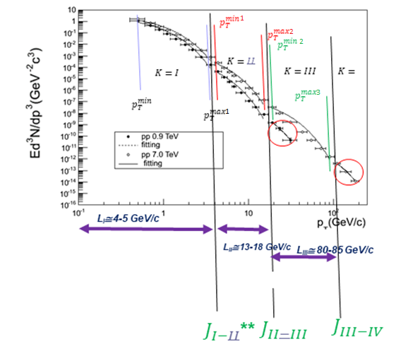

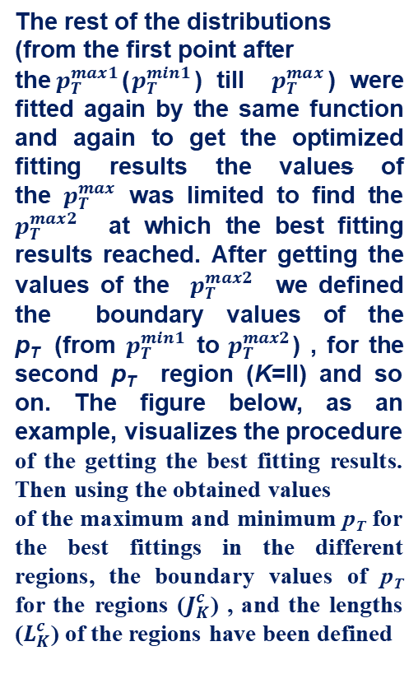
Method
$\text{The} \text{rest} \text{of} \text{the} \text{distributions}\text{ (}\text{from} \text{the} \text{first} \text{point} \text{after} \text{the}{ p}_{T}^{max1}$($p_{T}^{min1}$) till $p_{T}^{max}$) were fitted again by the same function and again to get the optimized fitting results the values of the $p_{T}^{max}$ was limited to find the $p_{T}^{max2}$ at which the best fitting results reached. After getting the values of the $p_{T}^{max2}$ we defined the boundary values of the p_{T} (from $p_{T}^{min1}$ to $p_{T}^{max2}$) , for the second p_{T} region (K=II) and so on. The figure below, as an example, visualizes the procedure
of the getting the best fitting results. Then using the obtained values
of the maximum and minimum p_{T} for the best fittings in the different regions, the boundary values of p_{T} for the regions ($J_{K}^{c}$) , and the lengths ($L_{K}^{c}$) of the regions have been defined
80-100 GeV/c
y₁=a₁e^{-b1pT}
y₂=a₂e^{-b2pT}
y₃=a₃e^{-b3pT}

Slide 5
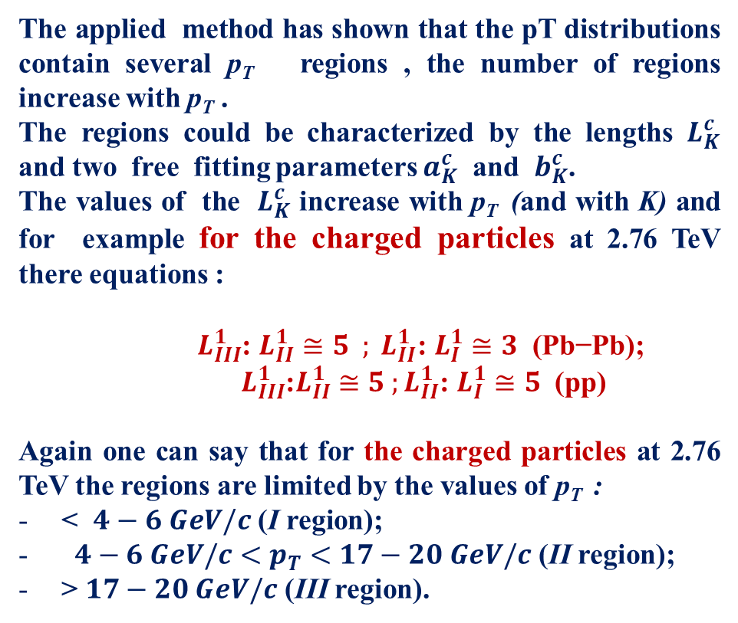
Results
The applied method has shown that the pT distributions contain several p_{T} regions , the number of regions increase with p_{T} .
The regions could be characterized by the lengths $L_{K}^{c}$ and two free fitting parameters $a_{K}^{c}$ and $b_{K}^{c}$.
The values of the $L_{K}^{c}$ increase with p_{T} (and with K) and for example for the charged particles at 2.76 TeV there equations :
${ L}_{III}^{1}$: $L_{II}^{1}≅5 ; L_{II}^{1}\text{: }L_{I}^{1}≅3 \text{ (}\text{Pb}\text{−}\text{Pb}\text{); }$
${ L}_{III}^{1}$:$L_{II}^{1}$ $≅5 ;L_{II}^{1}$: $L_{I}^{1}≅5$ (pp)
Again one can say that for the charged particles at 2.76 TeV the regions are limited by the values of p_{T} :
< $4−6 GeV/c \text{(}\text{I} \text{region}\text{)}\text{;}$
${ 4−6 GeV/c<p}_{T}<17−20 GeV/c$ (II region);
> $17−20 GeV/c$ (III region).
80-100 GeV/c
Let us note that the II region is the area where Nuclear Modification Factor has minimum for the most central heavy ion collisions- jet suppression.

Slide 6
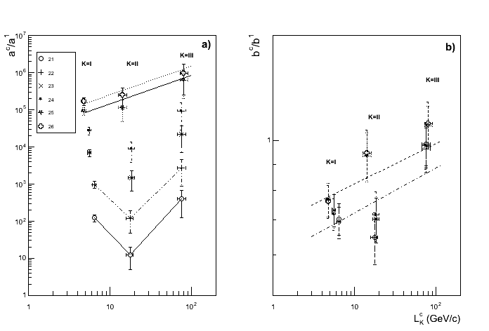
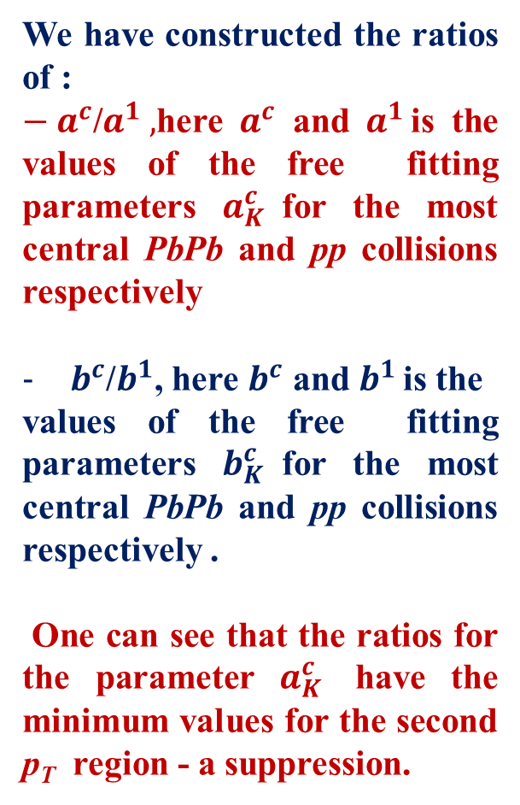
Results
We have constructed the ratios of :
${− a}^{c}$/$a^{1} ,$here $a^{c}$ and $a^{1 }$is the values of the free fitting parameters $a_{K}^{c}$for the most central PbPb and pp collisions respectively
$b^{c}$/$b^{1}$, here $b^{c}$ and $b^{1 }$is the
values of the free fitting parameters $b_{K}^{c}$for the most central PbPb and pp collisions respectively .
One can see that the ratios for the parameter $a_{K}^{c}$ have the minimum values ​​for the second p_{T} region - a suppression.

Slide 7

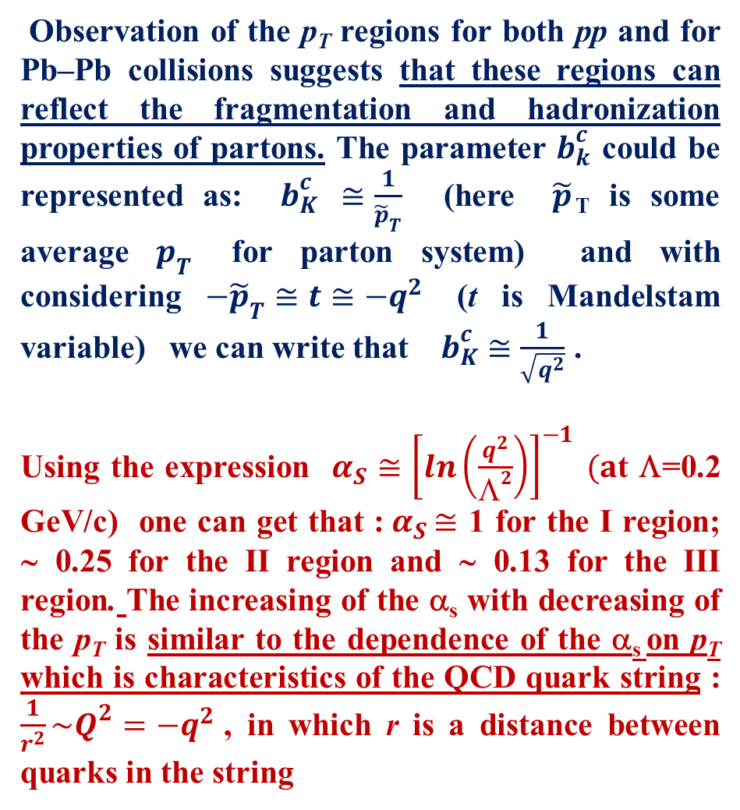

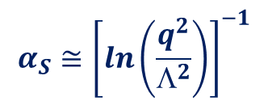

Results
Observation of the p_{T} regions for both pp and for Pb–Pb collisions suggests that these regions can reflect the fragmentation and hadronization properties of partons. The parameter $b_{k}^{c}$ could be represented as: $b_{K}^{c}$ $≅\frac{1}{{\tilde{p}}_{T}}$ (here $\tilde{p}$_{T} is some average $p_{T}$ for parton system) and with considering $−{\tilde{p}}_{T}≅t≅−q^{2}$ (t is Mandelstam variable) we can write that $b_{K}^{c}$ $≅\frac{1}{\sqrt{q^{2}}}$ .
Using the expression $α_{S}≅{\left[ln\left(\frac{q^{2}}{Λ^{2}}\right)\right]}^{−1} (a$t Λ=0.2 GeV/c) one can get that ${\text{:} α}_{S}≅$ 1 for the I region; ∼ 0.25 for the II region and ∼ 0.13 for the III region. The increasing of the α_{s} with decreasing of the p_{T} is similar to the dependence of the α_{s} on p_{T} which is characteristics of the QCD quark string : $\frac{1}{r^{2}}\sim Q^{2}=−q^{2}$ , in which r is a distance between quarks in the string
${ α}_{S}≅$ 1
∼ 0.25
∼ 0.13
$$−{\tilde{p}}_{T}≅t≅−q^{2}$$
$b_{K}^{c}$ $≅\frac{1}{\sqrt{q^{2}}}$
Λ=0.2 GeV/c
$$α_{S}≅{\left[ln\left(\frac{q^{2}}{Λ^{2}}\right)\right]}^{−1}$$

Slide 8
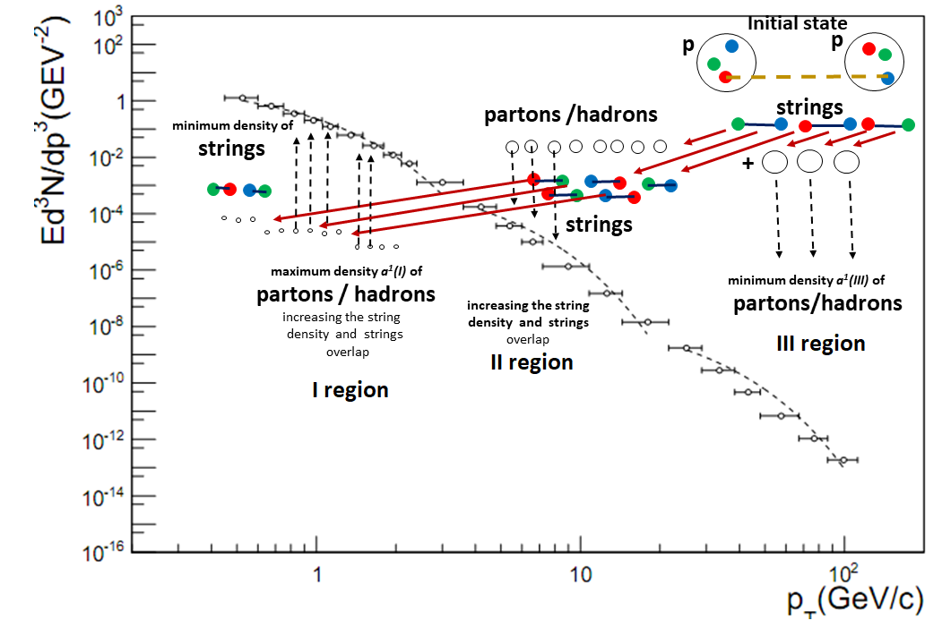
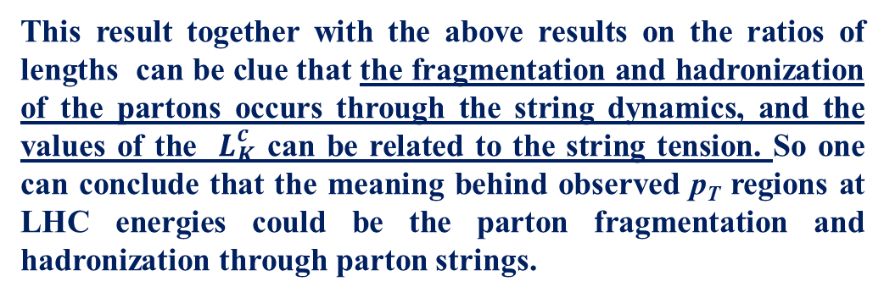
Results
This result together with the above results on the ratios of lengths can be clue that the fragmentation and hadronization of the partons occurs through the string dynamics, and the values of the $L_{K}^{c}$ can be related to the string tension. So one can conclude that the meaning behind observed p_{T} regions at LHC energies could be the parton fragmentation and hadronization through parton strings.
The region III is the domain of creation of first generation partons/strings during collisions, where the most energetic hadrons /partons / strings(with highest tension) are produced and weakly modified by the medium. The region II is the one with highest density of the strings decayed from ones in region III.

Slide 9


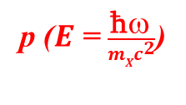

Results
p ($E_{ }$= $\frac{\text{ħ}ω_{ }}{m{Xc}^{2}}$)
The high density causes string fusion and a collective phenomenon, which is as a result of the new string formation in the most central Pb-Pb interactions. It can explain the anomalous behavior of the Nuclear Modification Factor in this region.
The region I is the one with the maximum number of hadrons and minimum number of strings.
In the paper [Mais Suleymanov arXiv: nucl-ex/1710.09296 ] we have discussed that the phenomena string fusion can explain anomalous behaviour of the Nuclear Modification Factor in this region as a result of the inverse Compton effect for partons.
We support that in the case of a coherent collision of the new string with a parton which has a lower energy than the string, the parton can gain energy, resulting in its acceleration and shifting to the higher p_{T} region. After losing a significant part of its energy new string can decay into partons with lower energies - slowed partons in the interval of lower p_{T}.
ϕ
p₁ ($E_{1 }$= $\frac{\text{ħ}ω_{1 }}{mXc^{2}}$)
new string
θ
γ= $\frac{E_{X}}{mXc^{2}}$

Slide 10
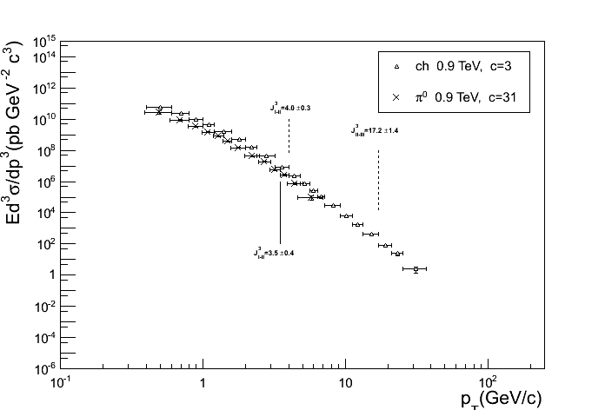
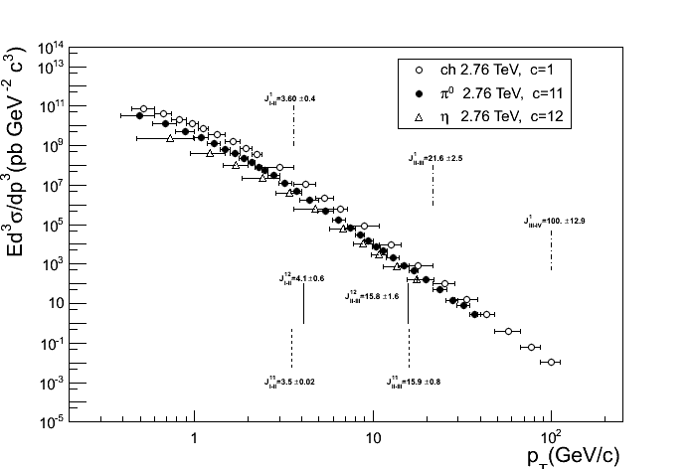
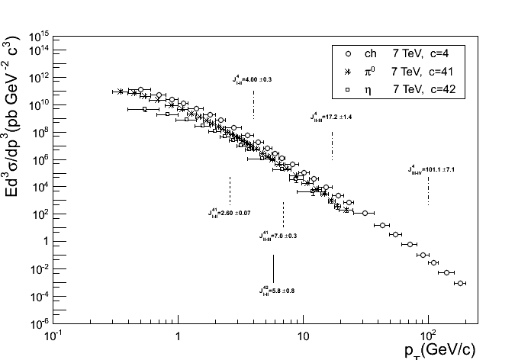
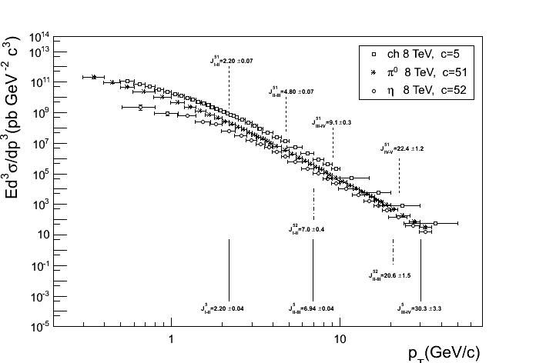
Results
The including of the spectra of neutral mesons to the consideration and increasing the energy of colliding particles has given new results to study some properties of the p_{T} regions.

Slide 11
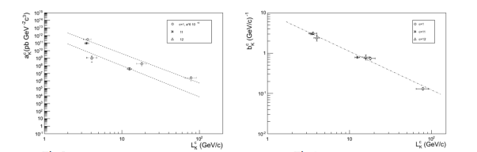
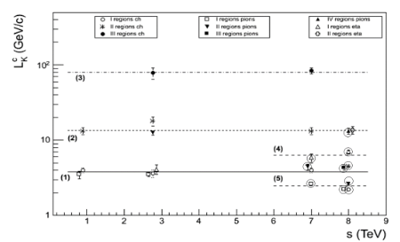
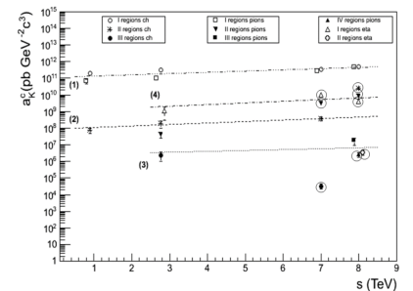
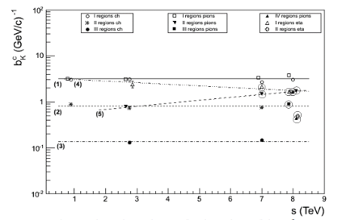
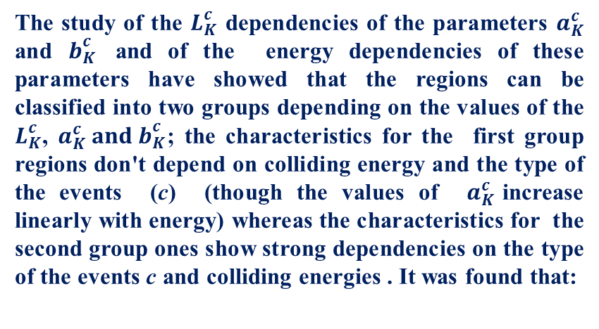
Results
The study of the $L_{K}^{c}$ dependencies of the parameters $a_{K}^{c}$ and $b_{K}^{c}$ and of the energy dependencies of these parameters have showed that the regions can be classified into two groups depending on the values of the $L_{K}^{c}$, $a_{K}^{c} and b_{K}^{c}$; the characteristics for the first group regions don't depend on colliding energy and the type of the events (c) (though the values of $a_{K}^{c}$increase linearly with energy) whereas the characteristics for the second group ones show strong dependencies on the type of the events c and colliding energies . It was found that:
- the first group of regions the lengths of the regions are 3-5 times greater than the lengths of neighboring, lower p_{T} regions.
- the second group of regions the lengths of the regions are 1-2 times greater than the lengths of neighboring lower p_{T} region.
In the framework of the string fragmentation and hadronization dynamics, this could mean that the particles in the group I of regions are produced through previous-generation strings decays into 3-5 strings while those in group II originate from previous-generation strings decays into 2 strings.

Slide 12
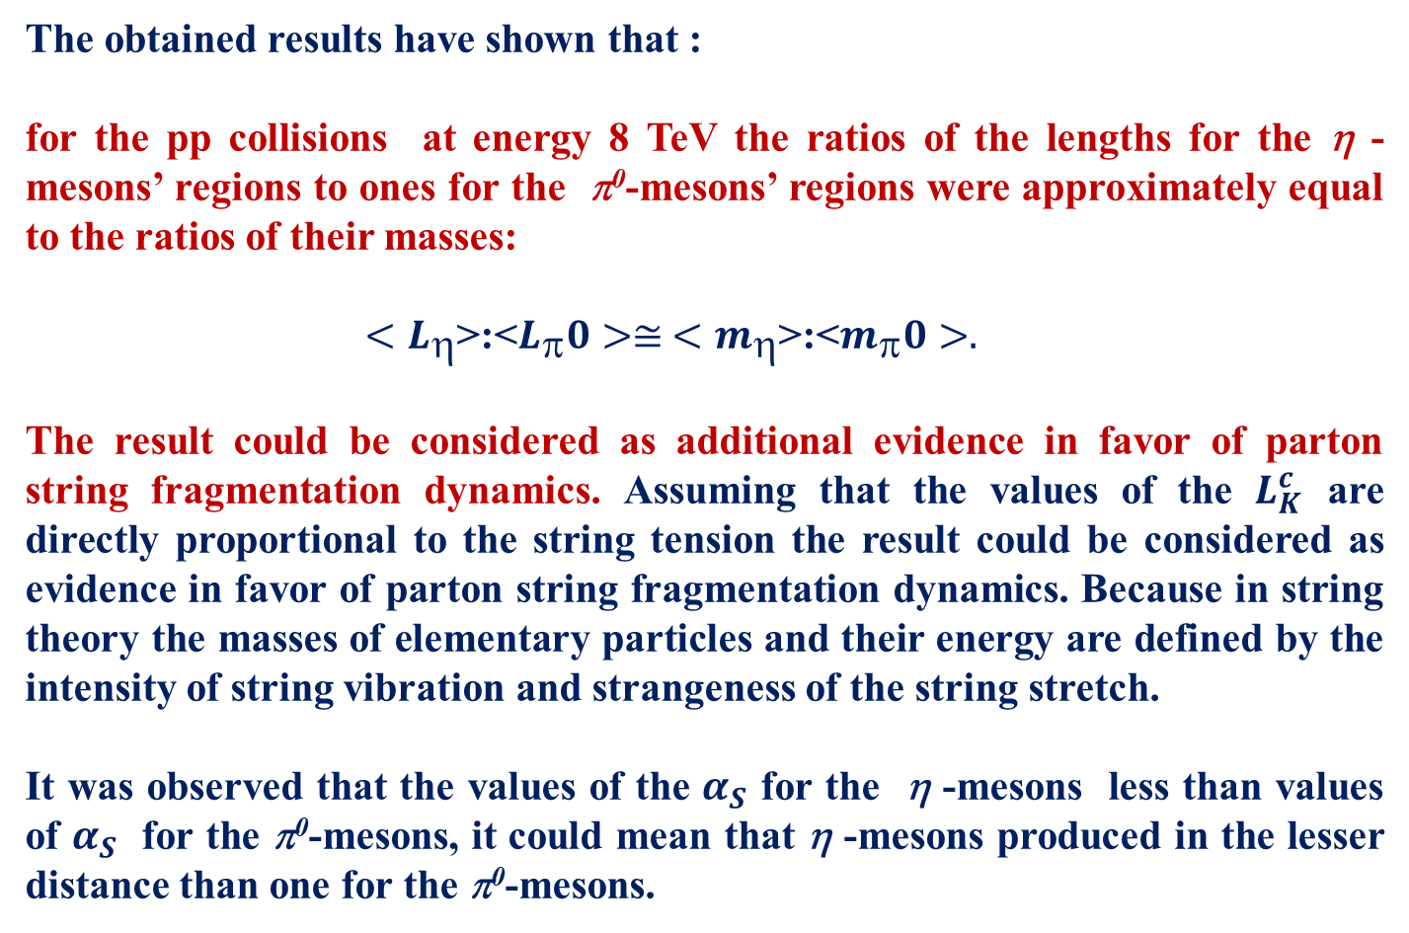
Results
The obtained results have shown that :
for the pp collisions at energy 8 TeV the ratios of the lengths for the η - mesons’ regions to ones for the π⁰-mesons’ regions were approximately equal to the ratios of their masses:
$<L_{}$>:<$L_{}0>≅$ $<m_{}$>:<$m_{}0>.$
The result could be considered as additional evidence in favor of parton string fragmentation dynamics. Assuming that the values of the $L_{K}^{c}$ are directly proportional to the string tension the result could be considered as evidence in favor of parton string fragmentation dynamics. Because in string theory the masses of elementary particles and their energy are defined by the intensity of string vibration and strangeness of the string stretch.
It was observed that the values of the $α_{S}$ for the η -mesons less than values of $α_{S}$ for the π⁰-mesons, it could mean that η -mesons produced in the lesser distance than one for the π⁰-mesons.

Slide 13
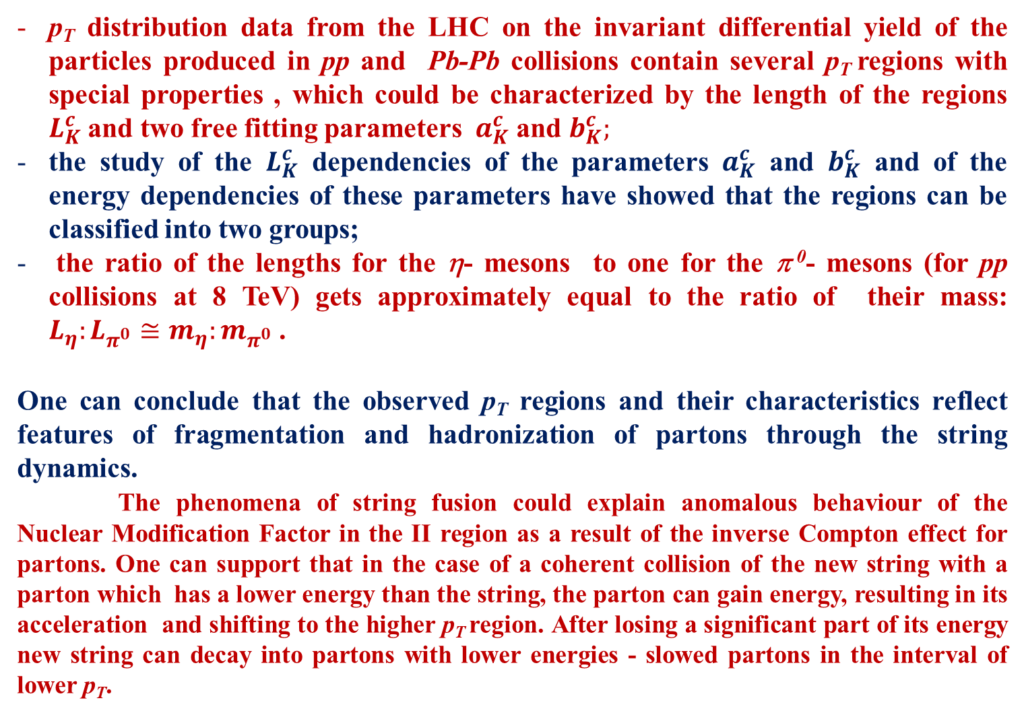
CONCLUSION. One can say that
p_{T} distribution data from the LHC on the invariant differential yield of the particles produced in pp and Pb-Pb collisions contain several p_{T} regions with special properties , which could be characterized by the length of the regions $L_{K}^{c}$and two free fitting parameters $a_{K}^{c}$ and $b_{K}^{c};$
the study of the $L_{K}^{c}$ dependencies of the parameters $a_{K}^{c}$ and $b_{K}^{c}$ and of the energy dependencies of these parameters have showed that the regions can be classified into two groups;
the ratio of the lengths for the η- mesons to one for the π ⁰- mesons (for pp collisions at 8 TeV) gets approximately equal to the ratio of their mass: $L_{η}:L_{π^{0}}≅m_{η}:m_{π^{0}}$ .
One can conclude that the observed p_{T} regions and their characteristics reflect features of fragmentation and hadronization of partons through the string dynamics.
The phenomena of string fusion could explain anomalous behaviour of the Nuclear Modification Factor in the II region as a result of the inverse Compton effect for partons. One can support that in the case of a coherent collision of the new string with a parton which has a lower energy than the string, the parton can gain energy, resulting in its acceleration and shifting to the higher p_{T} region. After losing a significant part of its energy new string can decay into partons with lower energies - slowed partons in the interval of lower p_{T}.

Slide 14
Thank you very much

