Slide 1


HOYLE STATE AND UNSTABLE NUCLEI IN DISSOCIATION OF RELATIVISTIC NUCLEI
Andrei Zaitsev
LHEP, JINR
LXX International conference "NUCLEUS – 2020. Nuclear physics and elementary particle physics. Nuclear physics technologies"
Saint Petersburg, 11-17 October 2020

Slide 2
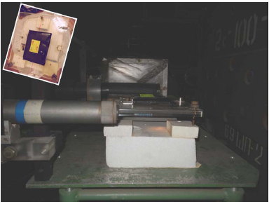
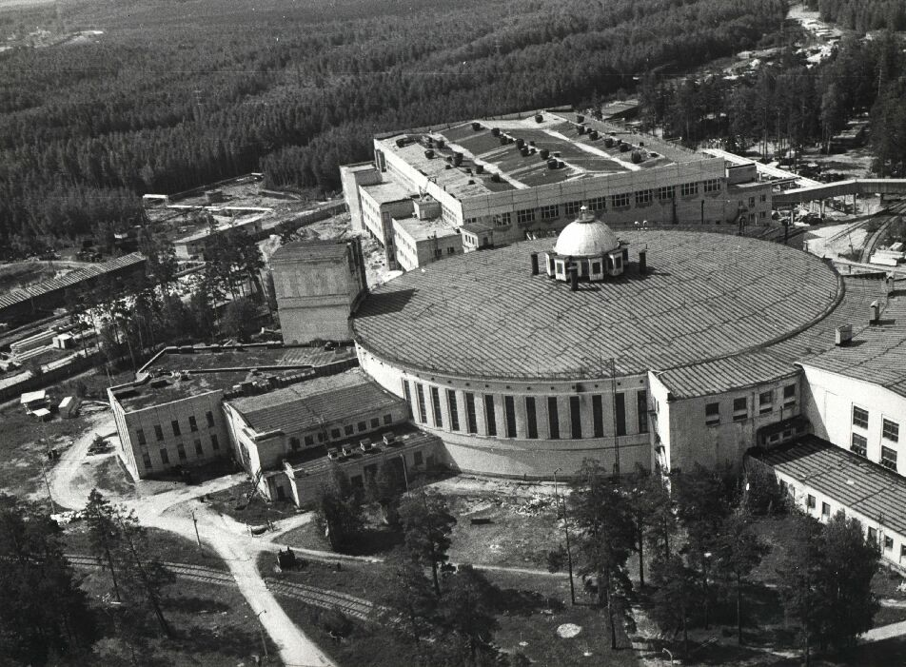
BECQUEREL Experiment at Nuclotron JINR
Within the framework of the project, a systematic study of the cluster structure of light nuclei is carried out. The project is based on the analysis of layers of nuclear emulsion longitudinally irradiated in primary and secondary nuclear beams with an energy of about 1 A GeV. The research is provided by the developing laboratory and the laboratory of viewing and measuring microscopes of the sector of thick-layer nuclear emulsion of the V. Veksler & A. M. Baldin Laboratory of High Energy Physics JINR.

Slide 3
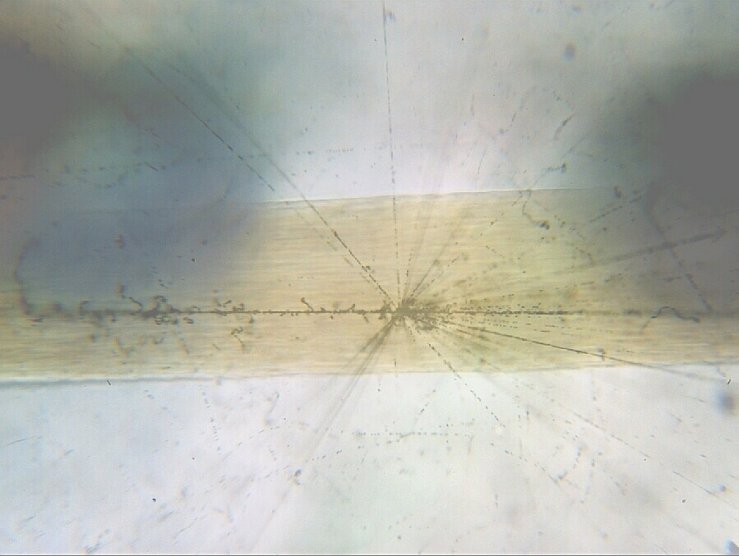
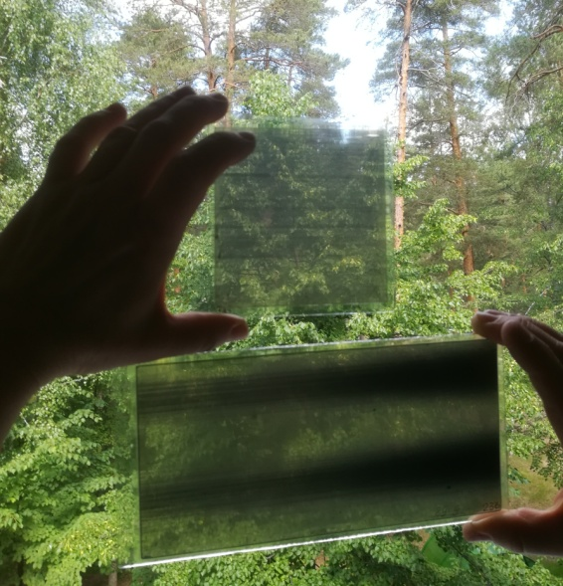
AgBr Crystal - 0.2 μm
Atom - 10⁻⁴ μm
Proton - 10⁻⁹ μm
Hair
60 μm
The project is based on the method of nuclear track emulsions (NTE) providing unrivaled spatial resolution (0.5 μm) and a sensitivity range for measuring tracks of charged particles, starting with highly ionizing short-range ions and up to singly-charged relativistic particles. The use of NTE in newly created beams of relativistic nuclei accelerators makes it possible to make analysis that can not to be reach by electronic detection methods. The accuracy and completeness of the measurement of the angles of emission of fragments generated in peripheral interactions of relativistic nuclei provides unique opportunities for studying the nucleon clustering of light nuclei.

Slide 4
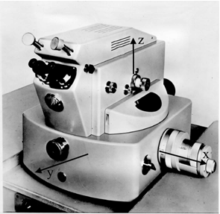
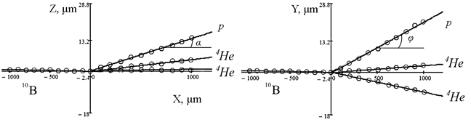
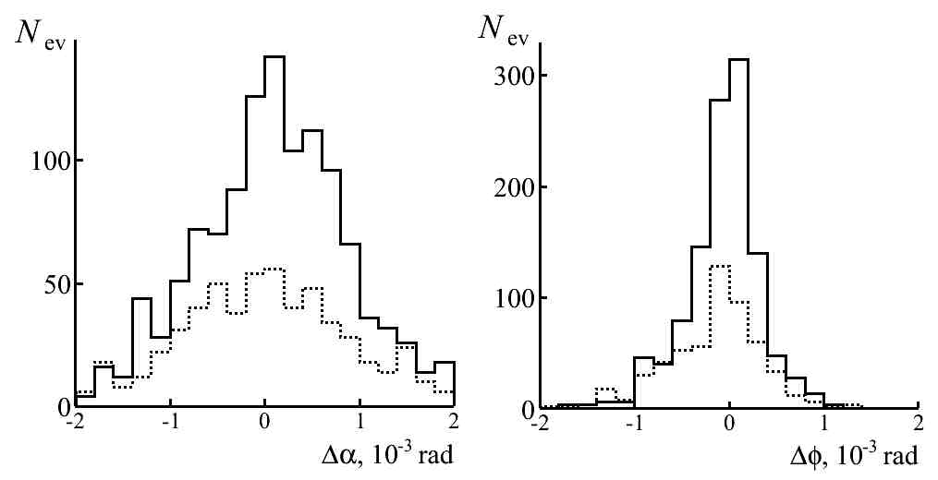
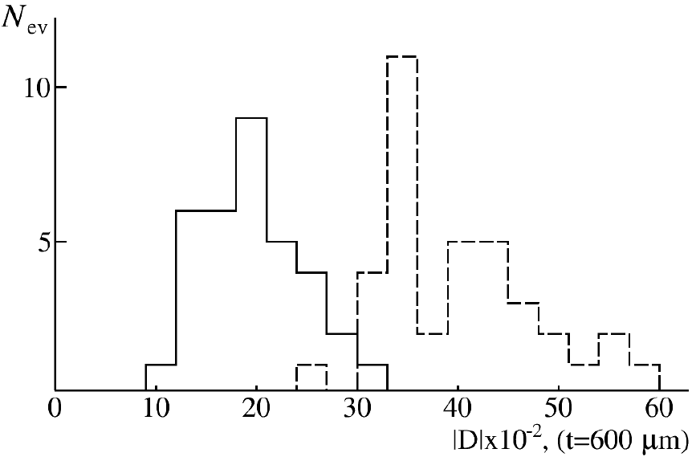
Reconstruction of emission angles of secondary fragments
Example of the restored directions of emission of fragments in the plane of XOZ and XOY in the event №10107 by channel of ¹⁰В → 2α + р.
Microscope KSM-1
⁴He
³He
Errors in reconstruction of deep (α) и plan (φ) angles for tracks of He (solid) and H (dotted) fragments in event ¹⁰B → 2He + H. 〈Δα〉 = 0.08 ± 0.02 (0.78) mrad and 〈Δφ〉 = 0.06 ± 0.01 (0.39) mrad.
A_{fr} = P_{fr}β_{fr}c/(P₀β₀c)

Slide 5
Earlier observations were made in NTE exposures with the nuclei ¹²C, ¹⁶O, ²²Ne, ⁶Li and ⁷Li and were carried out at the JINR Synchrotron in the 70-90s. Within the BECQUEREL Project the peripheral interactions were analyzed in NTE exposed to the following set of nuclei: ⁶He, ^{7,9}Be, ^{8,10,11}B, ^{9,10,11}C and ^{12,14}N. These experimental results allow to present a comprehensive picture of clustering for a family of nuclei at the beginning of the isotope table.

Slide 6
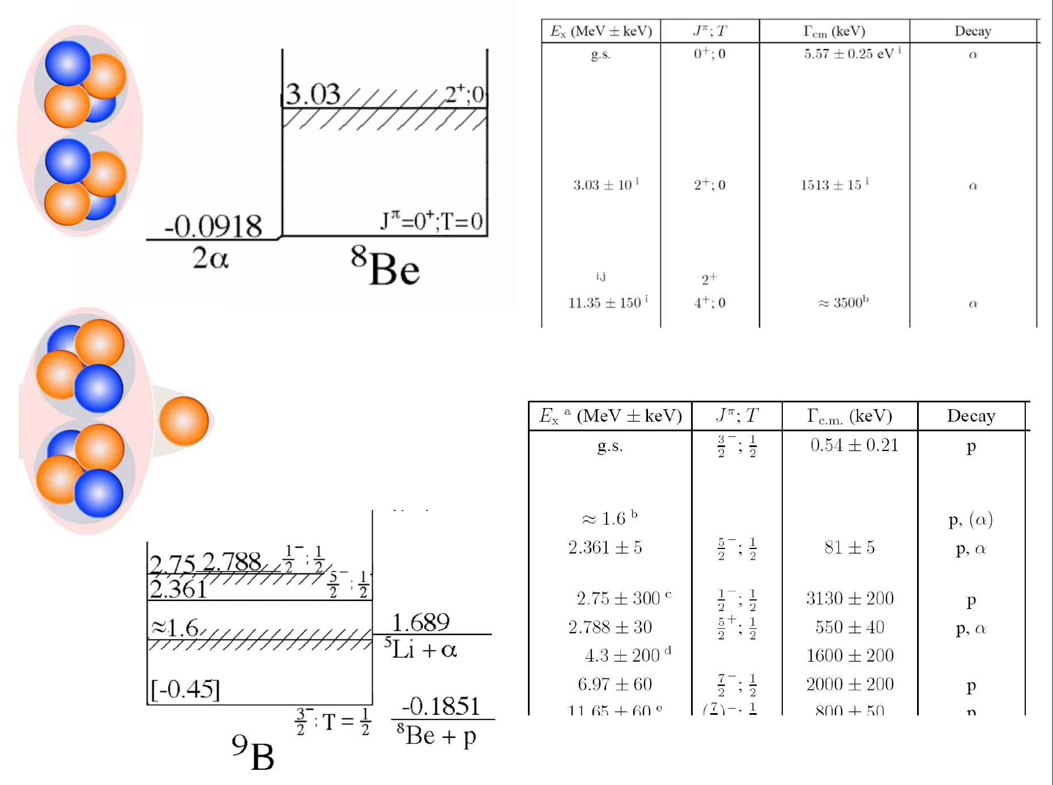

Slide 7
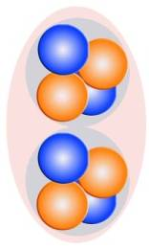

2 A GeV/c ⁹Be → 2α
⁹Be
2α
Q_{2α} = M∗ - M
M^{*2} = ∑(P_{i}·P_{k})
Distribution of number of 2α-pairs N_{2α} over invariant mass Q_{2α} in all 500 events of dissociation ⁹Bе → 2α (dotted line) at 1.2 A GeV and in 198 “white” stars out of them (solid); in the inset, the enlarged part of the distributions Q_{2α} < 1 MeV.
The distribution over Q_{2α} of 2α-pairs (N_{2α} = 500), including “white” 2α-stars (N_{ws} = 198), indicates the condition Q_{2α}(⁸Be) < 0.2 MeV. Then the fraction of decays ⁸Be 36 ± 3 and 41 ± 5%, respectively. Two “influxes” deserve to be noted around 0.6 and 3 MeV. The first of them corresponds to decay through the ⁹Be 2.43 MeV excitation, and the second corresponds to decay from the first excited state ⁸Be₂₊.

Slide 8
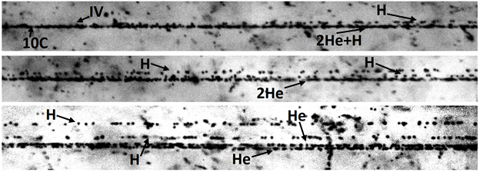
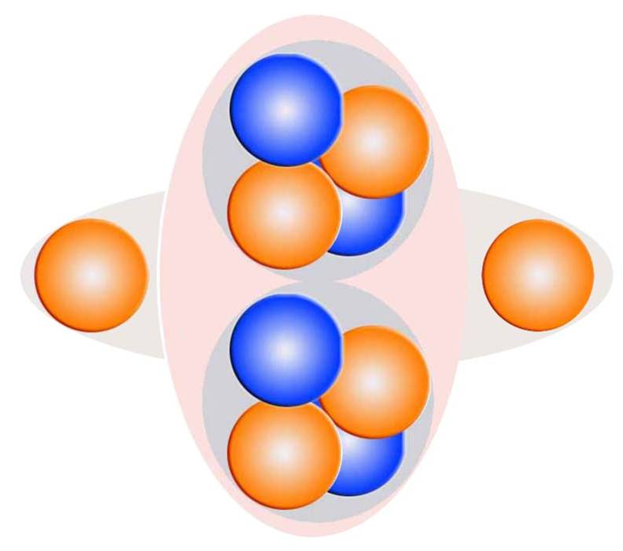
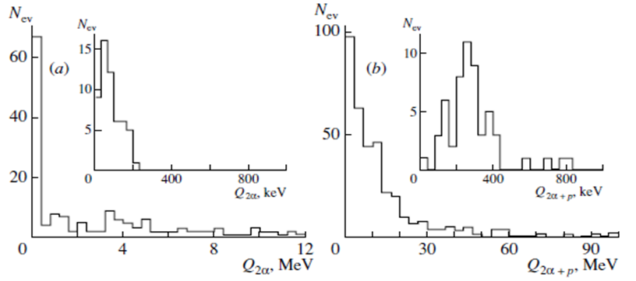
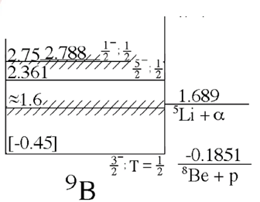
¹⁰C
Channel | Ratio
2He + 2H | 82%
He + 4H | 5%
6H | 4%
3He | 3%
Li + 3H | 3%
Be + He | 1%
⁸Be
⁹B
A clear correlation between Q_{2α} and Q_{2αp} points to the cascade process ¹⁰C → ⁹B → ⁸Be. The contribution of these decays allows concluding that the ⁹B nucleus manifests itself with a probability of (30 ± 4)% in the ¹⁰C structure.

Slide 9
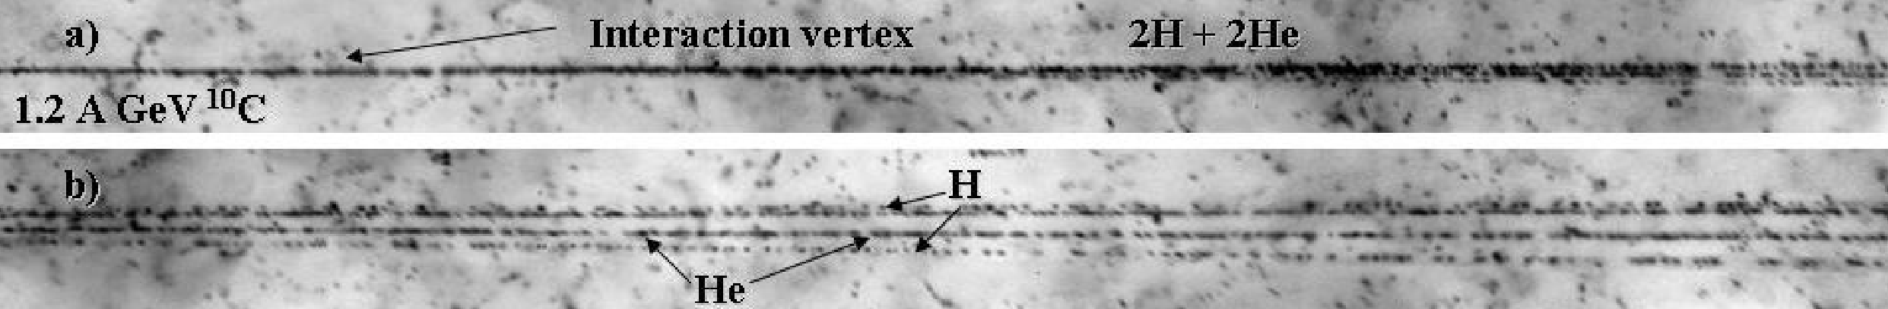
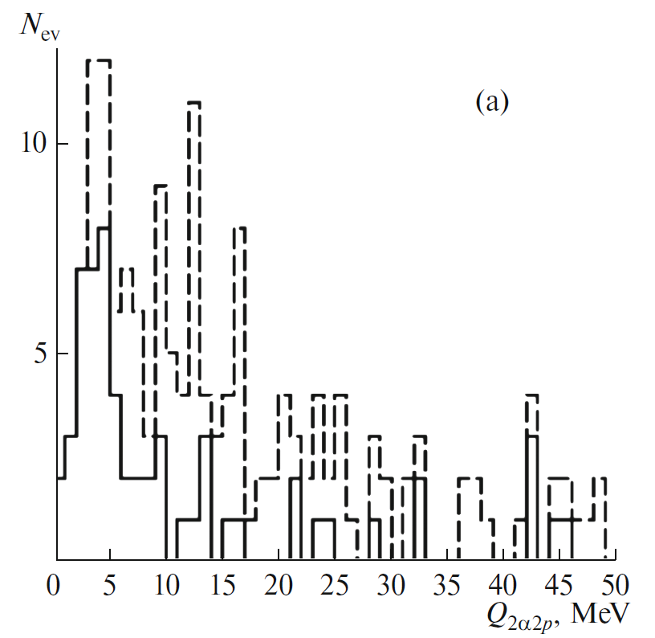
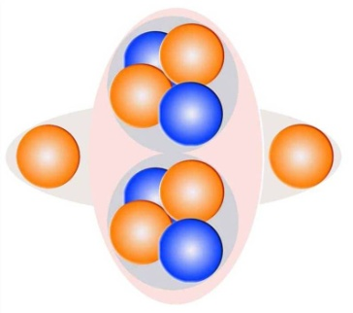
Distributions over energy Q_{2α2p} of all “white” stars ¹⁰C → 2He + 2H (dashed) and the ones with the presence of ⁹B (solid). The distribution Q_{2α2p} for the ¹⁰C stars containing ⁹B decays features the distinct peak with a maximum at 4.1 ± 0.3 MeV at RMS of 2.0 MeV. The peak statistics present 17 ± 4% of the total number of the ¹⁰C “white” stars or 65 ± 14% of those containing ⁹B decays.

Slide 10
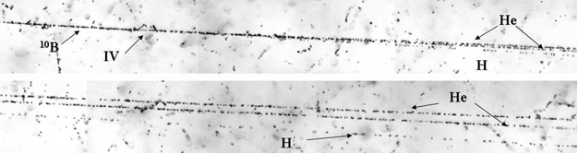
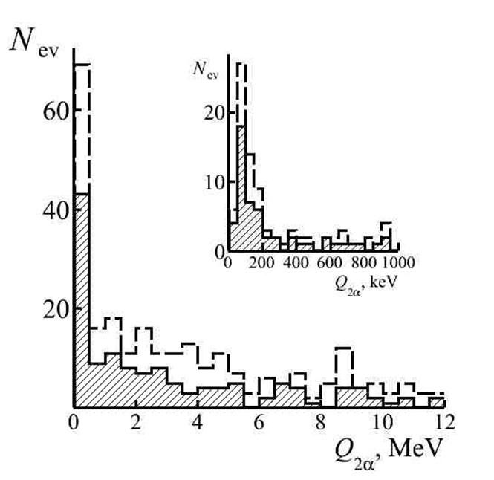
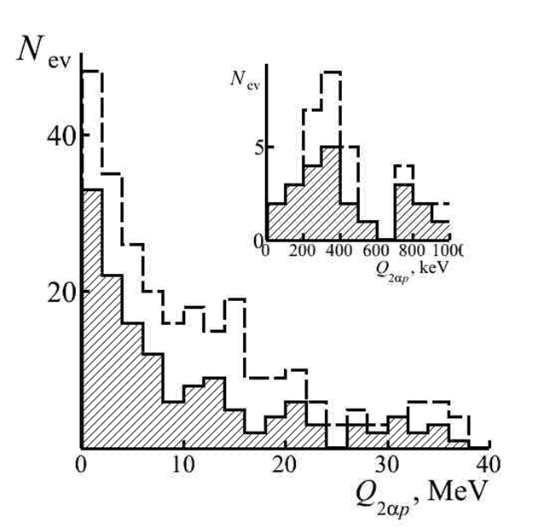
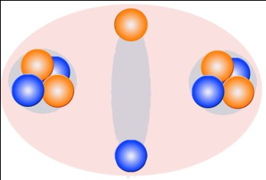
¹⁰B
Channel | Ratio
2He + H | 77%
He + 3H | 13%
Li + He | 4%
Li + 2H | 4%
Be + H | 1%
5H | 1%
The ⁸Be_{g.s.} nucleus is manifested in the coherent dissociation ¹⁰B → 2He + H with a probability of 25% including 13% of ⁹B decays.

Slide 11
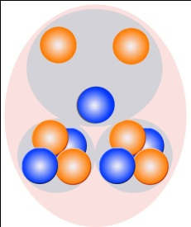
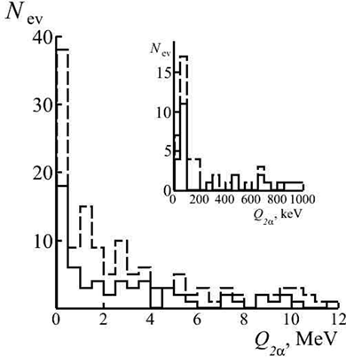
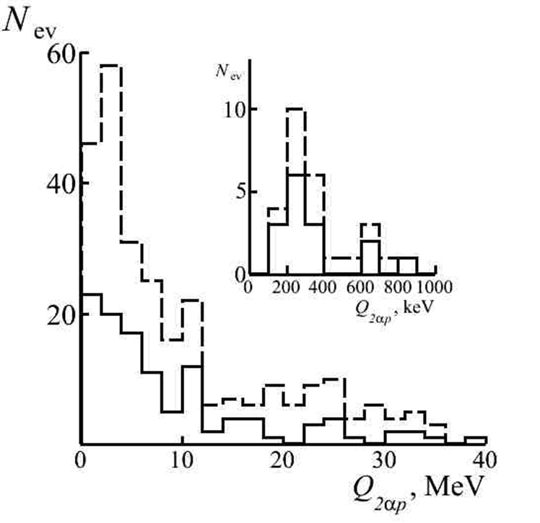
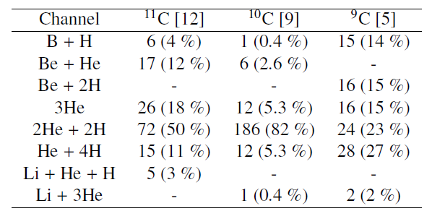
¹¹C
The distributions of He fragments over the Q_{2He} show that ⁸Be_{g.s.} decays are presented in 20% and ⁹B with 13% in 2He + 2H .
Table. Distribution of white stars produced by carbon isotopes (of energy 1.2 GeV per nucleon) among charge channels of the dissociation of nuclei.

Slide 12
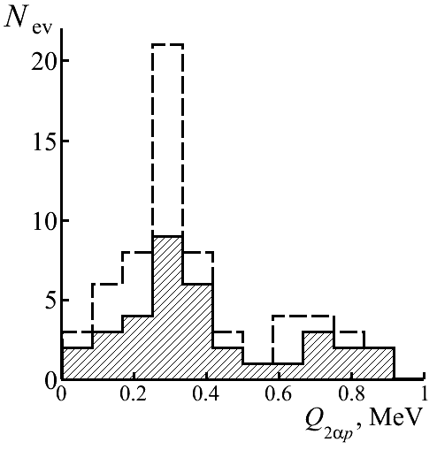
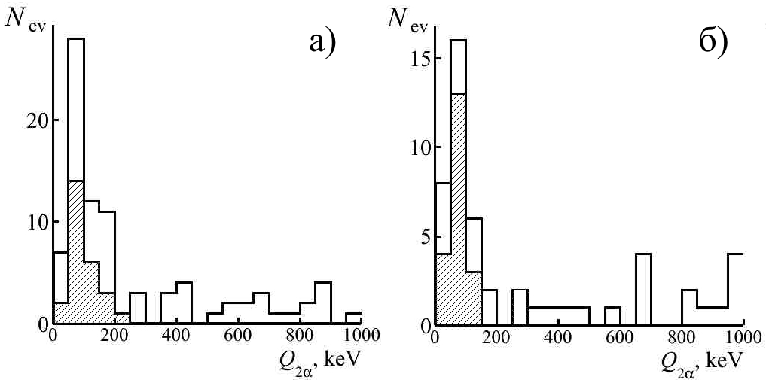
Reconstruction of ⁹B nucleus
The combined data on the average value of Q_{2αp} in observed events with narrow triples 2αp.
Nucleus (P₀, А GeV/c) | 〈Θ_{2αp}〉 (Θ_{2α} < 10.5 mrad), RMS | 〈Q_{2αp}〉 (Q_{2αp} < 400 keV), RMS
¹⁰B (1.6) | 11.8 ± 1.1, 2.5 mrad | 227 ± 24, 96 keV
¹⁰C (2.0) | 9.5 ± 0.3, 5.0 mrad | 254 ± 18, 96 keV
¹¹C (2.0) | 11.3 ± 0.1, 4.8 mrad | 256 ± 15, 68 keV
¹⁰B → ⁹B →⁸Be
¹¹C → ⁹B →⁸Be
The distribution over the invariant mass of 2α + p triples in the events of the dissociation of ¹⁰B nuclei (shaded histogram) and added for ¹¹С (dotted line).
In the fragmentation of ¹⁰B nuclei only 50% ⁸Be_{gs} decays arise from ⁹B decays, and for ¹¹С – 66%. In the case of the ¹⁰C nucleus – 100%.

Slide 13

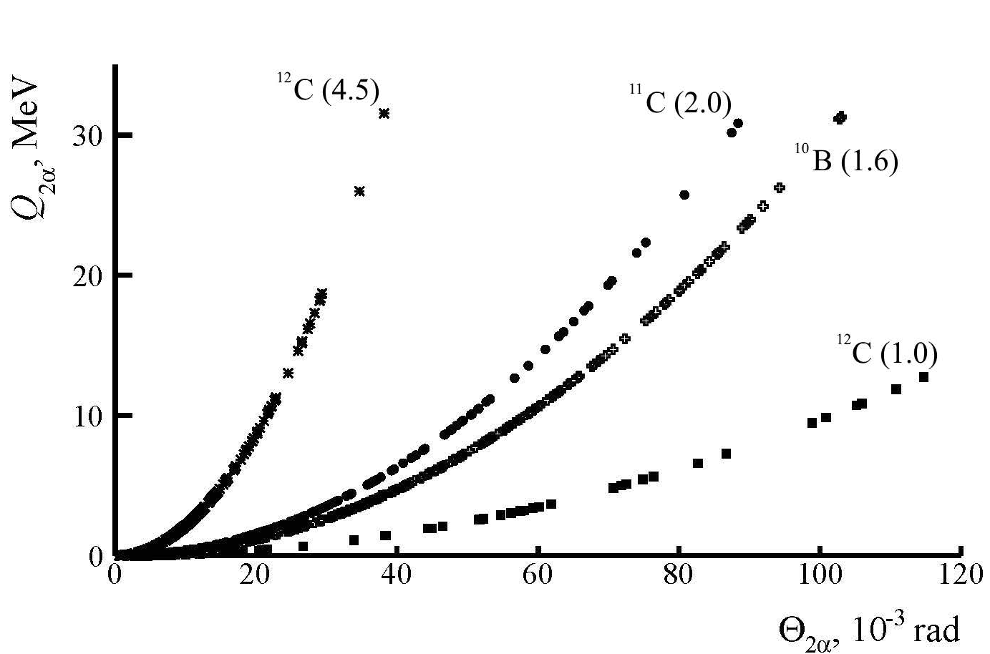
Unstable ⁸Be nucleus in dissociation of light relativistic nuclei
Average value 〈Θ_{2α}〉 (Q_{2α} < 300 кэВ) и 〈Q_{2α}〉
Nucleus (P₀, A GeV/с) | 〈Θ_{2α}〉 (RMS), mrad (Q_{2α} < 300 keV) | 〈Q_{2α}〉 (RMS), keV
¹²С (4.5) | 2.1 ± 0.1 (0.8) | 109 ± 11 (83)
¹⁶O (4.5) | 1.8 ± 0.3 (0.6) | 81 ± 2 (50)
²²Ne (4.1) | 1.9 ± 0.1 (0.8) | 82 ± 5 (52)
¹⁴N (2.9) | 2.9 ± 0.2 (1.9) | 120 ± 10 (72)
⁹Be (2.0) | 4.4 ± 0.2 (2.1) | 86 ± 4 (48)
¹⁰C (2.0) | 4.6 ± 0.2 (1.9) | 63 ± 7 (83)
¹¹C (2.0) | 4.8 ± 0.3 (1.9) 5.3 ± 0.5 (1.5) | 77 ± 7 (40) 68 ± 17 (42)
¹¹C (2.0) → ⁹B → ⁸Be | 4.5 ± 0.3 (1.3) | 94 ± 15 (86)
¹⁰B (1.6) | 5.9 ± 0.2 (1.6) | 101 ± 6 (46)
¹⁰B (1.6) →⁹B → ⁸Be | 5.6 ± 0.3 (1.3) | 105 ± 9 (47)
¹²C (1.0) | 10.4 ± 0.5 (3.9) | 107 ± 10 (79)
The dependence of the calculated invariant masses of α-pairs Q_{2α} on the angles of expansion of Θ_{2α} into them in the events of dissociation ¹²С, ¹¹C и ¹⁰В; nuclei; impulse values are indicated in brackets (A GeV/c).

Slide 14
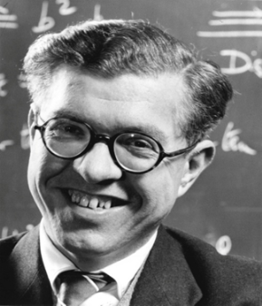
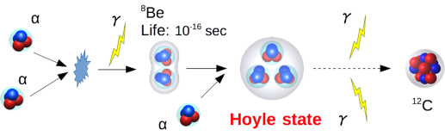
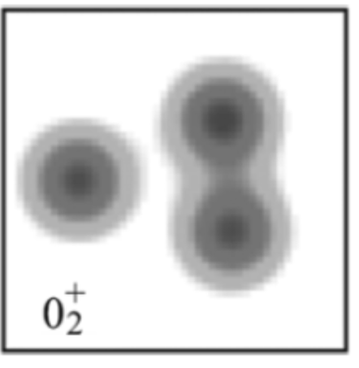
Hoyle
State
Scheme of ¹²C nucleus synthesis
Energy level of ¹²C
RADIUS - ?
STRUCTURE- ?
AMD density of HS
Occupation of the single-α orbitals of the Hoyle state of ¹²C compared with the ground state.

Slide 15
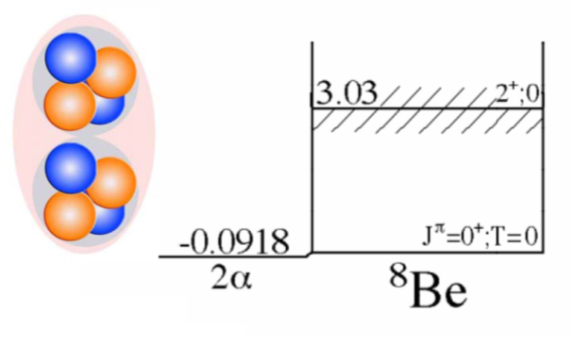
“Dumbbell” configuration
The ‘Ikeda diagram’, showing the development of cluster structure within α-conjugate nuclei as excitation energy is increased.
Example of calculating the density distribution of the ⁸Be nucleus (TSHR model; Bose-Einstein alpha condensate)

Slide 16
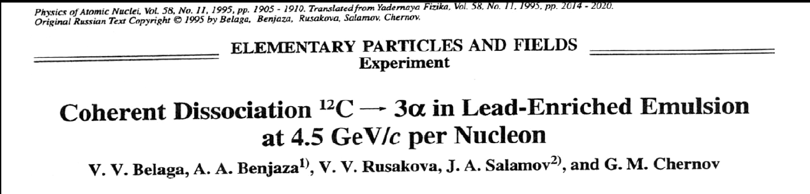
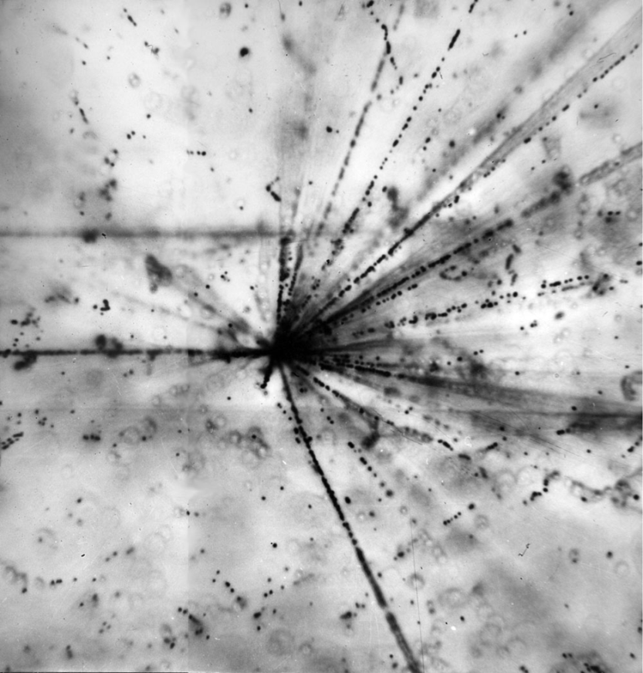
?
JINR Synchrophasotron
¹²C @ 3.65 A GeV

Slide 17
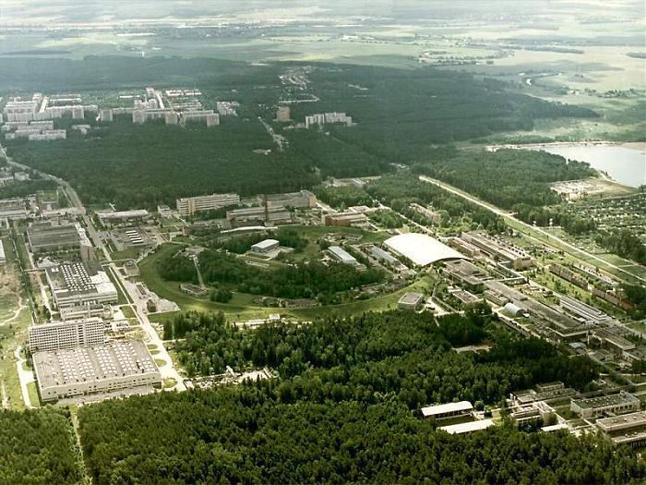
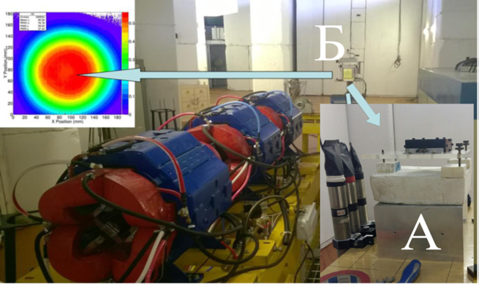
IHEP, Protvino
¹²C 450 A MeV
A medical beam of ¹²C nuclei in IHEP, used at the initial stage, ensures the required uniformity of irradiation. It has an energy corresponding to the maximum of the cross section of electromagnetic dissociation. Its working intensity, which is not less than 10⁸ nuclei per cycle, must be at least reduced 10³ times to avoid overexposure and to provide beam monitoring. The solution of this problem is not simple, since high intensity provides feedback for the tuning of the accelerator.

Slide 18
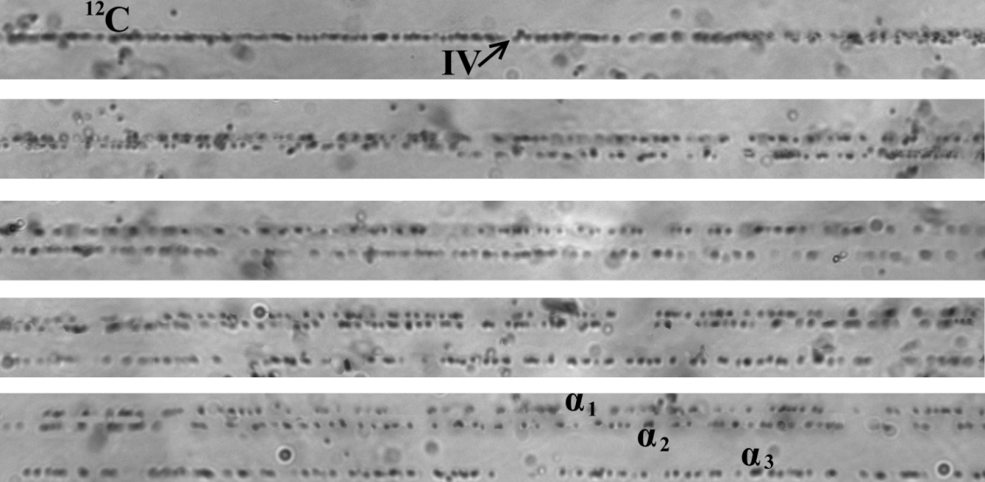
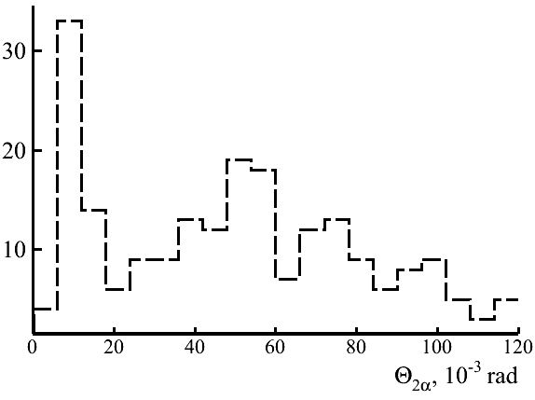
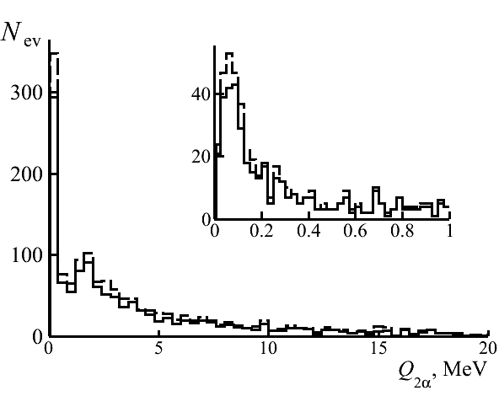
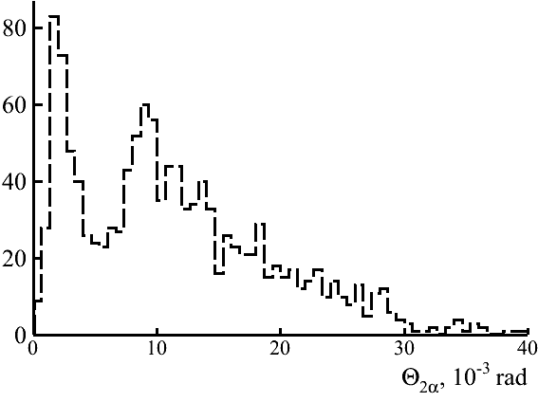
Observation of narrow α-pairs in dissociation of ¹²C nucleus
¹²C → 3α (1 А GeV/с)
Sequential microphoto of event ¹²C → 3α (P₀ 1 A GeV/с), IV – position of the interaction vertex. The main characteristics of the event : θ₁₂ = 8 mrad, θ₁₃ = 15 mrad, θ₂₃ = 8 mrad, Q₁₂ = 57 keV, Q₁₃ = 227 keV, Q₂₃ = 61 keV, Q_{3α} = 230 keV.
¹²C → 3α (4.5 А GeV/с)
¹²C → ⁸Be + α - (45 ± 4) %

Slide 19
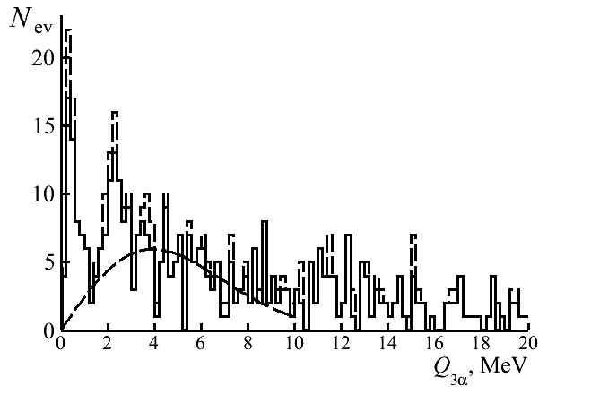
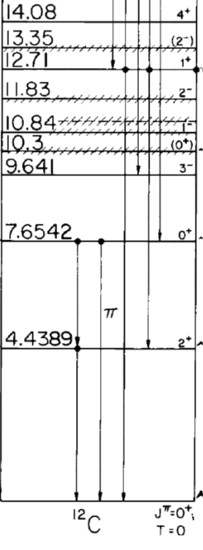
Identification in Hoyle state events
P₀, А GeV/с | 〈Q_{3α}〉, МэВ (Q_{3α} < 1МэВ) | Events Number(tot)
1 | 346 ± 28 | 9 (86)
4.5 | 397 ± 26 | 42 (424)
Σ | 415 ± 28 | 51 (510)
¹²C(HS) →⁸Be + α – (10 ± 2)%
7.275
3α
The distribution of the invariant mass of the α-triples Q_{3α} in the dissociation of ¹²C → 3α with 4.5 A GeV/c (hatched) and 1 A GeV/c (added); inset: region up to Q_{2α} < 2 MeV.

Slide 20
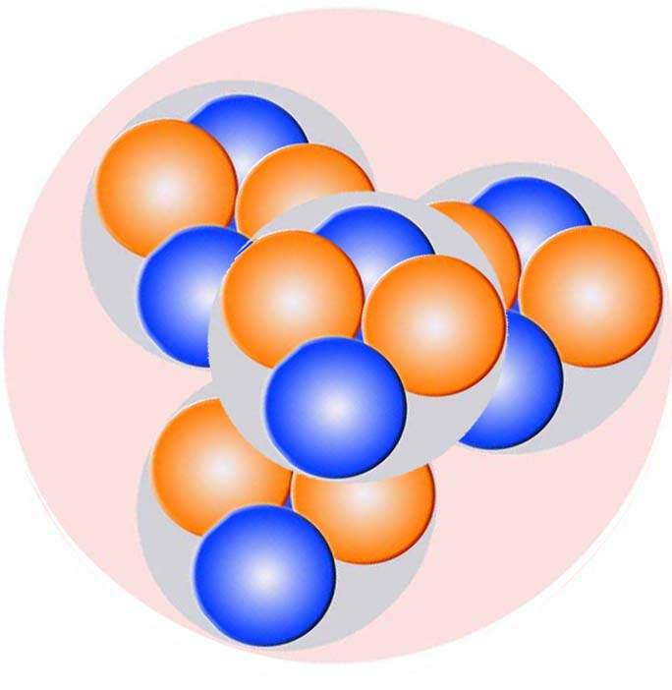
¹⁶O
Extensions to heavier nuclei
Energy level of oxygen-16

Slide 21
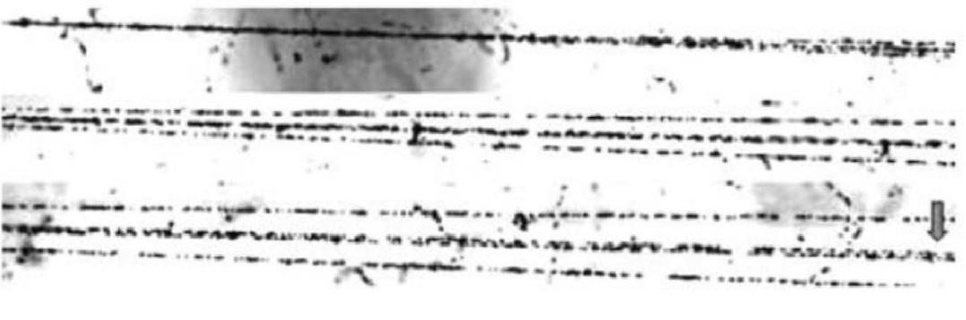
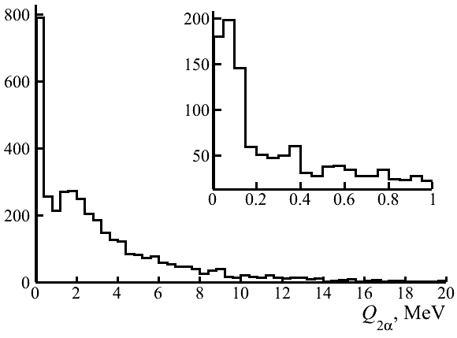
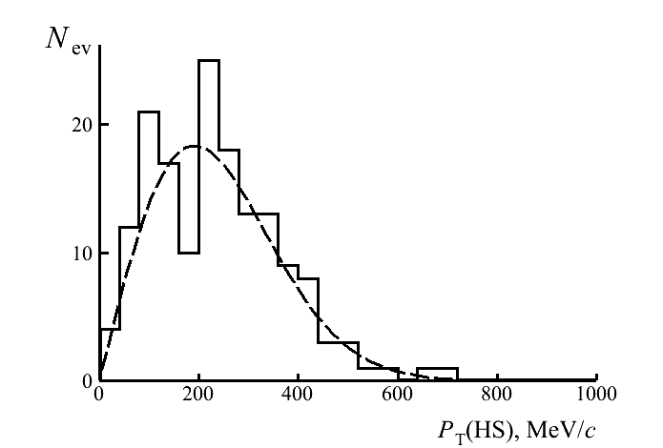
Coherent dissociation of ¹⁶O → 4α at 4.5 A GeV/c
¹⁶O → ⁸Be (62 ± 3)%
Fragmentation of a relativistic ¹⁶O nucleus at 4.5 A GeV/c in the peripheral interaction on heavy nucleus
¹⁶O → ¹²C*(HS) + α – (22 ± 2) %
σ_{PT(HS)} = (191 ± 8) МэВ/c

Slide 22
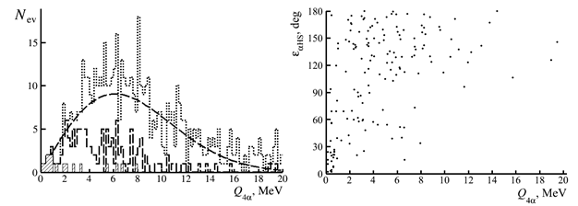
Coherent dissociation of ¹⁶O → 4α at 4.5 A GeV/c
¹⁶O(0⁺₆) → ¹²C*(→3α) + α – (7 ± 1) %
〈Q_{4α}〉= (624 ± 84) keV
Distribution over the invariant mass Q_{4α} in 641 “white” star ¹⁶O → 4α at 3.65 A GeV of all 4α-quartets (dotted line), αHS events (dashed line), and αHS events satisfying ε(αHS) < 45⁰ (hatched); the line is the Rayleigh distribution.

Slide 23
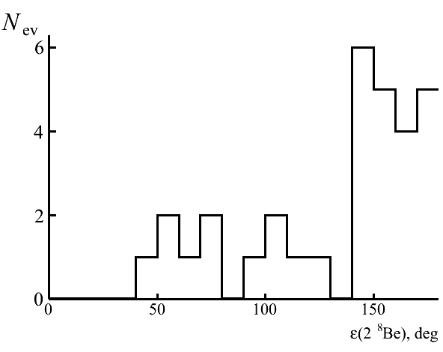
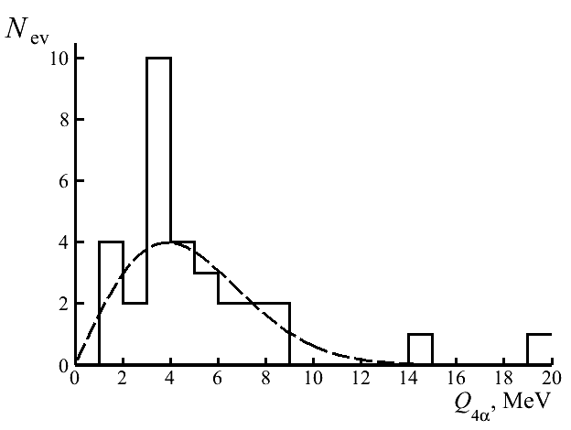
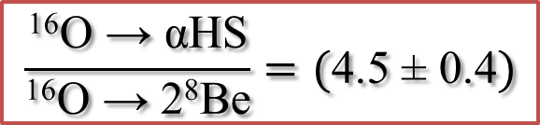
Search for ¹⁶O →2 ⁸Be events
¹⁶O → 2⁸Be – 5 ± 1%
Distribution of events ¹⁶O → 2⁸Be over azimuth angle ε(2⁸Be) between ⁸Be fragment.
Distribution of events ¹⁶O → 2⁸Be over invariant mass Q_{4α}; line - Rayleigh distribution
$$\frac{\text{16}\text{O}\text{ →} \text{αHS}}{\text{16}\text{O}\text{ →} \text{2}\text{8}\text{Be}}=(\text{4.5 ± 0.4})$$

Slide 24




Preliminary results of research of the dissociation of ¹⁴N
Distribution over Q of a system of 2α-particles. Solid line is the combination of all pairs of α-particles in the events ¹⁴N → 3α+ H, the shaded line is the limitation in the angle of expansion Θ_{2α}<6 mrad. Contribution of ⁸Be_{gs} nuclei is 46 ± 8%.
Distribution over Q of triplets of α-particles. The solid line is all events ¹⁴N → 3α (+ H), the shaded line - the events without identified ⁹B nucleus. For 4 “pure” correspond to the HS events.
¹⁴N → 3α + p
Measurements are on progress now
Distribution over Q of a system of 2α-particles and a proton. Contribution of ⁹B - (10 ± 4)%

Slide 25



Fragmentation of relativistic ²²Ne nucleus
1.2%
15%
Fragmentation of the relativistic nucleus ²²Ne → 5α at 4.1 A GeV/c in the peripheral interaction
10%

Slide 26

Q_{4α} = 791 keV
²²Ne → 4α
²²Ne → 5α

Slide 27
Q_{2α}
Q_{2αp}
Q_{3α}
Q_{4α}
14.6 A GeV ²⁸Si:
52 events Q_{2α} < 0.2 MeV; 15 events Q_{2αp} < 0.5 MeV (⁹B); 9 events Q_{3α} < 0.7 MeV (HS).

Slide 28

Au 10.7 A GeV

Slide 29

Q_{2α}
Q_{2αp}
Q_{3α}
Q_{4α}
1316 interactions of 10.7 A GeV Au; 160 α-pairs Q_{2α} < 0.2 MeV; 40 events with 2αp-triples Q_{2αp} < 0.5 MeV (⁹B); 12 events with α-triples Q_{3α} < 0.7 MeV (Hoyle state); 1 event with α-quartet Q_{4α} = 1 MeV.

Slide 30


New is well forgotten old

Slide 31
Conclusions
Preserved and recently obtained data on interactions of light relativistic nuclei in a nuclear track emulsion allowed to establish the contribution in their dissociation of unstable nuclei ⁸Be and ⁹B and the Hoyle state as well as to assess the prospects of such research in relation to medium and heavy nuclei. These three states are uniformly identified by the invariant masses calculated from the measured angles of emission of He and H fragments under the assumption of conservation of the primary momentum per nucleon.
The ⁸Be selection in dissociation of the isotopes ⁹Be, ¹⁰B, ¹⁰C, and ¹¹C is determined by the restriction from above of the invariant mass of 2α-pairs up to 0.2 MeV, and the ⁹B 2αp-triple mass up to 0.5 MeV. The certainty in the ⁸Be and ⁹B identification of became the basis for the search for decays from the Hoyle state in the dissociation ¹²C → 3α. In the latter case, the 3α triple invariant mass is set to be limited to 0.7 MeV. The choice of these three conditions as “cut-offs from above” is sufficient because the decay energy values of these three states are noticeably lower than the nearest excitations with the same nucleon compositions, and the reflections of more complex excitations is small for these nuclei.
Being tested in the studies of the light nuclei, a similar selection is applicable to the dissociation of heavier nuclei to search for more complex states. In turn, the products of α-particle or proton decay of these states could be the Hoyle state or ⁹B, and then ⁸Be. A possible decay variant is the occurrence of more than one state from this triple. In any case, the initial stage of searches should be the selection of events containing relativistic ⁸Be decays.
Dozens of ⁸Be and ⁹B decays are identified in the relativistic fragmentation cone of Si and Au nuclei. At the same time, the small number of 3α triples attributable to the decay of the Hoyle state which requires increasing statistics to the current ⁸Be equivalent. Then, the search for the excited state ¹⁶O(0⁺₆) will become feasible. There are no fundamental problems along this path since there are a sufficient number of earlier exposed NTE layers, with transverse scanning of which the required α ensemble statistics is achievable. This whole complex of problems, united by questions of identification of unstable states, is in the focus of the application in the BECQUEREL experiment in the present time.
It is hoped that the rapid progress in image analysis will give a whole new dimension to the use of the NTE method in the study of nuclear structure in the relativistic approach. The solution of the tasks set requires investment in modern automated microscopes and the reconstruction of NTE technology at a modern level. At the same time, such a development will be based on the classical NTE method, the foundations of which were laid seven decades ago in cosmic ray physics.

