Slide 1

Potential Description of α+²⁰⁸Pb Elastic Scattering
M Nure Alam Abdullah, M Zahid Hasan, Sinthia Binte Kholil and Dipika Rani Sarker
Department of Physics, Jagannath University, Dhaka-1100 Bangladesh
LXX International Conference “NUCLEUS-2020. Nuclear physics and elementary particle physics. Nuclear physics technologies”

Slide 2
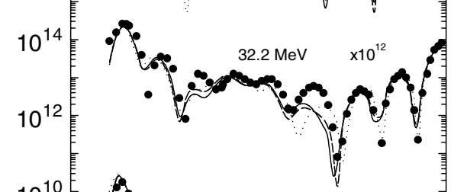
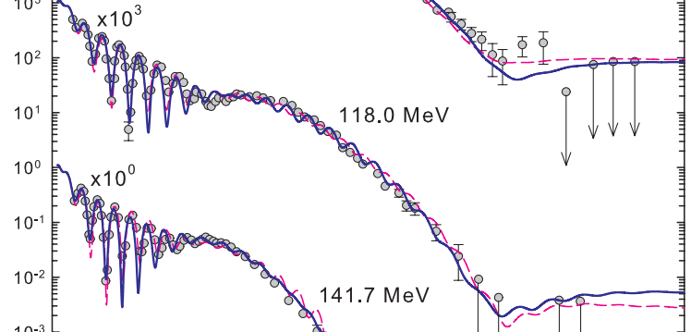
Introduction
Nuclear structure nucleus-nucleus interaction potential
Nuclear scattering due to nuclear forces (to analyse the experimental angular distribution of the emitted particles)
Nuclear potential
The optical model (OM) potential is pretty well known to explain the phenomena.
Alpha-particle elastic scattering ALAS (Anomaly in Large Angle Scattering)
ALAS is prominent but not unique to A ≈ 4n (n = 1, 2, 3, …) nuclei and for A ≤ 50.
Beyond this region, the ALAS effect rapidly dies down giving rise to the “rainbow scattering”.
K.W. Kemper, A.W. Obst and and R.L. White, Phys. Rev. C 6 (1972) 2090.
L. Jarczyk et al., Acta Phys. Pol. B 7 (1976) 53.
α+¹⁶O
ALAS
α+⁹⁰Zr
Rainbow
Scattering
Rainbow
Scattering

Slide 3
Introduction
Optical model (OM) potential
K.W. Kemper, A.W. Obst and R.L. White, Phys. Rev. C 6 (1972) 2090.
F. Michel et al, Phys. Rev. C 28 (1983) 1904.
M. E. Brandan and G. R. Satchler Phys. Rep. 285 (1997) 143.
M. N. A. Abdullah et al, Eur Phys J. A 18 (2003) 65
M. N. A. Abdullah et al, Nucl. Phys. A 760 (2005) 40.
K. A. Brueckner, S. A. Coon and J. Dabrowski, Phys. Rev. 168 (1968) 1184.
Phenomenological OM potential
(obtained empirically from the direct analysis of the elastic scattering data)
(i) Woods-Saxon (WS)
(ii) squared Woods-Saxon (SWS)
Problem suffer from discrete
and continuous ambiguities
OM potentials is derived microscopically or semi-microscopically
(i) Folded (both double-folded and
single-folded)
(ii) non-monotonic (NM) - derived from
the EDF theory of Brueckner, Coon
and Dabrowski (BCD).

Slide 4
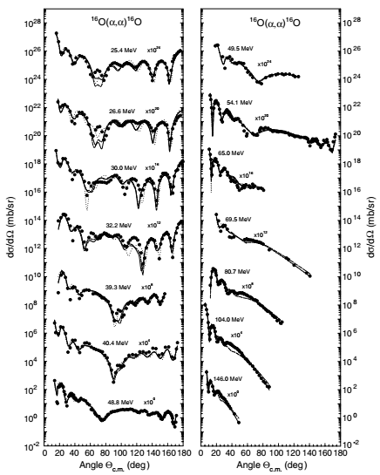
Introduction
Traditional double folded (DF) of effective N-N interaction and single folded (SF) of either α-N or α−α potentials need renormalizations at different incident energies.
In 2003, we proposed a single-folding model the resulting potential from which does not need any renormalization.
M. N. A. Abdullah et al., Eur. Phys. J. A 18 (2003) 65.
M. N. A. Abdullah et al., Phys. Lett. B 571 (2003) 45.
M. N. A. Abdullah et al., Eur. Phys. J. A 18 (2003) 65

Slide 5
Our Folding Model
r_{α}
Alpha
R
r_{N}
Alpha
Nucleon
Target
Assumptions:
the nucleons in the target are considered primarily in the α–cluster configuration, and rest in an unclustered nucleonic configuration
the wave function of a nucleus can be considered as the product of wave functions
of α-like configurations and those of unclustered nucleonic
configurations
This leads to a sum of two folding potentials, one convoluted over α-density distribution and another over nucleonic density distribution.
.

Slide 6
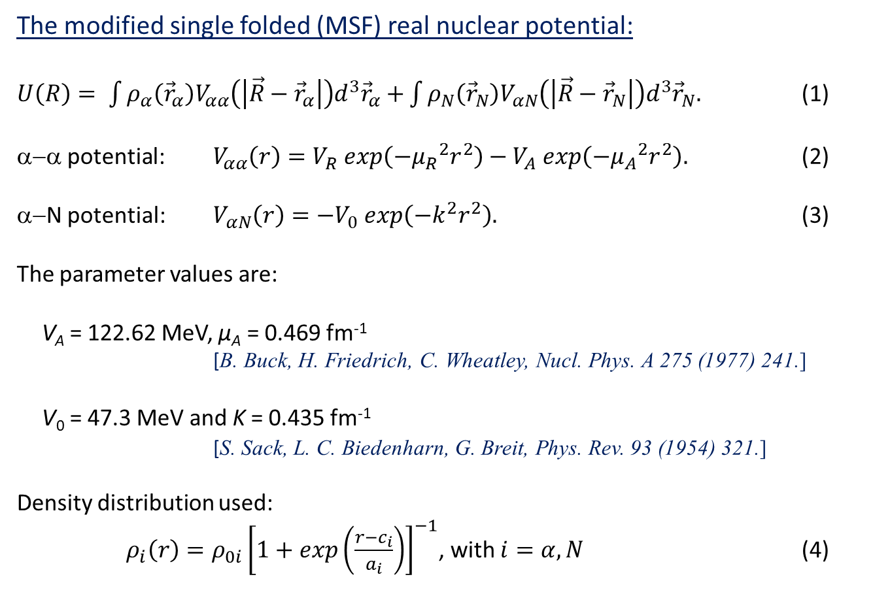
MSF Potential
The modified single folded (MSF) real nuclear potential:
$U\left(R\right)= \int{ρ_{α}\left({\vec{r}}_{α}\right)V_{αα}\left(\left|\vec{R}−{\vec{r}}_{α}\right|\right)d^{3}{\vec{r}}_{α}+}\int{ρ_{N}\left({\vec{r}}_{N}\right)V_{αN}\left(\left|\vec{R}−{\vec{r}}_{N}\right|\right)d^{3}{\vec{r}}_{N}.}$ (1)
α−α potential: $V_{αα}\left(r\right)=V_{R} exp\left(−{μ_{R}}^{2}r^{2}\right)−V_{A} exp\left(−{μ_{A}}^{2}r^{2}\right).$ (2)
α−N potential: $V_{αN}\left(r\right)=−V_{0} exp\left(−k^{2}r^{2}\right).$ (3)
The parameter values are:
V_{A} = 122.62 MeV, µ_{A} = 0.469 fm⁻¹
[B. Buck, H. Friedrich, C. Wheatley, Nucl. Phys. A 275 (1977) 241.]
V₀ = 47.3 MeV and K = 0.435 fm⁻¹
[S. Sack, L. C. Biedenharn, G. Breit, Phys. Rev. 93 (1954) 321.]
Density distribution used:
$ρ_{i}\left(r\right)=ρ_{0i}{\left[1+exp\left(\frac{r−c_{i}}{a_{i}}\right)\right]}^{−1}$, with $i=α,N$ (4)

Slide 7
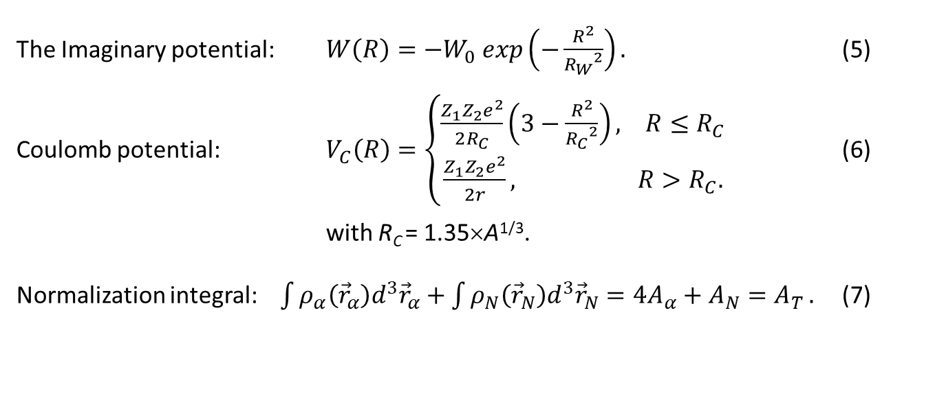
MSF Potential
The Imaginary potential: $W\left(R\right)=−W_{0} exp\left(−\frac{R^{2}}{{R_{W}}^{2}}\right).$ (5)
Coulomb potential: $V_{C}\left(R\right)=\left\{\begin{aligned}\frac{Z_{1}Z_{2}e^{2}}{2R_{C}}\left(3−\frac{R^{2}}{{R_{C}}^{2}}\right), R≤R_{C} \\ \frac{Z_{1}Z_{2}e^{2}}{2r}, & R>R_{C}.\end{aligned}\right.$ (6)
with R_{C} = 1.35×A^{1/3}.
Normalization integral: $\int{ρ_{α}\left({\vec{r}}_{α}\right)d^{3}{\vec{r}}_{α}+\int{ρ_{N}\left({\vec{r}}_{N}\right)d^{3}{\vec{r}}_{N}=4A_{α}+A_{N}=A_{T}}}.$ (7)

Slide 8
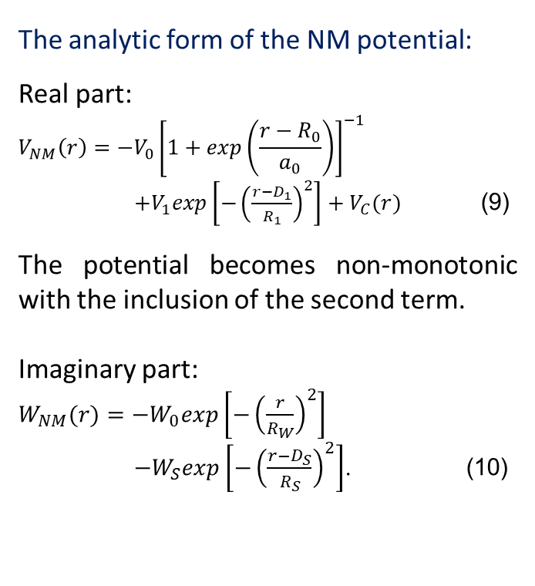
Non-monotonic (NM) potential
The analytic form of the NM potential:
Real part:
$$V_{NM}\left(r\right)=−V_{0}{\left[1+exp\left(\frac{r−R_{0}}{a_{0}}\right)\right]}^{−1}$$
$+V_{1}exp\left[−{\left(\frac{r−D_{1}}{R_{1}}\right)}^{2}\right]+V_{C}(r)$ (9)
The potential becomes non-monotonic with the inclusion of the second term.
Imaginary part:
$W_{NM}(r)=−W_{0}exp\left[−{\left(\frac{r}{R_{W}}\right)}^{2}\right]$
$−W_{S}exp\left[−{\left(\frac{r−D_{S}}{R_{S}}\right)}^{2}\right]$. (10)
[M. N. A. Abdullah et al, Nucl. Phys. A 760 (2005) 40.]

Slide 9
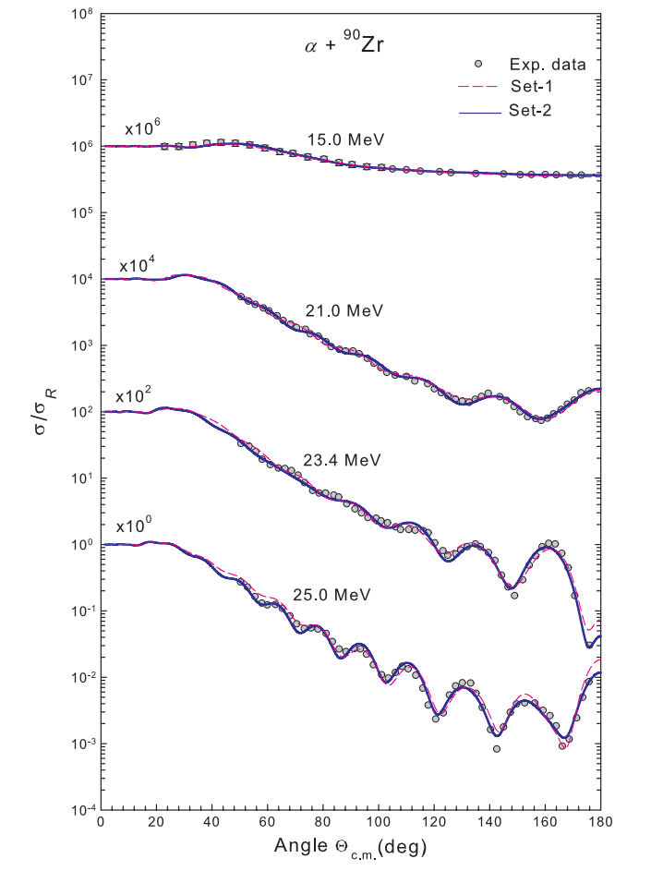
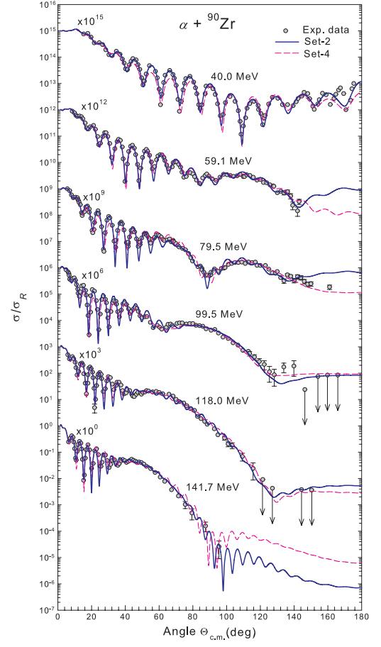
Non-monotonic (NM) potential
Hossain et al. was able to explain the refractive structure of α+⁹⁰Zr elastic scattering using the NM potential derived from the EDF theory.
The potential in the central region of the target nucleus seems to be significant in describing the α elastic scattering data on ⁹⁰Zr.
S. Hossain et al, J. Phys. G: Nucl. Part. Phys. 40 (2013) 105109.

Slide 10
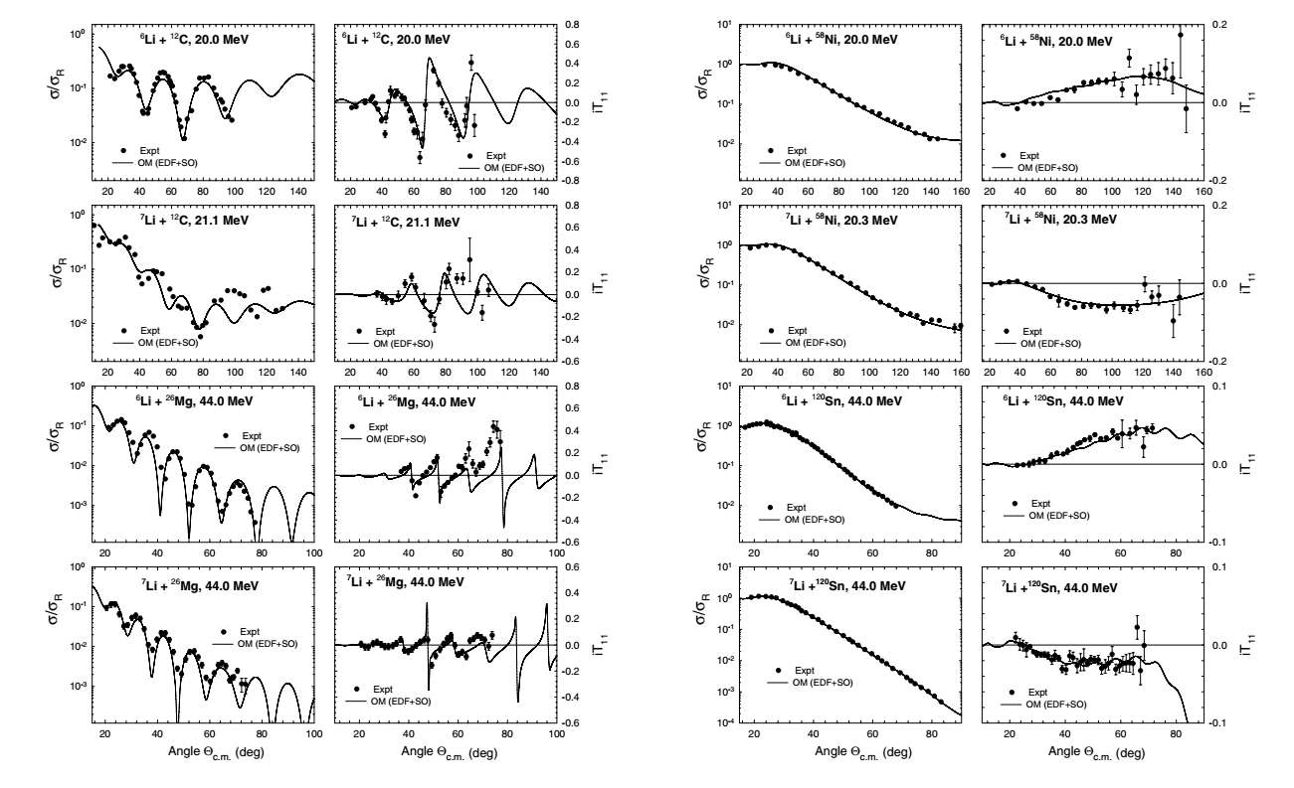
Non-monotonic (NM) potential
Basak et al. successfully extended the approach of using the NM potential, derived from a realistic two-nucleon (NN) potential using the EDF method, to reproduce simultaneously
the elastic scattering cross-sections and
the vector analyzing power data for ^{6,7}Li projectiles on ¹²C, ²⁶Mg, ⁵⁸Ni and ¹²⁰Sn
without adjusting the shape or depth parameters of the EDF-derived potentials.
A. K. Basak et al, Europhys. Lett. 94 (2011) 62002.

Slide 11
Non-monotonic (NM) potential
Strikingly, their analysis correctly described the observed opposite signs in the elastic scattering VAP data for ⁶Li and ⁷Li of the same energy incident on ⁵⁸Ni and ¹²⁰Sn nuclei.
These successes are attributed to the following features:
the NM nature of the central real potential arising from the use of the Pauli effect in the EDF theory
(ii) optimum use of empirical absorption
an appropriate choice of the effective SO potential of either sign, being a manifestation of the projectile excitation process.

Slide 12
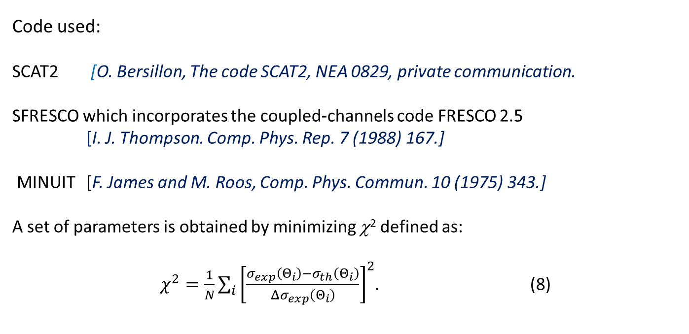
Analysis
Code used:
SCAT2 [O. Bersillon, The code SCAT2, NEA 0829, private communication.
SFRESCO which incorporates the coupled-channels code FRESCO 2.5
[I. J. Thompson. Comp. Phys. Rep. 7 (1988) 167.]
MINUIT [F. James and M. Roos, Comp. Phys. Commun. 10 (1975) 343.]
A set of parameters is obtained by minimizing χ² defined as:
$χ^{2}=\frac{1}{N}\sum_{i}{{\left[\frac{σ_{exp}\left(Θ_{i}\right)−σ_{th}\left(Θ_{i}\right)}{Δσ_{exp}\left(Θ_{i}\right)}\right]}^{2}}$. (8)

Slide 13
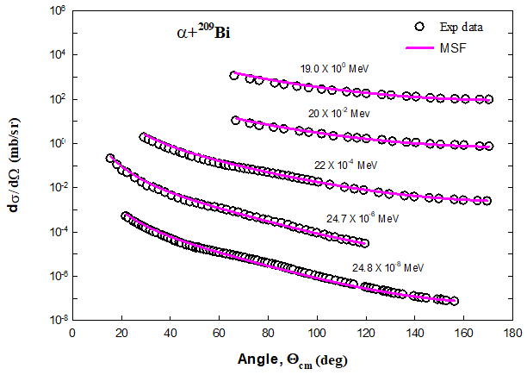
Results of MSF
Fig. 2. The predicted cross sections for the α+²⁰⁹Pb elastic scattering using the MSF potentials at E_{α} = 19.0-50.0 MeV. The open circles are the experimental data.

Slide 14
Results of MSF
Table 1. Energy independent parameters and the deduced results for α+²⁰⁸Pb elastic scattering. ρ_{0α} and ρ_{0N} are in fm⁻³; c_{α}, c_{N}, a_{α}= a_{N} and R_{rms} in fm.
Target | ρ_{0α} | ρ_{0N} | c_{α} | c_{N} | a_{α} = a_{N} | 4A_{α} | A_{N} | A_{T} | R_{rms}
²⁰⁸Pb | 0.0347 | 0.192 | 6.62 | 3.0 | 0.546 | 180.0 | 28.0 | 208 | 5.514
Table 2. Energy dependent parameters along-with the volume integrals and χ². E_{a}, and the depth parameters V_{R} and W₀ are in MeV; μ_{R} in fm⁻¹; R_{W} in fm; and J_{R}/(4A) and J_{I}/(4A) in MeV.fm³.
E_{α} | V_{R} | μ_{R} | W₀ | R_{W} | J_{R}/(4A) | J_{I}/(4A) | χ²
19.0 | 15.0 | 0.60 | 18.0 | 7.20 | -397.4 | -41.52 | 1.81
20.0 | 20.0 |  | 19.0 |  | -391.1 | -43.83 | 1.74
22.0 | 25.0 |  | 24.0 |  | -384.8 | -55.36 | 0.31
23.5 | 30.0 |  | 29.0 |  | -378.4 | -66.90 | 2.59
26.0 | 40.0 |  | 40.0 |  | -366.0 | -92.27 | 3.57
27.6 | 50.0 |  | 40.0 |  | -353.5 | -92.27 | 7.57
40.0 | 55.0 |  | 42.0 |  | -347.2 | -96.88 | 3.86
50.0 | 65.0 |  | 45.0 |  | -328.5 | -103.8 | 3.78

Slide 15
Results of NM
Fig. 3. The predicted cross sections for the α+²⁰⁹Pb elastic scattering using the NM potentials with unshifted repulsive core (green broken lines) and shifted repulsive core (red solid lines) at E_{α} = 19.0-50.0 MeV are compared to the experimental data (open circles).

Slide 16
Results of NM
Table 3. The real part of the NM potentials for the fits to the α+²⁰⁸Pb elastic scattering at $E_{α}=19.0−50.0$ MeV. V₀ and V₁ in MeV, and R₀, a₀, D₁, R₁ and R_{C} in fm.
Set | V₀ | R₀ | a₀ | V₁ | D₁ | R₁ | R_{C} | J_{R}/(4A)
Set-1 (D₁ = 0) | 11.49 | 7.674 | 0.2876 | 141.7 | 0.00 | 2.610 | 10.5 | -100.0
Set-2 (D₁ ≠ 0) | 14.50 | 7.3648 | 0.3650 | 40.465 | 2.00 | 2.60 | 10.5 | -100.0
Table 4. The imaginary parameters of the NM potentials for fits to the α+²⁰⁸Pb elastic scattering data. W₀ and Ws are in MeV; R_{S}, R_{W}, D_{S} in fm; J_{I}/(4A) in MeV.fm³.
E_{a} | Set-1 (D₁ = 0) |  |  |  |  |  |  | Set-2 (D₁ ≠ 0)
 | W₀ | R_{W} | W_{S} | D_{S} | R_{S} | J_{I}/(4A) | χ² | W₀ | R_{W} | W_{S} | D_{S} | R_{S} | J_{I}/(4A) | χ²
19.0 | 15.0 | 1.0007 | 5.20 | 6.450 | 1.5874 | -99.45 | 0.014 | 10.0 | 1.0007 | 2.20 | 6.445 | 1.587 | -42.35 | 0.0060
20.0 |  |  |  |  |  |  | 1.102 |  |  |  |  |  |  | 0.919
22.0 |  |  |  |  |  |  | 0.089 |  |  |  |  |  |  | 0.085
23.5 |  |  |  |  |  |  | 0.151 |  |  |  |  |  |  | 0.055
26.0 | 38.9 | 1.0409 | 2.75 | 6.3954 | 1.2946 | -44.35 | 0.057 | 40.0 |  |  |  |  | -44.45 | 0.115
27.6 | 129.5 | 1.0007 | 8.37 | 6.450 | 1.5874 | -167.31 | 0.0617 | 25.0 |  | 3.20 |  |  | -62.32 | 0.787
40.0 |  |  | 5.20 |  |  | -107.06 | 0.376 | 32.0 |  | 3.20 |  |  | -62.81 | 1.01
50.0 |  |  | 8.80 |  |  | -175.16 | 1.896 | 30.0 |  | 5.20 |  |  | -100.50 | 2.69

Slide 17
Discussion and Conclusions
Both the MSF and NM potentials satisfactorily describe the α+²⁰⁹Bi elastic scattering data.
However, the MSF potential slightly underestimates the cross sections at 27.6 MeV. This may be due to the lack of proper density parameters. To the best of our knowledge, there is no density distributions available in the literature for ²⁰⁸Pb and as so we have used density distribution of ²⁰⁷Pb.
The derived MSF potential does not need any renormalization for a satisfactory description of the data over the entire energy range.
The addition of the repulsive component conforms to the Pauli exclusion principle.
The radius c_{N} = 3.0 fm of the unclustered nucleonic distribution is much less that c_{α} = 6.62 fm of the α-like clusters.

Slide 18
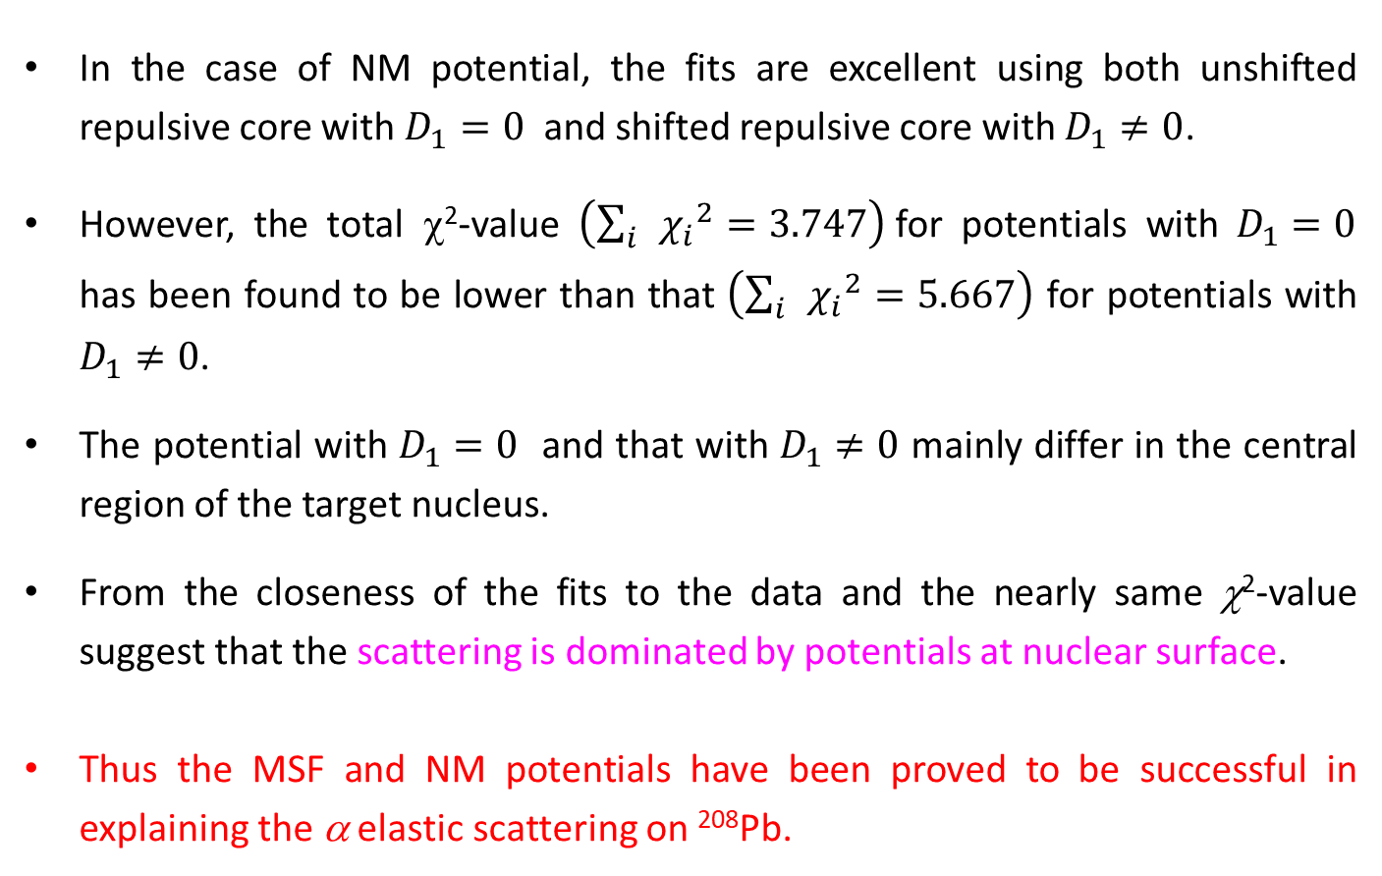
Discussion and Conclusions
In the case of NM potential, the fits are excellent using both unshifted repulsive core with $D_{1}=0$ and shifted repulsive core with $D_{1}≠0$.
However, the total χ²-value $\left(\sum_{i}{{χ_{i}}^{2}=3.747}\right)$for potentials with $D_{1}=0$ has been found to be lower than that $\left(\sum_{i}{{χ_{i}}^{2}=5.667}\right)$ for potentials with $D_{1}≠0$.
The potential with $D_{1}=0$ and that with $D_{1}≠0$ mainly differ in the central region of the target nucleus.
From the closeness of the fits to the data and the nearly same χ²-value suggest that the scattering is dominated by potentials at nuclear surface.
Thus the MSF and NM potentials have been proved to be successful in explaining the α elastic scattering on ²⁰⁸Pb.

Slide 19
THANK YOU FOR YOUR PATIENCE

