Slide 1
Guidelines, Suggestions
February 05 2010
Rene Brun

Slide 2
Keys for success
Continuous users trust in the development team
Robustness before anything new
Improve user support before anything else
Maintain and improve team spirit
Developers must always have a critical approach
Developers must anticipate user needs
Developers must be polychrome

Slide 3
Reality
LHC will run 2 years at 2x3.5TeV
collaborations do not want to see major changes. They will need consolidation, bug fixes, performance improvements.
December release 5.28 should not include back incompatible changes, but be like 5.26k
Version 5.30 In December 2011 is an opportunity to come with important new developments.

Slide 4
IO : documentation
It is important to come with a document describing the basic principles of ROOT IO.
For example it is essential to come with the shortest possible subset of ROOT/IO showing how to read
objects saved as Tkey
simple loop on a Tree
and it would be nice to show this example in Java too.
This project will force a better documentation and give confidence that a ROOT file can be read in the future.

Slide 5

IO - general
Optimize the system assuming that files will be accessed through the network.
Used portions of files cached locally, eg xrootd client must be able to cache the 10 MB chunks of the treeCache + connections with proxys
T1
T3

Slide 6
IO: StreamerInfo
Rewrite ReadBuffer/WriteBuffer from a giant switch/case system to a system with pointers to each case and where new cases can be added dynamically.
Improve performance by removing virtuality at the wrong place, ie virtuality at the collection level and not at the member level as it is now.

Slide 7
IO- Zlib
Follow progress with Intel versions of zlib. Once they have fixed the remaining problems, the new zlib could show a huge speed-up factor.

Slide 8
Trees
Do not make the interface more complex than what it is.
Add support for a TVirtualBranch to better support foreign formats such as HDF5 and FITS.

Slide 9
TTree::GetEntry
Implement memory pools to minimize memory fragmentation and improve parallelism.
eg a Tree with 1000 branches and 100 cores.
each core creates one memory pool for 10 branches and process (read/write) the branches in parallel.
Do not create separate threads for unzipping

Slide 10
TTree::Draw
Generalize support for Ndim histograms
TTreeFormula via JIT/LLVM
Draw returns a TQueryResult (also change PROOF accordingly).
TQueryResults are kept/browsed/saved
htemp, graphs pointers obtained via TQueryResult
Must be in sync with the new TSessionManager

Slide 11
LLVM
Most urgent: evaluate run time overhead (memory).
Can we split the libllvm.a into manageable units?
Current VM for root.exe is about 20 MB on 32 bits machine, of which libCint.so is about 6 Mbytes.
Implement llvm2root to replace rootcint -> mydict.cxx and mydict.root. dict still used by cint.
Once llvm2root is well understood, do the same for gccxml.
Only when this basic llvm2root is well understood, replace cint by llvm. Design from the beginning for having one instance of the interpreter per thread.

Slide 12
LLVM and dictionaries
The target should be to remove completely the G_ files:
storing the necessary info about a class in xxx.root file and generate the stubs on the fly with the JIT.
In fact before replacing CINT by LLVM, one must show a prototype showing that this is possible

Slide 13
PyRoot
I am very impressed by Wim’s work. Without Wim the python interface from ROOT will be dead since a long time.
However I continue to believe that there is a growing impedance mismatch between C++ and Python. See for example the recent discussion about object ownership at the forum.
Will a direct Python/LLVM/ROOT interface be better? difficult to say without having a really working implementation, but this will be a lot of work.

Slide 14
Graphics
linking with OpenGL adds 60->100 MB of VM
Can we still produce graphics in batch? ie pdf, eps, png,etc
Implement cheap/efficient pdf for Timur’objects and ideally also for geometry objects. Forget gl2ps.
Use jpg, png, gif otherwise
I am convinced that somebody has already an efficient implementation (see Google).
libAfterImage strategy?

Slide 15
Graphics 2
Urgent to sort priorities in Olivier’s list (or not)
transparency (in TColor or TAttFill?)
pdf/ps improvements in Olivier’s list (eg images)
global canvas settings for fonts in pixels, ie same font size for all axis in all pads.
TAxis::SetPolar
TH2Polar, TH3Tube, TH3Sphere rendering
axis reverse order (many side-effects)
better bar-chart rendering and lego rendering for TH1

Slide 16
Graphics 3
Do not change the NDC system. This would generate far too many side effects.
Rationalize the projection system of TH2 and TGraph2D when drawing in 3d views. The current system complicates the life when superimposing other objects.
Upgrade fill areas types to support transparency, color gradients (up/down, left/right, inside/outside)

Slide 17
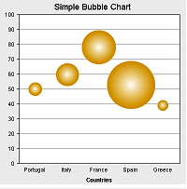
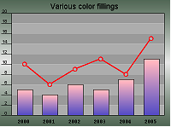
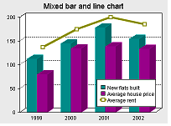
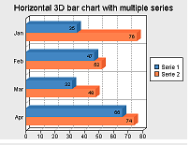
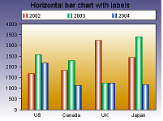
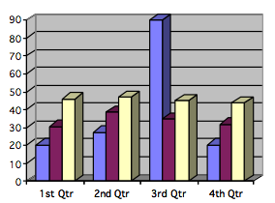
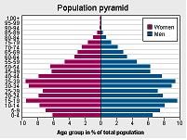
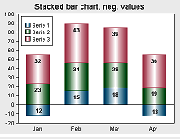
wanted

Slide 18
3D & GL
Worried by the size of EVE. We need a documentation explaining the architecture and various classes.
we need libEveUtils
Important to implement time component with GL,eg
showing an event generator with time
showing an event with its showers in time
showing animations
and of course a time slider (time-zoom, log(time),..)
with generation of animated gif files
POV-Ray interface (see http://hof.povray.org/ )

Slide 19
GUI
rethink structure assuming an application controlled via a remote browser, ie support for graphics objects across the network.
Do not start implementing costly gadgets before understanding the consequences of above point.
Show small prototype independent of ROOT.
Rethink the tutorials for GUI with small applications of one page max (rootshower, guitest far too complex)

Slide 20
GUI 2
Is it really difficult to make a TVirtualX implementation based on GL with the same look&feel? with TVirtualX as it is (more or less).
Same but with a TVirtualX redesigned in view of client/server.
Only when these 2 first steps are implemented consider a possible better rendering.
Remember! the quality of a GUI is inversely proportional to the number of widgets on the screen (think Google-Earth)

Slide 21
GUI 3
Main message: proceed in small steps such that users always see a progress.
What to do with QtRoot? assuming GUI based on GL

Slide 22
Hist
New class with binomial, poisson, asymmetric errors as suggested by Lorenzo.
Complete THnSparse and make it consistent with the other histogram classes
TH2Poly with bins = closed polygon (eg honeycomb, tubes, EU country map)
TH2Polar, TH3Tube, TH3Sphere
The 3 above require a rethinking/(back compatible extension of TH1)

Slide 23
Hist 2
The current separation of fitting and projections with DoFit, DoProjection makes the code unreadable and unmaintainable. For example, TH1::Fit and TGraph::Fit must have a picture illustrating the sequence of operations, including which files are involved.

Slide 24
Math
Rationalize support for matrices (smatrix, TMatrix). Same for Physics vectors.
Rationalize support for fitting (Minuit, Minuit2)
RooFit, tmva should use only MathCore. If libs like gsl or unuran are used, it must be via optional plugins.
Why not a separate product including mathmore, roofit, tmva with separate leadership? Stable Root /mathcore used by new math.

Slide 25
Proof
TQueryResult in common between bare-root, prooflite,proof and pod.
Parallel merge during process, not at the end
Work more for non-Trees use cases, eg
RooFit toy MCs
G4 event level parallelism
Improve documentation, usability and installation.
Development oriented from “simple to complex” instead of “complex to simple”.

Slide 26
geom
Interoperability with G4
view in padgl
Show examples of use in a fast MonteCarlo
Show examples of use in a reconstruction program
Each algorithm, in particular distance to boundaries (in and out) must be documented with graphics and math.

Slide 27
G4 and ROOT
G4 team main task:
develop E & H Physics
compare with data, ie validation
G4 geometry and TGeo are merged (functionality-wise) into one single package.
G4 uses ROOT as the underlying framework for
interpreter: CINT -> LLVM + dictionaries
all math libs: random numbers, physics vectors, etc
IO for geometry, cross-sections and generated data
parallel event generator with PROOF
visualization: detectors and hits
documentation
installation procedure

Slide 28
G4 and ROOT 2
The scenario from previous slide is followed. The SFT group makes sense as a group with a common vision.
A much reduced scenario is followed because of inertia or the common thinking that we need something in the very short term for LC.
eg a solution where TGeo is used for visualization and requires an interface G4geo->gdml->TGeo and a ROOT-based LCIO.
This pessimistic scenario for G4+ROOT would be the end of SFT and the birth of G5.

Slide 29
Installation
configure/make : key factor for our success even if the current system is becoming fat.
The web install page must be seriously revisited and extended.
a simple Install_GUI is welcome (see current mess on MAC), a must on Windows. Should be web-based.
I continue to believe that BOOT is a strategic direction. BOOT is not a tool to install ROOT only, but the system to install any application. Now that we have LLVM in mind + expertise in proxys, it should be easier to implement.

Slide 30
ROOT, G4, SPI
Installation procedures in common
Testing procedures in common
release procedures in common
Documentation generation in common
tools (valgrind, coverity,..) in common
We have 20 years experience with G3 and PAW

Slide 31
QA: Test coverage
Continue our program on QA.
Fix all coverity reports asap
Make sure to reach at least 66% for the test coverage
We need an automatic graph monitoring the progress per package.
roottest is essential but far too complex and it does not scale to more than 2 developers.

Slide 32
Documentation
Many classes are badly documented. We have tools, thanks to THtml to include graphics, html, examples in the classes.
Same for tutorials. Enough info must be in the comments in order to run any tutorial.
Classes doc will be in xxx.root files. It is urgent to evaluate the size of ROOT.root file (should be distributed with the binaries in eg $ROOTSYS/etc).
and of course Users Guide in a format (docbook?) such that we can generate pdf and html versions.

Slide 33
Forum/Savannah
forum: add interface to move item to Savannah, including assigning somebody to the problem.
Suppress: carrot, “CINT discussion”, “CINT bugs and features”

Slide 34
Next ROOT workshop
Following a discussion with Eddy Offermann, he proposes to organize it in Saas-Fe in March 2011.
Could be an opportunity to show 90% of what I have been talking about :☺ .
and also an opportunity for me “ de tirer ma reverence”

