Slide 1
Control of the HO Super-ferric correctors with magnetic saturation
First test results on the MCTXF
Michele Martino
based on Quentin King lecture “Controls and Interfaces” at:
“Power Convertors” CAS, Baden, May 2014

Slide 2
Preamble
In February 2019, WP3 informed WP6B that, for some magnets, differential inductance at 0 A and at nominal can differ by a factor of 3 …
At 69th TCC (28th February 2019) I raised this potential issue and stated that EPC had a working solution which would have however needed experimental validation

Slide 3
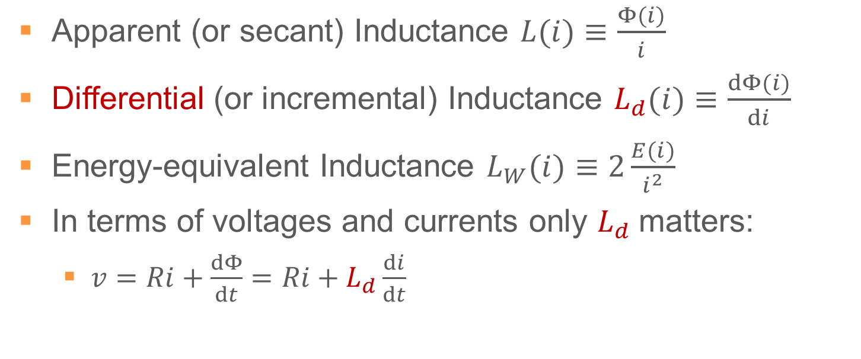
Some definitions
Apparent (or secant) Inductance $L(i)≡\frac{Φ(i)}{i}$
Differential (or incremental) Inductance $L_{d}(i)≡\frac{dΦ(i)}{di}$
Energy-equivalent Inductance $L_{W}(i)≡2\frac{E(i)}{i^{2}}$
In terms of voltages and currents only $L_{d}$matters:
  $v=Ri+\frac{dΦ}{dt}=Ri+L_{d}\frac{di}{dt}$
EDMS 1148084, Buzio et al., Measurement of the inductance of resistive magnets: two case studies

Slide 4
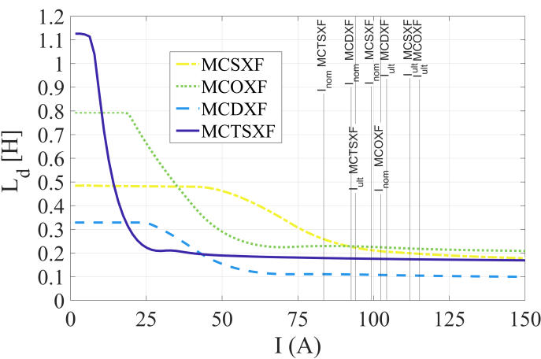
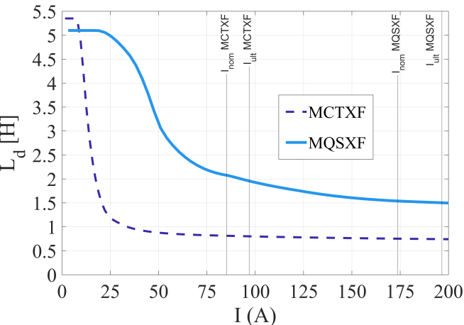

HO Correctors Differential Inductance
it drops by a factor $6.7$ !
EDMS 2156334, Mariotto et al., HL-LHC High Order Correctors Differential Inductance

Slide 5
Some basics concepts of current control
Reference
Generation
Regulation
Limitation
Actuation
Acquisition
Load

Slide 6
Some basics concepts of current control
Reference
Generation
Regulation
Limitation
Actuation
Acquisition
Load

Slide 7
Regulation Variables
Regulation concerns three variables:
  The reference – what you want
  The measurement – what you have
  The actuation – what you can control to make the measurement follow the reference

Slide 8
Regulation Variables
This presentation will refer to the CERN control model in which the reference and measurement concern the circuit current and the actuation is a voltage reference.
VS
I_REF
V_REF
Controller
Load
I_MEAS

Slide 9
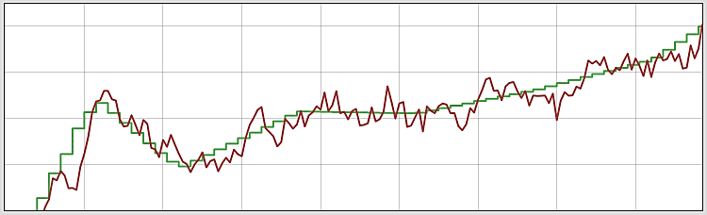
Regulation Requirements
In general, the objective of the regulator is to ensure that the current is within the acceptable limits from the reference value, when required
  DC operation
  Cycling operation
  Pulsed operation
Reject perturbations with the appropriate bandwidth
Track the reference with the appropriate bandwidth

Slide 10
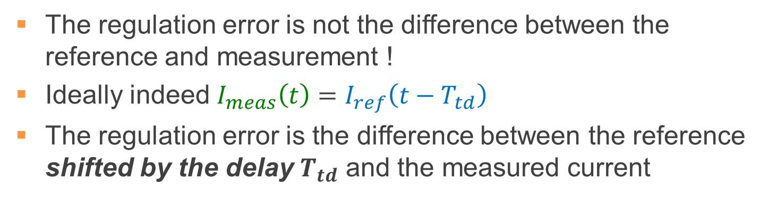
Regulation Error
The regulation error is not the difference between the reference and measurement !
Ideally indeed $I_{meas}\left(t\right)=I_{ref}\left(t−T_{td}\right)$
The regulation error is the difference between the reference shifted by the delay $T_{td}$ and the measured current
Time
now
Regulation error
✗
1.7T_{reg}

Slide 11
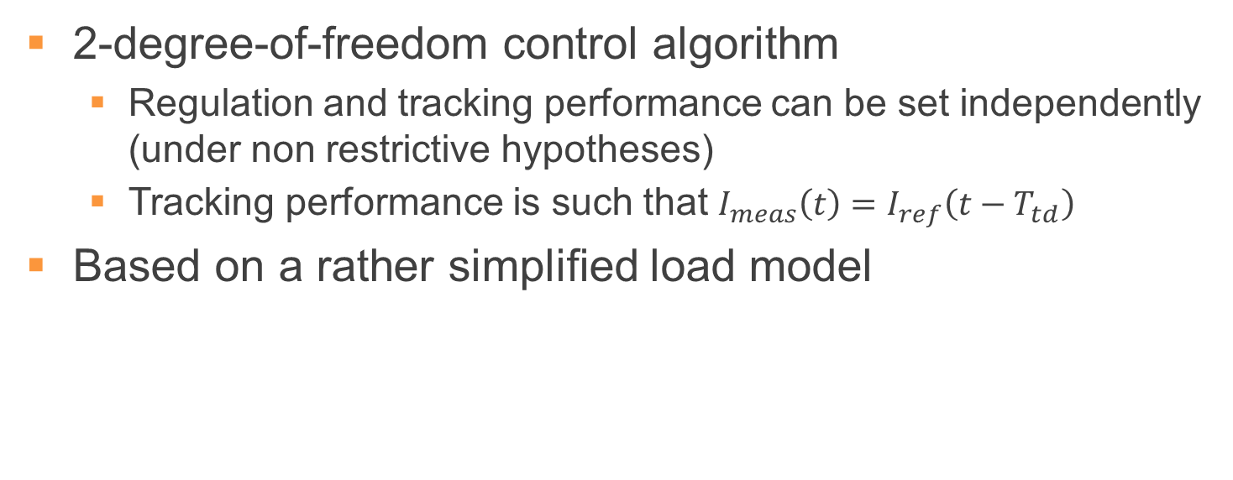
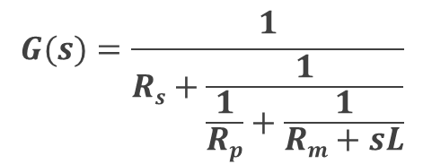
RST algorithm
2-degree-of-freedom control algorithm
  Regulation and tracking performance can be set independently (under non restrictive hypotheses)
  Tracking performance is such that $I_{meas}\left(t\right)=I_{ref}\left(t−T_{td}\right)$
Based on a rather simplified load model
V
$$G(s)=\frac{1}{Rs+\frac{1}{\frac{1}{Rp}+\frac{1}{Rm+sL}}}$$
L
Rs
Rm
I
g₀
Rp
Gain
g₁
Log(frequency)
f₀
f₁

Slide 12
(Very) Simplified Scheme of Current Regulation
V_{err} Lim
V_ERR
V_MEAS
RST: RefAct
Sat Comp⁻¹
-
+
LPF
ADC
LPF
I_REF_RST
I_MEAS
Delay
Ref, Meas &
Act histories
V divider
Function
Generator
VS model
I_REF
I_REF_LIMITED
V_REF
V_REF_SAT
VS
V_LOAD
+
+
I_{ref} Lim
RST: RefAct
Sat Comp
V_{ref} Lim
Link
Real-time
reference
REG_MEAS
I_MEAS
V_REF_LIMITED
T_{reg}
I_MEAS
I_MEAS_FLTR
Load
Delay
T_{meas}
FIR
T_{meas}
I_MEAS
+
-
LPF
ADC
LPF
DCCT
I_ERR
I_LOAD
I_{err} Lim
I_{meas} Lim

Slide 13
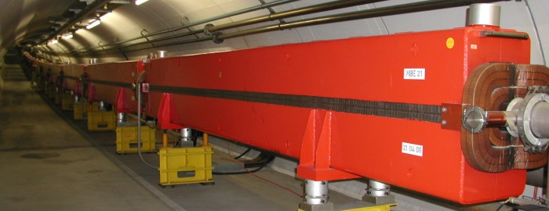
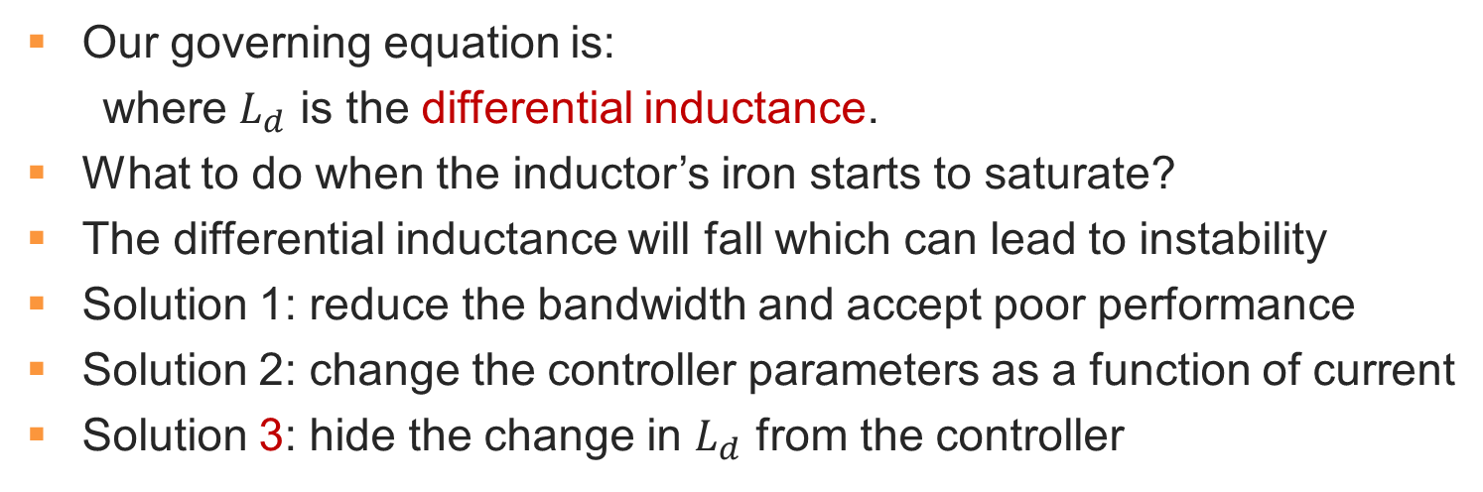
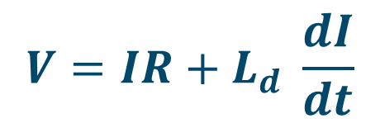
Magnet Saturation
$$V=IR+L_{d} \frac{dI}{dt}$$
Our governing equation is:
where $L_{d}$ is the differential inductance.
What to do when the inductor’s iron starts to saturate?
The differential inductance will fall which can lead to instability
Solution 1: reduce the bandwidth and accept poor performance
Solution 2: change the controller parameters as a function of current
Solution 3: hide the change in $L_{d}$ from the controller

Slide 14
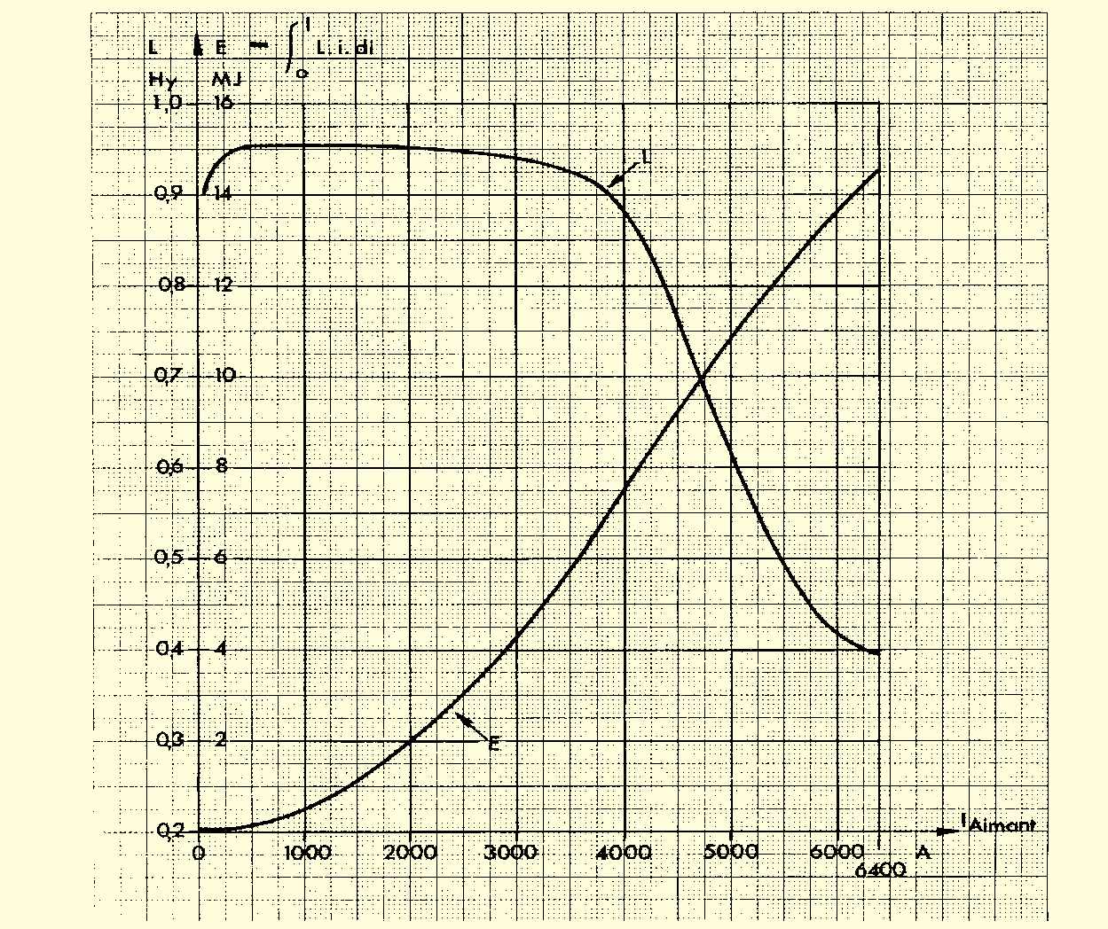
Magnet Saturation : CERN PS Main Magnets
Differential Inductance
0.95 H →
Differential Inductance drops by 60%
0.4 H →
Magnet Energy
O. Bayard, "La nouvelle alimentation de l'aimant du synchroton à protons du CERN,
Fascicule 2: description des composants", CERN 71-20, September 1971.

Slide 15
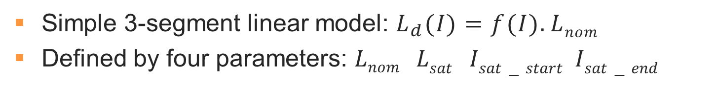
Magnet Saturation
Differential Inductance
L_{nom}
L_{sat}
Current
I_{sat_start}
I_{sat_end}
Simple 3-segment linear model: $L_{d}(I)=f(I).Lnom$
Defined by four parameters: $Lnom Lsat Isat−start Isat−end$

Slide 16
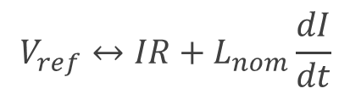

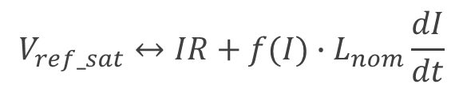
Magnet Saturation
Controller actuation pathway:
To calculate V_REF_SAT:
Differential
Inductance
V_REF
V_REF_SAT
V_REF_LIMITED
L_{nom}
L_{d}(I)=f(I).L_{nom}
RST: RefAct
Sat Comp
V_{ref} Lim
L_{sat}
$$V_{ref}↔IR+L_{nom}\frac{dI}{dt}$$
Current
I_{sat_start}
I_{sat_end}
f(I)
$$V_{ref_sat}↔IR+{f(I)∙L}_{nom}\frac{dI}{dt}$$
1
$$V_{ref_sat}↔IR+f(I)∙\left\{V_{ref}−IR\right\}$$
Current
I_{sat_start}
I_{sat_end}
$$V_{ref_sat}=V_{ref}∙f\left(I\right)+ \left\{1−f(I)\right\}∙IR$$

Slide 17
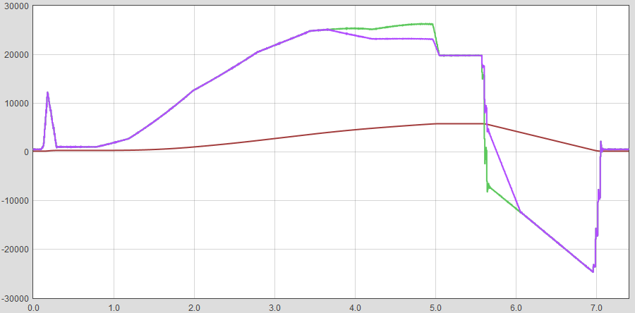

Example of Saturation Compensation
V_{ref}
V_{ref_sat}
I_{sat_start}
4000
I_{meas}
V$ref_sat=V_{ref}∙f\left(I\right)+ \left\{1−f(I)\right\}∙IR$
SPS Main Dipole Circuit

Slide 18

First Test Results on MCTXF
Tests performed on July 16th 2019
Temperature 4.2 K (no implications on diff. inductance)
RPMBA.SM18.RC2.G (LHC600A10V with FGC2)
Ramp Rate: 1.4 A/s
  RST designed by setting only L = 5.35 H and R = 5.7 mΩ
  $I_{meas}\left(t\right)=I_{ref}\left(t−20ms\right)$ with Aux Poles @ 1 Hz ($ζ=0.5$)
Slow application → large Gain Margin >18 dB achieved
  GM > 6 dB is usually imposed, but 18 dB is quite a luxury

Slide 19
Solution 1 – setting only $R$ and $L_{nom}$
>16 dB
other possible dissipative effects not investigated here

Slide 20
Solution 1 – setting only $R$ and $L_{nom}$

Slide 21
Solution 1 – setting only $R$ and $L_{nom}$

Slide 22
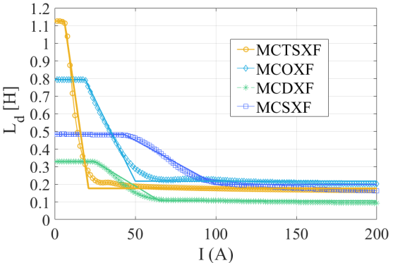
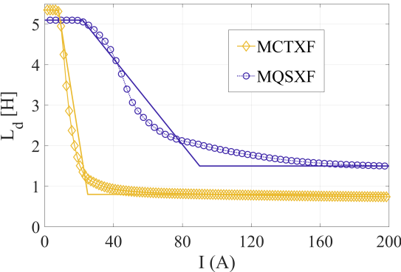
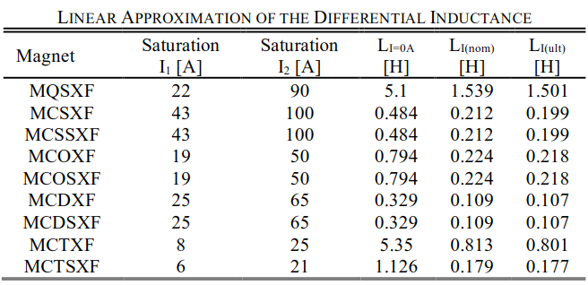
3-segment Linear Model (from EDMS 2156334)

Slide 23
Solution 3 – settings from EDMS 2156334

Slide 24
Solution 3 – settings from EDMS 2156334

Slide 25
Solution 3 – settings from EDMS 2156334

Slide 26
Conclusions
Currently available magnet saturation compensation works satisfactorily for the MCTXF which has the largest expected change in differential inductance of all HO Super-ferric Correctors
No problems expected due to saturation ☺

Slide 27
Thank you for your attention

Slide 28
Solution 3 – settings from EDMS 2156334 - zoom

Slide 29
Additional Graphs on Regulation

Slide 30
Additional Graphs on Regulation

Slide 31
Additional Graphs on Regulation

Slide 32
Ramp Down

Slide 33
Solution 3 – settings from EDMS 2156334

Slide 34
Solution 3 – settings from EDMS 2156334

Slide 35
Solution 3 – settings from EPC commissioning

Slide 36
Solution 3 – settings from EPC commissioning

