Slide 1
Shadowgraphy at AWAKE
Jan Pucek
23/08/2019
MPP Friday meeting

Slide 2
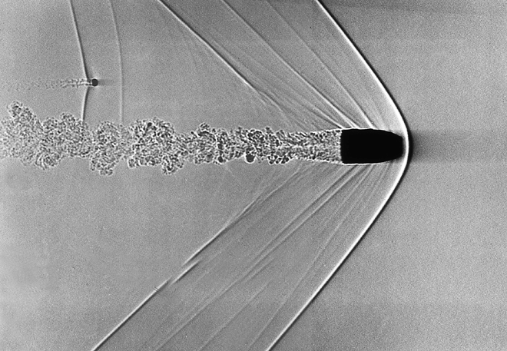
What is shadowgraphy?
Visualization of regions with different index of refraction (n)

Slide 3
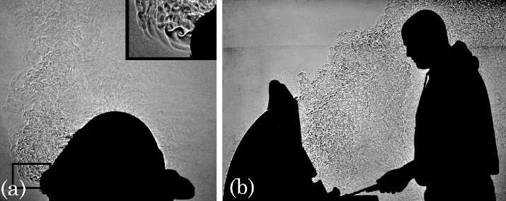

Slide 4
Why do we want to use it?
To obtain an image of plasma waves

Slide 5
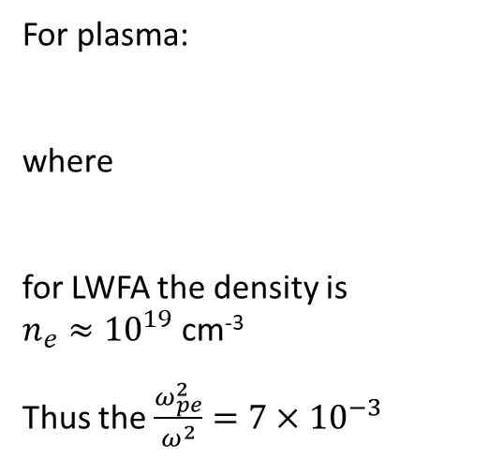


Laser wakefield measurement setup
$$n=\sqrt{1−\frac{ω_{pe}^{2}}{ω^{2}}}$$
For plasma:
where
for LWFA the density is
$n_{e}≈{10}^{19}$ cm⁻³
Thus the $\frac{ω_{pe}^{2}}{ω^{2}}=7×{10}^{−3}$
$$ω_{pe}=\sqrt{\frac{n_{e}e^{2}}{ε_{0}m_{e}}}$$

Slide 6
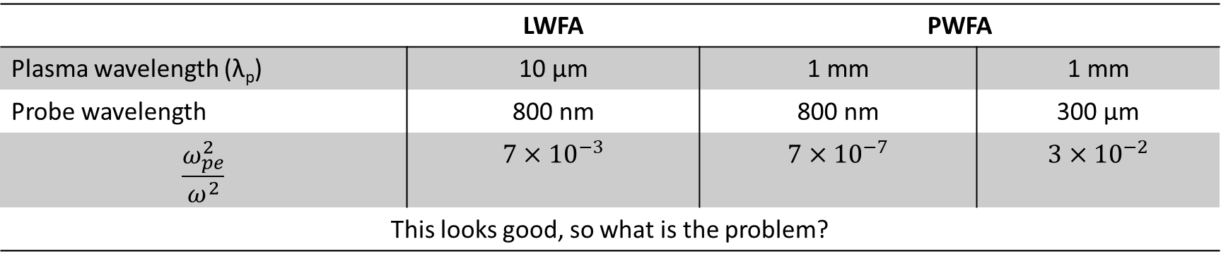
 | LWFA | PWFA
Plasma wavelength (λ_{p}) | 10 µm | 1 mm | 1 mm
Probe wavelength | 800 nm | 800 nm | 300 µm
$$\frac{ω_{pe}^{2}}{ω^{2}}$$ | $$7×{10}^{−3}$$ | $$7×{10}^{−7}$$ | $$3×{10}^{−2}$$
This looks good, so what is the problem?

Slide 7
Key questions
Usage of THz radiation is challenging
  How to generate the probe?
  What detection system (detector + optics) to use?
  How to interpret the signal?
  How will this constrain the design of the vapor source?

Slide 8
Proposed scheme
Stolen from Amrutha Gopal, HI Jena

