Slide 1




Software Development for Vacuum Controls – SCADA Functions Development
FCT Trainee: Rebelo, João
Informatics Engineer – Faculty of Science of the University of Lisbon
Starting date at CERN: 01/04/2019
Supervisor: Rocha, André
TE-VSC-ICM

Slide 2
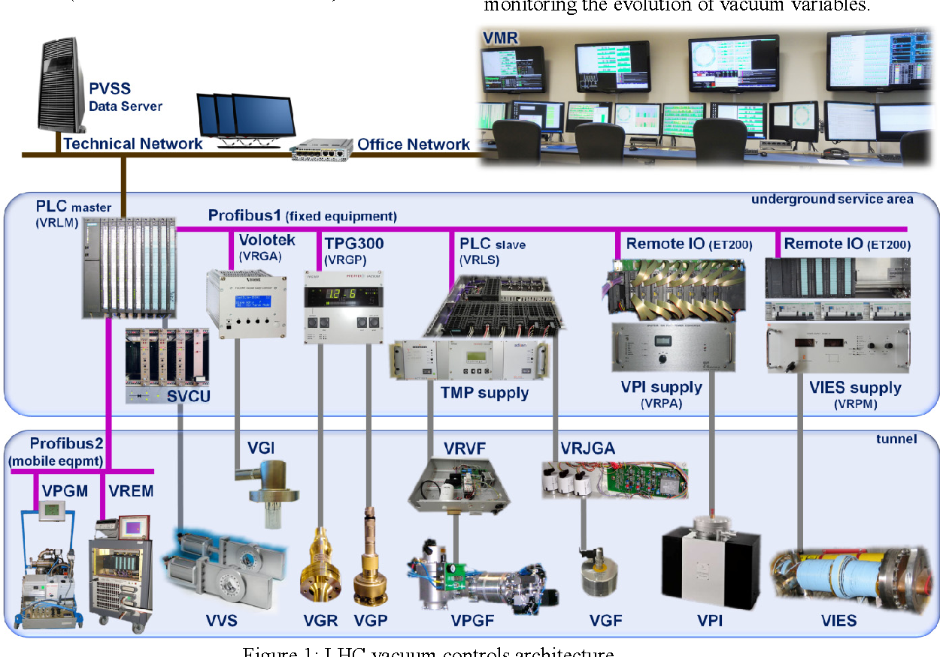
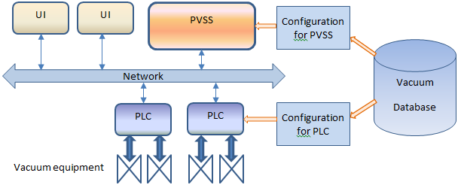
Context – Vacuum at CERN
With over 128km of vacuum chambers, CERN is home to the largest vacuum system in the world
The underlying architecture comprises approximately
  15 000 pieces of control equipment
  300 Programmable Logic Controllers (PLCs)
  7 Supervisory Control and Data Acquisition (SCADA) servers
Vacuum Control System
  Vacuum Database (vacDB) contains information of all devices in the system
  Device information is used to generate configuration files used by PLCs and PVSS (SCADA)

Slide 3
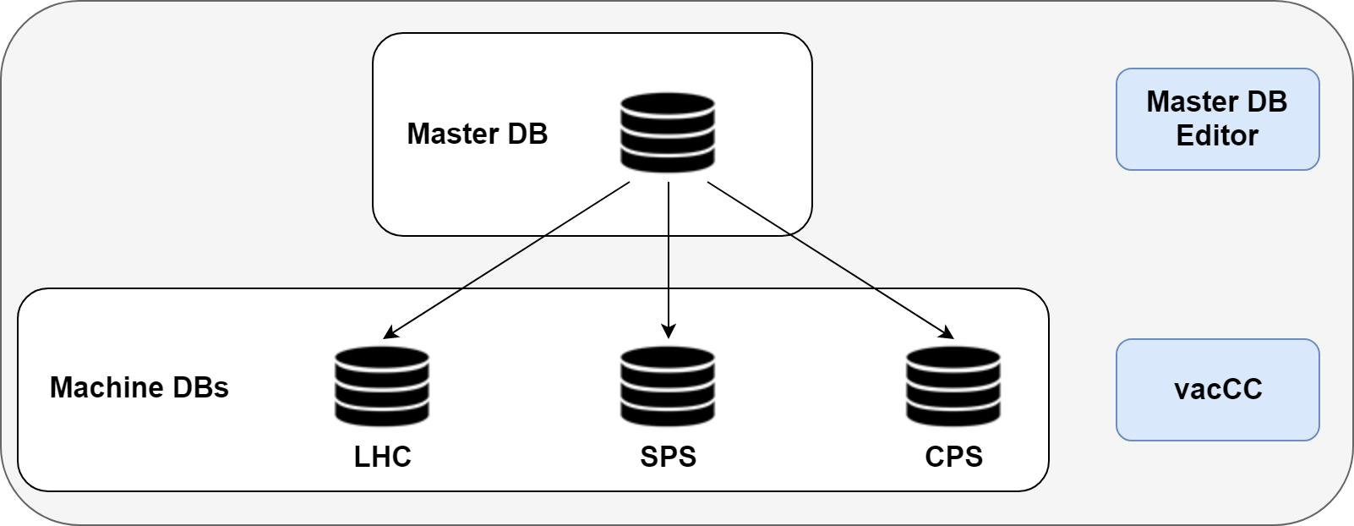
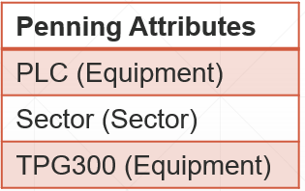
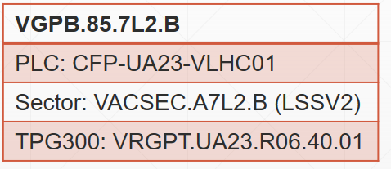
Vacuum Control System
In order to modify vacDB (Vacuum Database) in a user friendly and safe way, 2 applications (the vacuum DB editors) were developed over 15 years ago
  Master DB Editor – Edit metadata common to all machine databases
    Some examples are: Attribute Types, Data Point Types, Control Types, etc.
  vacCC (Vacuum Control Configurator) – Integrate and modify the vacuum devices within the control system
    Export configuration files for the communication between vacuum devices and the supervision system

Slide 4
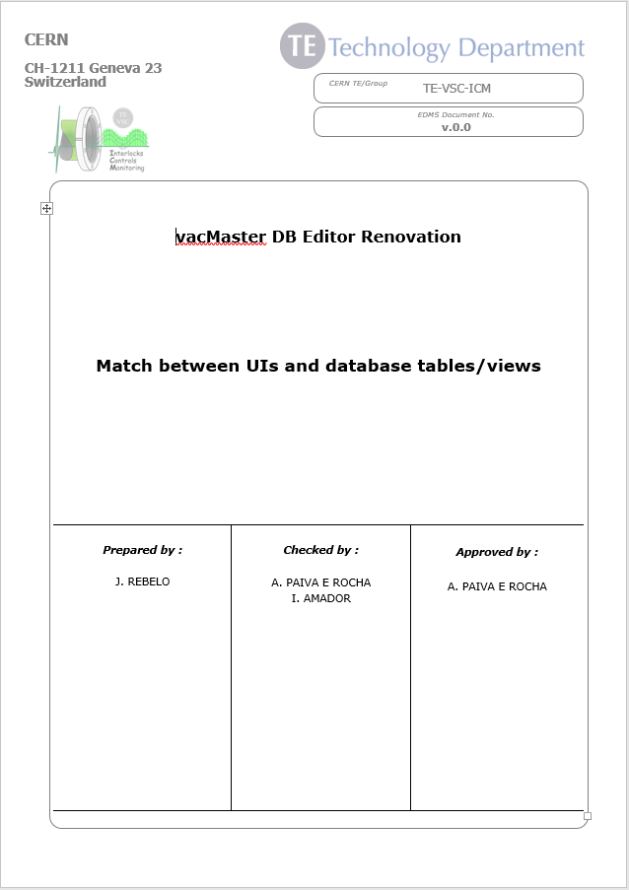
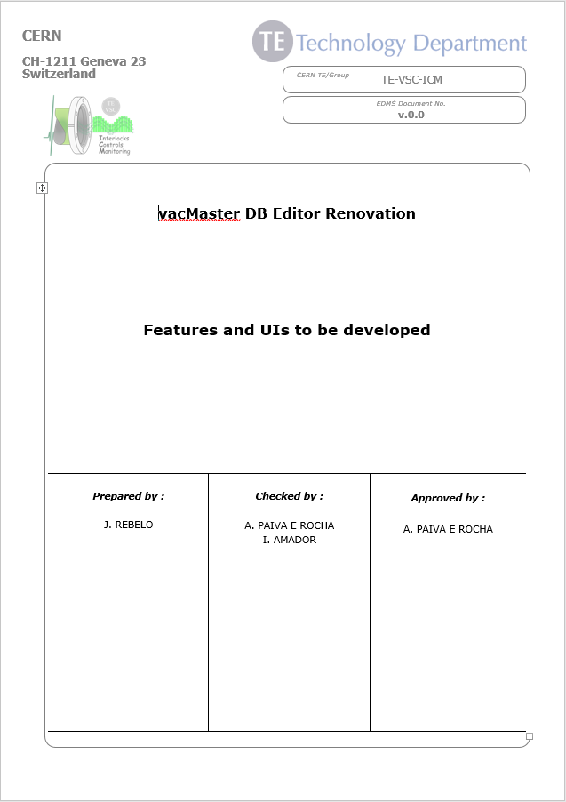
Team Integration and Framework Familiarization
To familiarize myself with the Vacuum Control System Framework I started to do some bug fixes and improvements in vacCC application
My main project is the renovation of the Master DB Editor. Some of the tasks already concluded are:
    Produced a database analysis document
    Studied the design of the legacy Master DB Editor
    Produced a diagram of the database schema

Slide 5



Software Development
Built Continuous Integration pipelines
Built the first skeleton of the application. Built both backend and frontend, as well as security features
Built functioning prototypes using two different frontend UI frameworks
  Analyzed both versions in order to pick the most appropriate one for the rest of the development
Build
Test
Deploy-D
Deploy-P
PROD
push
push
DEV
push

Slide 6
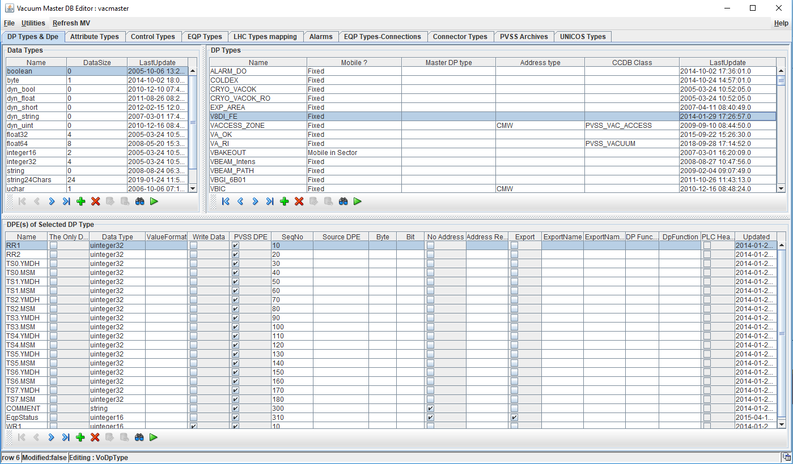
Projects – Master DB Editor
“DP Types & Dpe” page on Master DB Editor

Slide 7
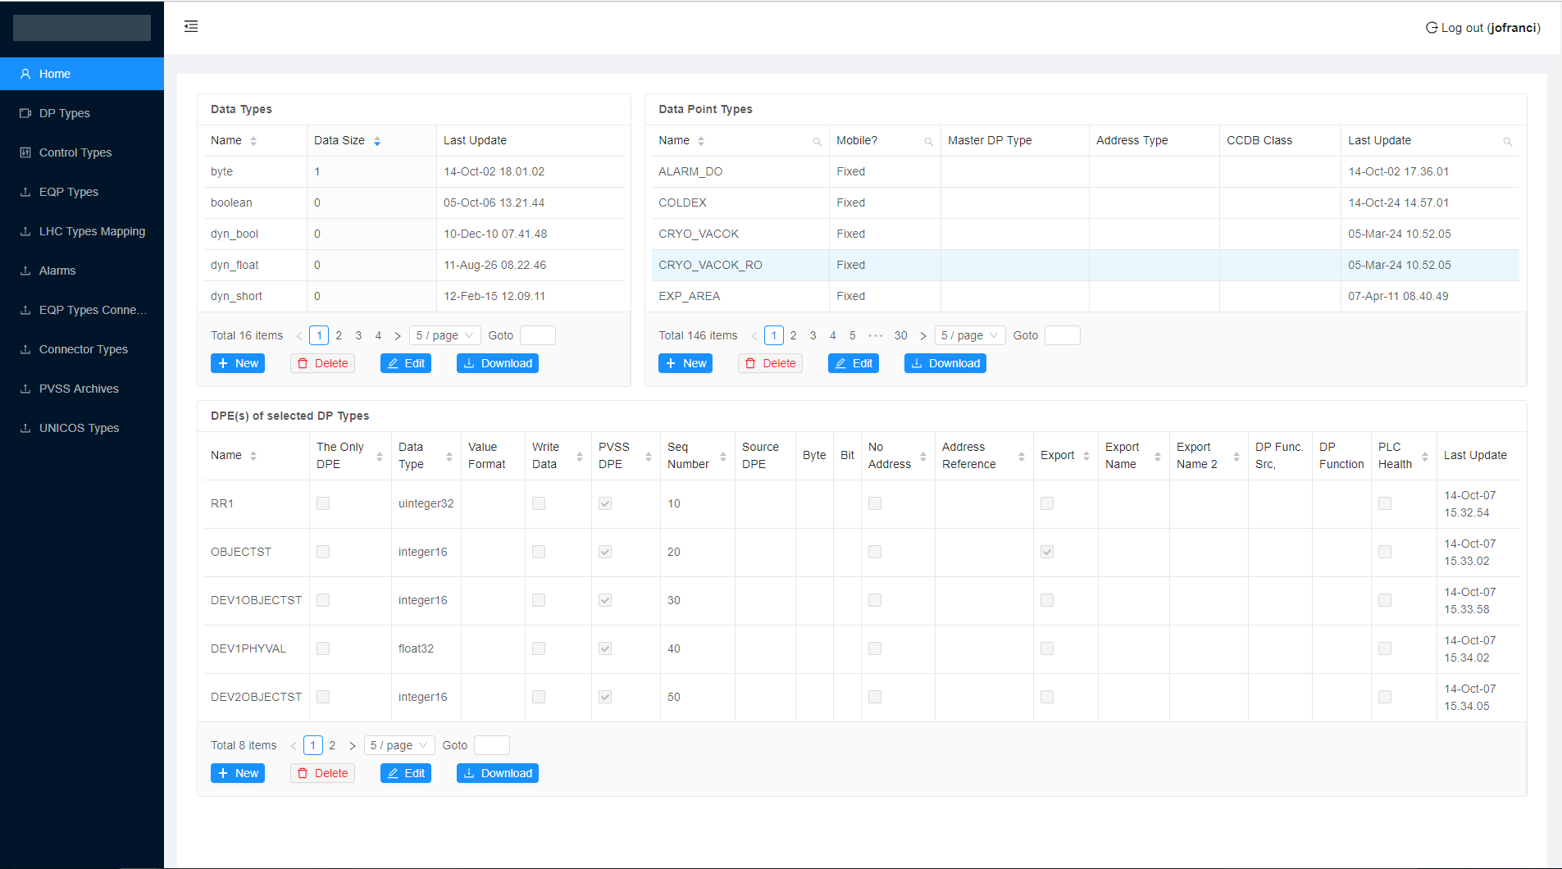
Projects – Master DB Editor Web
“DP Types & Dpe” page on Master DB Editor Web

Slide 8
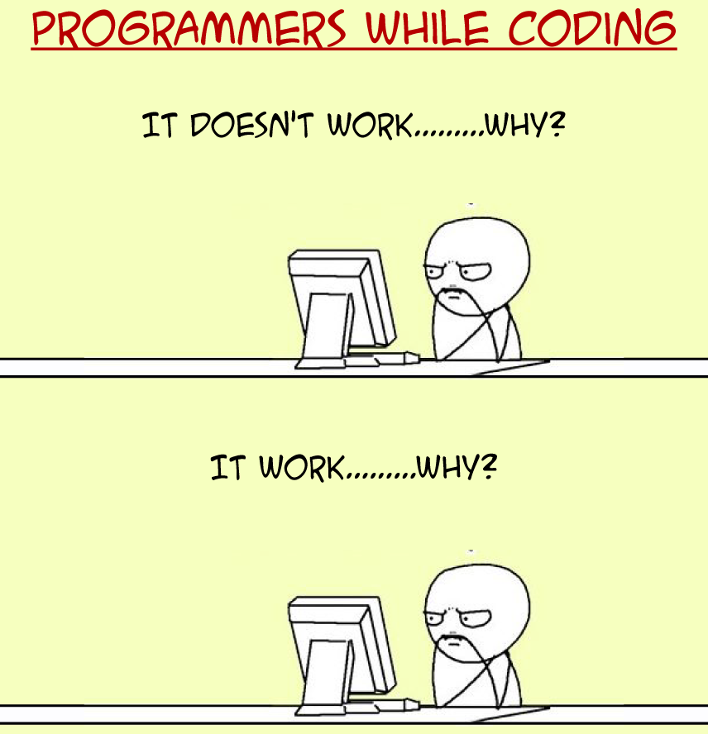
Experience/Personal Development
New technologies
  Java Frameworks (Spring Boot)
  Continuous Integration – Automatic deployment to test and production
  Deployment (openshift, docker containers)
  Front-End Frameworks (ReactJS)
  WinCC-OA
New methodologies
  Project Planning (Project Management Professional Guidelines)
  Agile Methodologies (Scrum)

Slide 9
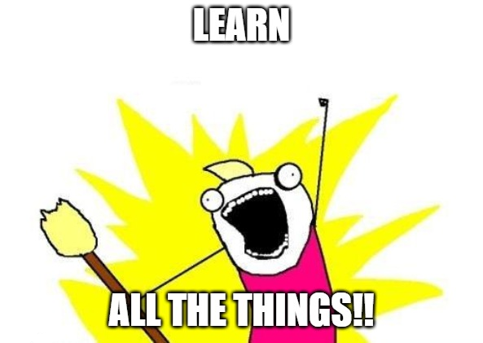
Training Courses
Spring & Hibernate for Beginners (May 22, 2019)
Full Stack Project: Spring Boot 2.0, ReactJS, Redux (June 6, 2019)
Just enrolled on French Course

Slide 10
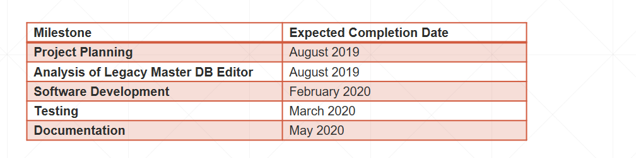
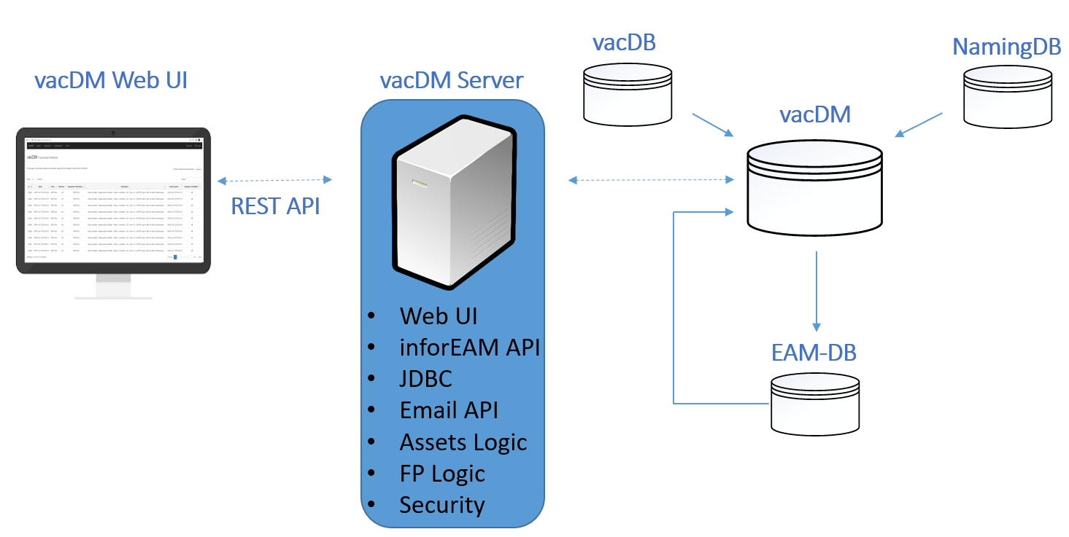
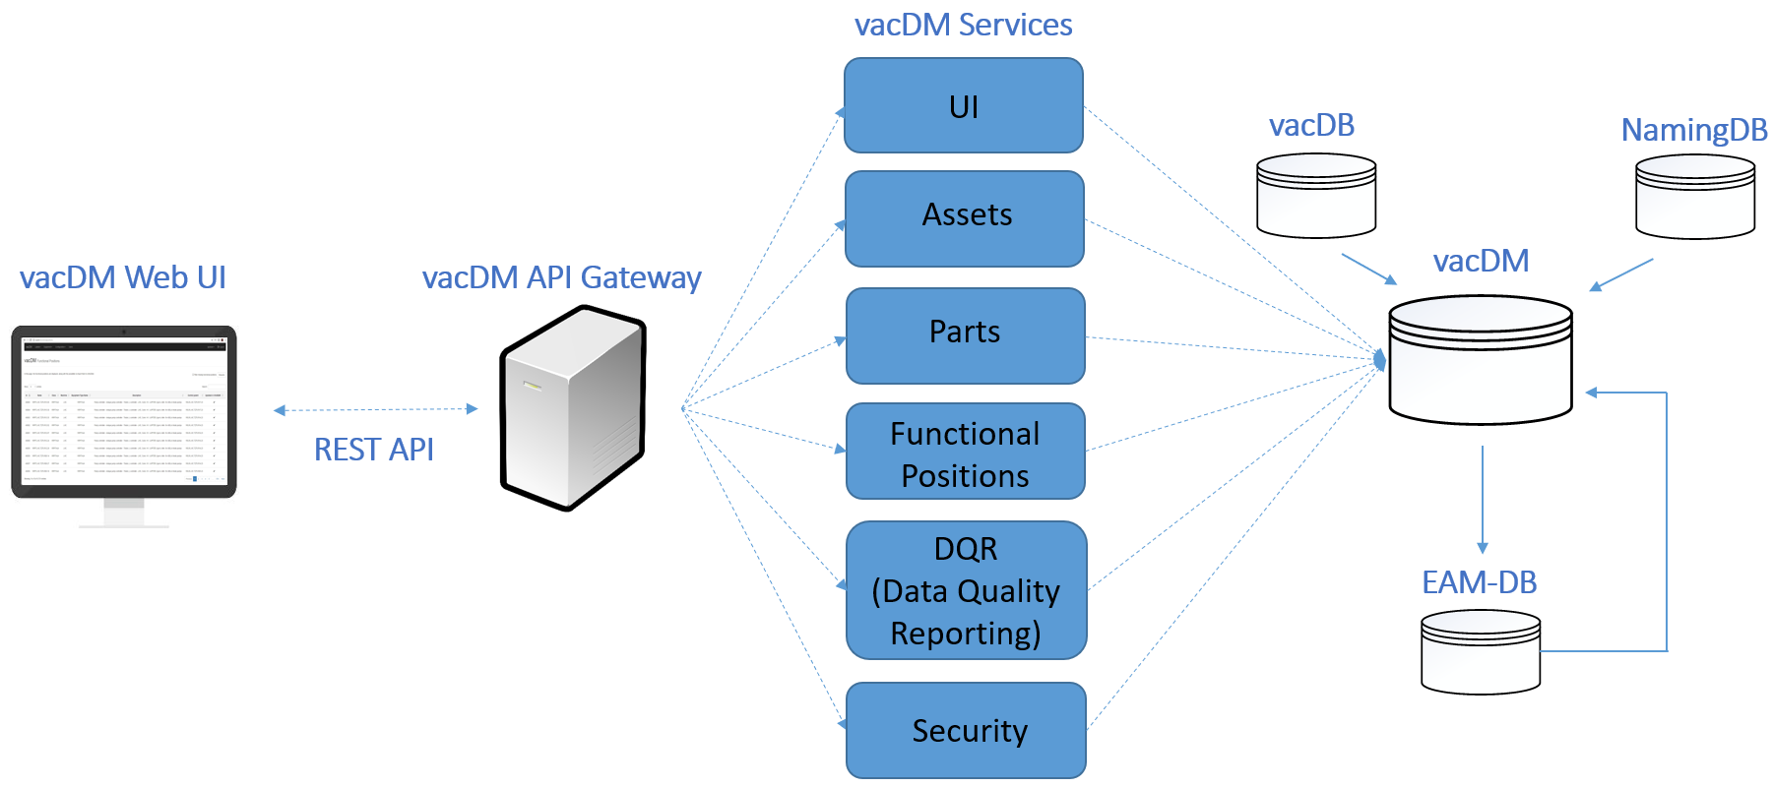
Future Work
Complete Master DB Editor Renovation
New Diagnostic tools for vacuum SCADA
  SMS notifications feature
  Vacuum monitoring room diagnostics enhancement
vacDM enhancements and refactor into a Micro-Services architecture

