Slide 1



EP-4022
Rui Vizinho de Oliveira
Msc Aerospace Engineering (IST, Lisbon)
PhD Mechanical Engineering (UBI, Covilhã)
September 2018 EP-CMS / HGCAL

Slide 2
HGCAL Topics
Dry-out system
  Modelling
  Conclusions
Endcap Structural supports
  Initial concept
  Architectural proposals
  FEM
Complete system
  Preliminary analysis

Slide 3
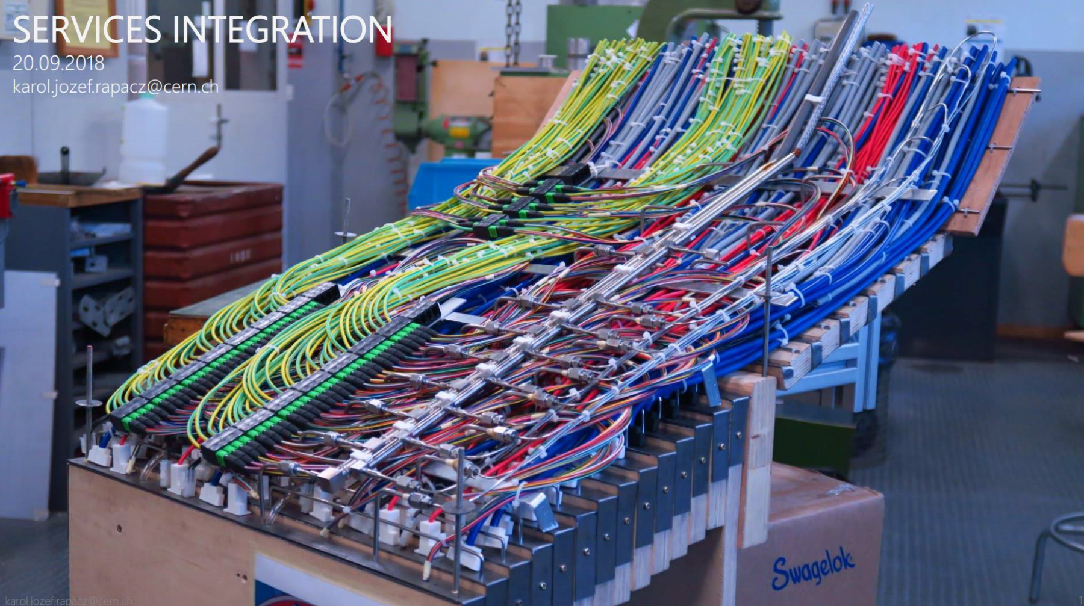
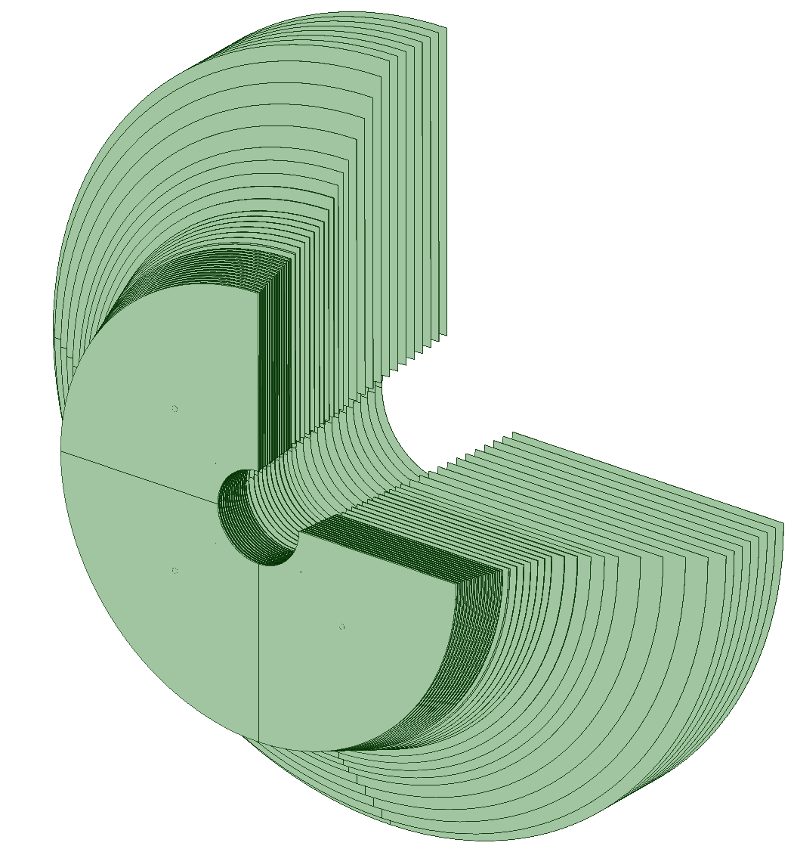
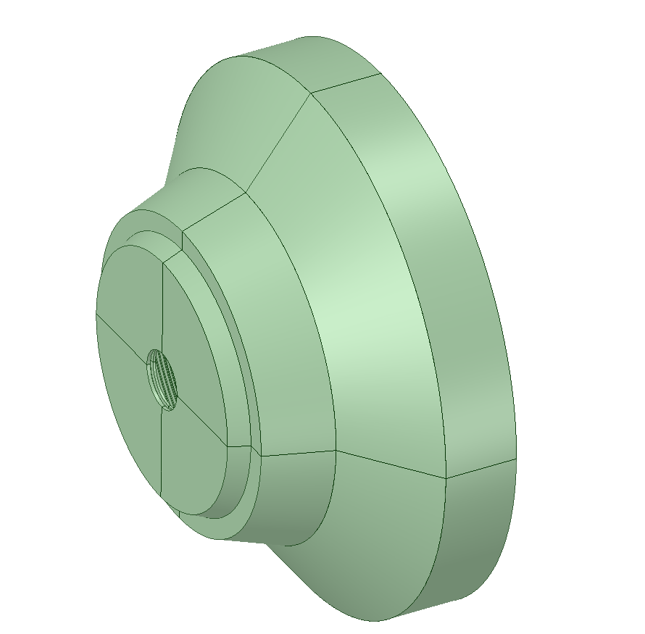
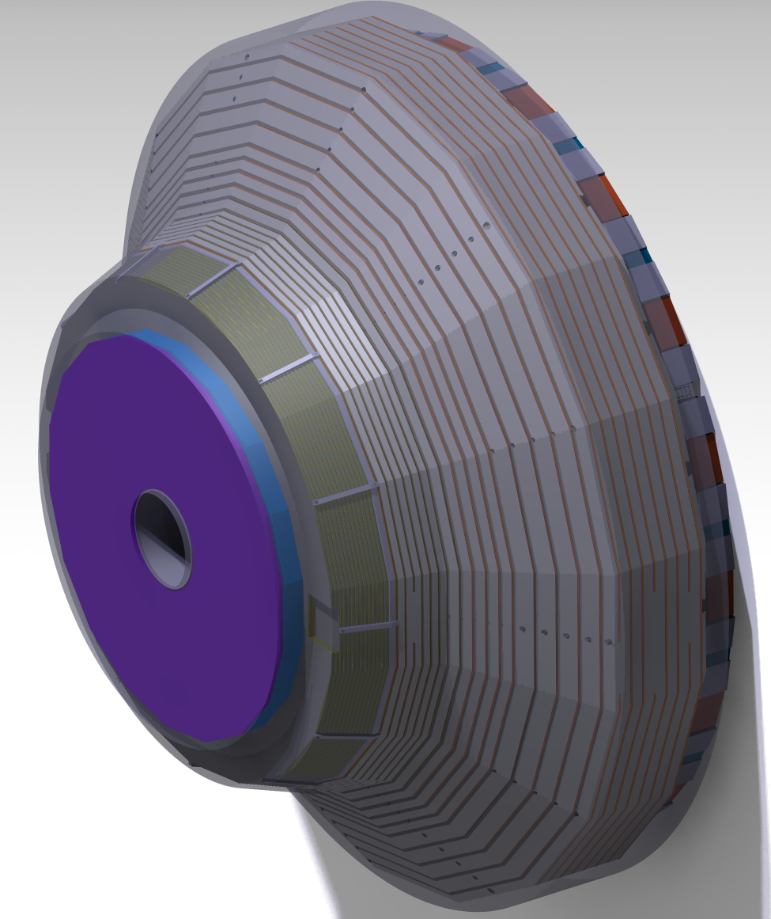
Dry-out system
Modelling

Slide 4
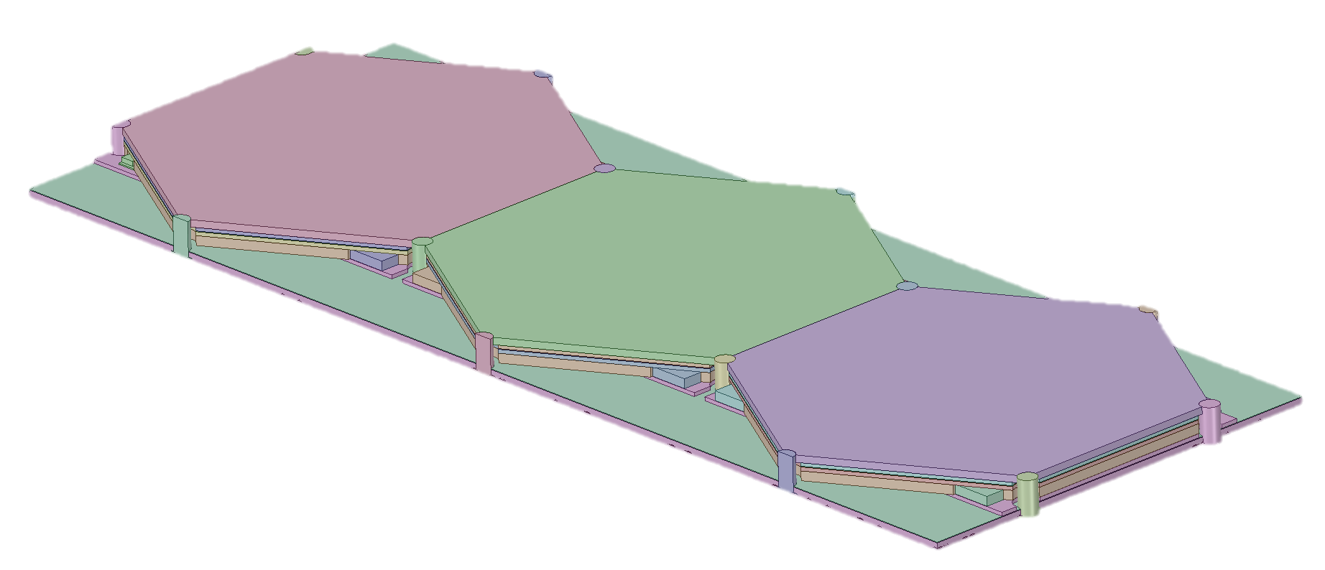
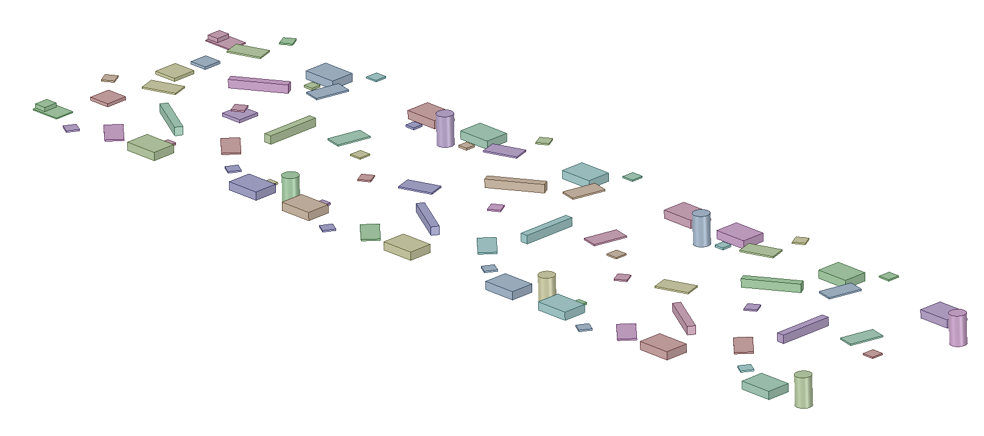
Dry-out system
Modelling
Silicon Sensors + Mother board + Electronic components
Flow blocking components

Slide 5
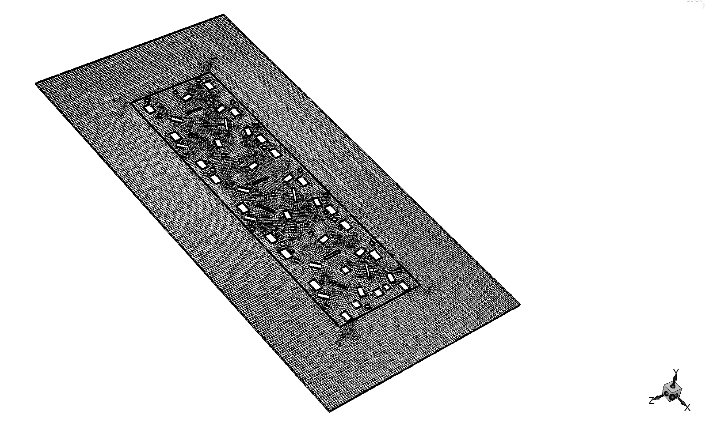
Dry-out system
Pressure outlet
Electronics Wall @ -27 C (246.15 K)
Modelling
Symmetry plane
Surrounding Wall @ -30 C (243.15 K)
Nitrogen gas (N2)
Gravity Orientation -X
Symmetry plane
Pressure outlet

Slide 6


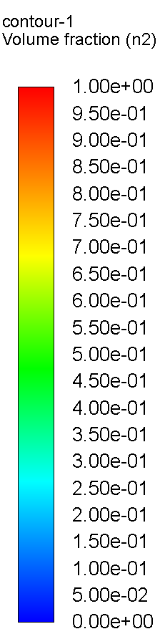
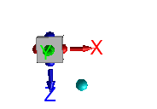
Dry-out system
Pressure outlet
With
Backflow of 100% Air
Modelling
Nitrogen gas (N2)
&
Air
Mid Plane
Wall Plane
No electronics Porous Media
Magnified Cross-section view region
Magnified Cross-section view region

Slide 7
Dry-out system
Conclusions
  HGCAL flush system volumetric flow (minimum)
    Variable outer radius, gap thickness according to CAD, all gaps (74):
      50.8 m³/hour

Slide 8
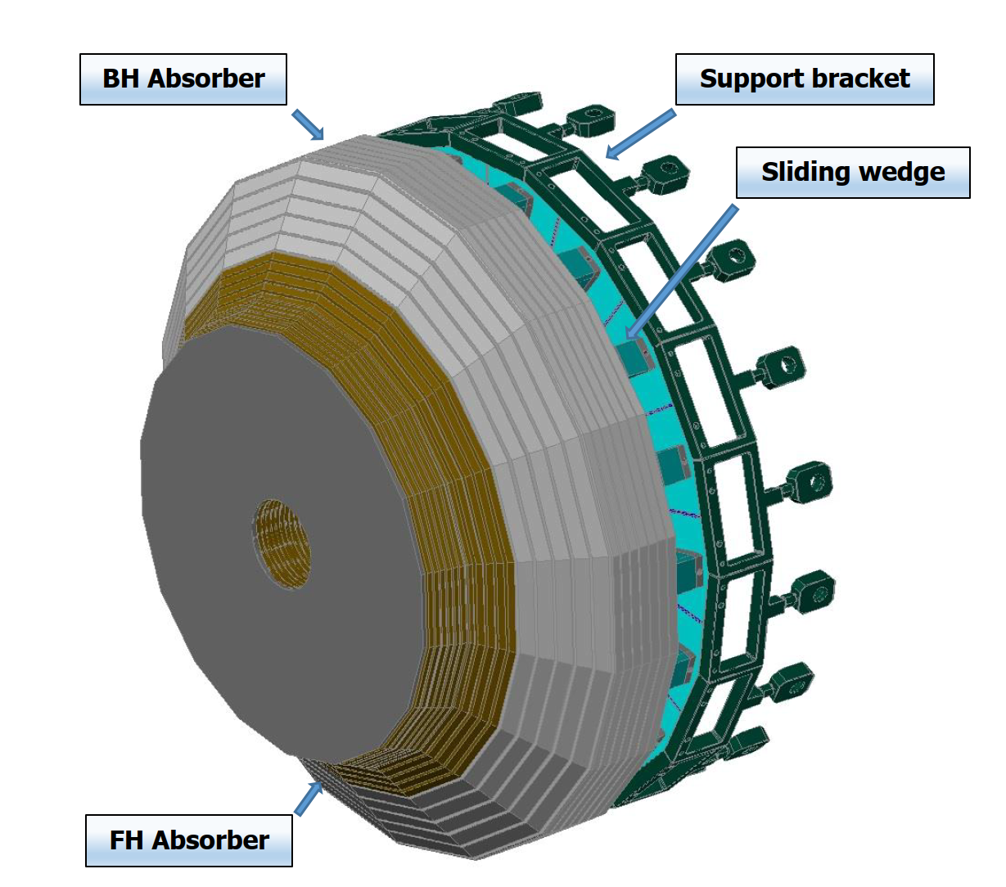
Endcap Structural Supports
Initial concept

Slide 9
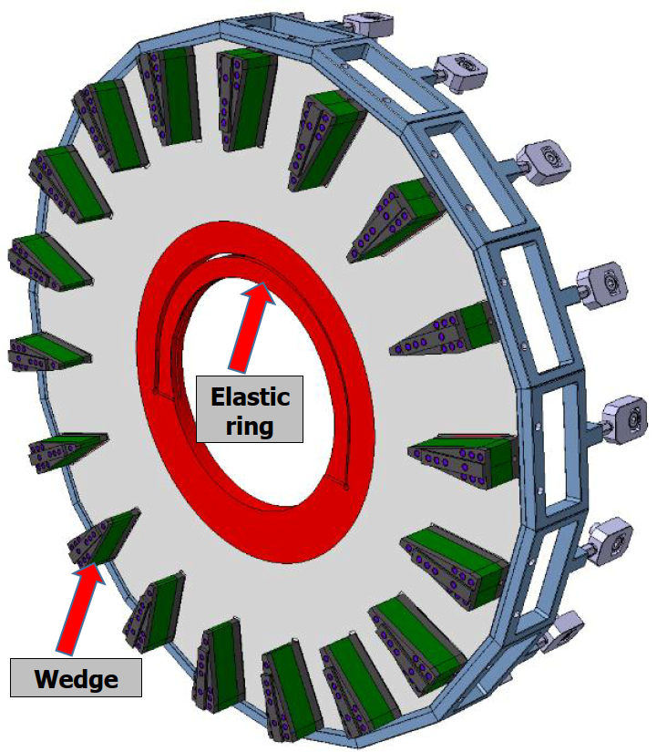
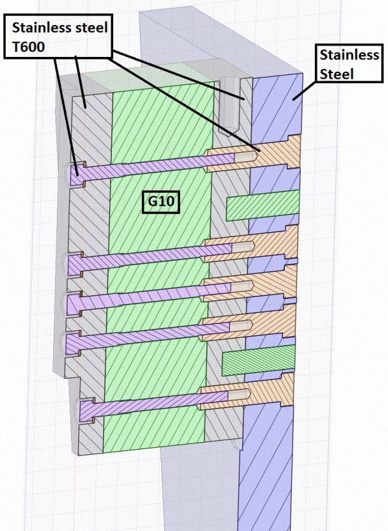
Endcap Structural Supports
Initial concept

Slide 10
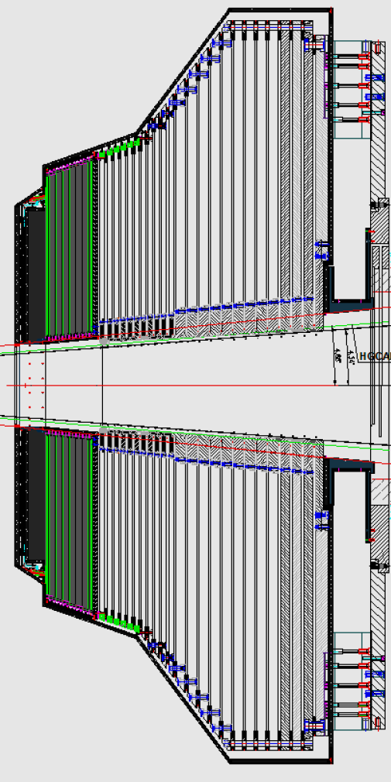
Endcap Structural Supports
Initial concept
Tie bars

Slide 11
Endcap Structural Supports
Initial concept
  Issues
    Lack of structural reliability of the 18 wedges design.
    Size of the used tie bars is too large (M55).

Slide 12
Endcap Structural Supports
Architectural proposals

Slide 13
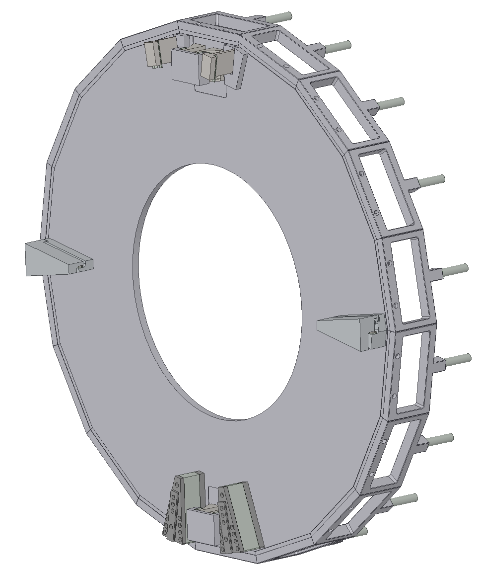
Endcap Structural Supports
Architectural proposals
  Wedge supports
Welded

Slide 14
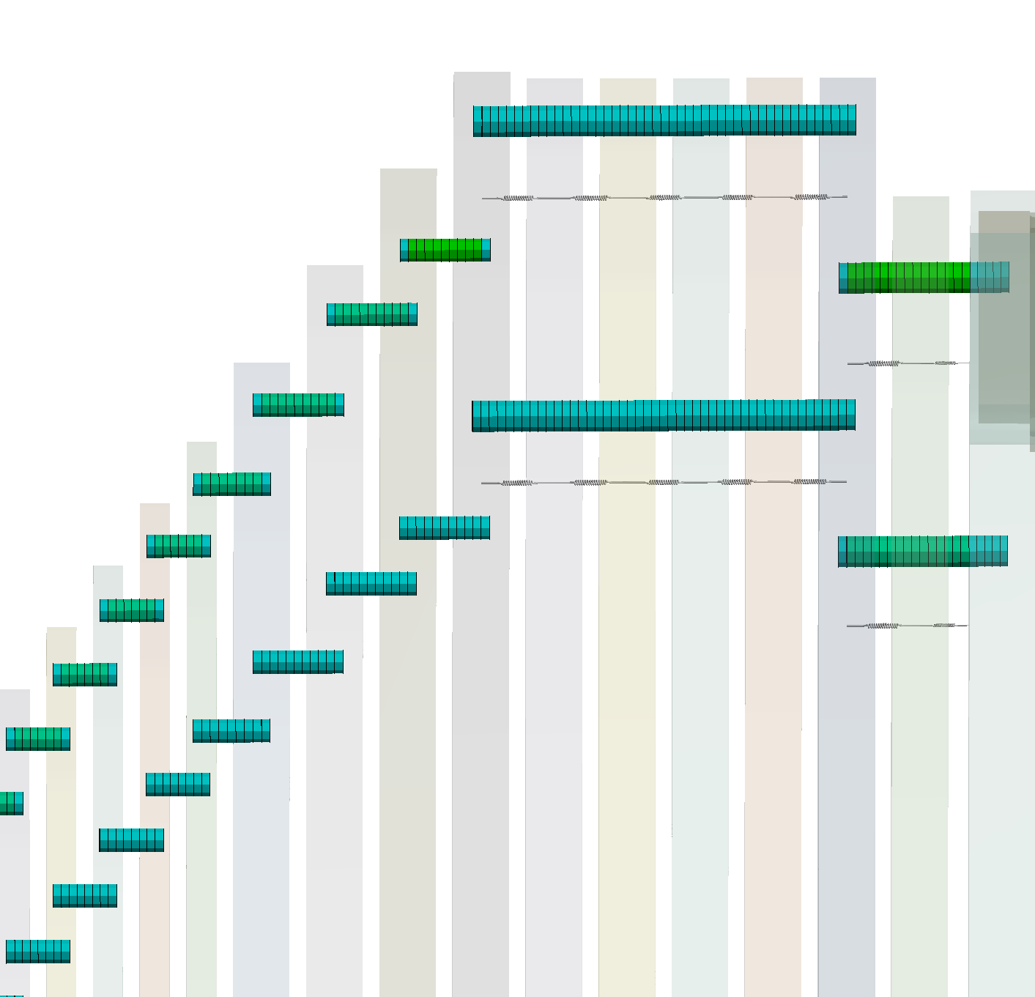
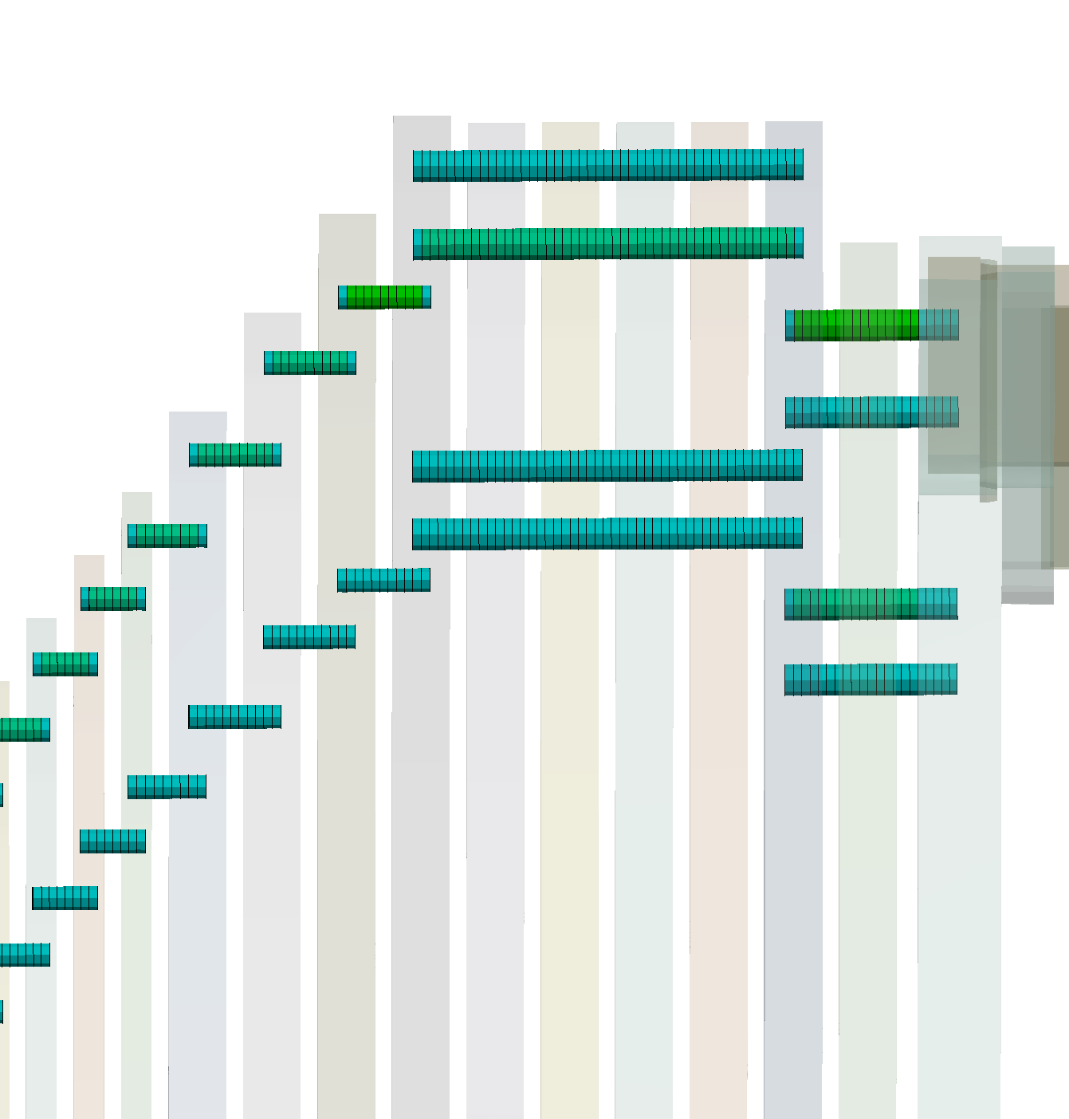
Endcap Structural Supports
Architectural proposals
  Wedge supports
  Tie bars

Slide 15
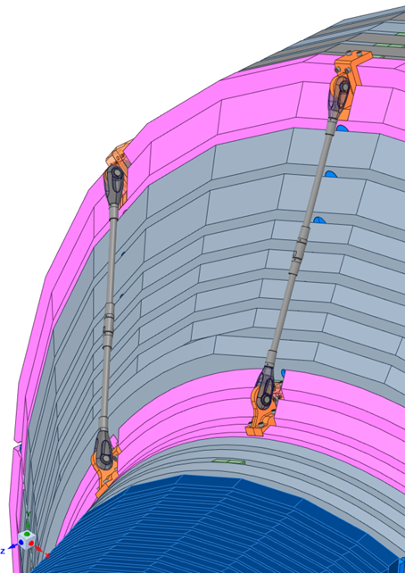
Endcap Structural Supports
Architectural proposals
  Wedge supports
  Tie bars
  External supports
External Bars

Slide 16
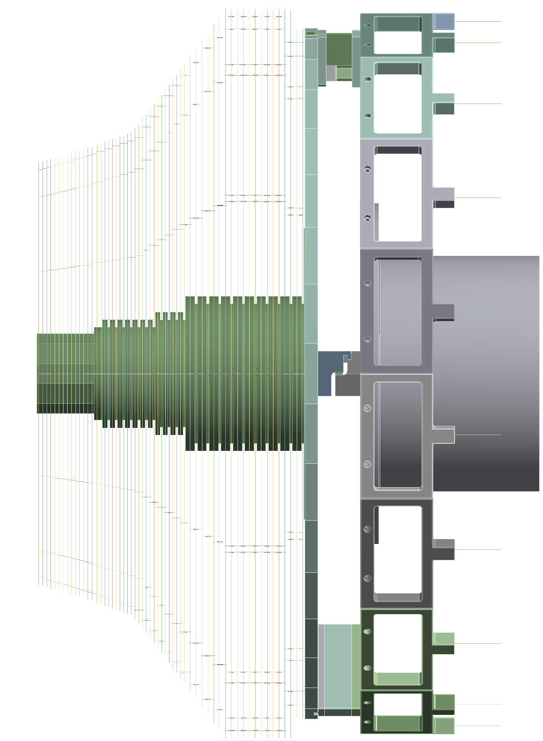
Endcap Structural Supports
FEM
  Modelling
Shell surfaces
+
Beam elements
+
Spring elements
+
Solid elements

Slide 17
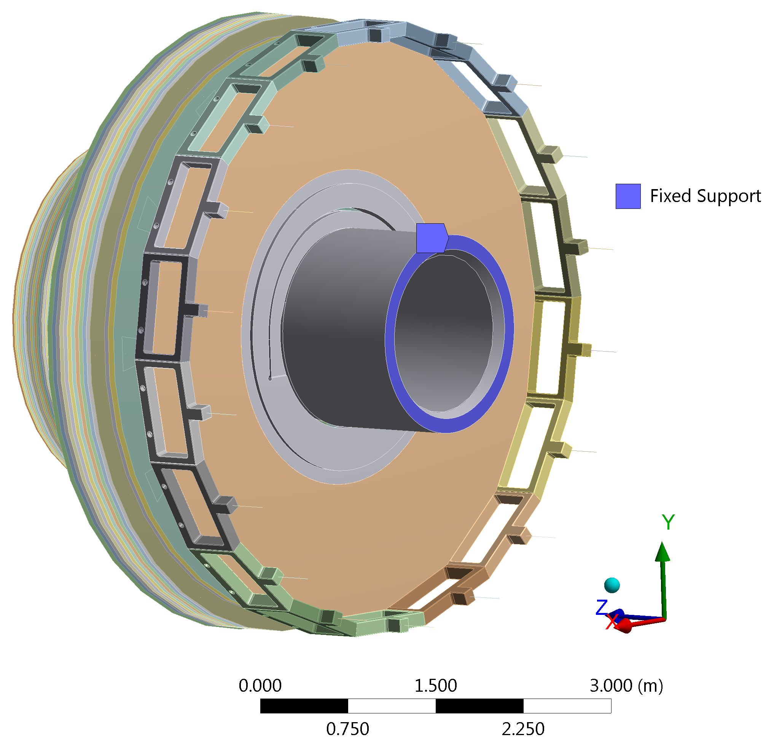
Endcap Structural Supports
FEM
  Modelling
Spherical Joints
Gravity orientation along Y

Slide 18
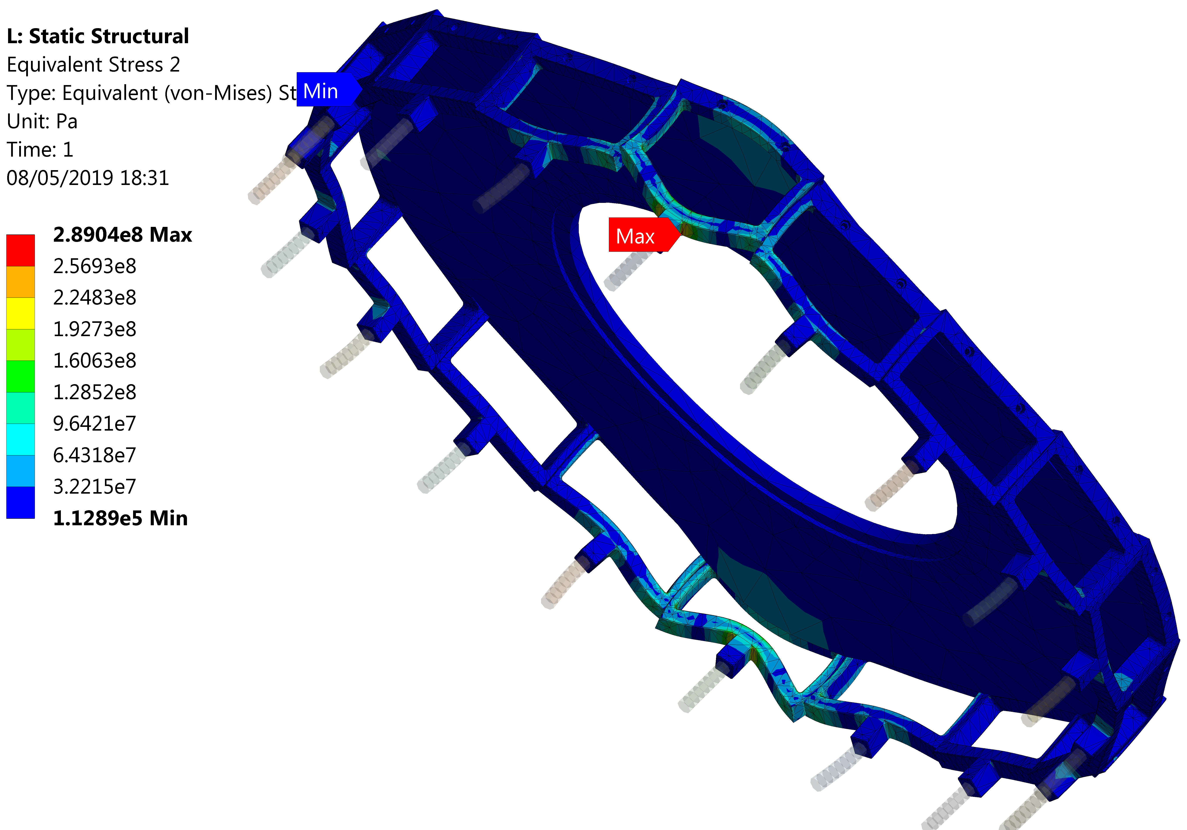
Endcap Structural Supports
Scale Factor of 140 times
FEM
  Results
    Brackets

Slide 19
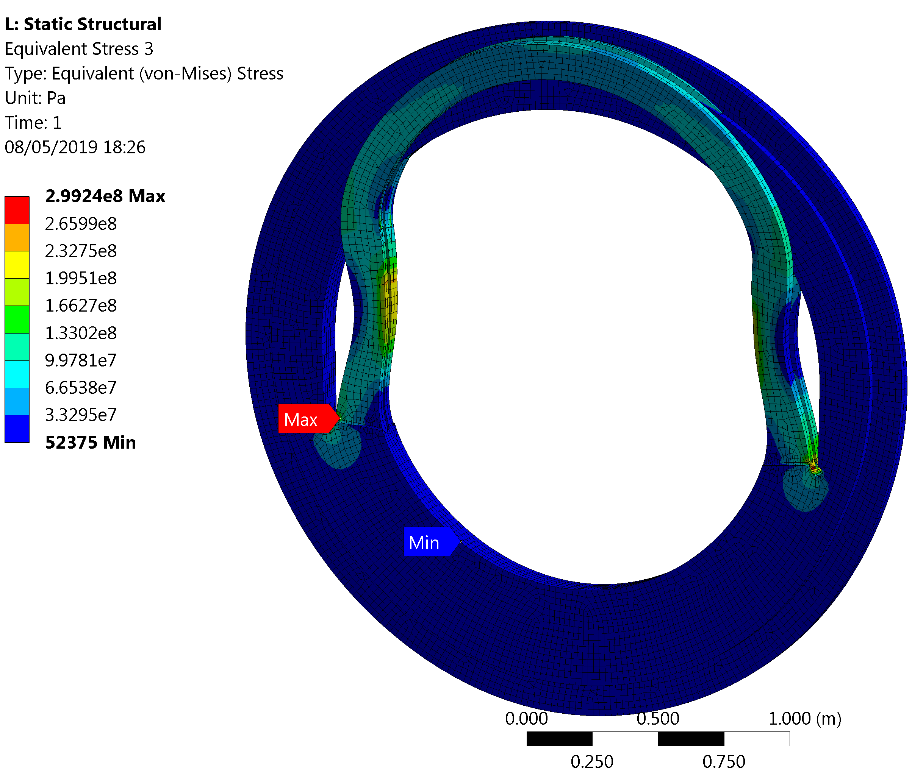
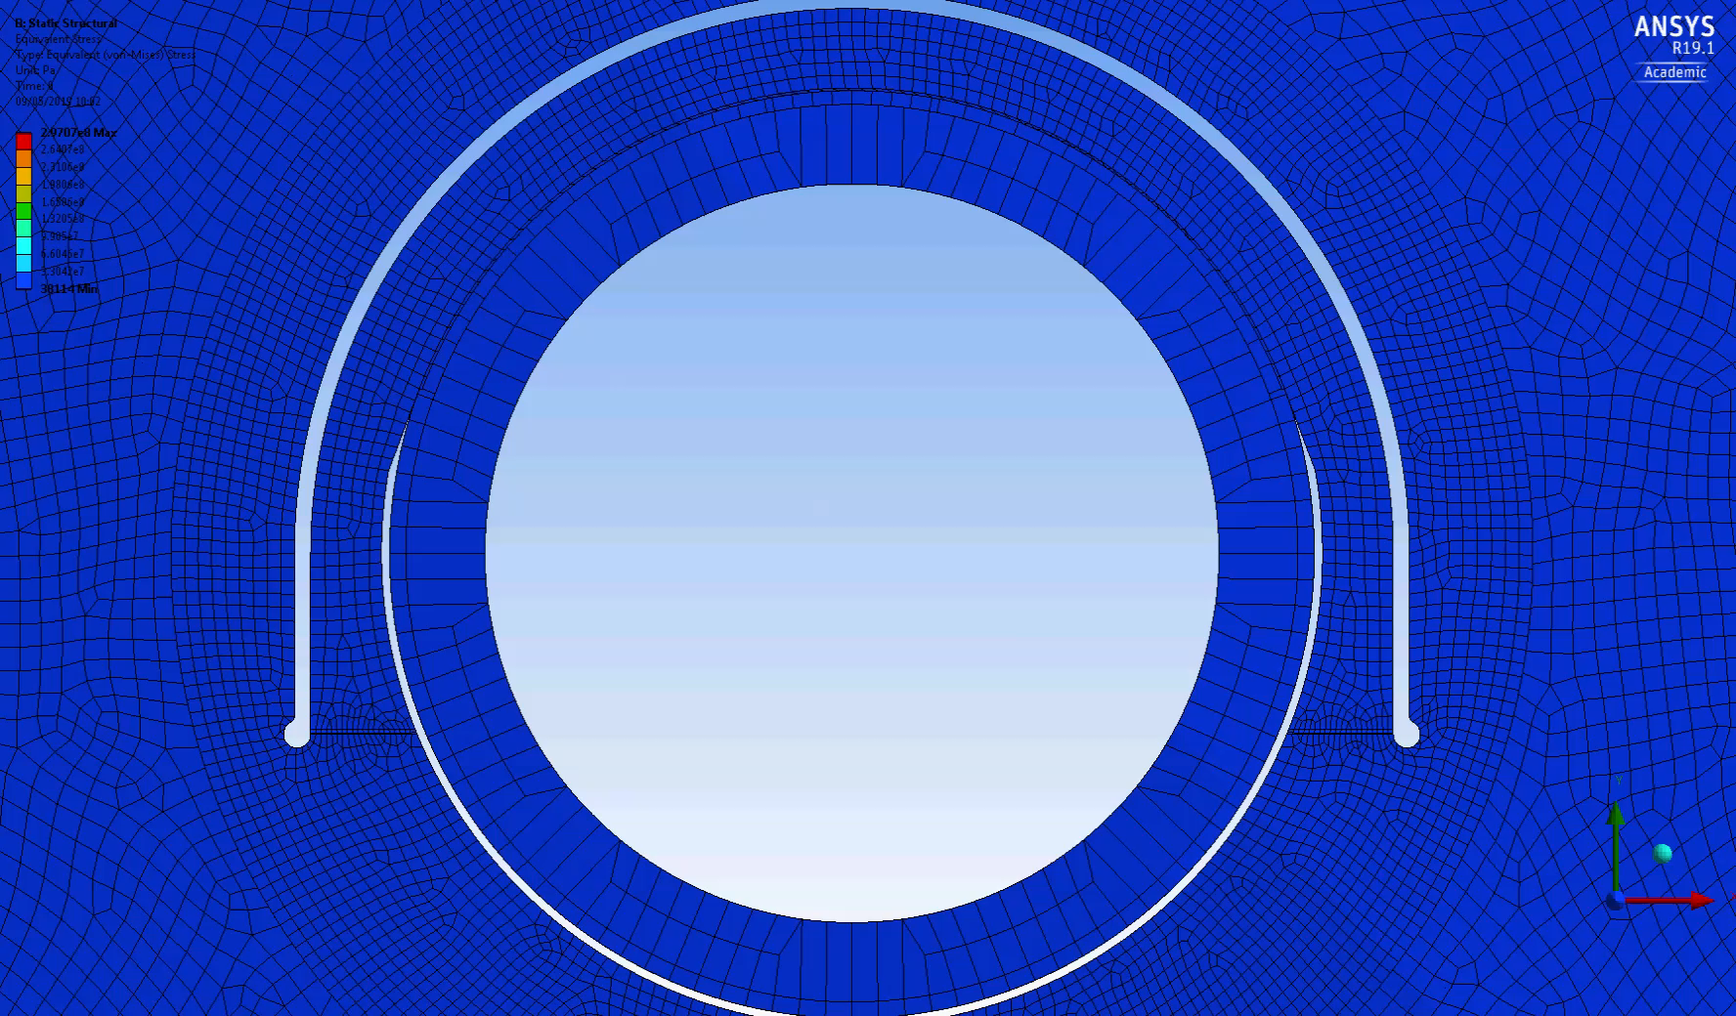
Endcap Structural Supports
Scale Factor of 300 times
FEM
  Results
    Elastic Ring

Slide 20
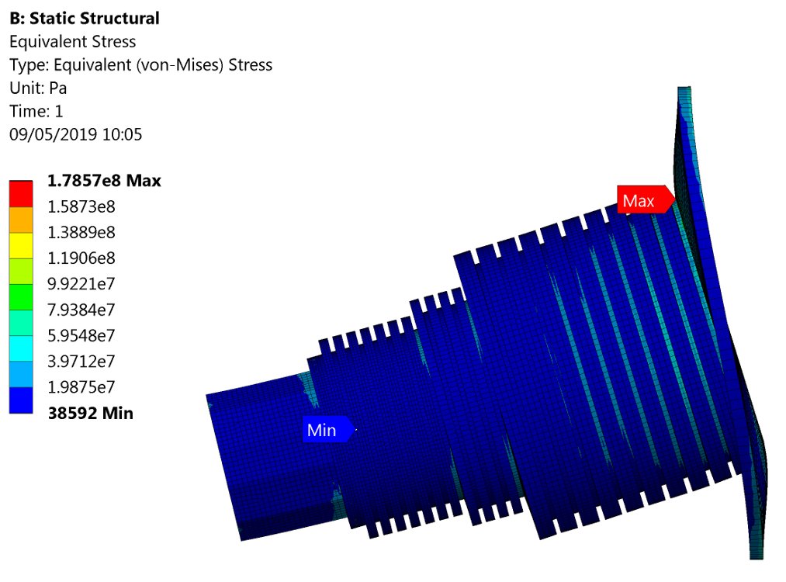
Endcap Structural Supports
Scale Factor of 300 times
FEM
  Results
    Central Tube

Slide 21
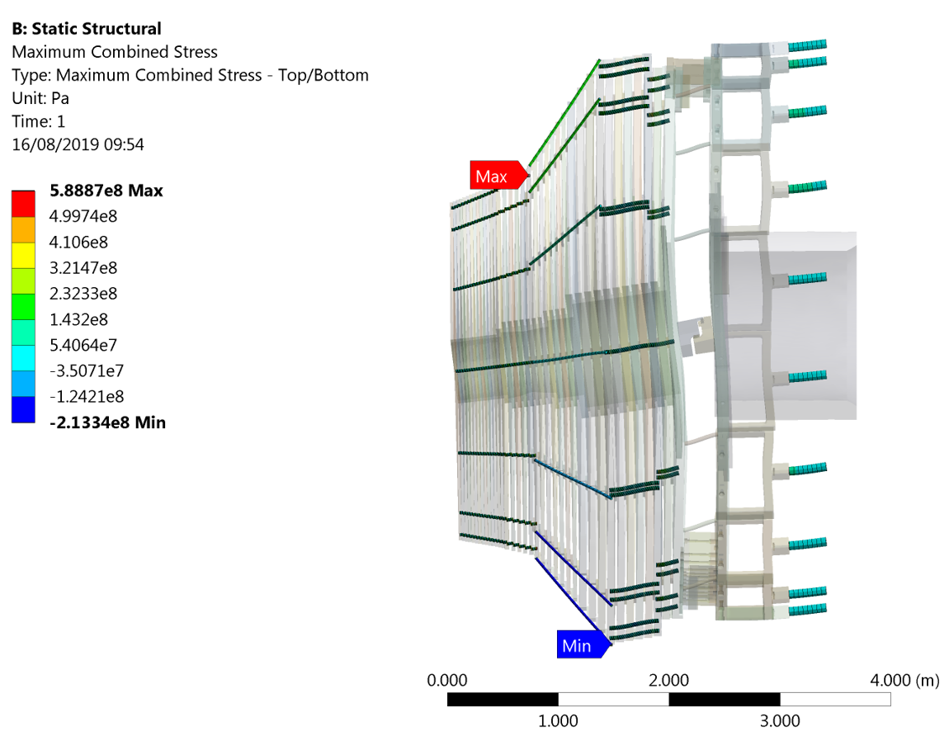
Endcap Structural Supports
Scale Factor of 300 times
FEM
  Results
    Tie Bars

Slide 22
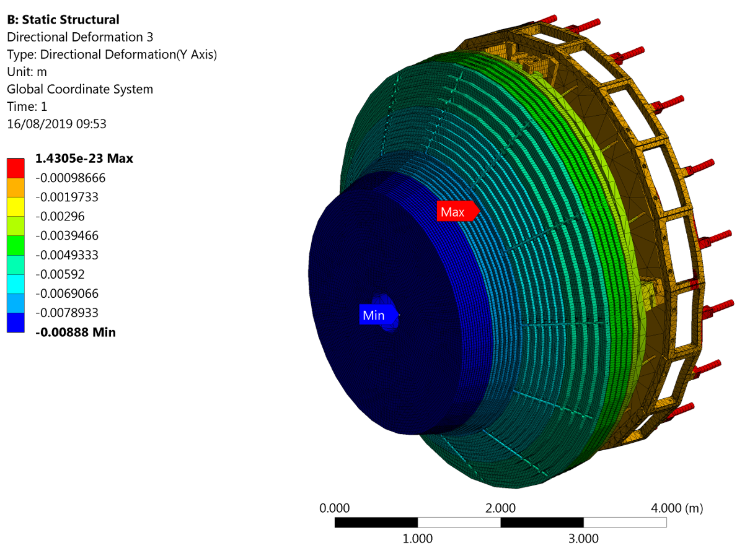
Endcap Structural Supports
Scale Factor of 50 times
FEM
  Results
    Overall deflection

Slide 23
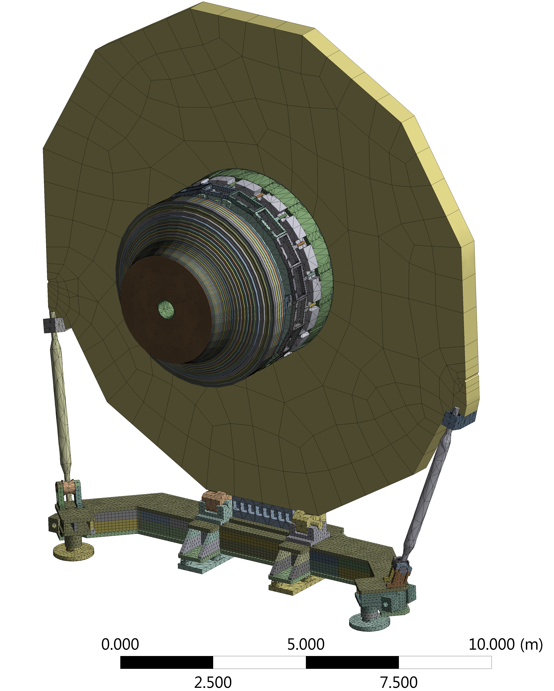
Complete system
Preliminary analysis

Slide 24
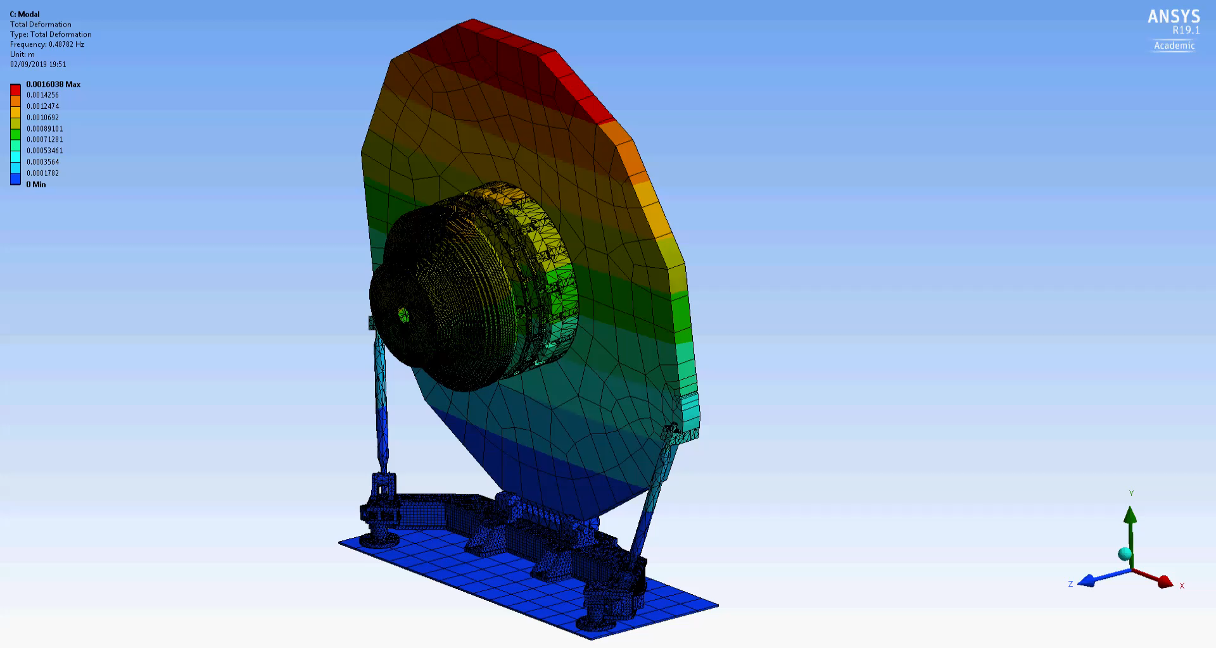
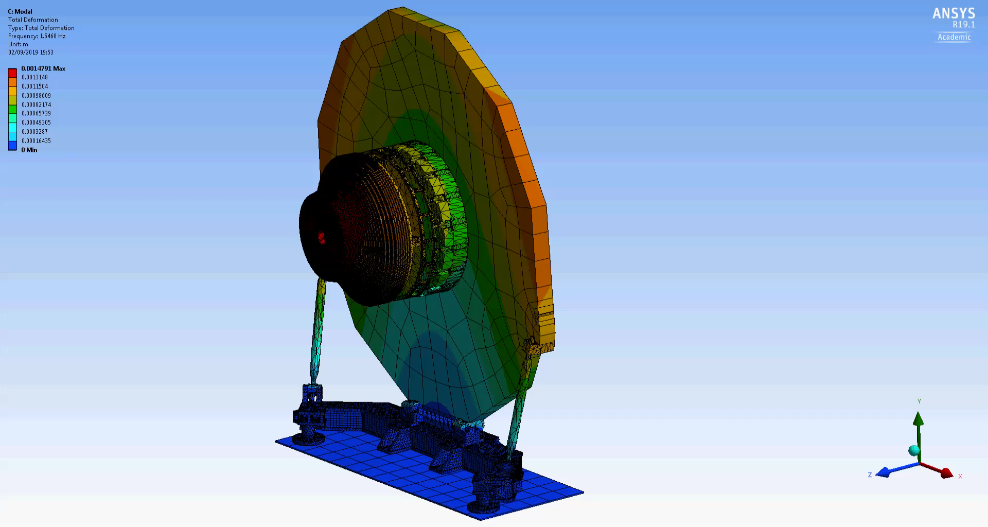
Complete system
Preliminary analysis
  Fundamental Modes

Slide 25
Q&A
Thank you for your time.

