Slide 1

FCT Trainee program follow-up
Afonso Ferreira

Slide 2
Afonso Soares Canas Ferreira
Masters degree in Electrical and Computer Engineering from the University of Porto
Supervisor – Ana Henriques Correia
Started 1st of April 2019
EP Department
Working for the ATLAS experiment

Slide 3
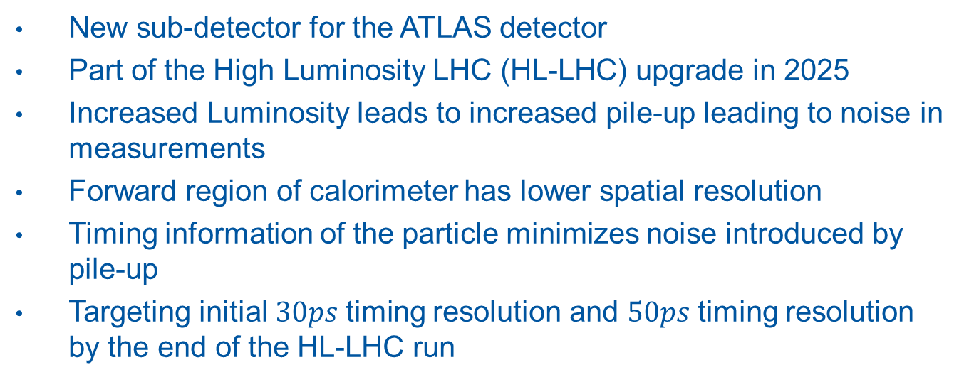
High Granularity Timing Detector - HGTD
New sub-detector for the ATLAS detector
Part of the High Luminosity LHC (HL-LHC) upgrade in 2025
Increased Luminosity leads to increased pile-up leading to noise in measurements
Forward region of calorimeter has lower spatial resolution
Timing information of the particle minimizes noise introduced by pile-up
Targeting initial $30ps$timing resolution and $50ps$timing resolution by the end of the HL-LHC run

Slide 4
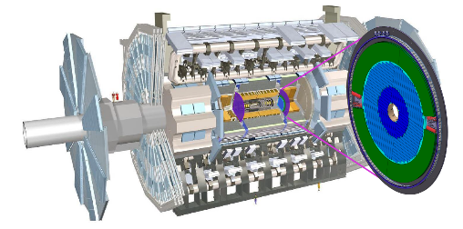
HGTD detector in ATLAS (picture taken from TDR)
Detector has a disk form and placed on endcaps of the Calorimeter
HGTD consists of many small Low Gain Avalanche Diodes (LGADs)
LGADs detect the passage of a particle
Groups of LGADs attached to electronics for readout
CERN group mostly focuses on sensor R&D and upcoming demonstrator development

Slide 5
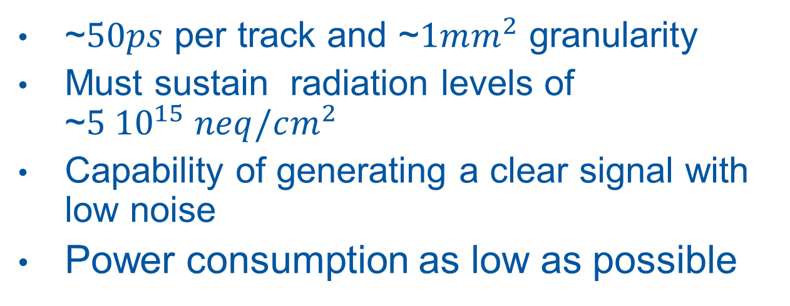
Challenges of Sensor Development
~$50ps$ per track and ~$1mm^{2}$ granularity
Must sustain radiation levels of ~$5{ 10}^{15} neq/cm^{2}$
Capability of generating a clear signal with low noise
Power consumption as low as possible

Slide 6
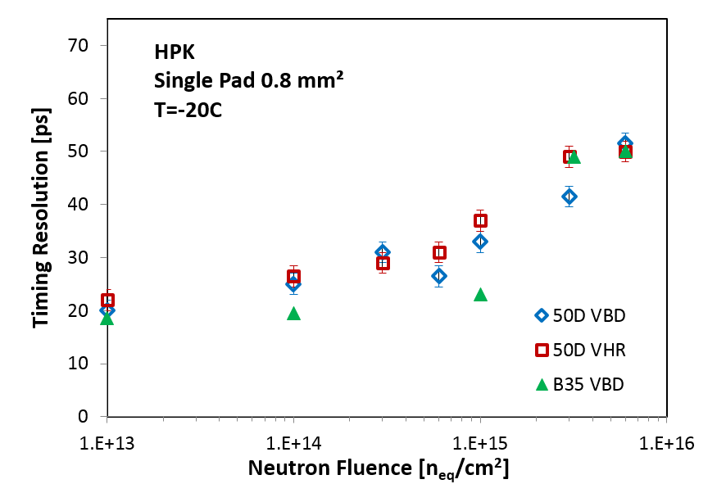
Sensor R&D at CERN
Multiple sensors from various providers
For each determine
  IV and CV curves
  Timing resolution
  Charge collection
Determine the best sensors for future implementation
Plot of time resolution in function of the fluence. Source 2018 HGTD Technical Proposal

Slide 7
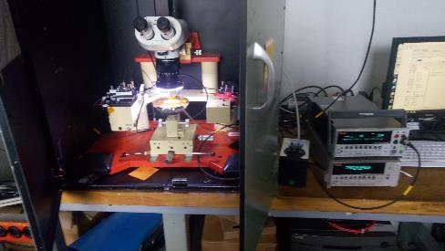
My Contributions to HGTD CERN Probe Station Setup
Helped establish and debug the setup
Made IV measurements of multiple LGADs
Upgraded the setup for CV capabilities
Presented results to other members and partners of HGTD

Slide 8
Heating Demonstrator
Demonstrator necessary to showcase viability of the cooling
Heaters simulate the heat generated by sensors
PCB necessary to readout and control the heaters
I am going to contribute to the PCB design
PCB based on a demonstrator implemented by another group
Initial development to start in September

Slide 9
Experience
Collaborated with different people of various backgrounds
Developed more experience with measuring equipment, software and procedures
Integrating at CERN was very easy
  Very welcoming team
  Very good onboarding
  Very welcoming people outside of the team

