Slide 1

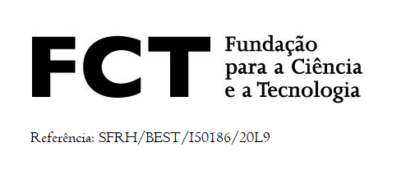
FCT Follow-up Meeting for Portuguese Trainees
Bruno Alves
Partial wafers performance studies on the future CMS high granularity calorimeter
Geneva, 3rd September 2019

Slide 2
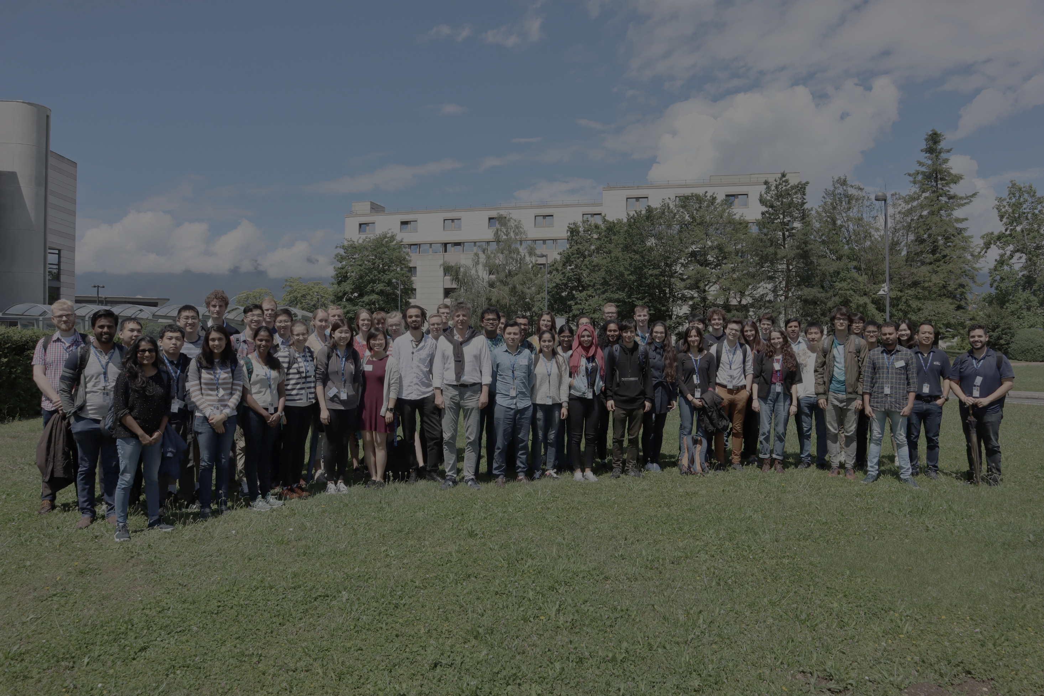
Personal overview
2012 – 2018:
  Integrated Master in Physics Engineering, Instituto Superior Técnico, University of Lisbon
  Master thesis done at LIP Lisbon (LIP/CMS group)
Summer 2016:
  Summer Student at CERN
Summer 2018:
  Image classification with machine learning: Leiden, Netherlands
September 2018 – March 2019:
  Data analysis and generative machine learning (GANs): Melbourne, Australia
From May 2019:
  Trainee at CERN (EP-CMG-PO), working with Dr. Pedro Silva and Dr. André David.

Slide 3

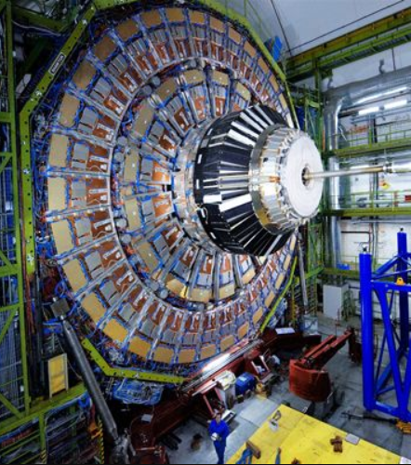
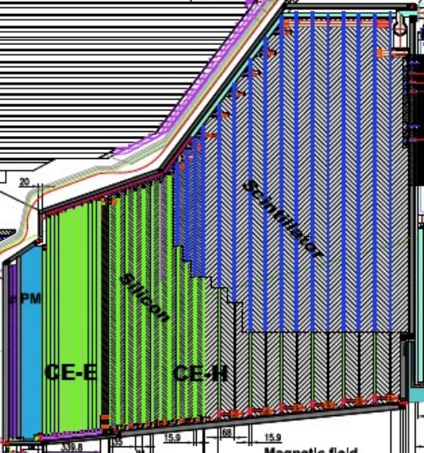
Project overview: HGCal
High luminosity LHC
Operational phase starts late 2026
Up to 200 collisions per proton bunch crossing
10 times more integrated luminosity than the LHC (very high fluences: up to 10¹⁶ n_{eq}/cm²)
Search for very rare processes (double Higgs, vector boson scattering, ...)
Forward calorimetry is crucial for the success of the scientific programme
CMS Calorimeter upgrade
600m² silicon
500m² scintillators
Weight: 228 x 2 tonnes
More than 6.2 million channels
High Granularity Calorimeter

Slide 4
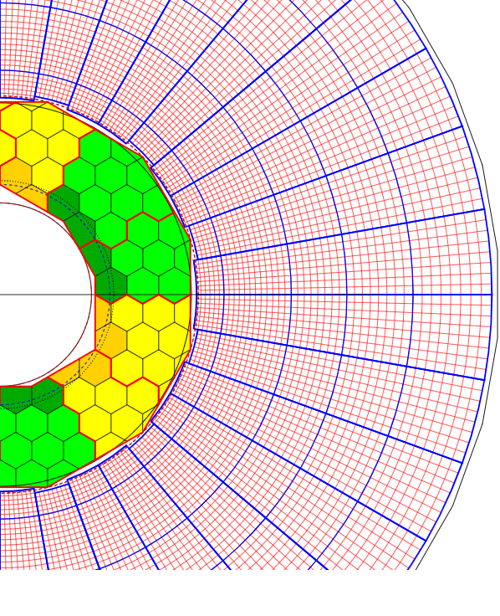
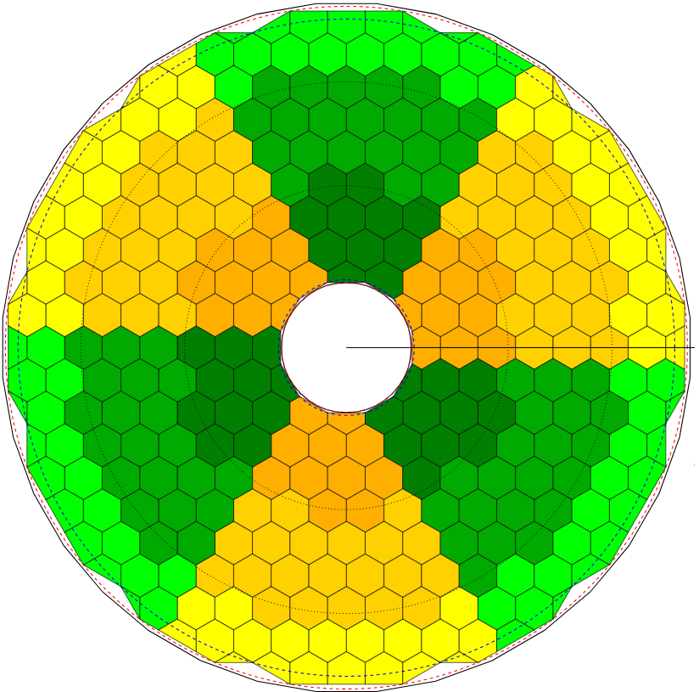
HGCal structure
The HGCal will make use of:
  Silicon sensors
  28+22 layers, with around 27000 silicon hexagonal wafers in total (high fluence region)
  measures electromagnetic and hadronic showers
  Plastic scintillators coupled to silicon PMs
  14 layers (low fluence region)
  measures hadronic showers
Decreasing particle fluence
Increasing sensor thickness
300μm
Increasing area of scintillator cells
200μm
120μm
Silicon + scintillator layer
Silicon only layer
Notes:
PM provide gain larger than 10^5.
Scintillator tiles go from 4cm^2 to 32cm^2.

Slide 5
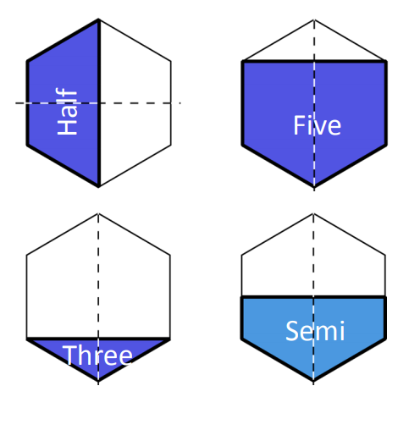
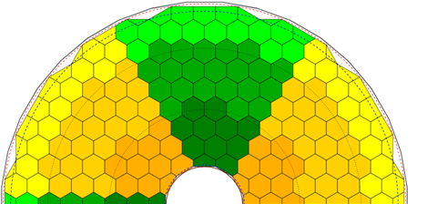
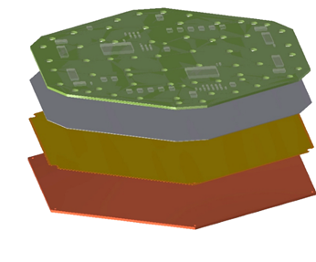
Project overview
What happens if other wafer shapes are considered near the boundaries?
  Challenging mechanics and electronics problems
  Study the impact of different Si wafer shapes
    Physics performance?
    Higher cost
    Increased total man-hours
Hexaboard
Silicon module
Silicon sensor
Kapton sheet + gold layer
WCu base plate
Silicon layer
Notes:
Copper provides excellet thermal conductivity. Tungsten reduces coefficient of thermal expansion for alignment with the silicon thermal expansion coefficient. Together they represent a significant component of the absorber.
Kapton (105um) provides electrical insulation of the sensor from the baseplate, which is held at ground.

Slide 6
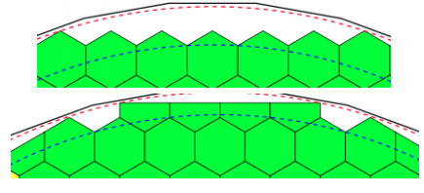
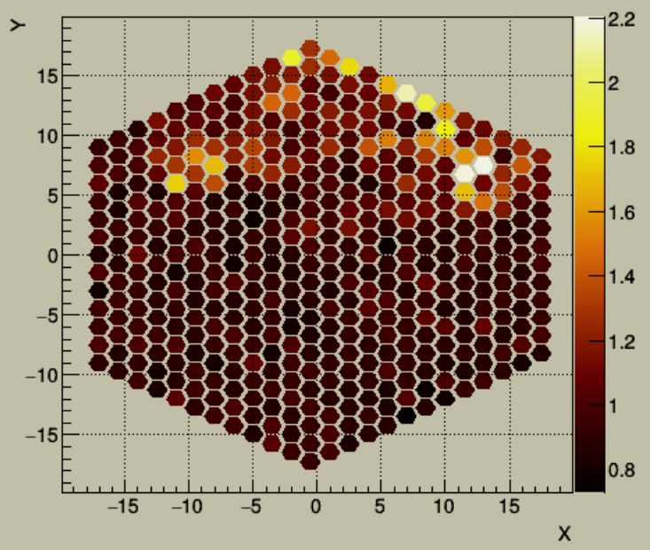
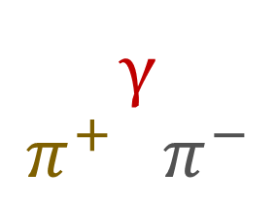

Project workflow
One hexagonal wafer contains tens of hexagonal cells (area of 0.5 or 1 cm² each)
simulate the response to pions and photons for a chosen geometry
γ
$$π^{+} π^{−}$$
with and without pile-up
γ
  Particle shower reconstruction
  Energy calibration
  + compensation for hadronic component
  + noise removal for non-zero pile-up
data analysis
measure the reconstructed hits in the calorimeter
  Software correction of the detector’s response
$$\frac{E_{gen}−E_{reco}}{E_{gen}}$$

Slide 7
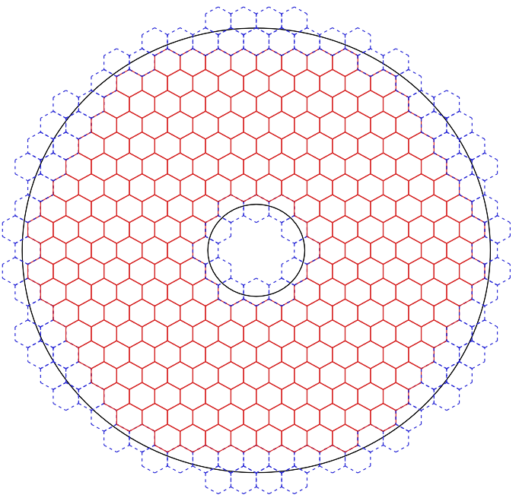
Regions of the detector studied
Frontal view of the HGCal:
Outer
Lateral view of the HGCal
(with pseudorapidity values):
Outer
Outer
1.45
Outer
region
1.65
Inner
Outer
Inner
Inner
Outer
Inner
2.70
Outer
Outer
Outer
Inner region
3.03
Proton – proton collision point
Proton beam line

Slide 8
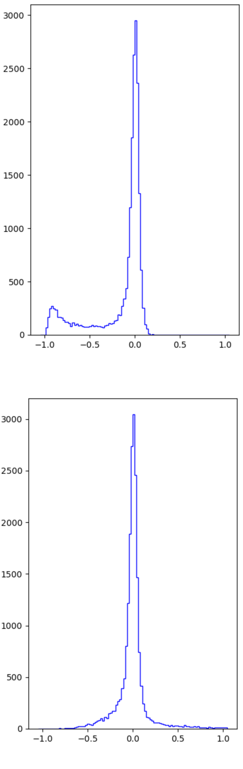
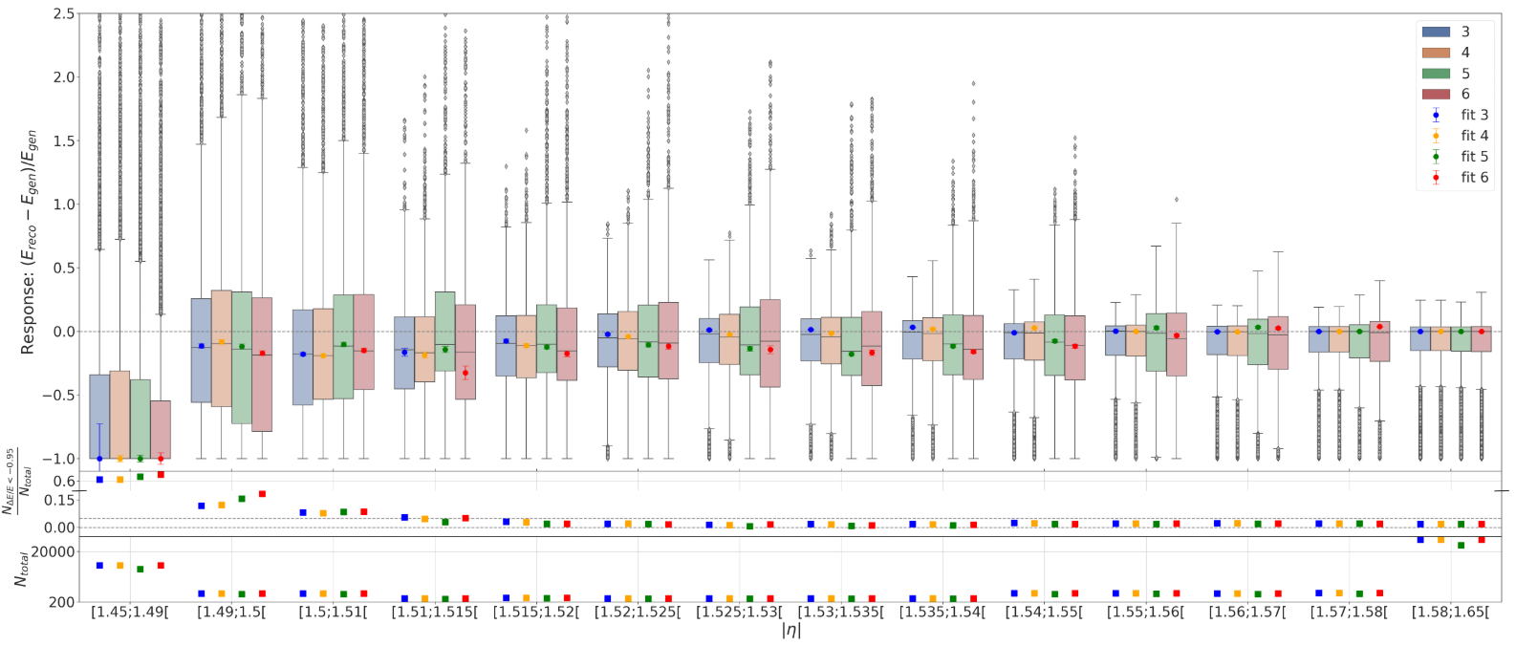

Final results
(all kinds of partial wafers)
(no partial wafers)
Mask 3
Mask 4
Mask 5
Mask 6
Increasing covered area by the geometries studied
Software correction

Slide 9
Experience acquired
Computing:
  Linux/Unix
  C/C++, Python, Shell / Bash
  Git (and related GitHub and GitLab online tools)
  Job submission to the computing grid
  Data visualization
  Near future
  CMS Hackaton: https://indico.cern.ch/event/835728/overview
  Openlab course #1: Computer architecture and efficient programming
  Openlab course #2: Programming and environments for parallelism
  Next project: GPUs (with potentially some machine learning)
Scientific:
Mathematics and Statistics
Calorimeter and detection physics
Others:
Regular presentations/discussions in weekly group meetings
Writing a CMS “Detector’s Note”

Slide 10
Thank you.
GitHub page: https://github.com/b-fontana
CV: https://github.com/b-fontana/CV

Slide 11
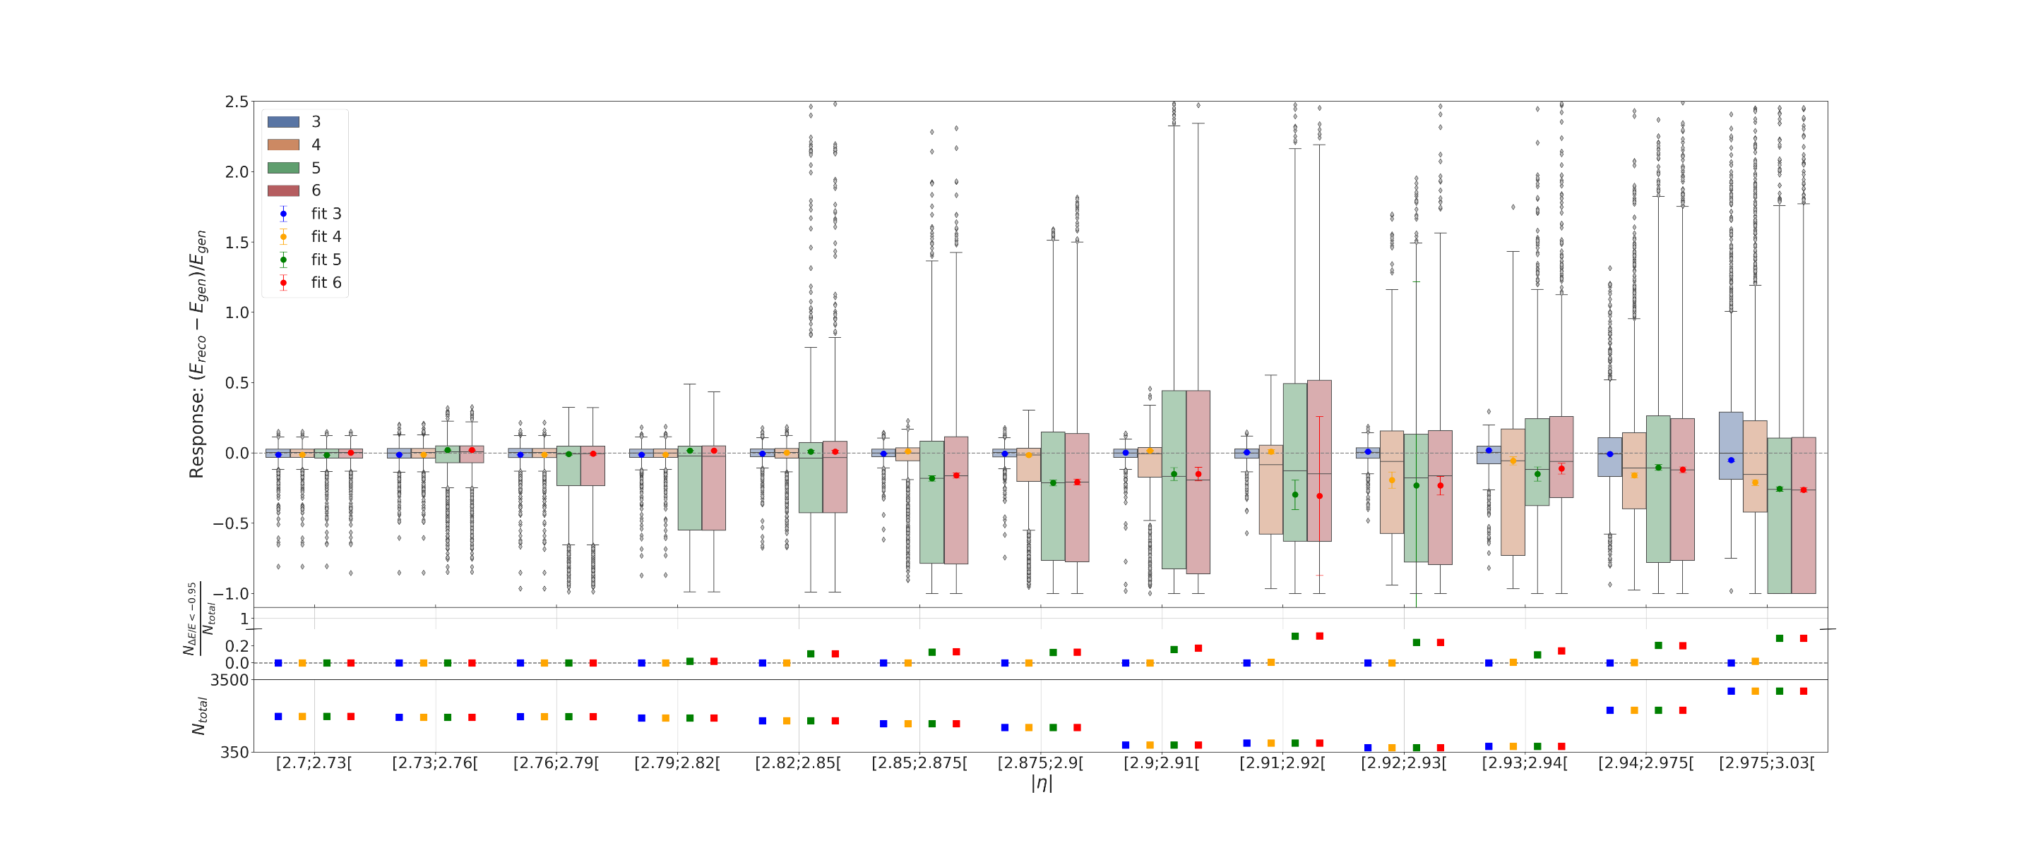
Final results (inner region)
(all kinds of partial wafers)
(no partial wafers)
Mask 3
Mask 4
Mask 5
Mask 6

