Slide 2
FCT and CERN
Portuguese Trainee Programme Report
Christopher Viana Lima
(June 2017 – June 2019)
Supervisor: Andre Rocha
CERN, Technology Department
Vacuum, Surfaces and Coatings Group
Interlocks, Controls and Monitoring Section
FCT and CERN Portuguese Trainee Programme Report
Notes:
I’m SW dev in ICM

Slide 3

Outline
Overview of Vacuum at CERN
Vacuum Control Architecture
My Main Project
  VacCC- Vacuum Control Configurator Tool
Challenges
Acquired Skills

Slide 4
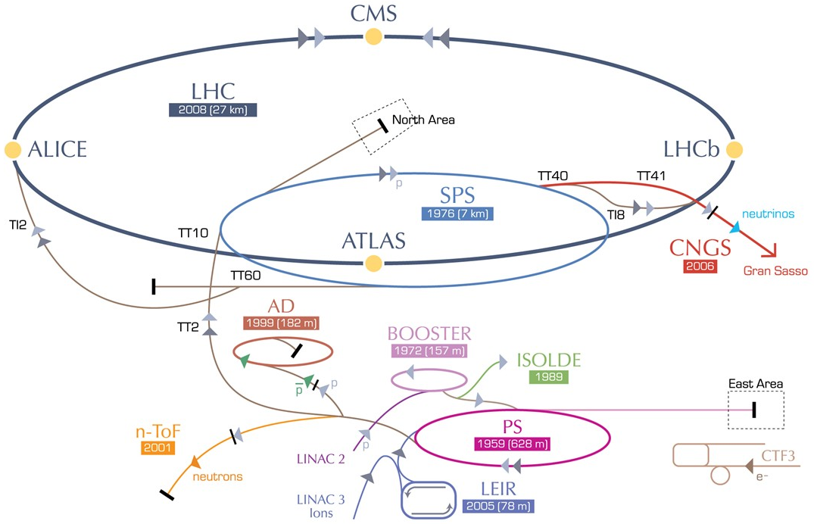
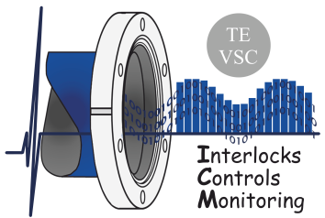
Overview of Vacuum at CERN
Beam and insulation vacuum
> 130 km of vacuum chambers across all accelerators
Pressure range from 10⁻⁴ to 10⁻¹² mbar controlled by:
  ~3000 vacuum pumps
  ~3000 vacuum gauges
  ~500 sector valves
How to supervise and control such a large system?
  7 SCADA servers
  ~300 PLCs
  Backboned by vacuum-specific software
TE-VSC-ICM

Slide 5
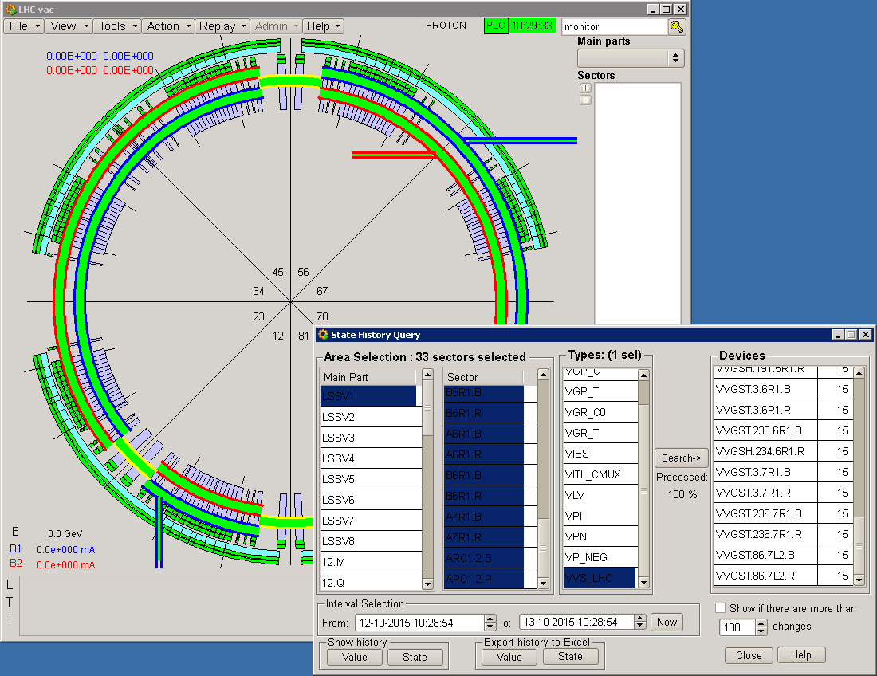
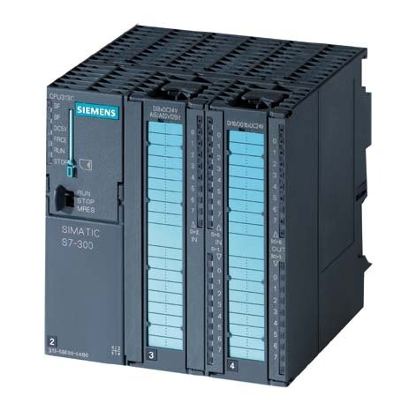
Vacuum Controls Architecture
LHC main view
SCADA (Supervisory Control And Data Acquisition)
  Communicates in real-time with controllers running the vacuum process
  Presents data to operators by an user interface (UI) in order to:
    Check the process / react to alarms / interact with devices
  Archives historical data
    Operators can check what happened in the past
PLC (Programmable Logic Controller)
  Connected to vacuum controllers and field equipment
  Communicates with vacuum SCADA
PLC Siemens S7-300
How to configure a large control system ?
Notes:
Consist in SCADA and PLCS
SCADA (Human Machine Interface)
-Provides a UI to manage remotely
PLC (big industrial computer)
-interact with the controllers
-send and receive information for SCADA

Slide 6
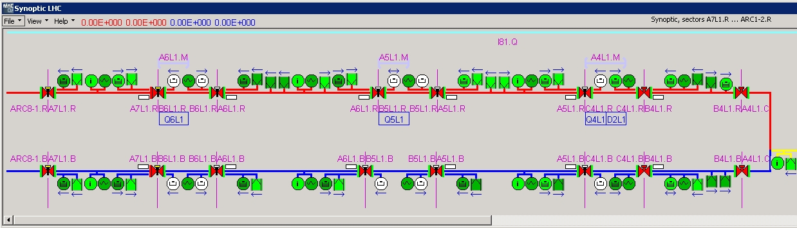
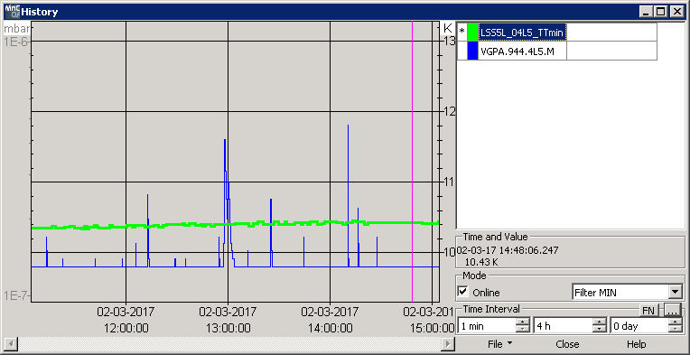
Configuring a Vacuum Control System
  Equipment specific parameters (type, control type)
  Equipment location (main part, position within sector)
  Equipment hierarchy (who controls who)
  Alarms
  Short and Long term archiving
  Publish data to other CERN services (CMW, DIP)
Synoptic from LHC
History window
Historical data
Notes:
-Set the parameters between SCADA and PLC

Slide 7

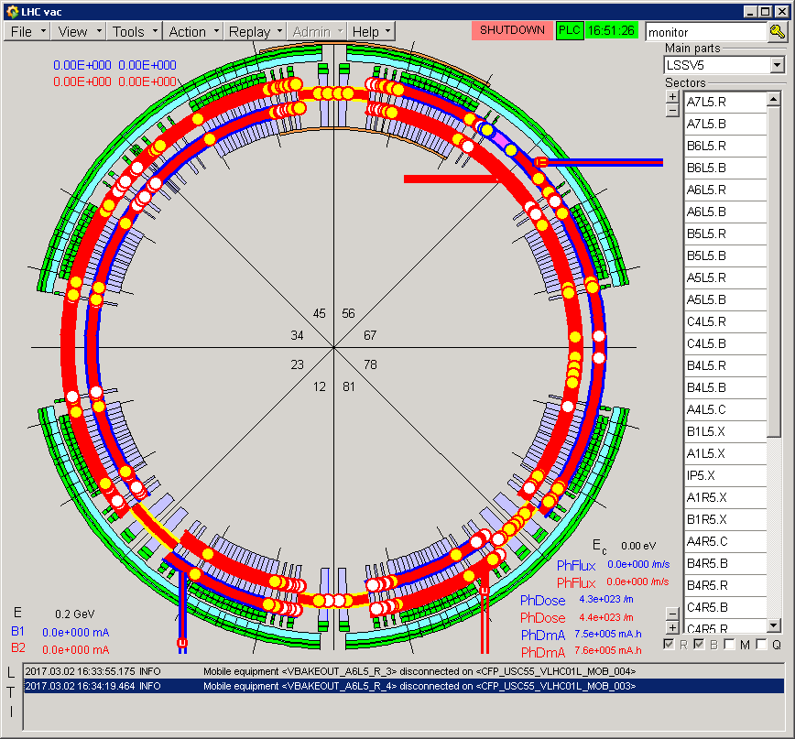
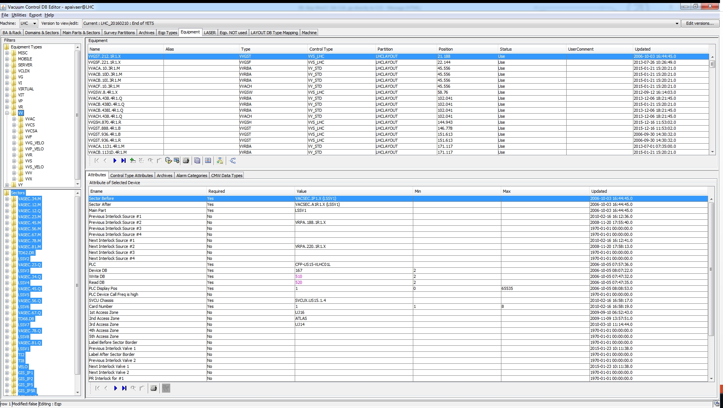


VacCC – Vacuum Control Configurator
Vacuum Control Configurator (legacy)
SCADA configuration files
Export
Memory Mapping
User
  Reduces human mistakes by performing data validation
  Simplifies the management of the vacuum devices
  Generates SCADA and PLC configuration files
PLC Configuration files
Notes:
Benefits
-By avoiding conflicts

Slide 8
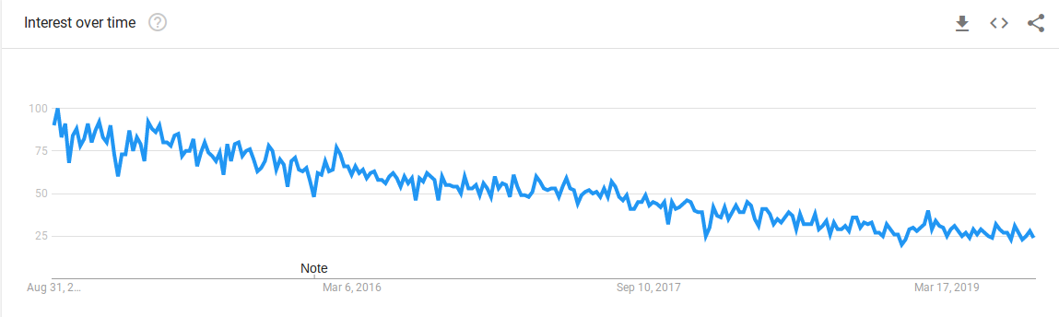
VacCC – Problems with legacy application
Oracle ADF* Framework lacks support
Written in Java 6 (released Dec 2006)
Running ADF on new Java versions causes unpredictable behavior
Progressively harder to develop and maintain
User base is declining, only used in legacy projects
*ADF: Oracle Application Development Framework

Slide 9
New VacCC – Motivations
Rewriting the VacCC Editor with:
Modern technologies with large support
Big set of components available to re-use
Modern test-driven development approach
=
Easy to maintain & expand current functionalities

Slide 10
New VacCC - Objectives
    Migrate from obsolete technologies
    Porting from a standalone application to a web application
    Take advantage of a microservice architecture
    Improve usability
Notes:
-SW modernization
-

Slide 11

New VacCC Editor - Project Organization
Backend
Database
Frontend
Exporter
Application Logic
Handle requests from user interface
Authentication and authorization
Data validation
Interact with the database
Stores configuration data
Extra data validation
User interface
Generates SCADA and PLCs configuration files
Under development
My main contributions
Notes:
-SW modernization
-

Slide 12
New VacCC – Architecture
VacCC - Before
VacCC After
Front End
(UI)
DB
UI
DB
Exporter
Backend
Exporter
Backend
Monolithic architecture:
One big application
One component failure will cause the whole system to fail
Microservices architecture:
Different functionalities = different components
Allows incremental implementation
Mix different programming languages and frameworks
Notes:
Gradually build a new application consisting of microservices, and run it in conjunction with your monolithic application

Slide 13
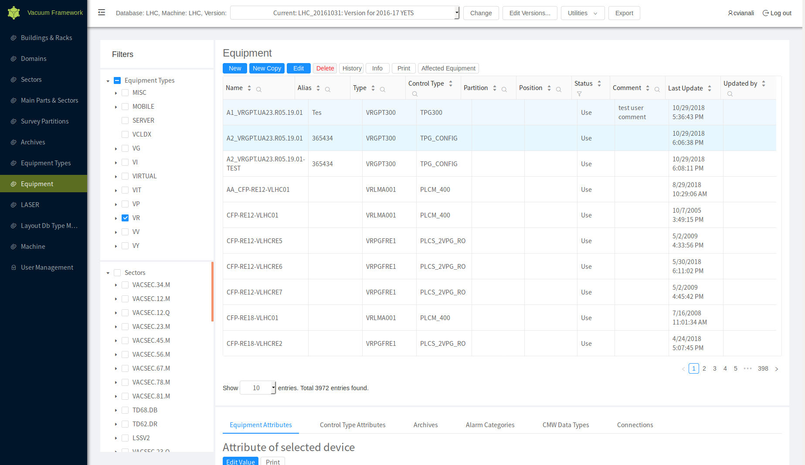



New VacCC Editor – Workflow
Types http://vacdbeditor.cern.ch
Client
Web Browser
Vacuum Control
User
Requests React code
Sends React code
Returns data to the front end
API calls
Front End
Server
Back End Server
vacdbeditor.cern.ch
Queries to DB
Returns query results
Databases
Databases
Databases
Notes:
The user makes an authentication with CERN credentilals, checking his role

Slide 14

FCT and CERN Portuguese Trainee Programme Report
Notes:
Example from LHC

Slide 15
Challenges
New VacCC
Several use cases to cover for the DB
Databases logic very challenging and interconnected with external databases
Replicate all databases for test purposes
Critical nature of the application: failure can lead to vacuum downtime
In general
Takes time to be productive in all vacuum applications (SCADA, DB editors, vacuum monitoring)
Notes:
The app works with more than accelerator

Slide 16
Competences
Skills acquired/improved:
  Web technologies (JavaScript, React, REST)
  Programming (Spring Boot)
  Databases (Oracle, PL/SQL)
  Continuous Integration/Deployment (GitLab Runner, Docker)
  Siemens WinCC-OA (SCADA)
  Agile Methodology (Scrum)

Slide 17
Currently (FELL)
Backend
Database
Frontend
Exporter
My main contributions
Notes:
-SW modernization
-

Slide 18
Currently (FELL)
Backend
Database
Frontend
Exporter
Layout DB Synchronization
My main contributions
Notes:
-SW modernization
-

Slide 19
Questions?
FCT and CERN Portuguese Trainee Programme Report

