Slide 1

On finding and maintaining collision in HL-LHC
Joel Andersson, Davide Gamba, Riccardo de Maria,
Jörg Wenninger
CERN
156th HiLumi WP2 Meeting – 20 August 2019

Slide 2
Outline
Fill stages in LHC
The OFB (Orbit Feedback)
Estimating the impact of OFB in (HL-)LHC
Increasing integrated luminosity in HL-LHC
Questions

Slide 3
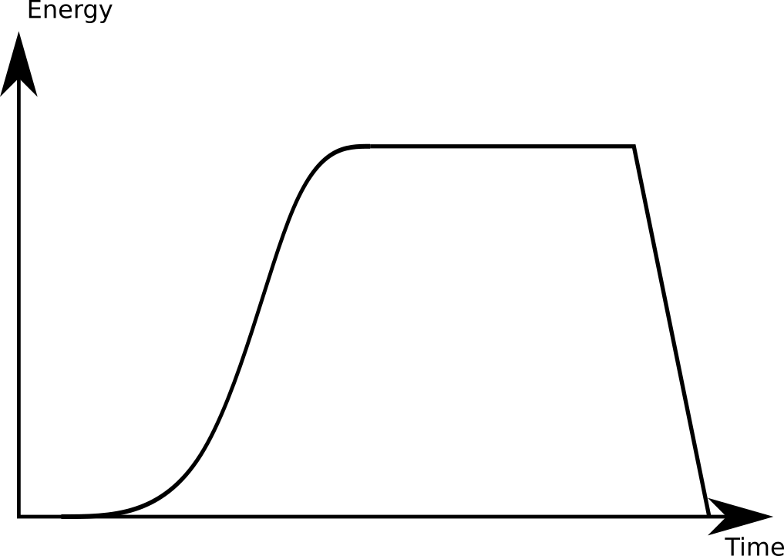
An LHC fill
Bring to collision
Collision
Ramp, squeeze
Ramp down
Injection

Slide 4
An LHC fill
Our focus
Bring to collision
Collision
Ramp, squeeze
Ramp down
Injection

Slide 5
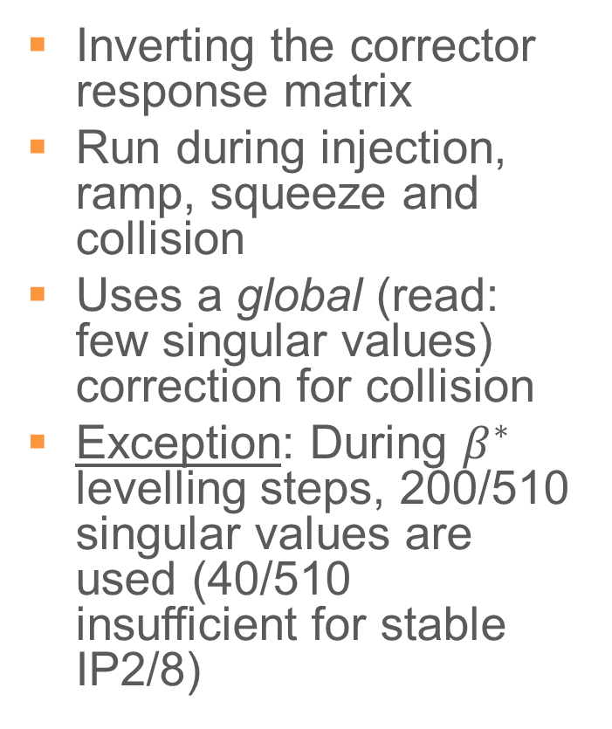
The OFB (Orbit Feedback) in LHC
Inverting the corrector response matrix
Run during injection, ramp, squeeze and collision
Uses a global (read: few singular values) correction for collision
Exception: During $β^{∗}$ levelling steps, 200/510 singular values are used (40/510 insufficient for stable IP2/8)
# := singular values used
Global correction
# = 40/510
Local correction
# = 400/510

Slide 6
Maintaining collision

Slide 7
OFB during collision in LHC
Uses ~40/510 singular values
Excludes triplet correctors
Excludes pathological BPMs (based on operator experience)
On top of OFB, local luminosity corrections are occasionally performed which are minimally impacted by OFB
For more details, see [1]
[1] Operation and Configuration of the LHC in Run 2,
J. Wenninger, link: https://cds.cern.ch/record/2668326?ln=en

Slide 8
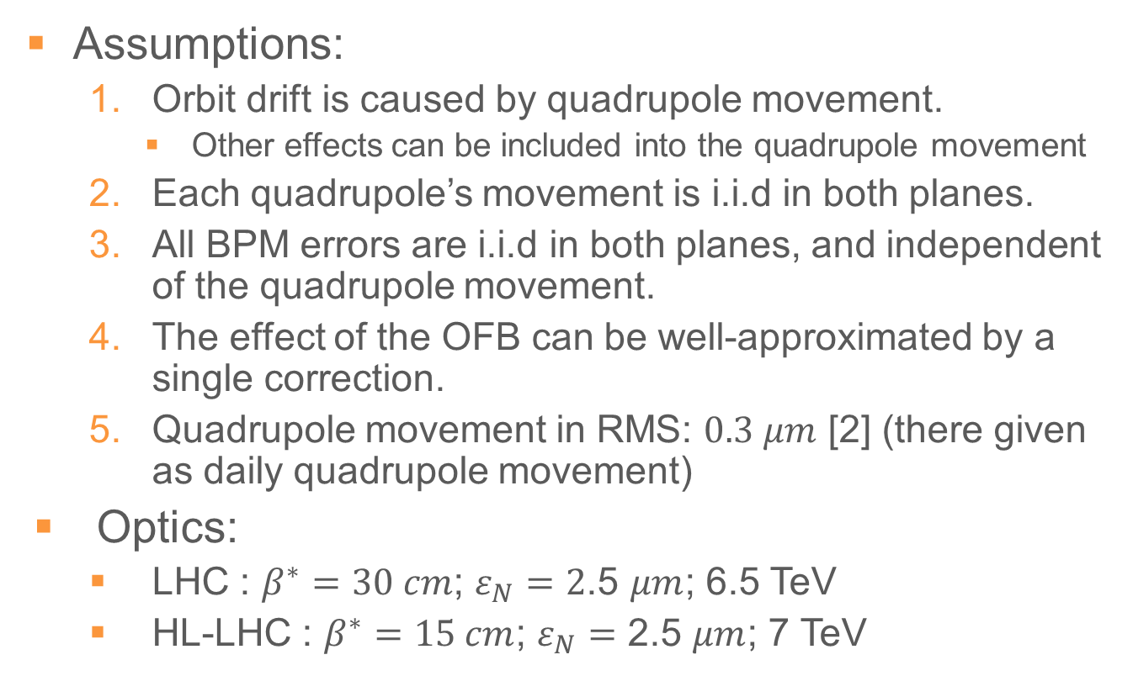
Estimating the effect of OFB for collision
Assumptions:
  Orbit drift is caused by quadrupole movement.
    Other effects can be included into the quadrupole movement
  Each quadrupole’s movement is i.i.d in both planes.
  All BPM errors are i.i.d in both planes, and independent of the quadrupole movement.
  The effect of the OFB can be well-approximated by a single correction.
  Quadrupole movement in RMS: $0.3 μm$ [2] (there given as daily quadrupole movement)
Optics:
  LHC : $β^{∗}=30 cm$; $ε_{N}=2$.5 $μm$; 6.5 TeV
  HL-LHC : $β^{∗}=15 cm$; $ε_{N}=$ 2.5 $μm$; 7 TeV
[2] Orbit drifts at the LHC interaction points during the squeeze,
A. Gorzawski, J. Wenninger,
link: https://cds.cern.ch/record/2668326?ln=en

Slide 9
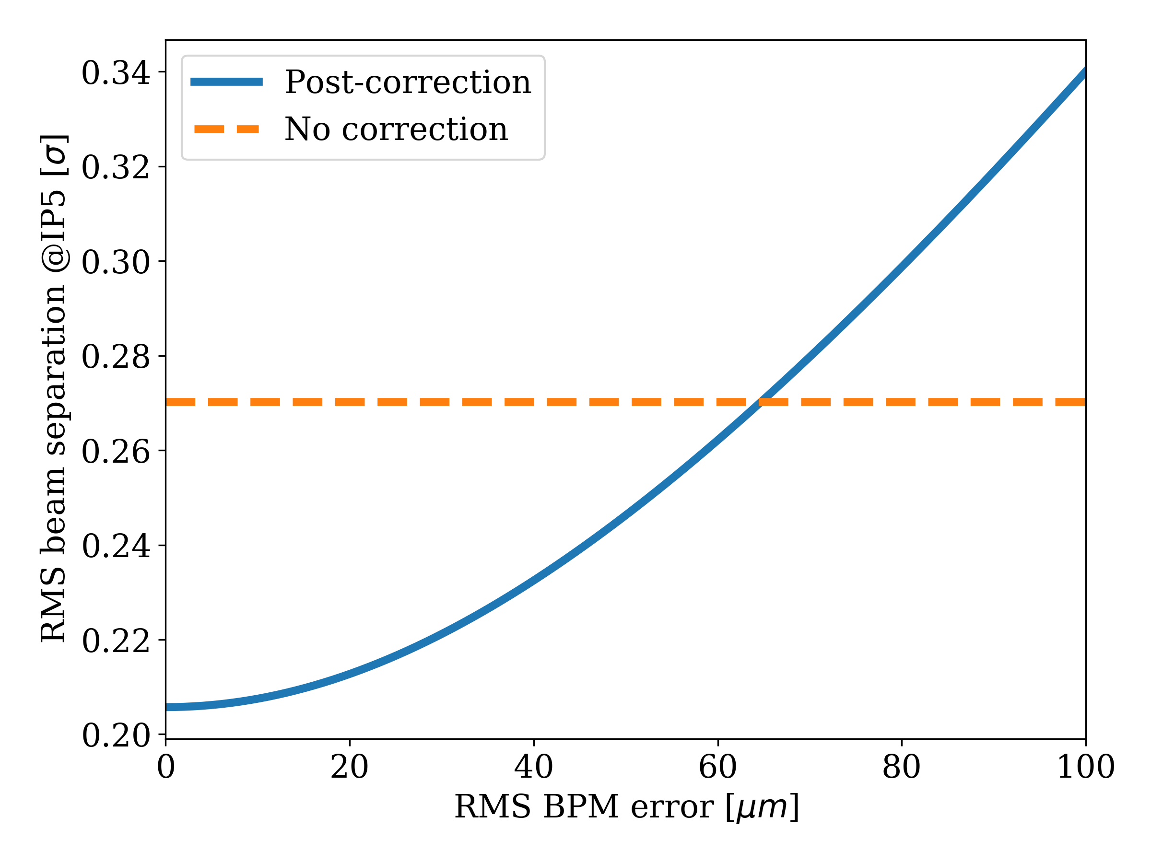

Correction vs BPM error in LHC
RMS quadrupole movement = 0.3 $μm$
The OFB corrects at IP5, but not much
  Not the point!
For sufficiently inaccurate BPMs, the OFB worsens
  Expected

Slide 10
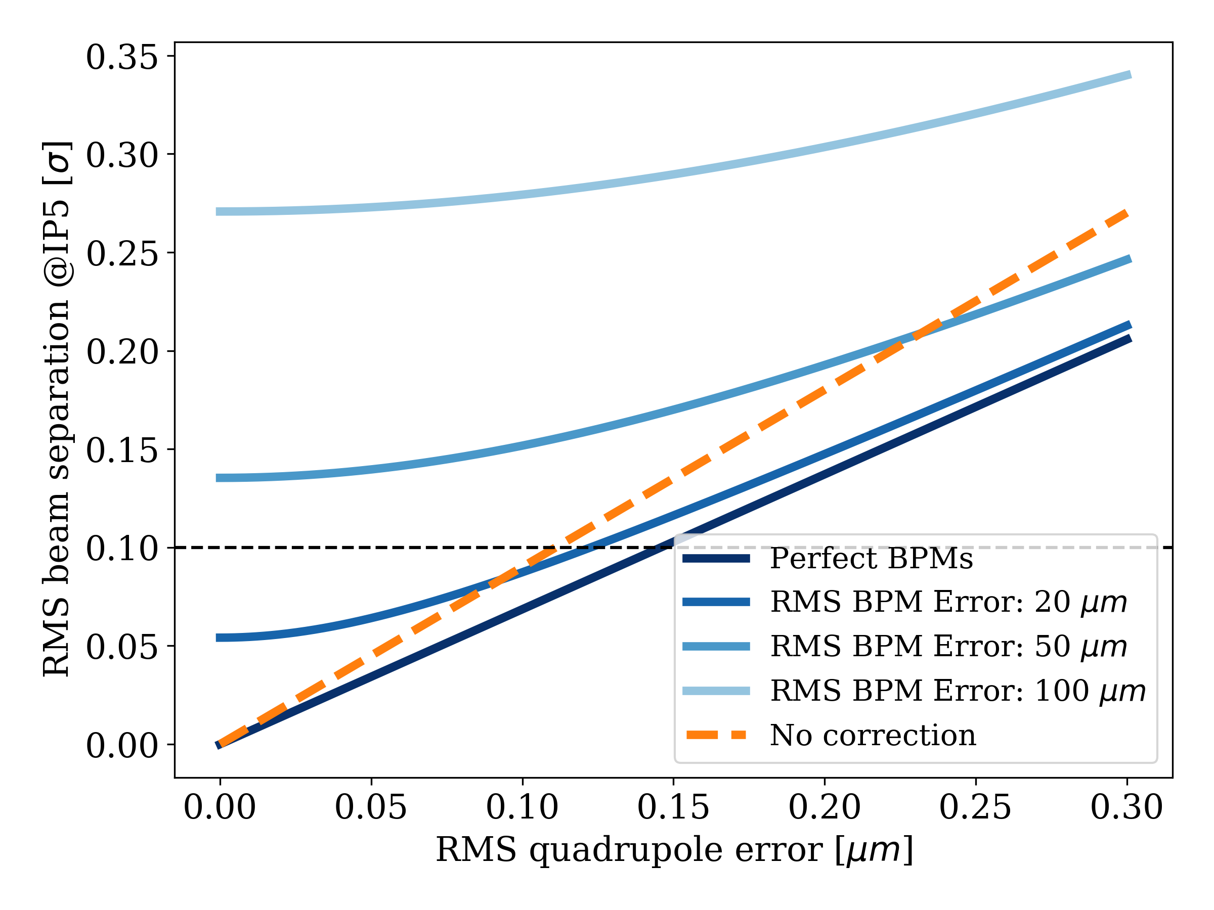

LHC as function of quadrupole error
Note: 0.1 $σ$ = 0.25 % instantaneous luminosity loss

Slide 11

LHC as function of quadrupole error
The more inaccurate BPMs, the bigger the necessary machine error for OFB to break even
  Reasonable!
Even for perfect BPMs, the OFB is not a big help in reducing beam separation at the IPs
Note: 0.1 $σ$ = 0.25 % instantaneous luminosity loss

Slide 12
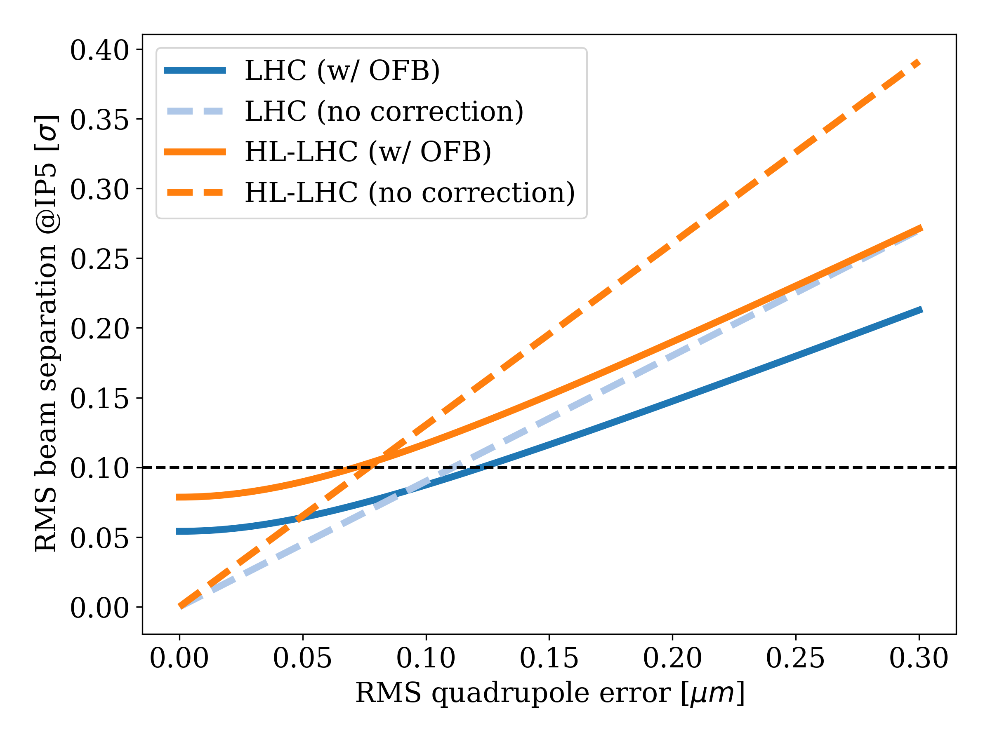

OFB applied to HL-LHC during collision
The effect of OFB for collision is similar across HL-LHC and LHC
  LHC better, but not drastically so
  A loss in luminosity, but not a spectacular loss
From the perspective of maintaining collision only, OFB is optional during collision
  OFB was not used during collision before LS1, and collision could be kept fairly stable
RMS BPM error = 20 $μm$
Note: 0.1 $σ$ = 0.25 % instantaneous luminosity loss

Slide 13
Room for improvement
But what if we want to improve?
  Avoid lumiscans during stable beam (and/or after levelling step)
    Not reasonable in practice according to Jörg, see next slide
  Make it easier to find collision
    From fill to fill
    After technical stop
    After winter shutdown
    After quench
  All this to be quantified in terms of integrated luminosity presently lost in LHC and projected to in HL-LHC
For everything, (much) better BPMs next to IPs and dedicated to local orbit feedback needed.
  How much better?

Slide 14
On the merit of not using lumiscans
Quote by Jörg: ‘'avoid lumiscans' is not reasonable in practice in my view. They will always be done at the start of fills and at some intervals as one will never trust blindly BPMs and reproducibility - very often it is even the experiments that ask for them when they are not done spontaneously. Put into perspective, the integrated luminosity loss from scans is in the per mille range. A simple equipment failure leading to a ramp down / intervention costs a similar amount. And this happens for ~ half of all fills.’
This strengthens the case for quantifying the cost-benefit of removing the lumiscans, as the immediate benefit seems very small and it having a big impact on operation.

Slide 15
Short time scale: avoiding lumiscans
  If one were to avoid lumiscans, an alternative would be necessary
  Naïve solution: local OFB!
    Probably not a great idea over long timescale
  More realistic: local BPM-based IP corrections
    Would only require short-term stability of BPMs around IP

Slide 16
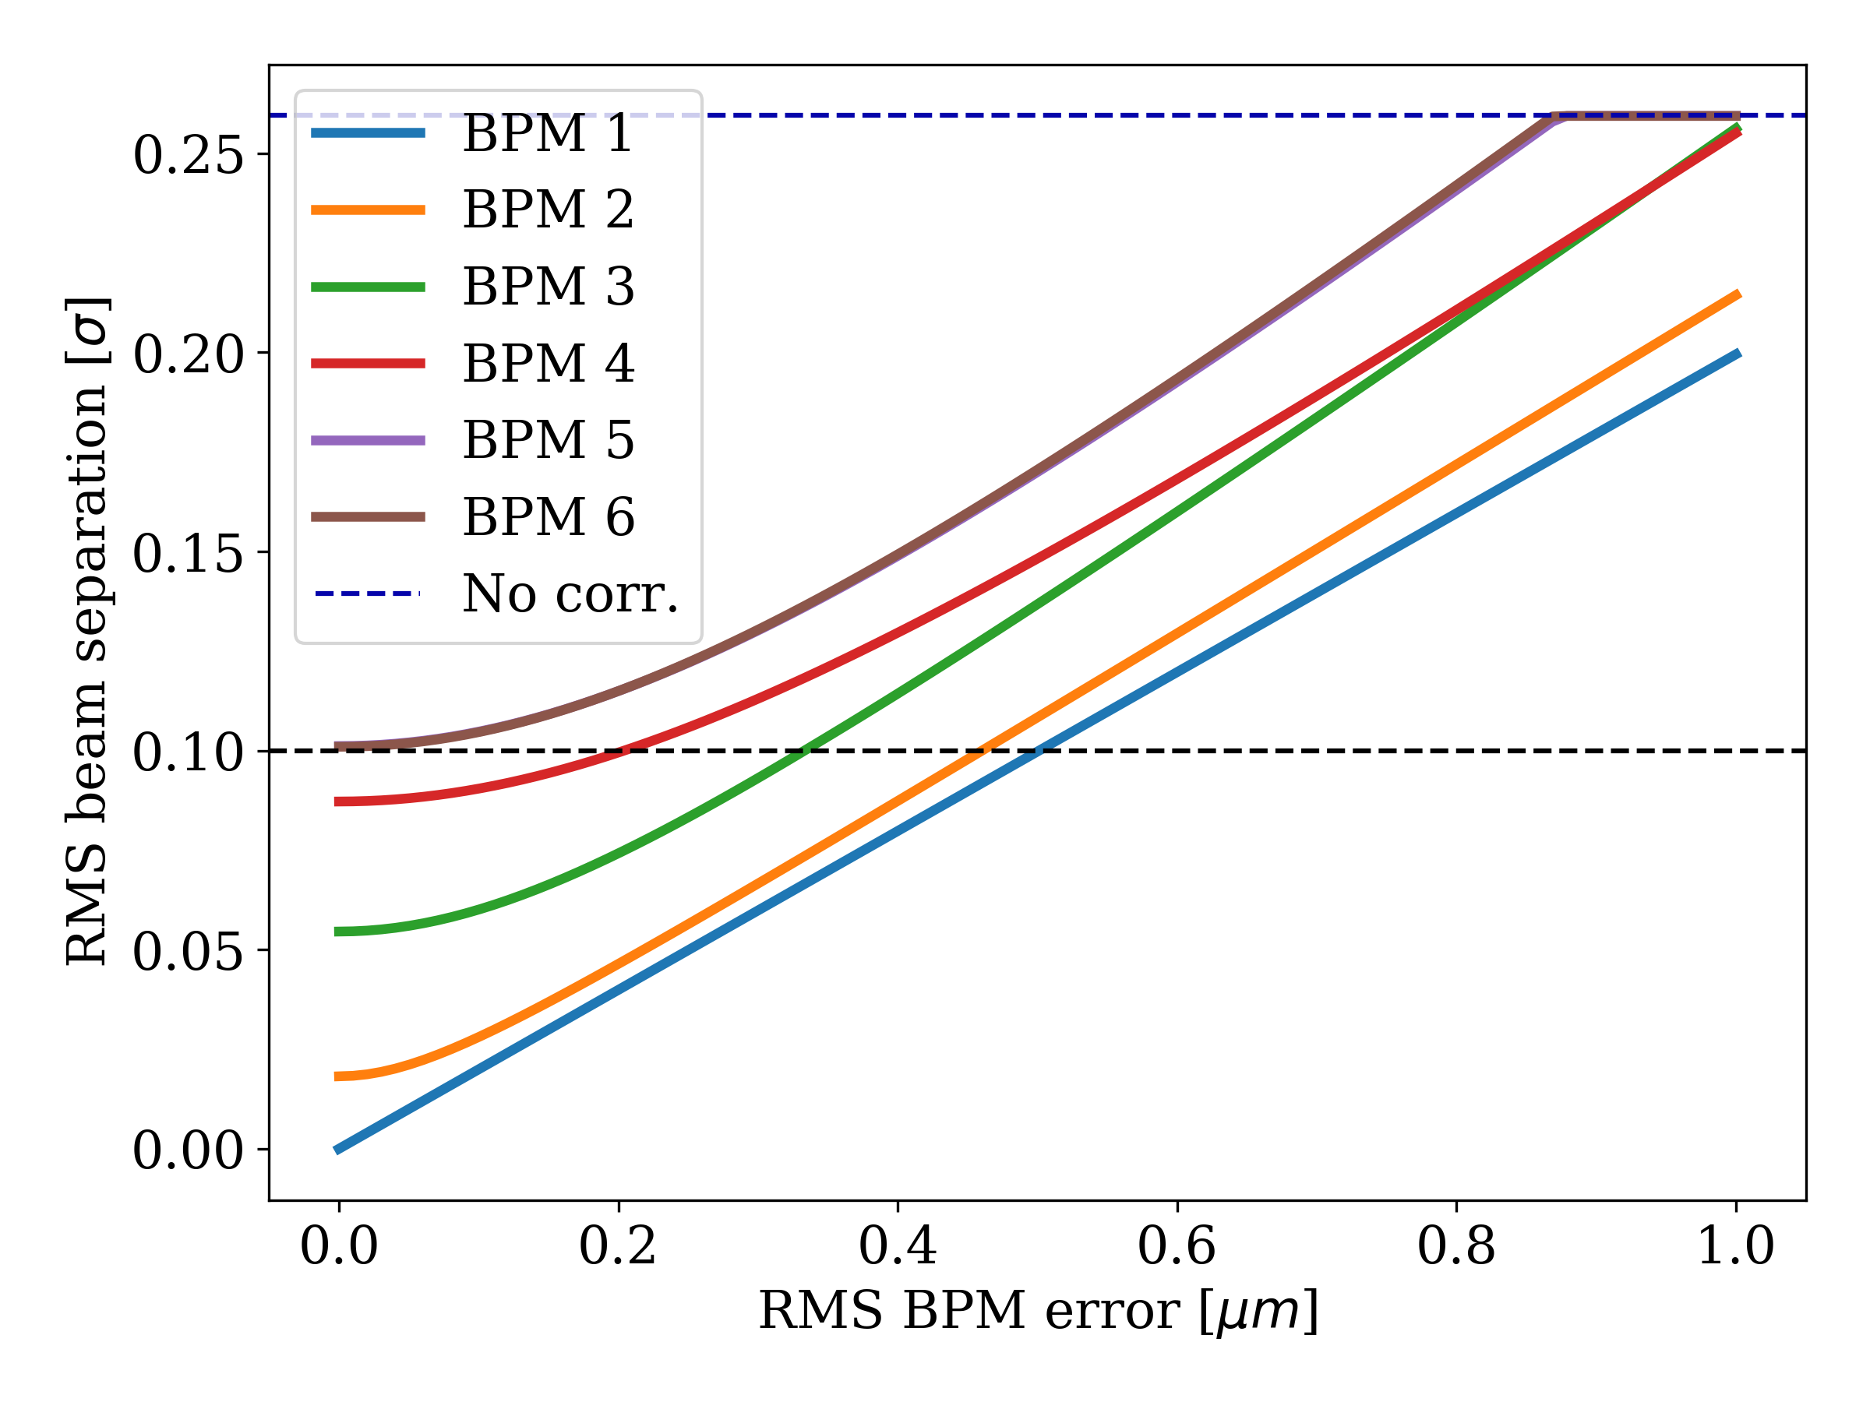
Comparison of BPMs: Correcting one-by-one
RMS quadrupole movement = 0.3 $μm$
Each pair of BPMs used on their own to correct at IP5
The closer to IP5, the better
  Nothing new, think phase-advance
  Less error sources
Dashed line corresponds to 0.25 % luminosity loss
6
5
4
3
2
1
1
2
3
4
5
6
IP5

Slide 17
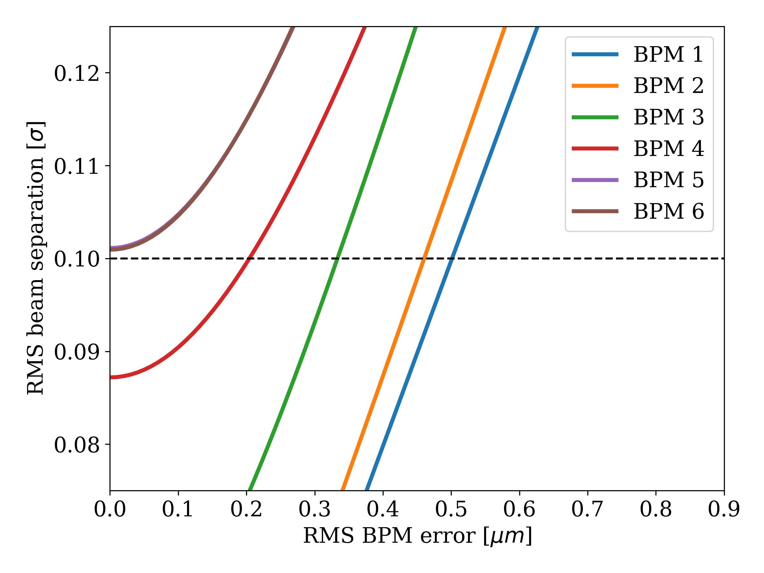
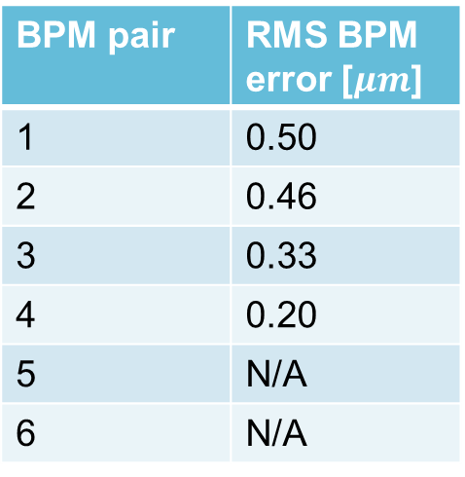
Comparison of BPMs: Correcting one-by-one
RMS quadrupole movement = 0.3 $μm$
For 0.25 % luminosity loss
BPM pair | RMS BPM error [$μm$]
1 | 0.50
2 | 0.46
3 | 0.33
4 | 0.20
5 | N/A
6 | N/A
Correcting using only closest BPMs could be doable
DOROS BPMs almost in this regime for short timescales (minutes) [3]
BPMs are ordered by their proximity to IP5!
[3] LHC beam orbit and collision position
determination & control – performance
and issues, prospects for Run 3, J. Wenninger, link: https://indico.cern.ch/event/813285/contributions/3406090/attachments/1854474/3047632/Orbit.LumiWS.June19.pdf

Slide 18
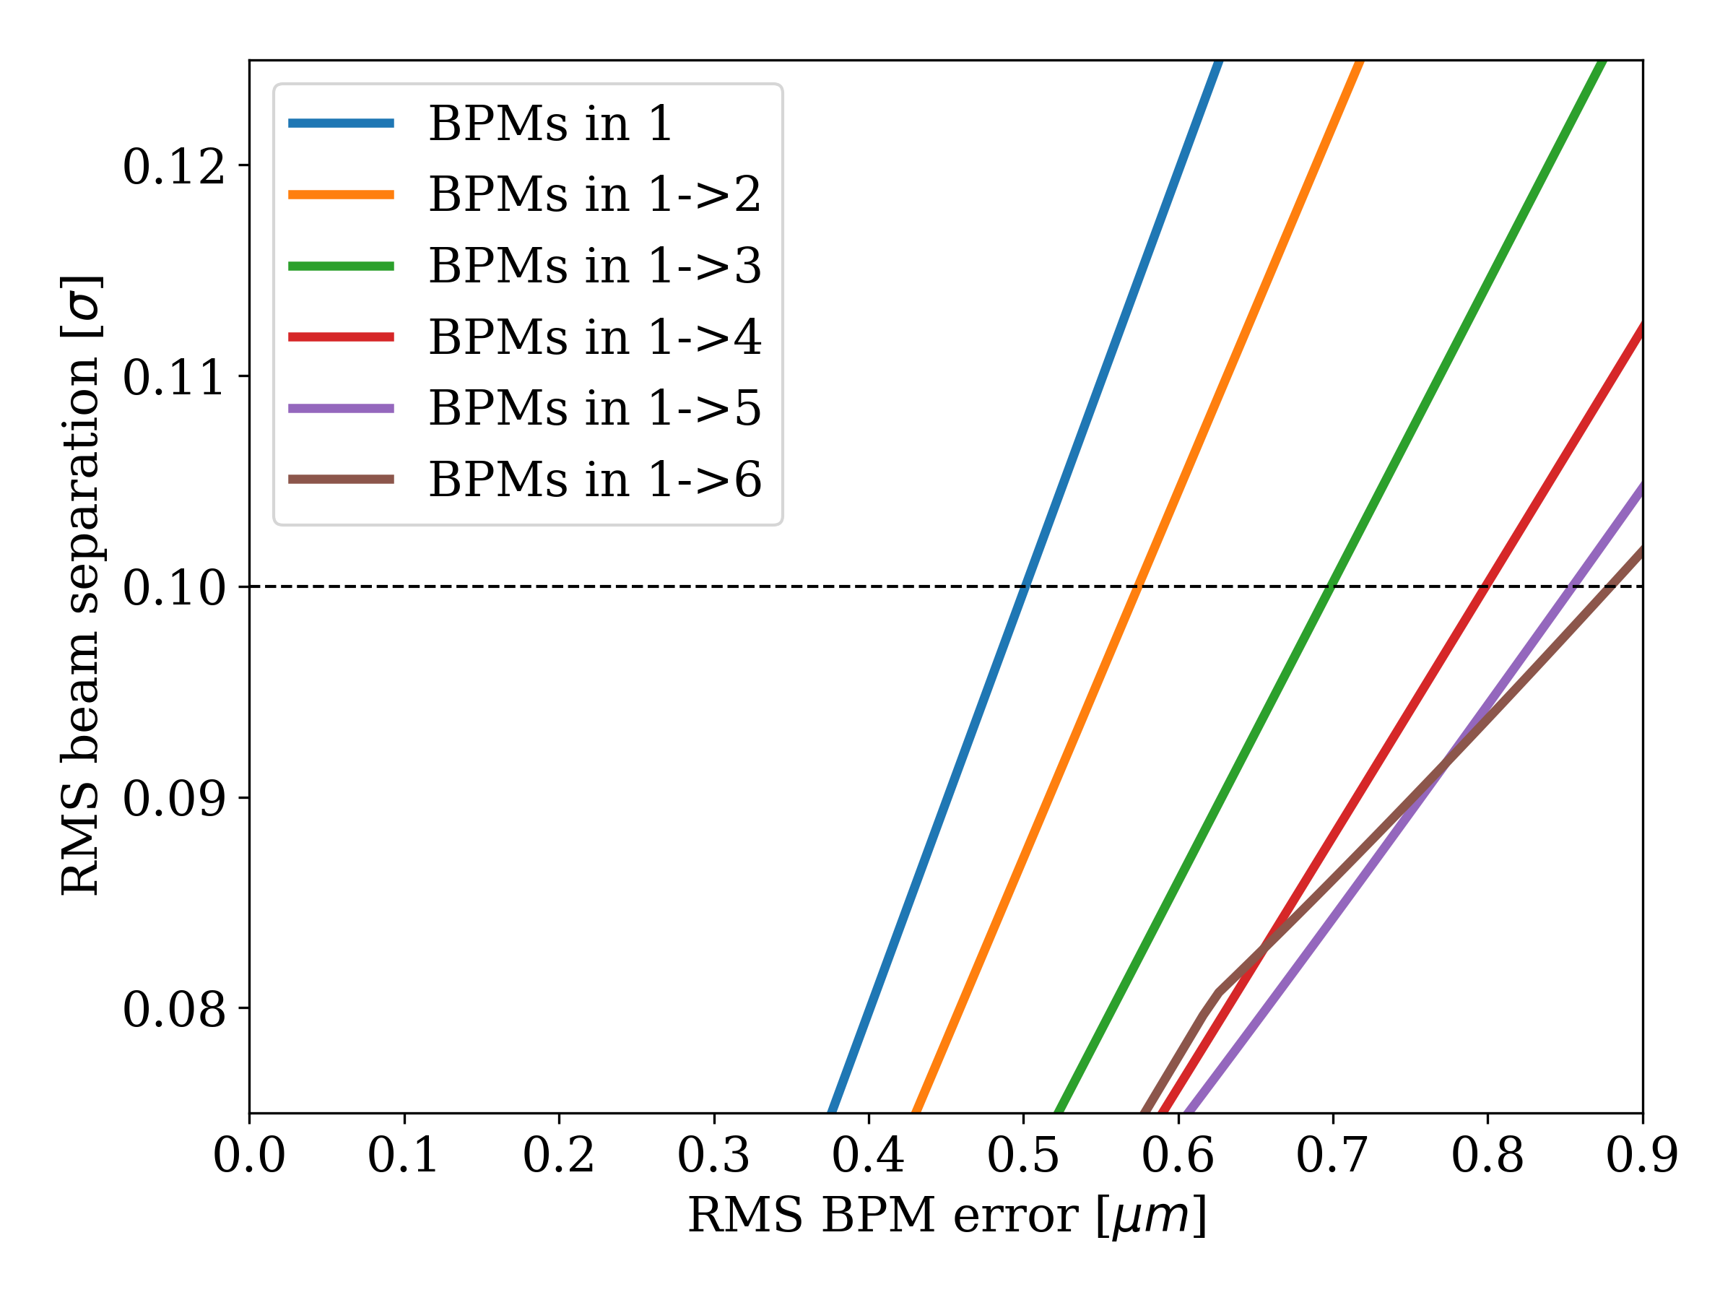
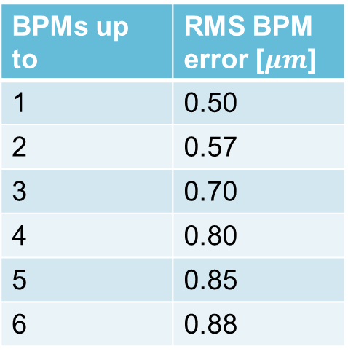
Comparison of BPMs: Using multiple BPM pairs
RMS quadrupole movement = 0.3 $μm$
For 0.25 % luminosity loss
BPMs up to | RMS BPM error [$μm$]
1 | 0.50
2 | 0.57
3 | 0.70
4 | 0.80
5 | 0.85
6 | 0.88
‘BPMs in 1->2’
6
5
4
3
2
1
1
2
3
4
5
6
IP5
Joel Andersson, Davide Gamba, Riccardo De Maria, Jörg Wenninger
18

Slide 19
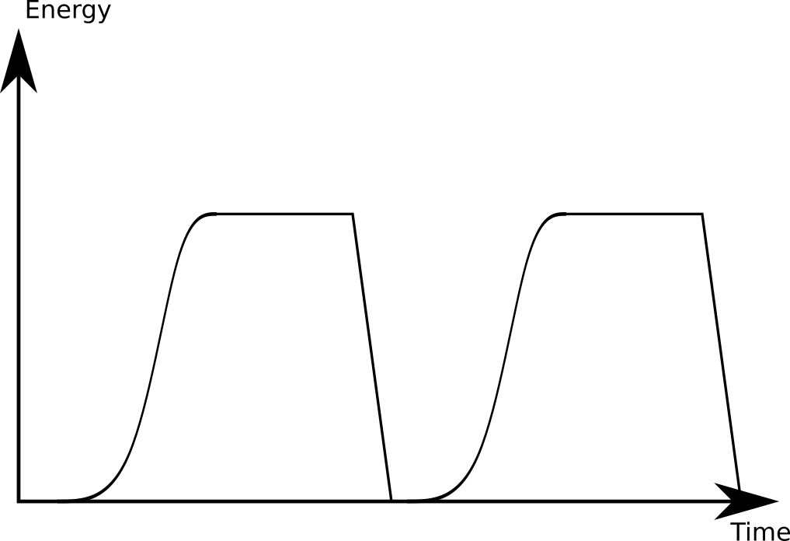
Long time scale – finding collision
A radial beam separation of ~4 σ (corresponding to about 99% luminosity loss) would still allow the beams to be brought head-on on a one-minute timescale with lumiscan [J. Wenninger]
Config i
Config i+1

Slide 20
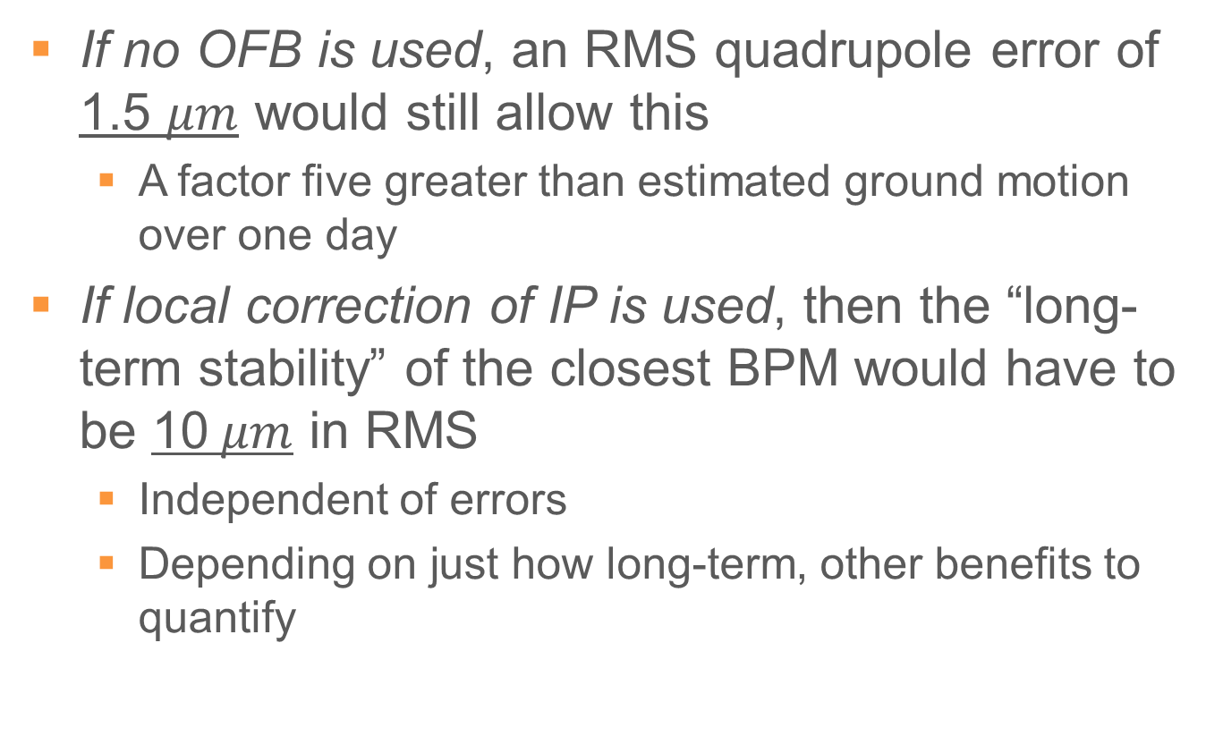
Two estimates on yielding 95 % chance of finding collision on a one-minute timescale
If no OFB is used, an RMS quadrupole error of 1.5 $μm$ would still allow this
  A factor five greater than estimated ground motion over one day
If local correction of IP is used, then the “long-term stability” of the closest BPM would have to be 10$μm$ in RMS
  Independent of errors
  Depending on just how long-term, other benefits to quantify

Slide 21
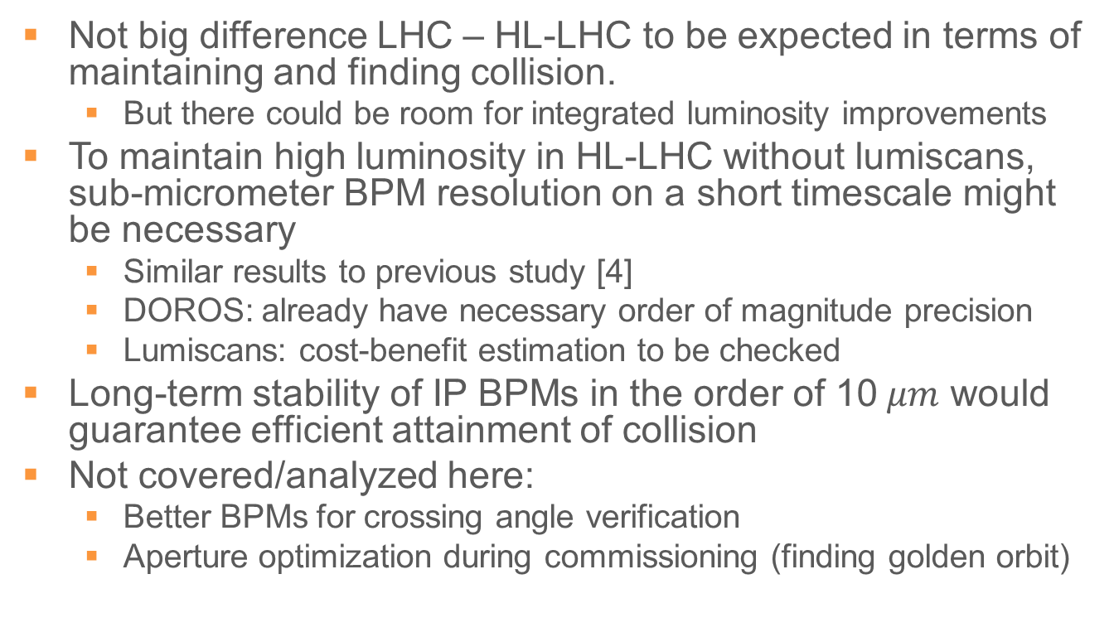
Conclusion
Not big difference LHC – HL-LHC to be expected in terms of maintaining and finding collision.
  But there could be room for integrated luminosity improvements
To maintain high luminosity in HL-LHC without lumiscans, sub-micrometer BPM resolution on a short timescale might be necessary
  Similar results to previous study [4]
  DOROS: already have necessary order of magnitude precision
  Lumiscans: cost-benefit estimation to be checked
Long-term stability of IP BPMs in the order of 10$μm$ would guarantee efficient attainment of collision
Not covered/analyzed here:
  Better BPMs for crossing angle verification
  Aperture optimization during commissioning (finding golden orbit)
[4] BPM Tolerances for HL-LHC Orbit Correction in the Inner Triplet Area, M. Fitterer, R. De Maria,
link: https://cds.cern.ch/record/2112241

Slide 22
Thanks! Questions?
[1] Operation and Configuration of the LHC in Run 2, J. Wenninger, link: https://cds.cern.ch/record/2668326?ln=en
[2] Orbit drifts at the LHC interaction points during the squeeze, A. Gorzawski, J. Wenninger,
link: https://cds.cern.ch/record/2668326?ln=en
[3] LHC beam orbit and collision position determination & control – performance and issues, prospects for Run 3,
J. Wenninger, link: https://indico.cern.ch/event/813285/contributions/3406090/attachments/1854474/3047632/Orbit.LumiWS.June19.pdf
[4] BPM Tolerances for HL-LHC Orbit Correction in the Inner Triplet Area, M. Fitterer, R. De Maria, link: https://cds.cern.ch/record/2112241

Slide 23
Appendix

Slide 24
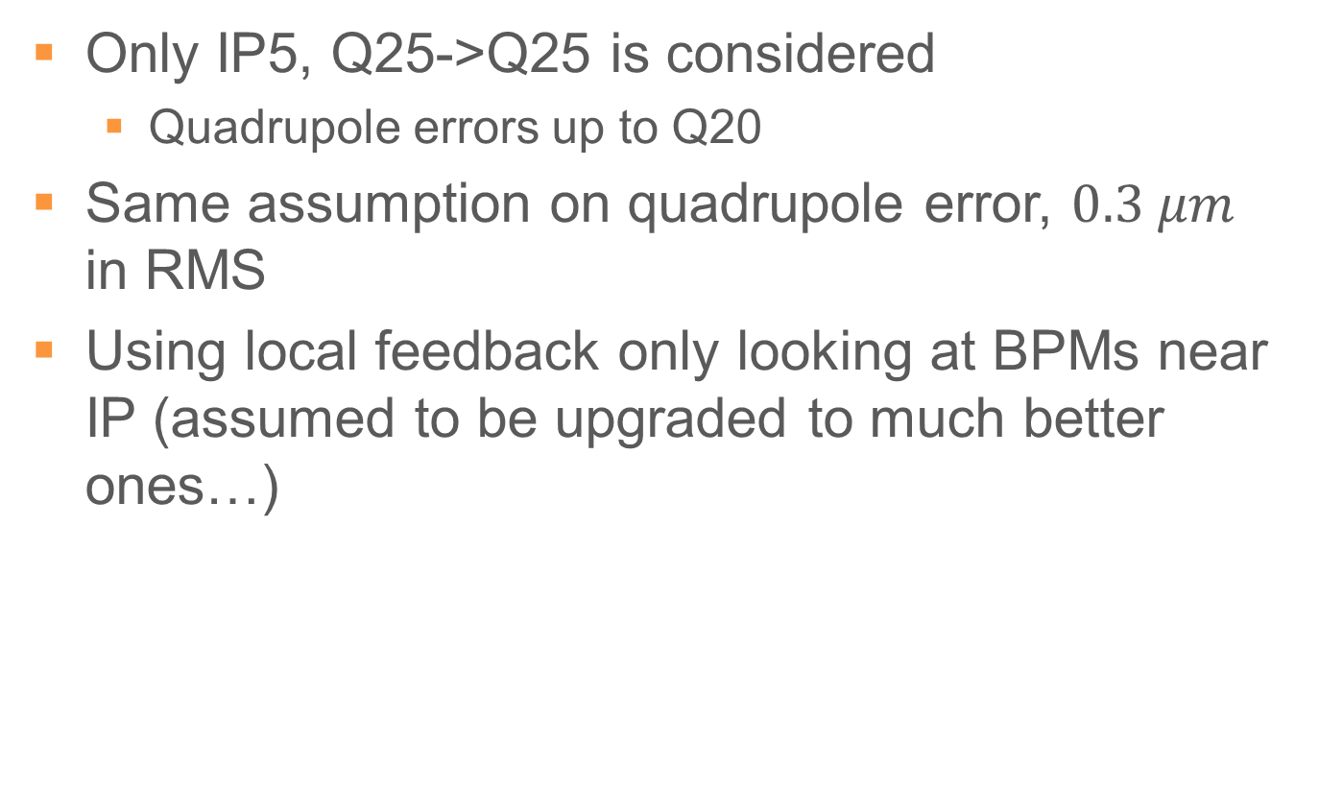
New assumption for HL-LHC
Only IP5, Q25->Q25 is considered
  Quadrupole errors up to Q20
Same assumption on quadrupole error, $0.3 μm$ in RMS
Using local feedback only looking at BPMs near IP (assumed to be upgraded to much better ones…)

Slide 25
Studying it in-depth
Would need to study residual from injection-ramp-squeeze, in parallel with slow drift
  Tricky, and not obvious how to be done
Has been estimated based on collision optics before
  A pointer, but not rigorous
Errors accumulate
Errors corrected

Slide 26
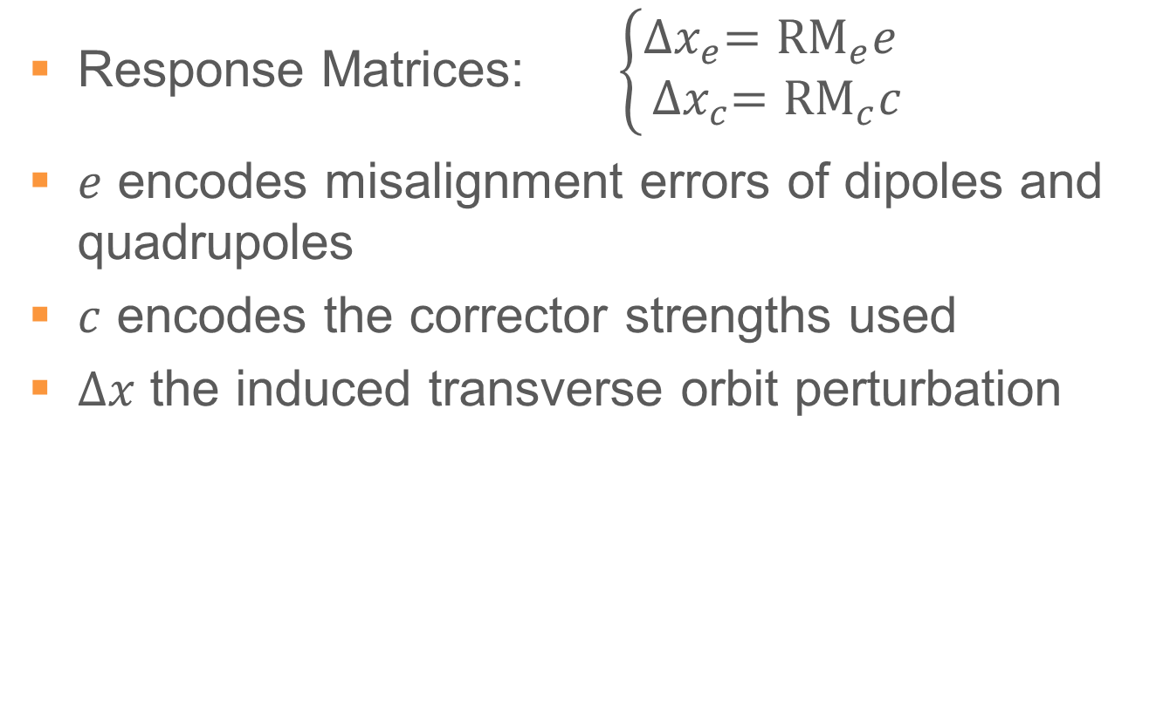
A Linear Treatment
Response Matrices: $\left\{\begin{aligned}{∆x}_{e}={\text{RM}}_{e}e \\ {∆x}_{c}={\text{RM}}_{c}c\end{aligned}\right.$
$e$ encodes misalignment errors of dipoles and quadrupoles
$c$ encodes the corrector strengths used
$∆x$ the induced transverse orbit perturbation

Slide 27
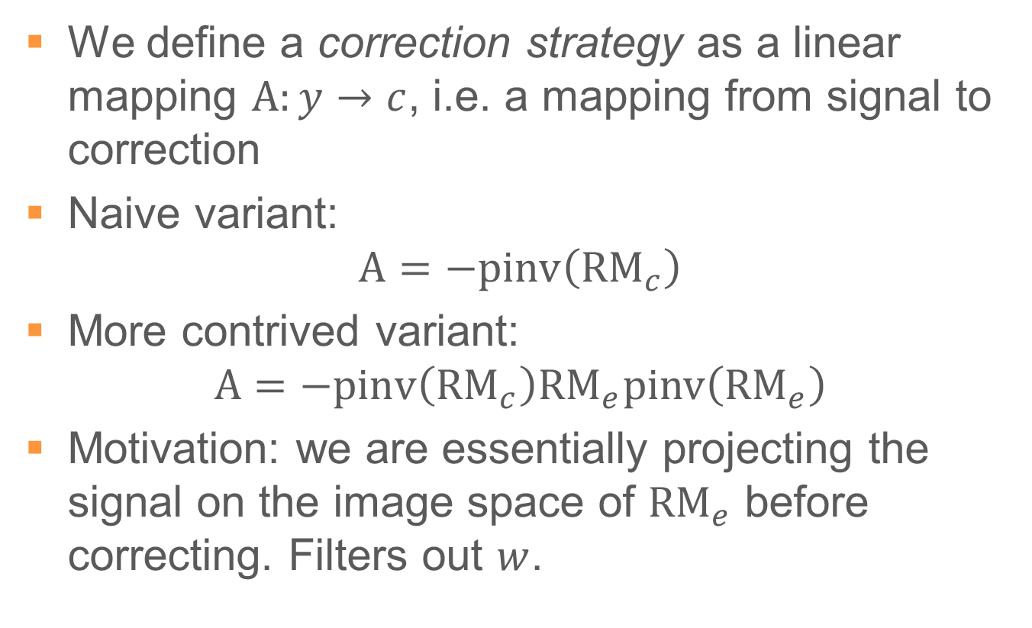
Correction Strategies
We define a correction strategy as a linear mapping $\text{A}:y→c$, i.e. a mapping from signal to correction
Naive variant:
$$\text{A}=\text{−}\text{pinv}\left({\text{RM}}_{c}\right)$$
More contrived variant:
$$\text{A}=\text{−}\text{pinv}\left({\text{RM}}_{c}\right){\text{RM}}_{e}\text{pinv}\left({\text{RM}}_{e}\right)$$
Motivation: we are essentially projecting the signal on the image space of ${\text{RM}}_{e}$ before correcting. Filters out $w$.

Slide 28
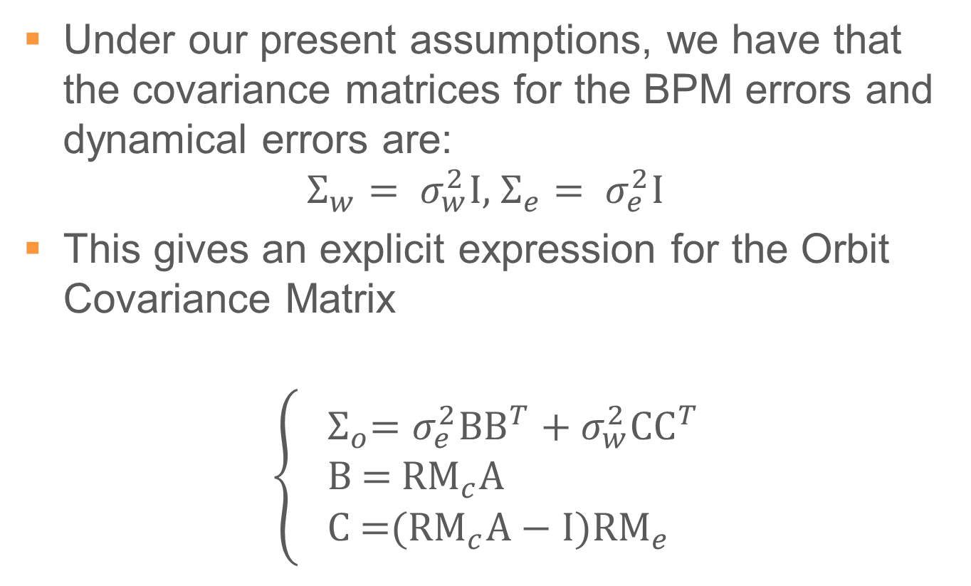
Formula for Orbit Covariance Matrix
Under our present assumptions, we have that the covariance matrices for the BPM errors and dynamical errors are:
$$Σ_{w}= σ_{w}^{2}\text{I}\text{,} Σ_{e}= σ_{e}^{2}\text{I}$$
This gives an explicit expression for the Orbit Covariance Matrix
$$\left\{\begin{aligned}&{ Σ}_{o}=σ_{e}^{2}\text{B}{\text{B}}^{T}+σ_{w}^{2}\text{C}{\text{C}}^{T} \\ & \text{B}\text{ = }{\text{RM}}_{c}\text{A} \\ \text{C} \text{=}({\text{RM}}_{c}\text{A}−\text{I}){\text{RM}}_{e}\end{aligned}\right.$$

Slide 29
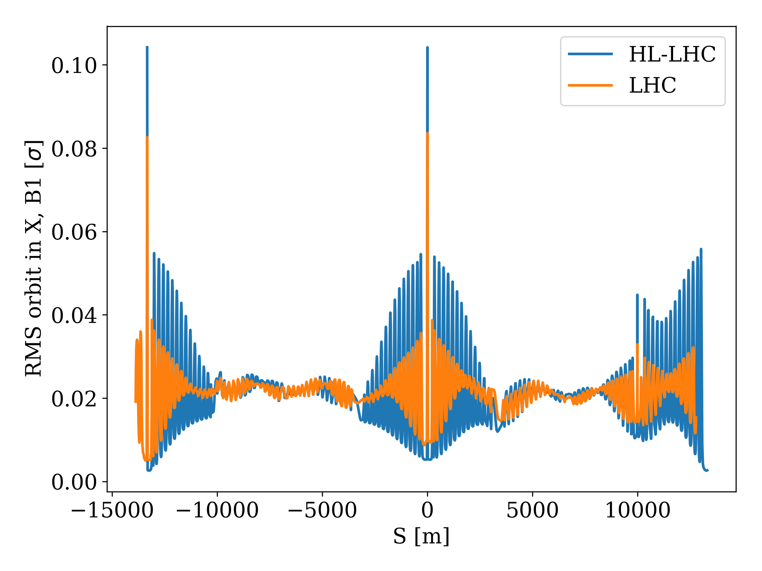
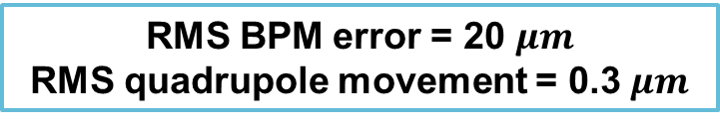
Global orbit residual post-correction
RMS BPM error = 20 $μm$
RMS quadrupole movement = 0.3 $μm$
IP1
IP5

Slide 30
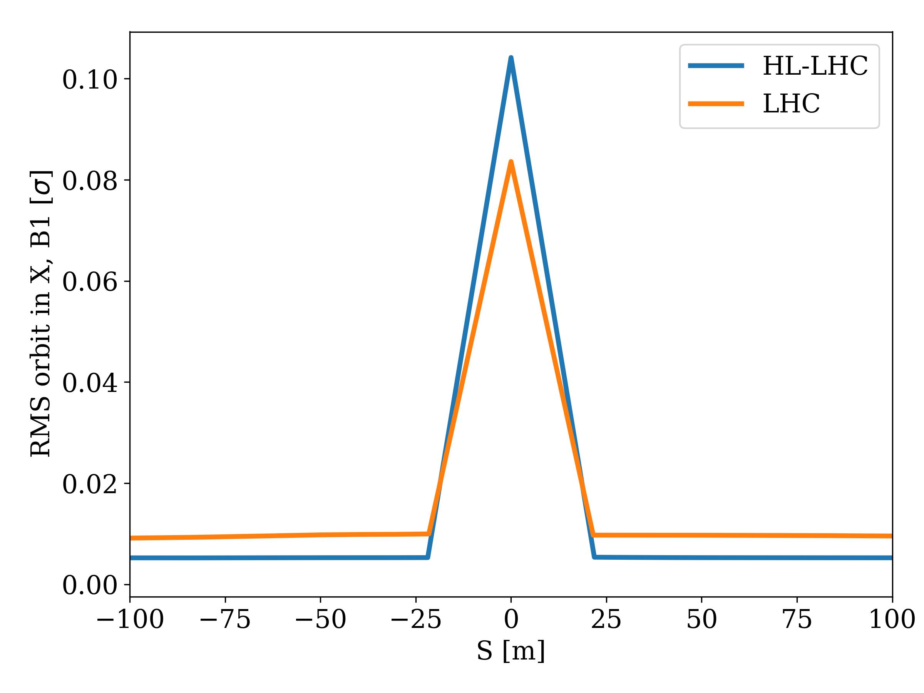
Residual post-correction at IP5
RMS BPM error = 20 $μm$
RMS quadrupole movement = 0.3 $μm$
~ 25 % increase

Slide 31
Triplet BPM names (appendix)
BPM number (proximity to IP5) | BPM Name
1 | BPMSQ.1[LR]5.B[12]
2 | BPMSQ.A2[LR]5.B[12]
3 | BPMSQT.B2[LR]5.B[12]
4 | BPMSQ.A3[LR]5.B[12]
5 | BPMSQ.B3[LR]5.B[12]
6 | BPMSQ.4[LR]5.B[12]
Mention something about which are being proposed for DOROS upgrade?

