Slide 1


CompactLight WP4 meeting
(29/8/2019)
David Alesini
On behalf of the XLS WP4 Study group @ LNF
(M. Diomede, A. Gallo, D. Alesini)

Slide 2
ACCELERATING STRUCTURE AND MODULE: PARAMETERS
Parameter | Value
Frequency [GHz] | 11.9942
Phase advance per cell [rad] | 2π/3
Shunt impedance R [MΩ/m] | 90-131
Effective shunt Imp. R_{s} [MΩ/m] | 387
Group velocity v_{g} [%] | 4.7-1.0
P_{out}/P_{in} | 0.215
Filling time [ns] | 144
Number of cells per structure | 108
Unloaded SLED Q-factor Q₀ | 180000
External SLED Q-factor Q_{E} | 23000
# structures per module N_{m} | 4
Module active length L_{mod} [m] | 3.6
Average iris radius <a> | 3.5
Iris radius input-output [mm] | 4.3-2.7
Structure length L_{s} [m] | 0.9
Accelerating cell length [mm] | 8.332
 | Rep. rate [Hz]
 | 100 | 250 | 1000
Average gradient <G> [MV/m] | 65 | 32 | 30.4
Max klystron available output power [MW] | 50 | 50 | 10
Required klystron power per module P_{K} [MW] | 39 | 42.5 | 8.5
RF pulse [µs] | 1.5 | 0.15 | 1.5
SLED | ON | OFF | ON
Av. diss. power per structure [kW] | 1 | 0.31 | 2.2
Peak input power per structure [MW] | 68 | 10.6 | 14.8
Av. Input power per structure [MW] | 44 | 10.6 | 9.6
Module energy gain [MeV] | 234 | 115 | 109

Slide 3
HIGH REP. RATE 1st SCENARIO: pulse shortening with high peak power klystrons
Operation probably possible with an optimization of the modulator rise/fall times
Ref. CPI VKX-8311A
50 MW, 1.5 µs, 100 Hz
50 MW, 150 ns, 250 Hz
KLYSTRON
KLYSTRON
MODE CONVERTER
MODULATOR HALL
MODE CONVERTER
MODULATOR HALL
CIRCULAR WAVEGUIDE
CIRCULAR WAVEGUIDE
MODE CONVERTER
MODE CONVERTER
SLED
SLED bypassed
LINAC HALL
LINAC HALL
1 klystron x LINAC Module
<E_{acc}> = 65 MV/m
1 klystron x LINAC Module
<E_{acc}> = 32 MV/m
Accelerating gradient and Linac energy reduced by a factor ∼2 @ 250 Hz rep rate;
The SLED has to be bypassed;
Klystron operated always at its nominal working point (good!);
Max rep rate very much dependent on modulator rise/fall times τ_{trans}

Slide 4
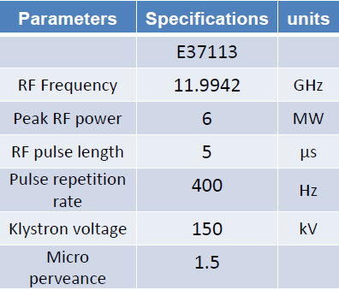
HIGH REP. RATE 2nd SCENARIO:
LOW POWER HIGH REP. RATE KLYSTRONS
Reference RF source CANON Commercially available
10 MW, 1.5 µs,
1 kHz
MODE CONVERTER
MODULATOR HALL
CIRCULAR WAVEGUIDE
MODE CONVERTER
SLED
LINAC HALL
10 MW, 1.5 µs, 1 kHz, operation probably possible in the near future
<E_{acc}> = 30.4 MV/m @ 1 kHz
1 kHz rep rate capability, with linac energy up to ≈ 47% of the max value;
R&D activity in progress @CANON and CPI on high rep. rate klystrons towards 10 MW, 1.5 µs, 1 kHz

Slide 5
HIGH REP. RATE 3rd SCENARIO:
COMBINATION OF HIGH REP. RATE AND LOW REP. RATE KLYSTRONS
Reference RF source CANON
10 MW, 1.5 µs,
1 kHz
50 MW, 1.5 µs,
100 Hz
RF smart combiner / switch
CPI VKX-8311A
MODE CONVERTER
MODULATOR HALL
CIRCULAR WAVEGUIDE
MODE CONVERTER
SLED
LINAC HALL
10 MW, 1.5 µs, 1 kHz, operation probably possible in the near future
<E_{acc}> = 30.4 MV/m @ 1 kHz
2 klystrons x LINAC Module
<E_{acc}> = 65 MV/m @ 100 Hz
Switching or combining 2 sources would preserve high gradient at low rep rate;
If source combination is possible, gradients > 30 MV/m available at rep rates ≤ 250 Hz;

Slide 6
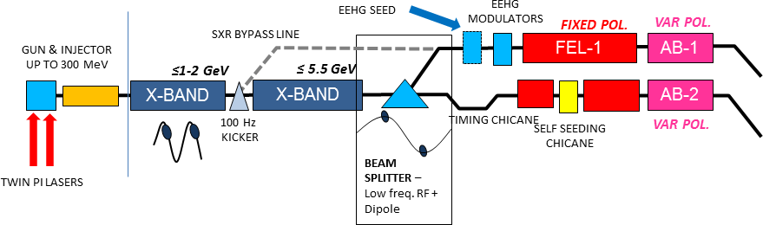
1st OPTION: DUAL MODE
Single rf source
single linac run in two operating modes
Cheapest
Limited increase in repetition rate (SLED by-passed)
Linac optics needs to operate at two gradient
LINAC 1
LINAC 2
X-BAND
X-BAND
Parameter | LINAC 1 | LINAC 2 | TOTAL
Number of structures | 32 | 60 | 92
Number of modules | 8 | 15 | 23
Number of klystrons | 8 (CPI) | 15 (CPI) | 23
Linac active length [m] | 29 | 54 | 83
Rep. rate [Hz] | 100 (250)
<E_{acc}> per struct. [MV/m] | 65 (32)
Energy gain per module [MeV] | 234 (115)
Max. Energy gain [MeV] | 1872 (921) | 3510 (1728) | 5382 (2649)
CPI
KLYSTRON
SLED
<E_{acc}> = 65 MV/m @ 100 Hz
<E_{acc}> = 32 MV/m @ 250 Hz

Slide 7
2nd OPTION: DUAL LINAC
two distinct linacs with different rf sources
SXR@ 1 kHz
HXR@ 100 Hz
SXR@ 900 Hz and HXR@ 100 Hz running in parallel
LINAC 1
LINAC 2
X-BAND
X-BAND
Parameter | LINAC 1 | LINAC 2 | TOTAL
Number of structures | 68 | 60 | 128
Number of modules | 17 | 15 | 32
Number of klystrons | 17 (HRR) | 15 (CPI) | 32
Linac active length [m] | 61 | 54 | 137
<E_{acc}> per struct. [MV/m] | 30.4 | 65 | -
Rep. rate [Hz] | 1000 | 100 | -
Energy gain per module [MeV] | 109 | 234 | -
Max. Energy gain [MeV] | 1853 | 3510 | 5363
HIGH REP. RATE KLYSTRONS
(ref. CANON)
CPI
KLYSTRON
SLED
SLED
<E_{acc}> = 30.4 MV/m @ 1 kHz
<E_{acc}> = 65 MV/m @ 100 Hz

Slide 8
3rd OPTION: DUAL SOURCE
Single linac with two sources
SXR@ 1 kHz
HXR@ 100 Hz
SXR and HXR CANNOT run in parallel
LINAC
X-BAND
X-BAND
Parameter | LINAC
Number of structures | 92
Number of modules | 23
Number of klystrons | 23 (HRR) + 23 (CPI)
Linac active length [m] | 83
<E_{acc}> per struct. [MV/m] | 30.4 (@1 kHz), 65 (@ 100 Hz)
Rep. rate [Hz] | 100-1000
Energy gain per module [MeV] | 109 (@1 kHz), 234 (@ 100 Hz)
Max. Energy gain [MeV] | 2507 (@1 kHz), 5382 (@ 100 Hz)
HIGH REP. RATE KLYSTRONS
(ref. CANON)
CPI
KLYSTRON
SLED
<E_{acc}> = 30.4 MV/m @ 1 kHz
<E_{acc}> = 65 MV/m @ 100 Hz

Slide 9
MODULE LAYOUT
The accelerating module layout with 0.9 m long accelerating structures has been completed for the two options: low energy and high energy
Courtesy Gianluca Di Raddo

Slide 10
MODULE LAYOUT
Courtesy Gianluca Di Raddo

