Slide 1

WP4: RF systems
Progress towards on 48GHz high power microwave sources
Laurence Nix¹, Liang Zhang¹ & A.W. Cross¹
¹Department of Physics, SUPA, University of Strathclyde, Glasgow, G4 0NG, UK
²School of Electronic Science and Engineering, University of Electronic Science & Technology of China, Chengdu, 610054, People's Republic of China
³ College of Electronic Science and Technology, Shenzhen University, Shenzhen, 518060, People's Republic of China
XLS | CompactLight Mid-term Review Meeting,
Helsinki, Finland, 1st-4th, July 2019

Slide 2
Present Status
Research groups (Strathclyde, UESTC, & Shenzhen)
36GHz, 3 MW gyro-klystron
  Simulation results
  1kHz pulse repetition frequency is feasible
Update on 48GHz gyro-klystron

Slide 3
Voltage (kV) | 150 | Current (A) | 50
Velocity ratio | 1.4 | Drive power (W) | 400
Beam guide radius (mm) | 2.3 | Magnetic field (T) | 1.46
36GHz Gyro-Klystron can operate a PRF of 1kHz
Power (MW) | 3.0 | Bandwidth | 0.3%
Efficiency | 40% | Gain (dB) | 39 (max 42)

Slide 4
Motivation
Lineariser (CompactLight, Cockcroft Institute)
  Correct the longitudinal phase space non-linearity from X-band linac
    compensate for the curvature imposed on the bunch by the fundamental by adding harmonic
  3rd (36GHz) or 4th (48GHz) harmonic of X-band (12GHz) LINAC frequency
    the higher the harmonic, the less amplitude (and thus microwave power) required
    the higher the frequency and power the shorter the lineariser

Slide 5
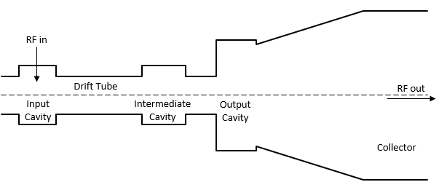
Gyro-klystrons
Gyro-klystron
  Azimuthal Bunching, TE modes
  Lower axial velocity than linear klystron
  High beam alpha (v_{perp}/v_{para})
  Operating frequency determined by the external magnetic field
  Open output cavity, high power capability
r
z

Slide 6
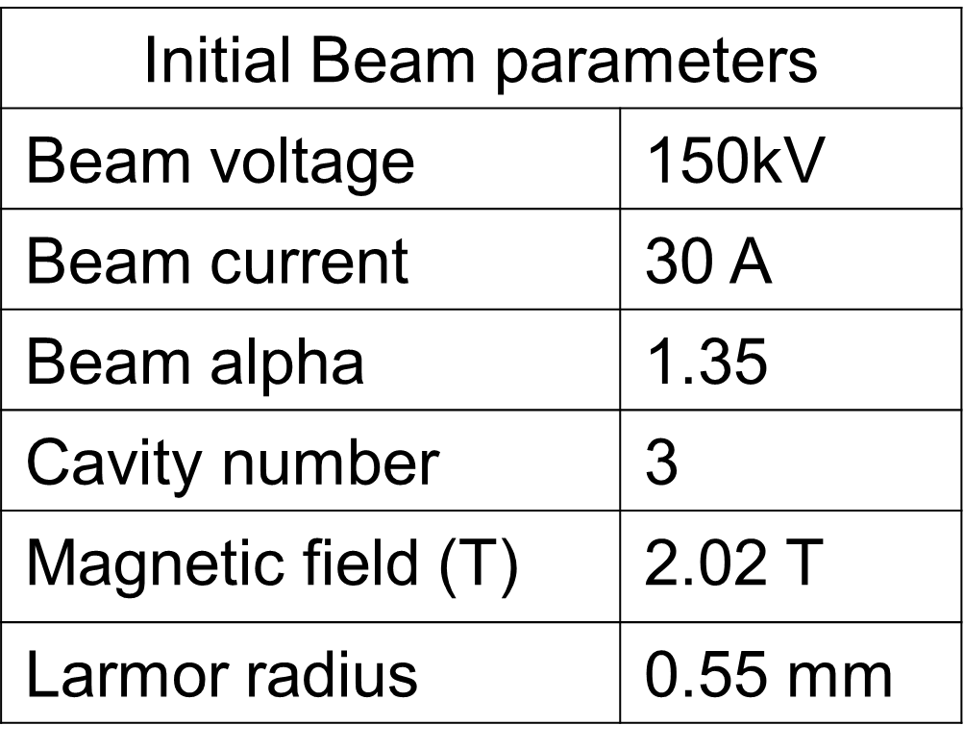
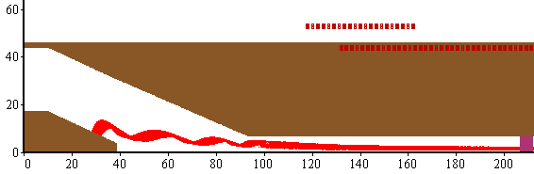
e-beam 48GHz Gyro-klystron
Magnetron Injection Gun
r (mm)
z (mm)

Slide 7
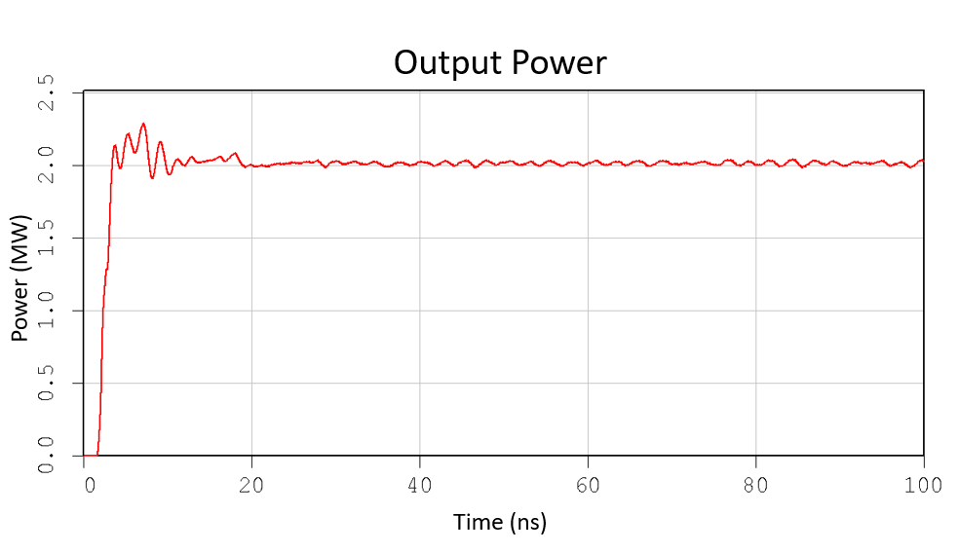
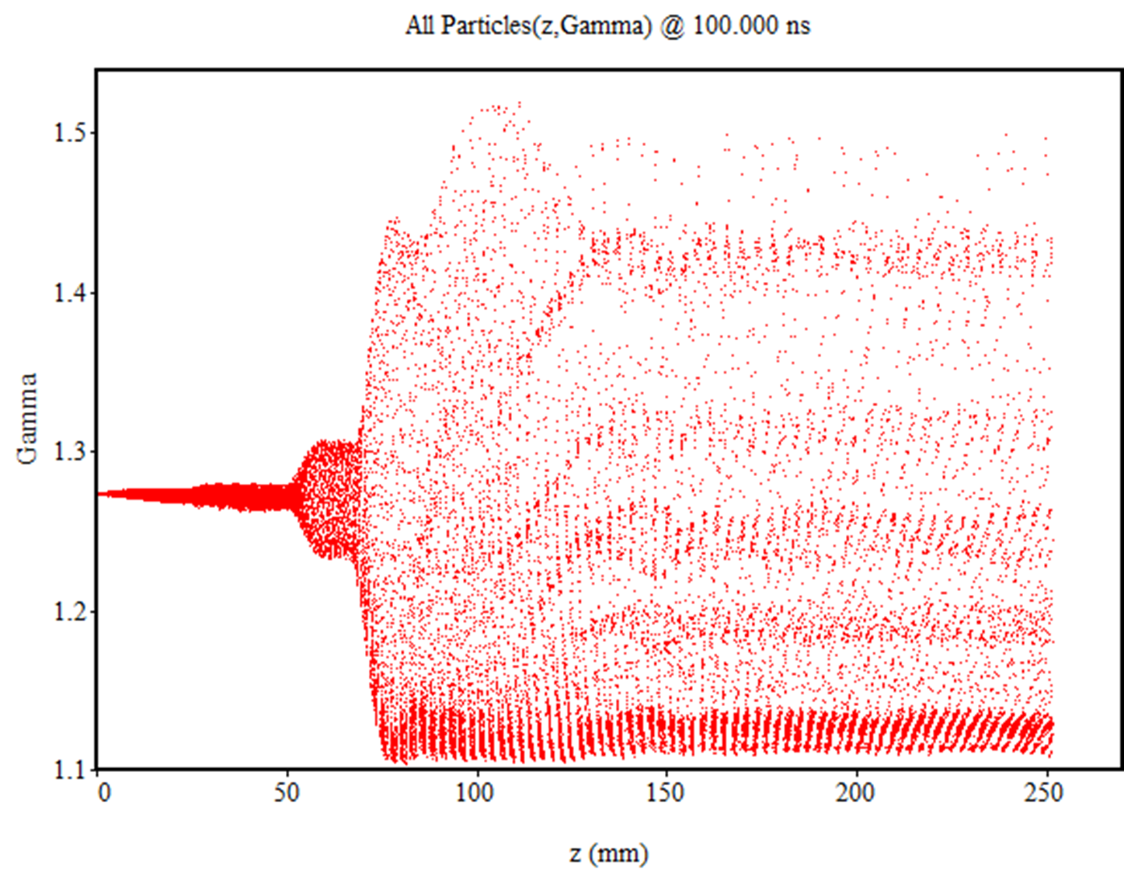
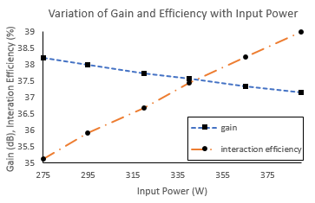
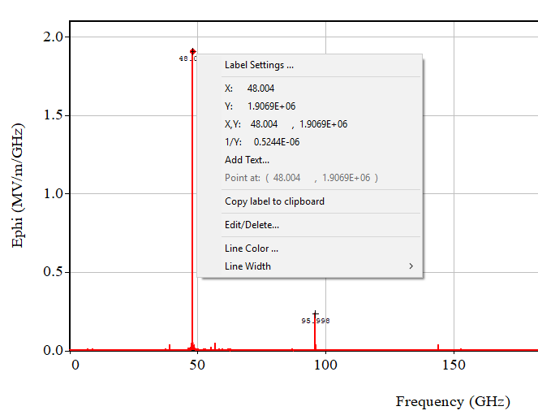
Latest 48GHz Gyro-klystron PIC simulations
2.0MW output power
Time (ns)

Slide 8

Conclusion
36GHz, Gyro-klystron (Strath, UESTC, Schenzhen)
  36GHz, 3 MW, 1kHz pulse repetition
  SLED II compressor, ~9MW at 36GHz
48GHz Gyro-klystron (Strathclyde)
  48GHz, 2.0MW
  SLED II compressor, ~6MW at 48GHz
Increase output power (10MW) need to operate at higher voltage
    450kV, 50A
Higher order mode in the output cavity
    co-axial gyro-klystron
Ka-band Gyro-klystrons have been developed and operated for many years in radar systems
  Strathclyde/UESTC (200kW, 36GHz, 220Hz)
  CPI, USA
  Gycom, Russia

Slide 9
Acknowledgement
This work is supported by the European Commission Horizon 2020 Project “CompactLight” (777431-XLS), and the State Scholarship Fund from the China Scholarship Council and the STFC, UK (Cockcroft Institute Core Grant)

