Slide 1
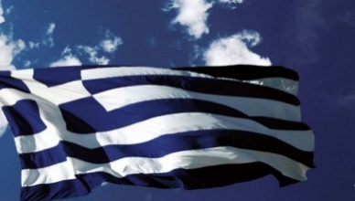

Status of Greek ILO activities
N. Manthos, UoI, Greek ILO
22nd CERN-Greek WGM, CERN, 4.9.2019

Slide 2
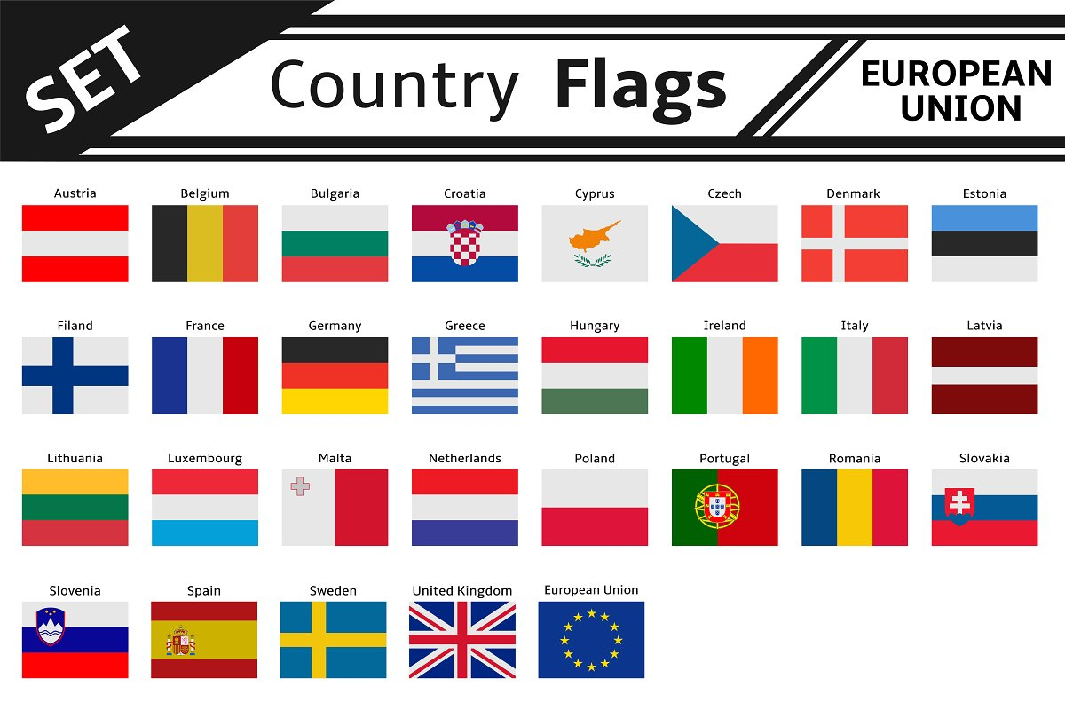
2018 return: Greece
2018 (CHF): 1 148 237 000, 12 567 300 (1.09%) 307 250 690, 146 758 913 1 973 013, 486 810 0.67 (1), 0.3 (0.4) overall 0.47
25/6/2018
NM_UoI
2

Slide 3
2018 return: Greece (kCHF)
Well balanced Member States for the period
1 Mar 2019 – 28 Feb 2020 (IRC>0.9)
Supplies | GR (KCHF) | Total (MCHF)
Civil engineering, building and technical services | 24 | 61
Electrical engineering and magnets | 226 | 63
Electronics and radio frequency | 537 | 30
IT | 0 | 35
Mechanical engineering and raw materials | 522 | 32
Vacuum and low temperature | 110 | 2
Particle and photon detectors | 0 | 2
Optics and photonics | 0 | 7
Gases, chemicals, radiation and waste equipment | 0 | 9
Health, safety and environment | 0 | 8
Transport, handling and vehicles | 1 | 20
Office supply, furniture, communication and training | 361 | 16
Miscellaneous | 184 | 16
TOTAL | 1973 | 307
Industrial services | GR (KCHF) | Total (MCHF)
Temporary labor contracts | 0 | 6
Service contracts | 487 | 140
TOTAL | 487 | 146
Supply Contracts
Bulgaria
Czech Republic
France
Hungary
Poland
Slovakia
Switzerland
Industrial Service Contracts
Denmark
France
Italy
Spain
Switzerland
United Kingdom
Industrial return coefficient (IRC)
Poorly : 0.3<IRC<1
Very poorly: IRC<0.3
Payments of Research teams | GR (KCHF) | Total (MCHF)
LHC | 166 | 29
others | 41 | 29
TOTAL | 207 | 58
25/6/2018
NM_UoI
3

Slide 4
2019 return Greece (kCHF) (until June 2019)
2019/2 (CHF): 1 171 170 100, 12 453 650 (1.06%) 269 915 811, 166 776 982 3 158 702, 341 400 1.1 (1), 0.19 (0.4) overall 0.6
2018 (CHF): 1 148 237 000, 12 567 300 (1.09%) 307 250 690, 146 758 913 1 973 013, 486 810 0.67 (1), 0.3 (0.4) overall 0.47

Slide 5
2019 return Greece (kCHF) (until June 2019)
TOTAL 2019/2: 341 400 + 3 158 702 + 83 128 = 3 583 230 / 12 453 650 = ~ 29%
2018: 486 809 +1 973 012 + 206 011 = 2 665 832 / 12 567 300 = ~ 21%

Slide 6
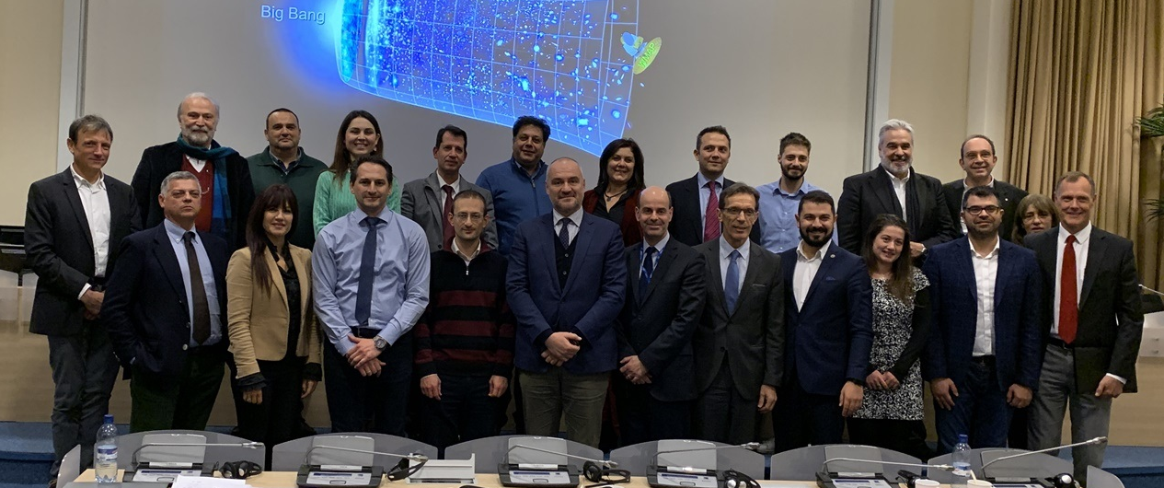
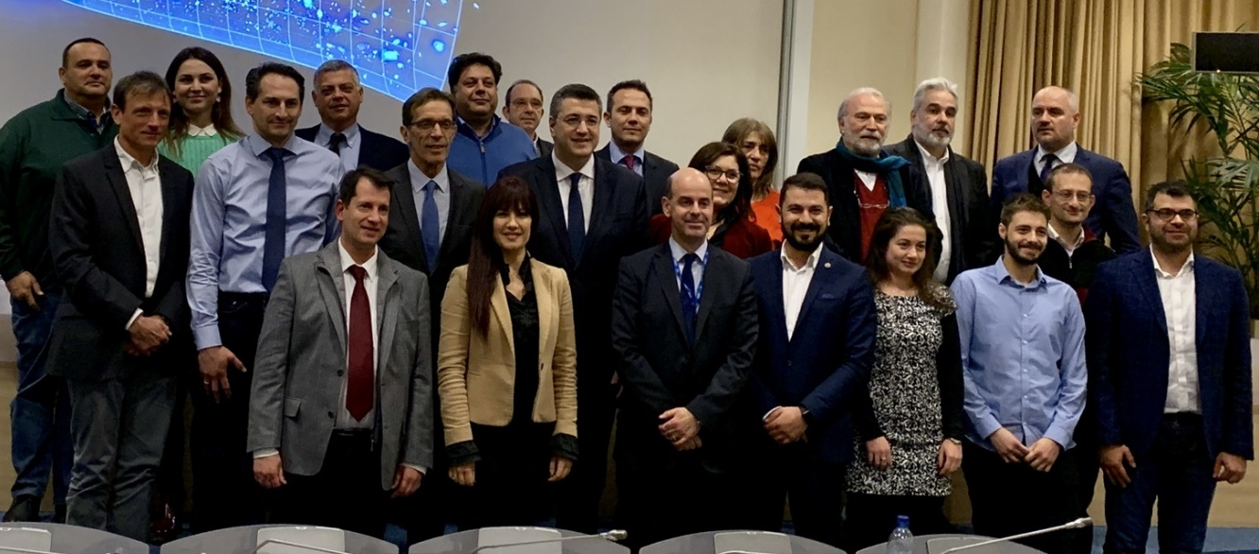
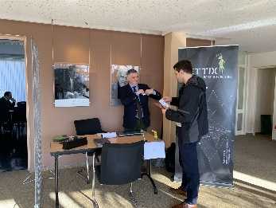
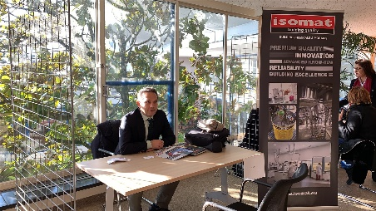
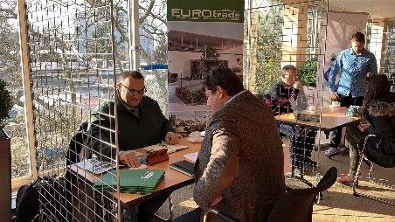
Greek firms (from North Greece) @ CERN. January 2019
Organized by Technopolis Thessaloniki ICT business park, and the authorities of the region of Central Macedonia-Greece with the Federation of Industries of North Greece (SBBE).
Firm Firm profile
Blocachain Software engineering, ICT applications
B&T Composites products using carbon-glass fibers etc.
Energy Construction comp. renewable energy construction systems
Eurotrade SA modular buildings, deployable containers
Fieldscale CAE applications and simulations
Infodim GIS services, e_government
Isomat SA waterproofing materials, paints etc
ILT logistics SA International transports-logistics
Kleeman SA lifts, escalators, moving walks, parking sys
Samaras&Co SA engine. and business consultant services
SiafarasElectricSystems electric system and services
SuperAlloys engineering customized industrial mechanical parts
Tettix industrial automation systems

Slide 7
Actions
Searching for potential firms to enrich the firm database.
Searching for potential firms-shops for off the self supplies.
Workshop with potential Greek firms organized by GSRT in Greece to advertise the CERN “market”. Talks by CERN procurement service experts.
It can be followed by a demonstration-exhibition at CERN (Greece@ CERN).

