Slide 1
Volunteers – General briefing session
Loraine Massarotti, Marie Bouvier, Aurélie Lawarée, François Briard
OD2019 Work Package 3.2 – Volunteers

Slide 2

TPG 20s spot
Crédit: Daniel Dominguez

Slide 3
Goal of the session
Overview of general organisation of the OD2019
Safety first!
Useful general information for your volunteer role
Links to help you prepare yourselves

Slide 4
What do we need to organize the OD?
2.5 35 000+
days
Visitors/day
9 150 90 80 000
sites
activities
tents
recyclable Open Days cups
And………..

Slide 5

Volunteers
Team of 2700+ volunteers
Assigned to 6600+ tasks
Thank you for your availability, commitment and flexibility!

Slide 6
Open Days – Schedule
Date | Programme | Who?
Friday 13 September | 1.30 p.m. – 5.30 p.m. LHC underground visits | CERN personnel + family + friends
Saturday 14 September | 9.00 a.m. – 6.00 p.m. 8.30 a.m. CERN sites opens 9.00 a.m. First activities/visits start 6.00 p.m. Last activities/visits 6.45 p.m. End of last visit to LHC points 7.00 p.m. CERN sites close | General public
Sunday 15 September

Slide 7
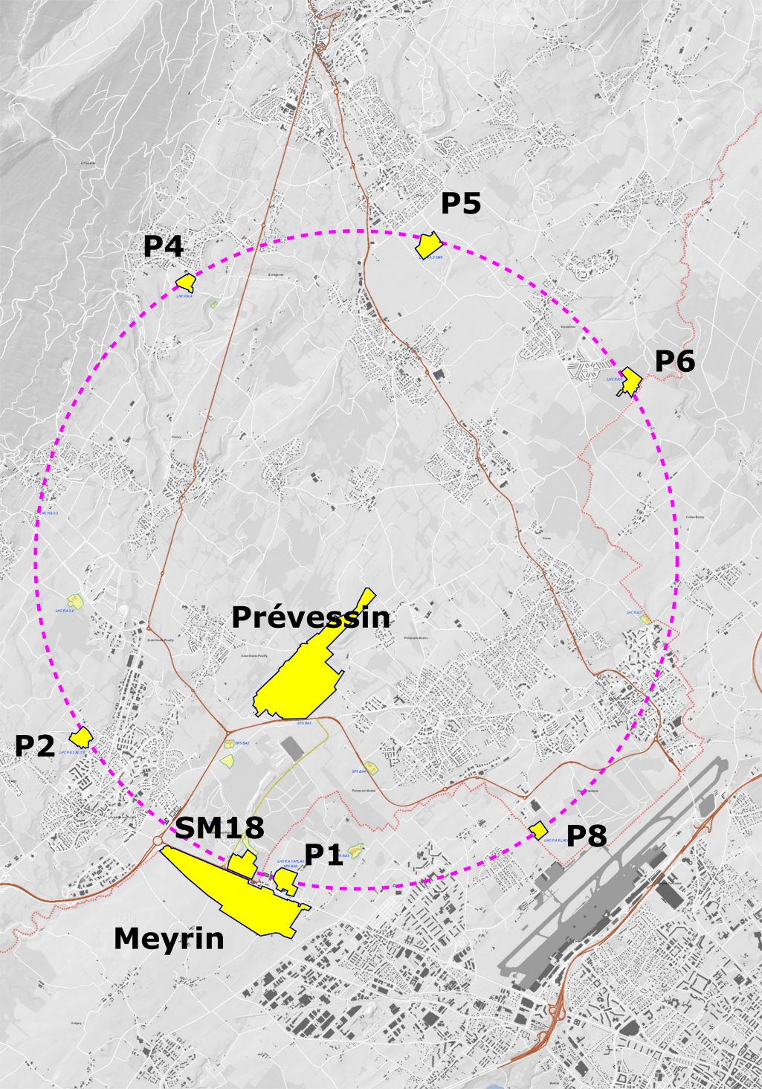
Open Days – Sites
  Meyrin
  Prévessin
  SM18
  LHC Point 1 – ATLAS
  LHC Point 2 – ALICE
  LHC Point 4 – LHC
  LHC Point 5 – CMS
  LHC Point 6 – LHC
  LHC Point 8 – LHCb

Slide 8
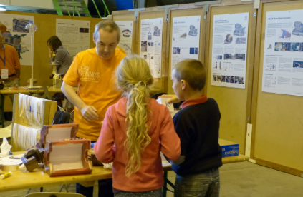
Open Days – Activities
All activities are coded per site.
Ex: ME.51, P1.12, etc.
All activities have a description
Signage and location maps

Slide 9
Traffic, parking - Visitors
Travel green! CERN encourages the use of public transport and soft mobility.
Sites will be mostly pedestrians (no bicycles!)
The TPG public transport from and to CERN significantly strengthened.
Remote parkings for visitors provided around the sites.
Regular shuttles arranged to and from these parking areas as well as between some of the sites.

Slide 10
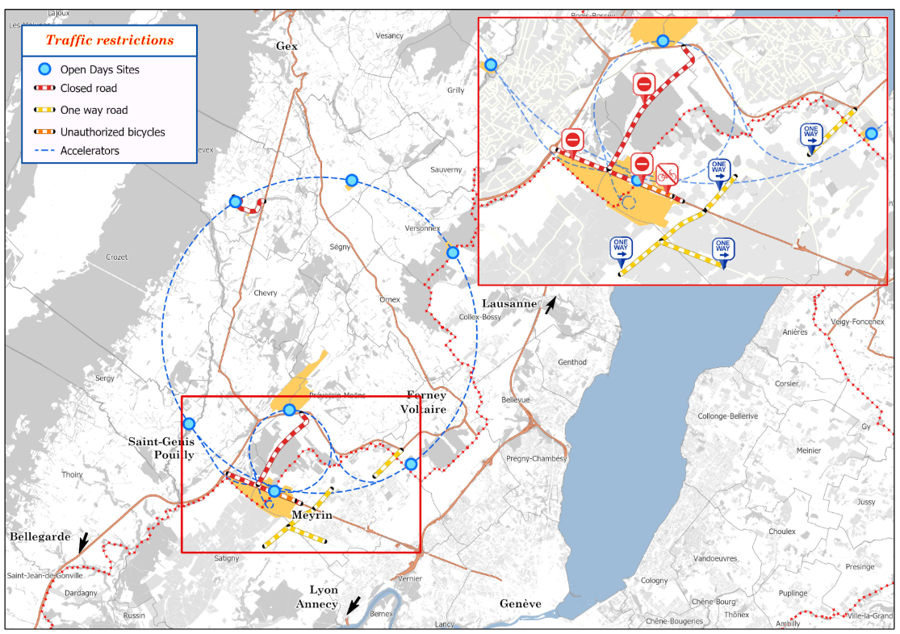
Road closure
Between 7.30 a.m. – 7.30 p.m.
Notes:
The following roads will be closed:
Route de l’Europe
Route de la vie Chenaille in Echenevex between the D984C and the corner of route François Estier
Route de Meyrin from the roundabout by the French gates to route du Mandement
Route de Meyrin to Ferney Voltaire and its continuation into Switzerland, avenue Auguste-François Dubois, in the direction from France to Switzerland

Slide 11
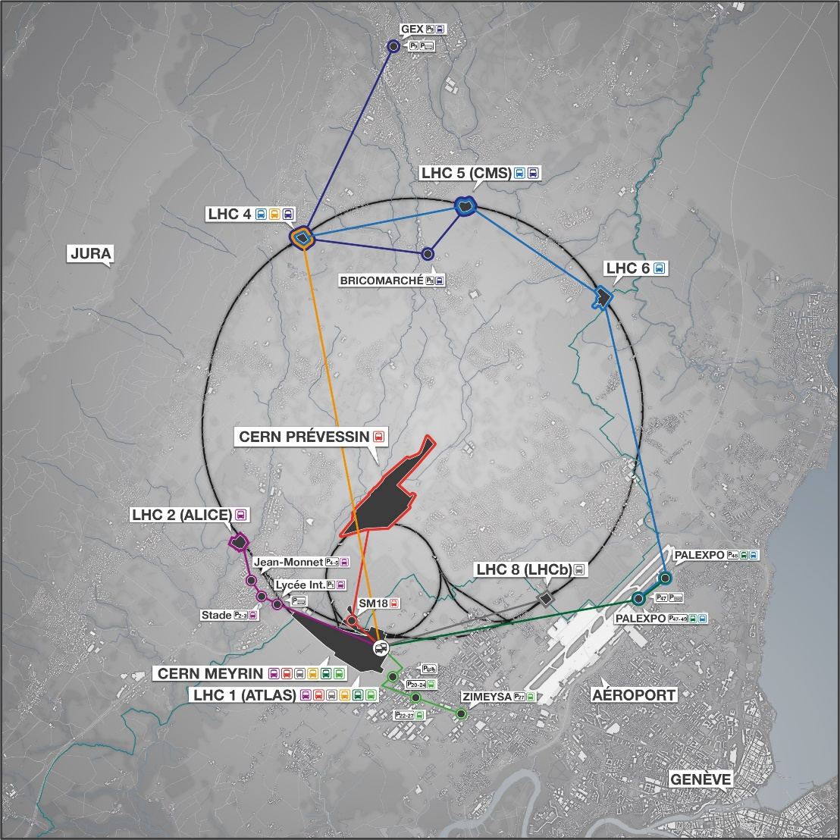
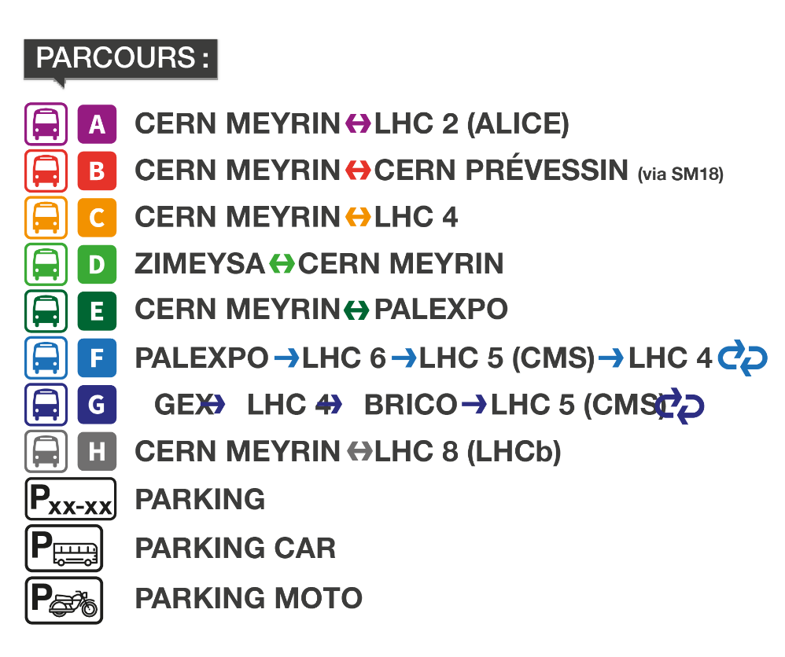
Buses and parkings
Between 8.30 a.m. – 7.30 p.m.

Slide 12
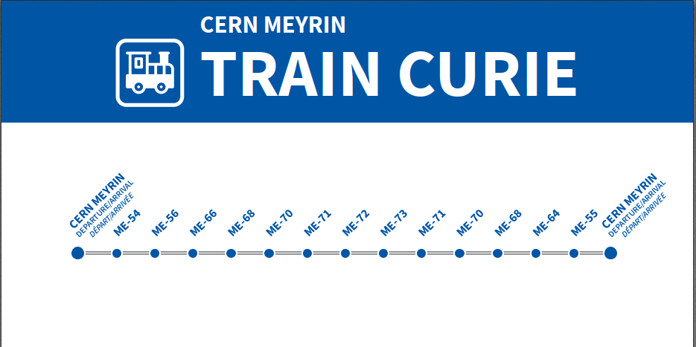
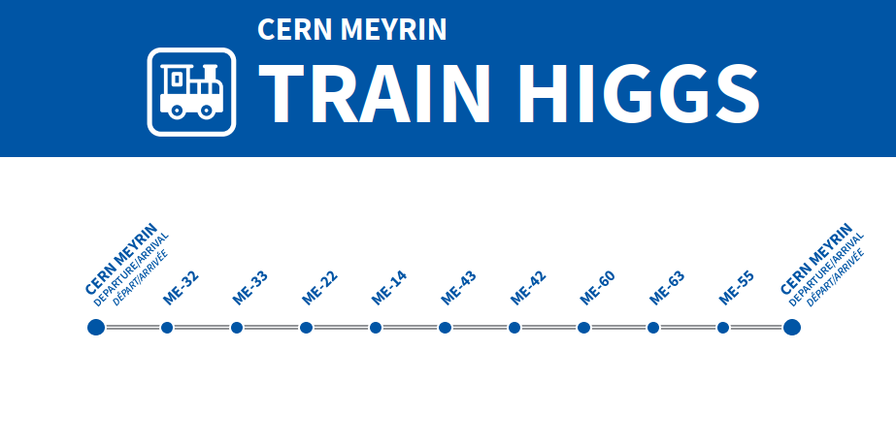
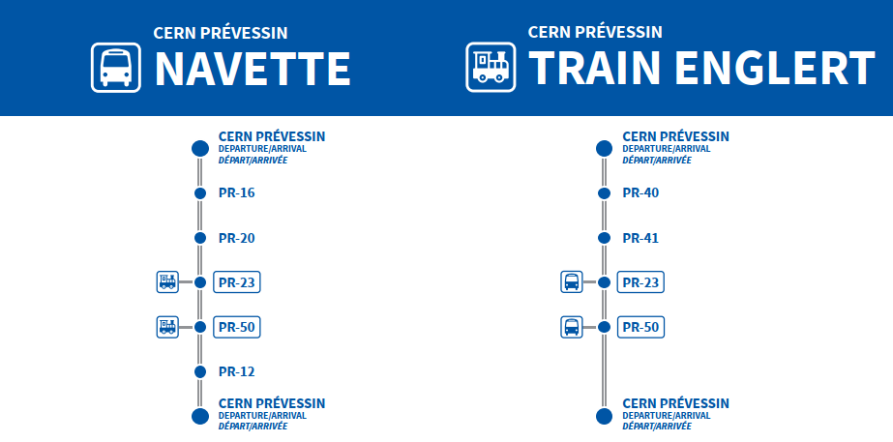
Shuttles and mini-trains

Slide 13
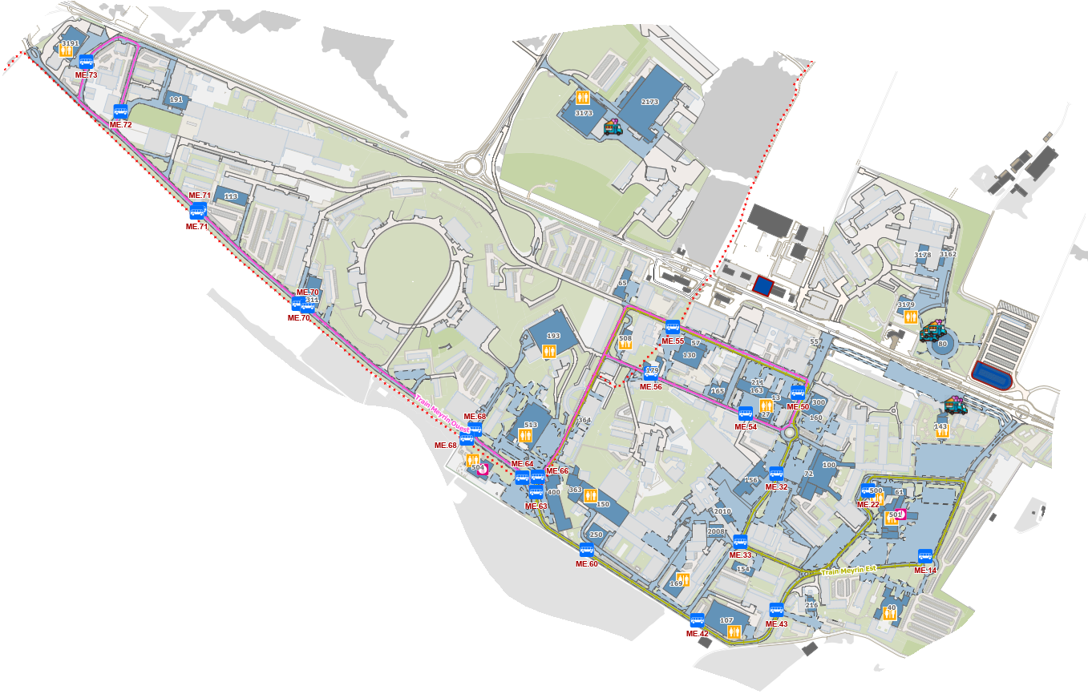
Mini-trains - Meyrin
Notes:
30 min rotation

Slide 14
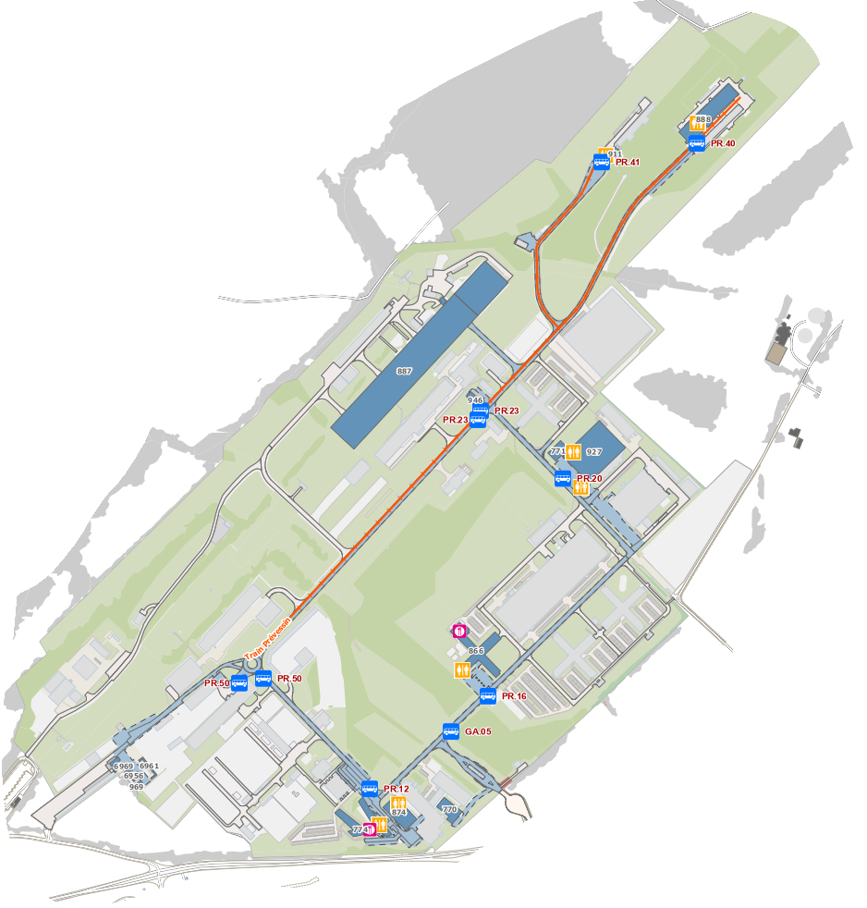
Mini-trains - Prevessin
Notes:
15 min rotation

Slide 15
Visitors - Registration
All visitors must have registered to be guaranteed access to the event
Registration is
  For a specific arrival point
  For a specific arrival time
  For a specific number of visitors (maximum 6)
Registration is NOT
  For a specific activity (including LHC visit)
  Subject to modifications (but we are flexible)
Once arrived, visitors can go on any site.
Notes:
All people taking part in activities have a wristband
Must have a wristband to get in

Slide 16
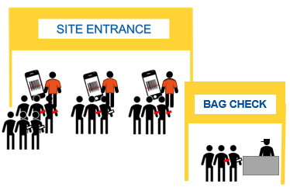
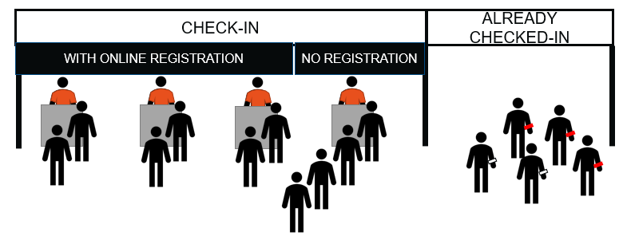
Visitors - Arrival points
Newcoming visitors directed to the Check-in tent
Collect a bracelet as per their registration OR register if they haven’t done so (limited)
Then only, directed to the site gate to enter the site where bracelets are scanned and bags visually inspected
Notes:
All people taking part in activities have a wristband
Must have a wristband to get in

Slide 17
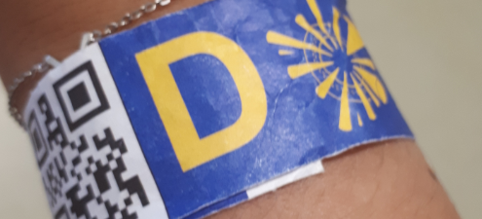
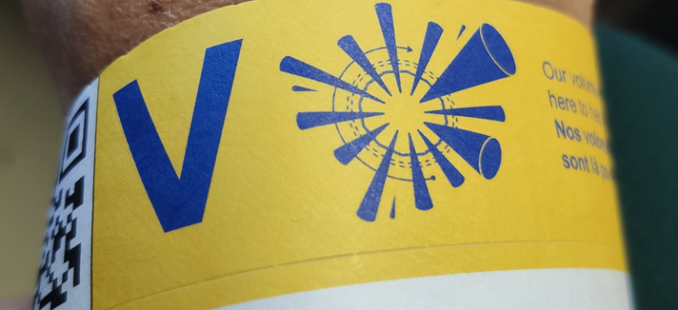
Bracelets… for what?
Identify Checked-In visitors vs newcomers
Count the number of visitors on each site (request from Host States)
And indirectly gather statistics on visitors (how many site, how long on each site, etc.)
Bracelets are anonymous !
Standard
Fast Track LHC
Notes:
Bracelets necessary to access activities. If no bracelet = bypoassin
Scanned at gate + UG visit.

Slide 18



Other categories of people on site
Don’t queue at the gate:
Volunteers
Press
(+CERN APS +Media teams)
CERN Service
Contributors
Hotel guests
Notes:
Mention CERN photographers and social media team

Slide 19

Open Days - Website and App
opendays.cern
  Description of activities
  Parking and shuttles
  Safety-related information
  FAQ
Download the public App!
opendays.app.link/app
  Description of activities
  Parking and shuttles
  Safety-related information
  Up-to-date information (waiting times)

Slide 20
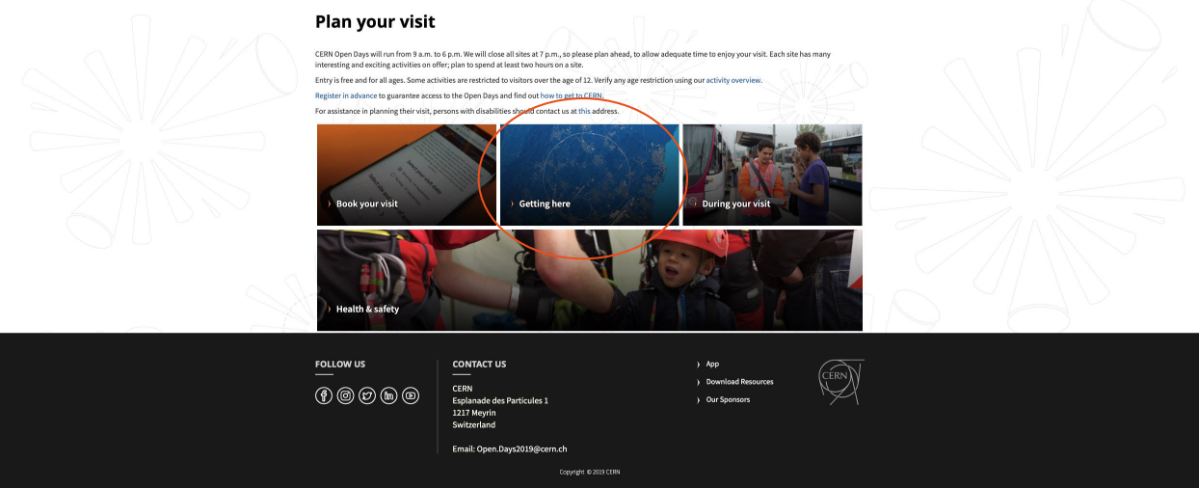
Open Days - Website and App
opendays.cern

Slide 21
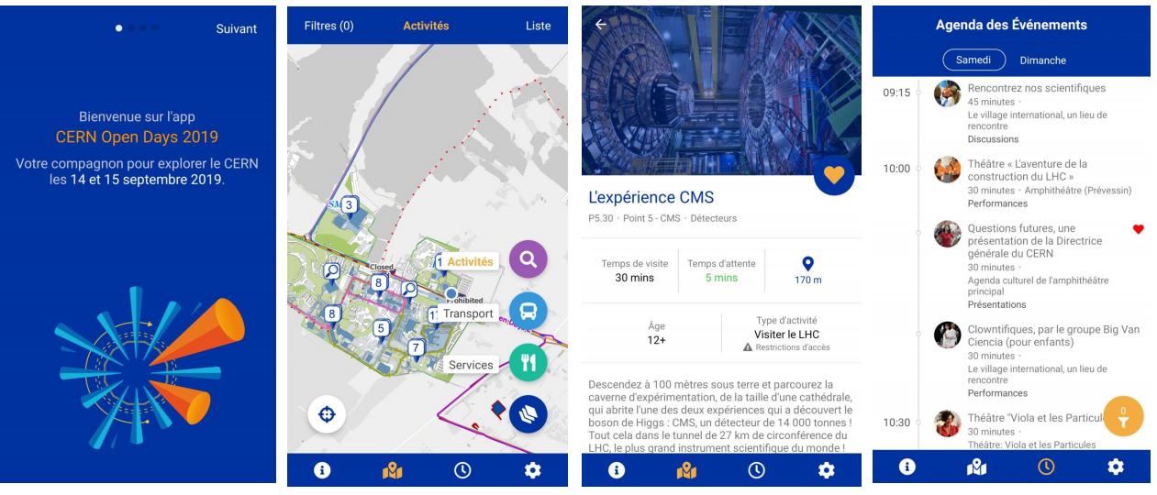
Open Days - Website and App
opendays.app.link/app

Slide 22
Volunteer session– Safety
Meriem Chniba, Kitti Hanol, Yann Léchevin.

Slide 23
First aid response
  Dispositive
  What to do in case of emergency
Safety Documentation
  How it looks
  Special plan A - B - C
Safety Vest code
Radiation Protection

Slide 24



First aid response

Slide 25
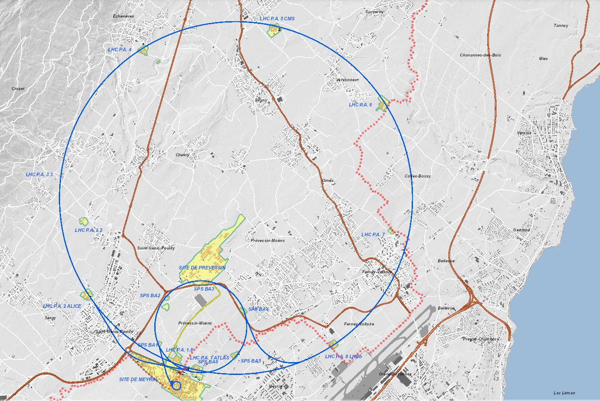






Medical
Source : M. NAS HSE-FB

Slide 26
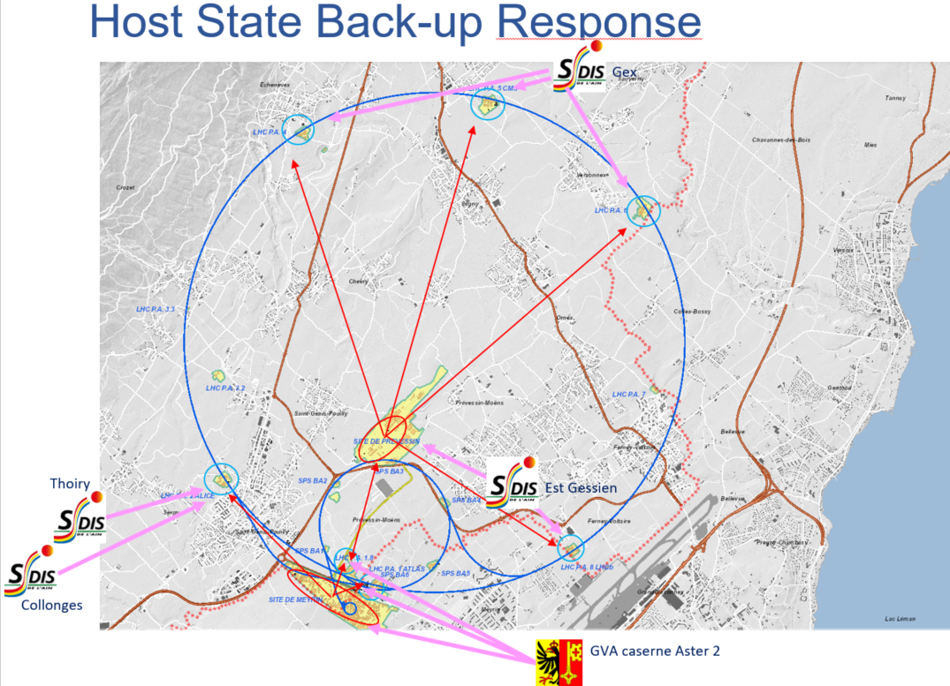
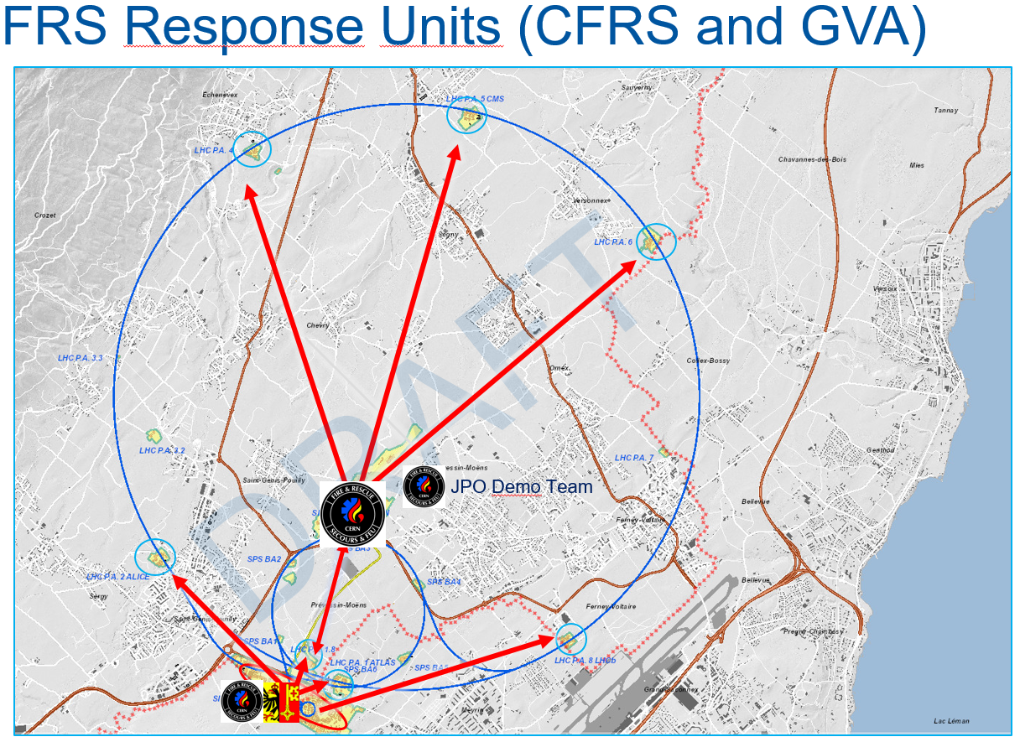
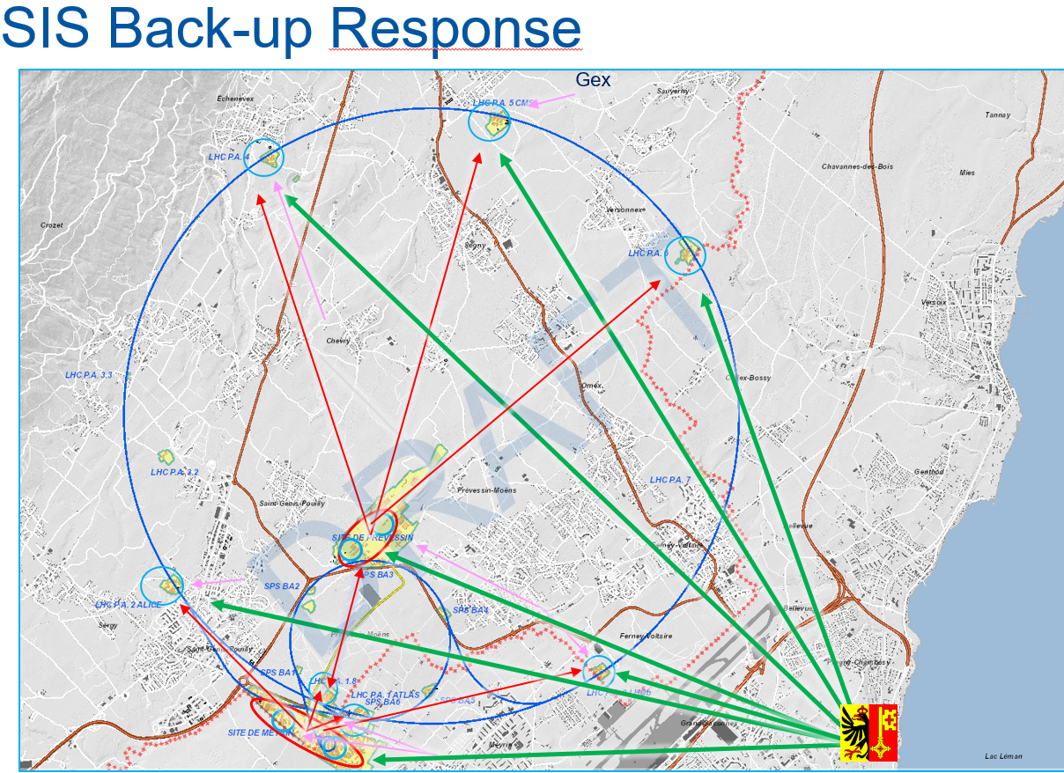
Fire and others
Réponse SSF
Réponse SDIS 01 / SIS
SIS Back up
27.06.2019
HSE-FB
Source : M. NAS HSE-FB

Slide 27
What to do in case of emergency

Slide 28
Call 74444
Contact local fire-fighters if near to you (but don’t look for!)
Use Red Phone (for LHC underground) / TETRA red buton

Slide 29
Standard procedure still works !
Earing an alarm ?
Evacuate and bring visitor with you !

Slide 30


Standard procedure still works !
People doesn’t feel well ?
Look around you for first aider and call 74444

Slide 31
Standard procedure still works !
Smoke, threat ?
Push evacuation alarm if needed,
Evacuate and bring visitor with you !
Call 74444 and after inform your site manager

Slide 32
Standard procedure still works !
Luggage? Problem with people ?
Take distance with your group and
Call 74444 and after inform your site manager

Slide 33
Standard procedure still works !
Lift stop ?
Reassure people,
Use lift interphone to contact Fire Brigade ASC technician are on each LHC site
Electrician also, and TI monitor the network

Slide 34







Behind the scenes
FB :
FB intervention
Piquet RP
Piquet HSE
Building 160
TI :
Piquet ELEC
Piquet ASC
Piquet CV
Piquet Gas / DET
Direct line :
66001
66002
77777 :
Daily support
Garbage,
Toilets,
Bus,
…
Source S. Lueders

Slide 35
Poste Coordination Operationnelle 160
Building 160
Direct line :
66001
66002
With ad-hoc services
With your site manager
Source S. Lueders

Slide 36
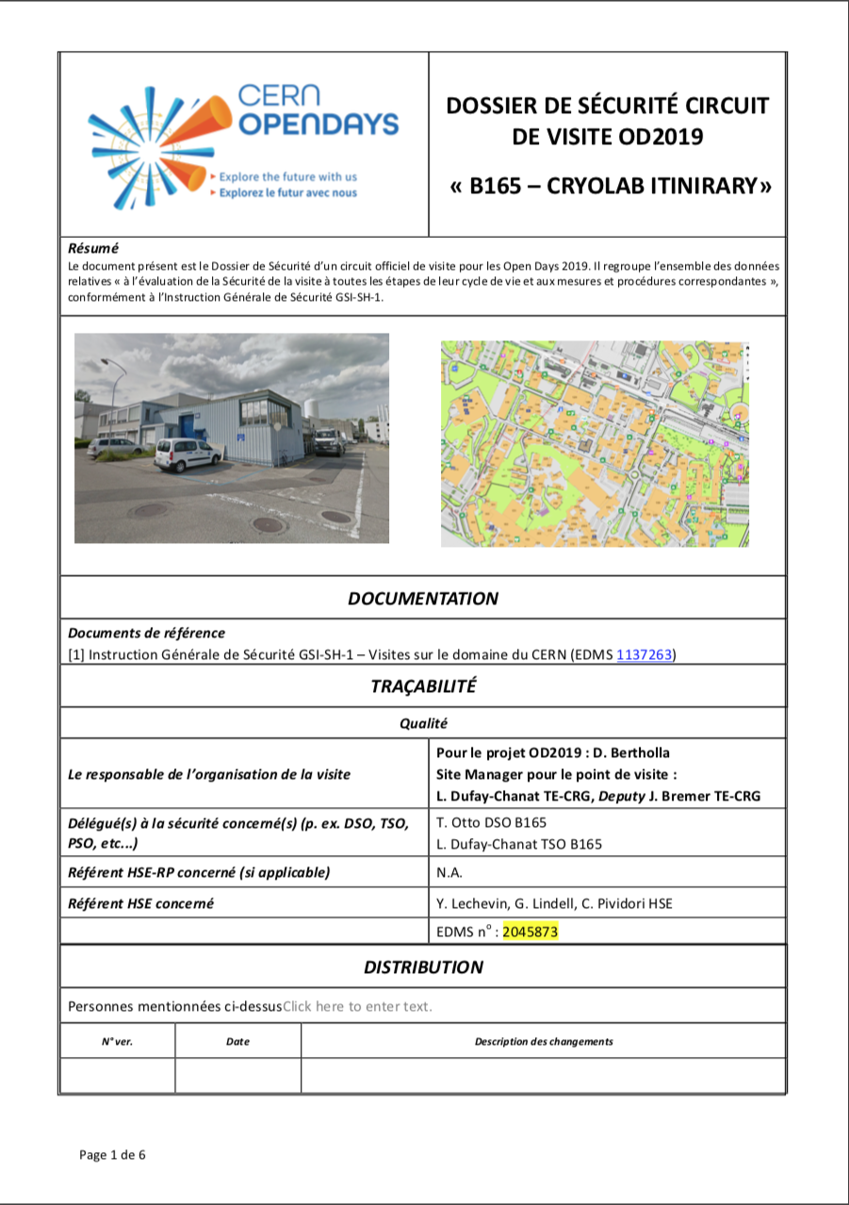
Safety documentation

Slide 37
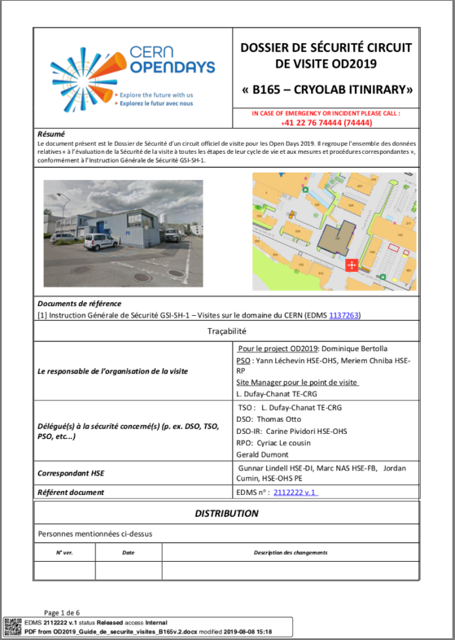
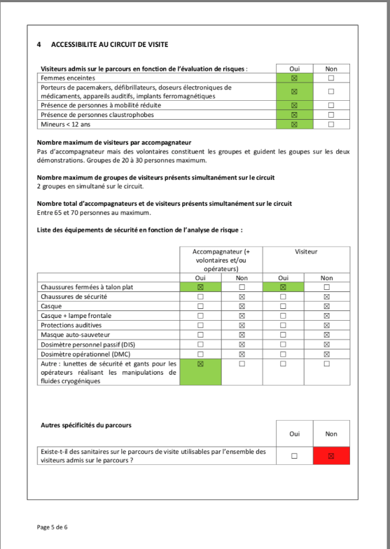
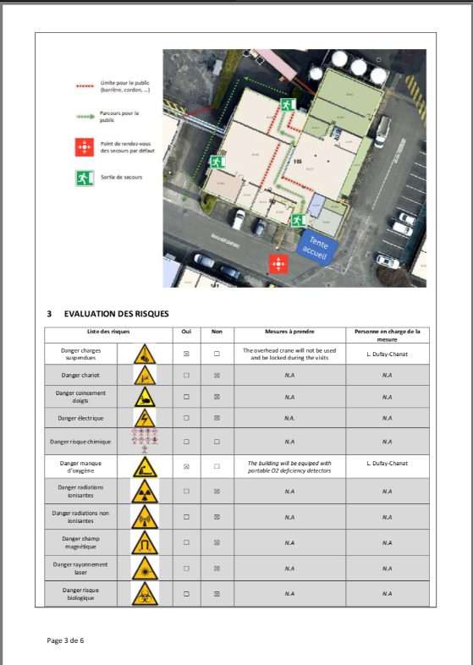
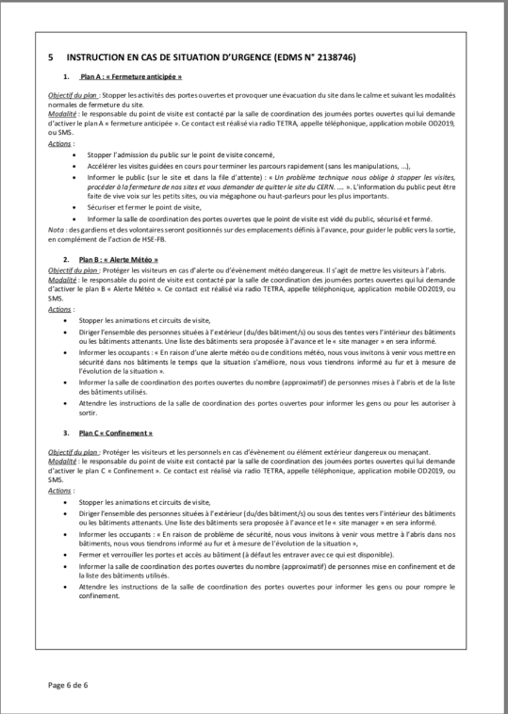
Safety documentation

Slide 38


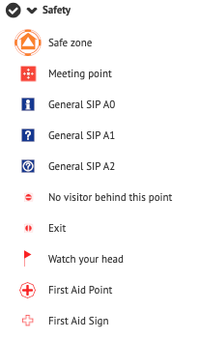
Safety documentation
Three scenarios:
  Plan A: Early closure
    Goal – “soft” evacuation of sites
  Plan B: Weather alert
    Goal – harbor visitors in safe buildings
  Plan C: Confinement from harmful exterior event
    Goal – harbor visitors in safe buildings
List of safe buildings on each site (in progress on GIS Portal)
Communication: messaging and channels

Slide 39

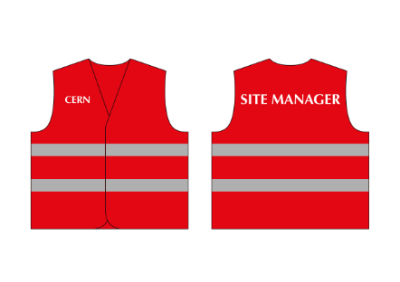
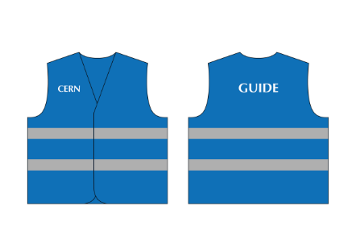
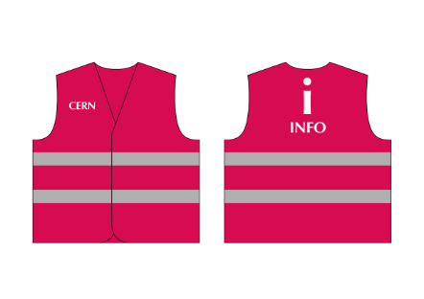


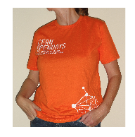
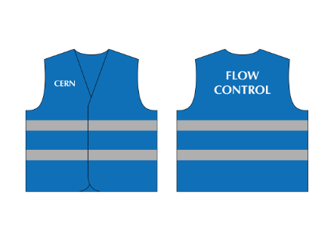


Identifications
OD2019 Core Team
Site Manager
General
First Aid
Safety help
HSE Teams, HSE RP Teams, LEXGLIMOS / DSO Teams

Slide 40



Radiation Areas
Sites | Bâtiments | Points de visite
Meyrin | 193 | Antiproton - ELENA decelerator
 | 2008/2010 | CLIC - CTF3
 | 400 | LINAC4
 | 150 | LINAC2
Prévessin and LHC points | 888 | COMPASS
 | 887 | EHN1
 | 911 | ECN3
 | p1 | ATLAS
 | p2 | ALICE + Machine
 | p4 | LHC RF + Machine
 | p5 | CMS
 | p6 | Machine
 | p8 | LHCb
Sources: 2013’s Tripartite, Memorandum Radiation Protection requirements for Open Days 2019 visits in Radiation Areas* :
Pregnant women allowed
Minimum age : 12yo
Maximum dose allowed :3uSv
In case of an incident : 10uSv
General behaviour available :
*Memorandum Radiation Protection requirements for Open Days 2019 visits in Radiation Areas – EDMS 2110782

Slide 41


Radiation Areas
Site | Bâtiment | Point de visite
Meyrin | 193 | Antiproton - ELENA decelerator
 | 2008/2010 | CLIC - CTF3
 | 400 | LINAC4
 | 150 | LINAC2
Prévessin and LHC points | 888 | COMPASS
 | 887 | EHN1
 | 911 | ECN3
 | p1 | ATLAS
 | p2 | ALICE + Machine
 | p4 | LHC RF + Machine
 | p5 | CMS
 | p6 | Machine
 | p8 | LHCb
Each Supervised Radiation Area Guide :
Mandatory
Personal dosimeter (passive)
Operational dosimeter (active)
Each Supervised Radiation Area Crowd Marshall :
Mandatory
Personal dosimeter (passive)

Slide 42
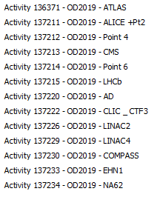
Radiation Areas
IMPACTs
Each Supervised Radiation Area Guide :
Mandatory
Personal dosimeter (passive)
Operational dosimeter (active)
Mandatory
Operationnal dosimeters activated :
  Specific IMPACT
  Each Shift (Beginning 1st guide: activation – End last guide: reset)
Before after each visit : Guides:
  Write down : Name, CERN id, time of the visit and the dose on the dosimeter

Slide 44

Contact
If :
  The dose on the dosimeter >= 3uSv
  Issues with the dosimeters
  Any doubt concerning radiation areas
  Use on an emergency exit going through Supervised Radiation Areas
  Call RP Coordination
  Coordination RP : Meriem Chniba 77999
RP

Slide 45
Reporting – Best practices
In case of doubt about an object or a situation, do not hesitate to report it to the 74444 (00 41 22 767 4444), the guards nearby or PCO (66001 or 66002), depending on the urgency.
→ Do not rely on anyone else to do so.
→ It is better to warn 10 times for nothing than not to do it.
Safety is everyone’s matter!

Slide 47
VOLUNTEERS - Tools

Slide 48
Volunteers - Specific tools
SharePoint cern.ch/od2019/volunteers
  Exhaustive general information for volunteers (access, parking, food choices, roles, etc.)
Volunteers’ platform cern.ch/volunteers
  Your personnal information (assignments, trainings, choice of meals, size, co-volunteers, etc.)
Volunteers App – ODScan cern.ch/odscan (shown at the end)
  Point status updates, internal messages, check-in and bracelet scanning

Slide 49
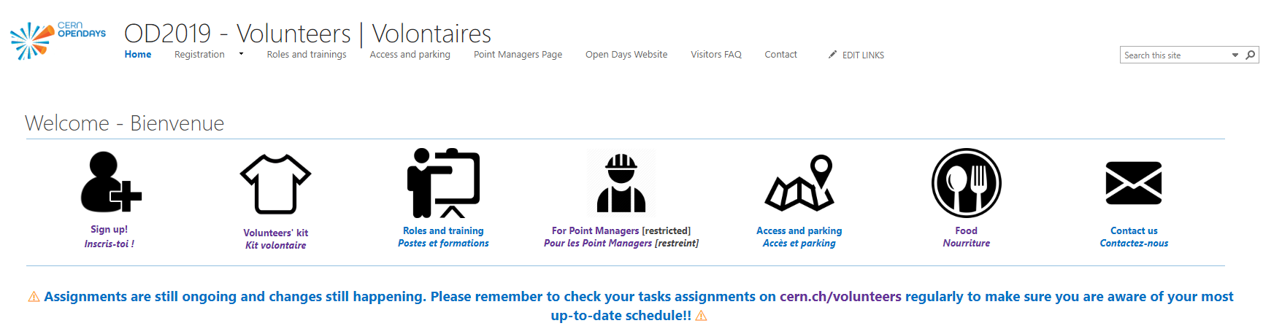
Volunteers - Sharepoint
cern.ch/od2019/volunteers

Slide 50
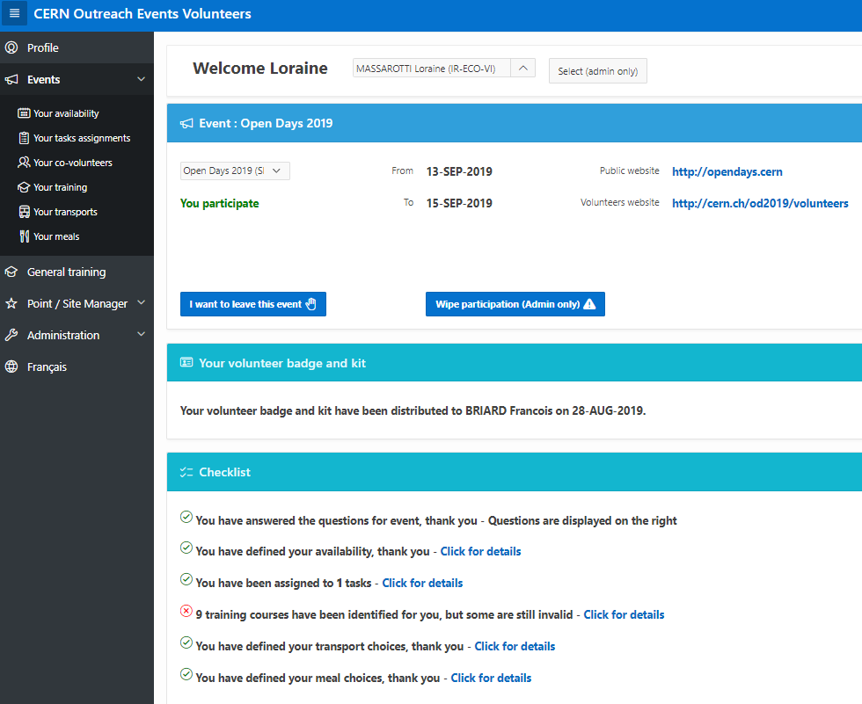
Volunteers - Volunteers’ platform
cern.ch/volunteers
Your personnal information:
assignments
trainings
choice of meals
size
co-volunteers, etc.

Slide 51
VOLUNTEERS - Tasks
You and your role

Slide 52
Volunteers - Shifts
​Friday 13.09.2019 (CERNies afternoon)
  12.30 p.m.- 6.30 p.m.
​Saturday 14.09.2019
  ​7.30 a.m. - 1.30 p.m.
  1.30 p.m. - 7.30 p.m.
​Sunday 15.09.2019
  ​​7.30 a.m. - 1.30 p.m.
  1.30 p.m. - 7.30 p.m.
Shift rotation = critical time
Task should keep on running (even with less volunteers)
Use the App to update waiting time if you are understaffed for a little while
Share good practices with your replacement
Notes:
If doing one shift, we would appreciate your flexibility at this time

Slide 53
Volunteers - Roles
Check-in agent | Welcome visitors, check registrations, distribute access wristbands.
​Gate agent | ​Manage queue, scan the wristbands of incoming and outcoming visitors on sites or activities.
​Crowd marshal | Manage the visitor flow on visit points and waiting areas.
​Supervised areas crowd marshal | ​Manage the visitor flow on visit points and waiting areas located inside supervised areas (thus requiring special safety trainings and equipment).
​OD App updater | ​Report regularly visitor flow information on the mobile app and to Core Team.
Guide | ​​Guide visitors in a visit circuit.
​Supervised areas guide | Guide visitors in a visit circuit located inside supervised areas (thus requiring special safety trainings and equipment).
​​Activity host | Interact with visitors: shows, exhibitions, demonstrations, hands-on, etc.
​Info agent | ​​​Welcome visitors, provide guidance and information: activities, accessibility, location, waiting time, etc.
​Shop assistant | Advise visitors on souvenirs at the Open Days shop.
​Traffic security | ​​Guide vehicles on designated parking areas, inform visitors about special shuttles and control vehicle movements on the sites.
​Logistics helper | ​Help with general organisation.
​Work well feel well | ​Replace other volunteers during their breaks (help with food and drinks), assist them in case of problems or overflowing situations.
Notes:
Insister sur work well, logistics helpers, info, ODApp.

Slide 54


Volunteers’ assignments
Task
Point/Activity
Availability
Role

Slide 55
Assignments are ongoing!!
Assignments are never definitive!! Check them regularly until the D-day
Why?
Many request for assignment changes
Changes have consequences on other volunteers assignments (as well as on trainings and lunch pack distribution)
→ Please be flexible and try to accept what was proposed

Slide 56
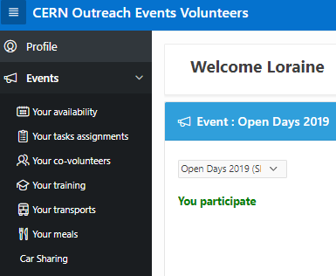
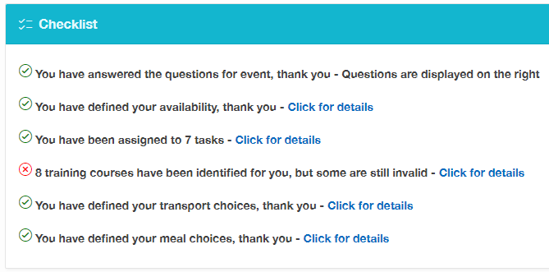
Where to find your assigned tasks?
  http://cern.ch/volunteers > Your tasks assignments

Slide 57
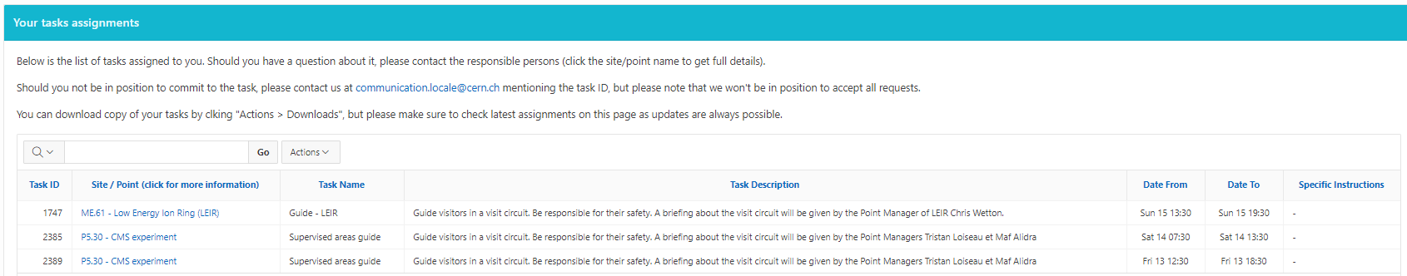
Understanding your task(s)
Where?
Activity code
What?
Task description
When?
Shift

Slide 58
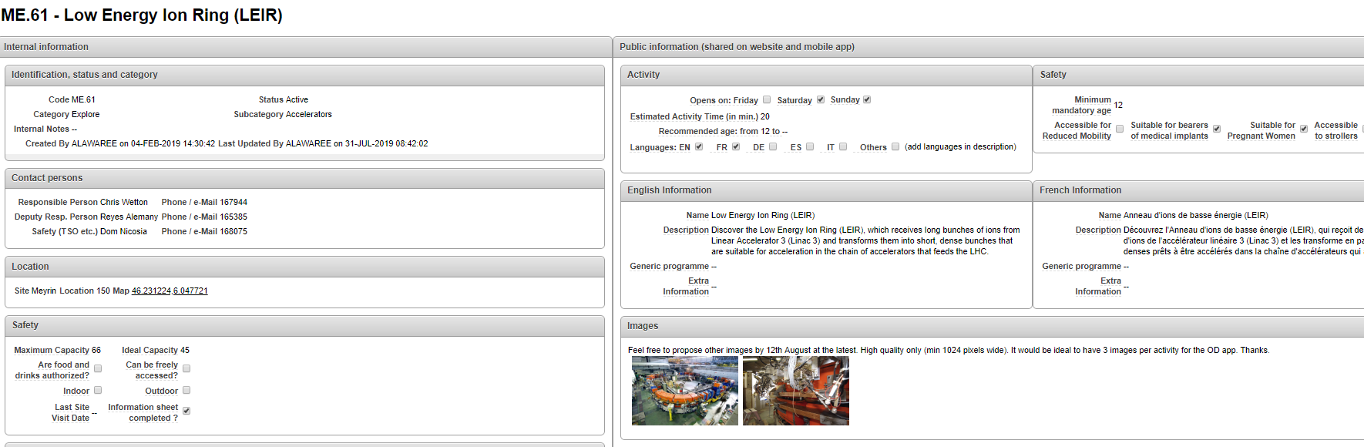
Activity - Location, description and Point Manager
Activity description + conditions
Activity/Point manager
Activity/task
Location

Slide 59
Your Site / Point Manager
Responsible for your visit point
Contact person in case of problems/questions
Provides you with specific information about your task (non exhaustive)
  time and location for arrival on the point
  provision of reflective vest (if applicable)
  specific circuit
  emergency evacuation plan
  break area, lockers, etc.

Slide 60
Safety training – LMS (CERN Learning Hub)
OD2019 catalogue available on lms.cern.ch
Training proposed in 2 formats:
  e-Learning (online)
  Workshop / Seminar (with given dates)
Might be mandatory for all, or related to assigned tasks
→In case of a question, contact meriem.chniba@cern.ch

Slide 61
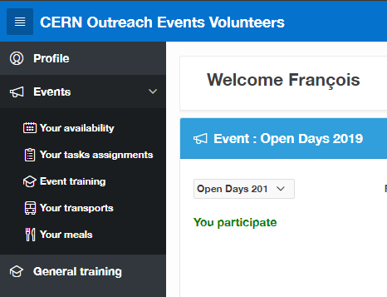
Where can you get your training needs?
http://cern.ch/volunteers

Slide 62
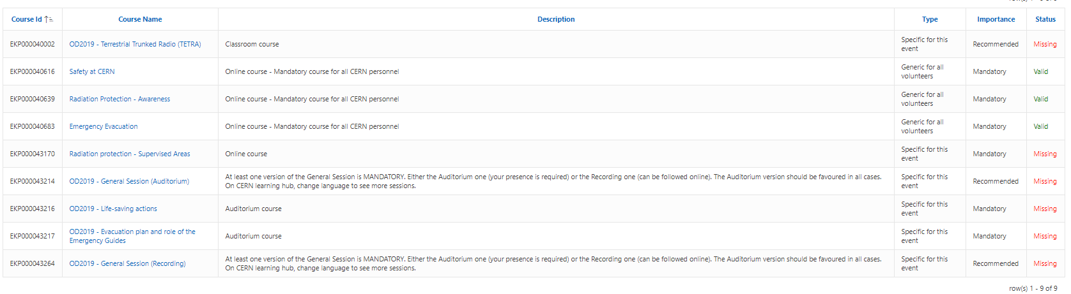
Your training(s)
In case of a question, contact meriem.chniba@cern.ch
We are aware of an issue with the sync between LMS and the Volunteers’ platform. The correct information is the one on lms.cern.ch

Slide 63

Volunteers - Mission
Welcome
Guide
Provide info
Orientate
Share your passion
Safety first!

Slide 64
VOLUNTEERS - Outfit

Slide 65
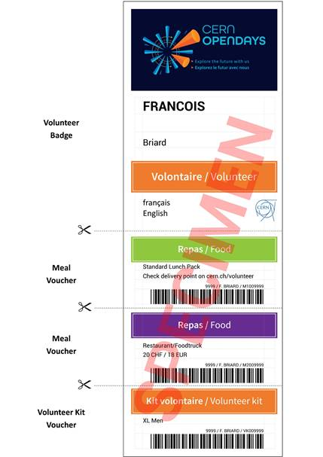
Volunteers’ name badge
Mandatory to access the sites as a volunteer
Holds:
  your choice of meals
  the coupon to collect your volunteer’s kit

Slide 66




Volunteers’ kit
Must be worn at all times during assigned shifts (please remove once shift is over)

Slide 67
Where to collect your badge and kit?
Where? Building 73
When? By batches until Wednesday 11 September
What time?
7.30 a.m. to 12noon
1.00 p.m. to 4.00 p.m.

Slide 68
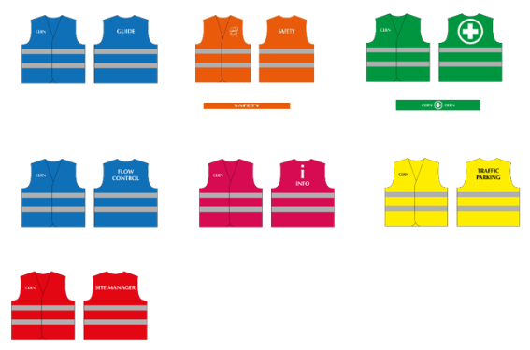
Volunteers’ vests
Some volunteers will need wear a reflective vest to be easily identified.
Same color code for all volunteers.
These will be distributed to you by your Point Manager.
→ Remember to leave your vest at your point before leaving your shift!
Flow control
Guide
Info
Traffic parking
Science. Questions?

Slide 69
Volunteers – Lunch options
Vouchers : to be used at Novae restaurants or food trucks (indicated on CERN Open Days App).
Pre-ordered standard / vegetarian packed lunch: to be picked up at R1, R2 or R3 between 7 a.m. and 3 p.m. on the day of your assignment, depending on your assignment location. → Check cern.ch/volunteers > Events > Your meals
What about asking one volunteer per point to go pick-up your lunch packs ? Give them your lunch ticket and he/she will collect it for the group!
Make sure to get organised among yourselves to never leave your task unmanned.
Notes:
Know that vouchers got distributed based upon availabilities on the day of printing. If you received 2 vouchers but end up volunteering one day only, please be honest and only use one!

Slide 70
VOLUNTEERS – Access and parking

Slide 71
Volunteers – Access and parking
Road closures apply to visitors and volunteers… but so do shuttles and mini-trains!!
Access by car
Volunteers doing two shifts per day: opportunity to enter the sites and park anywhere if arrival before 7.45 a.m. and departure after 7.30 p.m.
Volunteers doing one shift should use designated volunteer parking areas or use visitors shuttles
→ Details per site on cern.ch/od2019/volunteers

Slide 72
Volunteers – Access and parking
Car sharing (highly encouraged)
Find who is doing the same task, on the same point, at the same time as you and check their mean of transport and departure point
  → If they are coming by car, feel free to contact them
  If not, LHC Site Managers have access to the transportation information of all volunteers on his/her site
Don’t forget to update your transport means on the Volunteer platform once you’ve found a lift.
→ Details on cern.ch/od2019/volunteers

Slide 73
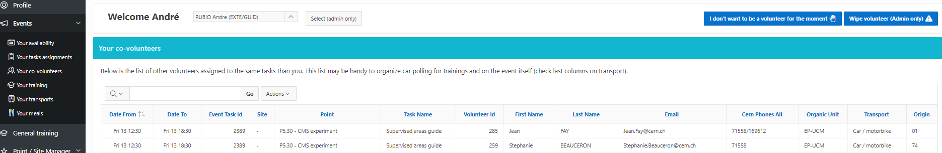
Volunteers – Access and parking
Car sharing to access LHC sites (highly encouraged)

Slide 74
Volunteers – Access and parking
Bicycles
Bicycles’ parkings for the volunteers = same as for the visitors.
Not allowed to circulate with bicycles inside the sites between 7.45 a.m. and 7.30 p.m.
Visitors shuttles
To change points/sites during visitors opening hours use the buses, shuttles and mini-trains.
All details available on cern.ch/od2019/volunteers > Access and parking

Slide 75
OD Scan

Slide 76
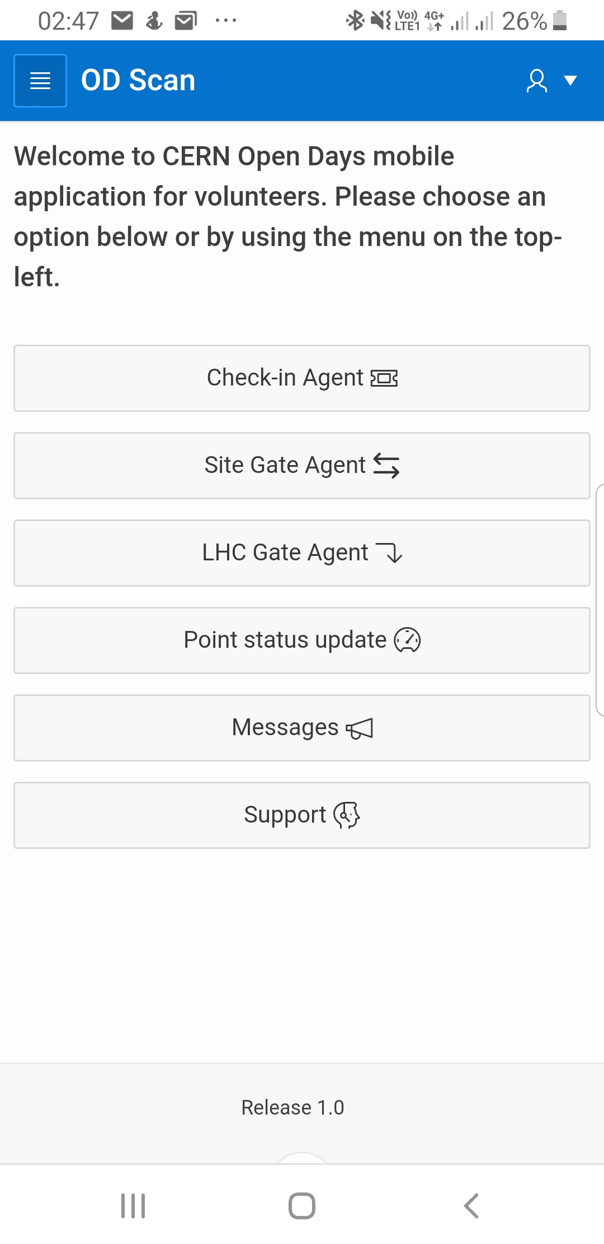

Volunteers - ODScan
cern.ch/odscan with your CERN login
Web application (no installation needed)
Internet required
Does not run on Safari (MacOSX, iOS)
Try an alternative browser (Chrome etc)

Slide 77
ODScan
3 functions for Check-In and Gate Agents
(will be presented at the end of this session)
2 functions of interest for everyone

Slide 78
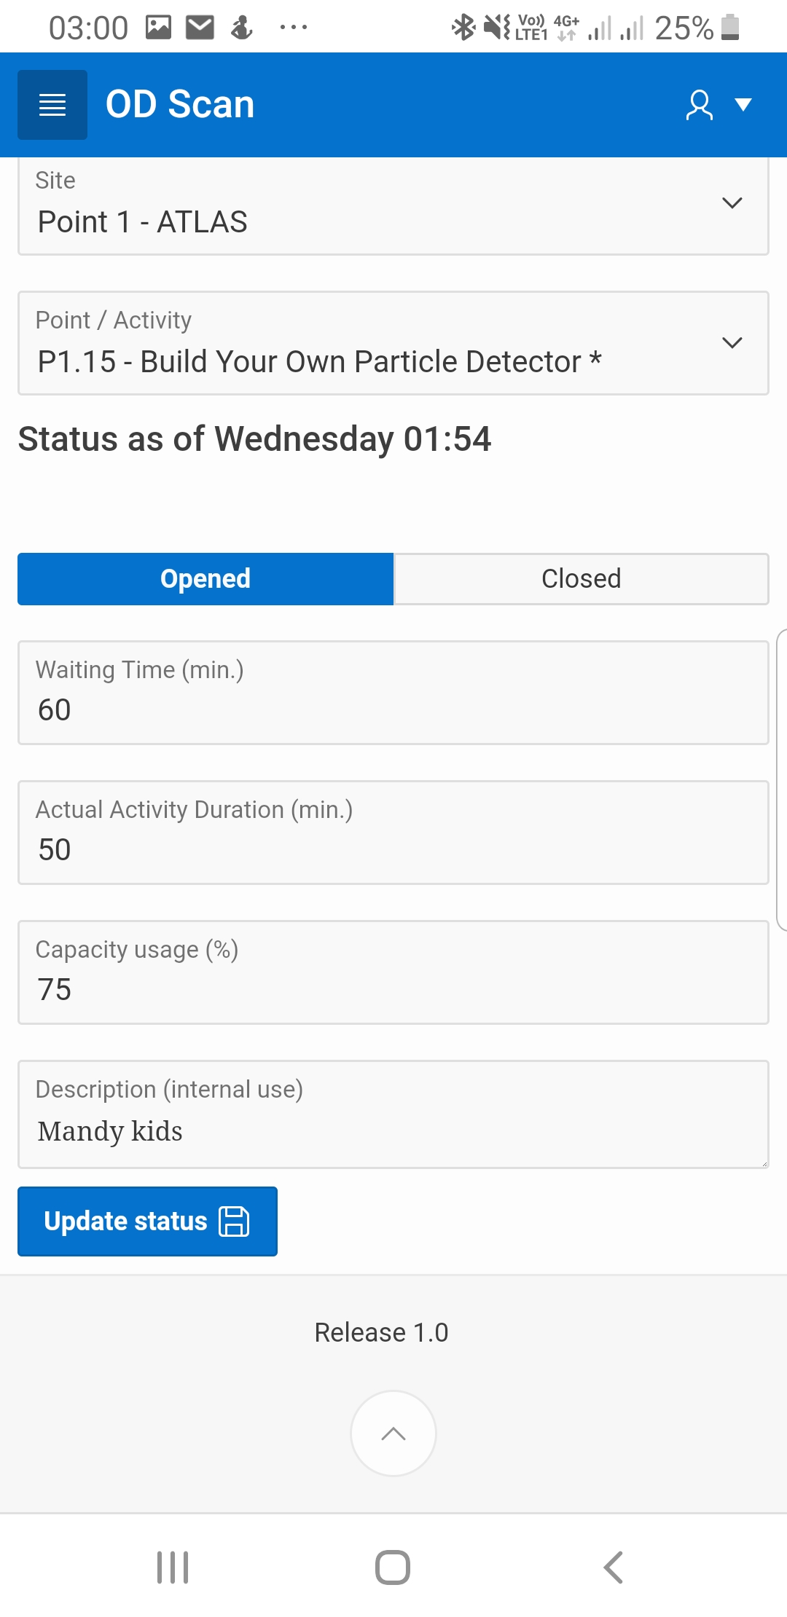
Point Status Update
Allows any volunteer to communicate:
if a point is opened or closed
its waiting time (min)
its actual activity duration (min)
its capacity usage (%)
any other comment
This information is pushed to public app!

Slide 79
Messages
Allows any volunteer to
communicate any information of general
interest linked or not to a point.
Some messages may be made public.
Don’t misuse messages instead of status:
We have too many people !
Send us visitors !

Slide 80
Some more links and tips

Slide 81
Before your shift
Don’t bring any valuable items with you other than what you need for your task
Remember to wear your badge and volunteer kit
Familiarize yourself with the information available
  About CERN Open Days: opendays.cern, CERN Open Days App
  About CERN

Slide 82
Open Days - Useful links
Open Days - Visitors
opendays.cern
opendays.app.link/app
→ Download the public App!
Open Days – Volunteers Specific
SharePoint cern.ch/od2019/volunteers
Volunteers’ platform cern.ch/volunteers
Volunteers App – ODScan cern.ch/odscan

Slide 83
About CERN - Useful links
Selection of photos and videos about CERN classified by topics https://home.cern/resources-topic
LHC the guide – faq: https://home.cern/resources/brochure/accelerators/lhc-facts-and-figures
https://home.cern/resources/faqs - Q & A on frequestly asked questions from the public (dangerous? how to visit? Future? God? Black holes?)
CERN IT in 8 minutes - https://videos.cern.ch/record/1604210
HiLumi Fact sheet: http://hilumilhc.web.cern.ch/sites/hilumilhc.web.cern.ch/files/HiLumiFactsheet_final.pdf

Slide 84
After your shift
Share good practices with your replacement (if applicable)
Leave your vest on your point (or give it to your replacement)
Take off your volunteer outfit

Slide 85
Thank you!
You are taking part in a unique event
Take advantage to meet new colleagues
Share your passion with our visitors
The Open Days wouldn’t be possible without you

Slide 86
Open Days Volunteer Survey
Before 14 September http://cern.ch/go/x77B
Explores the communication aspects of the Open Days as well as the overall experience for both visitors and volunteers.
Second complementary survey after the Open Days
→ Your participation is precious - it helps us to improve CERN's future public events!

Slide 87
Questions?

