Slide 1
Manufacturing Process Modelling (MPM)
Ramentor R&D for TAU-CERN-BF co-innovation project
Videoconference 2019-09-17
Jussi-Pekka Penttinen

Slide 2
Ramentor MPM – Background
Ramentor is a private software/expertise company
  Founded in 2006, based in Tampere, Finland
  Solutions for reliability engineering and risk management
In 2014 Ramentor joined FCC Study consortium
  ELMAS software was used for CERN LHC availability modelling
  2016–2018 Ramentor developed in co-operation with CERN and TAU a new approach (OpenMARS) for complex analyses
  Currently the new approach is tested for FCC-ee operation modelling and identification of critical systems (arto.niemi@cern.ch)

Slide 3
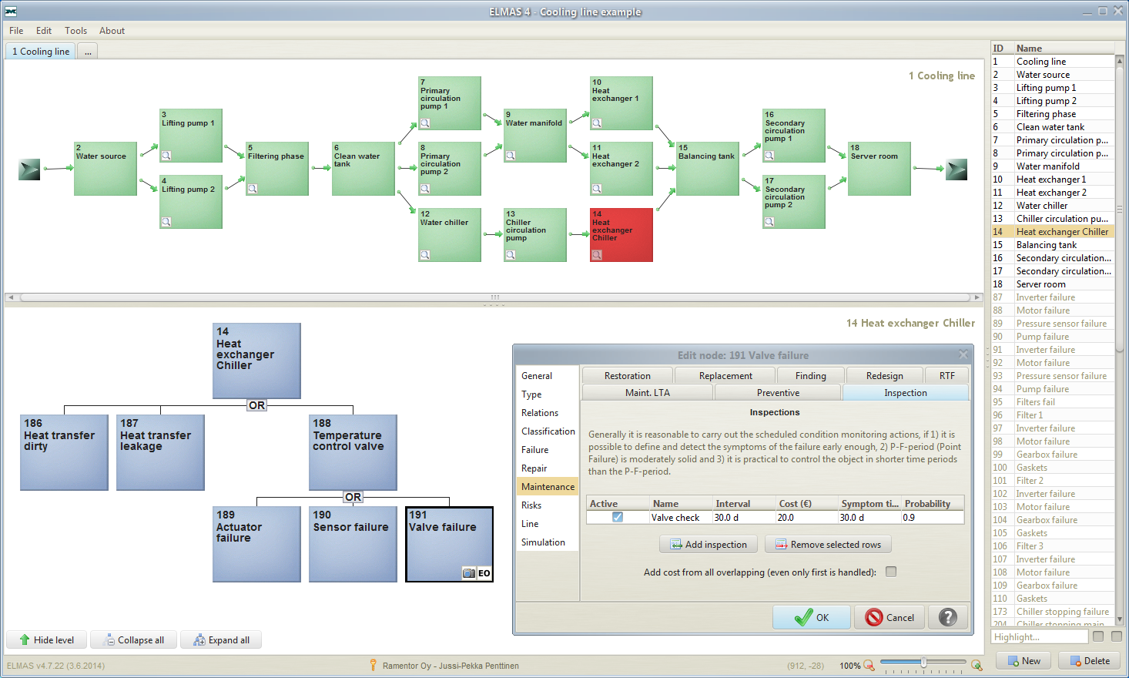
ELMAS 4.9
http://www.ramentor.com/elmas/
Model process functions (RBD)
Primary cooling circulation - Water
Secondary cooling circulation
Water filtration
Primary cooling circulation - Chiller
Model failures of the selected system (FTA)
All items of the model listed
Input data for the selected component

Slide 4
Ramentor MPM – Three phases for R&D
Define a new approach for MPM
  The approach should enable including capacities, resources, failures, delays, quality aspects and other essential features
  Assess/analyse manufacturing process' key performance indicators (KPI)
Specify interfaces between MPM and MES/ERP
  Enables system providers to integrate MPM into their MES/ERP
Evaluate the benefits of applying the new MPM
  Case: CERN's superconducting magnet manufacturing process

Slide 5
Ramentor MPM – Extends OpenMARS

Slide 6
Ramentor MPM – OpenMARS documents
Modelling Future Hadron Colliders’ Availability for Physics
  Dissertation: http://urn.fi/URN:ISBN:978-952-03-1057-8
  PARB journal: https://doi.org/10.1103/PhysRevAccelBeams.19.121003
An open modelling approach for availability and reliability of systems - OpenMARS
  RESS journal: https://doi.org/10.1016/j.ress.2018.11.026
  Preprint: https://cds.cern.ch/record/2649261
  Specification: https://cds.cern.ch/record/2302387

Slide 7
Ramentor Oy

