Slide 1



R&D on Experimental Technologies
WP8
Detector Magnet R&D
Herman ten Kate and Benoit Cure
EP R&D day, October 24, 2019

Slide 2
WP8 Detector Magnet R&D
Organization
WP8 leader: Herman ten Kate
Deputy: Benoit Cure
Proposed supervisors of Fellows and Students :
Matthias Mentink
Alexey Dudarev
Team effort from:
EP/DT for instrumentation
TE/CRG and TE/MPE, respectively, for magnet cryogenics and protection.

Slide 3
WP8 Detector Magnet R&D
Scope
To stay within the budget constraints:
Scope was revised wrt proposals described in last EP R&D workshop.
Activities were re-organized and some delayed to a later stage of the R&D program, typically from 2025 onwards.

Slide 4
WP8 Detector Magnet R&D
Proposals from Working Group 8:
8.1 Advanced Magnet Powering for High Stored Energy Detector Magnets,
8.2 Reinforced Super-Conductors and Cold Masses,
8.3 Ultra-Light Cryostat Studies,
8.4 New 4-Tesla General Purpose Magnet Facility for Detector Testing,
8.5 Innovation in Magnet Controls, Safety Systems & Instrumentation.

Slide 5
WP8 Detector Magnet R&D
Final activities, scope for WP8 in years 2020-2024:
8.1 Advanced Magnet Powering for High Stored Energy Detector Magnets,
8.2 Reinforced Super-Conductors and Cold Masses,
8.3 Ultra-Light Cryostat Studies,
8.4 New 4-Tesla General Purpose Magnet Facility for Detector Testing,
8.5 Innovation in Magnet Controls, Safety Systems & Instrumentation.
Modifications:
8.1 Scope reduced: activity on HTS Busbars delayed to a later stage of the EP R&D program.
8.2 Delayed to next R&D step after 2024.
8.3 Integrated into WP4 work plan.

Slide 6
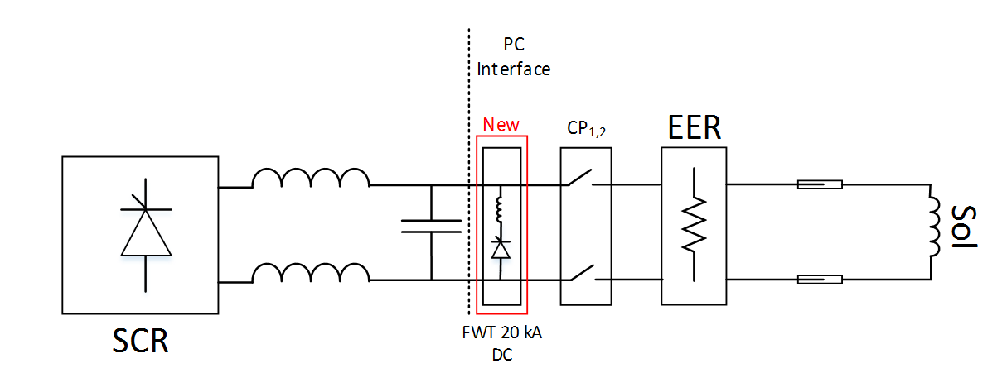
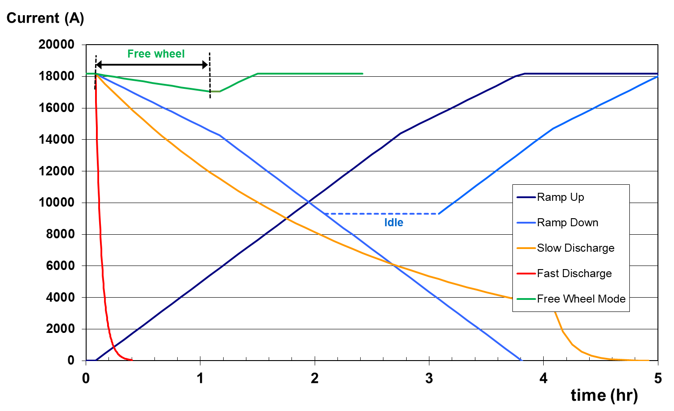
WP8 Detector Magnet R&D
WP 8.1
Advanced Magnet Powering for High Stored Energy Detector Magnets
Studies will cover:
1) Magnet Powering and Protection Circuit (including dump units),
2) Free Wheel System (FWS) and Persistent mode Current Switch (PCS),
3) Energy Extraction Studies and Quench Protection.
Applied to the 4-T General Purpose test facility study, as user case (WP8.2).
Participation to the CMS FWT system commissioning end of LS2
Silicon Controlled Rectifier
Energy Extraction Resistor

Slide 7
WP8 Detector Magnet R&D
WP 8.1
Work plan
Year | Deliverable | Milestones | Fellow (per year) | Student (per year)
2020 | Feasibility Study of Magnet Powering Modes. Recent Technology Study Report based on literature research. | Review of options and study report finished. | 0.5 | 1
2021 | Technical Requirements Report and CDR based on Simulation and model R&D. Selection of demonstrators. | Technical requirements and Conceptual Design of system and demonstrators finished. | 0.5 | 1
2022 | Technical design and Engineering Report. Construction of demonstrator models and testing. | Technical design finished and construction of demonstrators in progress. | 0.5 | 1
2023 | Continued R&D on demonstrators and testing. | Test report of demonstrators. | 0.5
2024 | Final report. | Final report, evaluation, outlook and conclusion. | 1

Slide 8
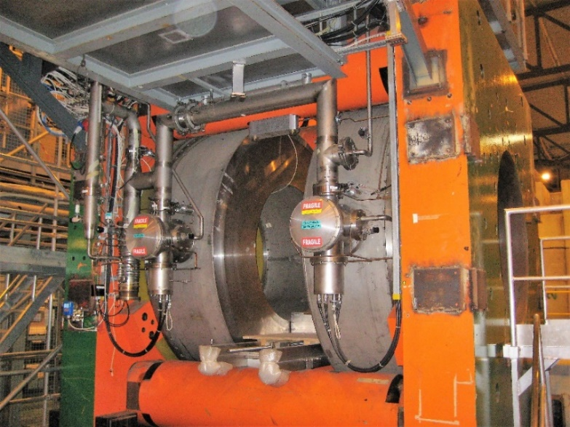
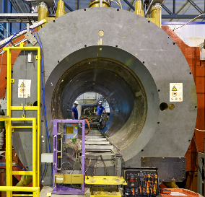
WP8 Detector Magnet R&D
WP 8.4
New 4-Tesla General Purpose Magnet Facility for Detector Testing
Design of a 4-T magnet for a beam test facility, in view to complement and eventually replace in the future the aged facilities now available at CERN.
The design will include the technologies proposed in WP8.1 and WP8.3.
High field beam line facilities now at CERN
CMS-M1 (3T)
Morpurgo (1.9T)

Slide 9
WP8 Detector Magnet R&D
WP 8.4
Work plan
Year | Deliverable | Milestones | Fellow (per year) | Student (per year)
2020 | Magnet design | Magnet conceptual design report | 0.5
2021 | Magnet subsystems design and integration: powering circuit, cryogenics, vacuum, cryostat, yoke, support system. | Magnet Technical Specification and drawings. | 0.5
2022 | Demonstrators testing, control, instrumentation, powering. | Final report Design and Technical Specification. | 0.5
2023
2024

Slide 10
WP8 Detector Magnet R&D
WP 8.5
Innovation in Magnet Controls, Safety Systems & Instrumentation
Three domains of study:
Quench protection: fast detection, sensitivity, low voltage;
Magnet controls : requirements, identification of future systems;
Instrumentation: magnetic measurement, interfaces CAN FD.
Applied to the 4-T magnet beam test facility to test and qualify these systems.

Slide 11
WP8 Detector Magnet R&D
WP 8.5
Work plan
Year | Deliverable | Milestones | Fellow (per year) | Student (per year)
2020
2021 | Report on future needs for magnet control systems. | Definition of future needs for control systems, interfaces, instrumentation. Survey of the developments in industry. | 0.5 | 1
2022 | Conceptual design, simulations, prototyping of new control systems and instrumentation. | Conceptual design completed. | 1 | 1
2023 | Simulation and validation tests. | New controls and instrumentation validated. | 1 | 1
2024 | Final report. | Final report submission. | 0.5

Slide 12
R&D on Experimental Technologies
Conclusion
Resources confirmed: 7.5 fellow-year and 6 student-year over period 2020-2024.
Driving prioritized work: design of the 4-T magnet beam test facility.
Fellows and Students assignments:
mostly charged with design studies and prototyping,
integrated into the EP magnet team, they will benefit hands-on examples and experiences from ATLAS, CMS, North Area magnets on-going upgrades and future CLIC & FCC developments.

