Slide 1
pyAWAKE
THE AWAKE ANALYSIS LIBRARY
AMAN SINGH THAKUR
SPENCER GESSNER

Slide 2


GOOGLE SUMMER OF CODE
Google Summer of Code Program links interesting open sourced problem statement to capable students.
One of the most prestigious competitions in the world. Every project receives funding and global recognition.
CERN-HSF is the open sourced umbrella organization participating in GSoC every year.

Slide 3
GOOGLE SUMMER OF CODE
In 2019, CERN-HSF has 38 projects with 30 organizations. It is hosting about 33 interns out of ~1100 interns selected all over the world.
The complex problem statement of building a AWAKE analysis library was developed by my mentors Spencer Gessner and Marlene Turner.
Out of 7,555 proposals submitted across 103 countries, 45 proposals were submitted on the problem statement of AWAKE out of which my proposal was accepted.
As part of internship I’ll be working with Spencer and Marlene from roughly May-September to deploy a stable python based analysis tool for AWAKE..

Slide 4
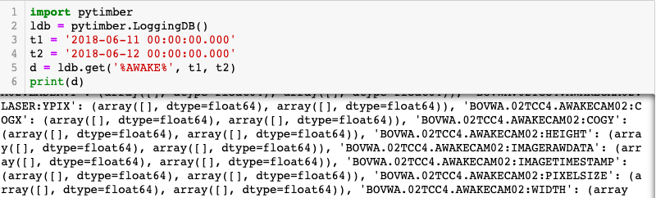
PREVIOUS WORK
Previously, pyTimber library and AWAKE Analysis Tools were used for performing data logging and analysis on data discovered by AWAKE.
pyAWAKE would be a new library inspired from pyTimber and AWAKE_ANALYSIS_TOOLS to create a new database engine as well as provide tools for data analysis.

Slide 5
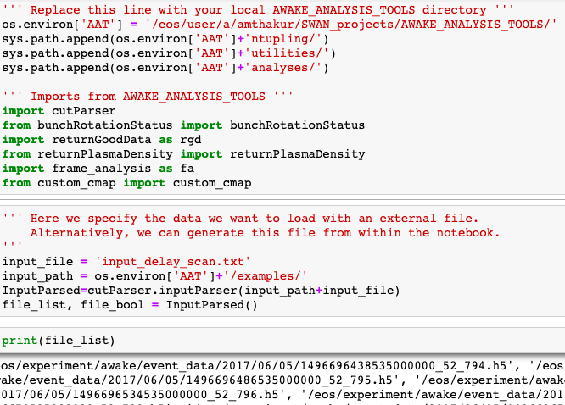
AWAKE
ANALYSIS TOOLS

Slide 6
OBJECTIVES
To read about 12TB of data created during 2017-18 experimental run and create a faster and simpler AWAKE database.
To supply API for Indexing as well as Searching images or datasets.
Provide capability to visualize one or many datasets.
Using NumPy, SciPy and Matplotlib for data analysis and visualization.
Porting existing analysis done by Awake Analysis tools.
Encapsulate in a library structure and provide example notebooks.

Slide 7
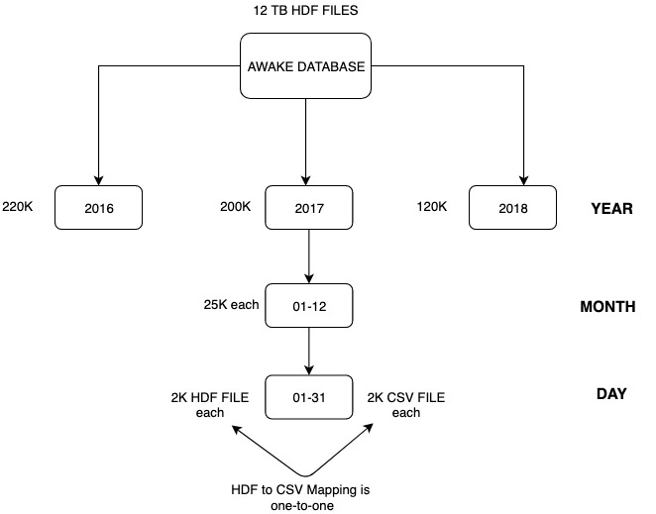
AWAKE DATABASE STRUCTURE

Slide 8


INDEXING PROCESS
In first attempt, we used a multi-threaded python program to create CSVs.
For 12TB data, it would have taken 30 days to index which was not feasible.
In Second attempt, we used CERN-IT team’s help in deploying the program on SPARK technology under SWAN service.
With the help of head of SPARK division Mr. Prasanth Kothuri and Mr. Piotr Mrowczynski, we ported the code as well as fine tuned the SPARK to accommodate the program.
Using utmost 256 nodes, The whole process now runs in 3 hours ideally.
The indexing for year 2017-18 is done and testing has begun.

Slide 9
SEARCHING PROCESS AND VISUALIZING
Enter Dataset value and/or comment value with Timestamp Range
User selects dataset and loads all CSV with dataset value in timestamp
Datasets loaded can be visualized in movies and graph
Start
<1 sec
25 ms/file
2 sec/file
<1 sec
Looks for substrings in caches and loads all related datasets
User gives range of datasets to load

Slide 10
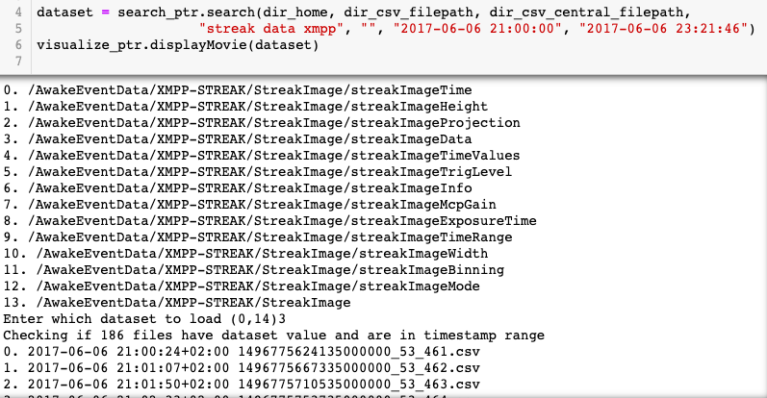
SEARCHING PROCESS AND VISUALIZING

Slide 11

STREAK DATASET VISUALIZED USING AWAKE ANALYSIS TOOLS AND pyAWAKE

Slide 12
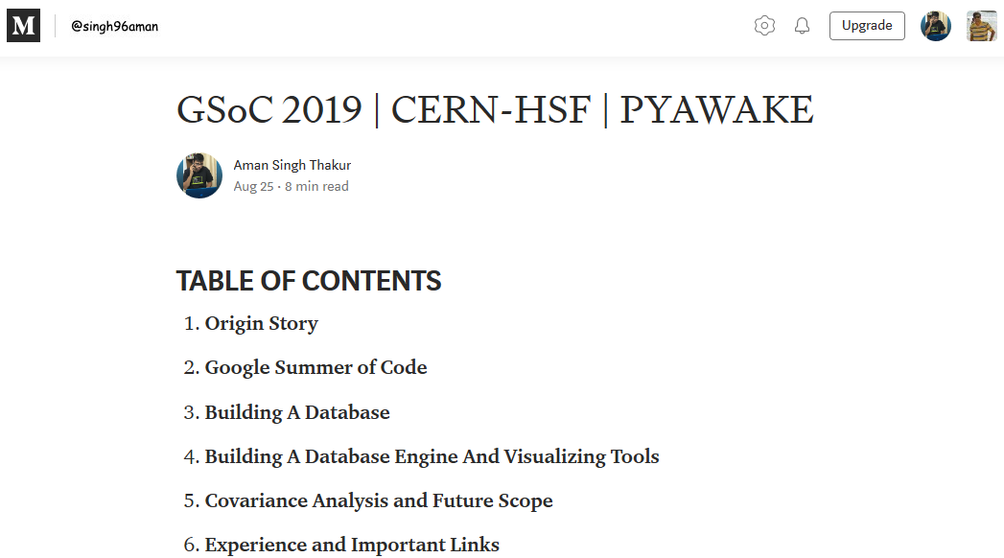
Deploy and Publish

Slide 13
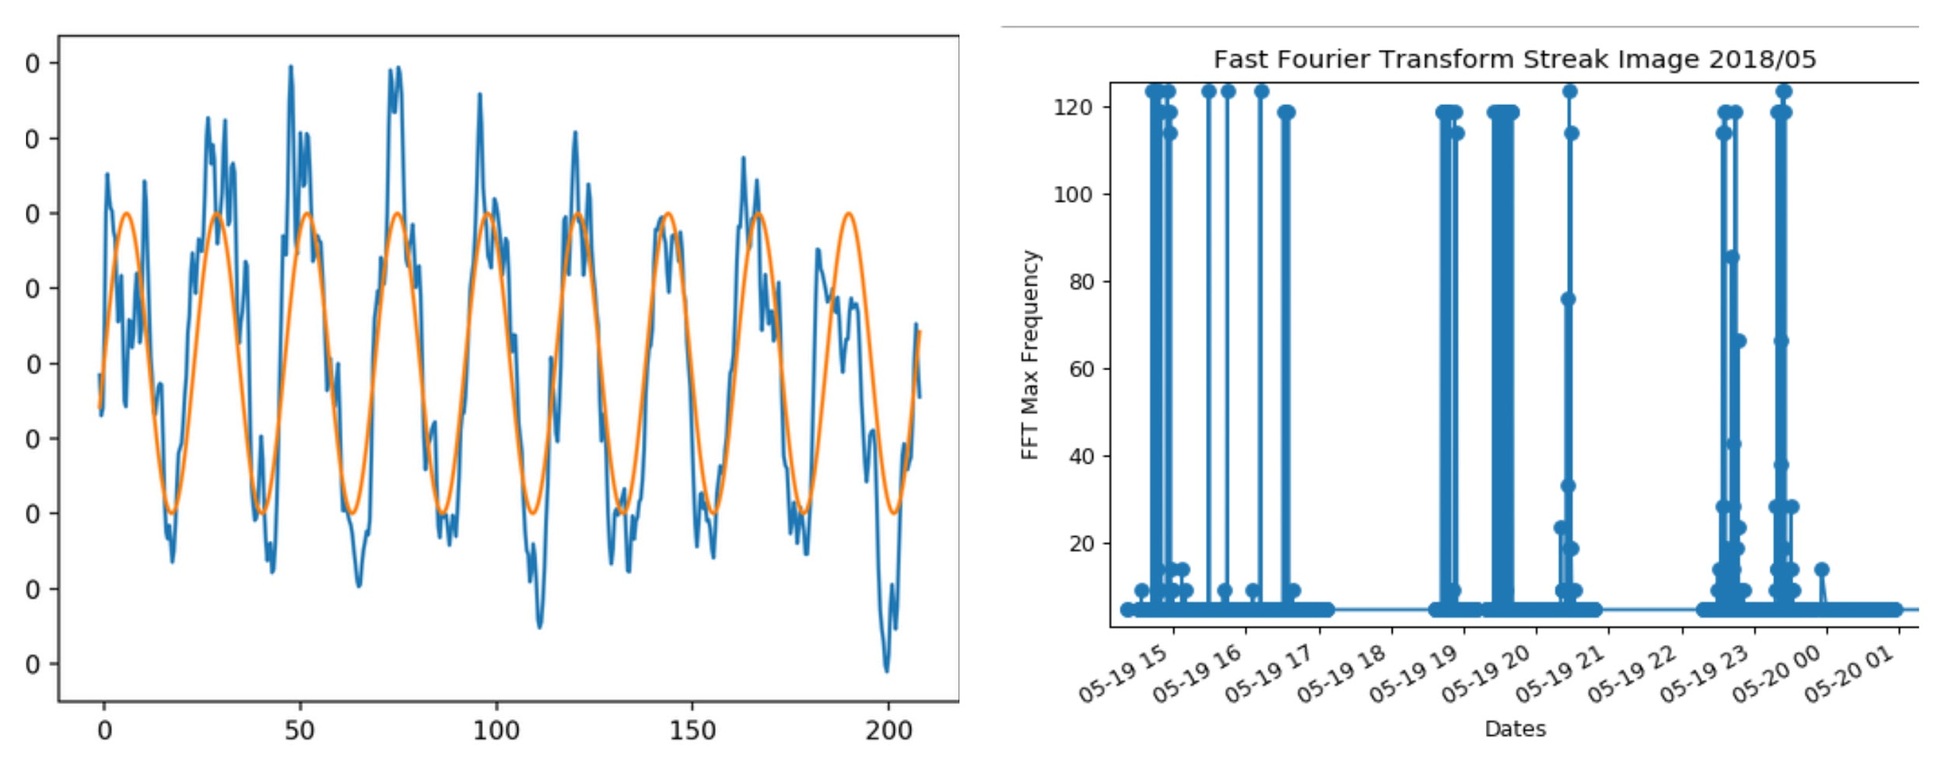
Streak Covariance Analysis

Slide 14
THANK YOU

