Slide 1

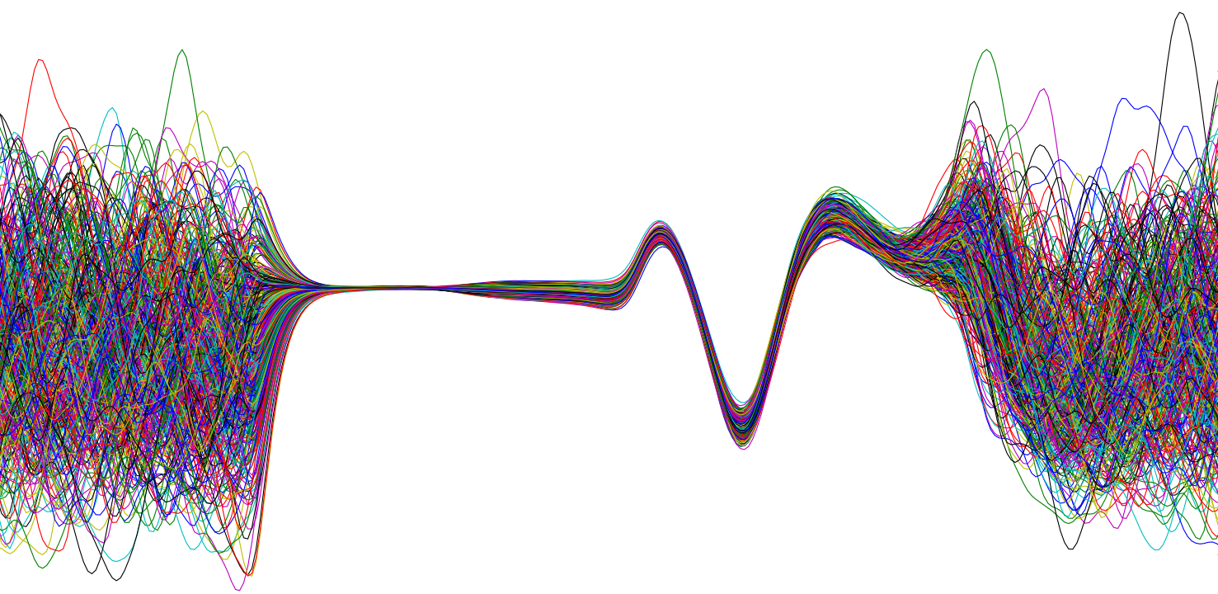
SPS BPM system renovation
Status review
September 2019

Slide 2
Outline
Status and planning in January Vs. today
Reviewed planning till the end of LS2
  Installation
  Development of the interlock system
  Dry runs
System performances as from the production batch

Slide 3
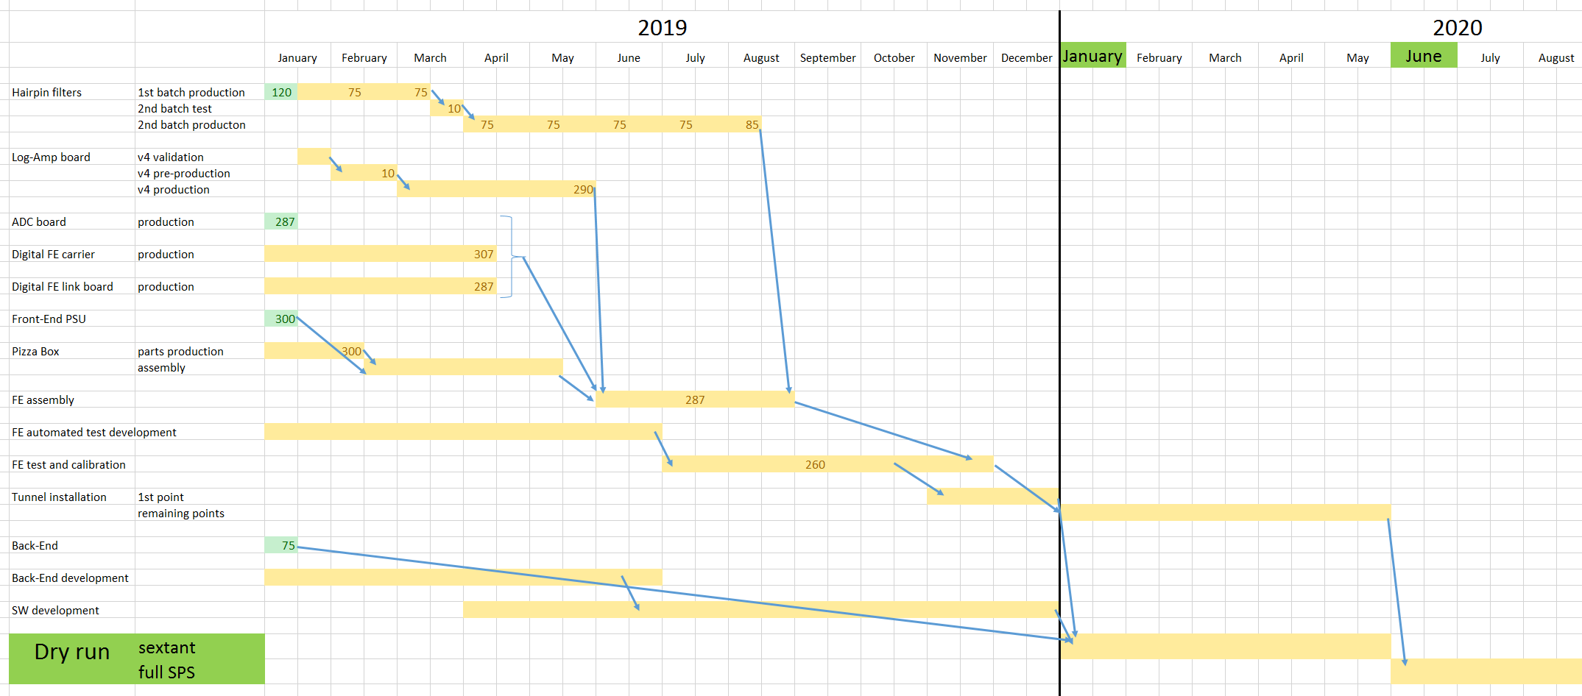
Status and planning in January

Slide 4
Status of the production today

Slide 5
Status of the production today

Slide 6
Status: Hairpin filters
350 at CERN: 100 paired and 50 pizza boxes assembled
100 to come by the end of September
150 expected in November
No impact of the 1st sextant installation
End of installation postponed to September from June

Slide 7
Status: Hairpin filters
350 at CERN: 100 paired and 50 pizza boxes assembled
100 to come by the end of September
150 expected in November
No impact on the 1st sextant installation
End of installation postponed to September 2020 (was June)

Slide 8
Status: Pizza Boxes
All the boxes produced and equipped with PS
50 fully assembled
Remaining ones waiting for hairpin filters….

Slide 9
Status: Automated test bench
Hardware set up finalized but with some delays
Delay due to review of calibration procedures/fitting algorithms that have been just recently approved

Slide 10
Status: Automated test bench
Hardware set up finalized but with some delays
Delay due to review of calibration procedures/fitting algorithms that have been just recently approved
No impact on production: 1st 50 can be manually tested

Slide 11
From now to LS2 end: installation and dry runs

Slide 12
Planning till the end of LS2
1st sextant installation by the end of 2019 (unchanged)
Dry runs can start Early 2020 (unchanged)
End of production delayed by 3 months (no impact on general planning)
  End of installation potentially moved to end of September 2020
  Full accelerator dry runs possible from October 2020
Interlock functionality implemented in the FPGA/FESA early 2020
  Test starting in spring 2020

Slide 13
Planning till the end of LS2: dry runs
Sextant dry run : Jan-March 2020
  Validation of FESA JASP integration
  Validation of logging
  Validation of the various acquisition modes
    FIFO
    Injection trajectory
    Orbit
    Trajectory
Interlock tests: May-June 2020
  Validation of the BIS connections
Full SPS dry run : October-December 2020
  Points synchronization
  Full data logging

Slide 14
What we can emulate in dry runs

Slide 15
Performances as from the production batch

Slide 16
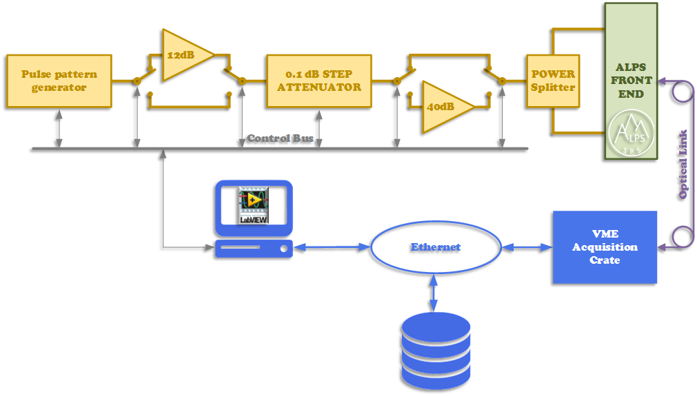
Calibration procedure and limits

Slide 17
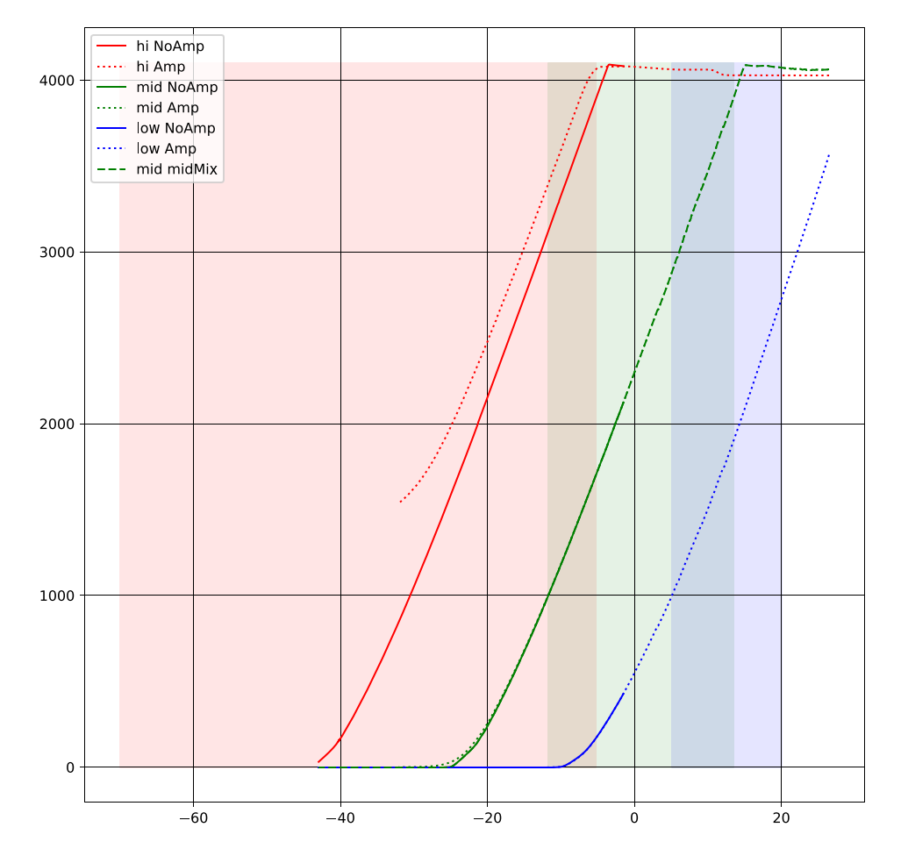
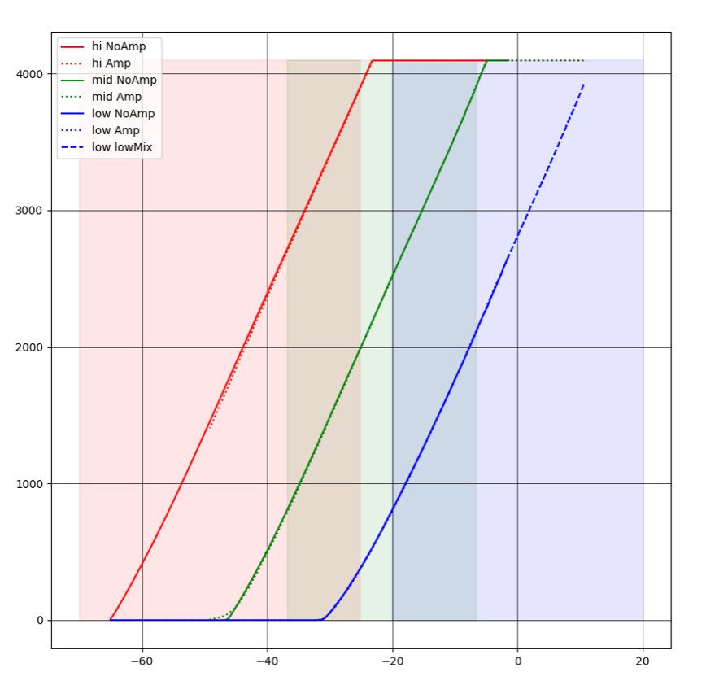
Calibration procedure and limits
ADC counts
Single bunch
5ns train

Slide 18
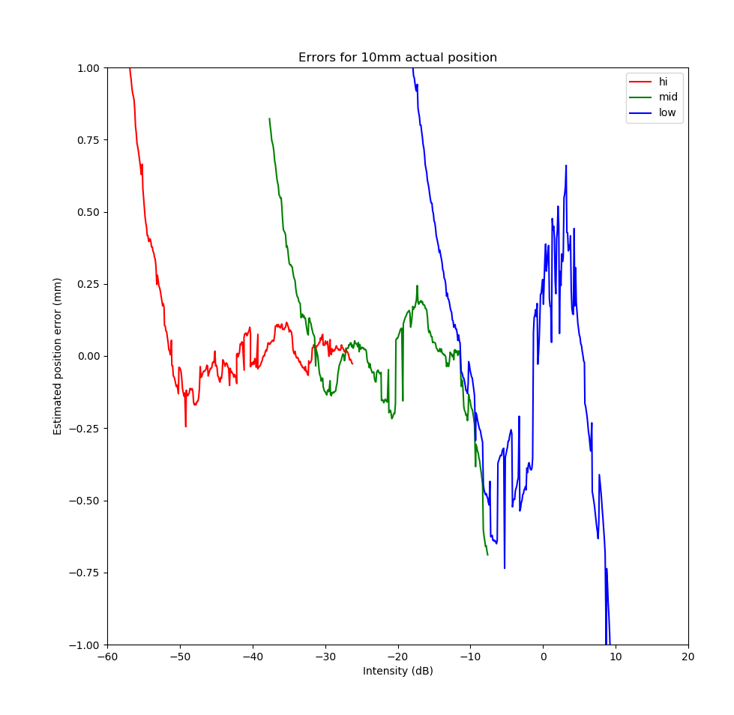
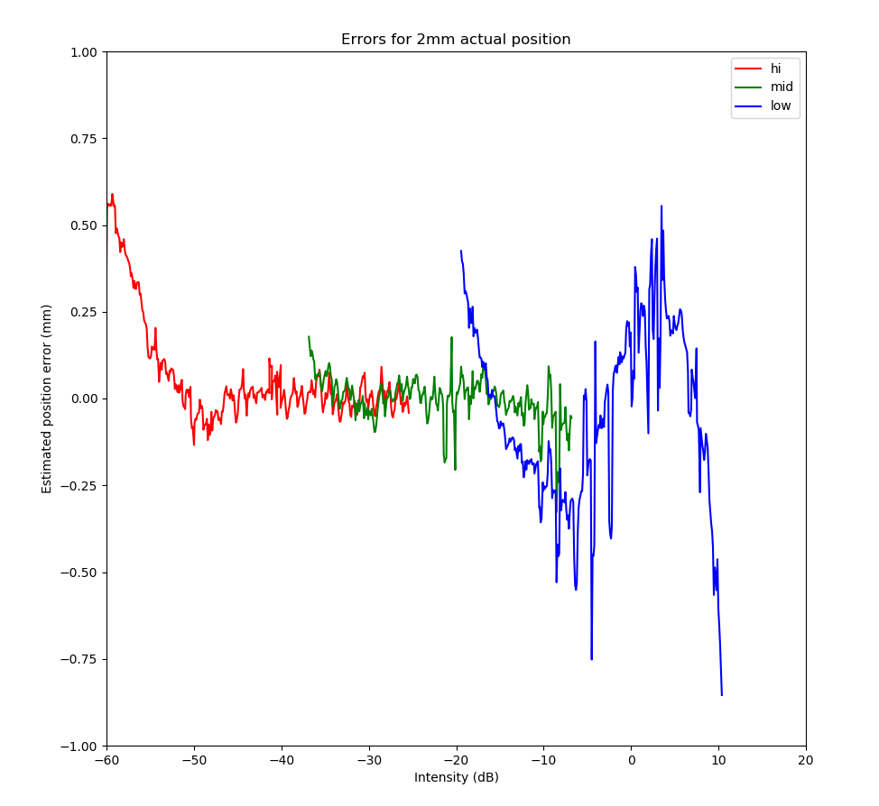
Multi bunch: results (5ns)
2mm displacement
10mm displacement
1e9
1e10
1e11
1e9
1e10
1e11

Slide 19
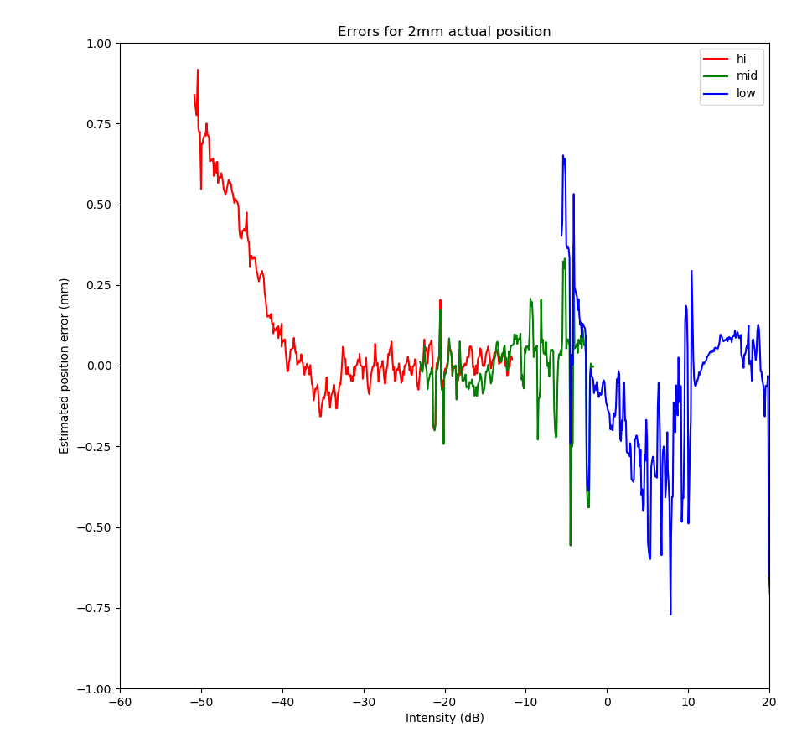
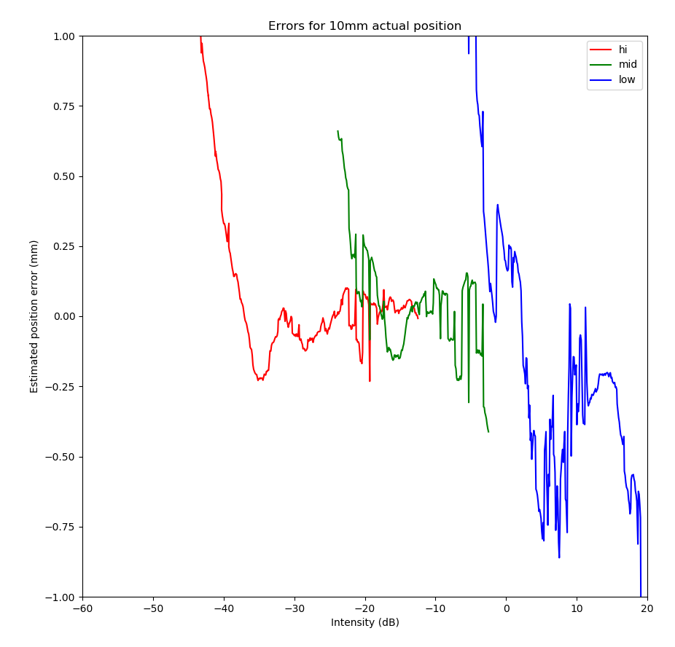
Multi bunch: results (25ns)
1e9
1e10
1e11
1e9
1e10
1e11

Slide 20
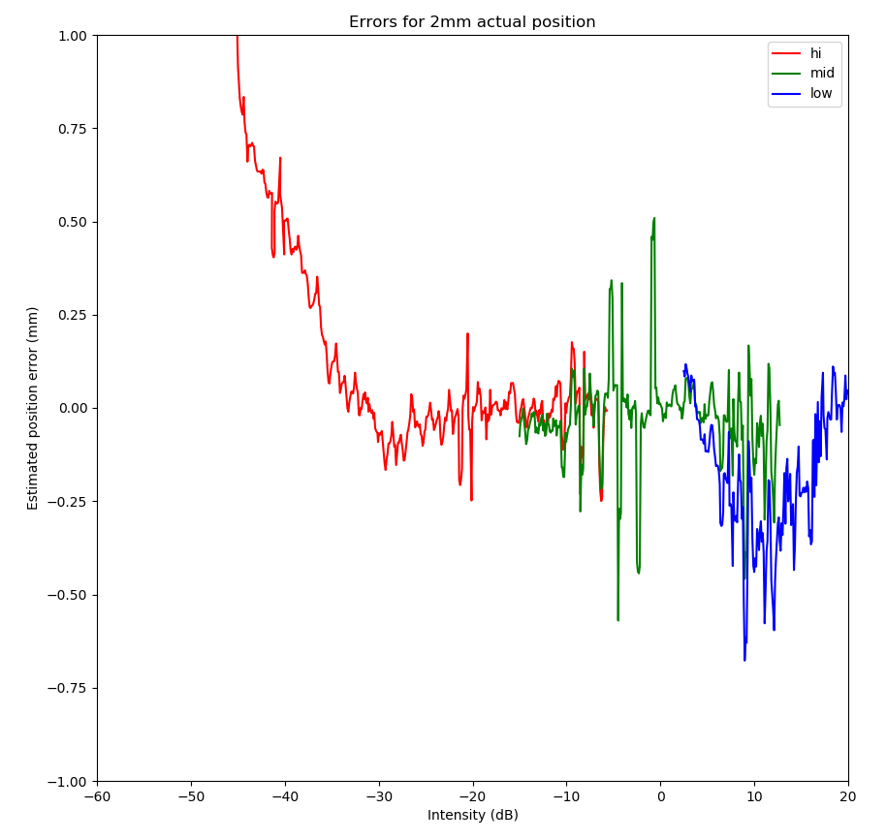
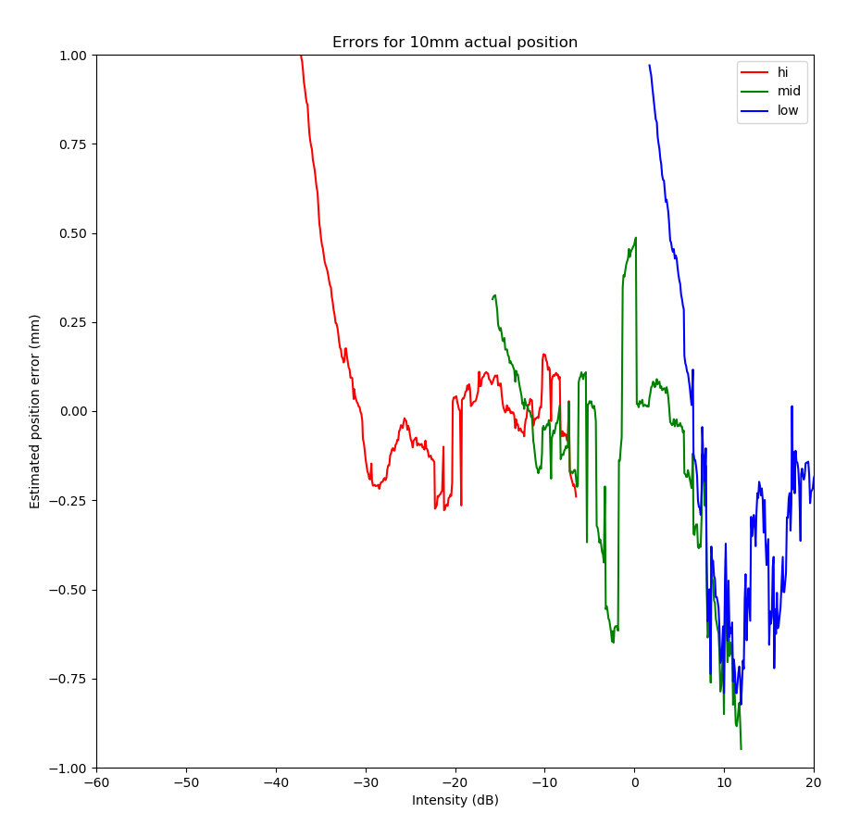
Multi bunch: results (50ns)
1e9
1e10
1e11
1e9
1e10
1e11

Slide 21
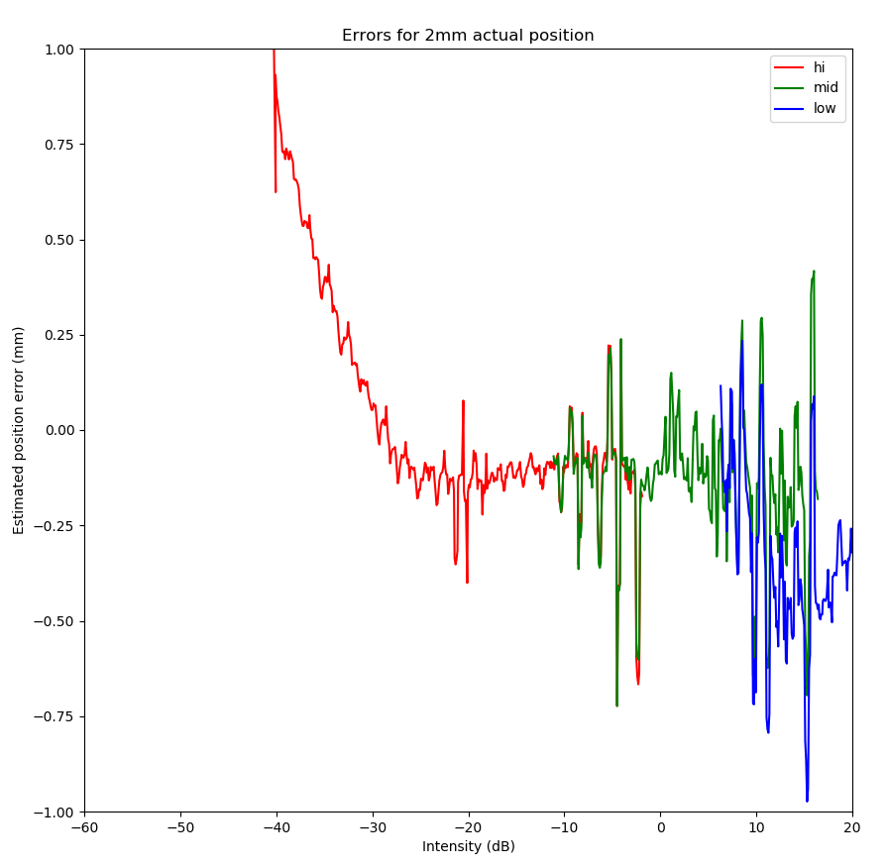
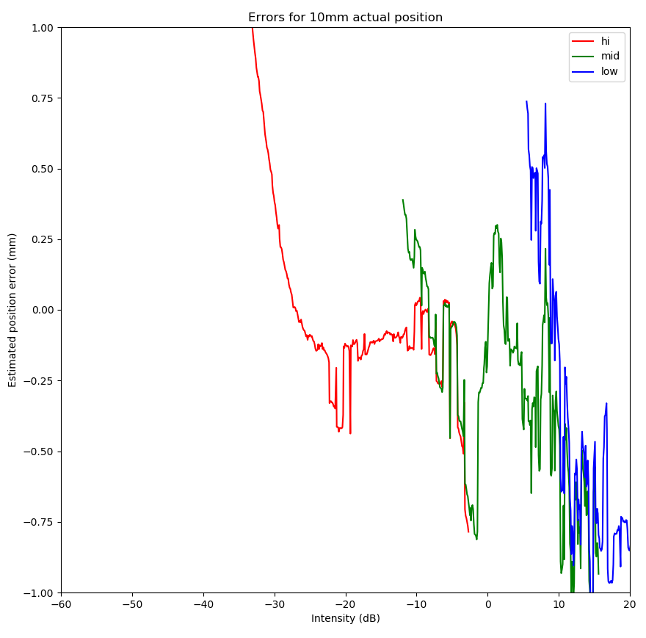
Multi bunch: results (75ns)
1e9
1e10
1e11
1e9
1e10
1e11

Slide 22
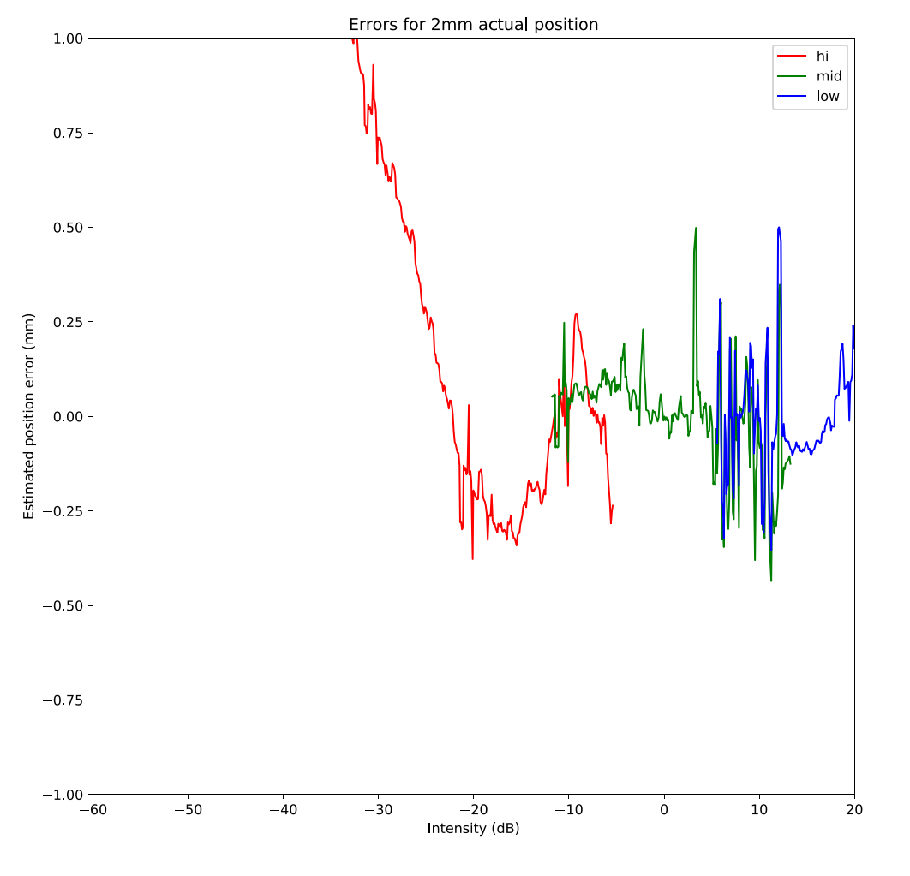
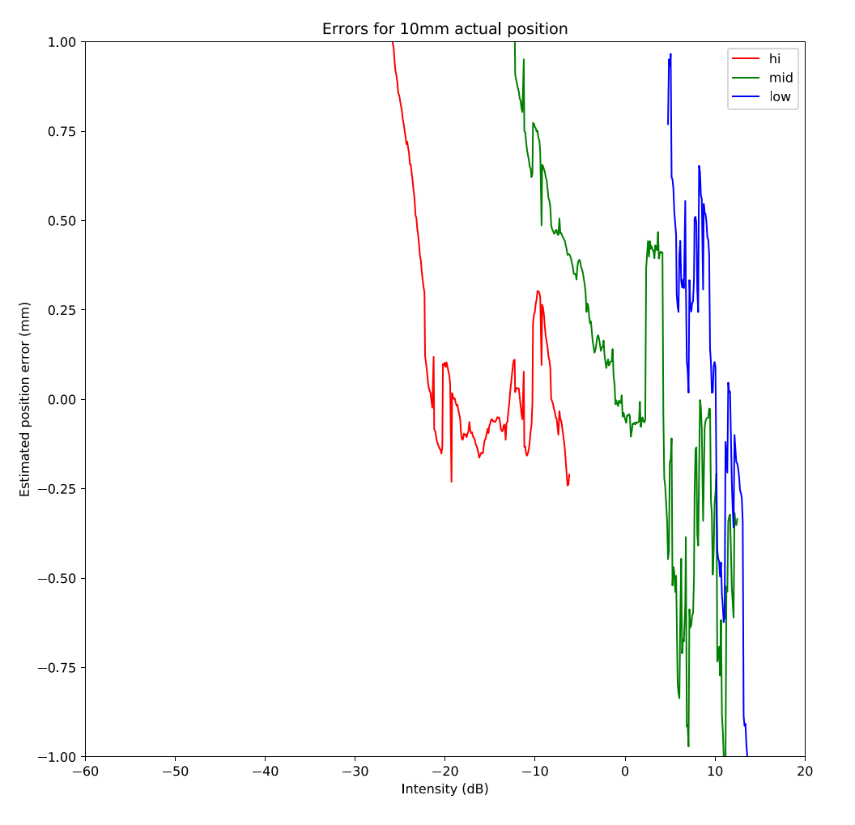
Single bunch: results
1e9
1e10
1e11
1e9
1e10
1e11

Slide 23
Performances summary
1e10
1e10

Slide 24
Performances summary
Intensity dependent systematics
  <250um for small displacements (less than 5mm)
  <1mm for big displacements (10mm plus)
Expected Resolution:
  Single bunch
    turn by turn: 500-700um
    Orbit @1ms : ~100um
  Trains (72 bunches @25ns):
    turn by turn: 50-80um
    Orbit @1ms : ~15um

