Slide 1
CERN-NTNU Cooperation:
Taking it to the next level
Vice-Rector Jørn Wroldsen, NTNU and
Dr. Odd Oyvind Andreassen, Cern
CERN-NO Working Group
25 September 2019
Notes:
Thank you
Opportunity to give an update on the CERN – NTNU cooperation
Very glad about – two last days visited Cern
NTNU’s pro-rector for research at Cern
Interesting discussions
Ambitions for the cooperation discussed and laid out
Impressed by Cern – facilities and people/expertise – as always
Enthusiastic about the continued cooperation
Signed agreement on Ph.D. cooperation yesterday

Slide 2
Notes:
NTNU – Cern – has Memorandum witch was signed in 2017
This agreement lays the foundation for different projects and initiatives
Every time we would like to start a new collaborative project – we sign an addendum
One example is a new project lead by NTNU Filippo Berto and Marko Calviani at Cern.
The project is about:
5 Addendum -> MArco Calviani (caracteriszation og material in extreme environments), Armin (CO2 Cooling Atlas), Stian (PJAS), Joergen (PJAS TwinEBIS)
Student and young engineers from NTNU are excepinally atonomous, skilled in their field and have a good mix between theory and practical approch. In general the are pragmatic and alway eager to "Getting things done" rather then ....

Slide 3

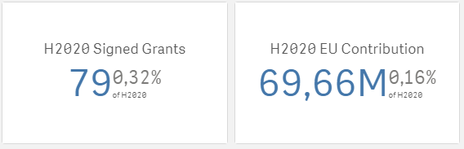
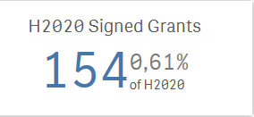
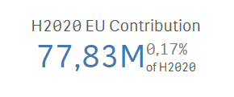
CERN
No joint projects
NTNU
Notes:
But we want more to be going on between Cern and NTNU.
One example is in the EU FP.
Both institutions active – no cooperation.
We want this to happen as well.

Slide 4

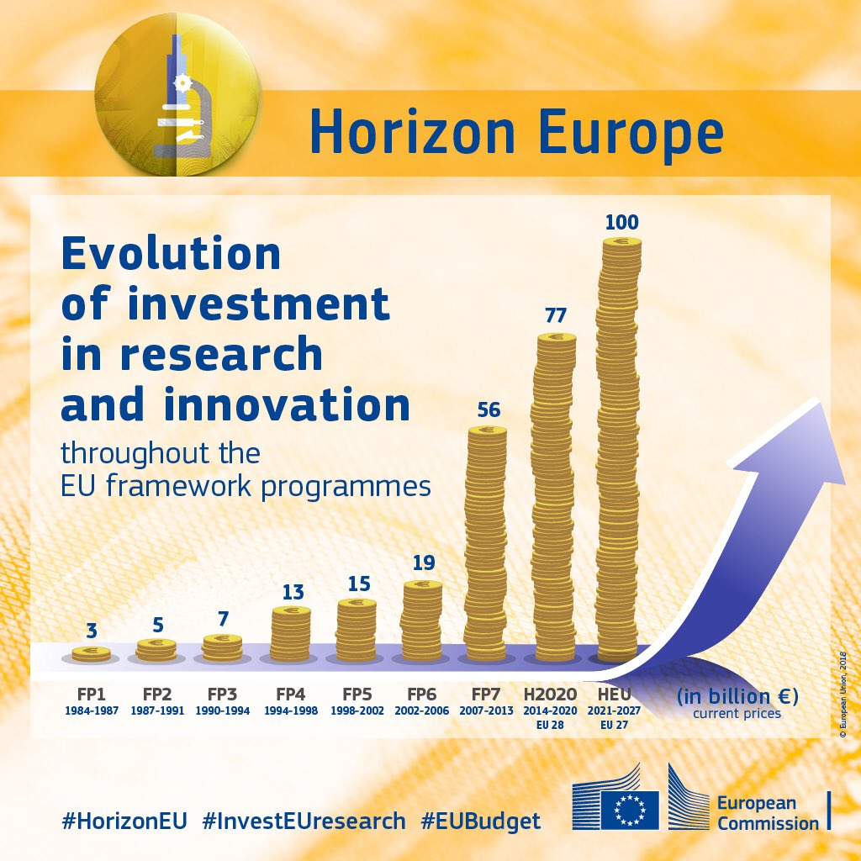
Notes:
New FP – Horizon Europe from 2021.
Increased budget.
A lot of opportunities.
Cern strong in the Research Infrastructure programme – so are NTNU
But also in thematic programmes
And not least in the programmes supporting basic technology research

Slide 5
Notes:
NTNU has an excellent Lab. Roberto Losito Visited NTNU in April 2017 and did a tour of the whole facility.
- Engineering
CO2 cooling test facility
Material LAb
Robot Lab (with more than 10 Kuka robotic arms)
Close collaboration with SINTEF, Norway's leading Non profit, independent research organization (2000 employees)

Slide 6
Notes:
42.000 Students
75% of every Technology master student comes from NTNU
~120 Laboratories at campus
Industry 4.0
Machine learning and remote controlled systems over large distances and under harsh conditions
Trondheim has the worlds first fully autonomous harbor and are, in collaboration with NTNU, testing autonomous systems for docking, undocking and navigating large unmanned ships.

Slide 7
Joint publications
46 co-publications since 1970
11 co-publications since 2015
Most co-publications in physics and astronomy
1 NTNU professor with 5 co-publications with CERN, no other NTNU staff with more than 2 co-publications
Notes:
Not very happy about the level of co-publications
Cooperation and projects are good – we need also to see this in the publication patterns

Slide 8
Student exchange CERN - NTNU
2016, 2017 and 2018: 3 – 7 students each year
Notes:
Also – there is a potential to increase the student mobility from NTNU ot Cern
Cern has fantstic porgrammes fro students – in many disciplines
NTNU- mobilixe moire students

Slide 9
CERN – NTNU longterm and robust partnerships
Notes:
One approach – NTNU’s international action plan – build robust and long-lasting cooperation with selected institutions internationally
Cern certainly of great interest to NTNU
Education – research – innovation
Many fields and researchers involved in both institutions

Slide 10
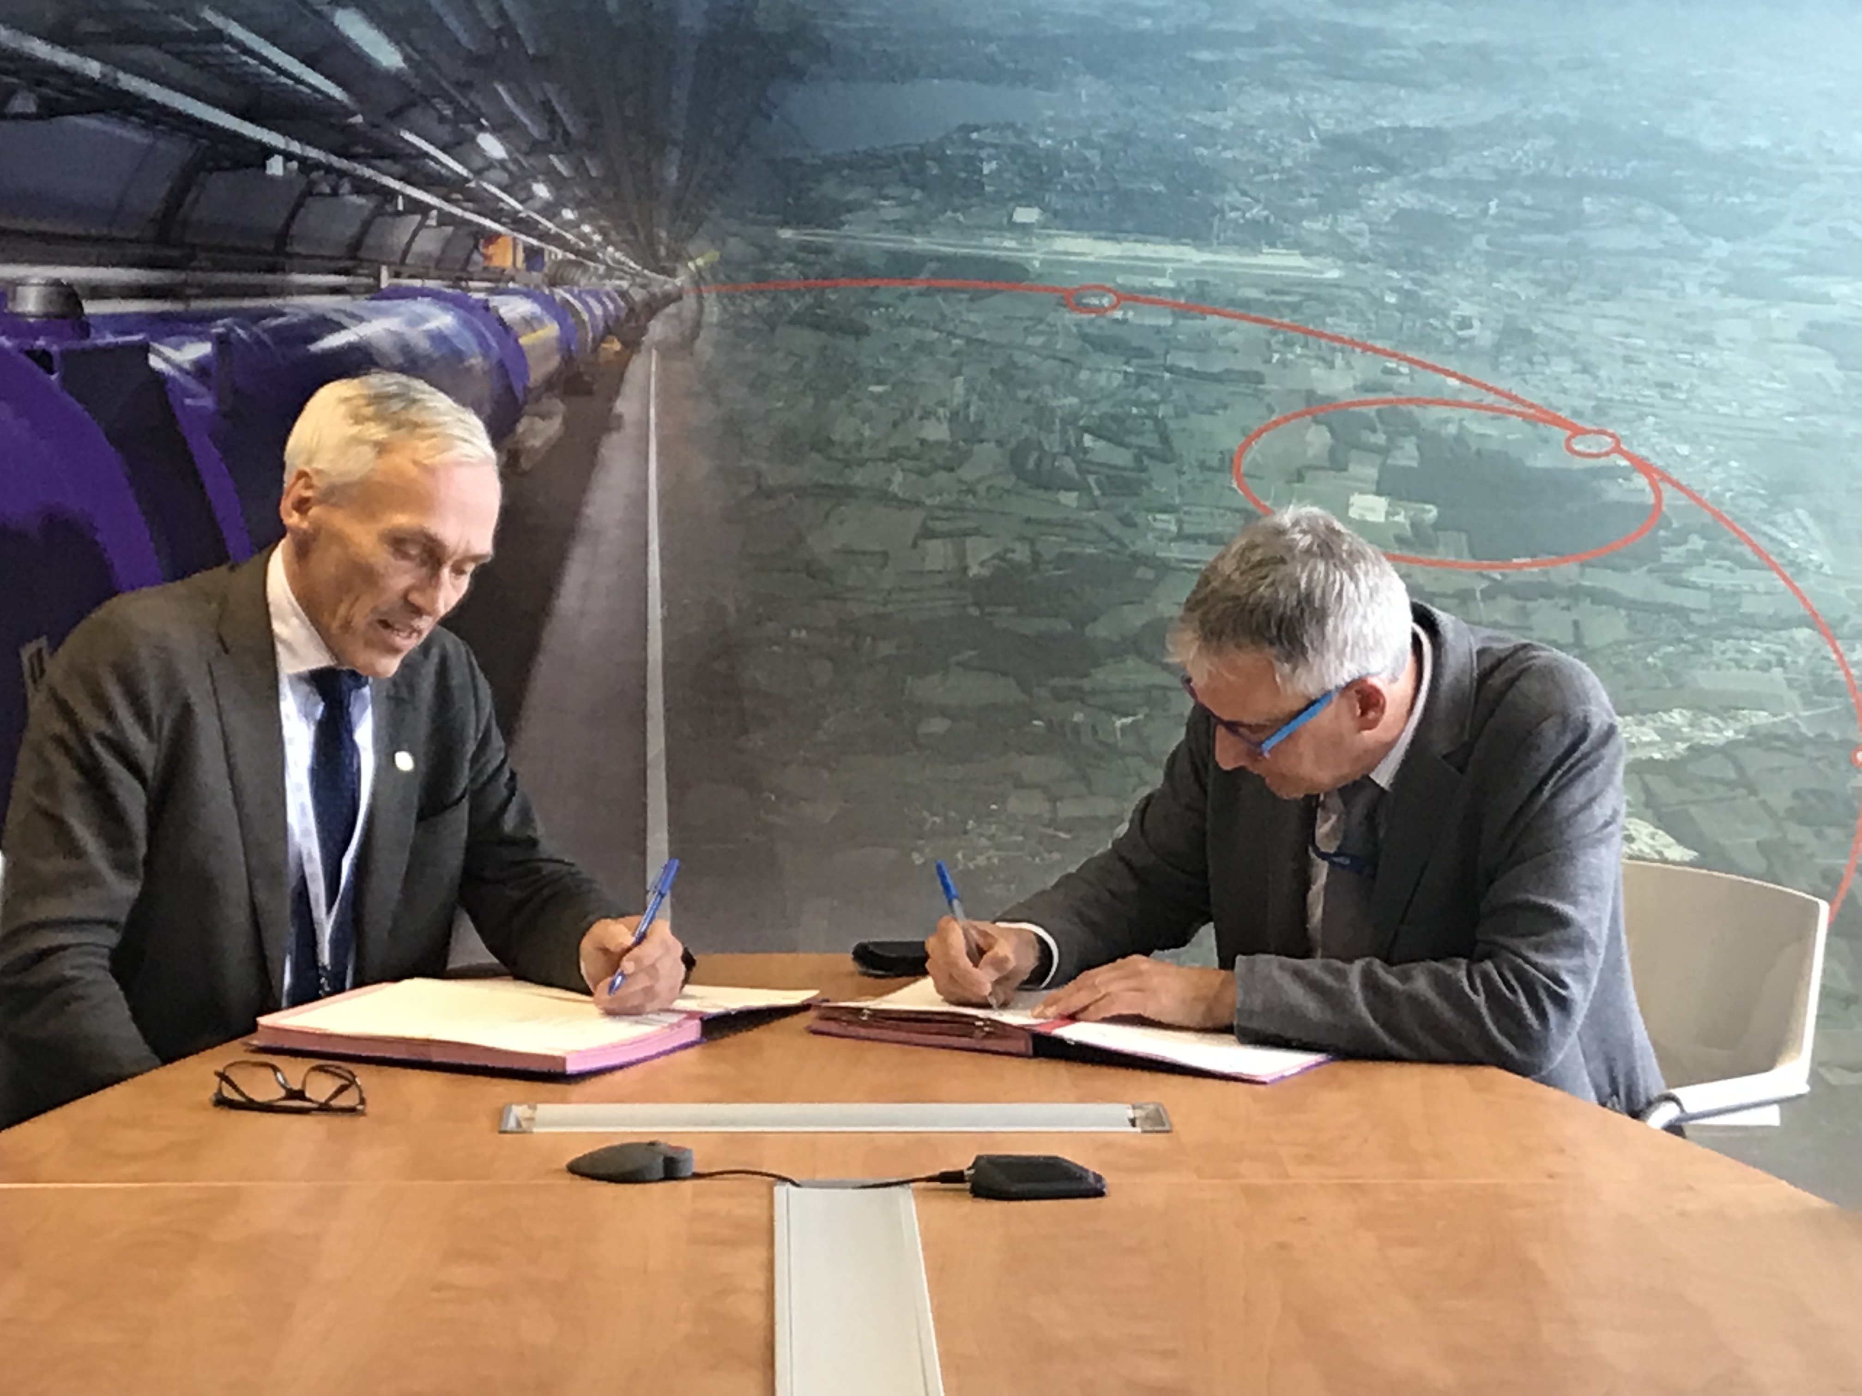
CERN – NTNU Agreement on Joint Doctoral Programme signed 24 September 2019
Notes:
To achieve this
Joint PhD. Programme
Agreement signed by Pro-Rector Bjarne Foss and Director Frédérick Bordry yesterday
Taken some time to sort put details – national Ph.D. regulations must be followed!
Now the agreement is signed
Very happy

Slide 11
Joint application for Ph.D.-projects
Joint supervision
1 ½ year at NTNU and 1 ½ year at CERN
Long-term impact: Joint publications, Funded projects from Horizon Europe, Researcher mobility, Student projects and mobility, Infrastructure cooperation
Notes:
To follow up on our ambitions
Not only words
We are investing substantially
Up to 8 Ph.D. positions announced to support joint projects
4 funded by NTNU and 4 from Cern
Deadline 1 October
Eager to see the applications
Hope for many applications
Ph.D.-candidates will spend half their time at NTNU and half their time at Cern
Supervisor from each institution
Ph.D. programme at NTNU and degree from NTNU
Jointness/Togetherness is key criteria
Combined expertise and knowledge must be more that 1 + 1 = 2 – must at least be 3!
Added value
Complementary skills and expertices merged in projects
We expect surrounding activities – student mobility – joint publications – and funded projects – from Horizon Europe – workshops and masterclasses
The larger research groups at both institution to be involved – not only supervisors and Ph.D.-candidates
We expect and hope for long-term impact on the cooperation of the Ph.D.-positions

Slide 12

Notes:
Science for peace
Knowledge for a better world
A natural match in itself!

Slide 13
Notes:
In the end – it is all about contributing to a better world
Never before – so much hope and expectations that research should and can deliver solutions to the grand challenges
NTNU and Cern s partners is in a position be able to contribute with important knowledge

