Slide 1
DESIGN OF THE Q1a K-MODULATION CIRCUIT
Felix Rodriguez Mateos, Lloyd Williams, Florian Pasdeloup, Samer Yammine
… with inputs from several WPs
TCC no. 82
2019-08-30

Slide 2
Introduction
The Q1a K-modulation circuit was proposed by WP2 during the Circuits Internal Review in March 2017 (link)
  It provides a factor 2 improvement of ß* control in round optics
  Measurement of up to 0.01 tune variation
  HL-LHC optics target requires a 35 A Q1a k-modulation circuit
NB. Circuit layout after approval of the on-going IT ECR

Slide 3
Boundary Conditions
During K-modulation measurement, the current is a sine wave
  Amplitude = 35 A
  Period about 1 min
  Few cycles are needed, but design takes into account 8 hours (thermal steady state)

Slide 4
Worst Case Analysis - 1
In case of imbalance of the quench resistance between the two halves of the Q1 magnet (Q1a and Q2a), an over-current may appear through the k-modulation feeder leads.
This over-current would last for a few tenths of a second, with a peak value of about 4 kA. For design purposes, it was proposed to include this imbalance effect within the technical requirements of the k-modulation feeders.
The design should consider an initial sinusoidal signal of 35 A peak for 8 hours (steady state), with consecutively a current pulse, with a value of 4 kA during 0.4 s.

Slide 5
Worst Case Analysis -2
Evaluation of current discharge during quench
  Assuming a global quench in Q1a
  RRR_{Q1a} = 100, RRR_{Others} = 300
  Cu/nonCu_{Q1a} = 1.1, Cu/nonCu_{Others} = 1.3
Initial current in all magnets: 17.8 kA
Quench detection + 10 ms validation
Q1a Crowbar and DC cables ≈ 200 mΩ
Resultant Current Profile
  Maximum Current = 4.1 kA
  MIITs = 1.57 MA²/s
Reference: MCF meeting no. 23 (link)

Slide 6
Design requirements
Electrical Parameters
HVWL to ground: 5kV at leakage current below 15µA
CLIQ: maximum feeder branch resistance: 2.5 mΩ, 5mΩ total
Maximum Conductor Insulation Temperatures
Limited to about 350K with respect to a glass transition temperature between 630 and 680K* for Polyimide insulation
Minimum Conductor Warm End Temperature
Not below 288K for a nominal air temperature of 290K sourced from cryogenics experts with LHC operational experience.
This general rule is confirmed by analysis of the dew point data obtained for one sector in the LHC tunnel over one complete year, where a minimum temperature above the dew point of 2.6 K has been measured.
Ionizing Radiation Resistance
The increase in luminosity at the interaction points 1, ATLAS and 5, CMS that will be provided by the HL-LHC Triplets, leads to a roughly equivalent increase in activation of all LHC machine equipment on each side of these interaction points.
All HL-LHC equipment in the long straight sections to the left and right of ATLAS and CMS must withstand an integrated dose of 1 MGy.
Activated Environment
Installed in highly activated and less well ventilated zones of the LHC, consequently all three feeder systems may exploit only the available natural heat convection to prevent the formation of condensation on their warm ends.
* Dupont data sheet for Kapton® NH

Slide 7
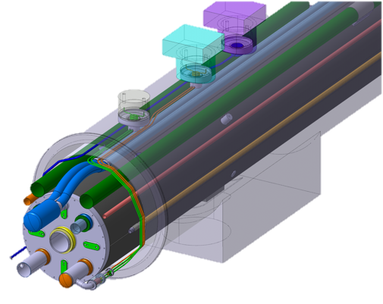
Design Constraints – Integration Issues
The IFS, CLIQ and K-mod feeders design, have been largely adapted to an existing cryo-magnet layout and this has constrained the minimum integrated lengths and therefore the cross-sections of their conductors.
Because all three types of feeders are mounted to and become part of the cold mass, integration at several stages must be considered:
  integration into the containment vessel for pressure and global leak testing,
  the integration during assembly of the cold mass into its cryostat
  the integration and ease of access in the LHC tunnel.
An engineering compromise is therefore presented here.

Slide 8
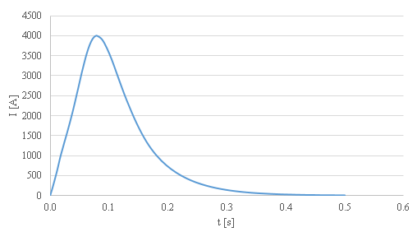
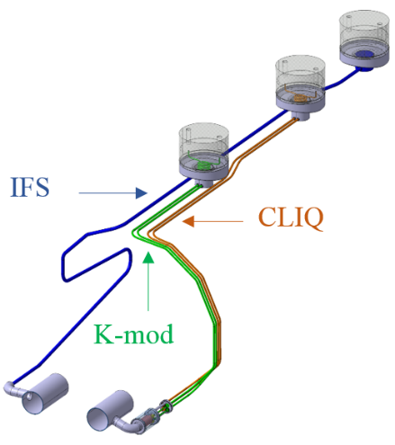
The k-mod Feeders Design - 1
  Courtesy of
  L. R. Williams and F. Pasdeloup
Static and dynamic performance must be considered
Dynamic: The “worst case” duty cycle, where resistive generation of heat occurs in the feeders in 2 contiguous phases:
During continuous 35 A peak (24.8A rms) sinusoidal supply for maximum 8 hours (1 shift)
Induced by a magnet quench contiguous with 1., a short time current pulse is generated, of magnitude up to 4000A
OHFC Copper
RRR ~100??
K-mod | #wires | Cond x-section OFHC Copper | L tube | L cond | Tube Dia | #tubes
1 | 2 | 2x10 mm2 | 1.7m | ~2 m | 8/6 mm | 2

Slide 9
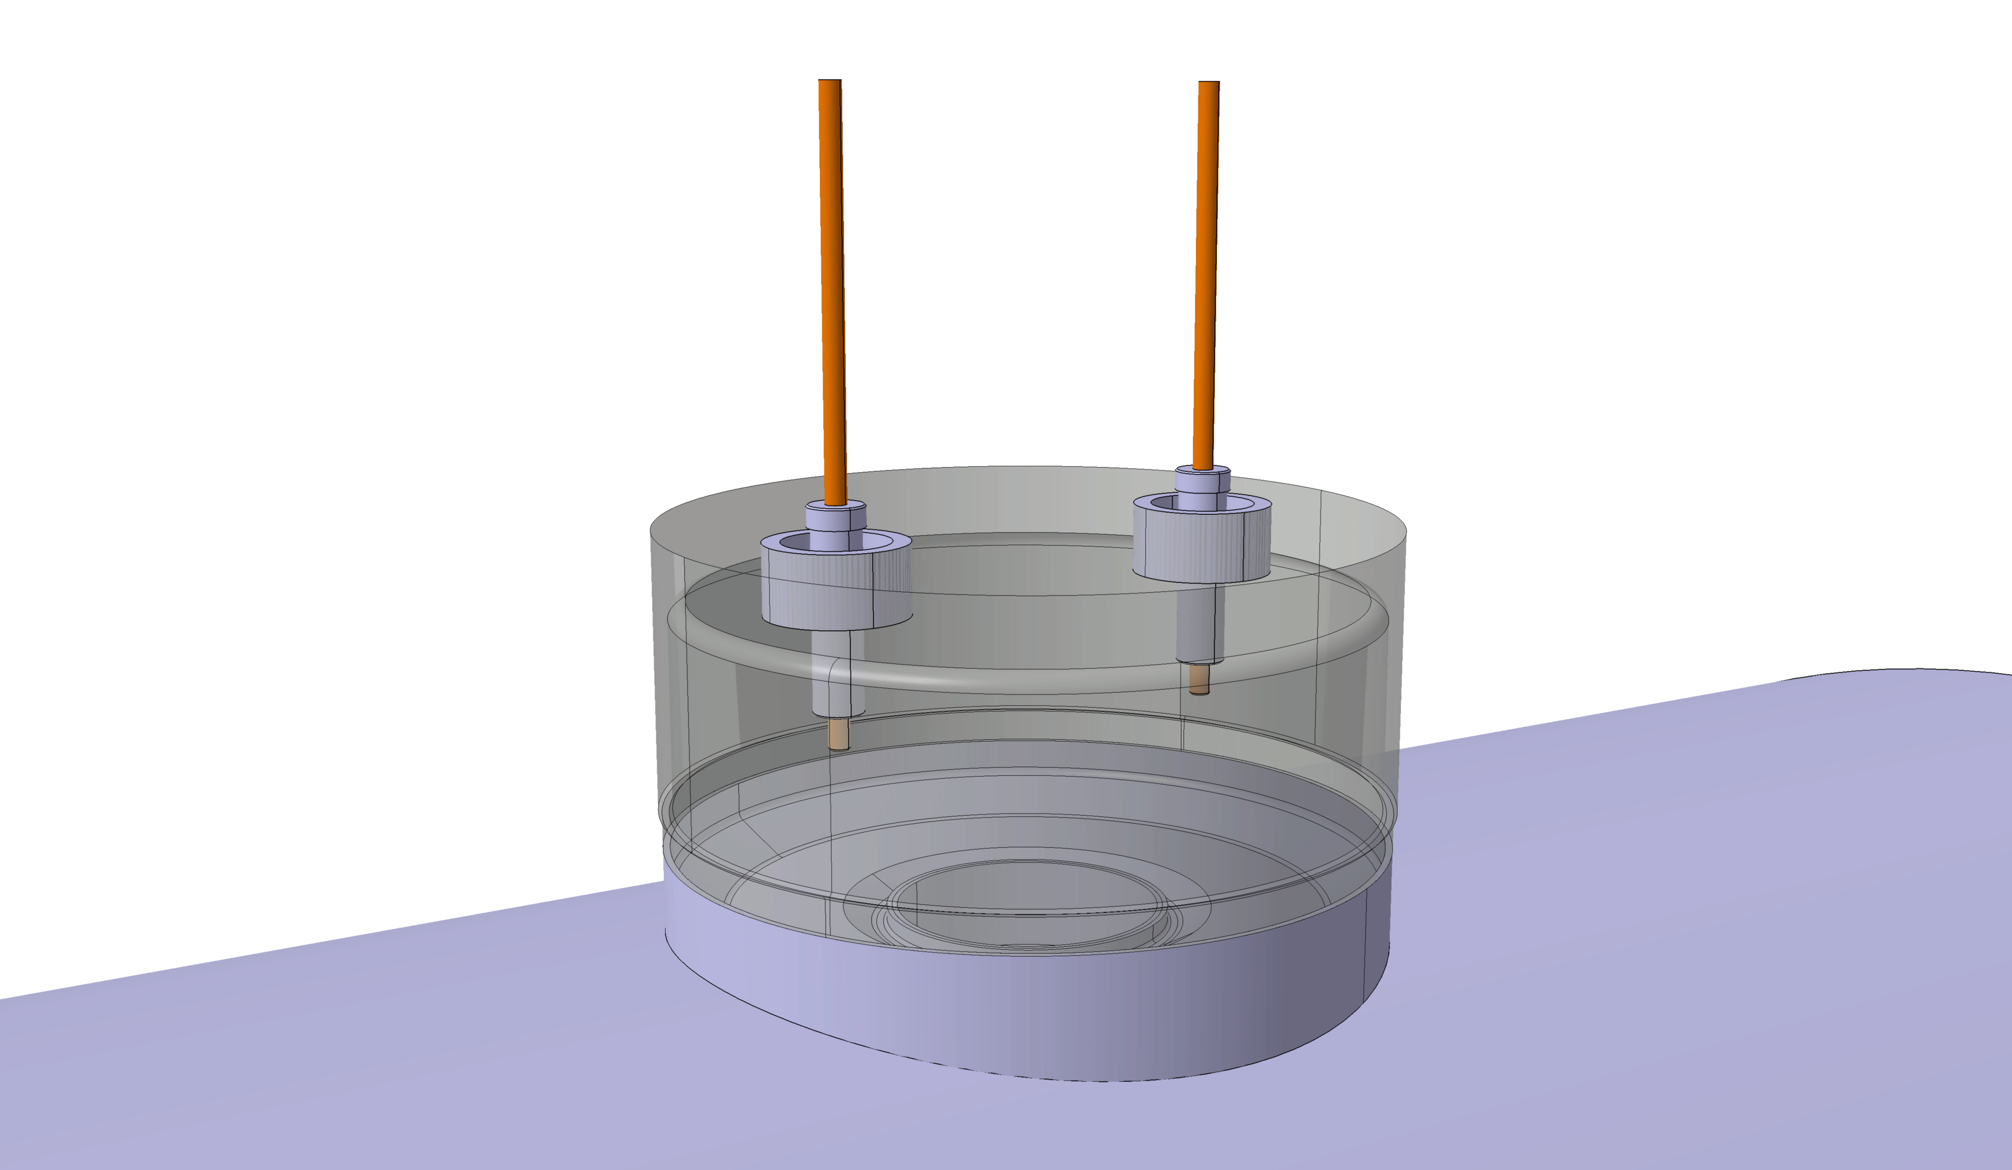
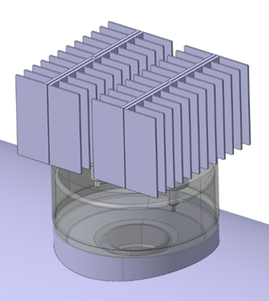
The k-mod Feeders Design - 2
  Courtesy of
  L. R. Williams and F. Pasdeloup
100
189
115
0.89W
0.89W
K-mod | #wires | Cond x-section OFHC Copper | L tube | L cond | Tube Dia | #tubes
1 | 2 | 2x10 mm2 | 1.7m | ~2 m | 8/6 mm | 2

Slide 10
K-modulation Circuit Design
Design parameters for warm cabling
  Two air cooled cables of 25 mm² section each
  Estimated length = 120-160 m per polarity (depending on PC position)
  Resistance = [170, 230] mΩ
  Consistent resistance value for current loops during non-quench discharges
Design parameters for power converter
  HL-LHC generation of the 60A power converter
  FGC3 controller used to implement the decoupling controller of the IT circuit
  Placed in the UR and connected on the same gateway as the RQX and RTQX power converters
  Modified crowbar system to support over-current during non-homogeneous quenches
  The power converter will be connected at all times (even without k-mod operation)
    To create path for CLIQ discharges
    One single configuration of the IT circuit is obtained
    For further information, please refer to MCF meeting no. 40 (link)

Slide 11
Thank you for your attention

