Slide 1
Inner Triplet Circuit
Engineering Change Request
Felix Rodriguez Mateos for MCF and WP concerned
TCC– 30th August 2019

Slide 2
Short recall and intro . . .
At the 77th TCC Meeting on June 6th 2019 an ECRs was presented that translated changes applied to the IT Circuit after the Circuit Review in 2017, in order to align the baseline and TDR 1.0
  Changes namely were:
    Suppression of Q2a trim circuit
    Addition of a k-modulation circuit across Q1a magnet
    Update of the ratings of the superconducting elements of the main circuit of the Inner Triplet
    The use of cold diodes
  At the same meeting, an ECR on pole order order and implications on polarity was presented by H Prin: slides)
Moreover there were two more ECRs in preparation:
  ECR on pole ECR on number of cold diodes (see presentation by S Yammine MCF Meeting # 47: IT Main Circuit Crowbars )
  ECR on connections of CLIQ and related hardware (see presentation by E Ravaioli MCF Meeting #49: IT Circuit recent analysis and optimisation )
Because of the possibility to update the TDR and in order to have a fully coherent documentation in front of the Circuits Review (9-10 September 2019), all these documents have been –in agreement with the Project Office, Isabel– merged into one.

Slide 3
Structure of the ECR
Changes addressed at the Internal HL-LHC Circuits Review 2017. The following changes are addressed within this chapter:
  Suppression of Q2a trim circuit
  Addition of a k-modulation circuit across Q1a magnet
  Update of the ratings of the superconducting elements of the main circuit of the Inner Triplet
  The use of very-thin base cold diodes
Change of pole order and implications on the circuit polarity.
Modifications of the warm part.

Slide 4
A.1 Suppression of Q2a trim
Accuracy of the measurement of the MQXF transfer function shall be better than 10 units;
Precision of the MQXF transfer function measurements shall be of 2 units or less in order to allow sorting of magnets;
Longitudinal alignment accuracy of the nodal points of the triplet quadrupoles shall be within ±2 mm;
Accuracy of the magnetic length shall be within ±5 mm.
Rogelio Tomás

Slide 5
A.2 Additional Q1a k–modulation circuit
The requirements from beam optics to apply only on magnet Q1a a sinusoidal modulation in order to measure up to 0.01 tune variation, i.e. measuring the β-function by k-modulation, have been translated into a 35 A circuit for that purpose.
This k-modulation circuit will be powered using local feeders and feedthroughs, which means that it will not be powered through the superconducting link.
Moreover, this 35 A circuit will be fed by a standard HL-LHC-60A-10V power converter with a specific crowbar system. It was agreed by WP6b and WP7 to keep the k-mod circuit permanently connected.
Details of this circuit are given in a separate presentation at this TCC meeting.

Slide 6
A.3 Ratings of the superconducting elements of the inner triplet circuit
The three intermediate current leads were initially rated at 2 kA. However, as it was confirmed after the review by simulations, during transient scenarios in a conservative case where large sections of one of the magnets are quenched by the effect of asynchronous beam dumps, the current leads and the cables connected to the trims of Q1 and Q3, as well as leads of Q2a/Q2b, could see up to 6.7 kA for some short time durations.
Consequently, the superconducting cables and leads corresponding to the three trim leads (B, C and D) will be designed for 7 kA (DC currents) and 5 MIITs. In particular, the corresponding conductors within the superconducting link will be designed for these ratings.
Moreover, the current leads are requested to be able to withstand an overcurrent of 0.2 kA during 15 seconds for reasons of current looping when power aborts are triggered.
The quench protection strategy for the inner triplet of the HL-LHC is such that any quench in a superconducting element of the circuit will trigger the quench protection of all the elements of the circuit (switching off all the power converters, firing quench heaters and CLIQ units in all magnets).

Slide 7
A.4 Cold diodes -1
As a recall, the cold diodes provide decoupling between cold and warm parts of the circuit and limit the over-currents in the superconducting bus bars and link conductors. Additionally, they will provide higher immunity and robustness in front of unexpected delays in the quench detection and protection systems.
Several presentations at TCC already on this subject - see TCC Meetings 66th (endorsement) and 73rd (results from irradiation and annealing)
Four diodes, one across each magnet, do not provide enough margin between the cold diode turn-on voltage and the voltage developed by the power converter crowbar during a power abort.
The limited margin (around 1 V) between the cold diode turn-on voltage and the power converter crowbar voltage increases the probability to turn on one of the cold diodes during current transients even when no quench is occurring. Such a turning‑on of the cold diode leads to a high dI/dt in the circuit which could trigger a spurious quench detection and consequently firing of the quench protection system.
In addition, turning-on of a cold diode leads to the dissipation of around 40 kJ heating the helium bath and the copper connections. Risks to quench neighbouring bus bars.
To avoid unnecessary turning-on of cold diodes, the MCF has recommended to increase the number from four to six per circuit: 2 diodes in series across each of Q1 and Q3, and 1 diode across each of Q2a and Q2b. In this case, the margin between the crowbar voltage and the threshold of the cold diodes increases from 1 V to 7 V.

Slide 8
A.4 Cold diodes -2
As a by-product of the circuit optimisation, the value of the crowbar resistances of the 2 kA trim power converters over Q1 and Q3 are defined at 2 mΩ which is compatible with the 0.5 mΩ (10 V) for the RQX (18 kA) power converter, allowing the discharge of the RQX circuit from ultimate to zero current in 18 minutes. In addition, several considerations on aspects of the trim circuits have led to the definition of the trim crowbar resistance values. These considerations are a trade-off between:
  preventing from current looping in the sub-circuits during crowbar discharges to limit the maximum currents to the sub-circuit design values, and
  preventing the cold diodes from being brought into conduction by exceeding their characteristic turn-on voltage of around 6 V.

Slide 9
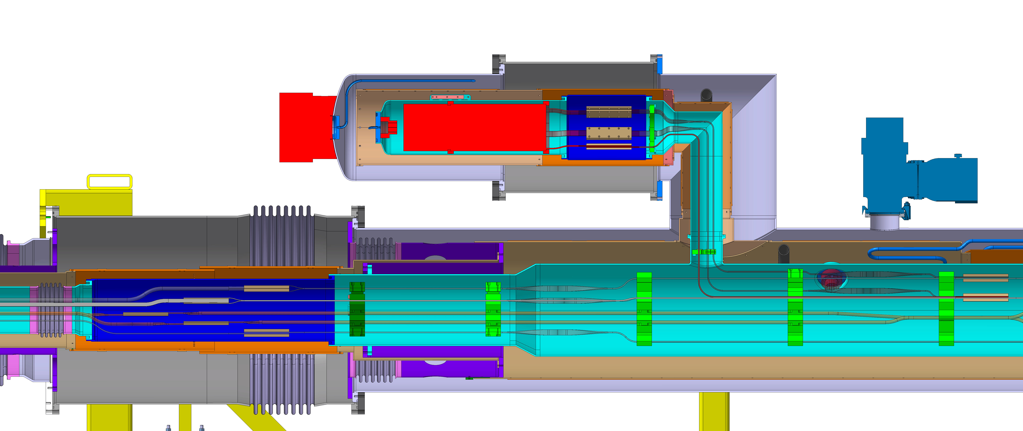
A.4 Cold diodes -3
Proposed location for the integration of the cold diodes.
The diode assembly will be located in between D1 and the DFX, in order to be accessible for maintenance and replacement.
For this reason, a dedicated container, as a part of the so-called D1-DFX Connection Module (DCM), operating at 1.9 K, is proposed.
Ref. Yann Leclercq et al.

Slide 10
A.4 Cold diodes -4
Results from FLUKA simulations on radiation levels at the DCM proposed location, normalized for the nominal HL-LHC scenario (3000 fb⁻¹).
The upper limits at the reference position are 12 kGy and 5x10¹³ cm⁻² for the dose and fluence, respectively [16].
The dose/fluence obtained during the CHARM irradiation campaign (between 10 and 12 kGy and about 2.10¹⁴ n/cm⁻²) are compatible with the simulation results, hinting that the cold diodes may have been already fully validated. To be followed in detail.
Ref. G Lerner, M Sabaté Gilarte, R García Alía, F Cerutti ; EDMS # 2201836

Slide 11
B – Change of pole order and implications on the circuit polarity
To eliminate additional splices in the Q1/3 cold masses and to be able to perform vertical tests of MQXFA magnets at BNL, it is proposed to change the pole order of the triplet magnets.
To maintain the field polarity as in the HL LHC baseline, the connection scheme on Q2 magnets as well as the main circuit, CLIQ, HDS and instrumentation wires have to be adapted accordingly.
This part of the ECR was presented in detail by H Prin at TCC’s 77th Meeting

Slide 12
C – Modifications to the warm part
The ECR does not add any change to the cold-mass manufacturing baseline.
Proposed changes are:
  Modification of the connection scheme of the CLIQ units protecting the Q1 and Q3 cold-masses. In the proposed design, each of the four CLIQ unit protecting Q1/Q3 is connected across two poles of just one magnet, i.e. Q1a, Q1b, Q3a, and Q3b.
  Addition of a parallel electrical path across magnet Q3a, using the warm lead already present in the baseline. This path includes two strings of ten diodes, connected back to back, in series to a 200 mΩ resistor. This resistance, which has the same design value as the resistance of the Q1a trim power supply leads and crowbar, is selected in order to limit the current passing through the lead itself. This additional path is not designed to carry the full circuit current, but only current unbalances between Q3a and Q3b, in particular in the case of a spurious CLIQ triggering.
With the proposed modification, in case of spurious triggering of any of the CLIQ units the oscillating current is introduced symmetrically in the two halves of the magnet to which is connected.
This arrangement prevents the occurrence of a severe failure caused by asymmetric magnetic fields in the Q3 coils. The proposed modification was presented, discussed, and endorsed at the Magnet Circuit Forum meeting on the 16 April 2019.

Slide 13
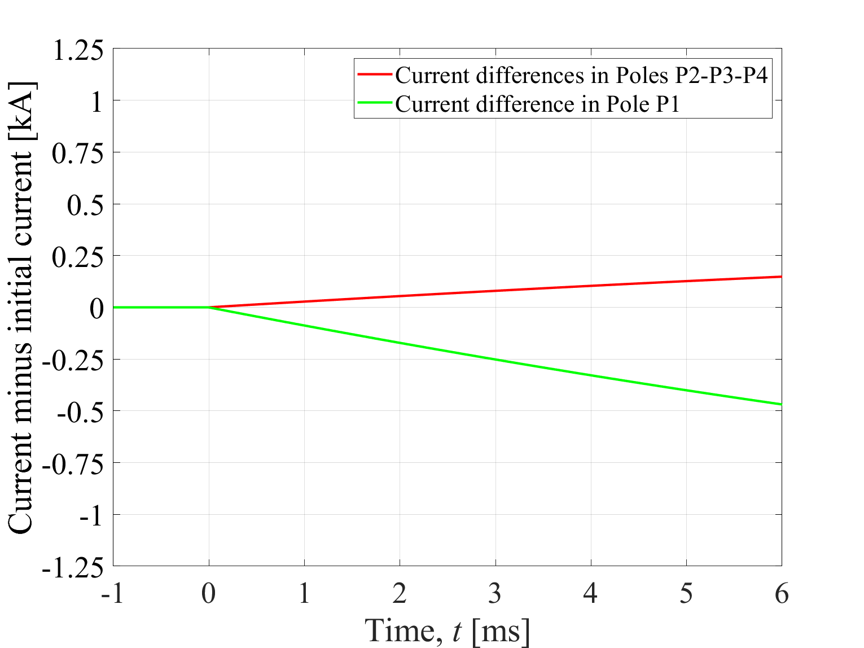
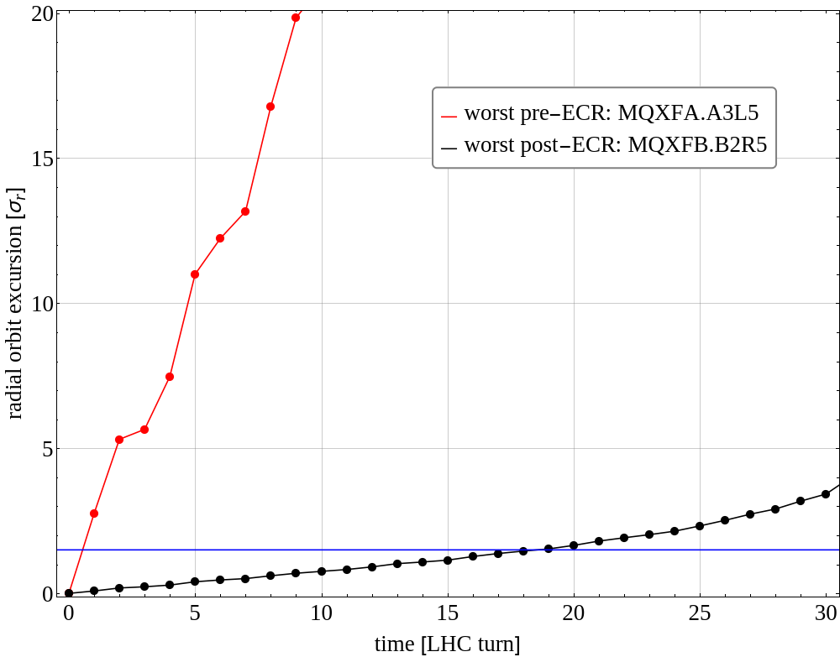
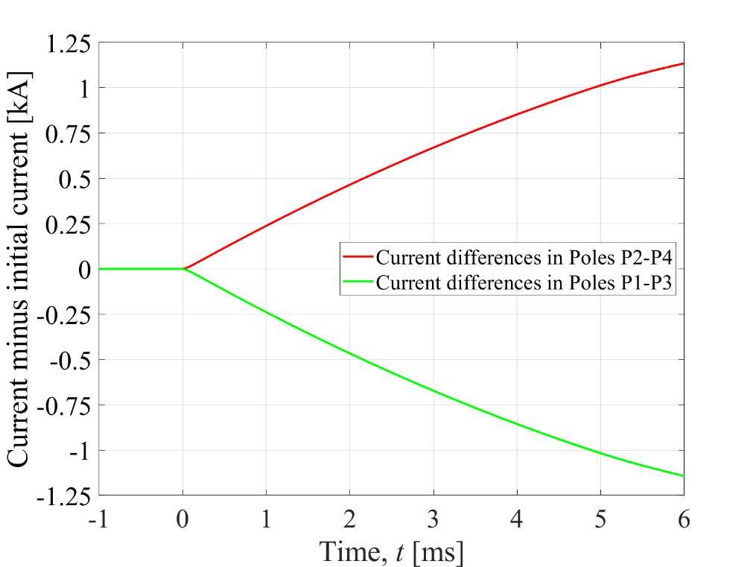
Effects on beam due to misfiring of a CLIQ unit
In the case of a spurious triggering of one of the two CLIQ units protecting the Q3 cold-mass, asymmetric currents are introduced in the poles P3 and P1/P2/P4.
The current changes imposed in the different poles at the moment of the CLIQ spurious triggering have significantly different amplitudes.
Within the first LHC turn (89 us), the orbit offset surpasses well 2 σ and reaching 5 σ after only 2 turns
The described scenario would be by far the fastest failure in the LHC and too fast to actively abort the beams before damaging loss levels are reached.

Slide 14
Implications of the change to quench protection
The worst-case peak voltage to ground and coil-to-heater voltage in Q1 and Q3, in case of CLIQ and/or quench heater failures, non-uniform conductor parameters, and/or sudden quench of large parts of the coil due to beam loss, are reduced.
The hot-spot temperature in the case of a quench at nominal current and simultaneous failure of one CLIQ unit protecting a Q1 or Q3 magnet increases by about 100 K. In this scenario, the hot-spot temperature would reach a worst-case hot-spot temperature at nominal current of about 370 K in case of strand parameters uniformly distributed, and about 400 K in case of strand parameters non-uniformly distributed.
  At ultimate current, a hot spot temperature of about 390 K and about 420 K can be reached respectively.
These values can be considered as acceptable for an event with such a low occurrence probability, implying in the worst case scenario the possibility of some retraining at ultimate current. With the previous baseline circuit, instead, the presence of two CLIQ units connected across two magnets of the same cold-mass would have provided some level of additional redundancy, resulting in a hot-spot temperature increase of only a few tens of K.
  It should be noted that in the present baseline the Q2a and Q2b cold-masses are already protected by individual CLIQ units, and the performance of their quench protection system is considered satisfactory.
The contents of the ECR and in particular the ones on this slide have been discussed with AUP colleagues, who agreed upon. Thanks Paolo and Giorgio.

Slide 15
Final comments
With the proposed modifications, the worst-case in terms of beam trajectory change is a spurious triggering of one CLIQ unit protecting the Q2a or Q2b magnet, with magnetic length of 7.15 m. In fact, a spurious triggering of one unit protecting Q1a, Q1b, Q3a, or Q3b would only change the magnetic field along the length of a 4.2 m magnet, and hence it would have a smaller effect on the beam orbit.
The radial beam trajectory change caused by the spurious triggering of one CLIQ unit protecting Q2a or Q2b was simulated with MAD-X. The critical excursion of 1.5 σ is reached after about 13 LHC turns, i.e. about 1.2 ms.
The CLIQ units will be monitored by the quench detection systems, which will initiate a beam abort in the case of a spurious CLIQ unit triggering. The two LHC beam will be dumped in less than 1 ms after the CLIQ unit spurious triggering.
The proposed modifications uniform the quench protection system of the Q1/Q3 and Q2a/Q2b cold-masses, which simplifies simulations, failure case analyses, and reliability studies. Very similar hot-spot temperature would be reached in Q1/Q3 and Q2a/Q2b, whereas the peak voltages to ground and coil-to-heater voltages in Q1/Q3 would be about 1.7 times lower than Q2a/Q2b. This is simply because of the different magnetic lengths of the magnets, which have a ratio of 7.15/4.2≈1.7.
With the proposed changes the tests performed on the 4.2 m long magnets at Brookhaven National Laboratory (BNL) will be fully representative of the final baseline, since in the new proposed circuit each Q1a, Q1b, Q3a, Q3b will be shunted by a parallel electrical path, and one CLIQ unit will protect each individual magnet. This is the same configuration foreseen for the tests at BNL.

Slide 16
Impacts - 1
 | A - 1. Trim Q2a suppression | A - 2. Addition of k-mod circuit | A - 3. Ratings of sc elements | A - 4. Cold Diodes | B – Pole order and circuit polarity | C – Modifications of the warm part
WP3 | No impact in cost, schedule or performance. The additional k-mod circuit on Q1a compensates the trim removal in Q2a. | No impact in cost, schedule or performance. The additional k-mod circuit on Q1a compensates the trim removal in Q2a. | No impact in cost, schedule or performance. | No impact on schedule or performance. The cold diode module design studies have been carried out since the beginning including the possibility of installing the diodes. An ECR in preparation on the DCM (D1-DFX Connection Module) will cover additional costs. | No impact on cost, schedule or performance is foreseen from reverting the current direction and re‑arranging the leads.
WP6a |  |  | Modifications to the design were implemented at an early stage and are part of the baseline. No impacts can be identified for WP6a. | Modifications to the design were implemented at an early stage and are part of the baseline. No impacts can be identified for WP6a. |  | Minor impact is foreseen from the additional cold diodes.
WP6b | No impact in schedule or performance. Regarding cost, there are 4 x RPLBC less to deliver (no net impact as Change 2 requires 4 converters more for Q1a trims). | No impact in terms of schedule. Concerning performance, no impact is expected, however, complexity of decoupling control and troubleshooting increases compared to Q2a trim (3 layers vs 2 layers). As regards cost, there are 4 x RPLAD more to be delivered (no net impact as Change 1 requires 4 converters less for Q2a trims). | No impact in cost, schedule or performance. | No impact in cost, schedule or performance. | The 18kA and 2 kA trim circuits polarities shall be reversed. This change does not have an impact on cost, schedule and performance.

Slide 17
Impacts - 2
 | A - 1. Trim Q2a suppression | A - 2. Addition of k-mod circuit | A - 3. Ratings of sc elements | A - 4. Cold Diodes | B – Pole order and circuit polarity | C – Modifications of the warm part
WP7 | No impact in cost, schedule or performance. | The number of simulations run on the IT circuit were increased because it did affect the previously considered failure scenarios. The change was properly studied and implemented without any quantifiable impact in cost, schedule or performance. | No impact in cost, schedule or performance. | Cost balance between warm and cold diodes is basically neutral. No impact in schedule or performance. Minor impact on additional instrumentation cabling. | CLIQ and QH power supplies must be connected according to updated electrical scheme related to the IP side configuration, without further impacts. | No impact on cost, schedule and performance from the change of the CLIQ connections.
WP15 | No impact in cost, schedule or performance. The changes have been already implemented in WP15 documentation. | No impacts in cost schedule or performance are expected. Therefore, no showstopper is foreseen. | No impact in cost, schedule or performance. | It is not easy to evaluate with the current state of the design. WP15.2 needs to be provided with the final mechanic designs (including volumes) in order to make a proper cost, schedule and performance estimation. This may have an impact (to be included in the ECR on DCM). | No impact in cost, schedule or performance.
WP17 | No impact in cost, schedule or performance. The changes have been already considered within WP17. Precisely, a total of 4 circuits of 28 meters long with a section of 70 mm² had been previously taken into account. | Addition of 4 new circuits of 120 meters long with a section of 25 mm², meaning, a total cabling length of 960 meters. | No impact in cost, schedule or performance. | No impact in cost, schedule or performance. | No impact in cost, schedule or performance. | For each IT circuit, 2x10 warm diodes, a 200 mΩ resistance, and warm leads from the Q3 cryostat to the cavern are required. This has a minor impact on cost and schedule.

Slide 18
New baseline circuit once the ECR approved

Slide 19
Thanks – Questions?
Many thanks to all participants in meetings, discussions and write up in particular to American Colleagues from AUP, Herve Prin, Emmanuele Ravaioli, Daniel Wollmann, Paolo Ferracin, Samer Yammine and Tiago Catalao Rolhas da Rosa

