Slide 1
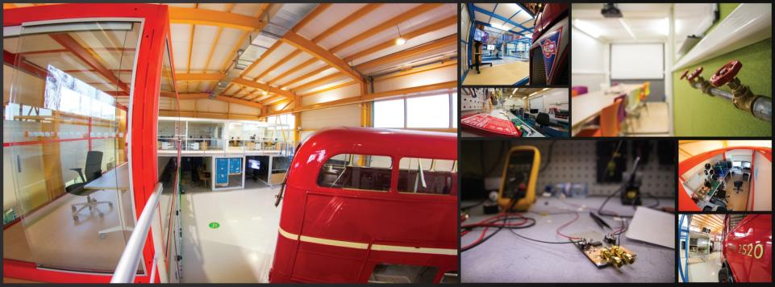
CERN Ideasquare
Presenter name
June 27, 2015
INTRODUCTION

Slide 2
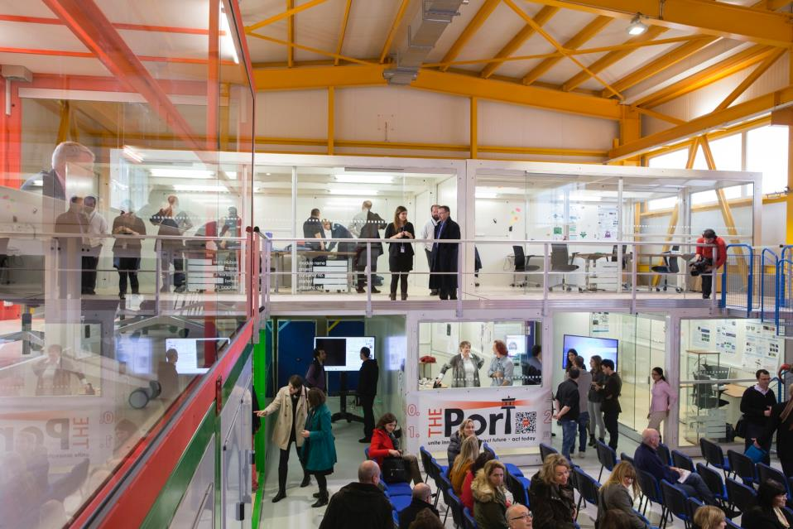
IDEASQUARE IN BRIEF
“Ideasquare is an experiment to bring together physicists, engineers, industrial partners, early-stage researchers and cross-disciplinary teams of students to work together on detector upgrade R&D and related technologies. The purpose is to co-develop new technologies for research purposes, and at the same time, create a fruitful environment for socially and globally relevant new product ideas and innovation.”

Slide 3
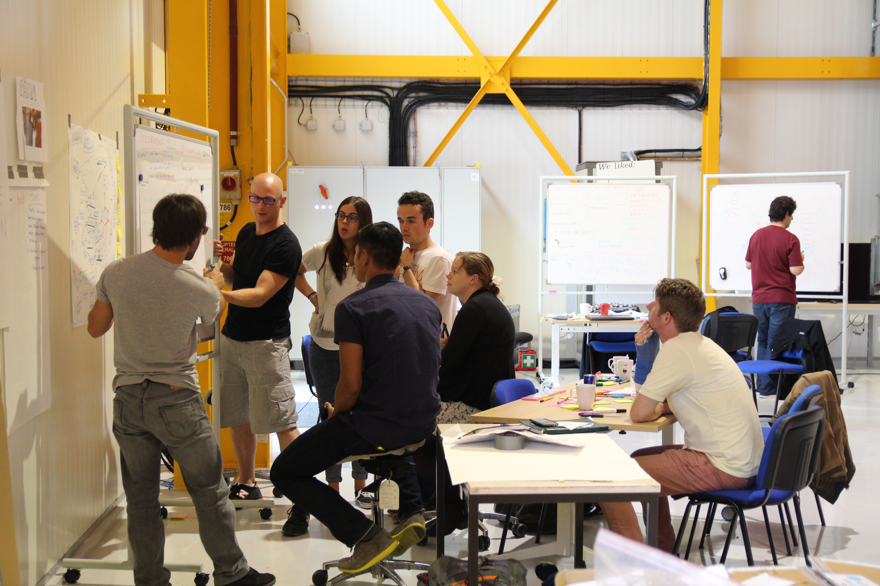

IDEASQUARE IS
Project with a dedicated building, hosting:
  EU-funded detector upgrade R&D projects
  Innovation events, workshops, hackathons
  Multidisciplinary master level student programs
...to prototype, test and iterate new forms of collaboration and co-creation in the areas or Research, Education and Technology - RET
Research
Education
Technology

Slide 4
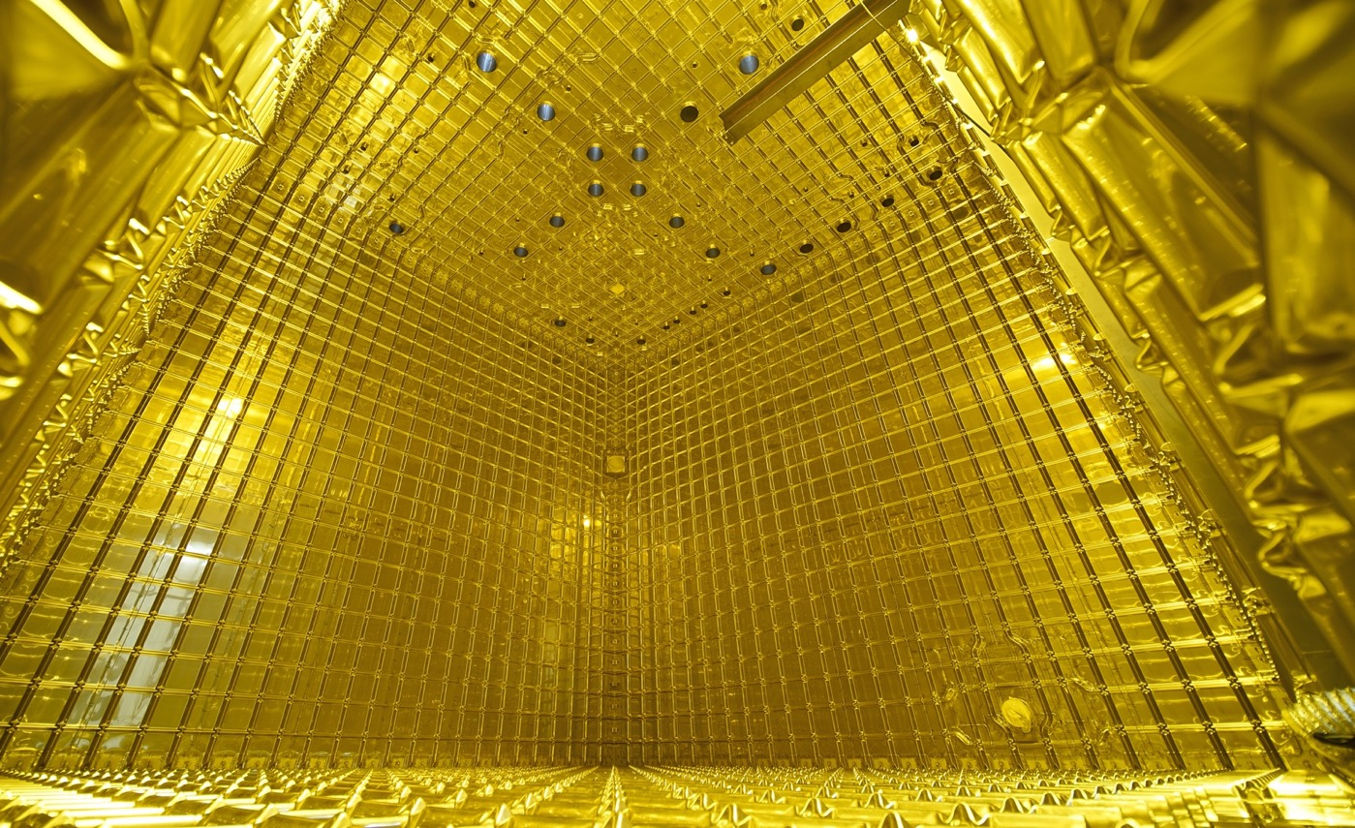

EXAMPLE: NEUTRINO PLATFORM PROJECT
Neutrino Platform (CENF) fosters fundamental research in the field of Neutrino Accelerator Physics
CENF supports generic detector, neutrino beams R&D and large detector prototypes or demonstrators. It gives technical, financial and logistics support to approved projects
Currently includes seven projects, including significant involvement in (Proto)Dyne
CERN & IdeaSquare provides a facility for R&D on future technologies (HW and SW) and partner in several neutrino research programs
www.attract-eu.com

Slide 5
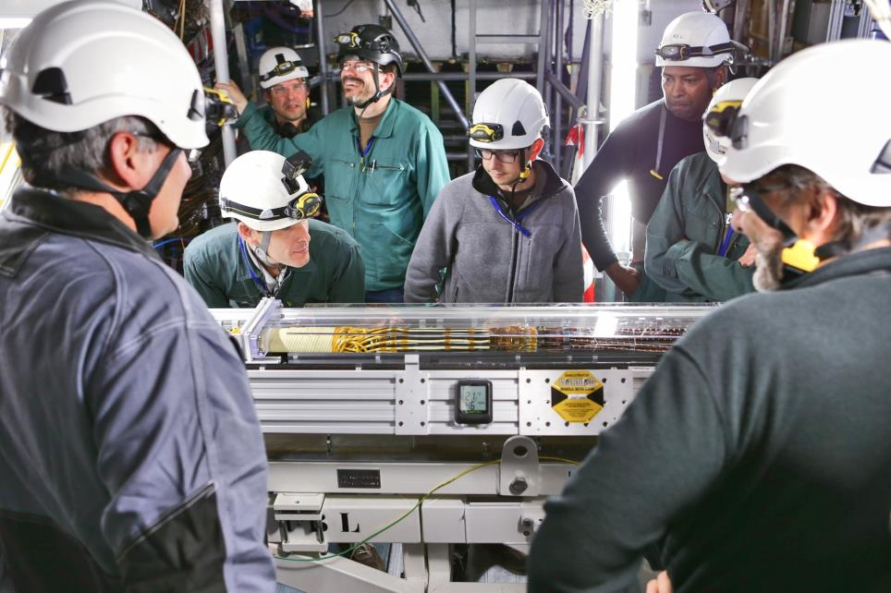

EXAMPLE: EU-FUNDED ATTRACT PROJECT(S)
ATTRACT funds 170 breakthrough projects in Detection & Imaging
Provides funding for developing early-stage ideas and prototypes
Focuses on high innovation with potential outside research
Engages with CBI-like student activities, seeking for unforeseen entrepreneurial opportunities for the young
Purpose is to create a new innovation ecosystem in Europe
ATTRACT is coordinated by CERN (IdeaSquare)
www.attract-eu.com

Slide 6
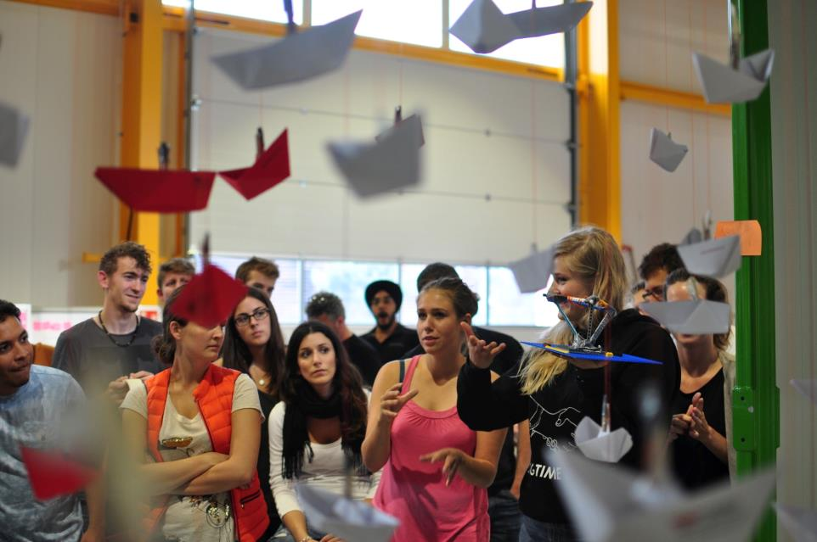

EXAMPLE: MASTER-LEVEL STUDENT COURSE
Challenge Based Innovation (CBI) is 5-6 month MSc-level specialization course for product and service development, run by participating universities from 8 countries around the world
Over 600 students have participated with more than100 conceptual prototypes produced, contributing to UN Sustainable Development Goals
In the course, multidisciplinary student teams learn how to apply Design Thinking – process for new product/service development; engaging with CERN researchers who act as technological coaches in the process
“Work extremely hard, learn and have fun!”
“Fail fast and often to succeed sooner”

Slide 7

EXAMPLE: STUDENT PROJECT PROTOTYPE

Slide 8
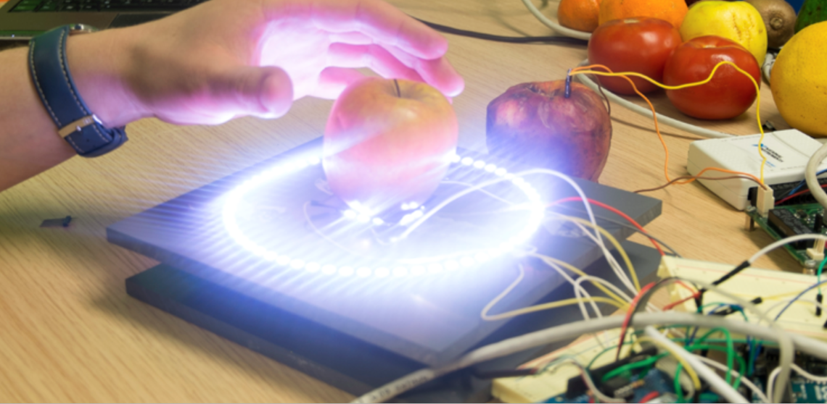
EXAMPLE: STUDENT PROJECT PROTOTYPE

Slide 9
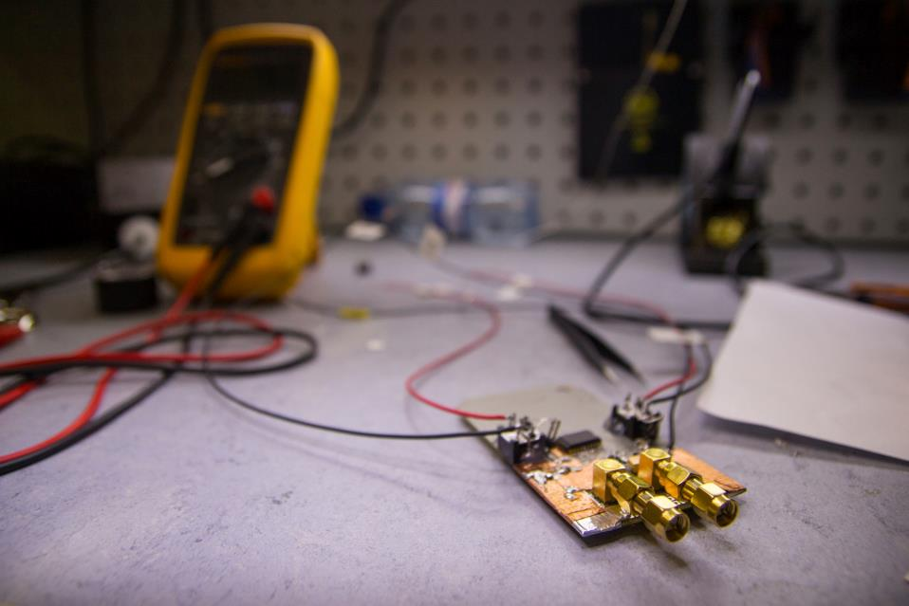
IDEASQUARE OUTPUT
Creating next-generation of young scientists and innovators
Accelerating flow of ideas and time from discovery to application
More effective sharing of ideas, spaces and resources across projects at CERN and outside
New results in socio-economic research about experimental innovation processes (IdeaSquare Journal of Experimental Innovation)
Making societal value of basic research more visible and tangible
New insights for ATTRACT (www.attract-eu.com)

Slide 10
CBI STUDENT INNOVATION CHALLENGE ON NANOSATELLITES
Introduction
IdeaSquare can host max 250 students per year related to Challenge Based Innovation (CBI) program;
Since 2017, discussions have taken place with several universities in CBI (e.g. UPC, TUT, Swinburne) to combine the idea of their own technical student projects around designing, testing, launching and operating small nanosatellite(s), with the human centric, science-society driven CBI-projects at IdeaSquare and allow a more “virtual” participation basis for students<
More recently, loose ideas have been exchanged also with UNOSAT and ESA
Project idea
Such “virtual” project would combine a related physics research aspect (e.g. study of cosmic background radiation distribution, cosmic ray coincidence measurements using multiple satellites etc.), and an initially user-experience & SDG-driven assignment;
Proposed topics: dedicated sensors for early warning of earthquakes or volcanic eruptions; detecting suitable underground water streams to drill wells for accessing drinking water in remote areas; optimizing use of crop pesticides in remote areas etc.;
The collaborative principles rely on open science and open innovation.

Slide 11
Current technical challenges in cube/nanosats (non-commercial)
Limited manoeuvrability (no accurate gyroscopes of complete retrofiring)
Limited power consumption (limited solar power collection and communication capabilities)
Limited communication coverage for LEO (Low Orbit) satellites of just a few minutes, unless a dedicated, shared data receiver network is in place
These constraints impose strong design and testing challenges and require dedicated labs in the universities.
Organizational challenges
Integrating such a program in universities curriculum
Integration of student input
Design, test and operate nanosatellites as part of the university educational programs
Proposed organization
CERN IdeaSquare – IT platform, collaborative approach, hosting related events
ESA – Integration (advice)
UNOSAT – Connection to societal challenges
TAU – Coordination
+ Participating universities
Contact: markku.kivikoski@tut.fi

Slide 12

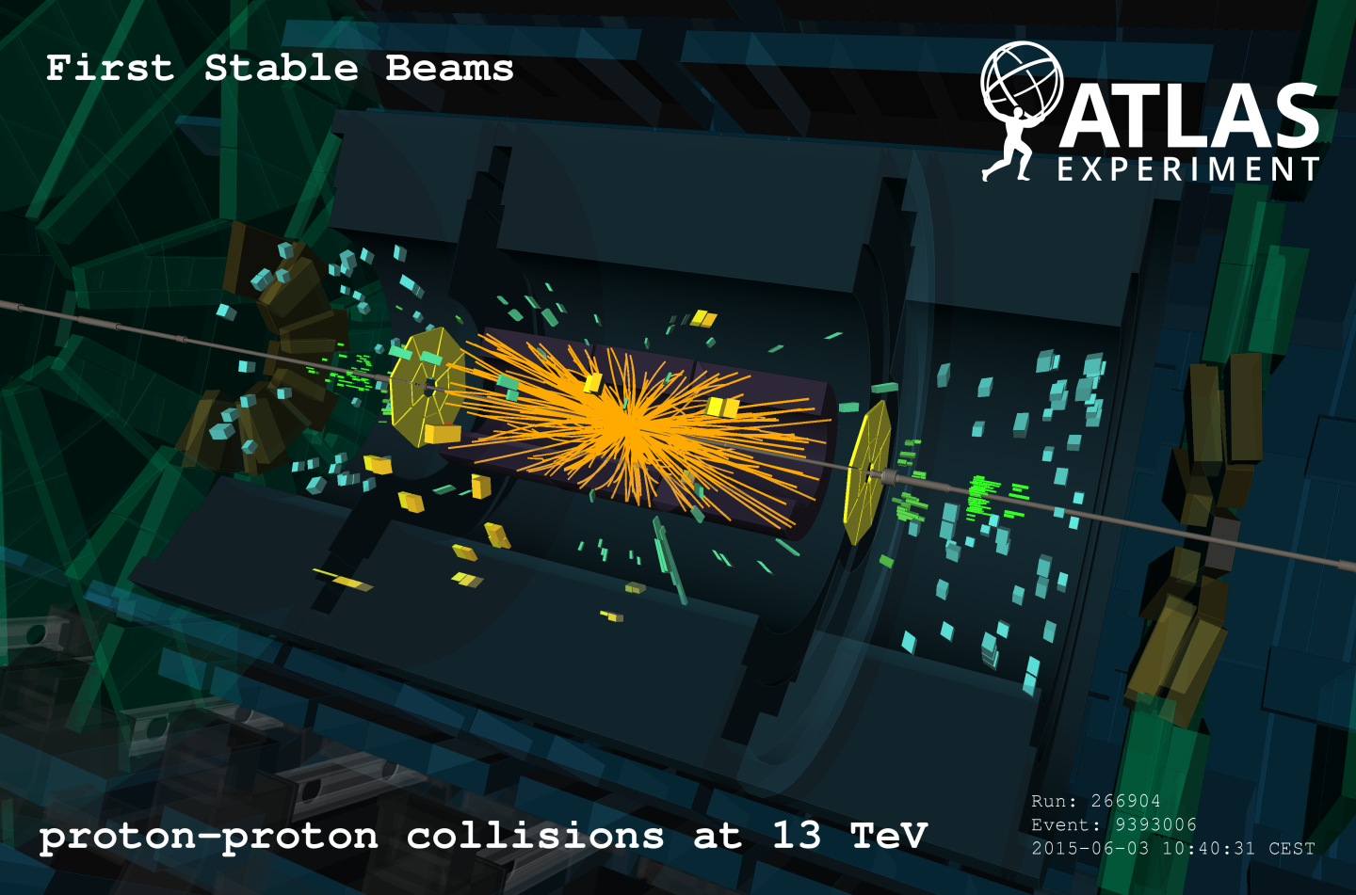


WHAT IS THE MOST INTERESTING LINK FOR NEW INNOVATION?
Detector R&D
Projects
Defined/closed
Technology
MSc-Level Student Programs (e.g. CBI)
Initially undefined/open
Product
Process
Focus

Slide 13
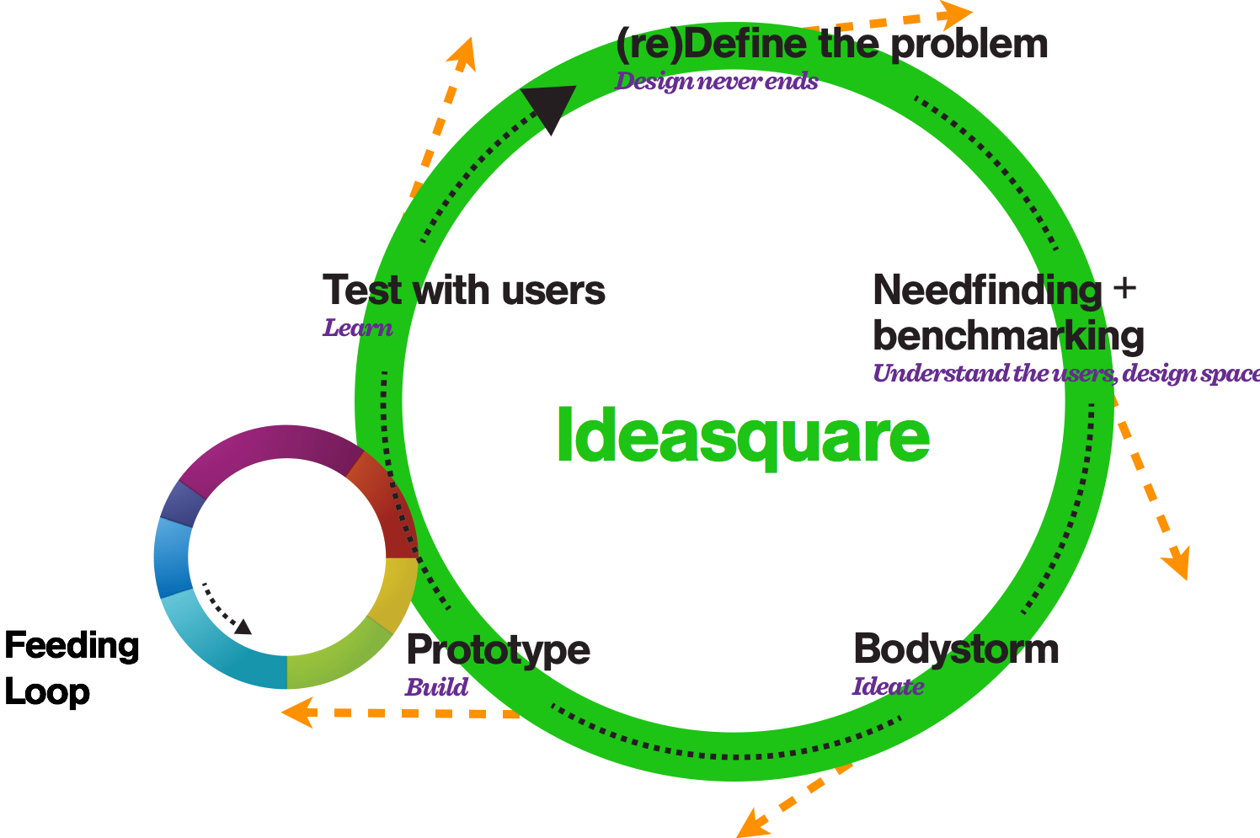
IDEASQUARE
The Small Human Collider

Slide 14


Questions? Comments?
Contact information:
Email
Skype
Let’s have a cup of coffee and make it happen!

