Slide 1
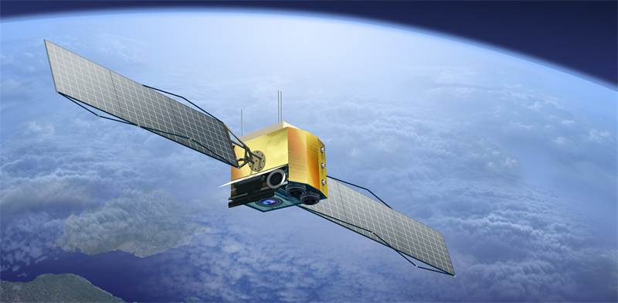
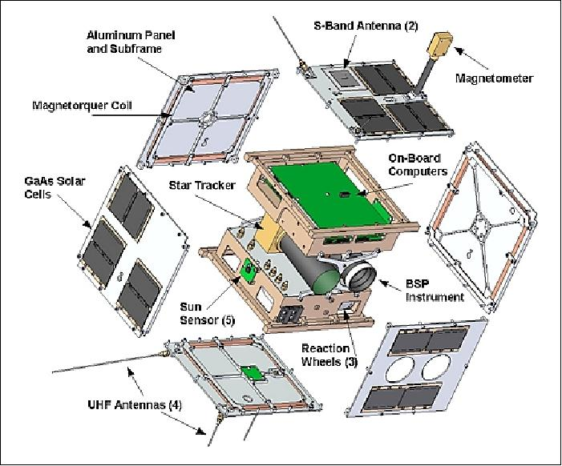
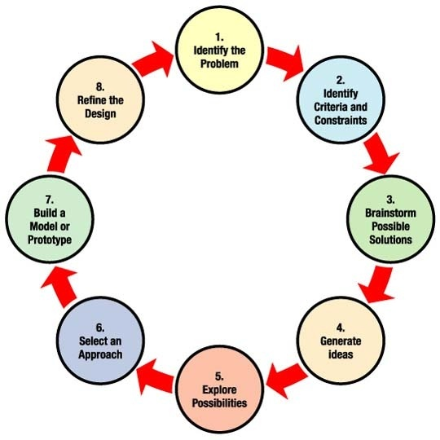
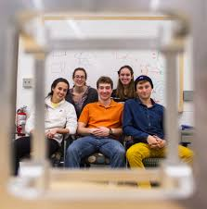
Nanosat Student Initiative (1st thoughts, September 3, 2019)
Notes:
If breakthrough technologies were generated and their value captured in the past just by serendipity …why not creating the necessary conditions to do it systematically?
Illustrations: CERN invented the WWW, Mouse, touch screen way before they were known or re-invented.

Slide 2
The student challenge: to design next-generation of nanosatellite(s) which combine new technologies and earth-observation challenges fulfilling Sustainable Development Goals. This will require detailed investigations among and across several disciplines where both experimental and modelling approaches are welcome. Potential sub-topics could include, among others:
Thermal: thermal protection systems, insulation….
Materials: light-weight materials development and characterization wrt thermo-mechanical fatigue, creep etc…
Structures: static and dynamic behaviour of integrated, multi-purpose structures for the full application range; optimization of structural layout…
Systems: design of on-board systems; electronics, power generation, communications and data links…
Positioning & Propulsion:
Operation, Logistics, Business: network infrastructures and interfaces, launch planning, cost assessment for development-manufacturing-exploitation, commercial viability…
Environmental issues: …
Overall Design and Integration

Slide 3
WG1:
Activity Coordination
WG4:
(thermo) dynamics properties
WG3:
Overall Design and Integration
WG5:
Materials & structures
WG6:
Systems
WG7:
Controls
WG8:
Propulsion
WG9:
Operation, Logistics, Business
WG2:
Collaborative Platform Coordination
Possible Working Groups?
WG10:
Environmental issues

Slide 4
Initiative overview
Minimum effort is 3 years;
If EU funding available it could be extended.
Dedicated Effort
Main Objective
Repository Analysis.
Potential targeted experimentation actions.
Main Objective
Prototype Conceptualization based on I and II.
Main Objective
Repository (peer reviewed) of challenge-specific R&D&I.
Phase I
Phase III
Ramping-up
Approx. 1 year
Phase II
Analysis
Approx. 1 year
Conceptualization
Approx. 1 year
Time

Slide 5
Phase I: Ramping-up
Resources
Existing curricular activities and resources in organizations.
CERN first version of collaborative platform available (allows creating repository).
Effort
Each organization requires limited effort.
Objectives
After 1 year elaborate a peer reviewed database out of existing R&D&I activities specifically challenge oriented.
Modus Operandi
Distribute participating organizations around the challenges (Work Groups).
Each WG has an overall coordinator.
Materials uploaded in repository should be peer reviewed by professors of each institution.
R&D&I database (or repository) based mainly on students’ projects (i.e. master thesis, PhDs, etc).
Increased engagement of Universities

Slide 6
Phase II: Repository Analysis
Resources
Within existing or beyond curricular activities in organizations.
Enhanced version of collaborative platform (CERN).
Effort
Effort from each WG coordinator beyond “daily activities”.
Objectives
After 2 years elaborate a synthesis of the gathered challenge oriented R&D&I.
Modus Operandi
Each WG coordinator spends time elaborating synthesis of results of Phase I and indicates key missing experiments/ simulations.
Propose complementary and missing key experimentation/ simulation suitable to be realised by students.
Integrate results in the synthesis.
Each organization determines the feasibility to carry on key missing experimentation/ simulation
Each WG coordinator elaborates a final report per challenge.

Slide 7
Phase II: Repository Analysis
Must have
In-kind contribution of participants.
Nice to have
EU funding to cover efforts related to synthesis and potential experimentation/simulation as well as other activities (i.e. design of enhanced collaborative platform, meetings, workshops, etc).
Enhanced collaborative platform.
At least 3 meetings among WG Coordinators.
General Workshop(s) for all participant organizations (i.e. to share and check challenges vs. synthesis).
Final synthesis report per challenge.
Extra key experiments/simulations based on synthesis report.

Slide 8
Phase III: Conceptualization
Resources
Existing and beyond curricular activities in organizations.
Enhanced collaborative platform.
Effort
Each organization requires effort beyond “daily activities”.
Objectives
After 3 years conceptualise a prototype of the future nanosat(s).
Modus Operandi
Organise participating organizations around the challenges (Work Groups).
Each WG has an overall coordinator.
General student activity: conceptualize prototype with information of all WGs.

Slide 9
Phase III: Conceptualization
Must have
In-kind contribution of participants.
Nice to have
EU funding to cover efforts related to conceptualization and potential experimentation/simulation as well as other activities (i.e. design of enhanced collaborative platform, meetings, workshops, etc).
Enhanced collaborative platform allowing WG collaborative work (synergies).
Final conceptualization report.
At least 3 meetings among WG Coordinators.
General Workshop(s) for all participant organizations (i.e. to share and check challenges).

Slide 10
High Level Gantt Chart
Minimum effort is 3 years;
If EU funding available it could be extended.
Year 1
Year 2
Year 3
Repository Dedicated R&D&I
Repository Synthesis.
Potential extra experimentation/simulation tailored to students.
Prototype Conceptualization (activity realised by all students)
Basic Collaborative Platform Advanced Collaborative Platform
Increasing in-kind effort required
Increasing EU funding useful.

Slide 11
Next steps: organizing the ramping up Meeting
Identify & invite the willing to take part in this initiative.
Populate the different Working Groups and challenges.
Nominate WG Coordinators.
Start developing the R&D&I repository.

Slide 12


