Slide 1
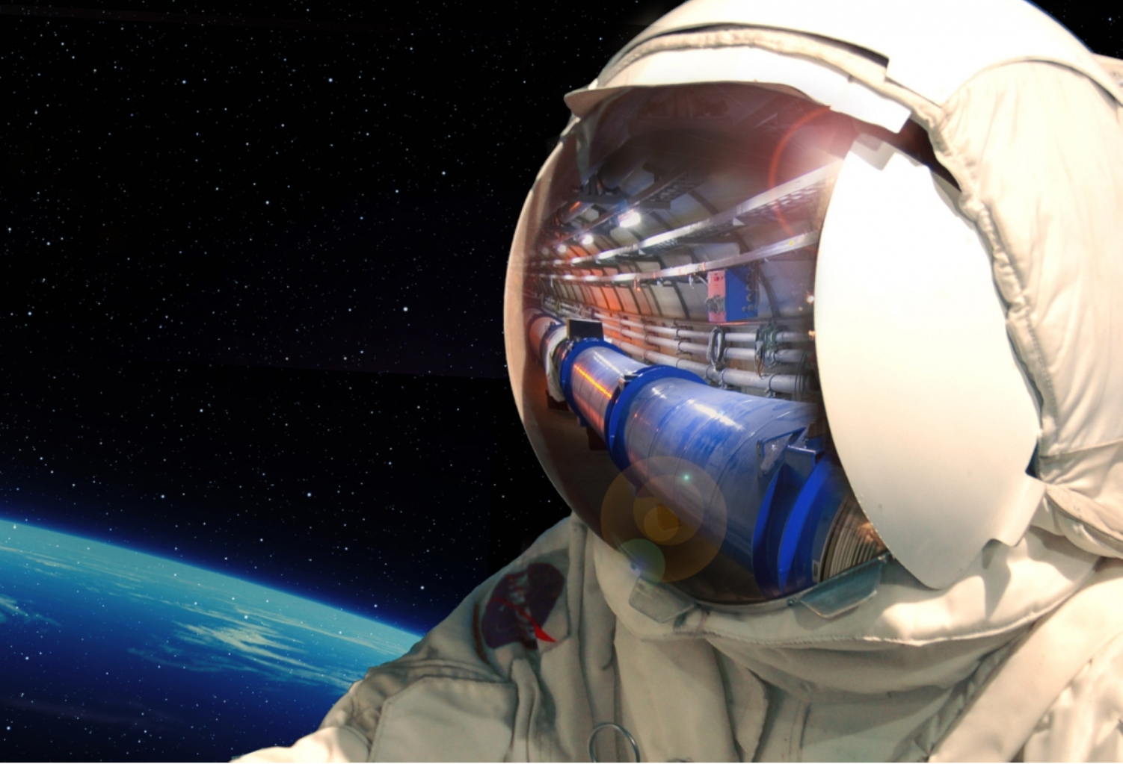
CERN’s
Aerospace
Applications
and Small
Sat Projects
Enrico Chesta
CERN
Knowledge Transfer Group
Aerospace Applications
Nanosat Student Initiative Brainstorming Meeting

Slide 2
CERN Technology Areas…
… and key Application Fields

Slide 3
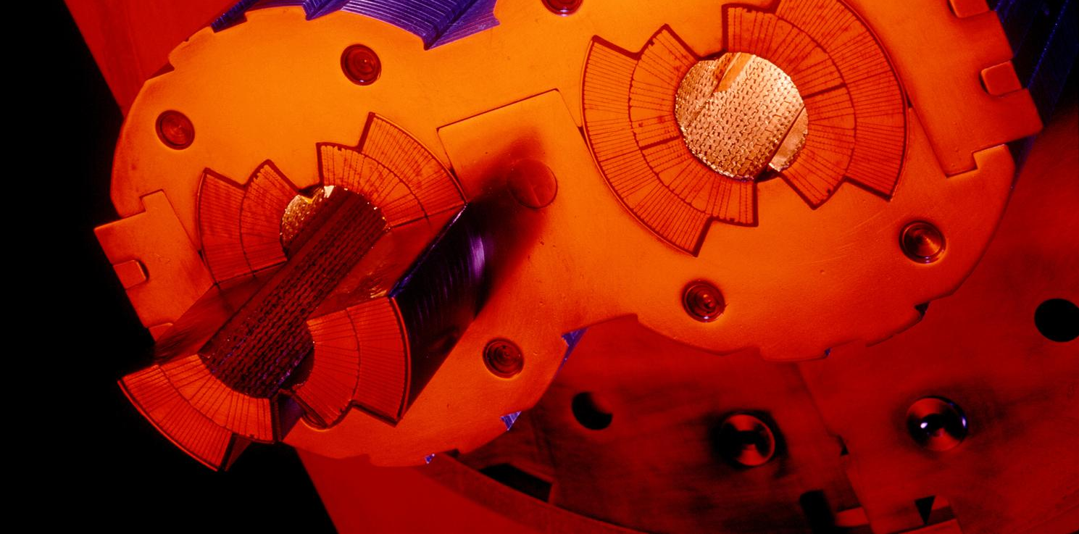
Very high vacuum
Notes:
These 2 pipes need to be as empty as possible (otherwise protons would hit air molecules all the time).
Thanks to turbo-molecular pumps and other technologies, we reach a vacuum of 10^-13 atmosphere in the centre of the pipes: this is 10 times emptiers than on the surface of the Moon or as empty as in the solar system.
The magnetic field which curves the beam, is provided by the coils surrounding the pipes. As each beam holds as much energy as in a high-speed train, the magnets must deliver a tremendous magnetic field of 9 T (tesla). This equates to 200’000 times the magnetic field of Earth (ca 45 micro tesla)
For that, each of the small electric cableyou see around the vacuum pipes (1mm by 10mm section) a current of 11’000 amperes (in comparison in your home there is a current of about 20 amperes in the wires).

Slide 4
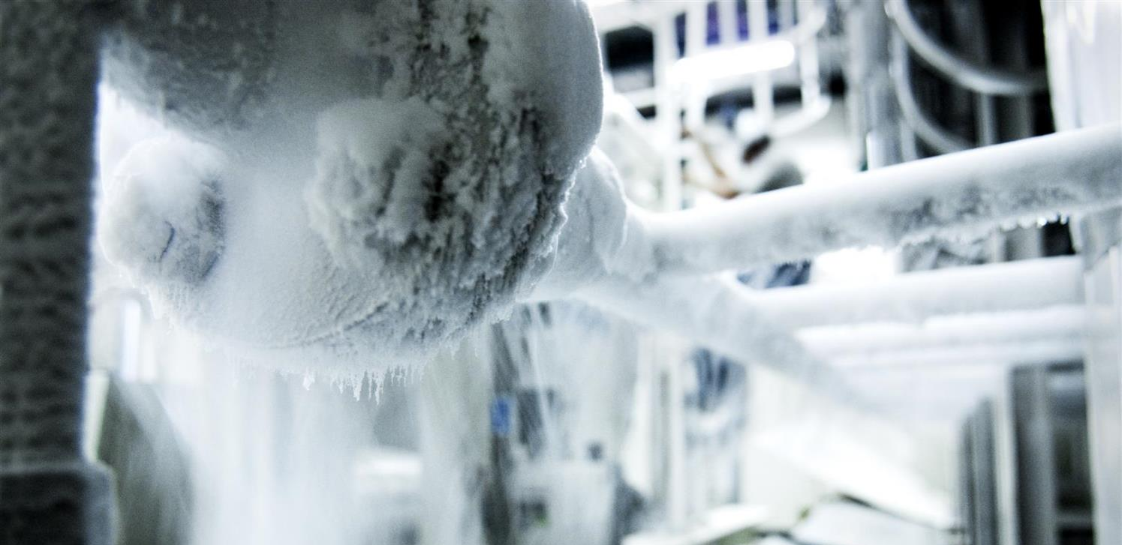
Extreme temperatures
Notes:
That’s why we need to cool down the cables to the lowest temperature possible.
We have to reach -271°C (or 1.9° kelvin, which is 1.9° above the absolute zero).
At that temperature, the cables made of Niobium Titanium (NbTi) are «superconducting», it means they don’t heat up anymore as they have no electric resistance.
LHC is colder than the vast majority of the Universe whose average temperature is 2.725° kelvin (if you look for a «cool» place to work, CERN is a good one)
This is possible thanks to cryogenic facilities using 120 tonnes or 700’000 litres of Helium!

Slide 5
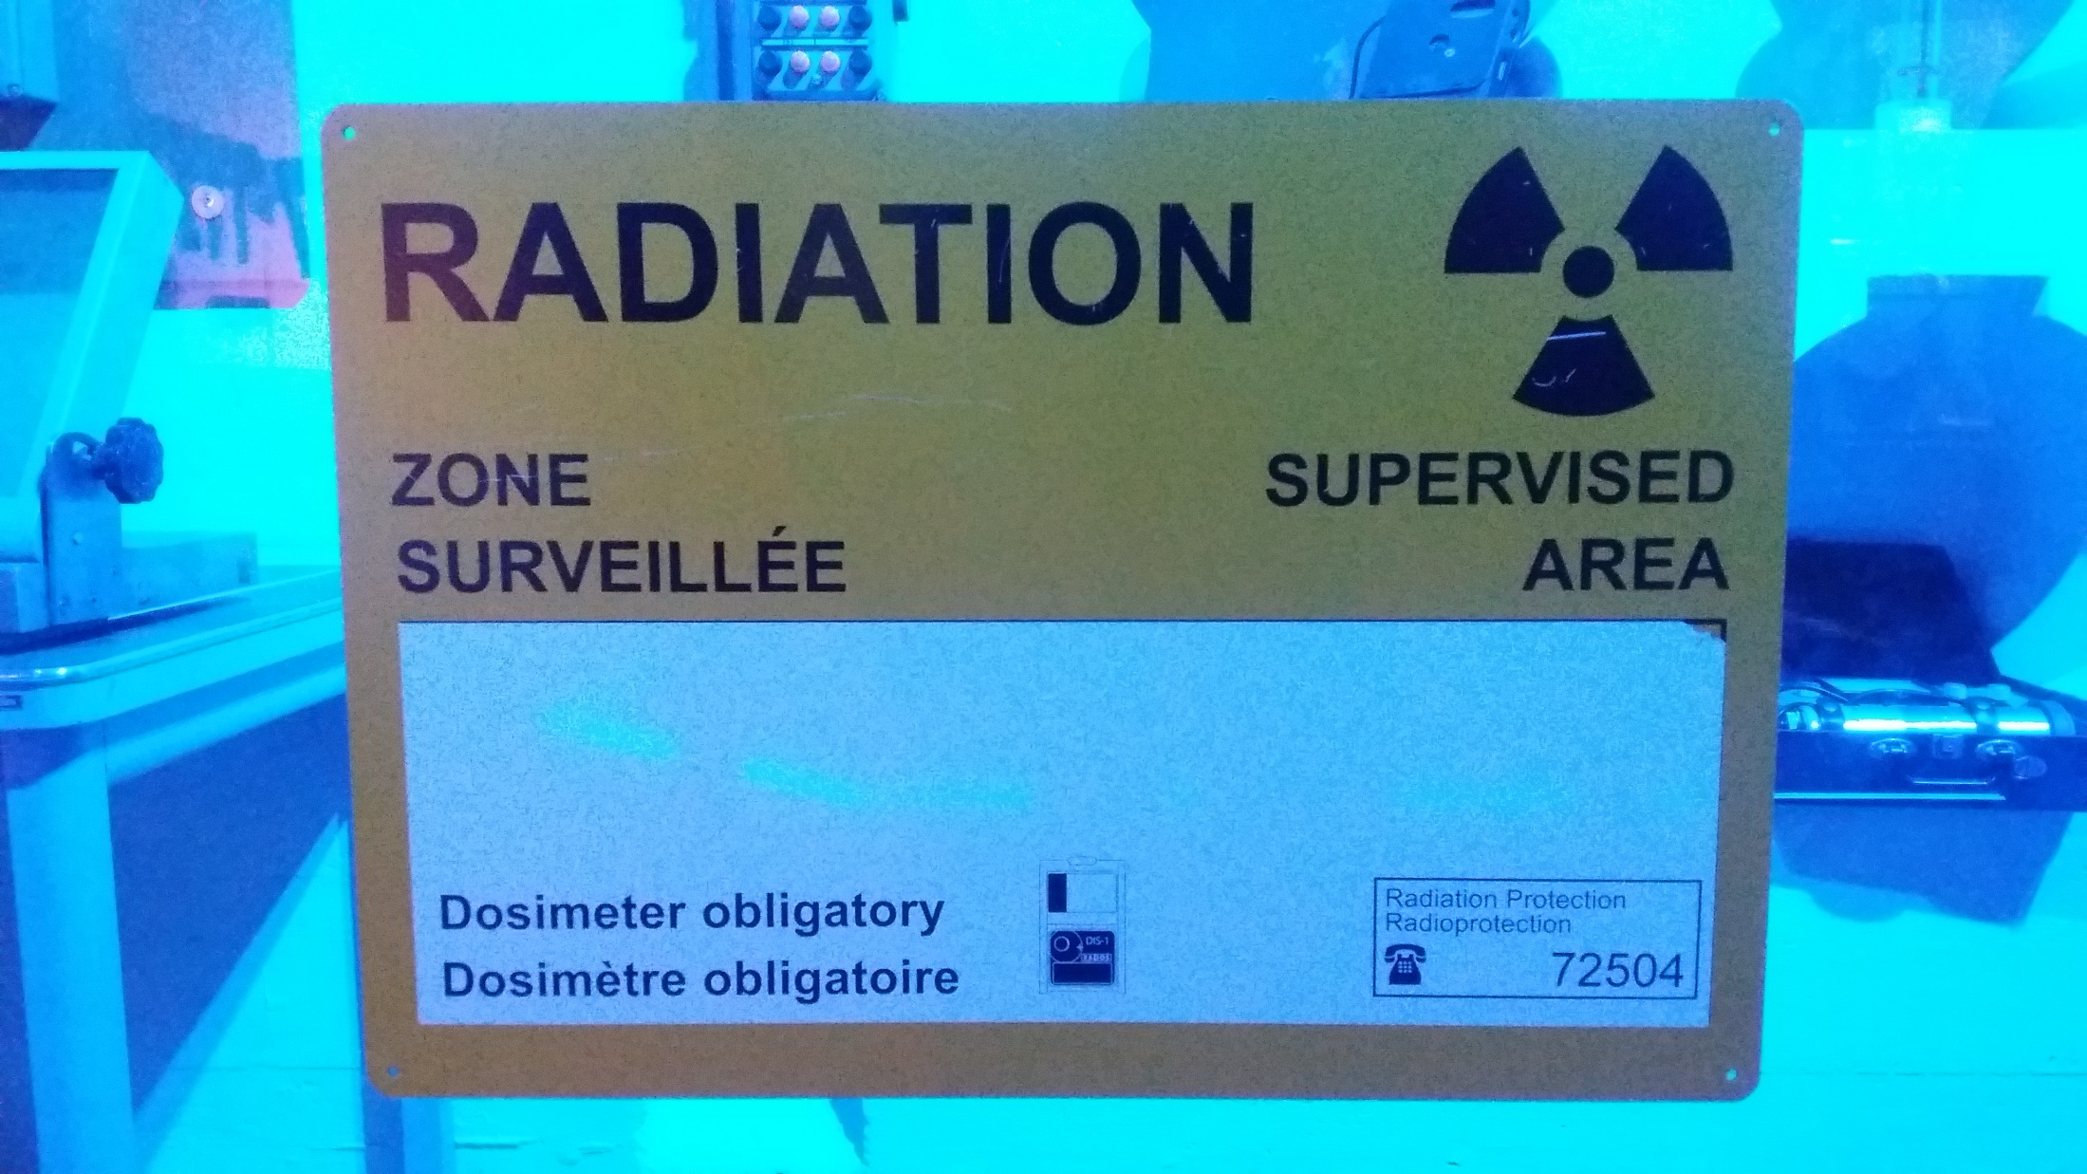
Radiations
Notes:
And the final experiment on the LHC is LHCb. Is is name after the «b» quark which it studies.
In fact LHCb studies the behaviour difference between the b quark and the anti-b quark.
It tries to find difference in the symmetry which may account for the lack of antimatter in the Universe.
It gathers 800 physicists from 69 universities and institutes in 17 countries.

Slide 6
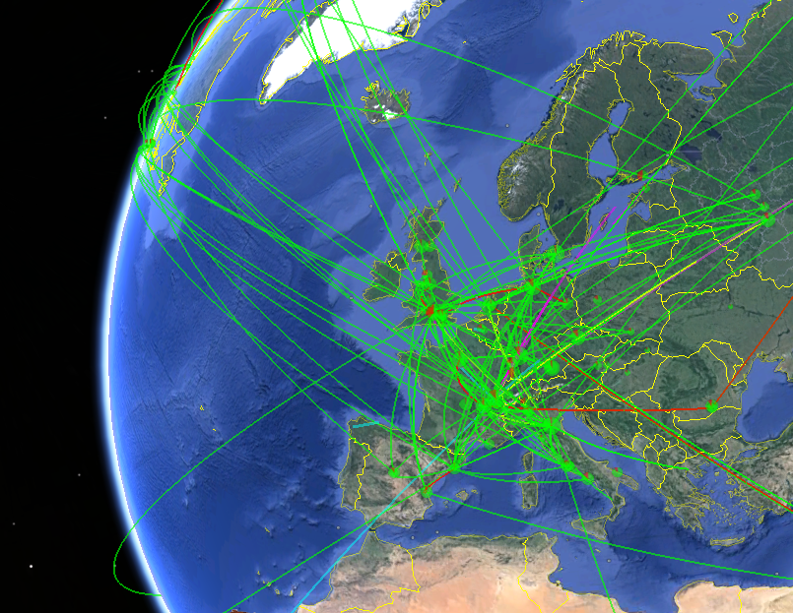
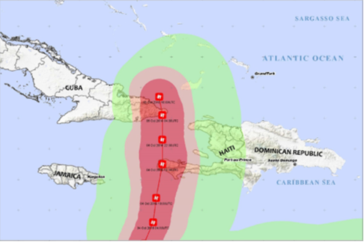
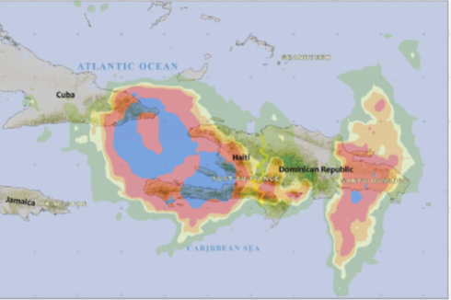
Big data
Collaboration with UNITAR-UNOSAT
Notes:
All these detectors will generate loads of data… about 1 PB (petabyte = million of gigabyte per… SECOND!)
Impossible to store so much data. Anyway not needed.
The event the experiments are trying to create and observe are very rare.
That’s why we make so many collisions but we keep only the interesting ones.
Therefore next to each detector is a «trigger», a kind of filter made of various layers (first electronic, then computers) which will select and keep only 1 collision out of a million average.
In the end will still generate dozens of Petabytes of data each year. We need about 200’000 computer CPUs to analyze this data.
As CERN has only about 100’000 CPUS we share the date over more than 100 computer centre over the planet (usually located in the physics institutes participating to the LHC collaboration). This is the Computing Grid, a gigantic planetary computer and hard drive!

Slide 7
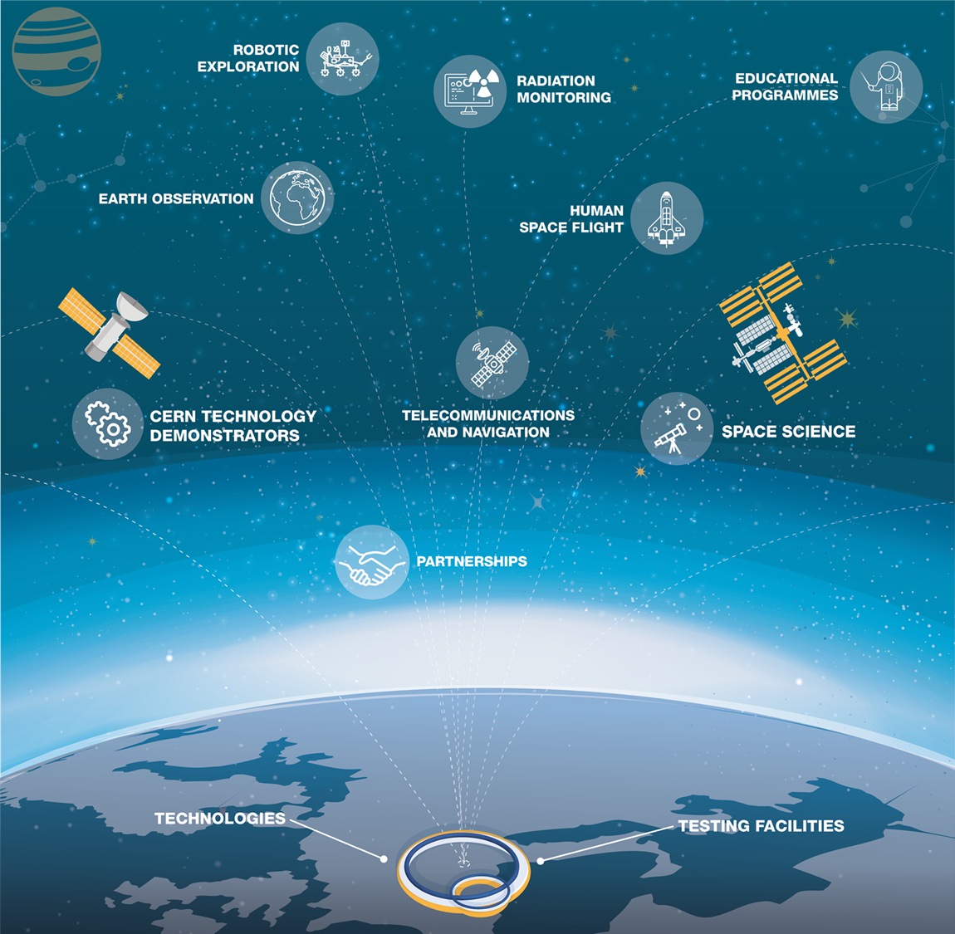
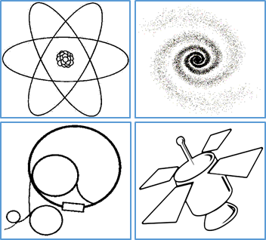
CE
RN
A
E
R
O
S
P
A
C
E
A
P
P
L
I
C
A
T
I
O
N
S

Slide 8



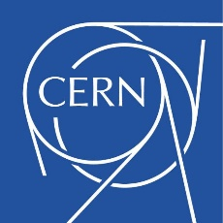




Institutional Cooperation
Implementation phase
Definition phase

Slide 9


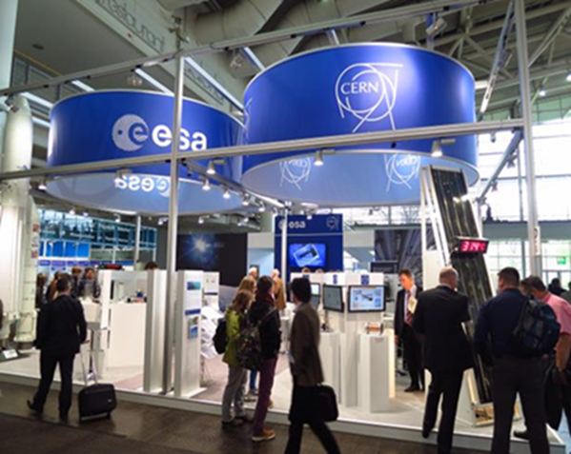
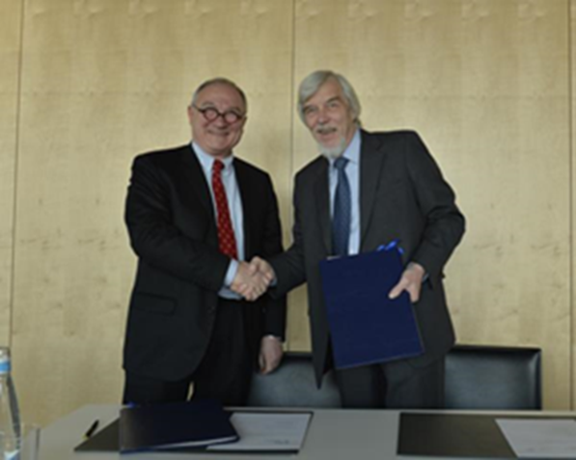
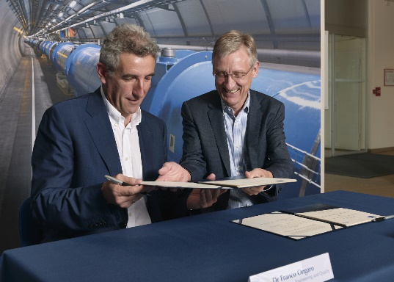
CERN-ESA Cooperation
Geneva, 28/03/14
Signature of CERN-ESA co-operation agreement:
“CERN and ESA have common roots and share a long history of pioneering research work in their respective fields. This new cooperation agreement will foster synergies between the expertise, know-how and facilities available in the two Organizations.”
12 identified technology areas under assessment to identify bilateral collaborative projects
Implementing protocol signed on 11/07/19 in the field of «Radiation Environments, Technologies and Facilities » - 7 specific projects

Slide 10
CERN’s Value Proposition for Aerospace
https://cernbox.cern.ch/index.php/s/8vyxln9xa8Z6n0s
DATA ANALYTICS
CERNs knowhow and experience with ‘big data’ analysis for high energy physics and control of systems used in the LHC.
HIGH VOLUME DATA MANAGEMENT & STORAGE
CERN’s unique knowhow derived from storage and worldwide distribution of vast amounts of data
MACHINE LEARNING & DEEP LEARNING
Knowhow and experience derived from early adoption of neural network techniques by particle physics community
HIGH & ULTRA-HIGH VACUUM SYSTEMS
Expertise in the design, construction and operation of one of the largest and most complex vacuum systems in the world
CRYOGENICS
CERN’s unique knowhow derived from 60 years of designing, installing and operating the world’s largest cryogenics installation
MANUFACTURING AND MECHANICAL PROCESSES
CERN develops manufacturing solutions for machines operating at the limits of precision, size, speed and power
MATERIAL SCIENCE
Novel fabrication methods and analysis procedures for materials operating at the extremes of precision and endurance
METROLOGY
Unique know-how derived from the precise construction and operation of some of the world's largest and most complex machines
OPTOELECTRONICS & MICROELECTRONICS
CERN’s unique know-how derived from years of designing, testing and installing microelectronics exposed to harsh environments.
PARTICLE TRACKING & CALORIMETRY
CERN’s unique know-how derived from years of designing, testing, building and operating complex detector systems.
RADIATION PROTECTION & MONITORING
CERN’s unique knowhow derived from years of designing, installing and operating systems to monitor level of radiations.
RADIO FREQUENCY TECHNOLOGY
Expertise in the design, construction, maintenance and upgrade of one of the most complex operational RF systems in the world
ROBOTICS
CERN’s unique knowhow in designing, building, operating robotics systems for interventions in harsh environments
SENSORS
CERN’s unique knowhow derived from years of developing, using, characterizing a large amount of sensors.
SUPERCONDUCTING MAGNETS
CERN’s knowhow and facilities for end-to-end design, assembly, testing and operation of superconductive magnet systems

Slide 11
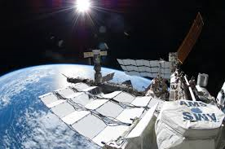
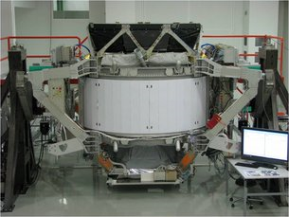
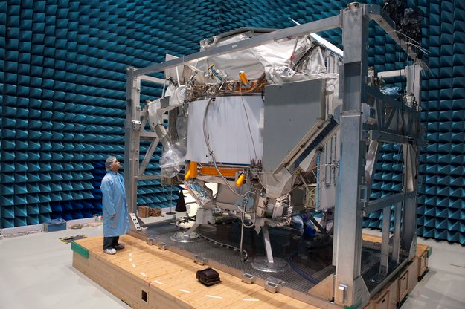
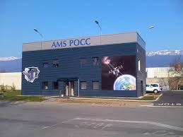
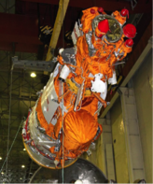
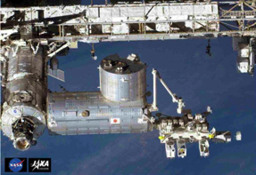
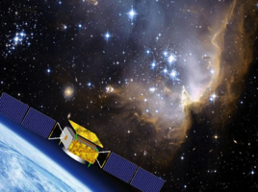
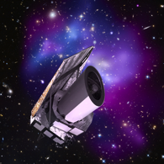
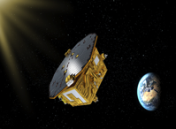
CERN Supported Scientific Experiments in Space - Examples
Astroparticle Physics – Astrophysics - Cosmology
AMS-02
Nucleon
LISA Pathfinder
EUCLID
CALET
DAMPE

Slide 12
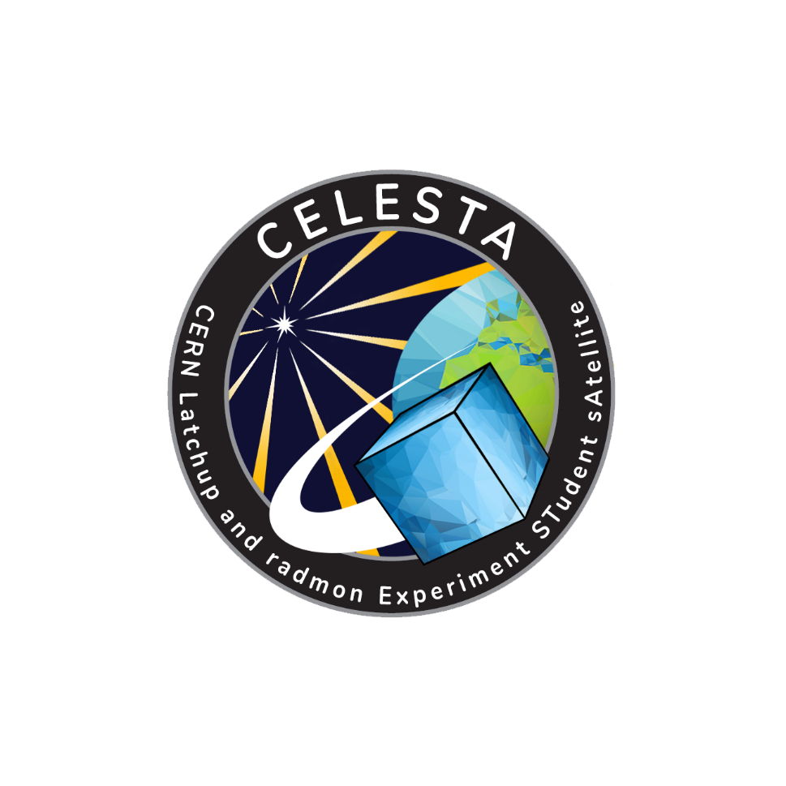
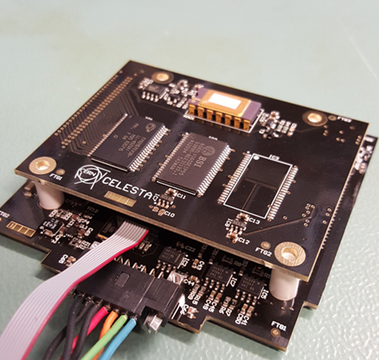
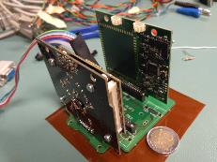
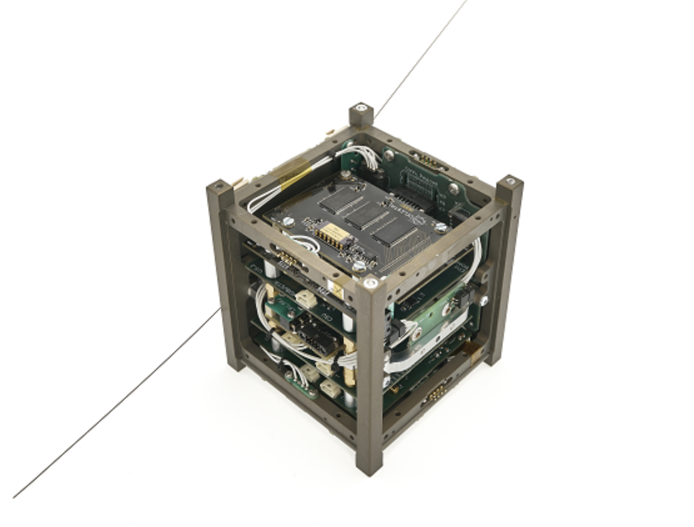
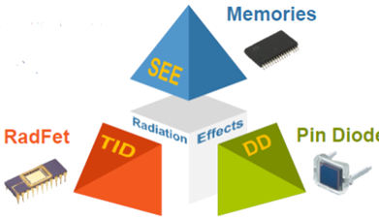
CELESTA – First CERN driven nanosat
Objectives:
Technological
  SpaceRadMon space demonstration
  CHARM ground validation
Scientific
  Radiation monitoring
Educational
  Collaboration with University of Montpellier
  Selected by ESA Fly Your Satellite programme for launch in 2020

Slide 13
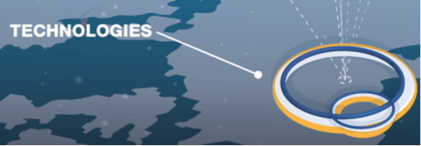
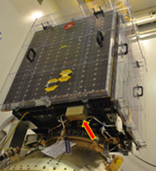
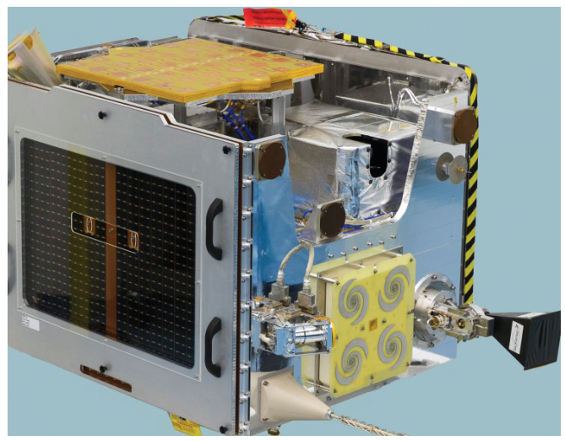
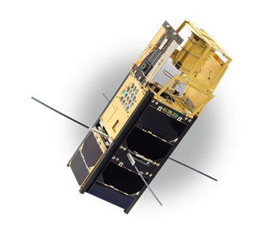
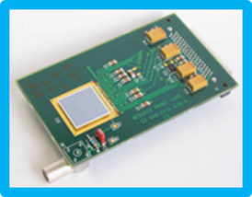
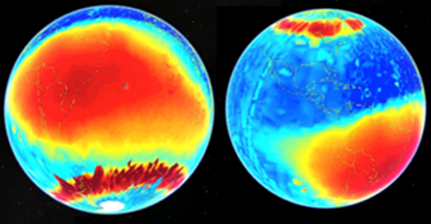
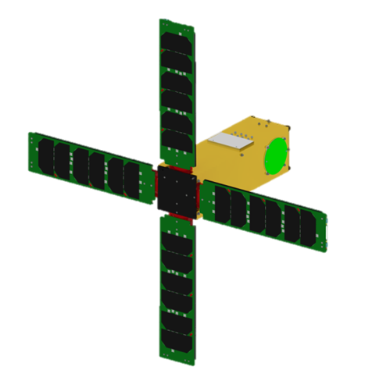
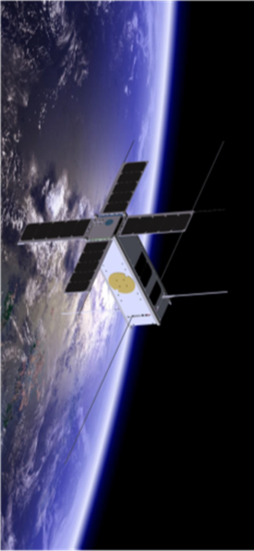
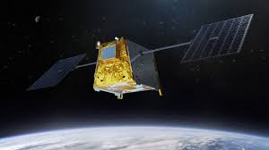
CERN’s technologies in small satellites
Completed/ongoing:
Timepix in-flight demonstration on PROBA-V (SATRAM, 2013), TechDemoSat-1 (LUCID, 2014-17), Orion EFT-1 (BIRD, 2014), VZLUSAT-1 (miniaturized X-ray telescope, 2017), ISS
In preparation:
SpaceRadMon on NIMPH, IODA, TAUSAT
EyeSat radiation characterization in CHARM

Slide 14
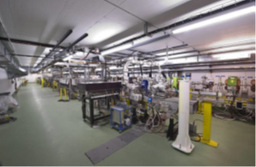
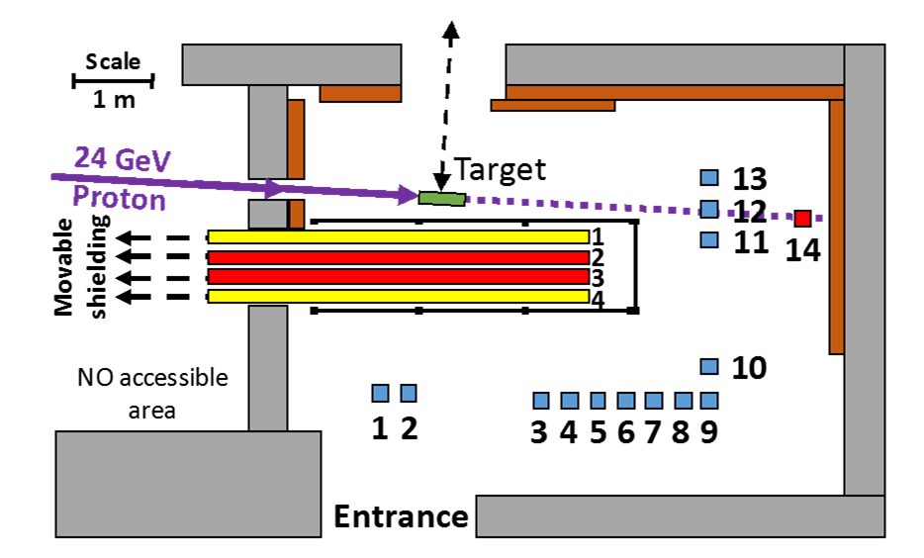


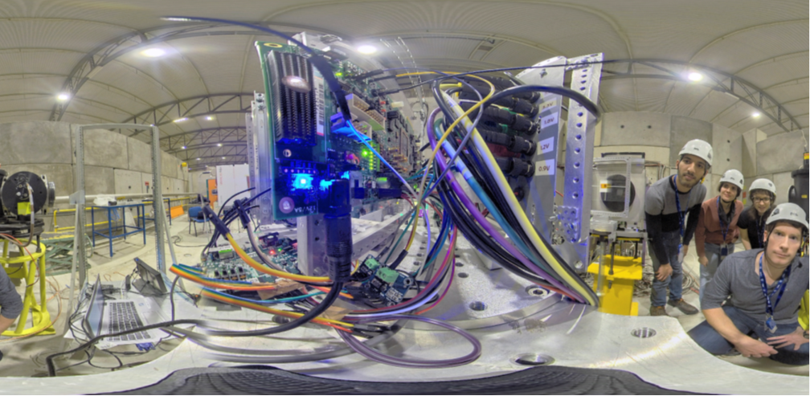
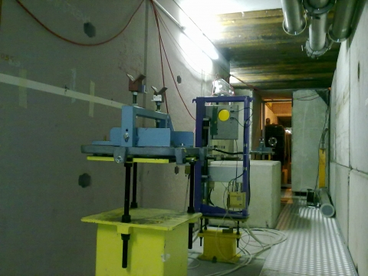
Unique Irradiation Facilities
VESPER
Very energetic Electron facility for Space Planetary Exploration missions in harsh Radiative environments
CHARM
CERN High energy AcceleRator Mixed field/facility
SPS North Area
Ultra High Energy Heavy Ions test line
CERF
CERN-EU high-energy reference radiation facility

Slide 15
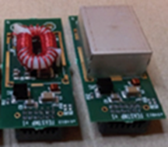
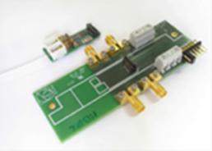
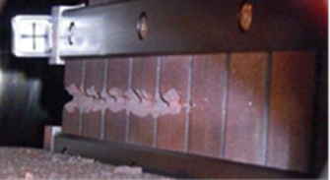
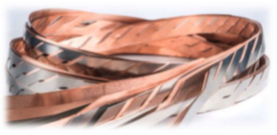
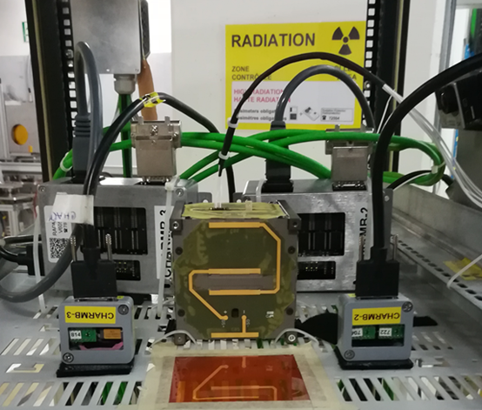
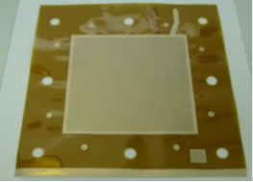
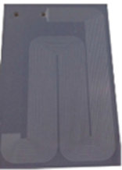
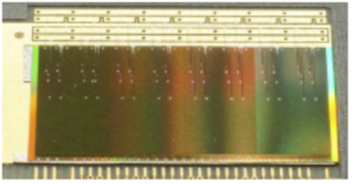

Exemples of CERN Technologies for Space
HTS magnets
Rad-hard electronic devices for power distribution and high speed optical links
Micro-engineering and advanced material solutions for thermal management
Expertise and data-base on COTS for space and rad-tol electronics
Detector technologies based on Monolithic Active Pixel Sensors (MAPS) or Gas Electron Multipliers (GEMs)
Data handling - analysis software and AI algorithms

Slide 16
Exemple of COTS application to Earth Observation

Slide 17
Exemple of AI application to Earth Observation

Slide 18
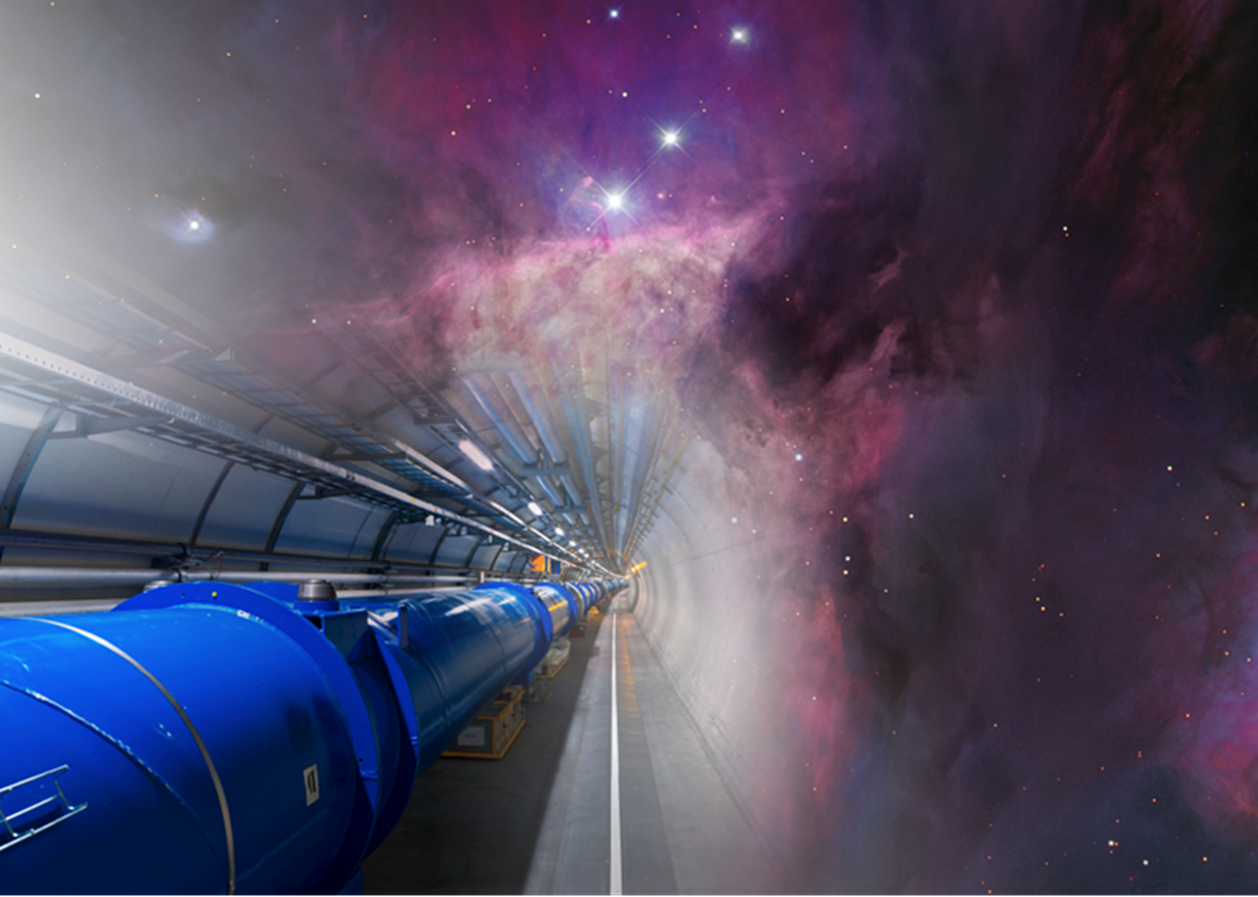
For more informations:
www.cern.ch/kt/aerospace
enrico.chesta@cern.ch

