Slide 1

Gravity waves from ALP dark matter fragmentation
Jürgen Berges, Aleksandr Chatrchyan, Joerg Jaeckel
Institute for Theoretical Physics, Heidelberg University, Germany
Based on: JCAP 1908 (2019) 020, in preparation

Slide 2
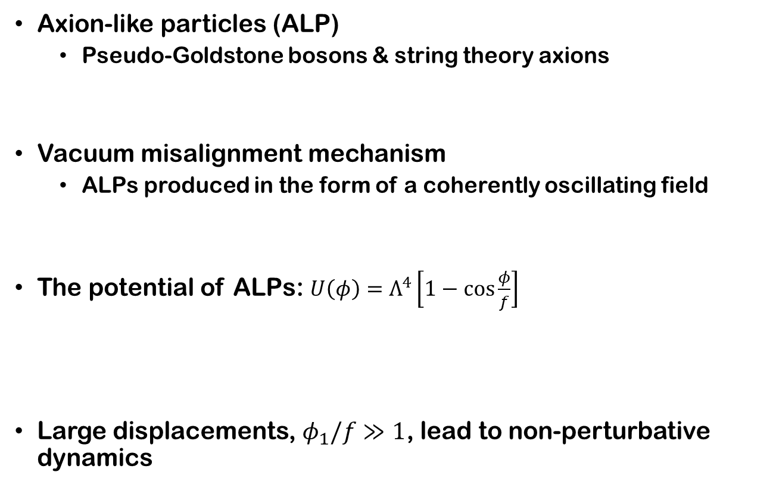

Axion-like particle dark matter
Axion-like particles (ALP)
  Pseudo-Goldstone bosons & string theory axions
Vacuum misalignment mechanism
  ALPs produced in the form of a coherently oscillating field
The potential of ALPs: $U\left(φ\right)=Λ^{4}\left[1−\cos{\frac{φ}{f}}\right]$
Large displacements, $φ_{1}/f≫1$, lead to non-perturbative dynamics
Arias et al.
JCAP 1206 (2012) 013
$$+\frac{m^{2}φ^{2}}{2}$$
Monodromy
Discrete shift symmetry
Silverstein, Westphal
PRD 78 (2008) 106003
Berges, Chatrchyan, Jaeckel
JCAP 1908 (2019) 020

Slide 3



Outline of the dynamics
1. Vacuum misalignment
2. Coherent oscillations
$$H∼\frac{m_{initial}}{3}$$
$$φ_{1}$$

Slide 4
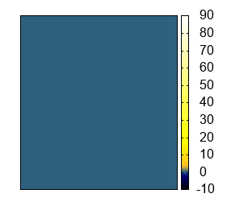

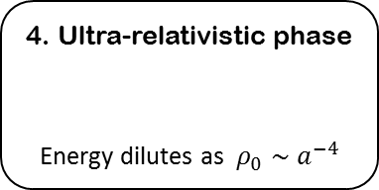


Outline of the dynamics
1. Vacuum misalignment
2. Coherent oscillations
3. Fragmentation of the ALP field
Emission of gravity waves
Density contrast: $δ\left(x\right)=\frac{ρ(x)−ρ_{0}}{ρ_{0}}$
$$H∼\frac{m_{initial}}{3}$$
$$φ_{1}$$
5. Non-relativistic phase
Warm dark matter
4. Ultra-relativistic phase
Energy dilutes as $ρ_{0}∼a^{−4}$
$$p∼m_{final}$$
Amin et al, JCAP 1012 (2010) 001,
Kusenko, Mazumdar
PRL 101 (2008) 211301

Slide 5
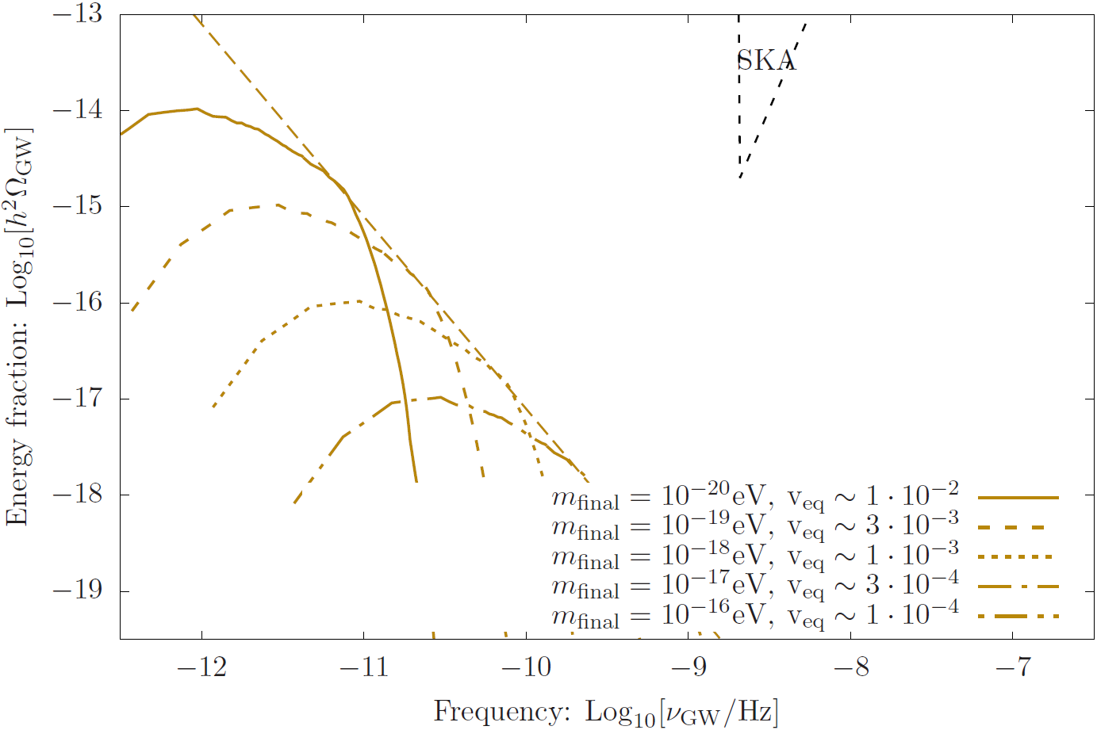

Stochastic GW background
Usually $m_{initial}∼m_{final}$ and the GW signal is weak.

Slide 6
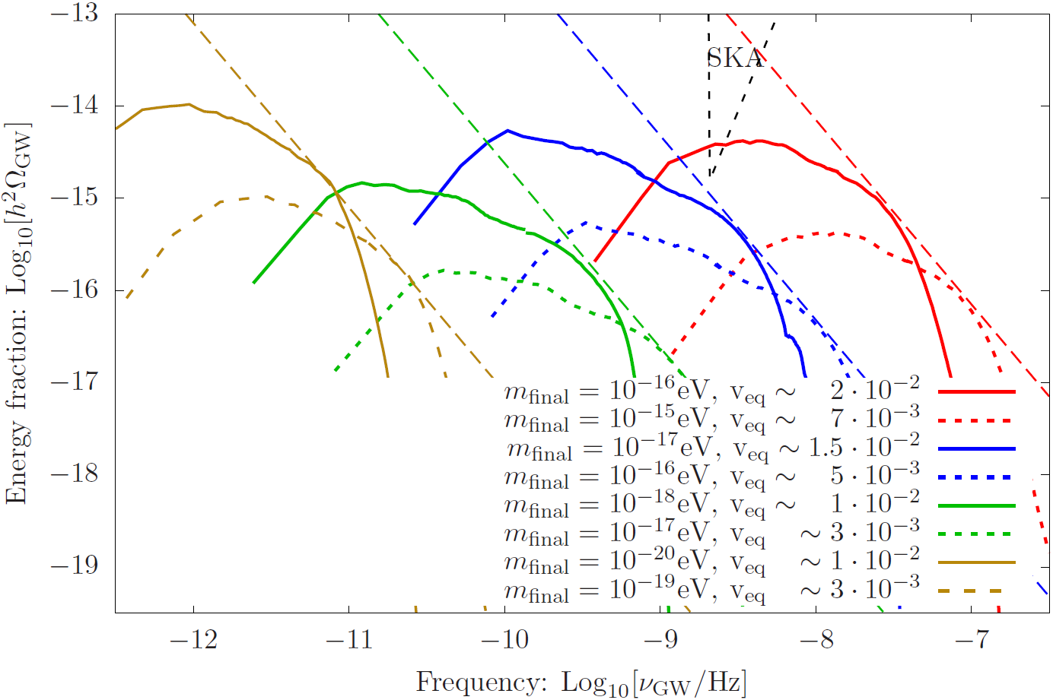
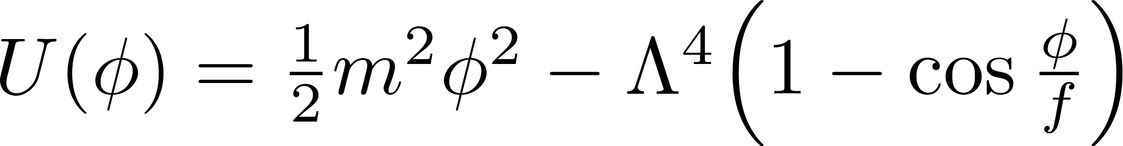





Stochastic GW background
Usually $m_{initial}∼m_{final}$ and the GW signal is weak.
If $r=\frac{m_{final}}{m_{initial}}$ is very small, signal is stronger.
E.g. in the case of a double cosine
  or of an inverted cosine
Similar mechanism
$$r={10}^{−3}$$
$$r={10}^{−2}$$
$$f={10}^{14}GeV$$
$$m_{final}={10}^{−16}eV$$
$$r={10}^{−1}$$
Machado et al
JHEP 1901 (2019) 053

Slide 7
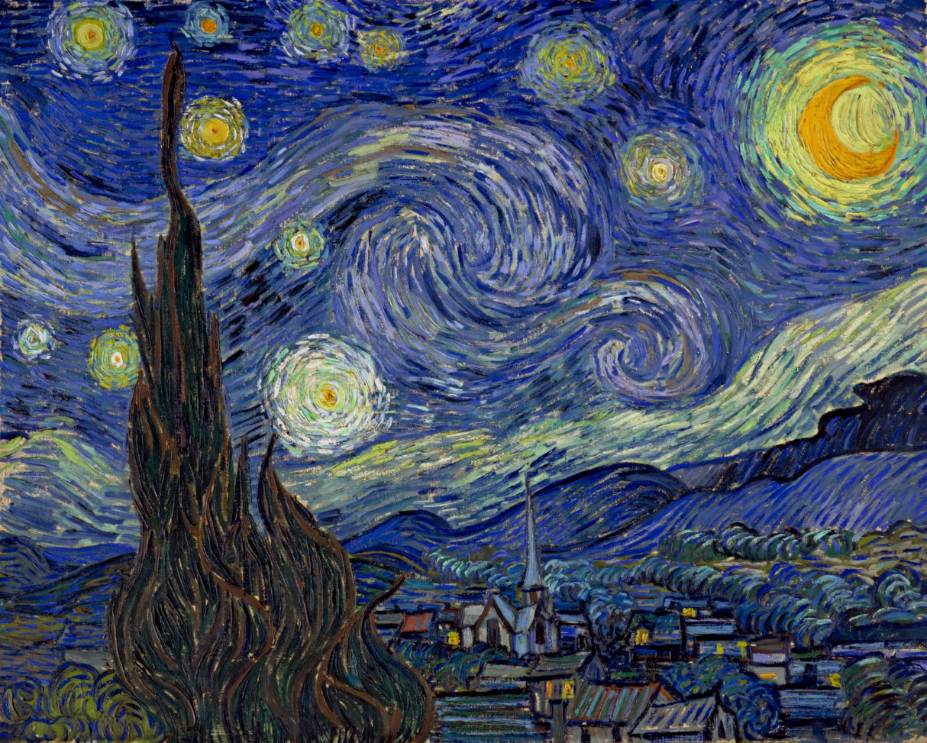
Thank you for your attention!

