Slide 1



System level testing status in the radiation effects community
A. Coronetti
CERN, 1211 Geneva, Switzerland
RADSAGA System Level Test Review
November 12th, 2019
RADSAGA is a project funded by the European Union’s Horizon 2020 research and innovation programme under the MSC agreement no. 721624.

Slide 2
System level testing status in the radiation effects community
Some definitions
In the context of radiation hardness assurance a system shall be considered as any assembly of two or more devices:
which concur to deliver a functionality that none of them can deliver by itself;
for which at least one of the devices is sensitive to radiation effects which can impact the functioning of at least one other device or the assembly as a whole.
Custom-built system based on COTS parts
Designed by the end user with direct control on features such as part selection and traceability
Radiation-based design
Fully commercial (COTS) System
System bought off-the-shelf with no control on part selection and traceability
No architecture/schematics available
Not radiation-based design
E.g. SoC
RADECS EAQMCS, October 28th, 2019

Slide 3
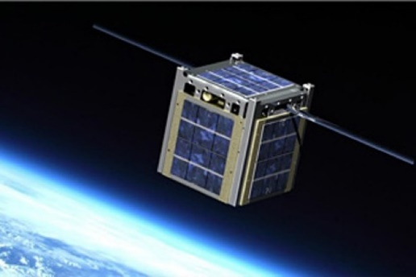
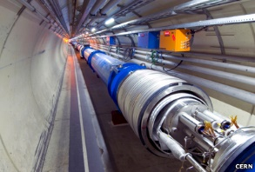

System level testing status in the radiation effects community
Application areas
People in the community are using system level testing
Space
Limited in-situ testing
Dedicated to commercial boards/subsystems
Accelerator
Implemented in the RHA process for accelerator equipment at CERN
Ground and avionics
Test of specific applications
Guidelines
Dedicated to high reliability electronics
RADSAGA System Level Test Review

Slide 4
System level testing status in the radiation effects community
System Level Testing as a Tool
Increasing Cost
Component level testing
+ system analysis
+ system level testing
Full picture
Component level testing + system analysis Extensive dataset
No testing
No radiation data
System level testing only
Restricted dataset
Risk Acceptance
Better assurance than no testing
May replace some component level testing
Too many devices to be characterized
Test real application, not user-defined stimuli
In synergy with standard component testing
Complex systems: not easy to identify all failure modes from system analysis
Many systems: higher likelihood of rare events
RADSAGA System Level Test Review

Slide 5
System level testing status in the radiation effects community
System Level Test Types
Global on the system
Irradiation of full system
Targeted on components
Focus on only one component to check effects on system functionality
Synergistic effects
Radiation source provides TID, DD and SEE
CHARM
High energy protons
Isolate TID from SEE (or DD)
Individual radiation sources
Co-60 + Spallation neutrons
Co-60 + Very high energy heavy ions (usually rather low LET)
Fault injection schemes
Only effects (and user-biased), no rate for application
Laser testing
Only effects, no rate for application
Heavy ion testing
Effects and rate as a function of LET
RADSAGA System Level Test Review

Slide 6
System level testing status in the radiation effects community
System Level Test Types
Global on the system
Only high penetration beams
Targeted on components
Multiple ion strikes are rare in application
Beam field homogeneity needed
Reduced beam time cost
Reduced sample preparation cost
Global functionality monitoring and rates
May not be cheaper than individual component testing
Test planning may be very elaborate
No global functionality rates
Still needs sample decapping
Verification of mitigations
Get information on failure modes features
Assess need for additional mitigations
RADSAGA System Level Test Review

Slide 7
System level testing status in the radiation effects community
Promising radiation testing methodologies
Survey from the RADECS Emerging Assurance Qualification Methods for Commercial Systems Modeling and Experiments, Pasadena, CA, October 28-29, 2019
Test while you fly
(directly on spacecrafts)
Laser testing
High energy heavy ions
(e.g. NSRL)
Use of radiation sources from hospitals and academia
RADSAGA System Level Test Review

Slide 8
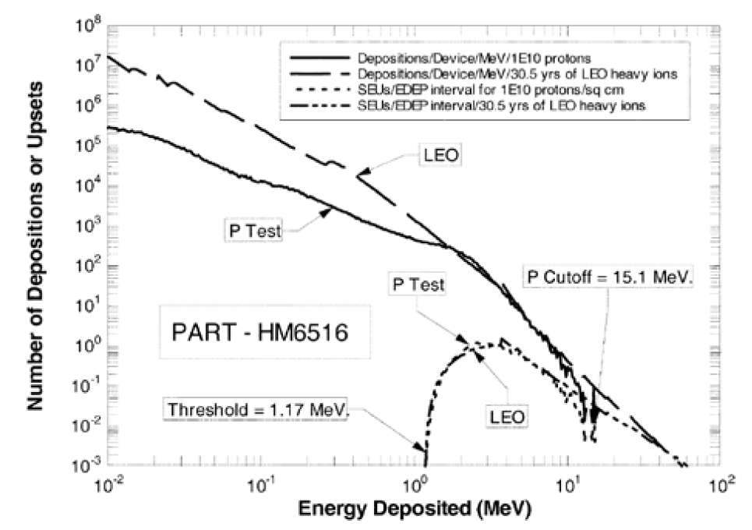
System level testing status in the radiation effects community
Existing Guidelines
Board level proton testing book of knowledge for NASA electronics parts and packages program (Guertin, 2017)
Example application: non-critical electronic equipment for the ISS
Test with higher energy to limit TID (200 MeV)
Good estimator for soft errors, but very poor for destructive events
It provides only a quite large upper bound to failure rate prediction
  Untested board upper bound 0.1 failure/board-day
  Fluence of 10¹⁰ p/cm² 0.01 failure/board-day
  Fluence of 10¹¹ p/cm² 0.003 failure/board-day
Estimated to cost 10 times less than individual device testing
Energy deposition and SEU rates for ISS orbit and proton testing. Good agreement for energy depositions in the 1-10 MeV range. The region above the proton testing cutoff brings a marginal contribution.
RADSAGA System Level Test Review

Slide 9
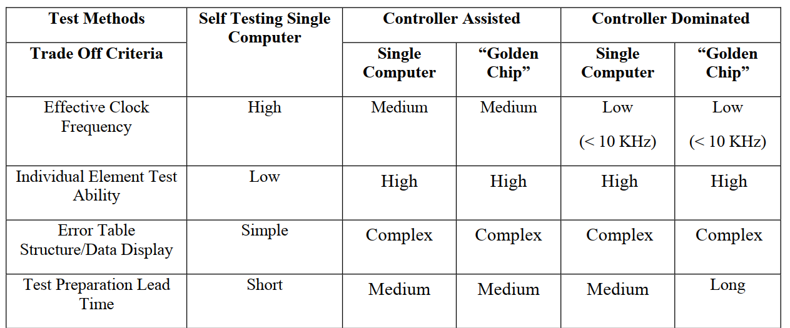
System level testing status in the radiation effects community
Existing Guidelines
Guideline for ground radiation testing of microprocessors in the space radiation environment (Irom, 2008)
First good example of testing complex devices whose findings can be extended to digital systems
Provides different test schemes
Provide a list of sub-components that have to be tested
  Registers
  Cache memory
  Operational SW
  Program hangs
Reports on orders of magnitude variations in the functional SEFI cross section as a function of firmware and software
Other works:
FPGA Single Event Effect Radiation Testing (Berg, 2012)
SoC Single Event Effect Testing Guideline development (Guertin, 2013)
RADSAGA System Level Test Review

Slide 10
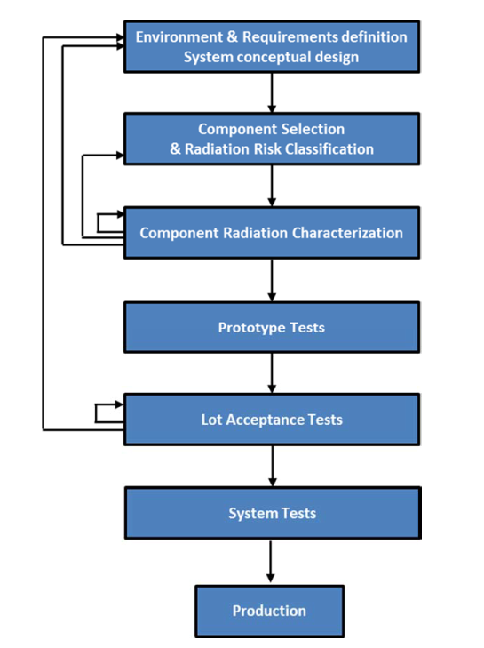
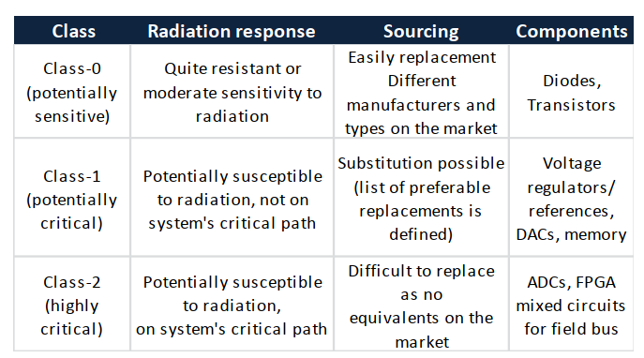
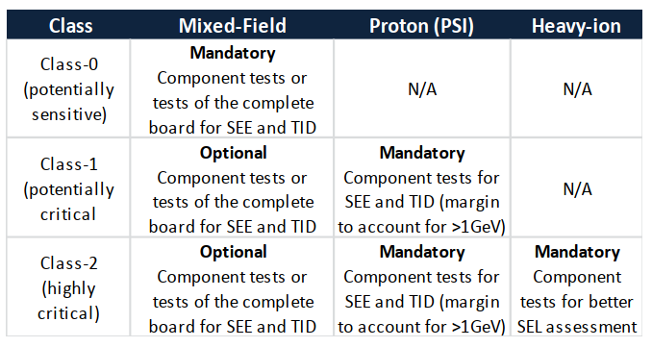
System level testing status in the radiation effects community
Existing Guidelines
Qualification of Electronics Components for a Radiation environment when standards do not exist (Uznanski, 2017)
Design and validation process applied to the FGCLite and extended to other accelerator equipment
Add whether I have radiation data for these parts from someone
else at component level or that was recovered through system level
RADSAGA System Level Test Review

Slide 11
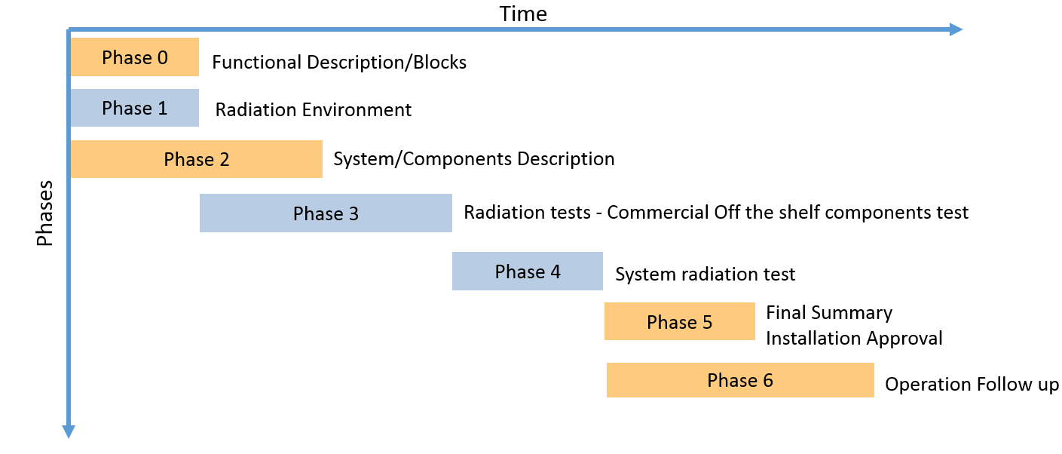
System level testing status in the radiation effects community
Existing Guidelines
Guidelines for the Radiation Hardness Assurance for CERN accelerators equipment (Danzeca, CERN internal)
Very first inclusion of system level testing within the design process and validation of a system to replace system modelling
First classification of failure modes at system level
Procedure to identify failure modes based on SEE or TID/TNID
Defines the required protocol to be followed for radiation testing at CHARM.
RADSAGA System Level Test Review

Slide 12
System level testing status in the radiation effects community
Within the community
Radiation effects engineers have been doing board/module/sub-system/system level testing over the last 20 years
There’s currently no session in conferences for radiation effects at system level and some publications may fall out of scope within TNS
There’s very poor documentation in literature of such tests
  Tested applications may be IPs
  Confidentiality needed for parts used within the system
  Lack of standardization on how system level data shall be reported
    e.g will the test report of a commercial PCB contain all the information that are needed if someone wants to buy and use the same PCB?
RADSAGA System Level Test Review

Slide 13
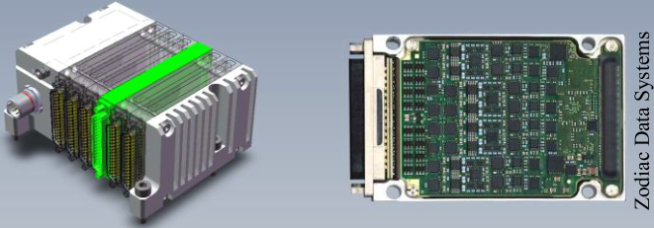
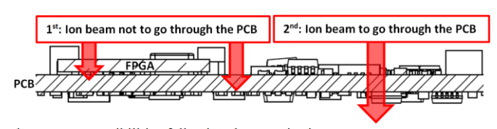
System level testing status in the radiation effects community
Within the community
Double-sided board testing of a data acquisition unit at NSRL (De Bibikoff, 2019)
Presented at RADECS 2019
Board modelling with TRIM
Required beam energies
Selection of ions for targeted LETs
Perform SEL measurements with new techniques
Higher energies can reduce energy gaps due to the Bragg peak among consecutive components
Ion beam fragmentation increases with energy
Double irradiation necessary for LET > 15 MeV.cm²/mg
Going through achievable when
LET < 15 MeV.cm²/mg
RADSAGA System Level Test Review

Slide 14
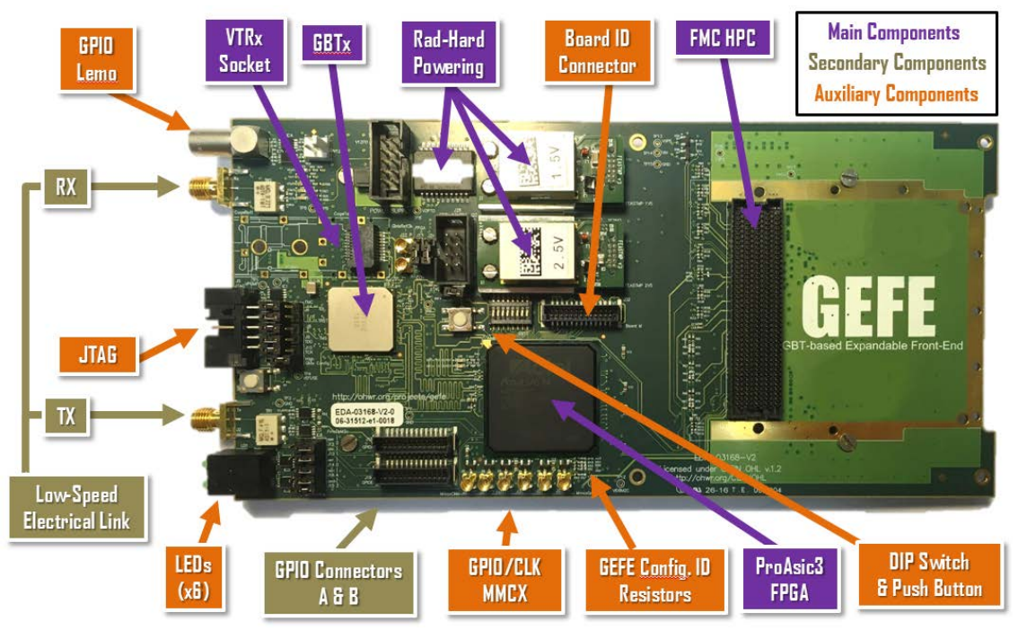
System level testing status in the radiation effects community
Within the community
GEFE – Gigabit Transceiver based Expandable Front-End (CERN BE-BI)
FPGA-based rad-tol card for multi-purpose applications:
  Fast data acquisition
  Slow control installed in the beamline
  Used in other systems according to user’s needs
Card qualification at CHARM
  Based on simplest functionality
  Use of architecture structure that will likely be replicated by users
Will be tested at CHARM in the various systems that will make use of it
RADSAGA System Level Test Review

Slide 15
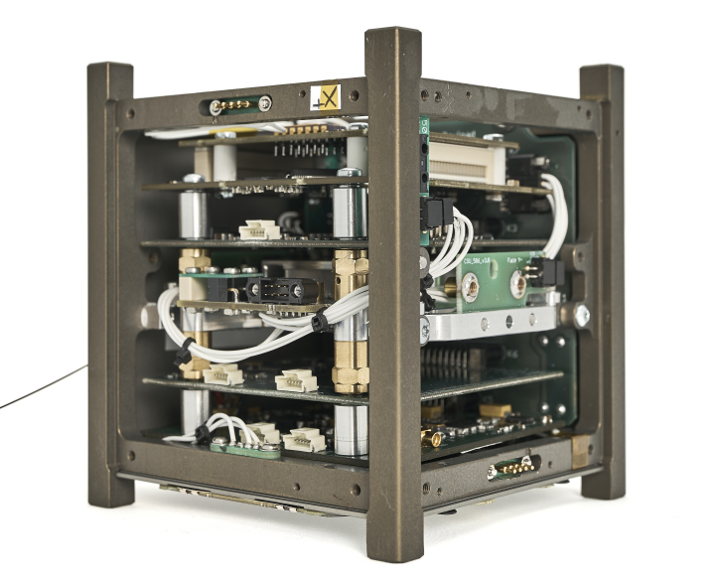
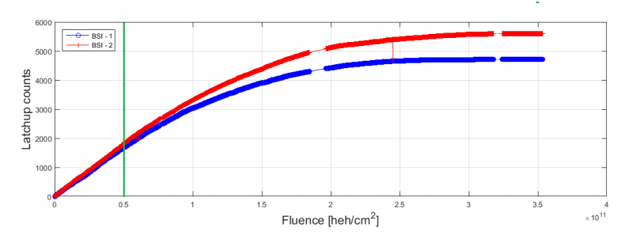
System level testing status in the radiation effects community
Within the community
CELESTA (Secondo, 2018)
First example of full satellite tested at CHARM
Payload is a space version of the CERN Radiation Monitor (self-monitoring of the beam flux)
Test at different fluxes and dose rates
Observed same degradation of SEL cross section measurements as it was observed during component level testing
The first test outcome was actually ‘fail’:
  Communication to the payload was lost at 140 Gy(Si)
  Root cause was identified
  Mitigation was applied
RADSAGA System Level Test Review

Slide 16
System level testing status in the radiation effects community
Objections to system level testing
With respect to no testing
  It is expensive
  I don’t know how to do it
  It’s not recognized by certification institutes as a way to perform RHA
  It is done only for in-house developments
With respect to replacing component level testing
  It is a pass/fail test
    Not clear what to do if the outcome is ‘fail’
  Lack of observability
    I may not understand what went wrong
  Worst Case Analysis for TID
    Cannot be performed without individual component level testing
  Data portability
    I have to start over even if I use same components
  Limited level of confidence
RADSAGA System Level Test Review

Slide 17
System level testing status in the radiation effects community
A. Coronetti
CERN, 1211 Geneva, Switzerland
RADSAGA System Level Test Review
November 12th, 2019
RADSAGA is a project funded by the European Union’s Horizon 2020 research and innovation programme under the MSC agreement no. 721624.

