Slide 1




RADSAGA System Level Testing Review
Work Packages 3 and 4
ESR12: Review of System-in-Package Point-of-Load converter
system level tests and qualification attempts
Tomasz Rajkowski, 3D-Plus

Slide 2

Agenda
  System under test
  Overview of performed system test campaigns
  System level testing
    How reproducible are component test with respect to performed corresponding system tests?
    Can system tests give additional information, when compared to component tests?
    Are system tests repeatable?
    Importance of running the system in real operation conditions
  Qualification
    Applicability of system level tests for TID/SEE qualification
    Qualification by system test from the point of view of industry
    Application of Bayesian networks for system qualification
  Outlook

Slide 3
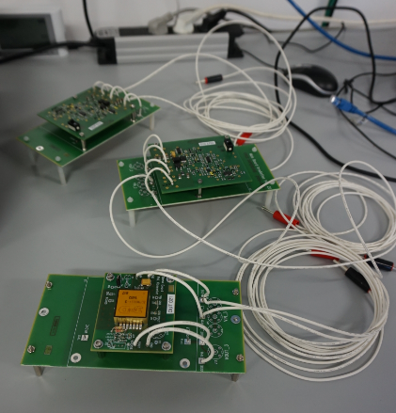
System under test
  Point of Load (PoL) converter from 3D-Plus
    custom-built system based on COTS, qualified by component level
    testing, commercial product of 3D-Plus
    we have significant knowledge about the system under test, it is
    not a black box
    3D System-in-Package or equivalent 2D board
    26 active components inside: transistors, diodes, 6 analog ICs
    target application: space, rather LEO (original qualification
    up to 50 krad)
    high level parameters
      input voltage: 5V +/- 5%
      output voltage: adjustable from 1.225V to 4V
      max output current: 5A
PoL modules prepared for X-Ray tests

Slide 4
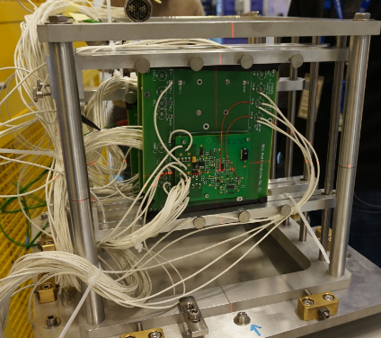
Overview of performed system test campaigns
  TID tests:
  X-Ray, high dose rate, 50 krad/h (University of Montpellier)
    2x 2D board, 1x 3D module
  Co-60, low dose rate, 15 rad/h (University of Montpellier)
    2x 2D board, 1x 3D module
  SEE tests:
  laser (University of Montpellier)
    1x 2D board, laser focused on 2 ICs
  heavy ions (UCL)
    1x 2D board, beam focused on 2 ICs
  heavy ions (GANIL)
    2x 2D board, packages of 4 ICs opened
  both SEE- and TID-oriented tests:
  mixed-field (CHARM)
    2x 2D board
  high flux/fluence heavy ions (CHARM UHE)
    2x 2D board, 1x 3D module
PoL boards and modules prepared for installation at CHARM facility

Slide 5
System level testing
  How reproducible are component test with respect to performed corresponding system tests?
    general limitations of system under test:
      each of the components can’t be tested in different configurations, but only in the one that is imposed by the configuration of the system (e.g. specific bias, operating frequency, etc.)
      because of the system integration, not all of the parameters may be monitored during system test, when compared to component test (e.g.: OpAmp bias current – not possible (or really hard) to measure this once OpAmp is part of the complex circuit)
      because of this integration, we start to characterize subsystems/system functions instead – and we need to learn how to define pass/fail conditions for them
    limitations specific for different system level test methodes/facilities (and SUTs) may appear in terms of:
      observability
      penetration

Slide 6
System level testing
X-Ray
Co-60
laser
(proposed characteristics of different facilities are based on user experience only – not any complex analysis)
observability
GANIL
UCL
CHARM UHE
CHARM mixed field
penetration

Slide 7
System level testing
  Can system tests give additional information, when compared to component tests?
    normally we don’t analyze if system function is still valid when components start to operate out of specified limits – system test may give this information
      margins given by the system might be calculated, if we compare e.g. qualification level of components and qualification level of the system (once we know how to do it...)
    potentially new failure modes observed during system test
    verification of the efficiency of mitigation techniques used
    potentially information on system level synergistic effects
      so far only system + setup synergistic effect (TID+SEE) was observed

Slide 8
System level testing
  Can system tests give additional information, when compared to component tests?
    information about propagation of faults in the system – e.g. new insight on what kind of SET would propagate, as during CHARM UHE and laser tests of PoL:
SUT block diagram
Electrical drawing of the undervoltage protection (UVP) circuit of the SUT

Slide 9
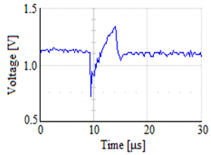
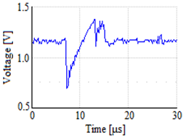
System level testing
  Can system tests give additional information, when compared to component tests?
    information about propagation of faults in the system – e.g. new insight on what kind of SET would propagate, as during CHARM UHE and laser tests of PoL
      propagation observed for transients with specific signature, when V+ and V- voltage difference in OpAmp is low [1]; propagation led to power cycling of the system
Not propagating SET
Propagating SET
Electrical drawing of the undervoltage protection (UVP) circuit of the SUT
[1] T. Rajkowski et al., Analysis of SET propagation in a system in package point of load converter, RADECS 2019

Slide 10
System level testing
  Can system tests give additional information, when compared to component tests?
    information about propagation of faults in the system – e.g. new insight on what kind of SET would propagate, as during CHARM UHE and laser tests of PoL
      propagation observed for transients with specific signature, when V+ and V- voltage difference in OpAmp is low; propagation led to power cycling of the system
      conclusions / recommendations:
        for SEE tests, for each design/system it should be defined what is the real worst case SET signature, based on the interface characteristics of the circuit to which SET might propagate
        this effect of enhanced sensitivity to unipolar transients should be taken into account for desings where V+ and V- voltage difference is low (this might be true e.g. for system end of life conditions)

Slide 11
System level testing
  Are system tests repeatable?
  e.g. how many tests of specific system do we need to perform, to be confident what is the TID threshold for the system?
    usually there will be spread due to spread of components’ parameters (also due to different test conditions applied? environmental conditions, control conditions)
    example 1: PoL 2D board and 3D module tested at CHARM UHE had their current draw changed by 3% and 14%
    example 2: PoL 2D boards failed at X-Ray after reaching 400 krad (first board) and 475 krad (second board)
there is some spread of TID level, but failure mode is repeatable – qualification should be easier
failure due to inrush current excessing overcurrent protection threshold (I_{PROT}):
I_{PROT} = f(V_{REF},V_{OUT},V_{OI},G_{I},V_{OFF},I_{BIAS},I_{OFF},V_{CC},V_{FILTER},V_{M},V_{MOS},V_{D},...)
(combination of component parameters and system function parameters)

Slide 12
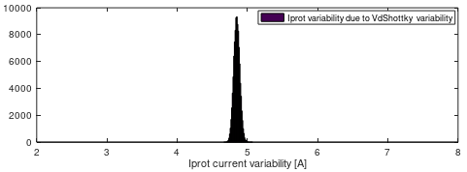
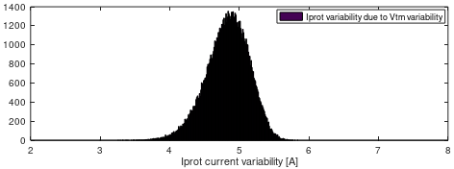
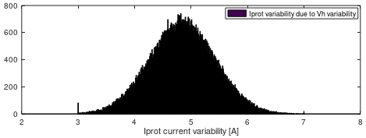
  Influence of different parameters might be different
    plots present results of Monte-Carlo simulations using analytic expression developed for I_{PROT}
    each plot is a histogram of results for 100’000 simulations
    for each of 3 parameters, gaussian spread was used with standard deviation 3 times higher than nominal for this parameter
Number of results per bin
Number of results per bin
Number of results per bin

Slide 13
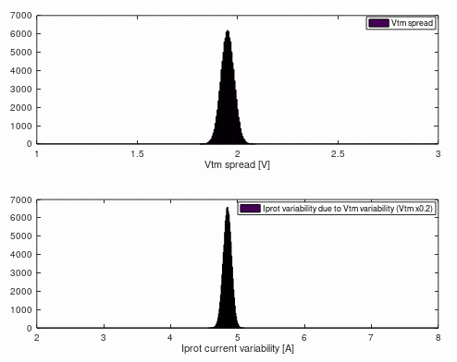
    And gaussian spread of the parameter doesn’t imply gaussian spread of the resulting function value, which may make the analysis more difficult.
    Do I know in what way is my system going to fail?
Number of results per bin
Number of results per bin

Slide 14
System level testing
  Importance of running the system in real operation conditions (including SW/control)
    failure mode discovered during TID tests was: problem to power up device once it was switched OFF (inrush current was higher than degraded overcurrent protection threshold) – device needs to be power cycled to verify health
    system under tests turned out to be sensitive to specific SETs when the supply voltage was slightly below specification
    environmental conditions seem to be of similar criticality (SEL – temperature, ELDRS – dose rate)
    but what is the worst case condition/configuration for system level test? probably it depends on system under test – what is it for PoL?
      what would happen, if I would irradiate system for different V_{OUT} or R_{LOAD}? for more complex systems, there will be more parameters like this (e.g. operating frequency, percentage of the logic resources used)
      low dose rate Co-60 tests of PoL started in February 2019, they will be compared with high dose rate tests
    is the worst case condition still crucial parameter, or if the real operation condition is of the most interest now?

Slide 15
Qualification
  Applicability of system level tests for TID qualification:
    good penetration (Co-60)
    good observability of parameters (no issues on facility side) (Co-60, X-Ray)
    margines given by the system will be included in the test results (more realistic results)
    potentially good representation of target environment (CHARM mixed-field)
    not clear how to define worst case conditions for system under test
      maybe real operation condition instead? going through different operation modes as during real operation?
      „test as you fly”
    not clear how to define number of system units to test, to have required confidence level

Slide 16
Qualification
  Applicability of system level tests for SEE qualification:
    for system on board, single test may verify SEE sensitivity and efficiency of mitigation techniques
    capability to irradiate certain IC (heavy ions) or part of IC (laser) – it’s possible to isolate area of concern
    +/- observability depending on the facility used
    usually poor penetration of the beam (exception: CHARM)
    not clear how to define worst case conditions for system under test
      potentially multiple test conditions to verify, e.g. irradiate system running in different modes
    not clear how to define number of system units to test, to have required confidence level

Slide 17
Qualification by system test from the point of view of industry
  Go step by step
    try new solutions and take time to improve them
    both company engineers and customers need to take time to adapt to new approach/methodology
  Potential first step
    for TID, replace new-lot-verification by system test
    after, replace qualification by system test
evaluation
evaluation
evaluation with good prediction of radiation performance
qualification
component-level
per-lot
qualification
component-level
per-lot
qualification
system-level
for some/all new lots
verification
component-level
for each new lot
verification
system-level
for some/all new lots

Slide 18
Qualification by system test from the point of view of industry
  Potential next steps
    system test for verification of design changes in the system
    propose new TID threshold of the system
      potentially higher than resulting from component-level qualification (not all components are working in worst case conditions)
      define margins given by the system
  Some important questions
    What’s the accessibility of the facilities?
    What’s the cost of the system test?
    What’s the worst case for the system test?
    What’s our confidence level after system test?

Slide 19
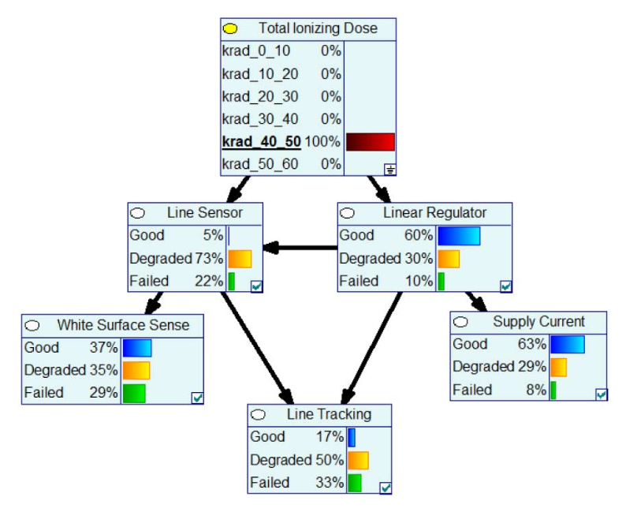
Application of Bayesian networks for system qualification
  Characteristics of this approach
    possibility to use data of different kind and integrate in one model
    „quantitative method for assessing the response of performance
    parameters of a system to TID” [2]
  Different applications of BN under study (based on [2])
    estimating probability of success of key system functions
    inference using observable parameters
    sensitivity analysis for design enhancement
  Approach under investigation at 3D-Plus
    build system model based on analytic expressions describing
    relations between different components/functions (nodes) of the system
    incorporate us much information as possible in one model (system function
    test results, system output test results,...), to have higher confidence of results
    investigate on what TID threshold level can we propose based on such test and modelling effort and what would be the confidence level of such results
  Figure source: [2]
  [2] Zachary J. Diggins et al., „System Health Awareness in Total-Ionizing Dose Environments”

Slide 20
Outlook
  Future tests of PoL:
    Co-60 high dose rate tests
      with measurements of all the parameters required to fill Bayesian network with data
      to compare with X-Ray results and Co-60 low dose rate results
      trying to propose the TID threshold of the system
  Future tests of 3D-Plus camera module:
    Co-60 high dose rate tests
    SEE system test of the camera 2D board (laser? heavy ions?)

Slide 21
Outlook
  Similarities in methodology for camera tests:
    both 2D board and 3D module tests
    both whole system test and component-at-system test (thanks use of 2D board)
    big number of parameters to measure, particularly for 2D board tests, to monitor specific functions health (and not only system main function)
    attempt to build a model and to extract more information from system test results
    several units tested to verify repeatability
  New challenges:
    more complex design with big digital part and with image sensor
    potentially new (unknown) failure modes may appear
    no as good analytical model as for PoL

Slide 22
Thank you for you attention!

Slide 23
Backup slides

Slide 24
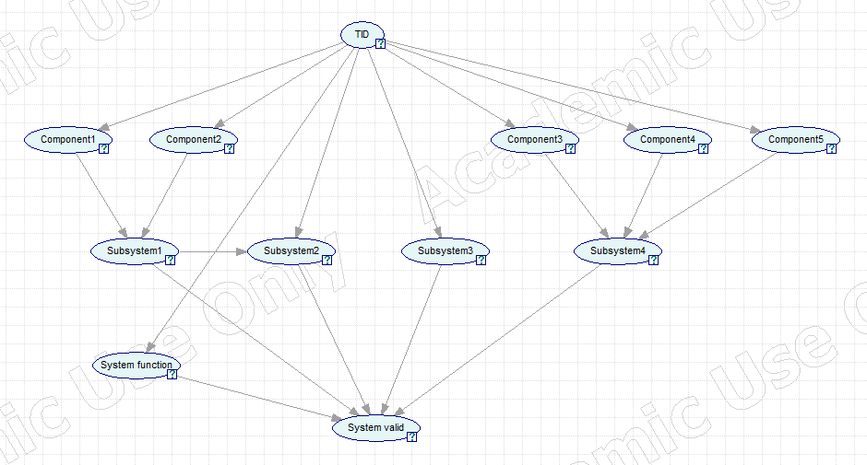
Probability tables for TID degradation of components (or simple subsystems) might be taken from system-level test results
Conditional probability tables might be defined based on analytic expressions taken from Desing Justification Document for PoL

Slide 25
The remaining part is the CPT table for the node, which is called here „system valid”.
„System valid” incorporates information from direct system function results and from susbsystems radiation performance.
Probability table for TID degradation of system function might be also taken from system-level test results

Slide 26
Other questions
  Are different versions of my system under test representative enough? (close enough to the system that will fly)
    e.g. 2D board vs 3D module

Slide 27
System level testing
  How reproducible are component test with respect to performed corresponding system tests?
    interesting example: observability limitation specific for PoL – current consumption drift

