Slide 1
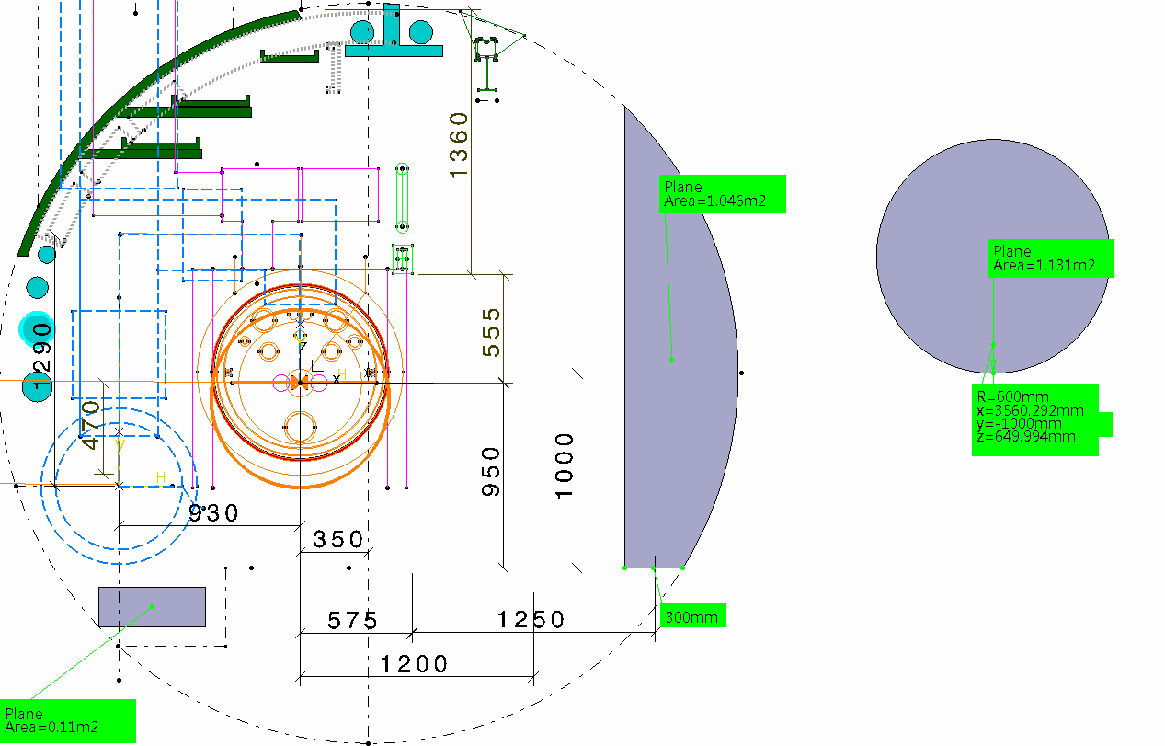
TUNNEL POINT 5 section zone rf cores
≈SURFACE EQUIVALENTE
1.15M2
Ø 1.2 M

Slide 2
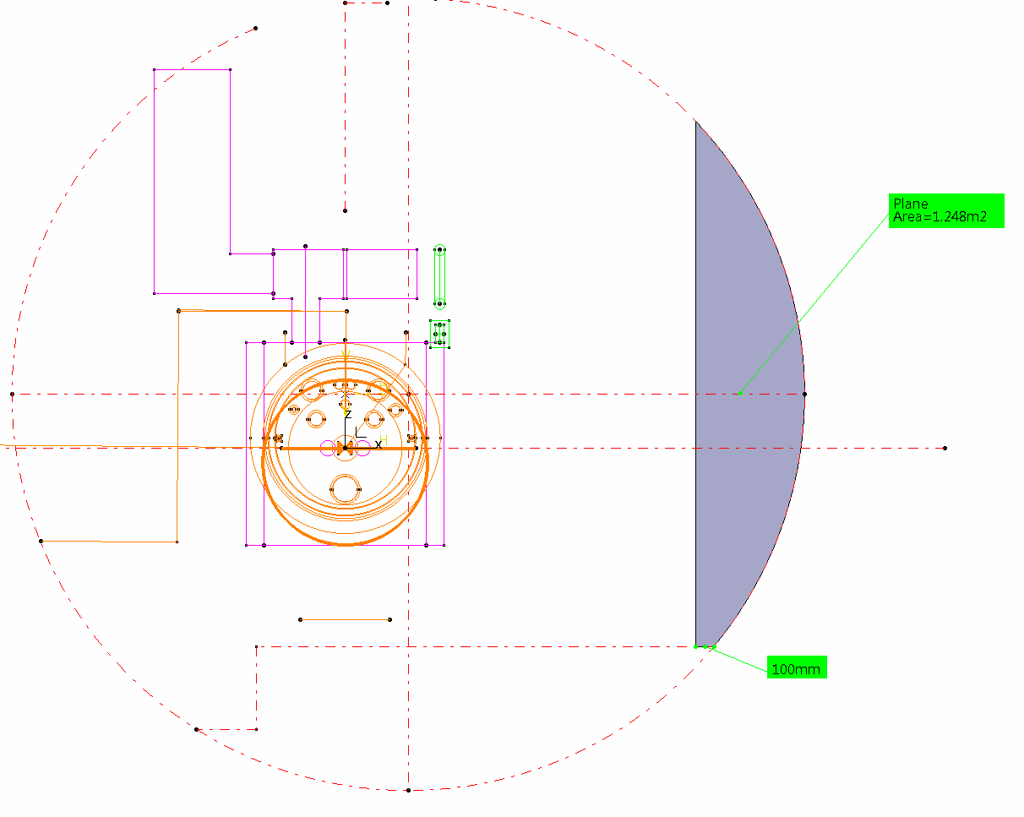
TUNNEL POINT 1 section zone rf cores

