Slide 1
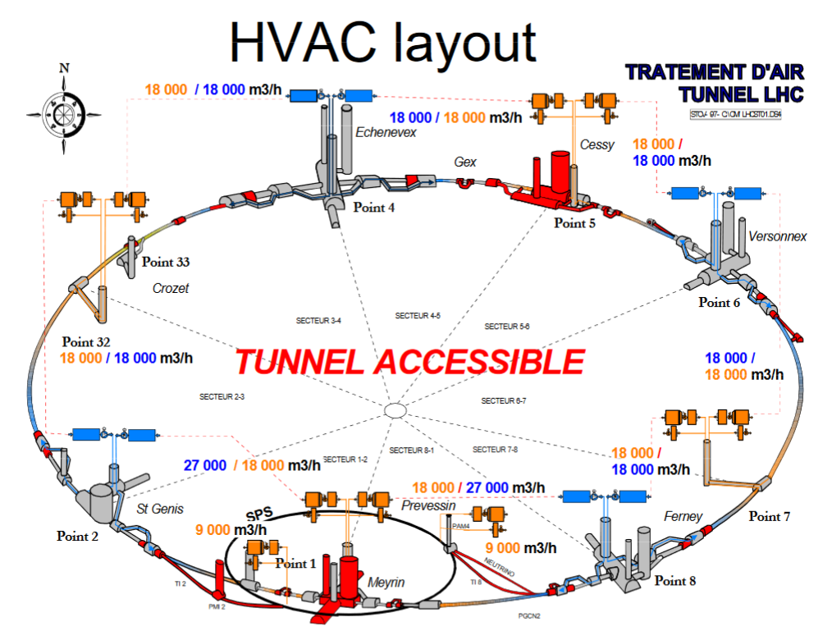
Concerning flow-rates:
18 000m³/h under nominal conditions from each side of the tunnel
  In SU2 UAPT-00203 takes care of the supply (36 000m³/h)
  UAES-00102 or UAES-00104 in SU1 for extraction (36 000m³/h)
During fire conditions the flow-rate is assumed to be twice: 36 000m³/h per side
18000m³/h
18000m³/h

Slide 2
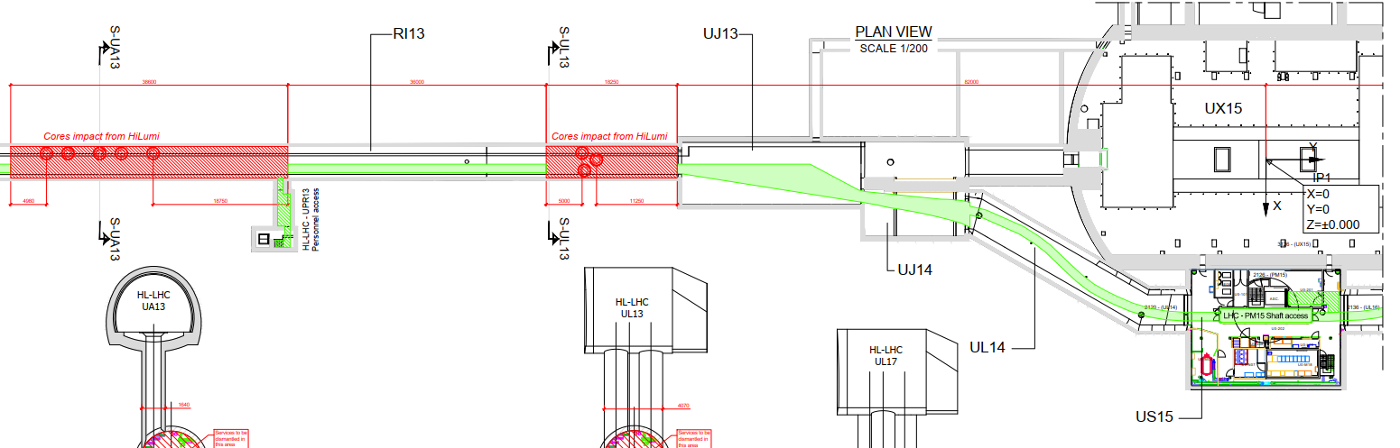
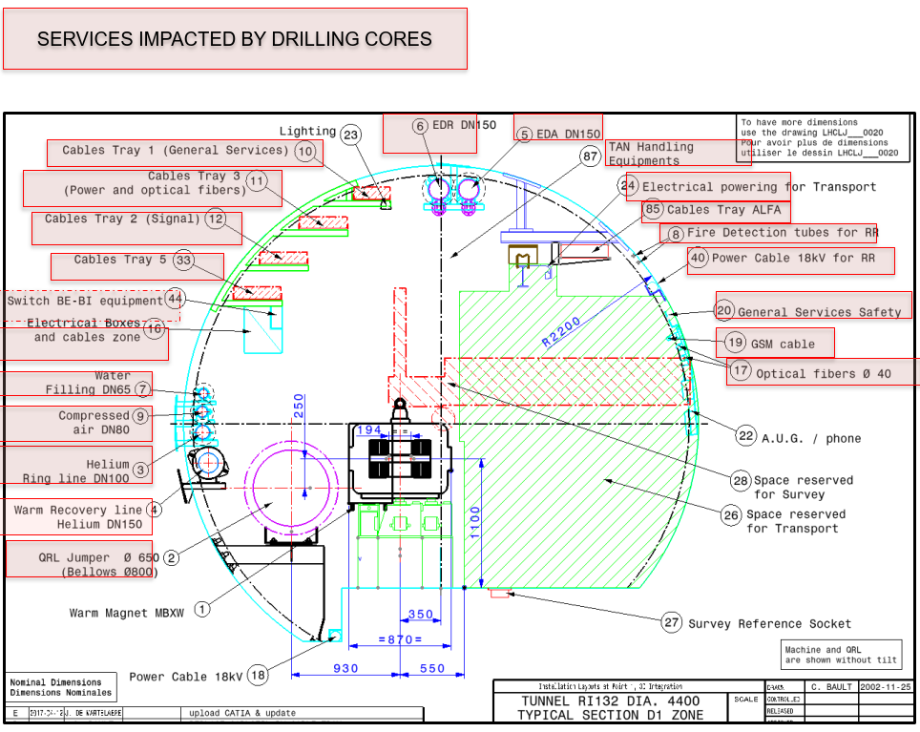
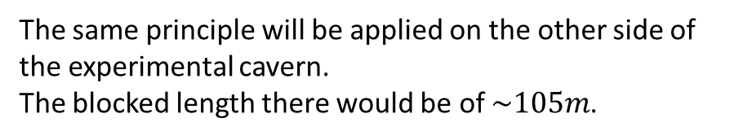

Point 1
$$\sim 93m$$
The same principle will be applied on the other side of the experimental cavern.
The blocked length there would be of $\sim 105m$.

Slide 3
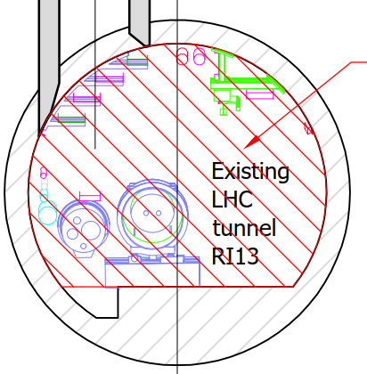

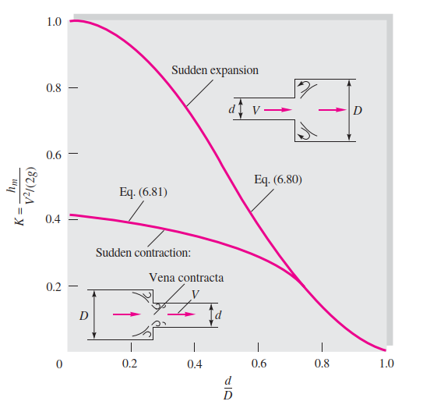
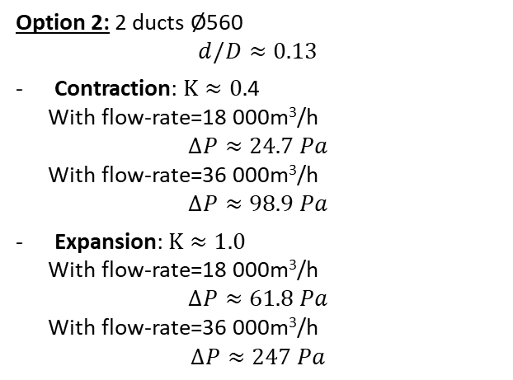
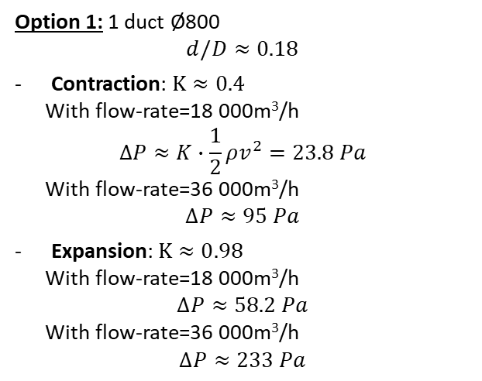
Option 1: 1 duct Ø800
$$d/D≈0.18$$
Contraction: $K≈0.4$
With flow-rate=18 000m³/h
$$∆P≈K∙\frac{1}{2}ρv^{2}=23.8 Pa$$
With flow-rate=36 000m³/h
$$∆P≈95 Pa$$
Expansion: $K≈0.98$
With flow-rate=18 000m³/h
$$∆P≈58.2 Pa$$
With flow-rate=36 000m³/h
$$∆P≈233 Pa$$
Option 2: 2 ducts Ø560
$$d/D≈0.13$$
Contraction: $K≈0.$4
With flow-rate=18 000m³/h
$$∆P≈24.7 Pa$$
With flow-rate=36 000m³/h
$$∆P≈98.9 Pa$$
Expansion: $K≈1.0$
With flow-rate=18 000m³/h
$$∆P≈61.8 Pa$$
With flow-rate=36 000m³/h
$$∆P≈247 Pa$$
Source: Fluid Mechanics, White (2011, 7^{ed})

Slide 4
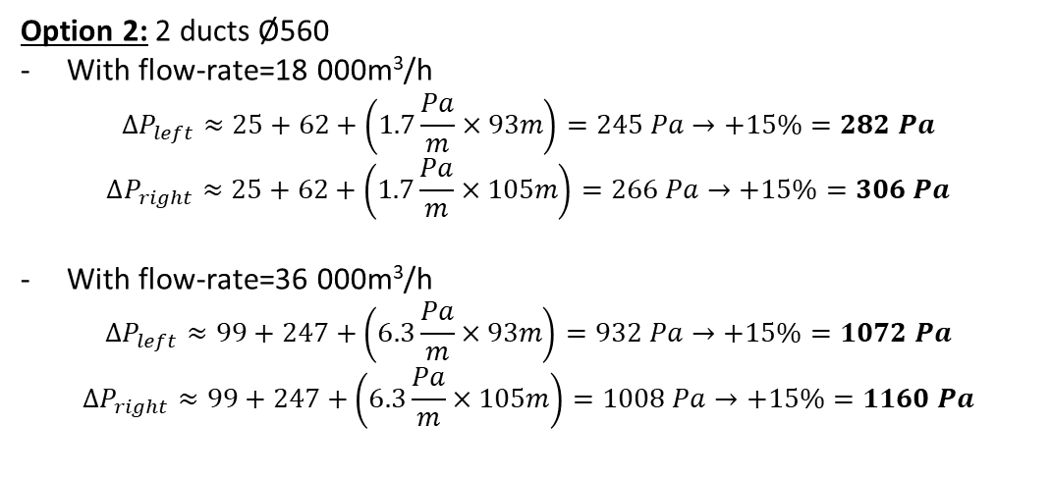
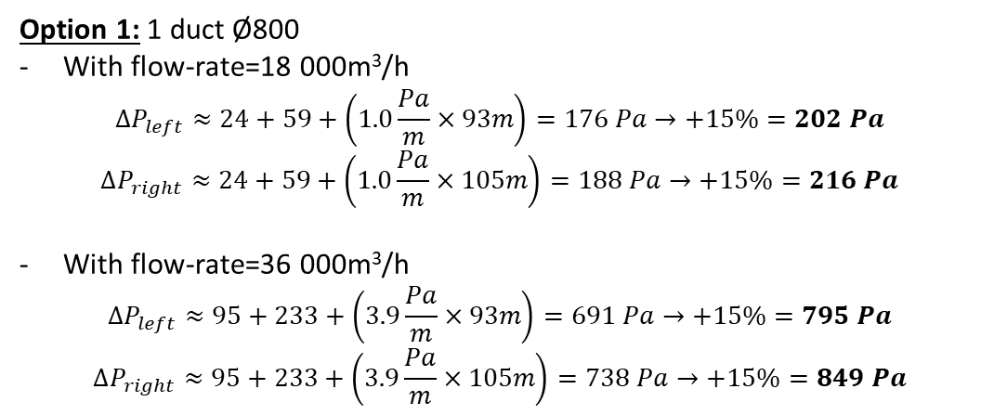
Option 1: 1 duct Ø800
With flow-rate=18 000m³/h
$$∆P_{left}≈24+59+\left(1.0\frac{Pa}{m}×93m\right)=176 Pa→+15\%=202 Pa$$
$$∆P_{right}≈24+59+\left(1.0\frac{Pa}{m}×105m\right)=188 Pa→+15\%=216 Pa$$
With flow-rate=36 000m³/h
$$∆P_{left}≈95+233+\left(3.9\frac{Pa}{m}×93m\right)=691 Pa→+15\%=795 Pa$$
$$∆P_{right}≈95+233+\left(3.9\frac{Pa}{m}×105m\right)=738 Pa→+15\%=849 Pa$$
Option 2: 2 ducts Ø560
With flow-rate=18 000m³/h
$$∆P_{left}≈25+62+\left(1.7\frac{Pa}{m}×93m\right)=245 Pa→+15\%=282 Pa$$
$$∆P_{right}≈25+62+\left(1.7\frac{Pa}{m}×105m\right)=266 Pa→+15\%=306 Pa$$
With flow-rate=36 000m³/h
$$∆P_{left}≈99+247+\left(6.3\frac{Pa}{m}×93m\right)=932 Pa→+15\%=1072 Pa$$
$$∆P_{right}≈99+247+\left(6.3\frac{Pa}{m}×105m\right)=1008 Pa→+15\%=1160 Pa$$

Slide 5
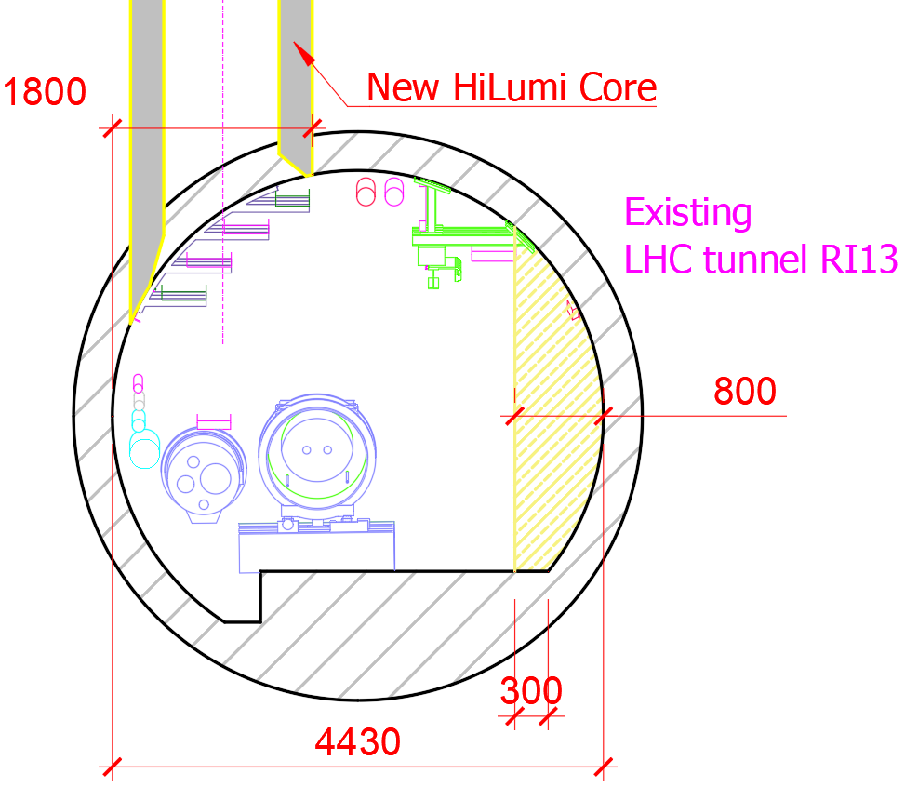
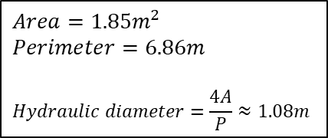
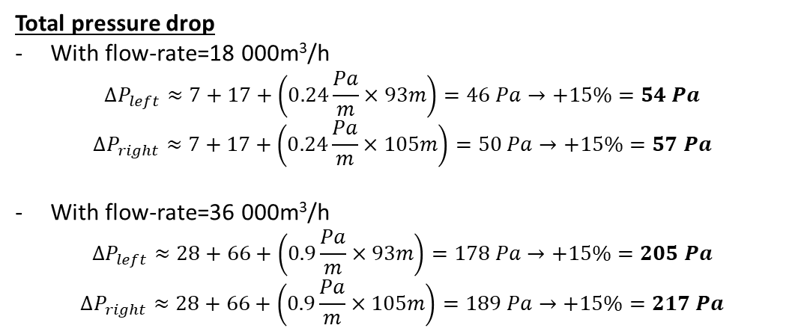
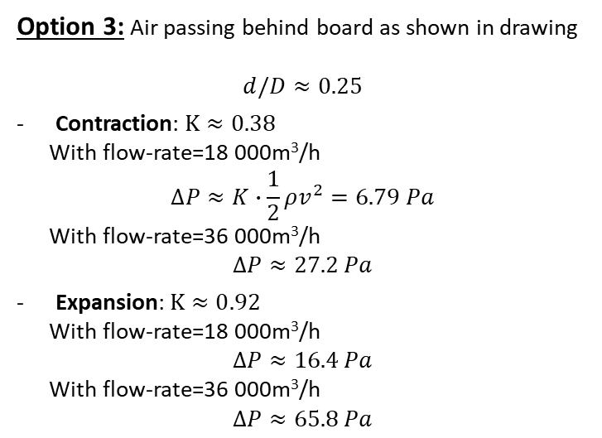
Option 3: Air passing behind board as shown in drawing
$$d/D≈0.25$$
Contraction: $K≈0.38$
With flow-rate=18 000m³/h
$$∆P≈K∙\frac{1}{2}ρv^{2}=6.79 Pa$$
With flow-rate=36 000m³/h
$$∆P≈27.2 Pa$$
Expansion: $K≈0.9$2
With flow-rate=18 000m³/h
$$∆P≈16.4 Pa$$
With flow-rate=36 000m³/h
$$∆P≈65.8 Pa$$
$$Area=1.85m^{2}$$
$$Perimeter=6.86m$$
$$Hydraulic diameter=\frac{4A}{P}≈1.08m$$
Total pressure drop
With flow-rate=18 000m³/h
$$∆P_{left}≈7+17+\left(0.24\frac{Pa}{m}×93m\right)=46 Pa→+15\%=54 Pa$$
$$∆P_{right}≈7+17+\left(0.24\frac{Pa}{m}×105m\right)=50 Pa→+15\%=57 Pa$$
With flow-rate=36 000m³/h
$$∆P_{left}≈28+66+\left(0.9\frac{Pa}{m}×93m\right)=178 Pa→+15\%=205 Pa$$
$$∆P_{right}≈28+66+\left(0.9\frac{Pa}{m}×105m\right)=189 Pa→+15\%=217 Pa$$
Source: Fluid Mechanics, White (2011, 7^{ed})

Slide 6
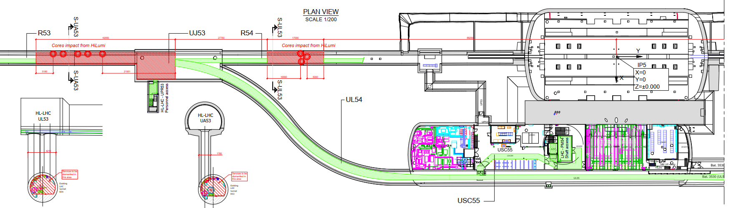
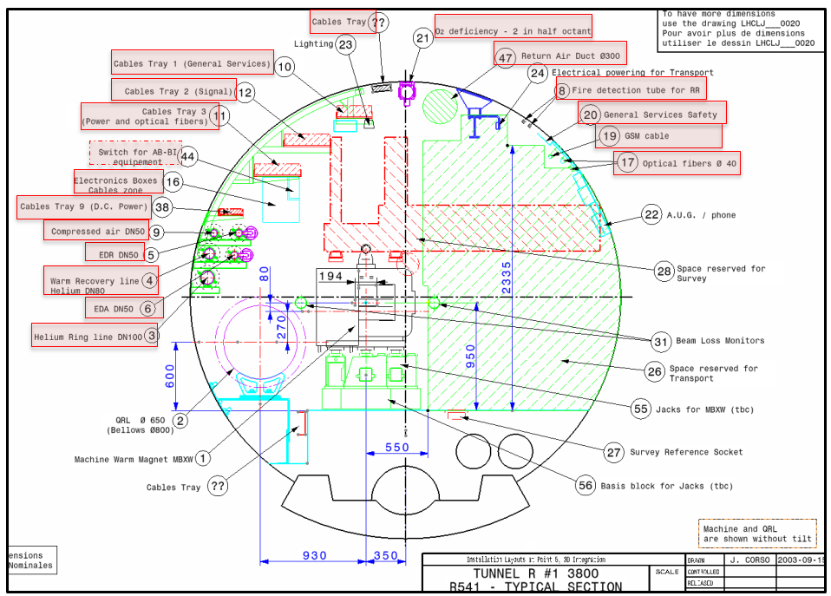
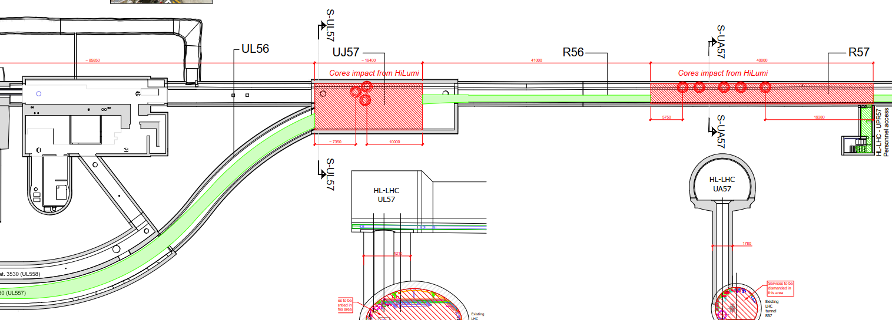


Point 5
$$\sim 87m$$
$$\sim 101m$$

