Slide 1
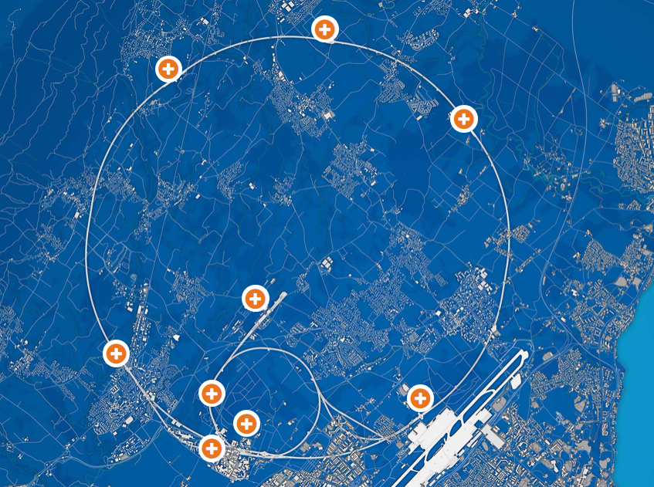

CERN Open Days 2019
Cern.ch/opendays
Saturday and Sunday 14 and 15 September

Slide 2
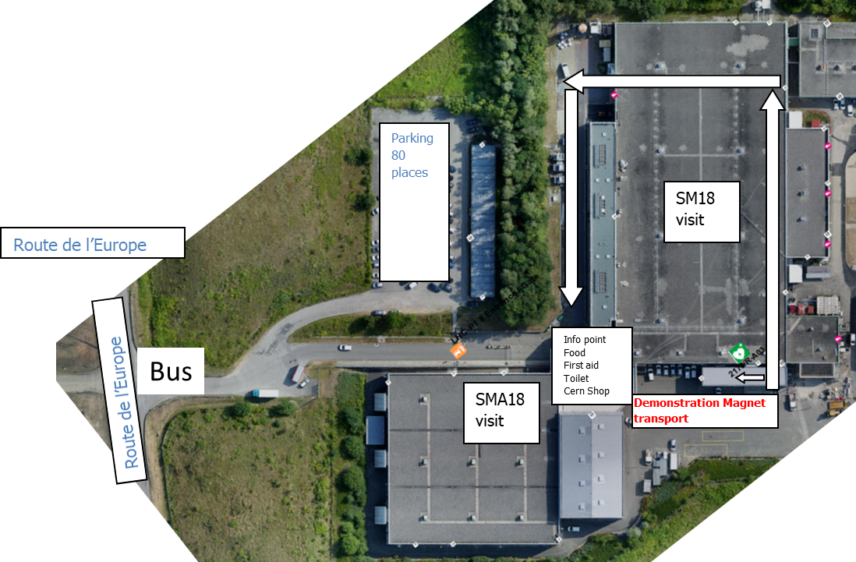
SM18 layout, CERN 2019 Open Days
Update 1 July 2019
Roads from St. Genis to Meyrin are blocked.
Access by bike, foot or bus event services.

Slide 3
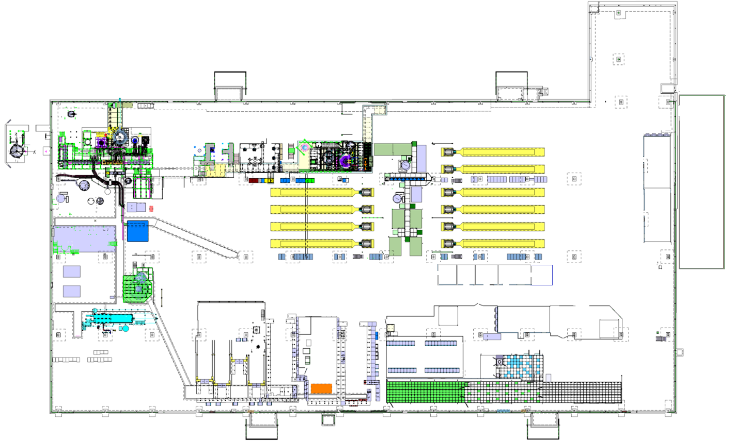


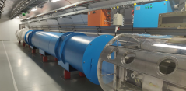

SM18 layout, CERN 2019 Open Days
Guide test station
Large cryostats
Visitor Area
Test technology display
Control room
Rest area
Nb3Sn prototypes
Show magnetic field effects
Superconducting coils
Miniature magnets
HL-LHC magnet
FRESCA2 world record magnet
Cross section
Tunnel Mockup
Inside remote controlled RoboTruck demonstration with magnet if rain
Slideshows
Emergency exit only
Covered area between SM18 and SMA18
Info point
Food/drinks?
First aid
Toilets
Cern Shop?
Return route
SMA18

Slide 4
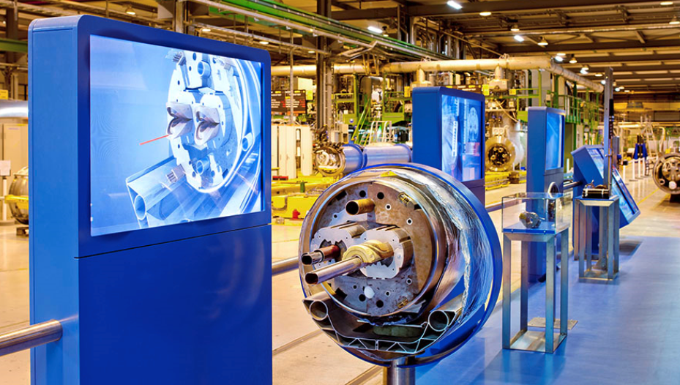
Flow of people
Create groups (Inside in the zone where we have the aerial photo) – 5 minutes, 1-2 persons host
2. Guided tour: Tunnel mockup + Visitor zone 10 to 15 minutes (3 guides).
3. Rocla Demonstration
2 Transport Personel, Free visit, no guides, 5 to 15 minutes
4. Magnet Playground:
Free visit, 10 to 20 minutes, 3 to 5 hosts.
5. Guided tour: Magnet test stand technology.
Cluster D, 10 to 15 minutes, 3 to 5 guides
6. Guided: Magnet Design and Technology, 10 to 25 minutes, 3 to 5 guides?
7. Goodbye hosts, Helium Balloons, 1 to 2 hosts.
1
2
2
Total time: 60 to 90 minutes
Number of guides/hosts: 14-22.

Slide 5
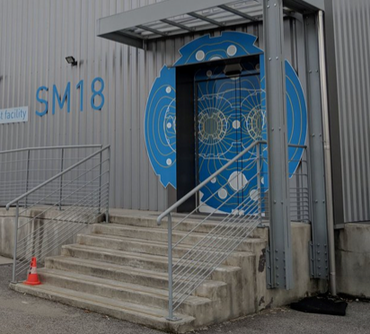
Activity 1:
Create groups (Inside in the zone where we have the aerial photo) – 5 minutes, 1-2 persons host
Goal:
Welcome visitors
Try to identify language groups (French, English, other).
Make groups of up to 12 persons for the first guided part.

Slide 6
Activity 2:
Guided tour:
Tunnel mockup + Visitor zone 15 to 20 minutes (3 guides).
Goal: General introduction why magnets are needed for an accelerator.
Electric field (cavities) to accelerate, magnetic field to steer.
Function of dipoles and quadrupoles.
1232 dipole magnets of 15 meter long to make a 360 degrees turn.
456 quadrupole magnets to focus the beam and keep particles together.

Slide 7
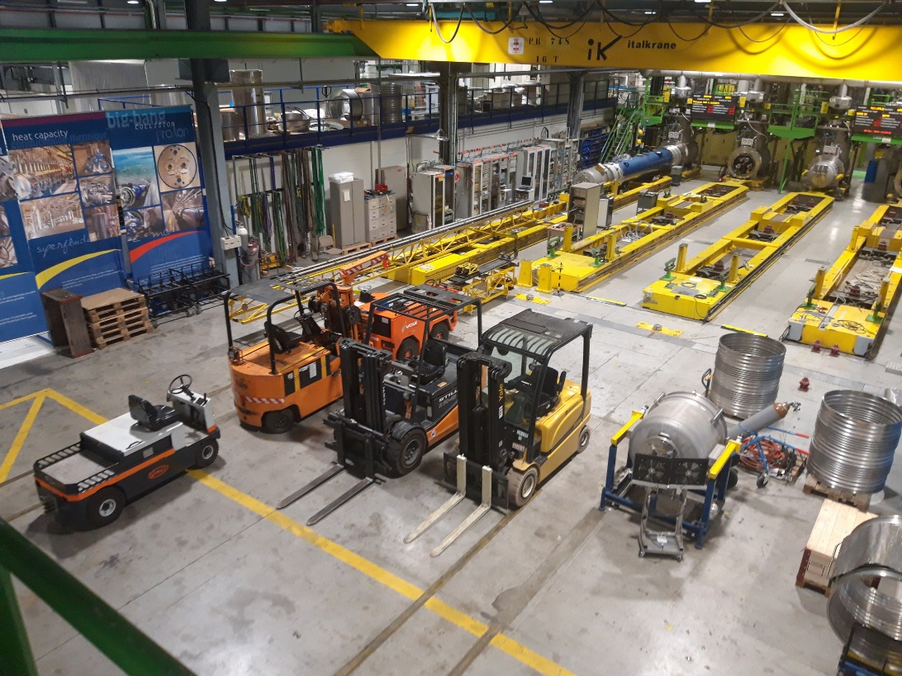
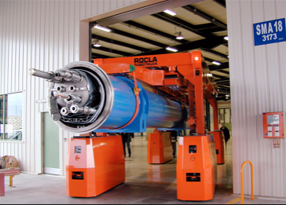
Activity 3.
Rocla Demonstration 2 Transport Personel, Free visit, no guides, 5 to 15 minutes
Rocla Demonstration.
Use Bench B1 and B2 to place or remove magnet.
Organized by Transport
Live media event.
Space for screens, media center for live broadcasting.
Live Event 16h00 to 17h30
Not part of SM18 event
Zone to be emptied Monday/Tuesday for preparation.
Live media event
Rocla Demo
Rocla show

Slide 8
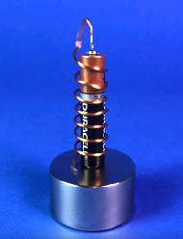
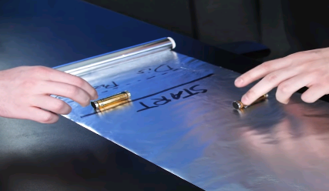
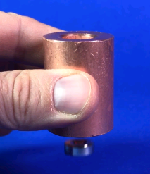
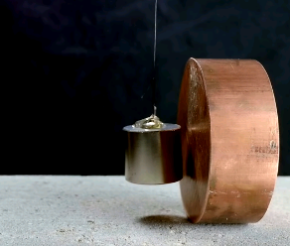
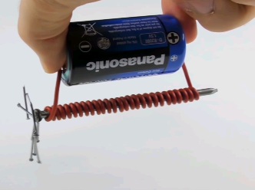
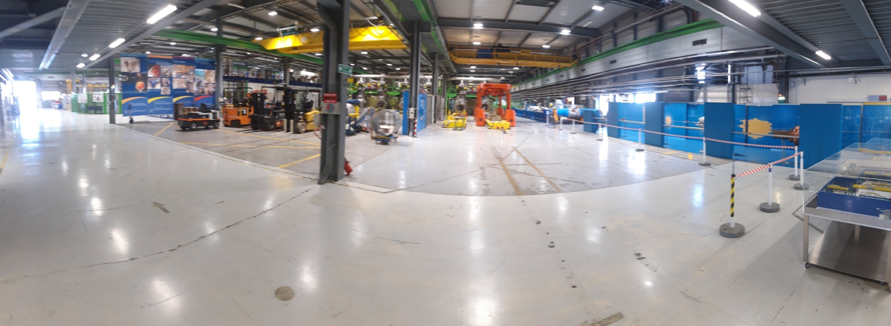
Activity 4.
Magnet Playground: ~10 small Do-It-Yourself experiments
Free visit, 10 to 20 minutes, 3 to 5 hosts.
Goal:
Discover how currents and fields interact.
Interactive, children and adults can play.
Supervision of hosts needed.
Leaflets available to reproduce the experiment at home.
Rocla Demo
5 to 10 tables
Playground

Slide 9
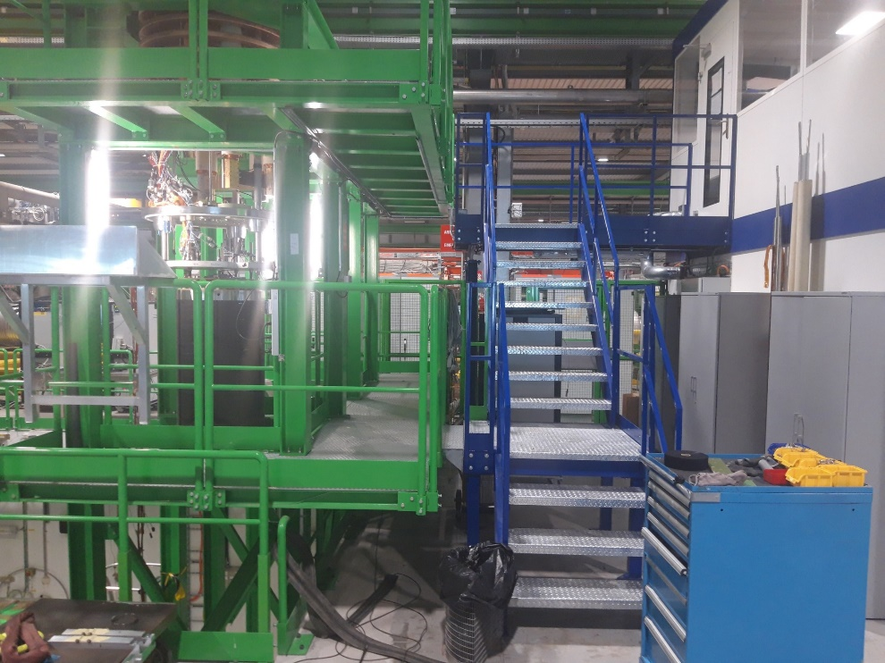
Activity 5:
Guided tour: Magnet test stand technology.
Cluster D, 10 to 15 minutes, 3 to 5 guides, mainly from the TF section, preferably our Mechanos and Operators.
Goal:
Show the technology of the magnet test stand.
Use posters to show the size of the cryostat.
Display MQXFS4c on the Cluster D insert and explain
This can be very technical and does not need to discuss the magnet itself.
Pass through upper control room, with view over the test stand.

Slide 10
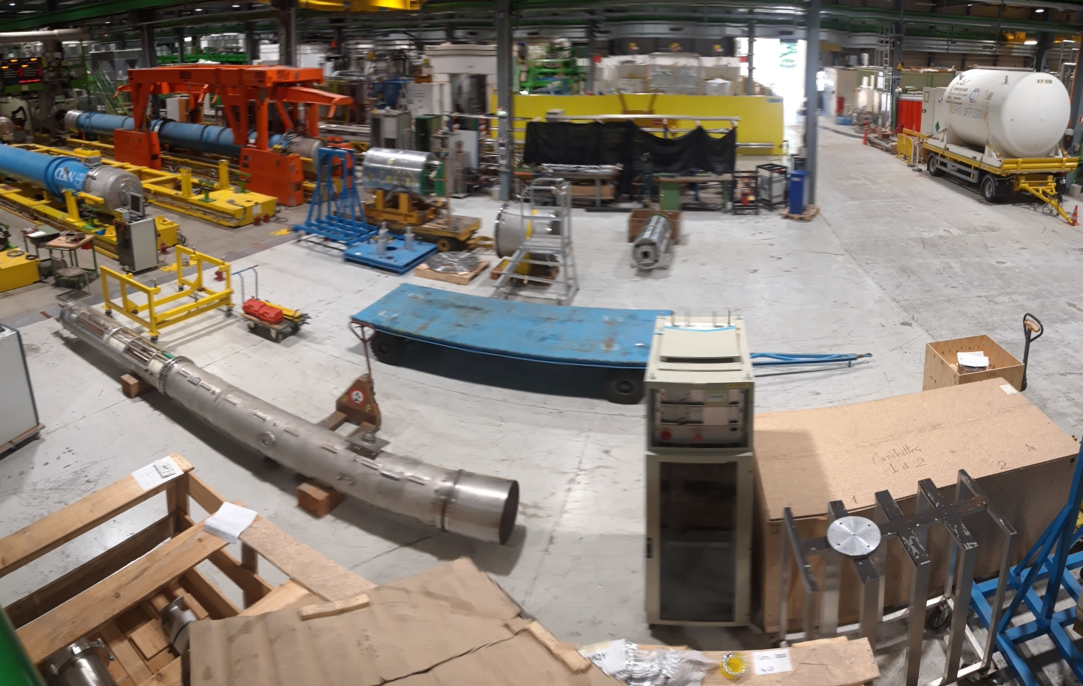
Activity 6:
Guided or hosted?
Magnet Design and Technology, 10 to 25 minutes, 3 hosts (protect material) and 2 guides?
Goal:
Show Magnet Design Technology.
Impregnated coils, non-impregnated coils
Magnet cross-sections
Videos of magnet assembly
Show FRESCA2 world record magnet
Etc.
Good bye balloons
Space for Magnet Design and Technology display
To be emptied in time.

Slide 11
Activity 7:
Goodbye hosts, Helium Balloons, 1 to 2 hosts.
Good bye balloons

Slide 12
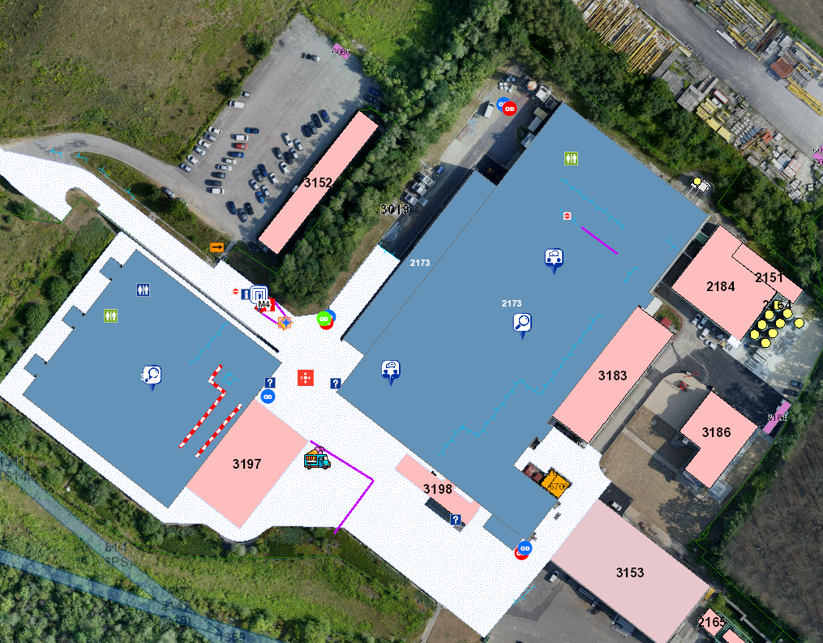
Toilets for visitors:
Mobile toilets outside.
Toilets in Cryo-corner
Toilets next to exposition
For guides/volunteers:
The meeting room upstair and kitchen will be open.
The toilets upstairs are open.

Slide 13
Mobility
Visitors from 9 AM to 6 PM.
Roads will be closed
If possible use public transport.
We are checking options with Virginia to find the best options for transport.
https://opendays.cern/plan-your-visit/getting-here/meyrin-point-1-atlas

Slide 14
Status of Magnet Test stations during open days:
Magnets warm up start the latest on Wednesday morning.
No Helium liquid in cryostats during open days for safety reasons.
Cluster D: MQXFS4 on insert on the tower to display
Cluster G: All magnets warm (if possible HFM with MQXFS6 pumped and purged and ready for cool down after Open Days).
Cluster G: Maintenance on Interlock Cabling planned from Wednesday 11 to Monday 16 September.

