Slide 1
Monitoring of RUCIO
Teng Li
University of Edinburgh
2019.9

Slide 2
RUCIO monitoring
Motivations
  Basic tool for data management
    System health
    Summary of SEs, data location, accounting etc.
    Trace data transferring activities
    Data access pattern analysis
Three categories of metrics from RUCIO
  Internal metrics
    Graphite/StatsD
  Data transferring / deletion events
    Java message queue
  Replica/ accounting / client trace
    Periodic dumping of the RUCIO database/ rucio web UI

Slide 3
Internal system health metrics
Internal metrics sent by rucio core and various daemons
Basically a set of counters/timers/gauges
  Client requests being queued/processing
  Rules being added/evaluated
  Activities of various daemons: Conveyor, Undertaker, Reaper, Necromancer…
Sent to Graphite, can be better viewed via Grafana
Spread all over RUCIO code, very undocumented
Core
pystatsd
Graphite
Grafana
Conveyer
Hermes
statsd
Kronos

Slide 4
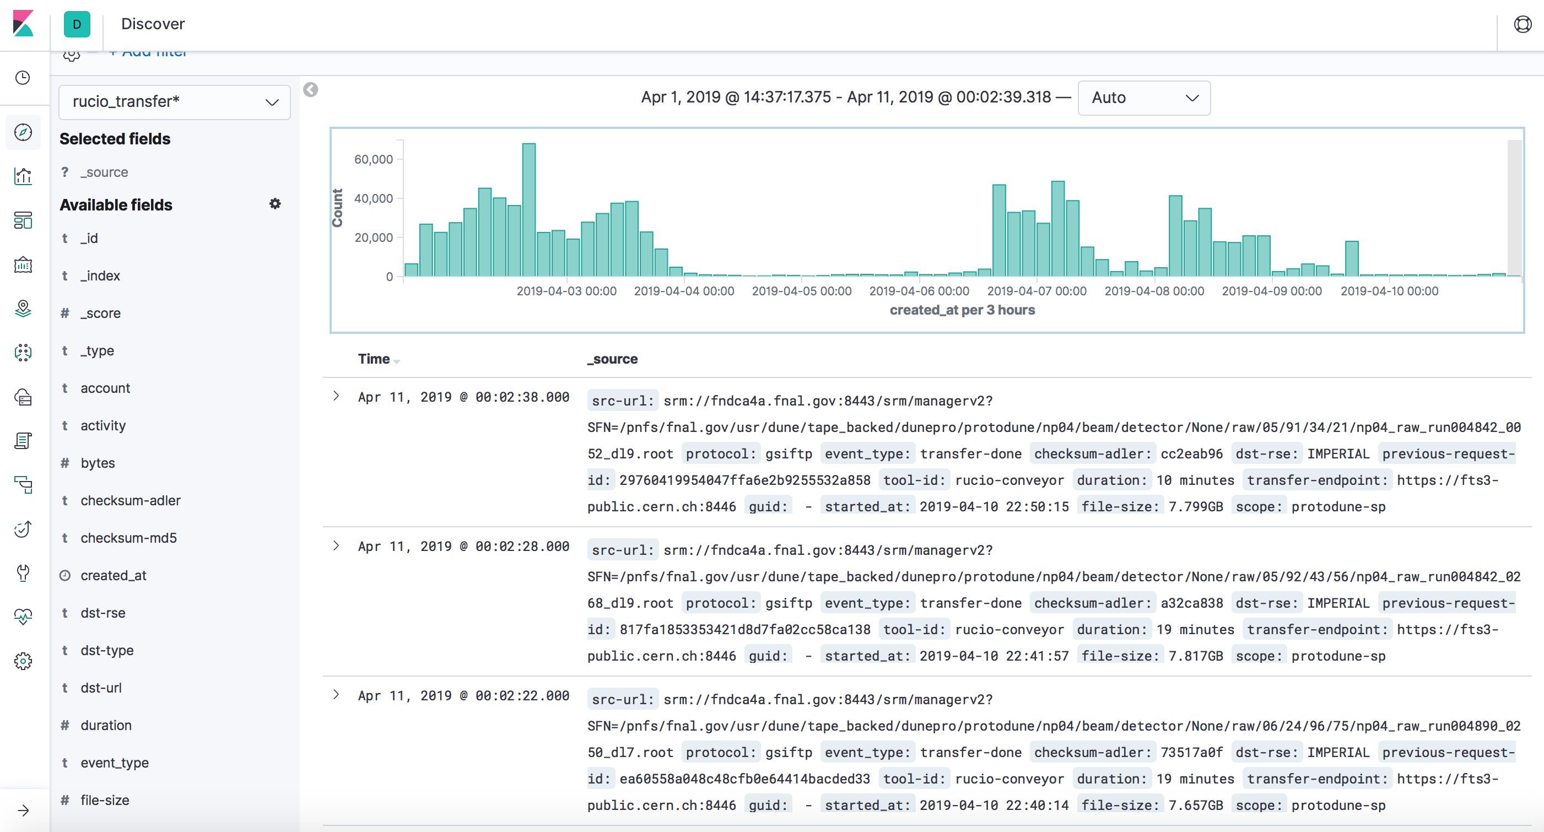

Data transferring / deletion events
Rucio daemons (Convoyer) generate messages when submitting / staging / queueing / finishing data transfer
Messages are sent to be cached in the broker (message queue)
Messages can be dumped to Elasticsearch and be visualized
Same to file deletion
RUCIO
transfer a file
ActiveMQ
logstash
Elasticsearch
Grafana
Kibana
msg format
Notes:
图

Slide 5
Data location/ Accounting/ Client trace
The replica location, accounting and client trace data are recorded in the RUICO internal database:
  DIDs (data identifier)
  Replicas (data location)
  Accounting (RSEs, user accounts)
  Requests from RUCIO clients
To efficiently visualize them, DB tables can be dumped to Elasticsearch periodically
  Use logstash pipelines with jdbc
  Perform joint queries to resolve RUCIO internal IDs
  Setup weekly/daily dump

Slide 6
DUNE monitoring
Graphite
Grafana
RUCIO
RabbitMQ
Kafka
Elasticsearch
Kibana
PostgreSQL
Logstash
daily
ingest
Elasticsearch
Kibana
Dev services in
Edinburgh

Slide 7
DUNE monitoring
All three categories of metrics are collected
  RUCIO and collectors mostly set up based on docker containers
  Dashboards set up in both Grafana (user space) and Kibana (dev space)
Dev services also set up at Edinburgh for testing/development
Daily database dump from FermiLab to Edinburgh
  DIDs, replicas, accounting data
    ~670,000 DIDs
    ~1,600,000 replicas
  ~500 Mb per day, taking ~20 minutes
Graphite
Grafana
RUCIO
RabbitMQ
Kafka
Elasticsearch
Kibana
PostgreSQL
Logstash
daily
ingest
Elasticsearch
Kibana
Dev services in
Edinburgh

Slide 8
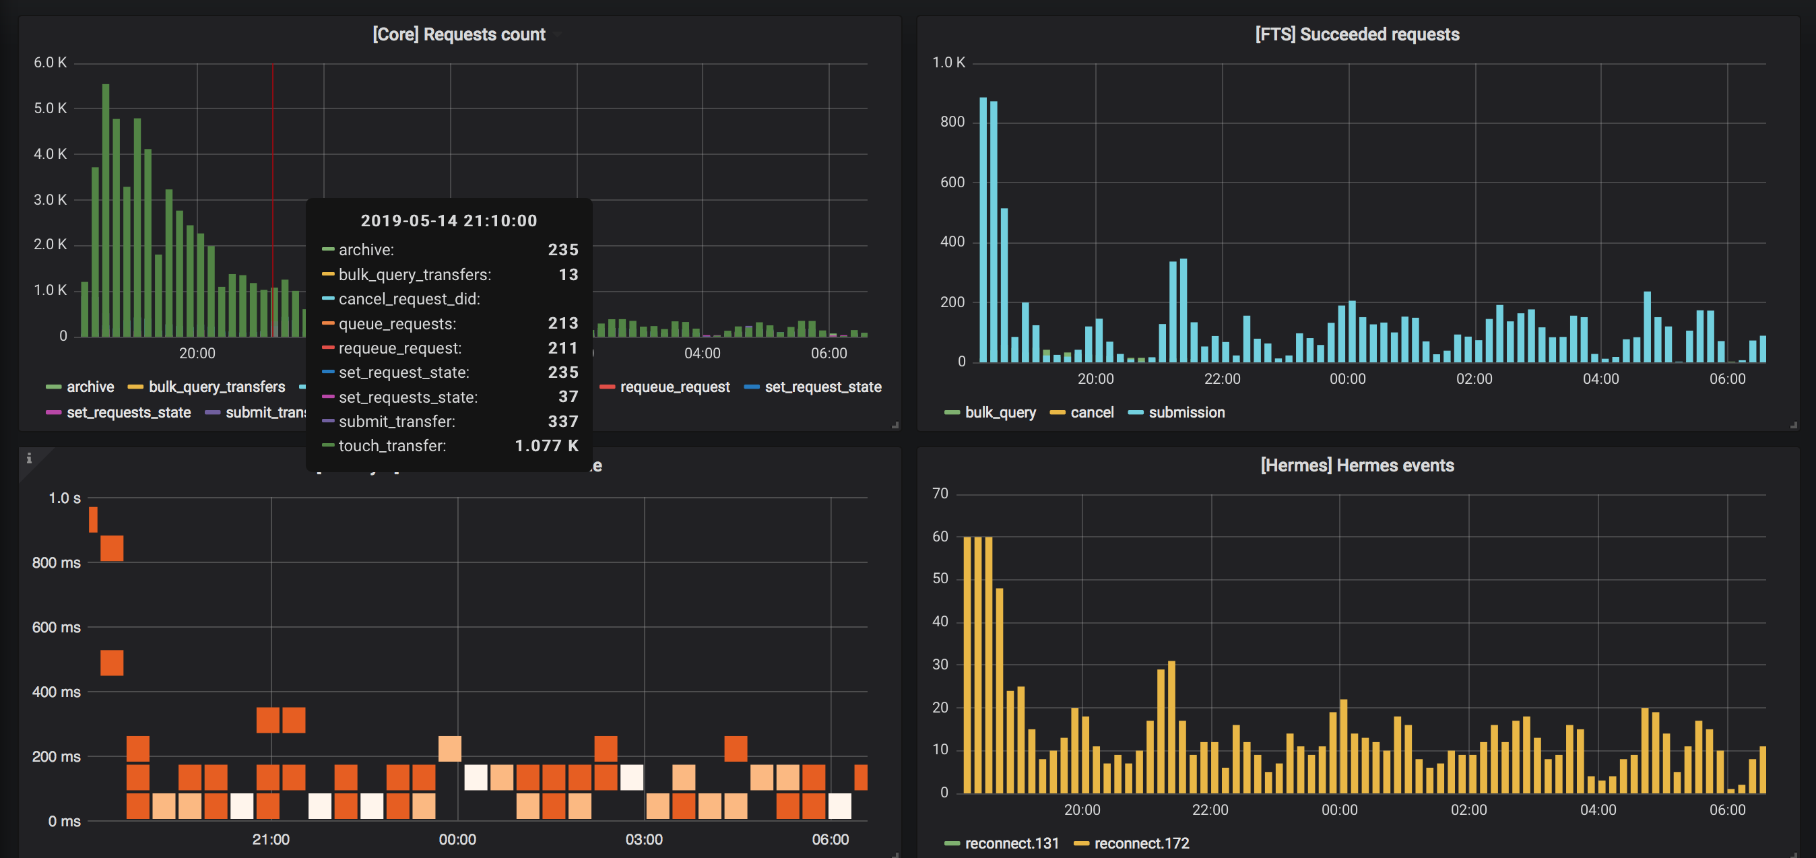
DUNE monitoring: internal metrics

Slide 9
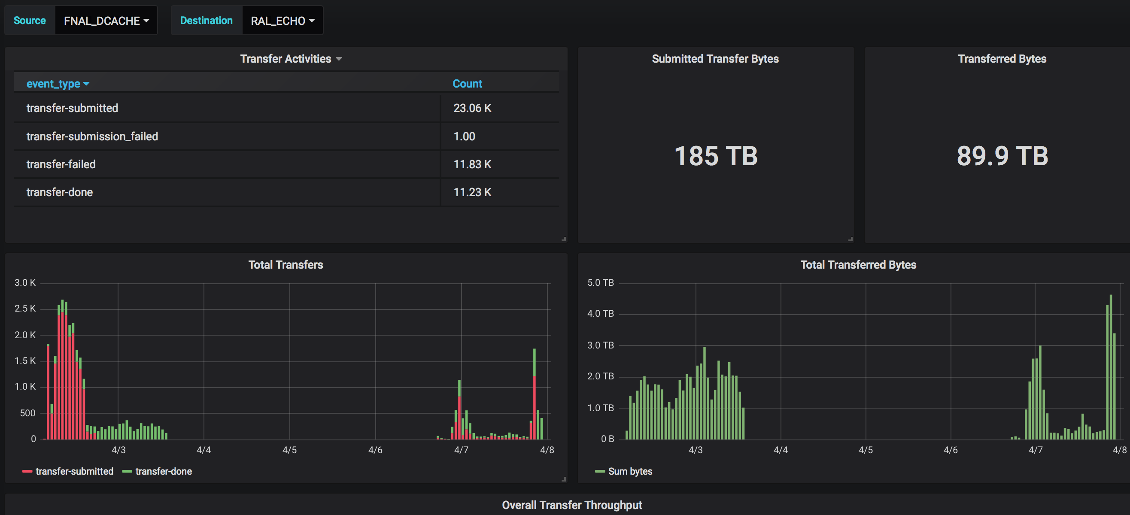
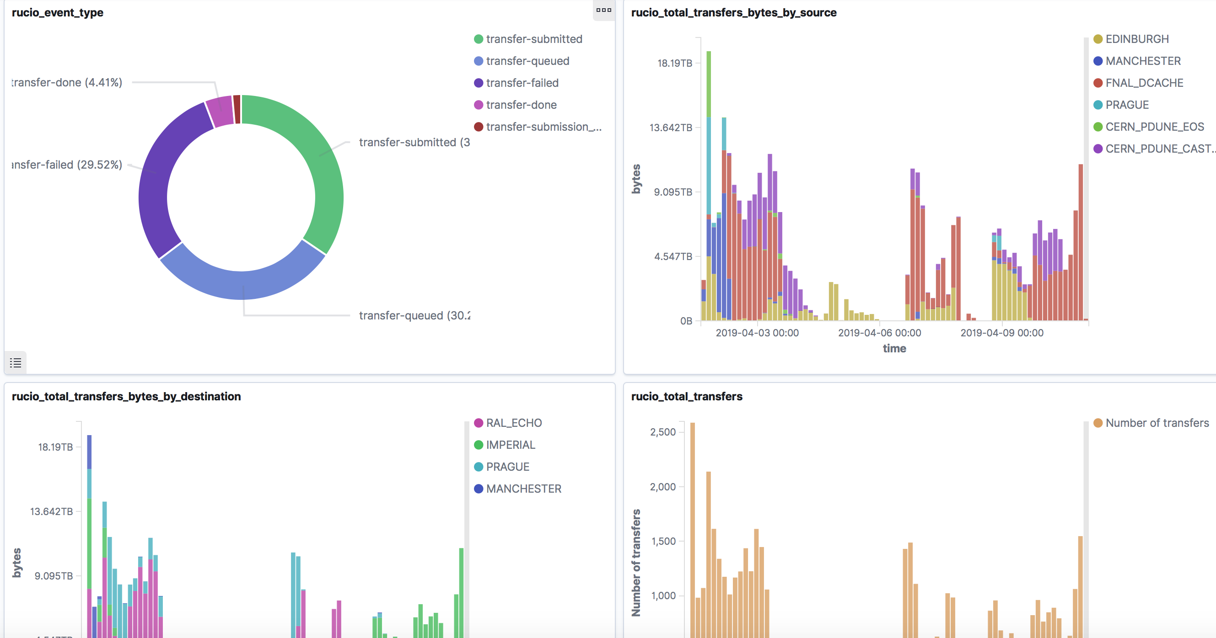
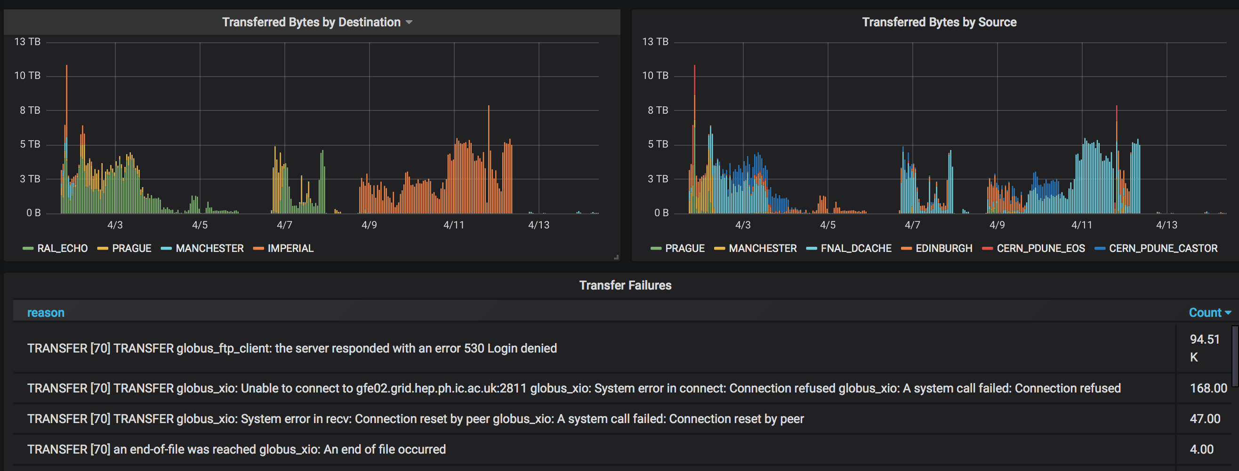
DUNE monitoring: data transferring

Slide 10
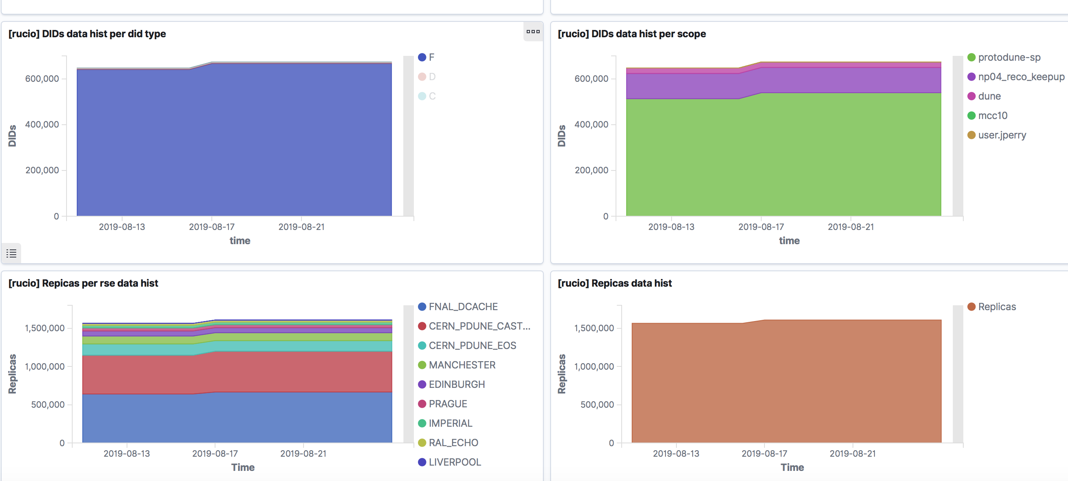
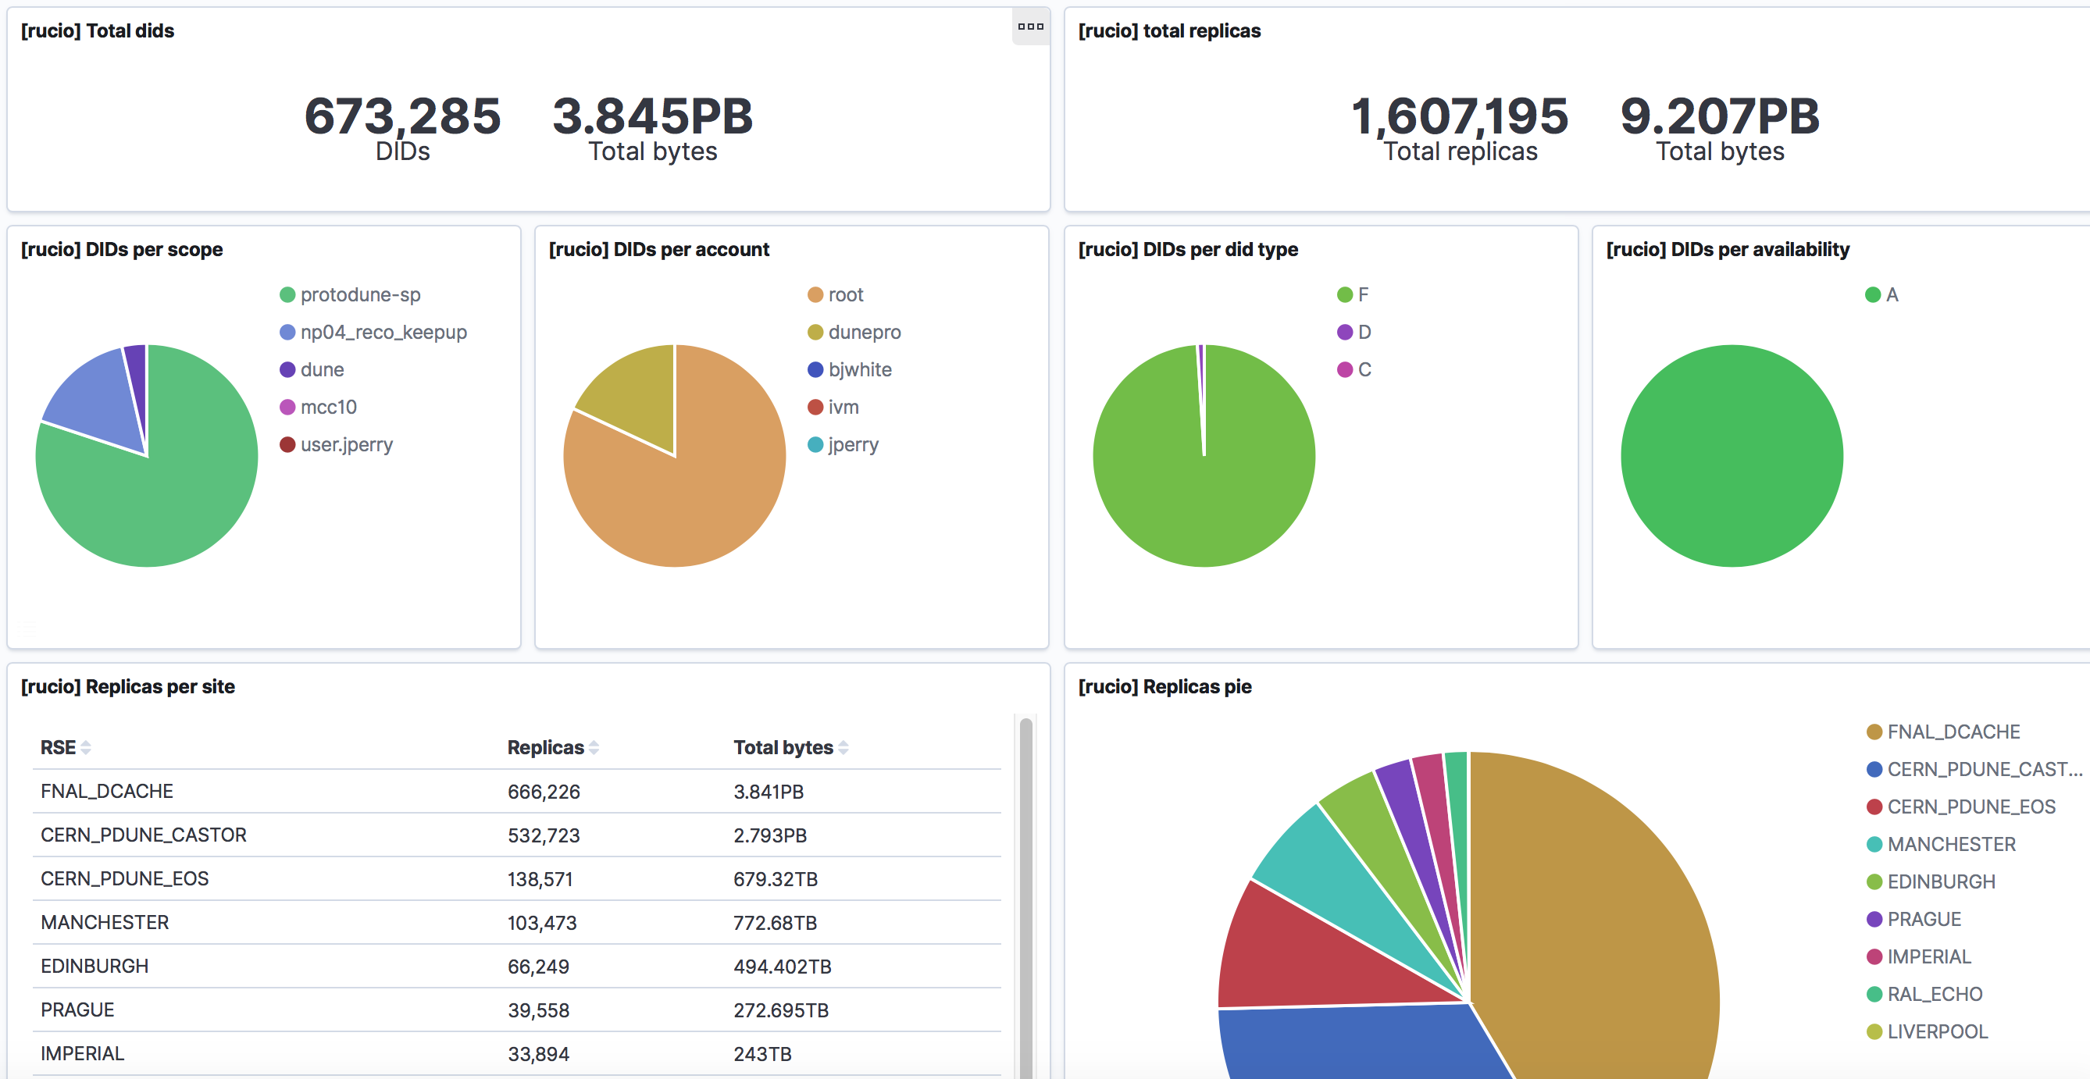
DUNE monitoring: data locality

Slide 11
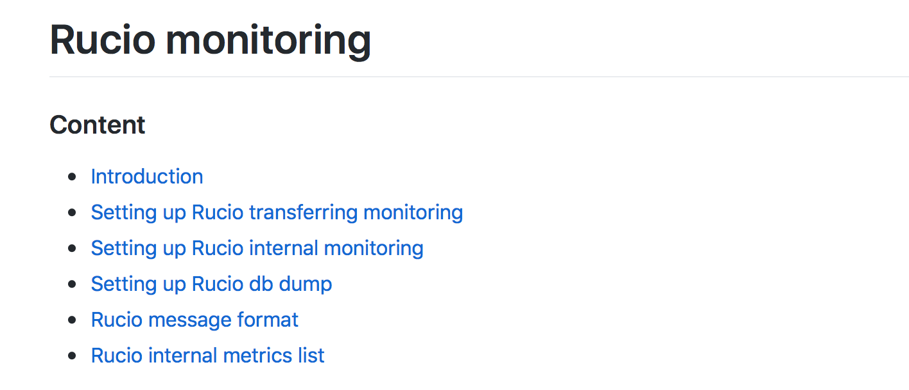
Documentation
For the interest of GridPP and IRIS
Documentation: https://github.com/feipengsy/rucio-monitoring
  How Rucio monitoring works
  Rucio message formats
  List of Rucio internal metrics
  How to dump Rucio database
  How to setup monitoring systems from scratch
  Exported dashboards (json files)
Feel free to refer to/contribute

Slide 12
Thanks
Q & A

