Slide 1
Introduction/Motivation and current wire HW
Adriana Rossi on behalf of the BBLR team
with material from O. Aberle, A. Bertarelli, C. Boccard, F. Carra, L. Gentini, Y. Papaphilippou, A. Poyet, K.Skoufaris, G. Sterbini
HL-LHC WP2/WP13 meeting on Wire Compensation, Fermilab, 17 October 2019
Notes:
Good morning,
thank you for the opportunity to present on behalf of the team the results of the Beam-beam long-range in LHC
1

Slide 2
This meeting
Scope of this meeting is to present the latest experimental and simulation results at LHC with the present demonstrator of wire for Beam-Beam Long Range Compensation.
Present the predictions for the HL-LHC, together with first ideas for the wire hard-ware design and possible implementation.
Building upon the existing collaboration between TRIUMF and CERN, look for a framework for future contributions from TRIUM to HL-LHC for BBLR wire compensation.
2
HL-LHC WP2/WP13 meeting on Wire Compensation, Fermilab, 17 October 2019

Slide 3
This meeting
LHC
Adriana Rossi : Motivations and present wire demonstrator
Guido Sterbini : MD results during LHC Run II and plans for Run III
Axel Poyet : Modelling of MD results and effect of crossing angles
HL-LHC
Kyriacos Skoufaris : Simulations for HL-LHC configuration
Dobrin Kaltchev : Correction of resonant driving terms with wires
Yannis Papaphilippou : Scenarios and timeline for wire
compensation at the HL-LHC
Alessandro Bertarelli : Wire HW design for HL-LHC
Oliver Kester: TRIUMF contribution to the BBLR Compensation
Project for HL-LHC
3
HL-LHC WP2/WP13 meeting on Wire Compensation, Fermilab, 17 October 2019

Slide 4
Outline
Brief introduction to BBLR compensation with wire
Recall the demonstrator HW: wire in-jaw collimator
Installation phases of the demonstrators in LHC
Integration in the HL-LHC
Summary and conclusions
4
HL-LHC WP2/WP13 meeting on Wire Compensation, Fermilab, 17 October 2019

Slide 5
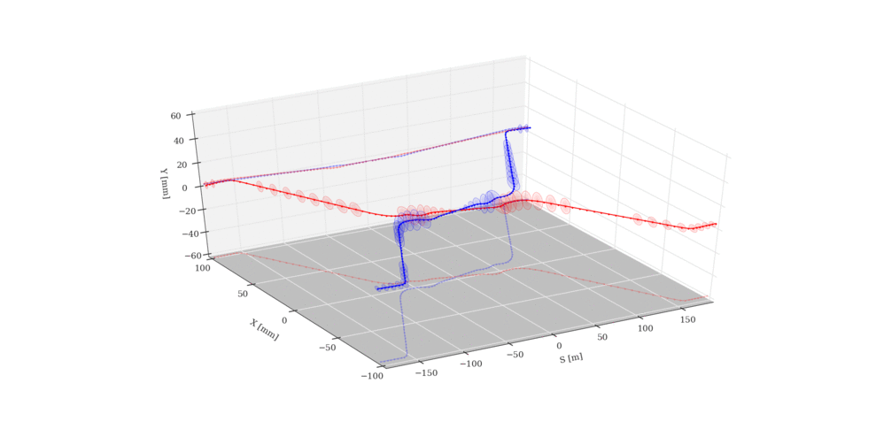
Long-Range Beam-Beam
LRBB interactions limit accelerator performance
  Perturb motion at large betatron amplitudes, where particles come close to opposing beam
  Produce beam blow-up and deterioration of beam lifetime
  Causes amplitude dependent detuning
  Limit closing crossing angle and therefore luminosity
Courtesy of
G.Sterbini
5
HL-LHC WP2/WP13 meeting on Wire Compensation, Fermilab, 17 October 2019

Slide 6
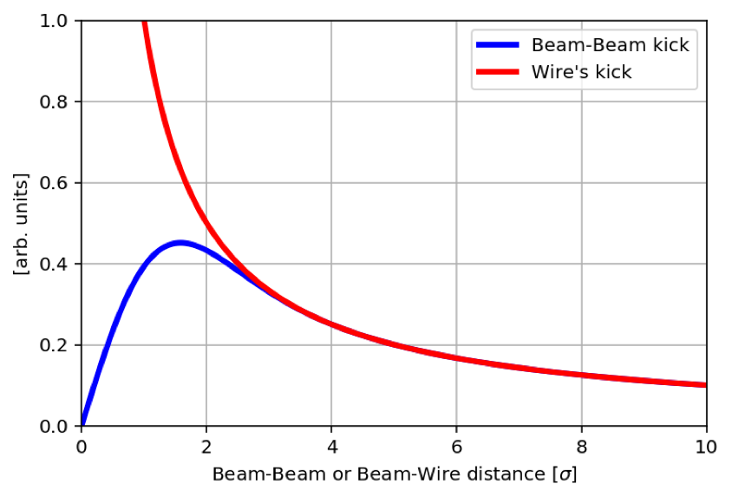
LRBB Wire compensation
≈1
for large separation
Beam-beam (LR) kick
(round Gaussian beam +
crossing in both planes)
with X/Y (beams separation)
Can be approximated by
an “infinite” wire
with X/Y (wire separation)
Courtesy of
Y.Papaphilippou
6
HL-LHC WP2/WP13 meeting on Wire Compensation, Fermilab, 17 October 2019

Slide 7
Recall of design of the demonstrator:
wire in-jaw collimator
Requirements for BBLR compensation coming from scaling lows [S.Fartoukh et al., Phys. Rev. ST Accel. Beams 18, 121001 (2015)]
  High current −> cooling
  Approaching the beam at few mm distance
  Specific optics (initially β_{x}/β_{y}~0.5 and 2 on both sides of IP )
Design: Wires embedded into operational TCTP type collimators :
  Joule heating can be cooled by the collimator jaw cooling system
  The wire can approach the beam while being protected
  TCT at almost the right beta ratio
  Maintain TCTP collimator complete functionality!
Simulations and experiments explored wider range of parameters and configurations: see talks of G.Sterbini, A.Poyet, K.Skoufaris
7
HL-LHC WP2/WP13 meeting on Wire Compensation, Fermilab, 17 October 2019

Slide 8
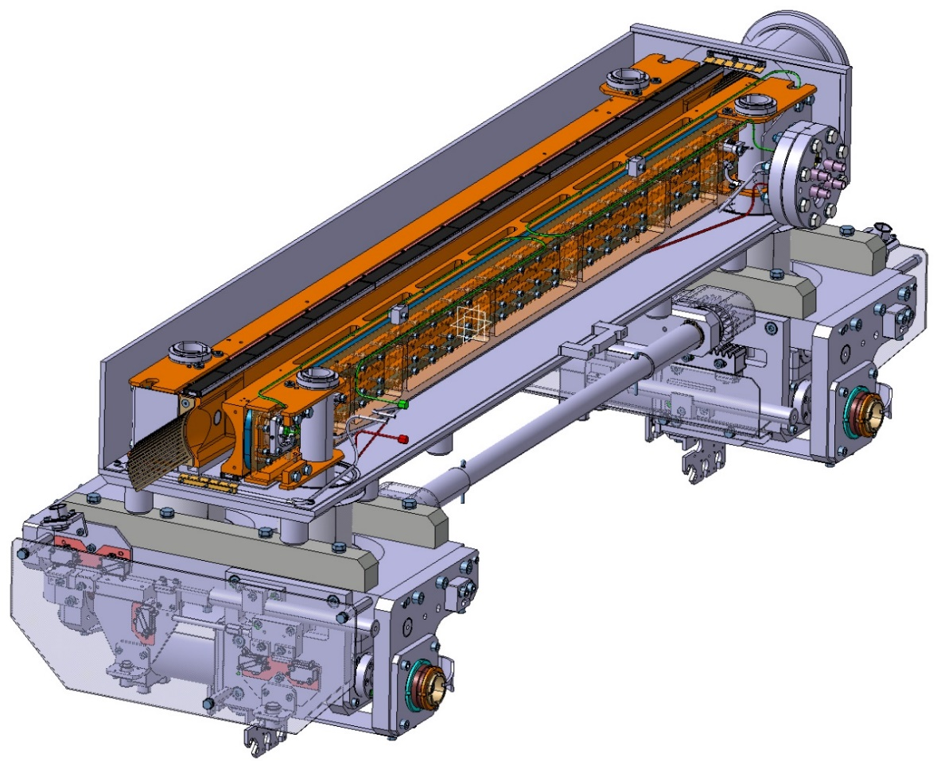
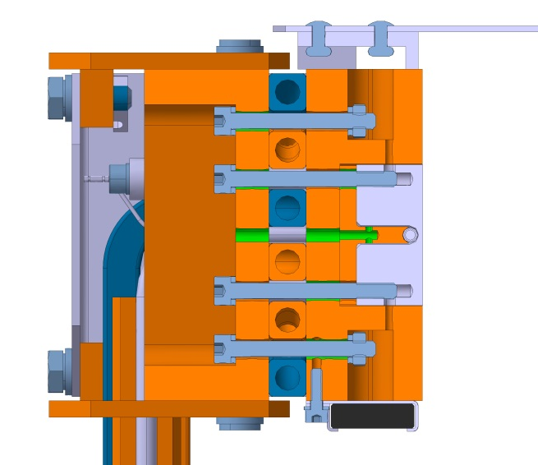
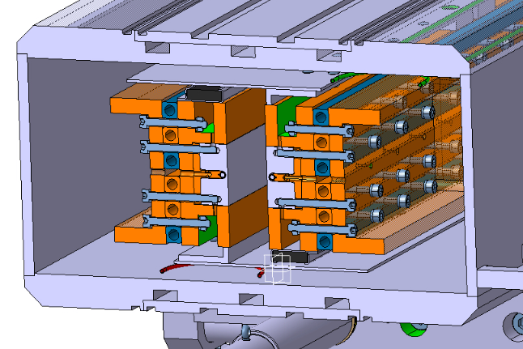
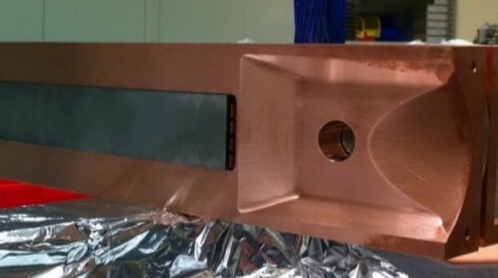

Wire-Embedded TCTW
Jaw/wire movement
In the plane of beam crossing the jaw position can be moved with a measured reproducible accuracy of 5 µm and with < 200µrad tilt
Possibility to move the wire in the transverse plane (collimator 5th axis) to align on orbit ~ 500µm from BPM dedicated measurements
Cooling pipes CuNi10
Vacuum tank
EN
Tungsten inserts
(Inermet® IT180)
Jaws
BBLRC wire
Glidcop “T” support
Glidcop Al-15 housing and back stiffener
Engineering Department
BPM button housing
Actuation system
8
HL-LHC WP2/WP13 meeting on Wire Compensation, Fermilab, 17 October 2019

Slide 9
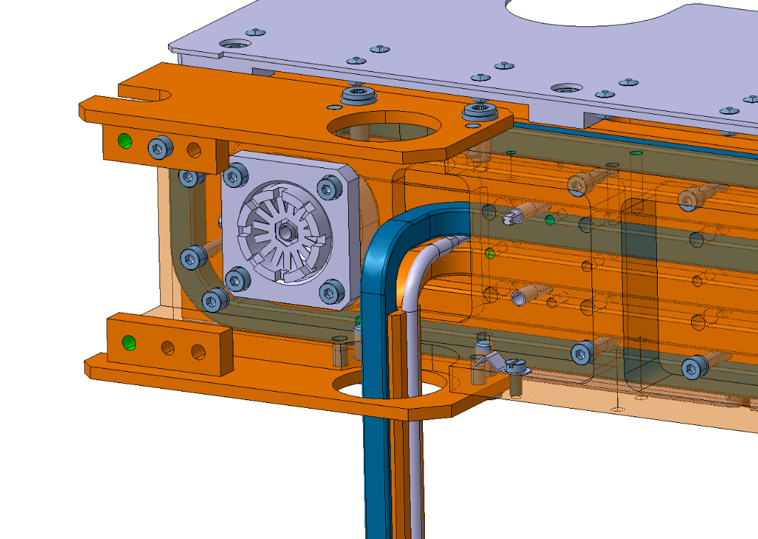
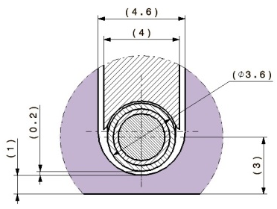
Wire-Embedded TCTW
Wire-in-jaw
3 mm wire/jaw surface distance ~ 3 beam sigmas
Wire-beam distance should be minimized to achieve best compensation performance
New solution for HL-LHC (see talk of
A. Bertarelli)
Wire is brazed to a Glidcop “T shape” support
  Brazing maximizes wire cooling
Tungsten block and “T” support connected in series with the housing via screws
Increase of diameter where the wire is not in direct contact with the jaw (extremities)
Also clamped to cooling pipes when it’s not in the jaw
EN
Thicker wire
Engineering Department
Cable dimensions (for 350A nominal current):
Transition 30°
0.3mm
MgO
0.41mm
MgO
ø2.48mm
Cu
Cu
ø3.45mm
0.26mm
316L
0.365mm
Note gap between wire and tungsten (0.1÷0.2 mm)
Total diameter inside the jaw: ø3.6mm
316L
Total diameter outside the jaw: ø5mm
9
HL-LHC WP2/WP13 meeting on Wire Compensation, Fermilab, 17 October 2019

Slide 10
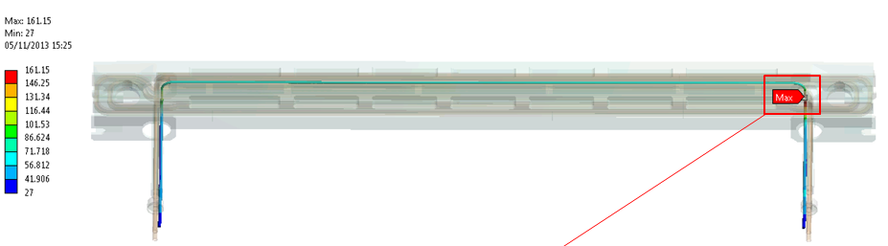
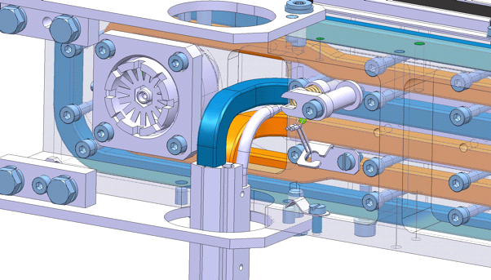
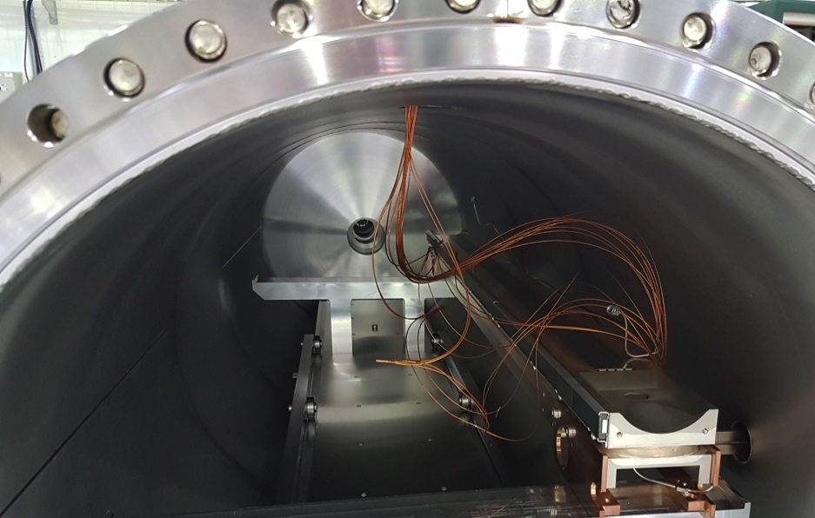
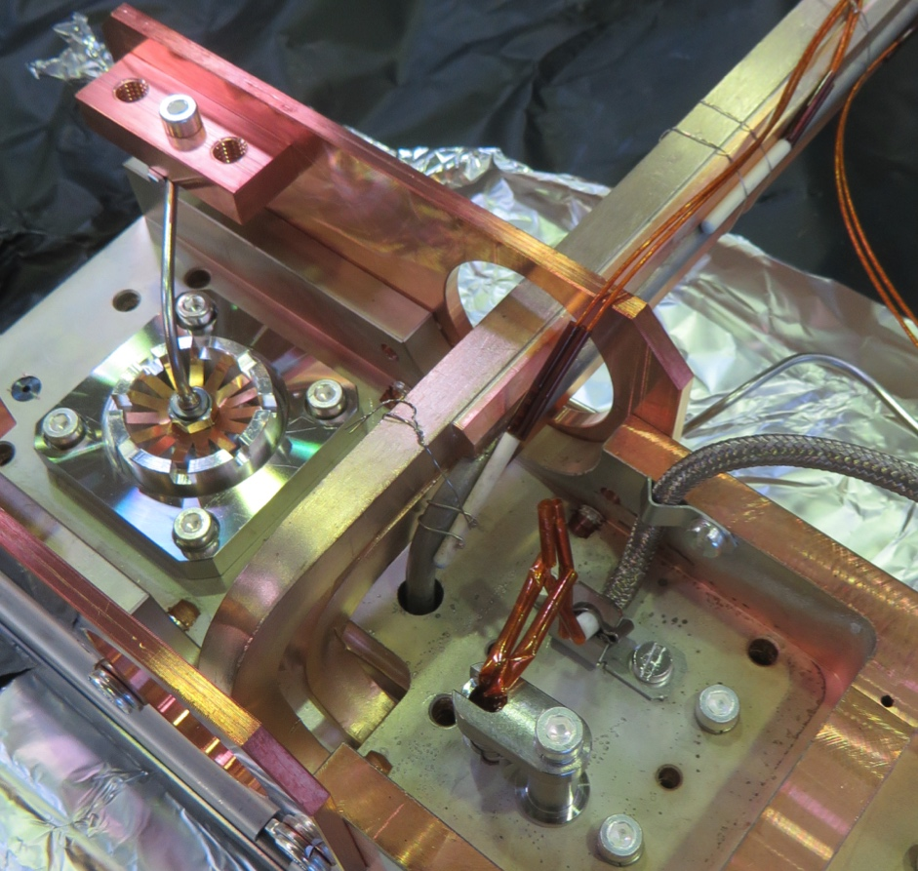
Tests with spare collimator jaw
≈1 m
Top view
Courtesy of F. Carra
Max. temperature at I_{W}=350 A: 161 ºC
Measurements of wire temp. and voltage drop with and without cooling
A. Rossi, Joint LARP CM28/HiLumi Collaboration Meeting, Napa Valley – 24-26 April 2017
10
HL-LHC WP2/WP13 meeting on Wire Compensation, Fermilab, 17 October 2019
Notes:
The wire-beam distance has to be of the order of few mm.
10

Slide 11
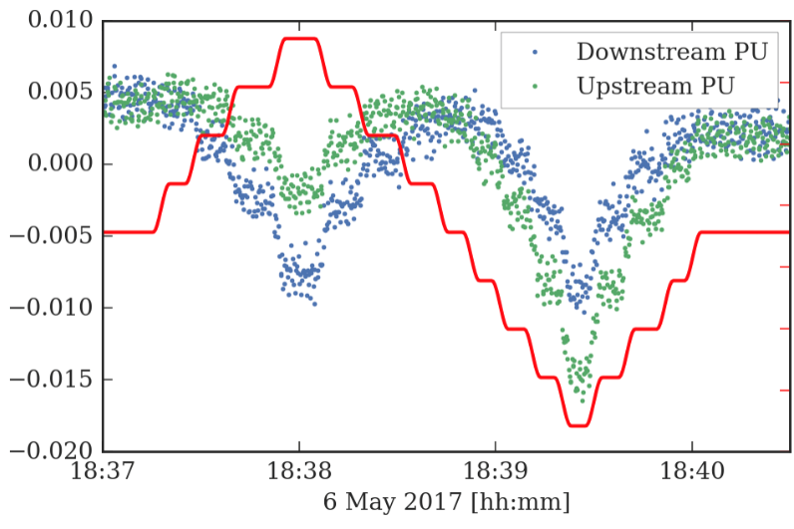
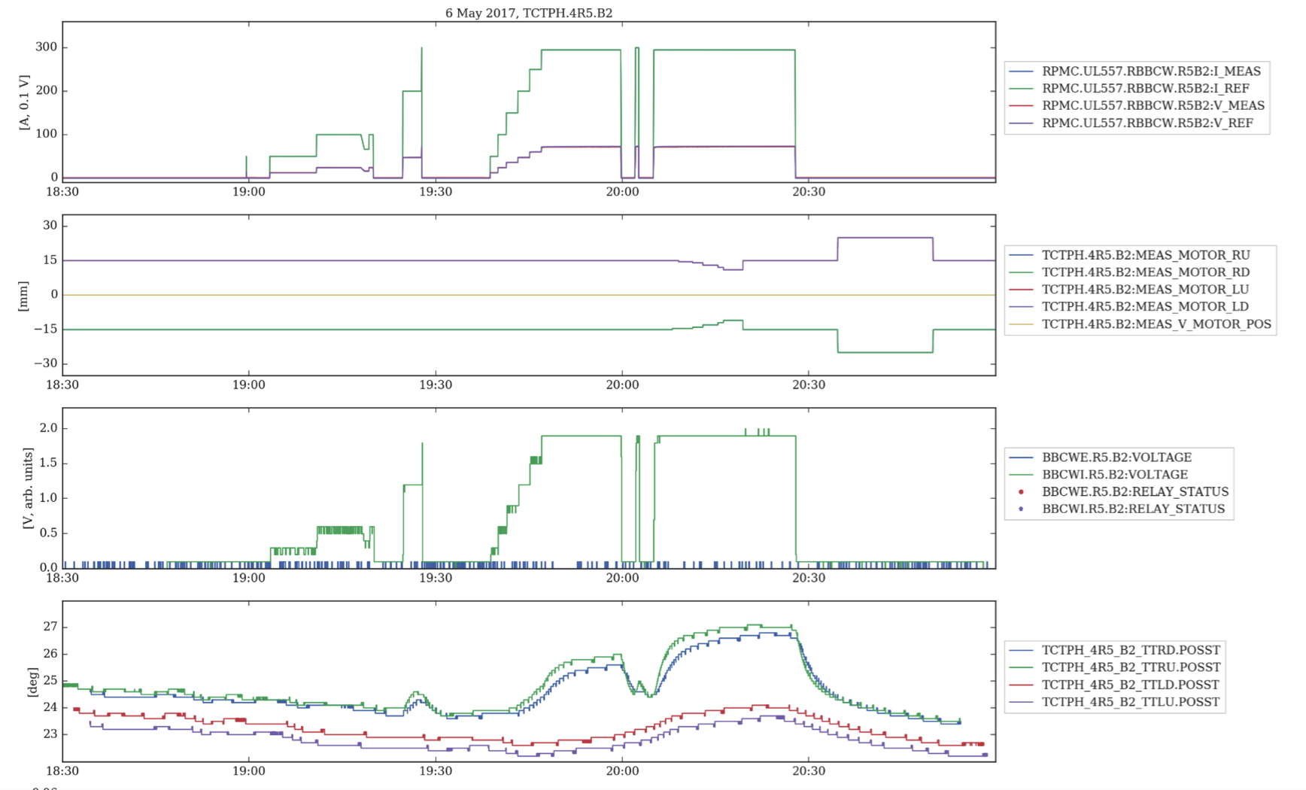
Tests at the LHC (G. Sterbini et al.)
Vertical centering with 3 pilot LHC bunches and orbit vertical bump (steps of 0.5mm)
Pressure (VPG.935.B4.R5) below threshold
Checking jaw temperature and movement with wire current ON
11
HL-LHC WP2/WP13 meeting on Wire Compensation, Fermilab, 17 October 2019

Slide 12
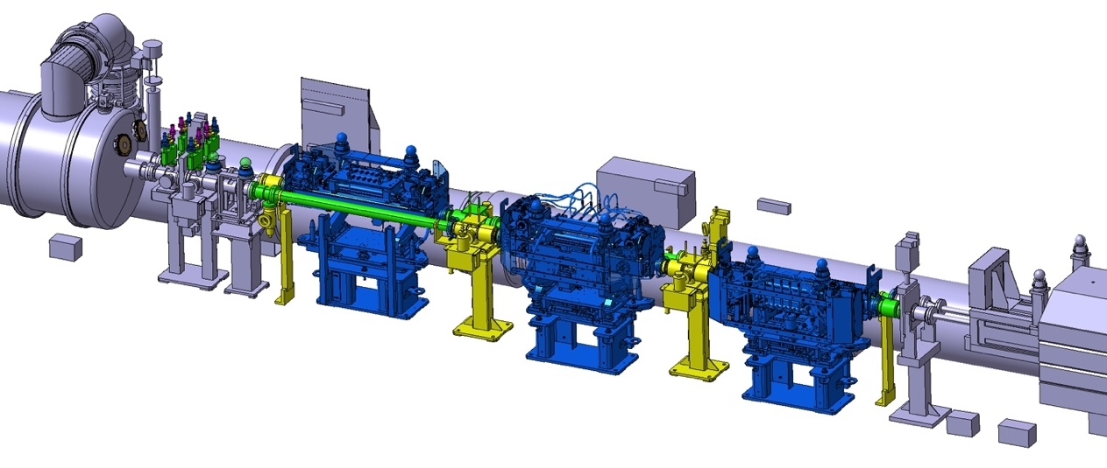
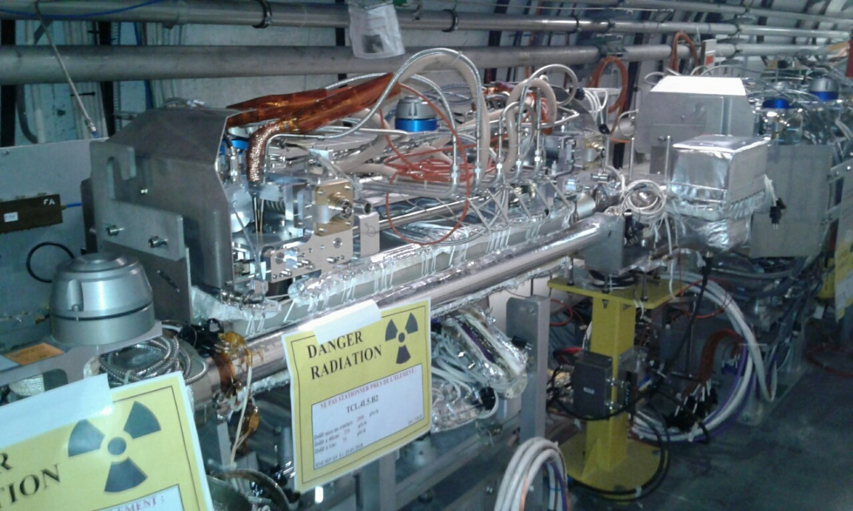
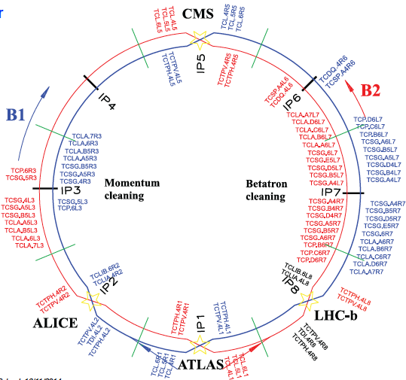
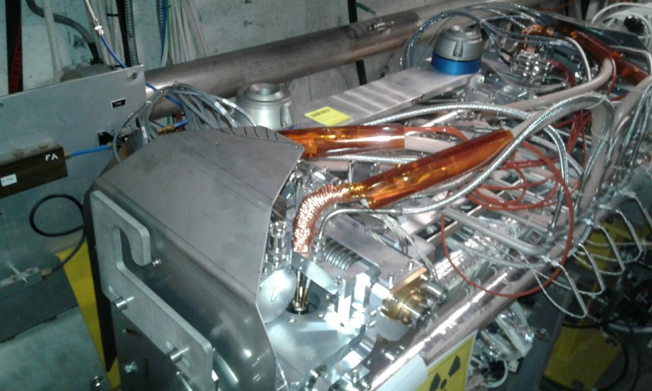
EYETS 2016-17 – replacement of TCTPH.4R5.B2 and TCL.4L5.B2
TCL.4L5.B2
TCTPH.4R5.B2
3D integration view: 4L5 top and 4R5 bottom.
BBCWE.4L5.B2
B2
BBCWI.4L5.B2
IP5
BBCWI.4R5.B2
D2
B1
BBCWE.4R5.B2
TCL
TCTPH
TCTPV
TAN
TCL.4L5.B2
TCTPH.4R5.B2
D2
TAN
TCL
See G.Sterbini’s talk
TCTPH
TCTPV
12
HL-LHC WP2/WP13 meeting on Wire Compensation, Fermilab, 17 October 2019

Slide 13
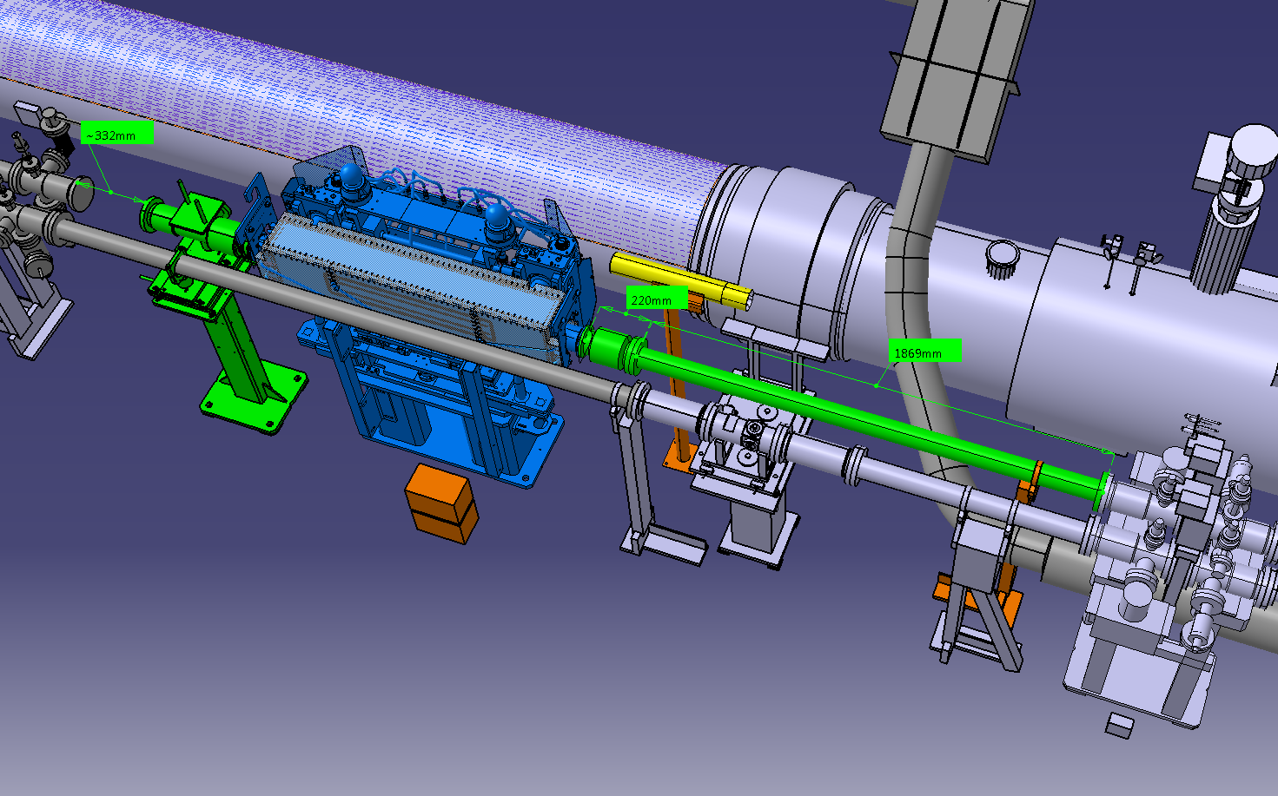
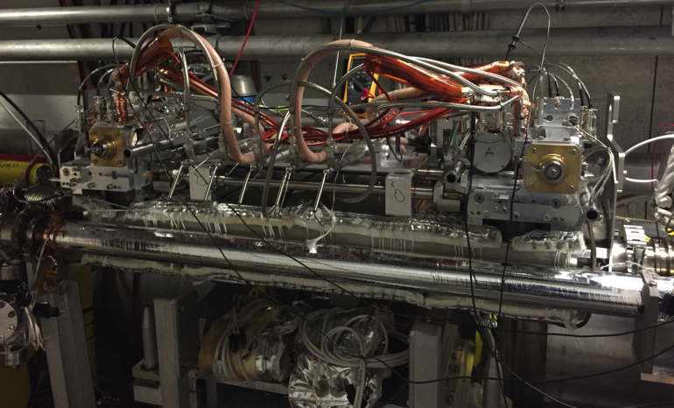
YETS 2017-18 – replacement of TCTPV.4R1.B2 and installation of new TCLVW.A5L1.B2
TCLVW.A5L1.B2
TCTPV.4R1.B2
BBCWT.5L1.B2
B2
BBCWB.5L1.B2
IP1
BBCWT.4R1.B2
Q5
B1
TCLVW.A5L1.B2
BBCWB.4R1.B2
3D integration view: 5L1
Q4
3D integration view: 4R1
D2
TAN
TCTPH
TCL
TCTPV
13
HL-LHC WP2/WP13 meeting on Wire Compensation, Fermilab, 17 October 2019

Slide 14
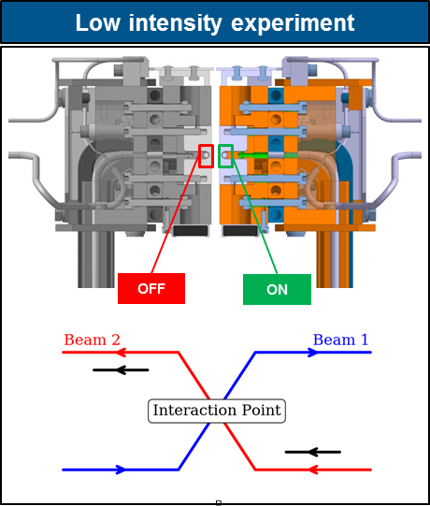
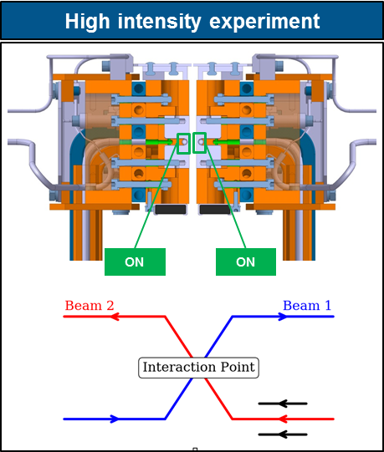
3 bunches, 5-6sigma distance
Compensation (TCT ops opening) provides a reduction of B2
(3 trains) losses by ~20%.
A. Poyet
See G.Sterbini’s talk
3 trains, TCT operational settings
A. Poyet
Almost full compensation, even at reduced crossing angle, for 1 regular bunch whereas head-on bunch not degraded.
IPAC19, G. Sterbini, contributed talk WEYYPLM3
14
HL-LHC WP2/WP13 meeting on Wire Compensation, Fermilab, 17 October 2019

Slide 15
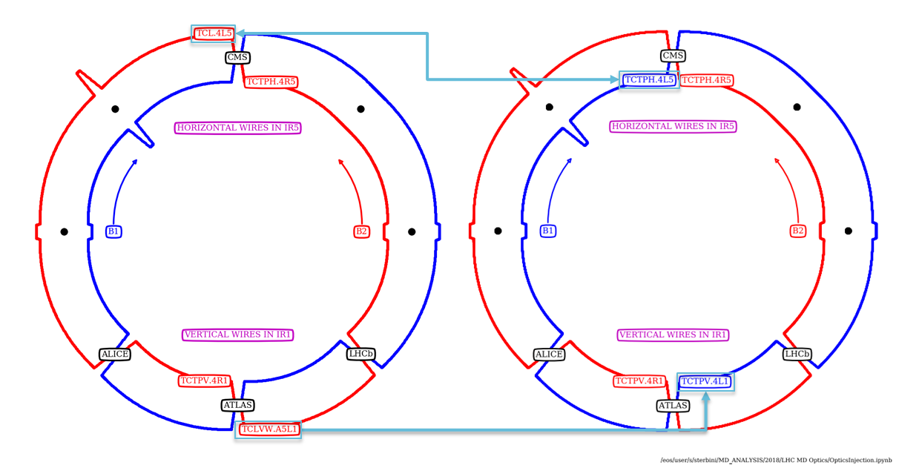
LS2 intervention before Run III
Moving of two wire collimators for BBLR compensation from B2 to B1 on IR1 and IR5
Before LS2 After LS2
Clear potential to improve also B1 as shown for B2 during MDs
Gain in operational experience with wires during operation in Run III and prove potential for HL-LHC (wires used operationally)
15
HL-LHC WP2/WP13 meeting on Wire Compensation, Fermilab, 17 October 2019

Slide 16
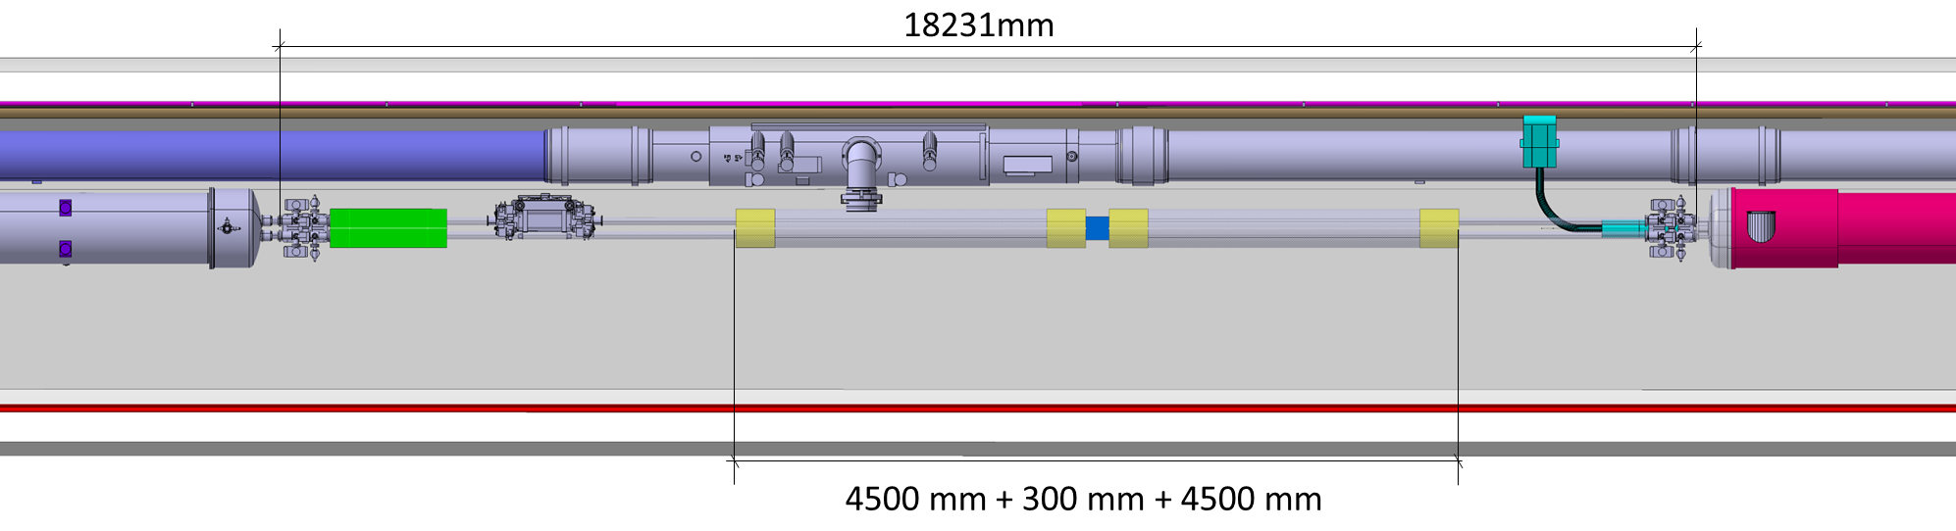
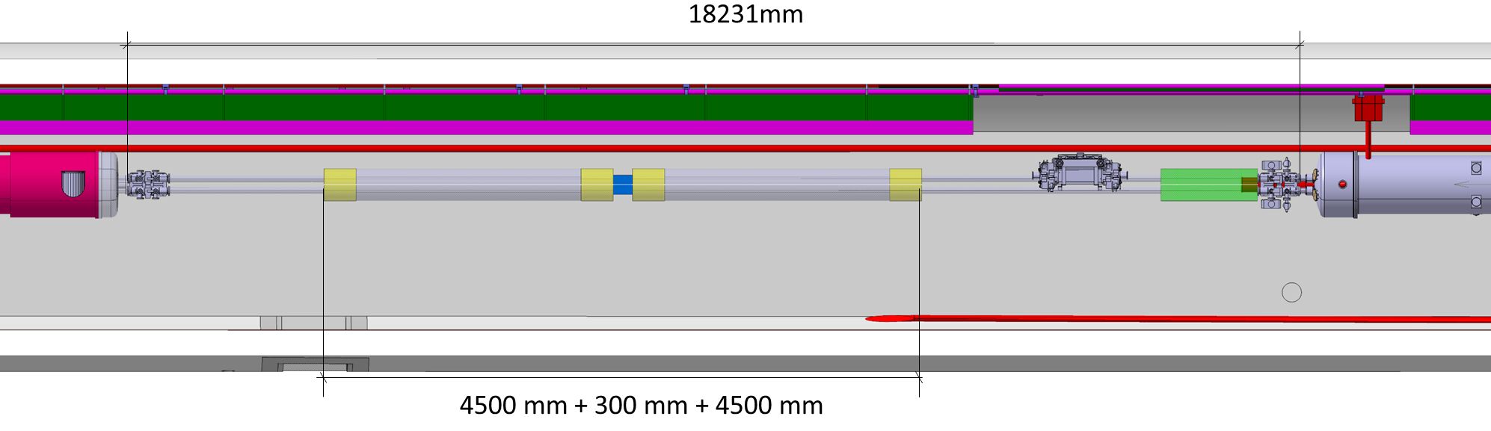
INTEGRATION of the BBLRW AT HL-LHC IP1/5
Half-cell 5L1/5L5
extraction from 3-D Model: ST0990131_01
Half-cell 5R1/5R5
16
HL-LHC WP2/WP13 meeting on Wire Compensation, Fermilab, 17 October 2019

Slide 17
RACKS IN IP1(=IP5) ZONE (S.Maridor)
17
HL-LHC WP2/WP13 meeting on Wire Compensation, Fermilab, 17 October 2019

Slide 18

Future for HL-LHC
See the rest of the meeting!
18
HL-LHC WP2/WP13 meeting on Wire Compensation, Fermilab, 17 October 2019

Slide 19

Summary and conclusions
Wires have been identified as possible BBLR compensation as early as in the late 1990s
The first proof of concept was actually implemented in the SPS
Wire-in-jaw collimators are being successfully used to test compensation at LHC and simulation work have been able to reproduce experimental results (see future talks)
Results extrapolated to HL-LHC show the possibility of improving standard operations with larger dynamic aperture, more comfortable working point in the tune space, and enhanced performance. Without Carb Cavities, part of the luminosity lost could be recovered.
We hope to rise TRIUMF interest in the project and obtain support to introduce this option at the HL-LHC
19
HL-LHC WP2/WP13 meeting on Wire Compensation, Fermilab, 17 October 2019

Slide 20
Thank you for your attention
Acknowledgments also to (not exhaustive)
D. Amorim, G. Arduini, H. Bartosik, R. Bruce, X. Buffat, L. Carver, G. Cattenoz, L. Ceccone, S. Deschamps, W. Devauchelle, E. Effinger, S. Fartoukh, M. Fitterer, N. Fuster, M. Gasior, M. Gonzales, A. Gorzawski, G.-H. Hemelsoet, M. Hostettler, G. Iadarola, R. Jones, D. Kaltchev, K. Karastatis, S. Kostoglou, I. Lamas Garcia, T. Levens, A. Levichev, L. E. Medina, A. Mereghetti, E. Métral, D. Mirarchi, R. Mompo, J. Olexa, Y. Papaphilippou, D. Pellegrini, M. Pojer, L. Poncet, S. Redaelli, B. Salvachua, H. Schmickler, F. Schmidt, M. Solfaroli, R. Tomas, G. Trad, A. Valishev, D. Valuch, D. Wollmann, C. Xu, C. Zamantzas, P. Zisopoulos and all participants to the design, production and commissioning of the wire compensator prototypes (WP2, WP5, WP13 and LHC MD coordinators).
20
HL-LHC WP2/WP13 meeting on Wire Compensation, Fermilab, 17 October 2019

Slide 21
Some literature
Y. Papaphilippou and F. Zimmermann, “Weak-strong beam-beam simulations for the Large Hadron Collider”, in Phys. Rev. ST Accel. Beams 2, 104001 (1999).
Y. Papaphilippou and F. Zimmermann, “Estimates of diffusion due to long-range beam-beam collisions”, in Phys. Rev. ST Accel. Beams 5, 074001 (2002).
J.-P. Koutchouk, CERN-LHC-Project-Note 223 (2000); Proc. PAC2001, Chicago, p. 1681 (2001).
F. Zimmermann, “10 years of wire excitation experiments in the CERN SPS“, in Contribution to the ICFA Mini-Workshop on Beam-Beam Effects in Hadron Colliders, CERN, Geneva, Switzerland, 18-22 Mar 2013, CERN Yel-low Report CERN-2014-004, pp.153-166.
S. Fartoukh et al, “Compensation of the long-range beam-beam interactions as a path towards new configurations for the high luminosity LHC” in Phys. Rev. ST Accel. Beams 18, 121001 (2015).
M.Garlasche, A.Bertarelli, F.Carra, “Energy deposition (E.Skordis) and Structural Analysis of Wire-in-Jaw TCTP collimators”, presented at LHC Collimation Working Group #181, 6 Oct 2014.
L.Gentini, “Wire-in-Jaw TCTP collimators recap on design” and O.Aberle “Tests and Assembly”, presented at LHC Collimation Working Group #203, 11 Apr 2016.
21
HL-LHC WP2/WP13 meeting on Wire Compensation, Fermilab, 17 October 2019

Slide 22
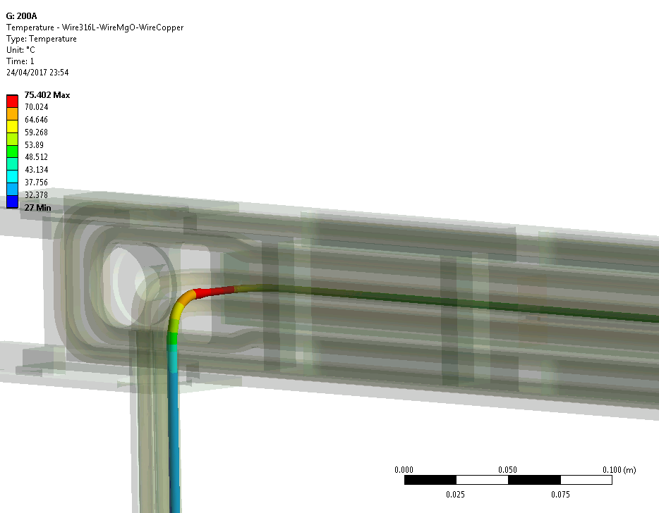
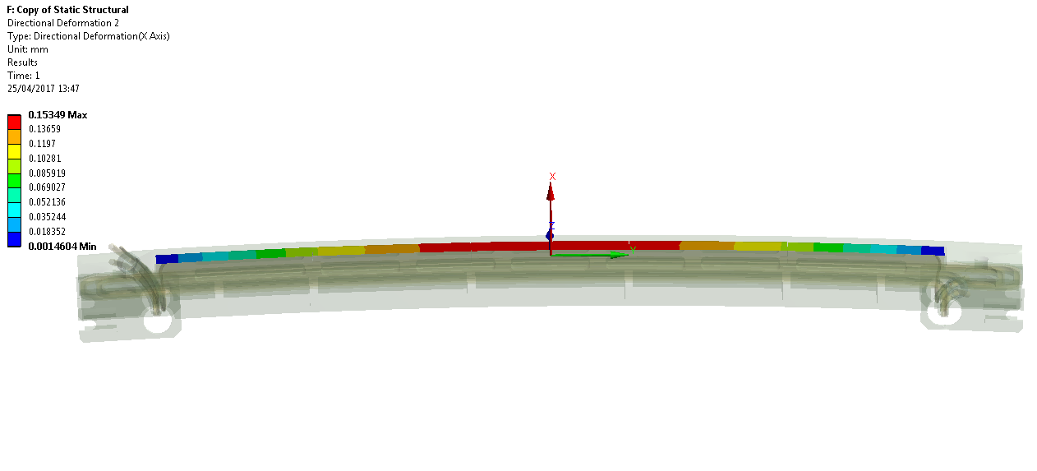
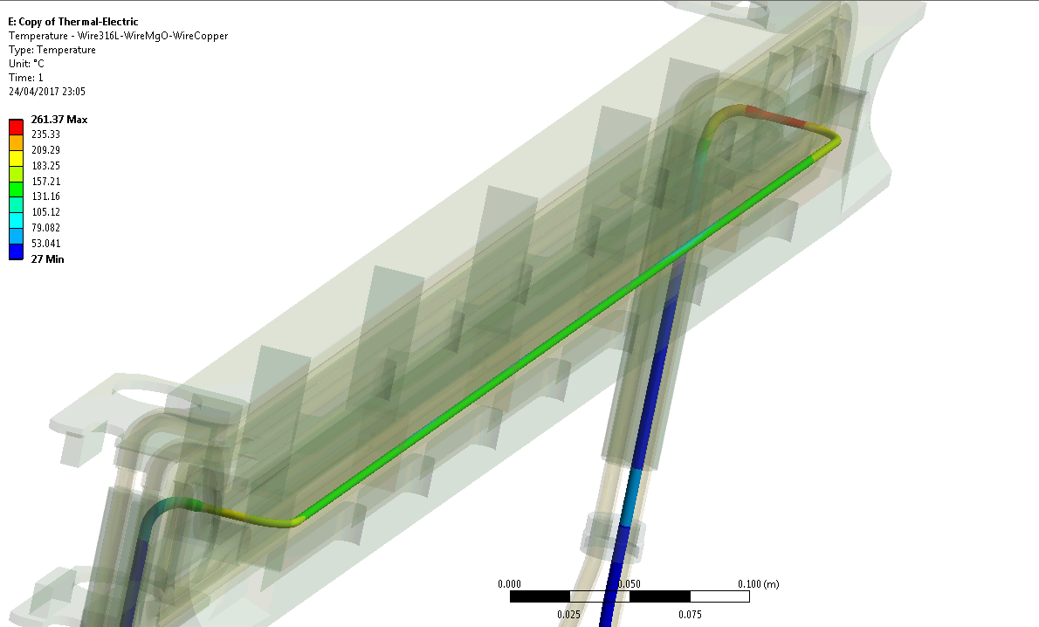
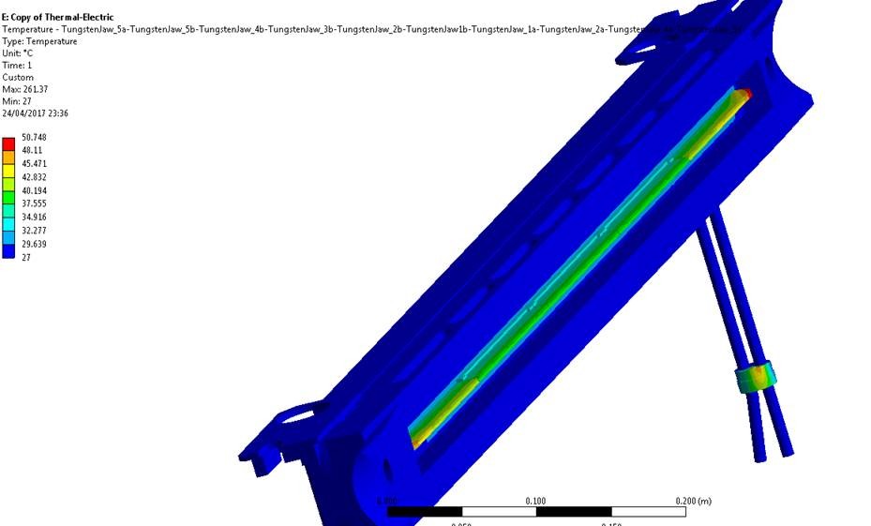
Wire current and temperature with cooling
Temperature profile at 200A
C. Boccard BE-BI
65°C
75°C
F. Carra EN-MME
50°C
@ 350A
260°C
Sagitta 150µm
Jaw @ 27°C
160°C
A. Rossi, Joint LARP CM28/HiLumi Collaboration Meeting, Napa Valley – 24-26 April 2017
22
HL-LHC WP2/WP13 meeting on Wire Compensation, Fermilab, 17 October 2019

Slide 23
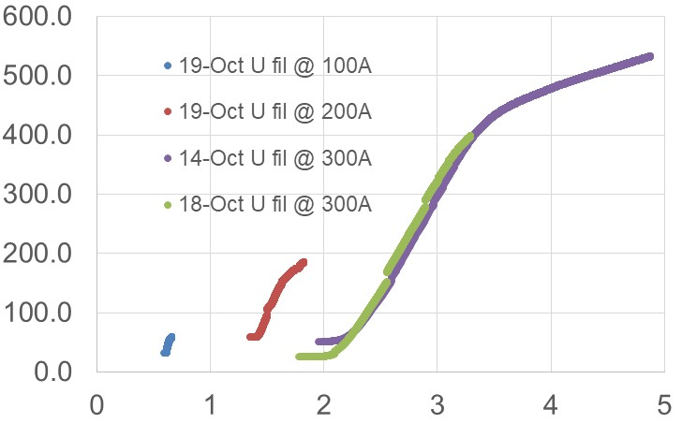
Wire current and temperature without cooling
U(V)
T(C)
T(C)
Voltage across wire U(V)
Time (hh:mm)
With cooling, the wire temperature as simulations: stable a few minutes after the current jump. Hottest spot at 120°C @ 350A
Without cooling, tests at 100/200/300A: Tw <200-300°C for U_{w} < 2-3V
Interlock set at 2.7V (note that U(350A)=2.5V)
A. Rossi BE/BI – 6th HL-LHC Collaboration Meeting – 14-16 November 2016
23
HL-LHC WP2/WP13 meeting on Wire Compensation, Fermilab, 17 October 2019
Notes:
The wire-beam distance has to be of the order of few mm.
23

